Slide 1
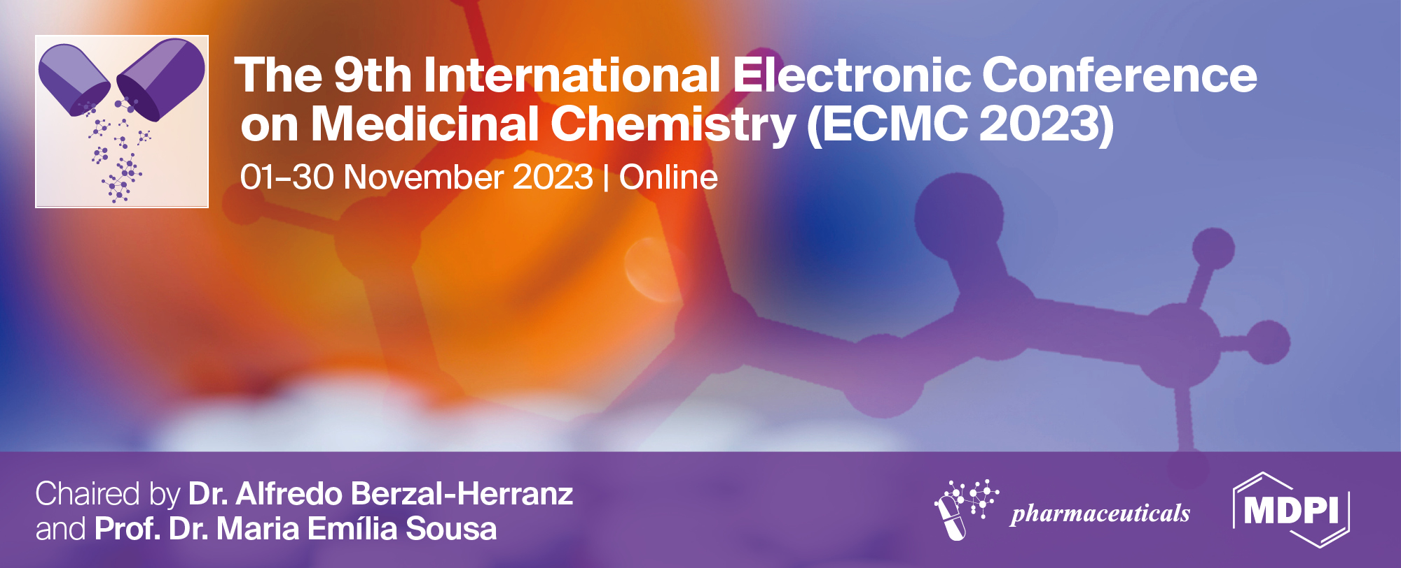
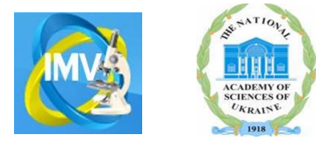
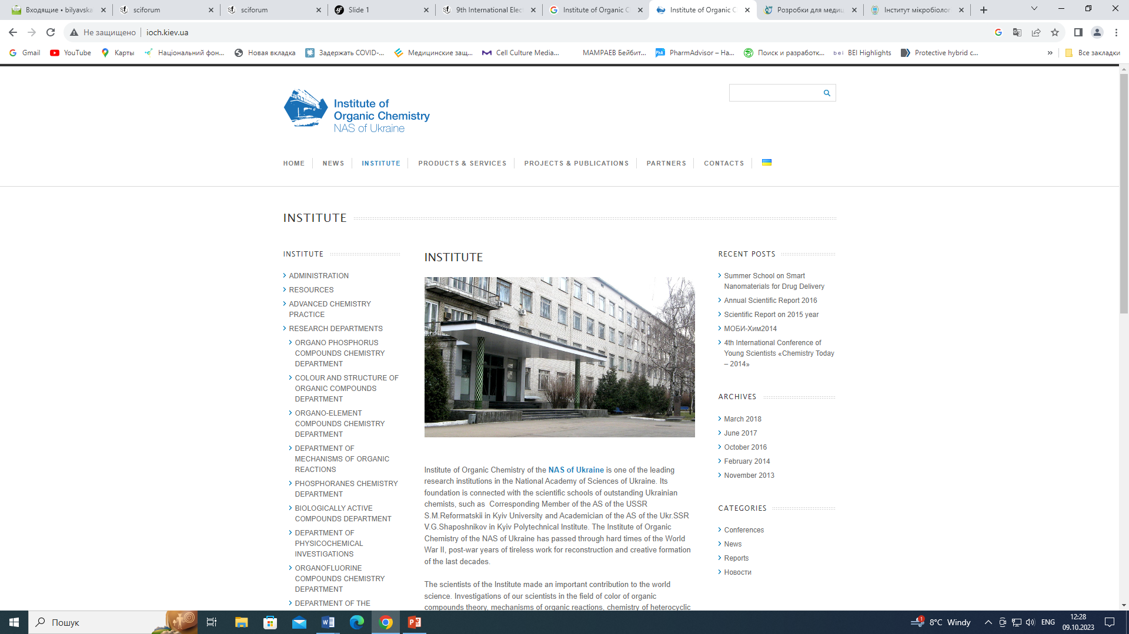
New low molecular weight heterocyclic compounds with antiviral activity
Liubov Artiukh^{1,}*, Olga Povnitsa¹, Polina Zaremba¹, Oleksandr Shalimov²,
Petro Onys'ko² and Svitlana Zahorodnia¹
¹
²
* Corresponding author: bilyavskal@ukr.net
Zabolotny Institute of Microbiology and Virology of the NAS of Ukraine, 03149 Kyiv, Ukraine
Institute of Organic Chemistry of the NAS of Ukraine, 02660 Kyiv, Ukraine

Slide 2
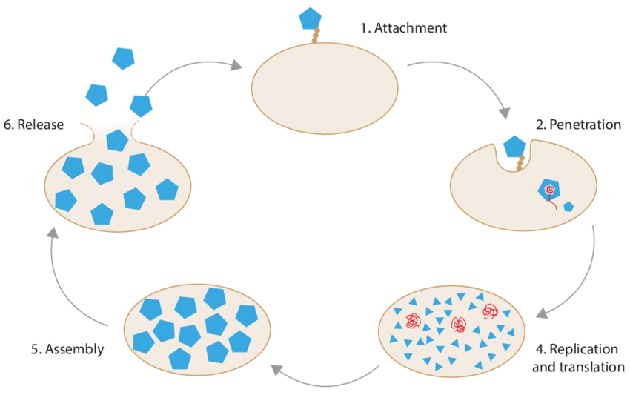
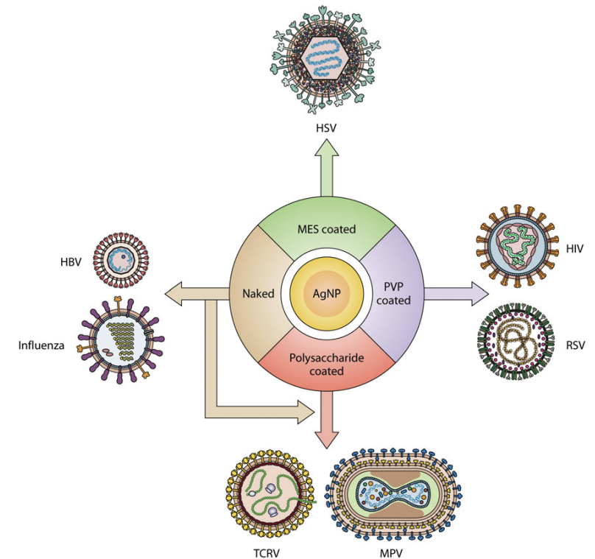
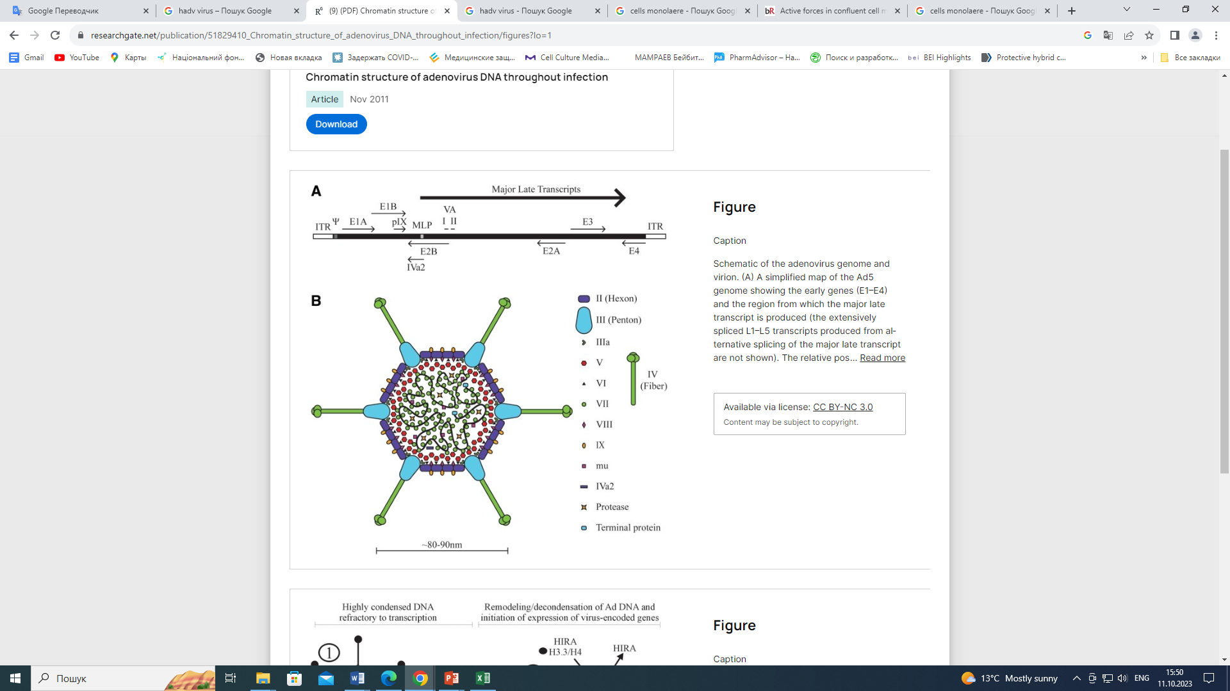
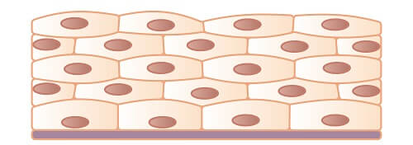
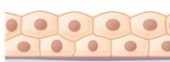
New low molecular weight heterocyclic compounds with antiviral activity
HAdV-2
H1N1
or
low molecular weight heterocycles
suppression of the virus life cycle
or
cells monolayer
infected cells

Slide 3
Abstract:
Development of an effective antiviral drug is typically followed by expansion of the successful strategy with numerous chemical variations of compounds providing improvements in parameters including affinity, solubility, lipophilicity, pharmacology, toxicity, drug resistance profiles etc. The aim of this study was to investigate the antiviral properties of newly synthesized fluorine-, chlorine-, and bromine-containing heterocyclic compounds against adeno-, herpes- and influenza viruses. Cytotoxicity and antiviral efficacy of compounds was determined using a tetrazolium-based colorimetric and yield reduction assays, respectively. It should be noted that viability results were dependent on the type of used cells. It was found that compound 5,7-dimethyl-4,7-dihydropyrazolo[4,3-e][1,2,4]thiadiazine1,1-dioxide with 3-(difluoromethyl), 3-(dichloromethyl) or 3-(bromodifluoromethyl) substituents (1784, 1779 and 1753, respectively) inhibited HAdV-2 development of virus cytopathic effect on cells up to 79% and decreased infectious titer of virus obtained de novo by 1-5 log₁₀TCID₅₀/ml. Also, significant antiinfluenza and antiadenoviral activity was observed for compound 3-(difluoromethyl)-2H-benzo[4,5]imidazole[1,2-b][1,2,6]thiadiazine-4-carbonitrile 1,1-dioxide, that decreased viruses reproduction up to 76%. Obtained data indicate that synthesized compounds may be promising antiviral agent. Furthermore, we showed that incorporation of the fluorine or chlorine atoms in molecule of compound significantly impact on its cytotoxicity and antiviral potency.
Keywords: antiviral potential; cytotoxicity; HAdV-5; heterocyclic compounds; IAV

Slide 4
Introduction
Viral diseases are one of the most important medical and social problems of the 21st century and occupy the first place among the causes of morbidity in the world (Adamson C., 2021). Treatment of patients with virus infection is not an easy task. The reasons for this are the complex strategy of parasitism, the opportunistic properties of pathogens, the multiple organ lesions, the presence of numerous complications, and the multifactorial nature of some lesions (De Clercq E., 2016). Antiviral compounds with broad-spectrum activity against different virus genotypes or subtypes are still very necessary, because the effectiveness of most antiviral drugs is limited to only certain viral strains (Zhang D.-J., 2014).
Despite the rapid advancement of pharmaceutical and biotechnological approaches, the development of successful antiviral treatments remains a challenge (De Clercq E., 2016), since:
potent antiviral drugs that counteract the highly variable nature of virus genomes are still required, because emerging drug resistance mutations remain a major cause of treatment failure
it is difficult to eradicate viral reservoirs using antiviral agents, because DNA viruses and retroviruses can integrate their genomes into human genomes
it remains a challenge to rapidly develop antiviral drugs and vaccines against emerging infectious diseases, calling for a joint effort between scientific and industrial partners
it is a challenge to pursue effective, low-toxicity, and well-tolerated drugs that enhance patient compliance and drug administration
efficient antiviral treatments against viral coinfections
access to and delivery of costly new therapies are becoming increasingly problematic in resource-limited settings

Slide 5
Introduction
Low molecular weight heterocycles are among the most common objects of modern bioorganic and medical chemistry, and are widely used in antiviral therapy.
(De A., 2021; Tran T.N., 2022)
Any pharmacophore element necessary for the interaction of the pharmacophore with the active sites of target molecules can be introduced into their structure
Heterocycles-target interactions are determined by a number of non-covalent interactions, including hydrogen bonding, van der Waals forces, and π effects. Bonds between lone pairs of amino acid residues and the heterocyclic ring play a significant role in molecular binding to the target.
The aim of this study was to investigate the antiviral properties of newly synthesized fluorine-, chlorine-, and bromine-containing low molecular weight heterocyclic compounds against different type of viruses.

Slide 6
Objects and methods
Compounds:
Fluorine-, chlorine-, and bromine-containing heterocycles
Cell cultures:
Vero cells (african green monkey kidneys)
MDCK cells (dog kidneys)
Viruses:
Influenza virus type A (IAV), H1N1, strain A/FM/1/47
Human adenovirus type 2 (HAdV-2)
Herpes simplex virus type 1 (HSV-1)
Methods:
Cytotoxicity of compounds was determined using a tetrazolium-based colorimetric assay.
Antiviral efficacy of compounds against IAV and HAdV-2 was estimated by inhibition of the development of viruses cytopathic effect on cells and the reduction of virus infectivity.

Slide 7
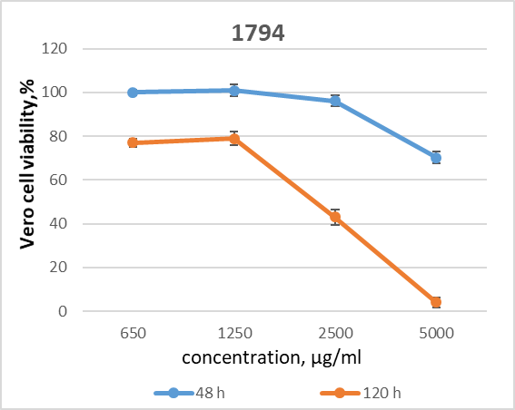
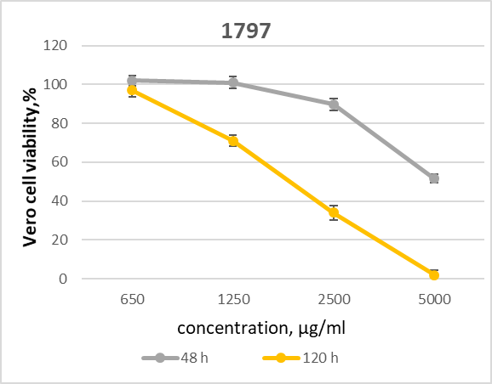
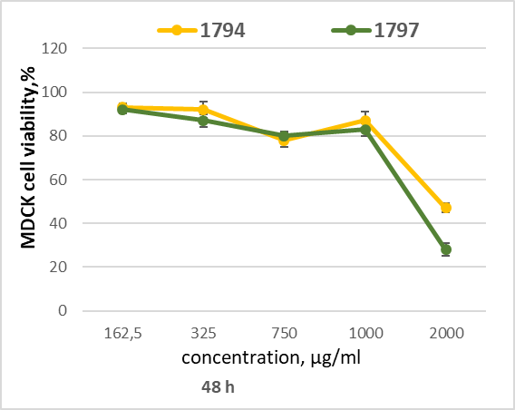
Results and discussion
Compounds structure
1794
1797
MW 343.1496
MW 331.1389
6-(brominedifluoromethyl)-2,3-dimethyl-7,8-dihydro-2H-pyrazolo[3,4-f][1,2,4]thiadiazepine 4,4-dioxide
2-bromo-N'-((1,5-dimethyl-1H-pyrazol-4-yl)sulfonyl)-2,2-difluoroacetimidamide
Cell cytotoxic effect of the compounds
Antiviral activity of the compounds
Antiviral effect of compounds against adeno-, herpes- and influenza viruses was not detected, as inhibition of the development of viruses cytopathic effect on cells and the reduction of viruses infectious titer did not exceed 10% and 0.8 log₁₀TCID₅₀/ml, respectively.

Slide 8
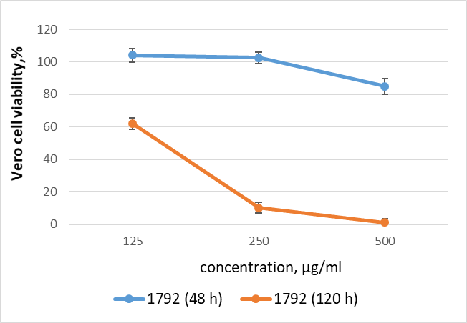
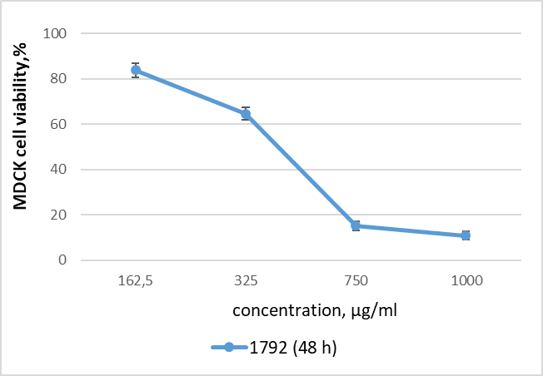
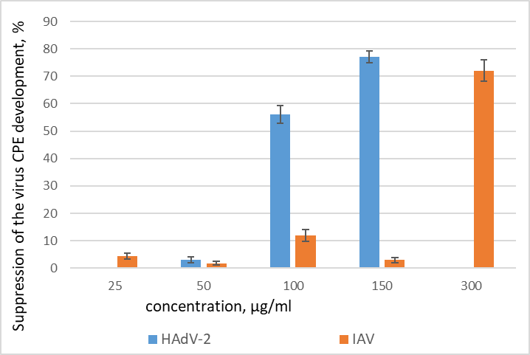
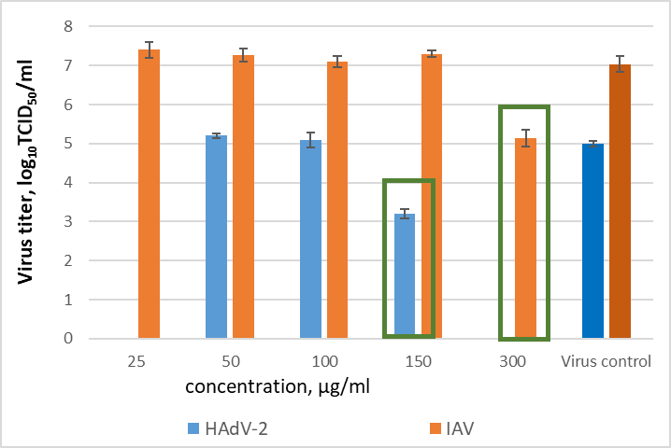
Results and discussion
Compound structure
Cytotoxicity of the compound
1792
MW296.2539
3-(difluoromethyl)-2H-benzo[4,5]imidazo[1,2-b][1,2,6]thiadiazine-4-carbonitrile 1,1-dioxide
Antiviral activity of the compound
Compound inhibited HAdV-2 and IAV reproduction up to 76% and decreased infectious titer of viruses obtained de novo by 2 log₁₀TCID₅₀/ml.

Slide 9
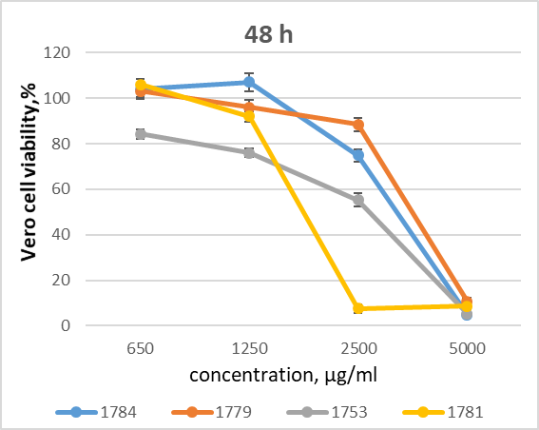
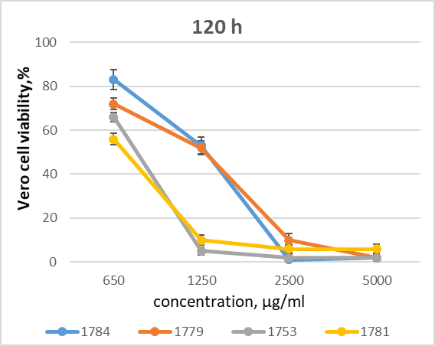
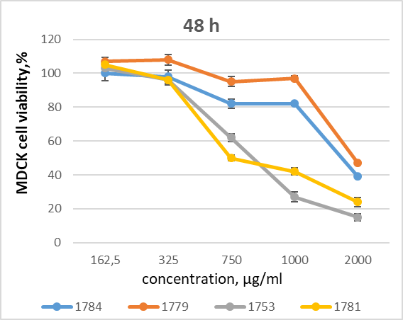
Results and discussion
Compounds structure
1784
1779
1781
1753
MW250.227
MW283.1356
MW 317.5803
MW 329.1230
3-(difluoromethyl)-5,7-dimethyl-4,7-dihydropyrazolo[4,3-e][1,2,4]thiadiazine 1,1-dioxide
3-(dichloromethyl)-5,7-dimethyl-4,7-dihydropyrazolo[4,3-e][1,2,4]thiadiazine 1,1-dioxide
3-(trichloromethyl)-5,7-dimethyl-4,7-dihydropyrazolo[4,3-e][1,2,4]thiadiazine 1,1-dioxide
3-(bromodifluoromethyl)-5,7-dimethyl-4,7-dihydropyrazolo[4,3-e][1,2,4]thiadiazine
1,1-dioxide
Cytotoxicity of the compounds

Slide 10

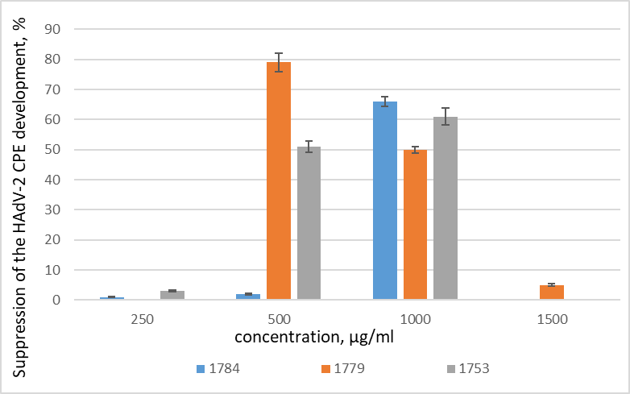
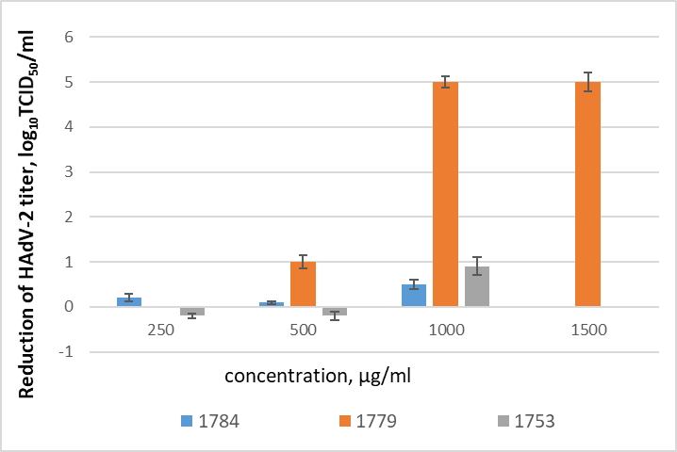
Results and discussion
Among the tested compounds in the group of thiadiazines, only compound 1779 reduced adenovirus reproduction by 79% and completely blocked the formation of full-fledged and infectious progeny of the virus. Indicating that incorporation of 3-(difluoromethyl), 3-(bromodifluoromethyl) or 3-(trichloromethyl) substituents in the molecule 5,7-dimethyl-4,7-dihydropyrazolo[4,3-e][1,2,4]thiadiazine1,1-dioxide leads to decreasing of its antiviral activity.
None of the synthesized compounds from the group of thiadiazines demonstrated antiviral activity against IAV and HSV-1.

Slide 11
Conclusions:
Seven fluorine-, chlorine-, and bromine-containing heterocyclic compounds were synthesized and their antiviral activities against DNA and RNA viruses were evaluated in vitro. Among them «leader structures» were found characterized by a high level of inhibitory activity and significant selectivity for adenovirus and influenza virus (3-(difluoromethyl)-2H-benzo[4,5]imidazo[1,2-b][1,2,6]thiadiazine-4-carbonitrile 1,1-dioxide and 3-(dichloromethyl)-5,7-dimethyl-4,7-dihydropyrazolo[4,3-e][1,2,4]thiadiazine 1,1-dioxide).
The structure-activity relationship for synthesized thiadiazines is analyzed. It was shown that incorporation exactly the dichloromethyl group in third position of the molecule 5,7-dimethyl-4,7-dihydropyrazolo[4,3-e][1,2,4]thiadiazine 1,1-dioxide significantly impact on compound cytotoxicity and increases its antiviral potency.
Obtained data indicate that compounds 1779 and 1792 may be promising antiviral agent.

Slide 12
References
1. Adamson C.S., Chibale K., Goss R. J. M., Jaspars M., Newman D. J., Dorrington R.A. Antiviral drug discovery: preparing for the next pandemic. Chem. Soc. Rev. 2021;50:3647. doi: 10.1039/d0cs01118e
2. De A., Sarkar S., Majee A. Recent advances on heterocyclic compounds with antiviral properties. Chem Heterocycl Compd (N Y). 2021;57(4):410-416. doi: 10.1007/s10593-021-02917-3.
3. De Clercq E., Li G. Approved antiviral drugs over the past 50 years. Clin Microbiol Rev. 2016;29:695–747. doi:10.1128/CMR.00102-15
4. Tran T.N., Henary M. Synthesis and Applications of Nitrogen-Containing Heterocycles as Antiviral Agents. Molecules. 2022; 27(9):2700. https://doi.org/10.3390/molecules27092700
5. Zhang D.-J., Sun W.-F., Zhong Z.-J., Gao R.-M., Yi H., Li Y.-H. et al. Synthesis and Broad-Spectrum Antiviral Activity of Some Novel Benzo-Heterocyclic Amine Compounds. Molecules. 2014;19(1):925–939. doi:10.3390/molecules19010925
Acknowledgments
This research was performed within the framework of funding by the National Academy of Sciences of Ukraine scientific and scientific-technical (experimental) work in the priority area "Creation of new chemicals and materials and physical and chemical processes for their production for basic sectors of the economy and the military-industrial complex" . Contract No. 6.4/3-2023 dated January 2, 2023.

