Slide 1
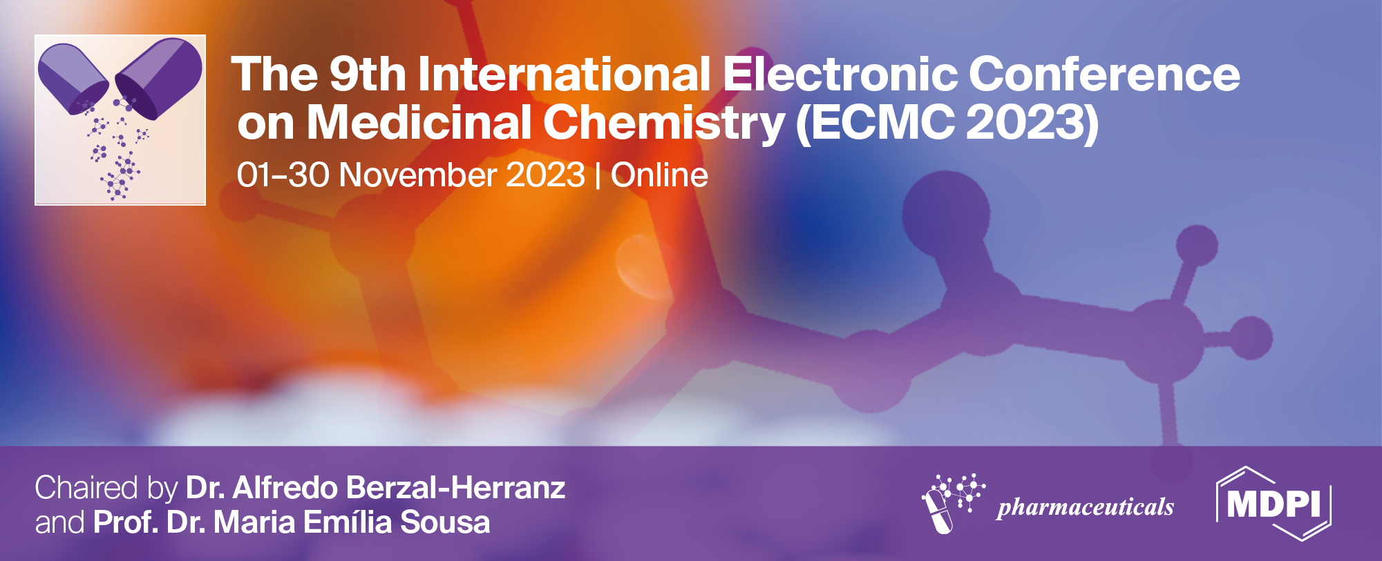
Synthesis and characterization of pyrazine-based precursors for the development of new photosensitizers
Daiane N. Maronde 1*, Ivo E. Sampaio-Dias 1, Luís Pinto da Silva 2, Leandro M. O. Lourenço 3, and José E. Rodríguez-Borges 1
1 LAQV/REQUIMTE, Department of Chemistry and Biochemistry, Faculty of Science, University of Porto,
Porto, Portugal;
2 Chemistry Research Unit (CIQUP), Institute of Molecular Sciences (IMS), Department of Geosciences, Environment and Territorial Planning, Faculty of Science, University of Porto, Porto, Portugal;
3 LAQV/REQUIMTE and Department of Chemistry, University of Aveiro, Aveiro, Portugal.
* Corresponding author: up202010482@up.pt
Notes:
Hello, everyone,
I'm Daiane, a Ph.D. student, and together with my research team, I'm going to present part of my doctoral project.

Slide 2
Synthesis and characterization of pyrazine-based precursors for the development of new photosensitizers
Notes:
Entitled “Synthesis and characterization of pyrazine-based precursors for the development of new photosensitizers”.

Slide 3
Abstract: Cancer belongs to a group of diseases involving abnormal cell growth with the potential to spread to other parts of the body, being currently the leading cause of death worldwide. Cancer therapy is still very challenging and most of the traditional treatments available are usually invasive and cause serious side effects to patients. In this context, photodynamic therapy (PDT) emerges as a good alternative for the treatment of cancer, since it offers great benefits, such as low invasiveness and highly selective.
This therapy combines a photosensitizer (PS), light of a specific wavelength, and molecular oxygen (³O₂) to produce reactive oxygen species (ROS), mainly singlet oxygen (¹O₂) species. Recent studies have shown that Coelenterazine (Clz) and its analogues can be used in PDT exhibiting relevant toxicity to different cancer cells (e.g., breast, liver, prostate, and neuroblastoma) without appreciable harm toward healthy cells.
Synthetically, these compounds can be obtained from pyrazine units. To develop new photosensitizers for the application in the PDT, herein we present the synthesis of new pyrazine-based scaffolds to prepare novel PS. The different products were characterized by spectroscopy techniques.
Keywords: Cancer; photodynamic therapy (PDT); photosensitizers (PS); pyrazine; reactive oxygen species (ROS); singlet oxygen (¹O₂) species.
Notes:
In this sense, we have designed a series of compounds through traditional and optimized organic synthesis strategies, and based on the literature we hope that the products obtained here can be a contribution to the application of photodynamic therapy or as sensitizers or precursors of new photosensitizers.

Slide 4
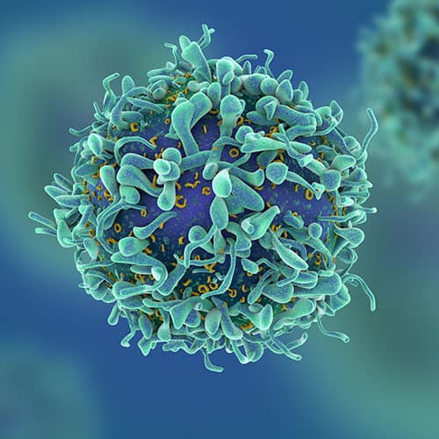
Introduction
Challenge:
Cancer is the leading cause of death worldwide, and statistics show that in 2020 there were around 10 million deaths caused by these diseases.
Treatments:
Surgery
Chemotherapy
Radiotherapy
Photodynamic therapy (PDT)
[1] S. Wang, Y. Liu, Y. Feng, J. Zhang, J. Swinnen, Y. Li, Y. Ni. Cancers 11 (2019) E1782.
[2] C.M. Magalhães, J.C.G. Esteves da Silva, L. Pinto da Silva. ChemPhysChem 17 (2016) 2286.
[3] K.A.D.F. Castro, J.A. Prandini, J.C. Biazzotto, J.P.C. Tomé, R.S. da Silva, L.M.O. Lourenço. Front. Chem. 10 (2022) 825716.
Notes:
Nowadays, the cancer treatment still is a big challenge, therefore being one of the causes of death in the world, and statistics show that in 2020 there were around 10 million deaths caused by these diseases. Furthermore, traditional methods of treatment are invasive and/or cause secondary harm to patients. In this context, photodynamic therapy (PDT) appears as an efficient alternative for its treatment. This therapy combines a photosensitizing drug, visible light, and molecular oxygen (³O₂) to generate reactive oxygen species (ROS), mainly singlet oxygen (¹O₂) species, which are cytotoxic for cancer cells.

Slide 5
Introduction
Aminopyrazine
Clz
[4] L.P. Silva, C.M. Magalhães, A.N. Montenegro, P.J.O. Ferreira, D. Duarte, J.E. Rodríguez-Borges, N. Vale, J.C.G.E. Silva. Biomolecules 9 (2019) 384.
Notes:
Recent studies show the use of aminopyrazine as a precursor for obtaining coelenterazine derivatives, compounds which have proven anticancer activity.
These compounds have shown relevant cell-selective toxicity in different cancer cell lines, such as breast, liver, prostate, and neuroblastoma, without cytotoxic effects in corresponding non-tumoral cells at the same concentrations.

Slide 6
Introduction
R: H, Br, Cl, I, Ph, 4-Br-Ph
Notes:
Based on these results, the present work has focused on the synthesis optimization and the structural characterization of different aminopyrazine derivatives using conventional methods in organic chemistry.

Slide 7
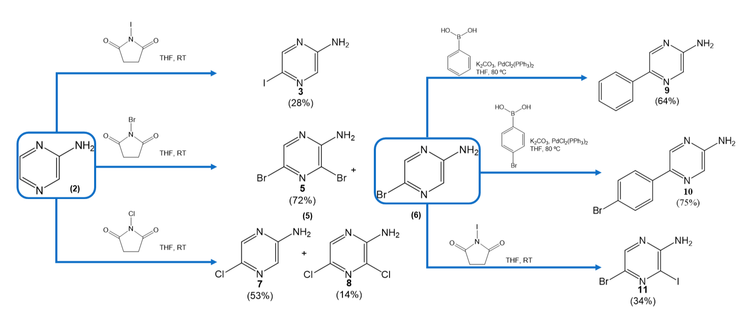
Results and discussion
(2)
(8)
(1)
(3)
(4)
(9)
(5)
(6)
(7)
The products 2-7 were obtained through halogenation reactions. From product 4, it was possible to synthesize 8 and 9 through the Suzuki coupling. The work-up was performed by conventional methodologies in organic chemistry. The obtained products were characterized by ¹H and ¹³C NMR spectroscopies.
Notes:
To obtain the expected products, aminopyrazine was used as the common precursor for all the products. The products 2-7 were obtained through halogenation reactions under mild conditions at room temperature (RT). From product 4, it was possible to synthesize 8 and 9 through the Suzuki coupling. The work-up was performed by traditional methodologies in organic chemistry with liquid-liquid extraction and column chromatography purification. The obtained products were characterized by NMR.

Slide 8
Conclusions
Synthesis
Reaction optimization
Chemical characterization
Next steps
Physical-chemical studies
Biological tests
Notes:
In this work, the synthesis of 8 compounds using aminopyrazine as a common precursor is presented. The optimization of the experiments led to high chemical yields for the assembly of the analogues. These compounds are currently being studied according to their physicochemical characteristics to evaluate their biological applications as photosensitizers or precursors for the assembly of new PS with potential application in PDT.

Slide 9
Acknowledgments
Thanks are due to the University of Porto, University of Aveiro, and FCT/MCTES for the financial support to CIQUP (UIDB/000081/2020), Associated Laboratory IMS (LA/P/0056/2020), and LAQV-REQUIMTE (UIDB/50006/2020) research unities, and FCT projects (PTDC/QUI-QFI/2870/2020 and PTDC/QUI-QOR/31770/2017), through national funds (PIDDAC) and where applicable co-financed by the FEDER-Operational Thematic Program for Competitiveness and Internationalization-COMPETE 2020, within the PT2020 Partnership Agreement. DNM (UI/BD/153613/2022), IES-D (2020.02311.CEECIND/CP1596/CT0004) and L.P.d.S. (CEECINST/00069/2021) thank FCT for their PhD scholarship and funding through the Individual/Institutional Call to Scientific Employment Stimulus, respectively.
Notes:
Our research group would like to thank everyone for their attention, as well as the universities of Porto and Aveiro, and the essential support of the FCT. So thank you very much!

