Slide 1
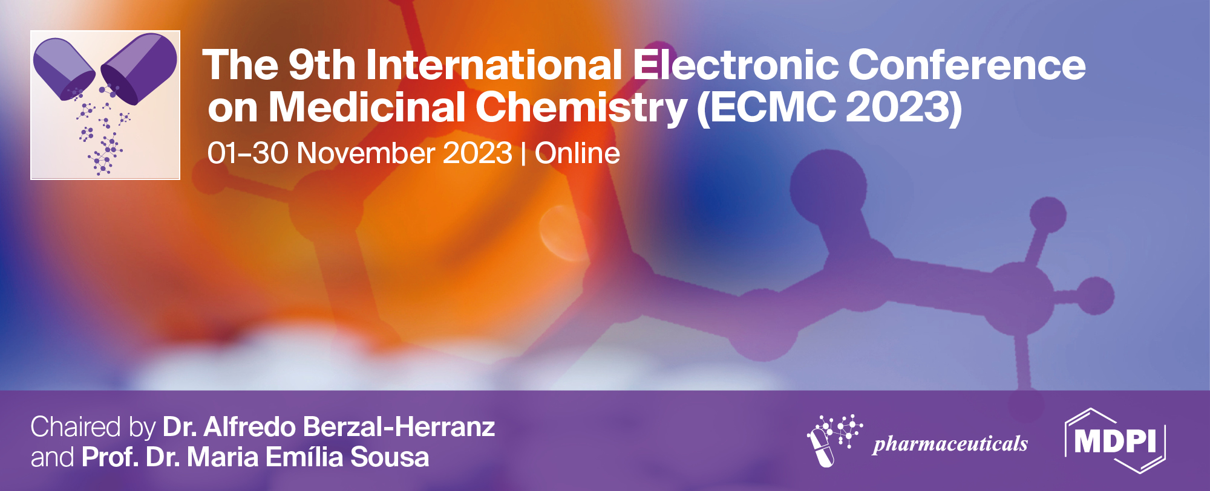

Interactions of synthetic oligonucleotides with signaling proteins and their receptors
Oleksandr Nuzhnyi^{1,}*, Roman Nikolaiev¹, and Zenovii Tkachuk¹
¹ The Institute of Molecular Biology and Genetics of the National Academy of Sciences of Ukraine (IMBG of the NASU);150, Ac. Zabolotnogo St., Kyiv,Ukraine, 03680;
* Corresponding author: alexnuzhny@gmail.com

Slide 2
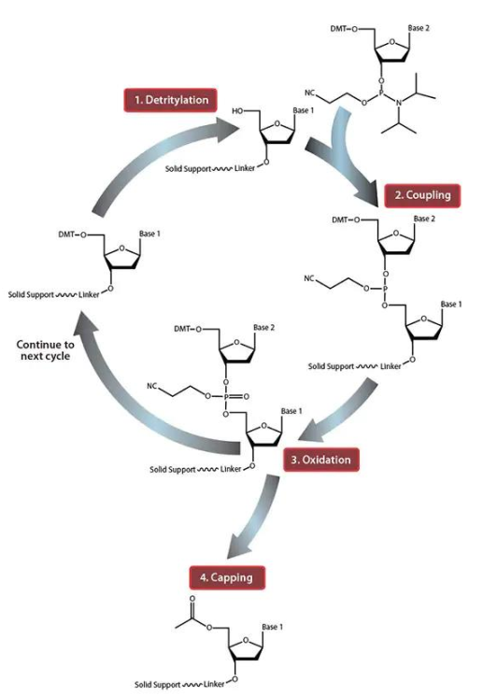
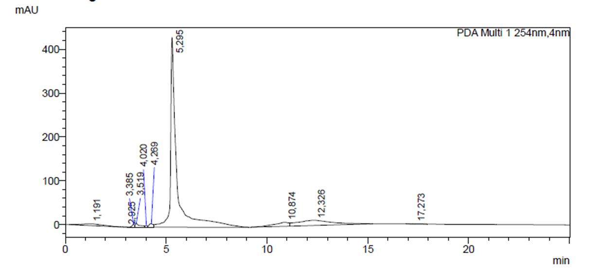
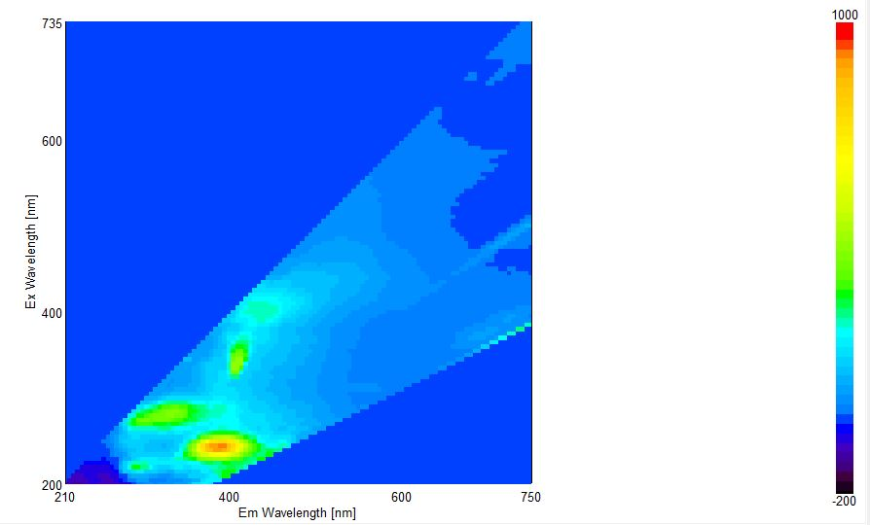
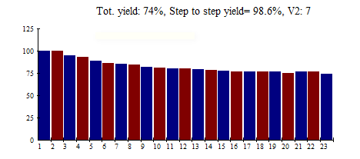
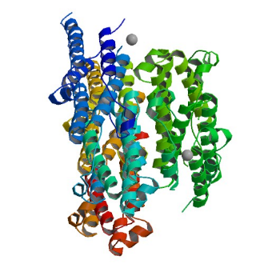

Interactions of synthetic oligonucleotides with signaling proteins and their receptors
Synthesis OLNs
Purification OLNs
Fluorescence titration OLNs + protein
The study successfully synthesized and purified eight oligonucleotides (OLNs) and investigated their interaction with recombinant signaling proteins and receptors using fluorescence analysis and the Stern-Volmer equation. The results indicated strong binding between OLNs and these proteins, with some cases showing positive cooperative binding and potential implications for therapeutic applications involving OLNs and signaling proteins and receptors.
Or
Analysis of protein interaction with OLNs

Slide 3
Abstract:
The study aimed to synthesize, purify, and investigate the interaction of oligonucleotides (OLNs) with recombinant signaling proteins and their receptors, assessing the binding strength using fluorescence analysis and the Stern-Volmer equation. OLN-1 to OLN-8 were synthesized and purified, and their purity confirmed by HPLC. Fluorometric titration revealed static binding of OLNs to proteins, forming non-fluorescent complexes, except for OLN-3 with insulin (INS) and OLN-2 with interferon α2-β (INF α2-β), showing mixed binding. This indicates that these proteins interacted with OLNs at very low concentrations. OLN-1, OLN-6, OLN-7, and OLN-8 exhibited high binding activity to all proteins. Moreover, positive cooperative binding (2A+B=A2B) was observed in some cases, where one OLN molecule facilitated the attachment of the next due to conformational changes. OLN-3 and OLN-4 displayed significant positive cooperative binding with INF α2-β. In conclusion, the study demonstrated a strong interaction between OLNs and recombinant signaling proteins and receptors, potentially influencing their conformation and biological activity. These findings have implications for the therapeutic use of OLNs in the context of signaling proteins and receptors.
Keywords: Oligonucleotides;Receptors;Signaling proteins;Synthesis;
Notes:
insulin (INS),interferon α2-β (INF α2-β)

Slide 4
Introduction
Oligonucleotides that bind to proteins and their receptors play a crucial role in various biological processes. These interactions provide valuable information about molecular recognition and are used in numerous applications in biotechnology and medicine.
Oligonucleotide-protein interactions have led to the development of innovative therapeutic agents:
- Antisense therapeutics: antisense oligonucleotides are designed to target disease-related RNA molecules, offering a promising approach to treating genetic and acquired diseases (Bennett et al., 2017).
- Aptamer-based drugs: Aptamers can target specific proteins involved in the development of diseases, such as cancer or blood clotting factors, with potential applications in diagnosis and therapy. (Ellington and Szostak, 1990).
Oligoribonucleotides have been the subject of extensive research for a long period of time, with a particular emphasis on recent years. They have attracted considerable attention as potential candidates for the development of new drugs targeting viruses, inflammation, and tumors. These molecules play a key role in the mechanisms of antiviral cell defense and contribute significantly to the most important cellular processes, including growth, differentiation, apoptosis and pathogenesis. Also, our laboratory has investigated the interaction of oligonucleotides with proteins using mass spectrometry. (Levchenko S. M., 2013)

Slide 5
The abbreviations used:
Insulin (INS)
Interferon α2-b (INF)
Insulin receptor (INSR)
Interferon receptor 1 alfa/beta (INFR)
Somatotropin (STP)
Short oligonucleotides of varying lengths and compositions (OLN1-8 or 1-8)

Slide 6
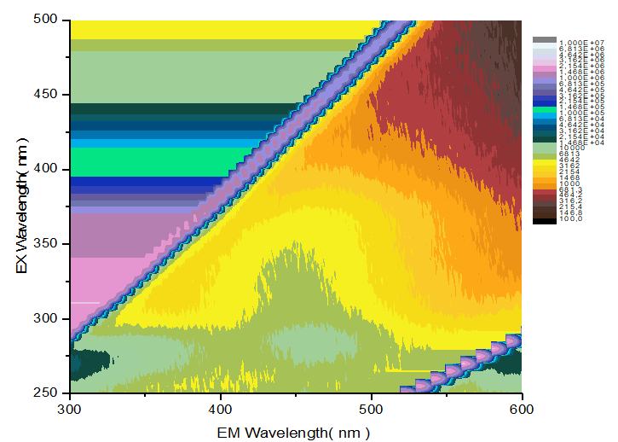
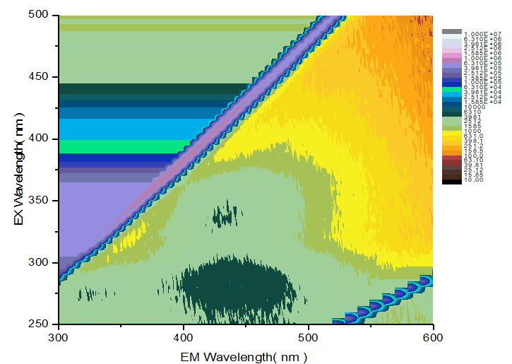
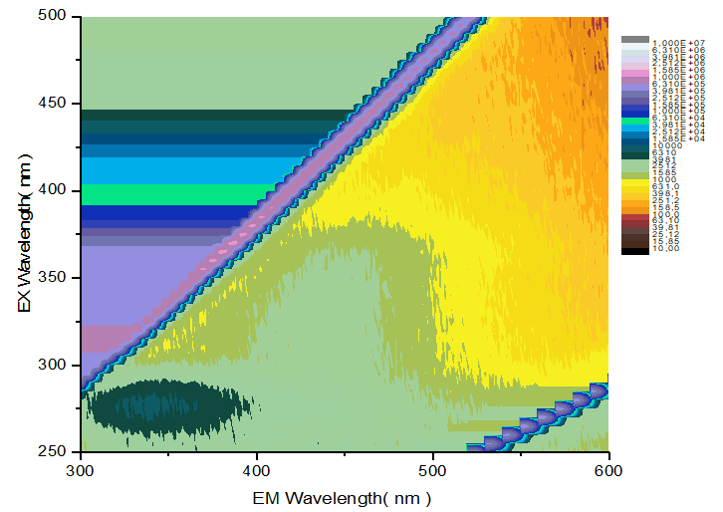
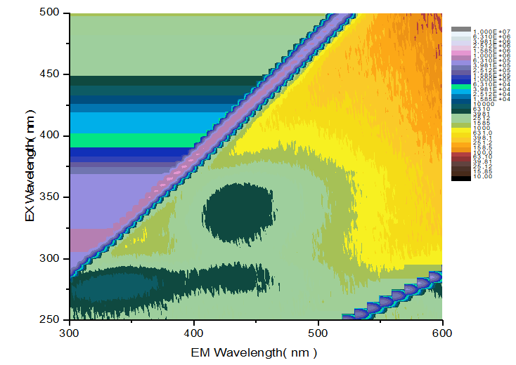
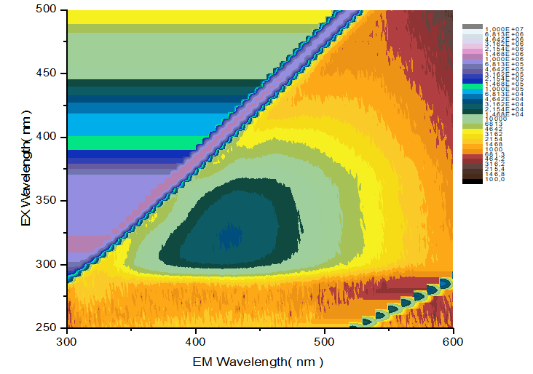
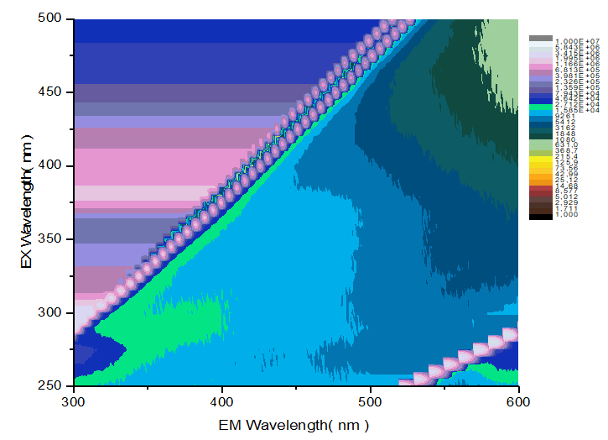
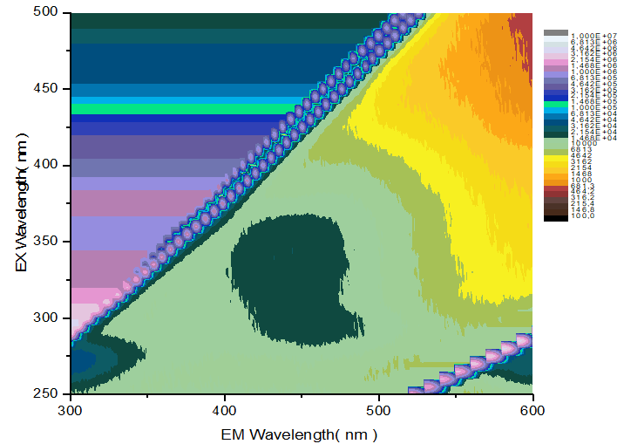
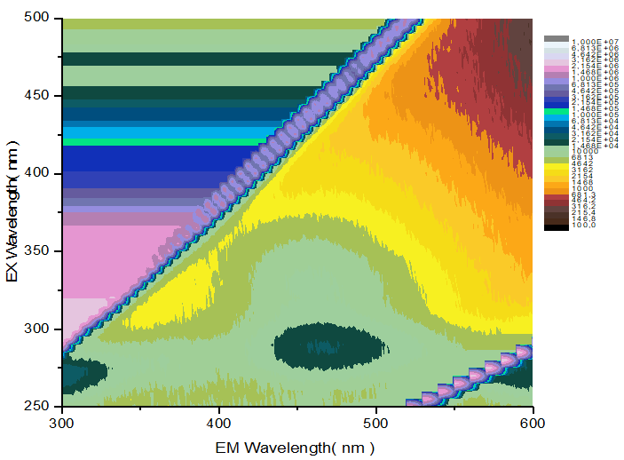
Results and discussion
Excitation Emission Matrix (EEM)
1 2 3 4
5 6 7 8

Slide 7
The Stern-Volmer constant
The Stern-Volmer constant is a value used to characterize the effect of external factors (e.g., binding to a partner molecule) on the fluorescent intensity of a fluorescent probe (e.g., fluorescent marker or fluorescent molecular probe). It is defined for a fluorophore and a partner (e.g., protein) and indicates the ability of the fluorophore to lose its fluorescent intensity when bound to the partner. An increase in the Stern-Volmer constant indicates an increase in the efficiency of fluorophore binding, which can be used to study interactions between molecules such as oligonucleotides (OLN) and proteins.
In our study, we used the Stern-Volmer constant to determine the interaction between OLN and proteins, as well as to determine the strength of this interaction. This allowed us to estimate how strongly the RNAs interact with the proteins, measure the static convergence, and determine whether conformational changes occur in the proteins during this interaction. Such studies can be of value in biochemistry and biology to understand molecular interactions and their impact on the biological activity of molecules.

Slide 8
Stern-Volmer Constants (Ksv1)
 | STP | INSR | INS | INFR | INF
OLN1 | 7,51 | 11,05 | - | 9,73 | 10,95
OLN2 | - | 37,01 | - | 8,14 | 20,70
OLN3 | 23,81 | 18,27 | 57,18 | 10,42 | -
OLN4 | 10,52 | 10,52 | 10,52 | 11,77 | -
OLN5 | 50,85 | - | 10,57 | - | 10,52
OLN6 | 20,09 | 13,40 | - | - | 14,56
OLN7 | 12,80 | 14,50 | 23,81 | - | 27,35
OLN8 | 12,17 | 30,50 | 10,59 | 10,52 | 35,60
After titration of OLNs with proteins on the fluorometer, the first-order Stern-Volmer constants (Ksv1) were calculated. This constant indicates the ability of the OLN to change its fluorescent intensity upon binding to a protein. A large value of Ksv1 indicates a significant effect of the protein on the fluorescent intensity of the OLN and may indicate a strong interaction between them.
Notes:
STP - Соматотропін

Slide 9
Why we moved to the second-order Stern-Volmer constant (Ksv2)
In some cases, when Ksv1 deviated from the linear distribution (R<0.9), we see negative or positive cooperative binding. In this graph, you can see an example of negative cooperative binding of INF + OLN3, positive cooperative binding of INs + OLN2 and with a linear distribution of INFR + OLN3.

Slide 10
Second-order Stern-Volmer constants (Ksv2)
 | STP | INSR | INS | INFR | INF
OLN1(1) | - | - | 37,98 | - | -
OLN1(2) | - | - | 28,60 | - | -
OLN2(1) | 34,01 | - | 31,31 | - | -
OLN2(2) | 10,96 | - | 25,67 | - | -
OLN3(1) | - | - | - | - | 2,94
OLN3(2) | - | - | - | - | 13,45
OLN4(1) | - | - | - | - | 2,59
OLN4(2) | - | - | - | - | 20,11
OLN5(1) | - | 85,06 | - | 111,82 | -
OLN5(2) | - | 13,96 | - | 69,22 | -
OLN6(1) | - | - | 27,00 | 31,31 | -
OLN6(2) | - | - | 10,96 | 10,96 | -
OLN7(1) | - | - | - | 255,66 | -
OLN7(2) | - | - | - | 121,02 | -
OLN8(1) |  | - | - | - | -
OLN8(2) | - | - | - | - | -
For those cases where Ksv1 deviated from a linear plot (R<0.9), we calculated the second-order Stern-Volmer constants (Ksv2). Each of these Ksv2 constants reflects the effect of one or more ROS molecules on the fluorescent intensity when interacting with the protein. In some cases, such as when OLN3 and OLN4 are added to INF, negative cooperative binding is observed, meaning that the interaction of one ONC molecule can lead to a change in the interaction with a second ONC molecule or protein.

Slide 11
Dissociation constants (Kd) of somatotropin
The Hill equation relates the fraction of occupied ligand binding sites to the ligand concentration - so it essentially describes how tightly a ligand binds to its cognate site. It uses two parameters: the dissociation constant (Kd), which is formally defined as the ligand concentration at which half of the binding sites are occupied, and the Hill coefficient (n), which is a measure of cooperativity. Kd is a fairly simple concept to understand intuitively - it is always in units of concentration, and lower values mean stronger binding. The easiest way to visualise the effect of these parameters is to plot the fraction against the logarithm (ligand concentration). This will be a sigma with an inflection point where the ligand concentration is equal to Kd. A change in Kd will shift the entire curve to the left (for lower values of Kd, highter binding) or to the right (for higher values, looser binding).

Slide 12
Dissociation constants (Kd) of insulin and its receptor.
In these graphs you can see the display of dissociation constants, with black binding A + B = AB and red binding A + 2B = AB2. That is, the protein binds to multiple oligonucleotide molecules. In the remaining cases, when it is possible to bind the second oligonucleotide molecule, it is more efficient than with the first molecule. This means that different effects can be observed under different conditions of protein-oligonucleotide interaction, and this can be important for understanding the molecular mechanisms that occur in the system.

Slide 13
Dissociation constants (Kd) in the interaction of OLN with interferon and its receptor.
In the case of interferon, when 3 and 4 oligonucleotide molecules are added, a negative cooperative effect is observed (i.e., binding to the second oligonucleotide molecule is more difficult due to interaction).

Slide 14
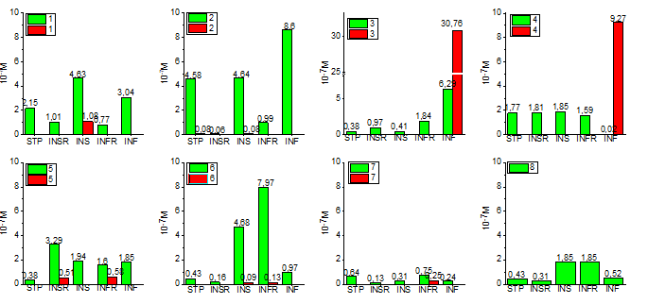
Dissociation constants (Kd)
Oligonucleotides of higher polymericity in salt form have higher binding constants than monomers and can have three binding mechanisms: static, positively and negatively cooperative. Oligonucleotides bind differently to different proteins, and different oligonucleotides can have different binding modes to the same protein.

Slide 15
Conclusions
The aim of our work was to synthesize and purify oligonucleotides (OLNs) and investigate their interaction with recombinant signaling proteins and receptors. Using fluorescence analysis and the Stern-Volmer equation, we found that OLNs bind strongly to these proteins, with cooperative binding observed in some cases. The results of our experiments indicate a high degree of interaction of OLNs with recombinant signaling proteins and their receptors, which may be accompanied by changes in their conformation and biological activity, which, in turn, may be important for their therapeutic use.

