Slide 1
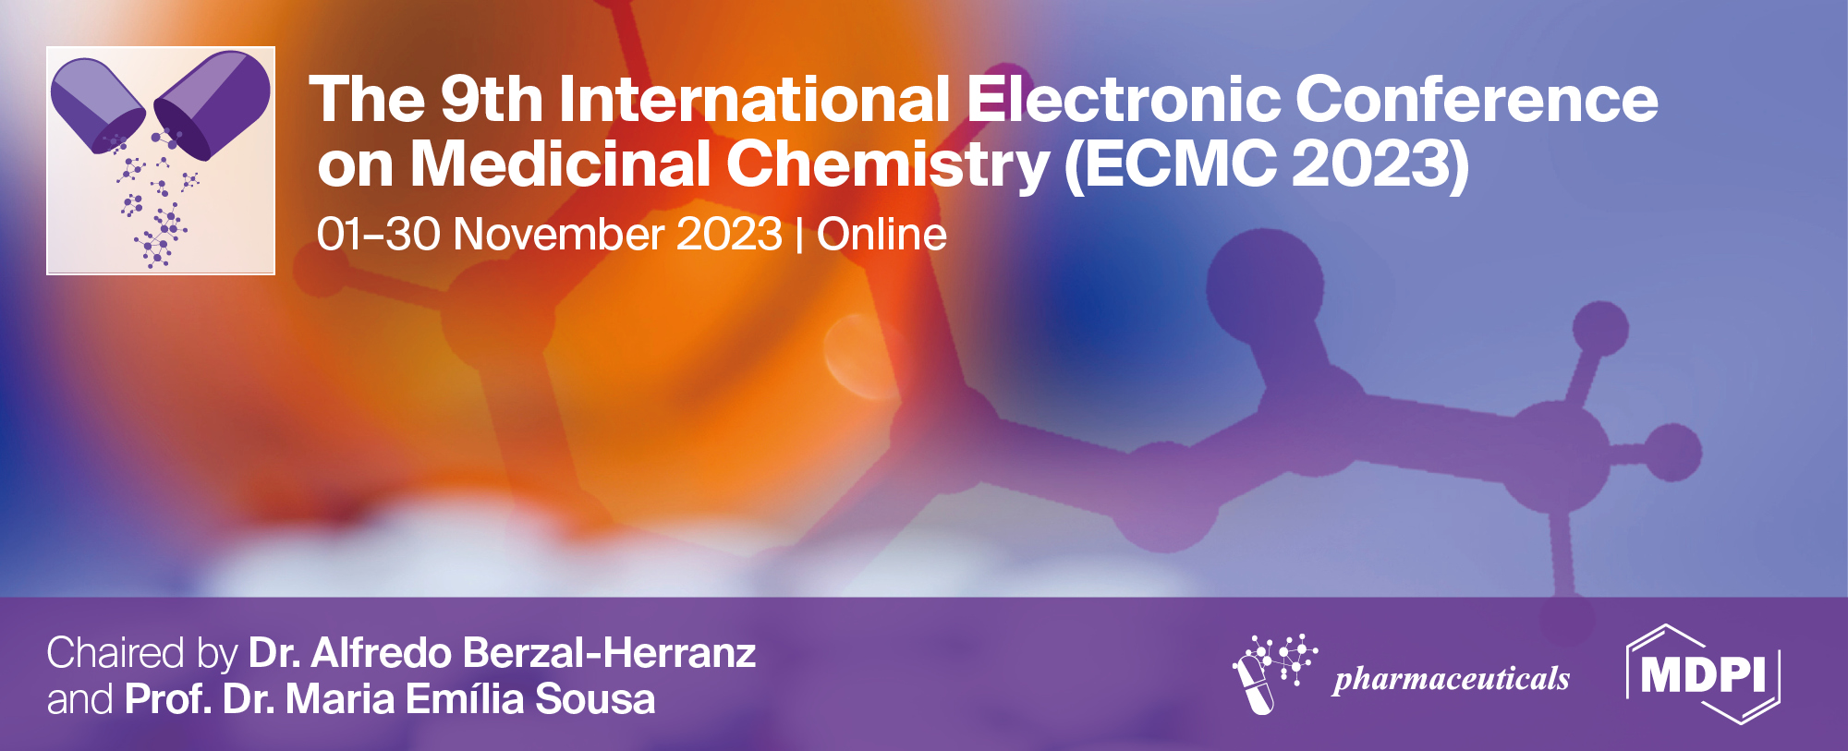



Adarotene-related retinoids as potential antimicrobial agents against multidrug-resistant gram-positive strains
Salvatore Princiotto ^{1,}*, Loana Musso¹, Francesca Sacchi¹, Lucia Magnani¹, Maria Luisa Mangoni², Claudio Pisano³, and S. Dallavalle¹
¹ Department of Food, Environmental and Nutritional Sciences (DEFENS), University of Milan, via Celoria, 2, 20133 Milan, Italy;
² Department of Biochemical Sciences "A. Rossi Fanelli", Faculty of Pharmacy and Medicine, Sapienza University of Rome, Piazzale Aldo Moro, 5, 00185, Roma, Italy
³ Preclinical Research & Biotech Development, Special Product's Line, Via Fratta Rotonda Vado Largo, 1, 03012 Anagni (FR), Italy
* Corresponding author: salvatore.princiotto@unimi.it

Slide 2
Adarotene-related retinoids as potential antimicrobial agents against multidrug-resistant gram-positive strains

Slide 3
Multidrug-resistant (MDR) pathogens are severely impacting our ability to successfully treat common infections. As a consequence, bacterial resistance to antimicrobial drugs represents one of the most impelling topics in medicinal chemistry. In recent years we have focused our efforts on the investigation of a panel of adarotene-related synthetic retinoids showing, together with favorable MICs, a detectable bactericidal effect on S. aureus and E. faecalis (including some MDR strains).¹ Based on these promising results, a small collection of adarotene related retinoids was prepared. Chemical modifications were performed on the carboxylic group and the double bond of the cinnamic portion, as well as polar substituents were introduced on ring A and ring B, in order to evaluate the potential structural determinants necessary to exert antibiotic activity (Figure 1). Overall, the results showed that compounds with a very good activity profile can be obtained by modulating the pattern of substitution on the adarotene moiety. Moreover, the shape and geometry of the molecules, together with the presence of key polar groups on the biphenyl backbone, could play a major role for the antimicrobial effect on resistant strains.
Figure 1: Structure of adarotene and suitable modifications on its scaffold.
References:
[1] S. Princiotto, S. Mazzini, L. Musso, F. Arena, S. Dallavalle, and C. Pisano, Antibiotics 2021, 10, 126.

Slide 4
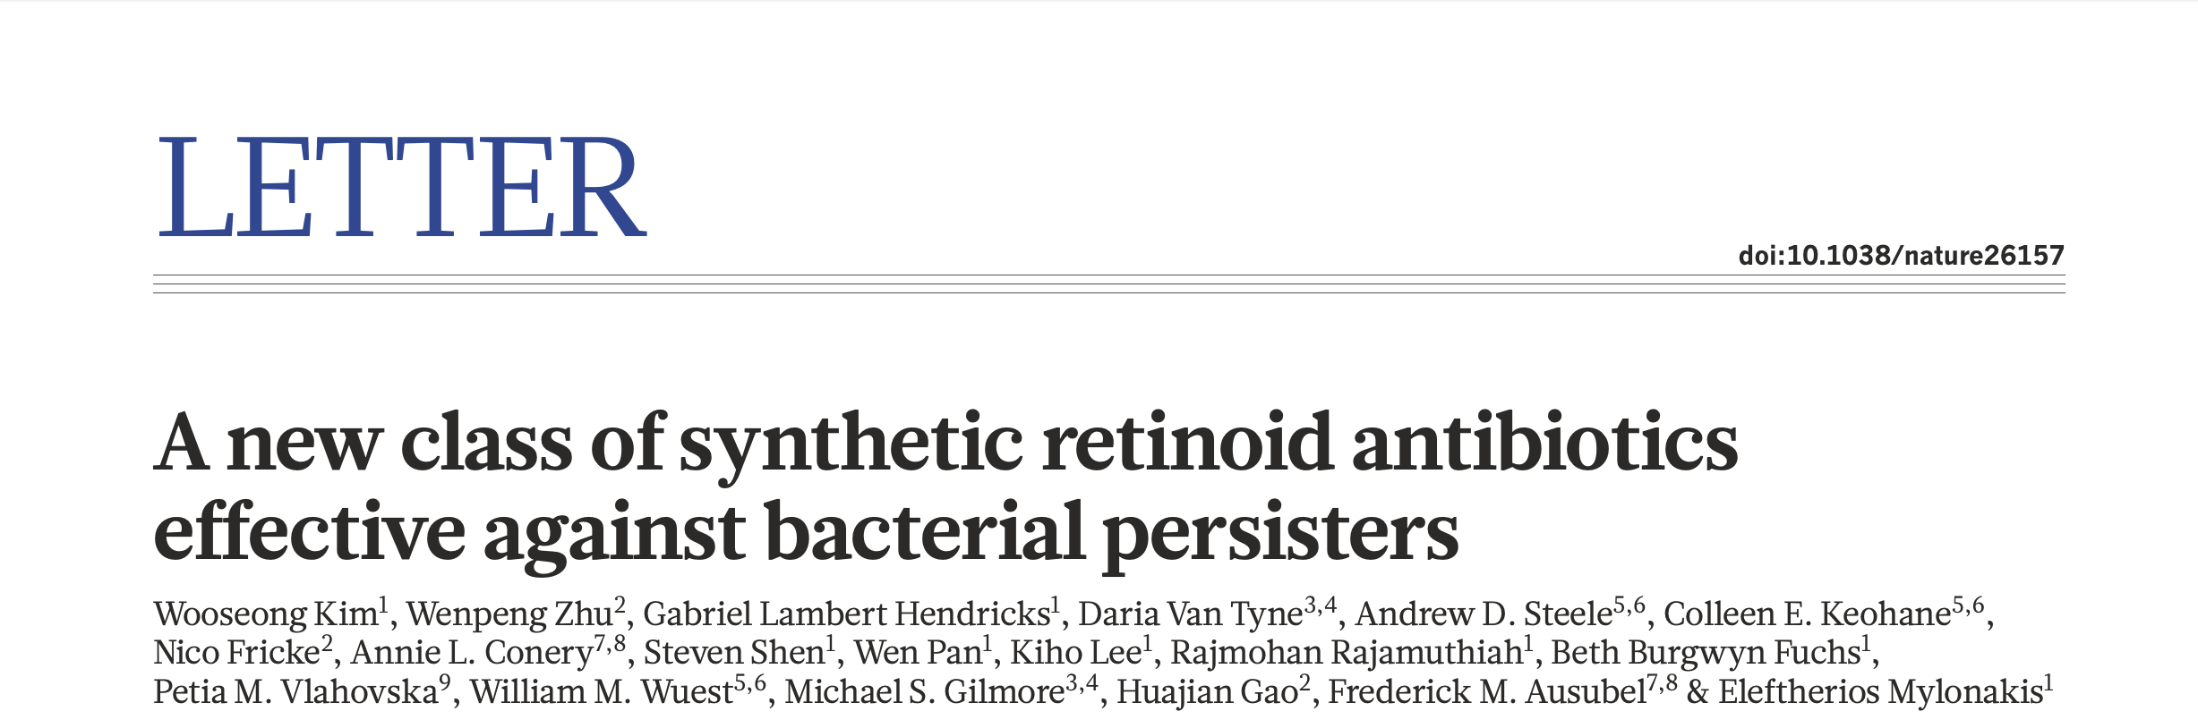
Retinoid-related molecules (RRMs)
Pro-apoptotic activity on solid tumors and leukemia
Evidences of antimicrobial activity (Kim et al. Nature 556, 103–107 (2018))

Slide 5
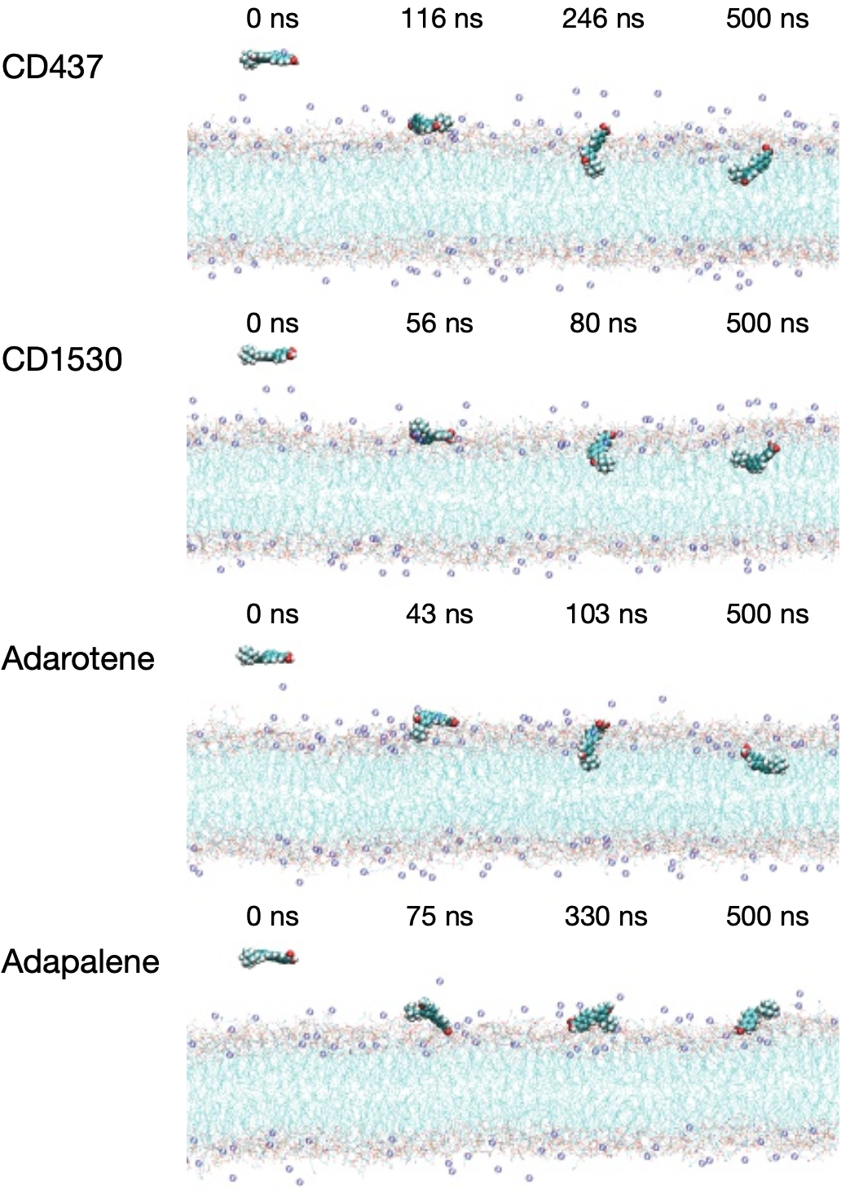
Retinoid-related molecules (RRMs)
Pro-apoptotic activity on solid tumors and leukemia
Evidences of antimicrobial activity (Kim et al. Nature 556, 103–107 (2018))

Slide 6
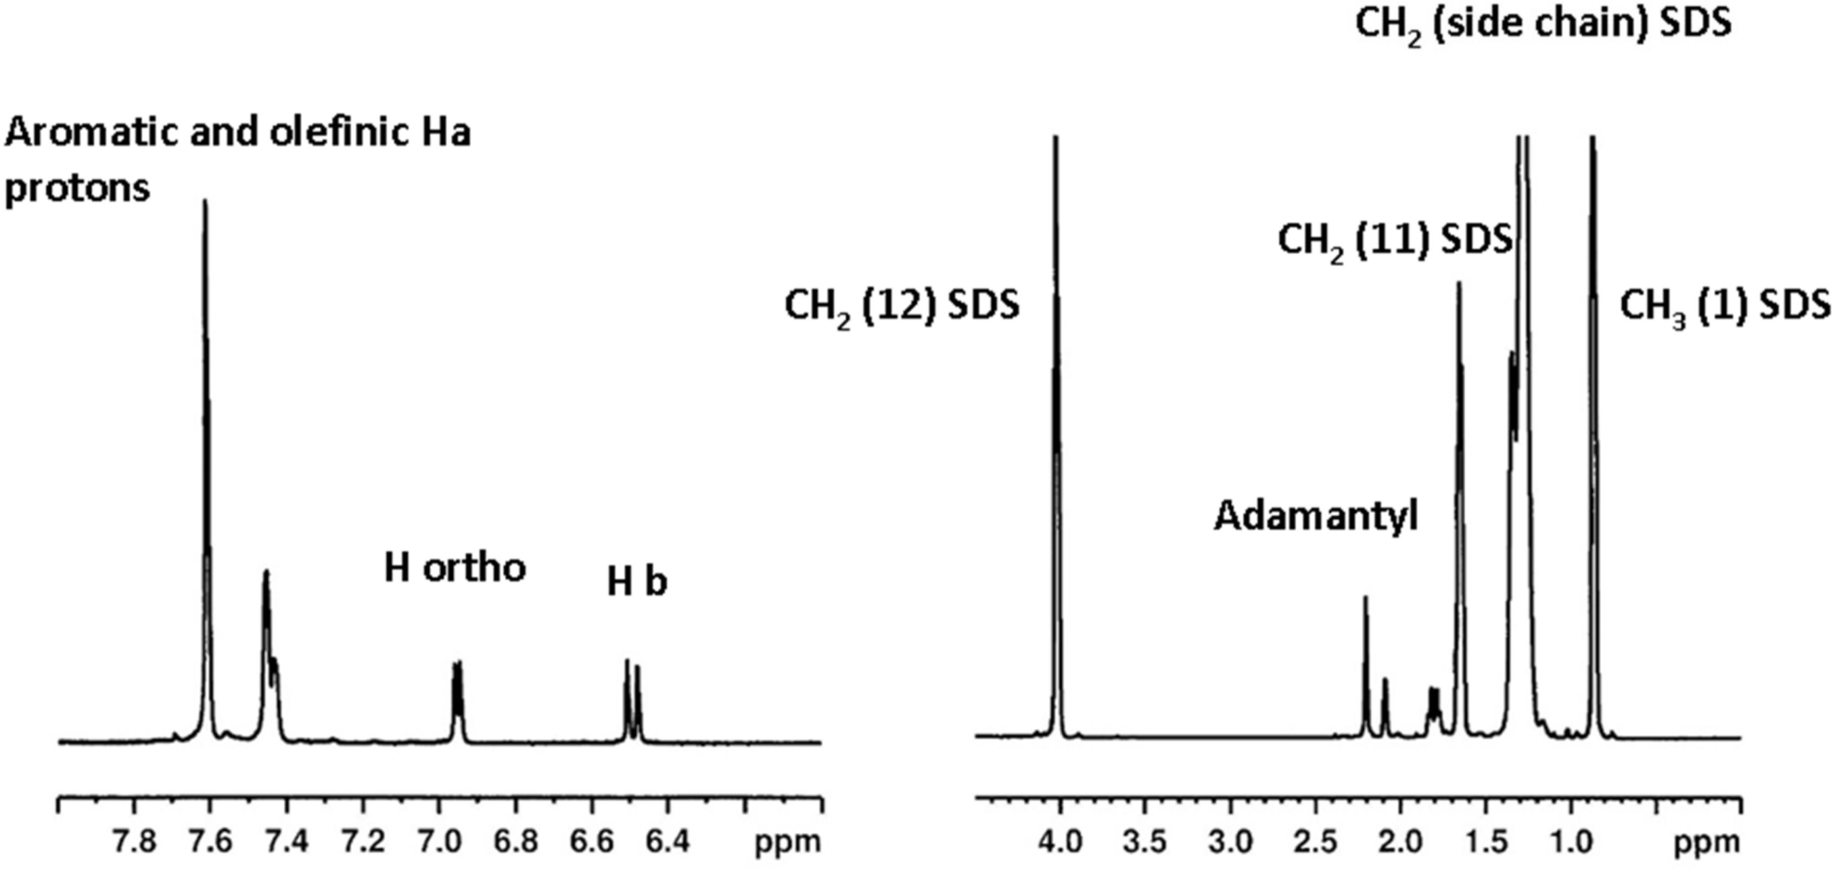
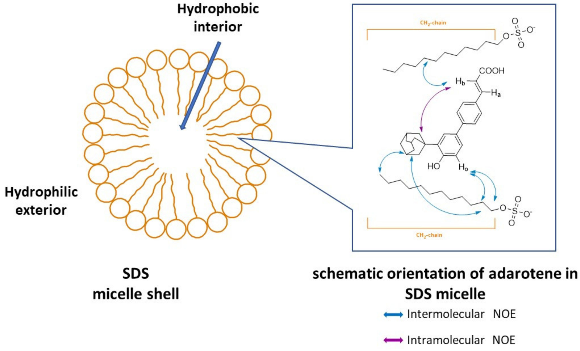
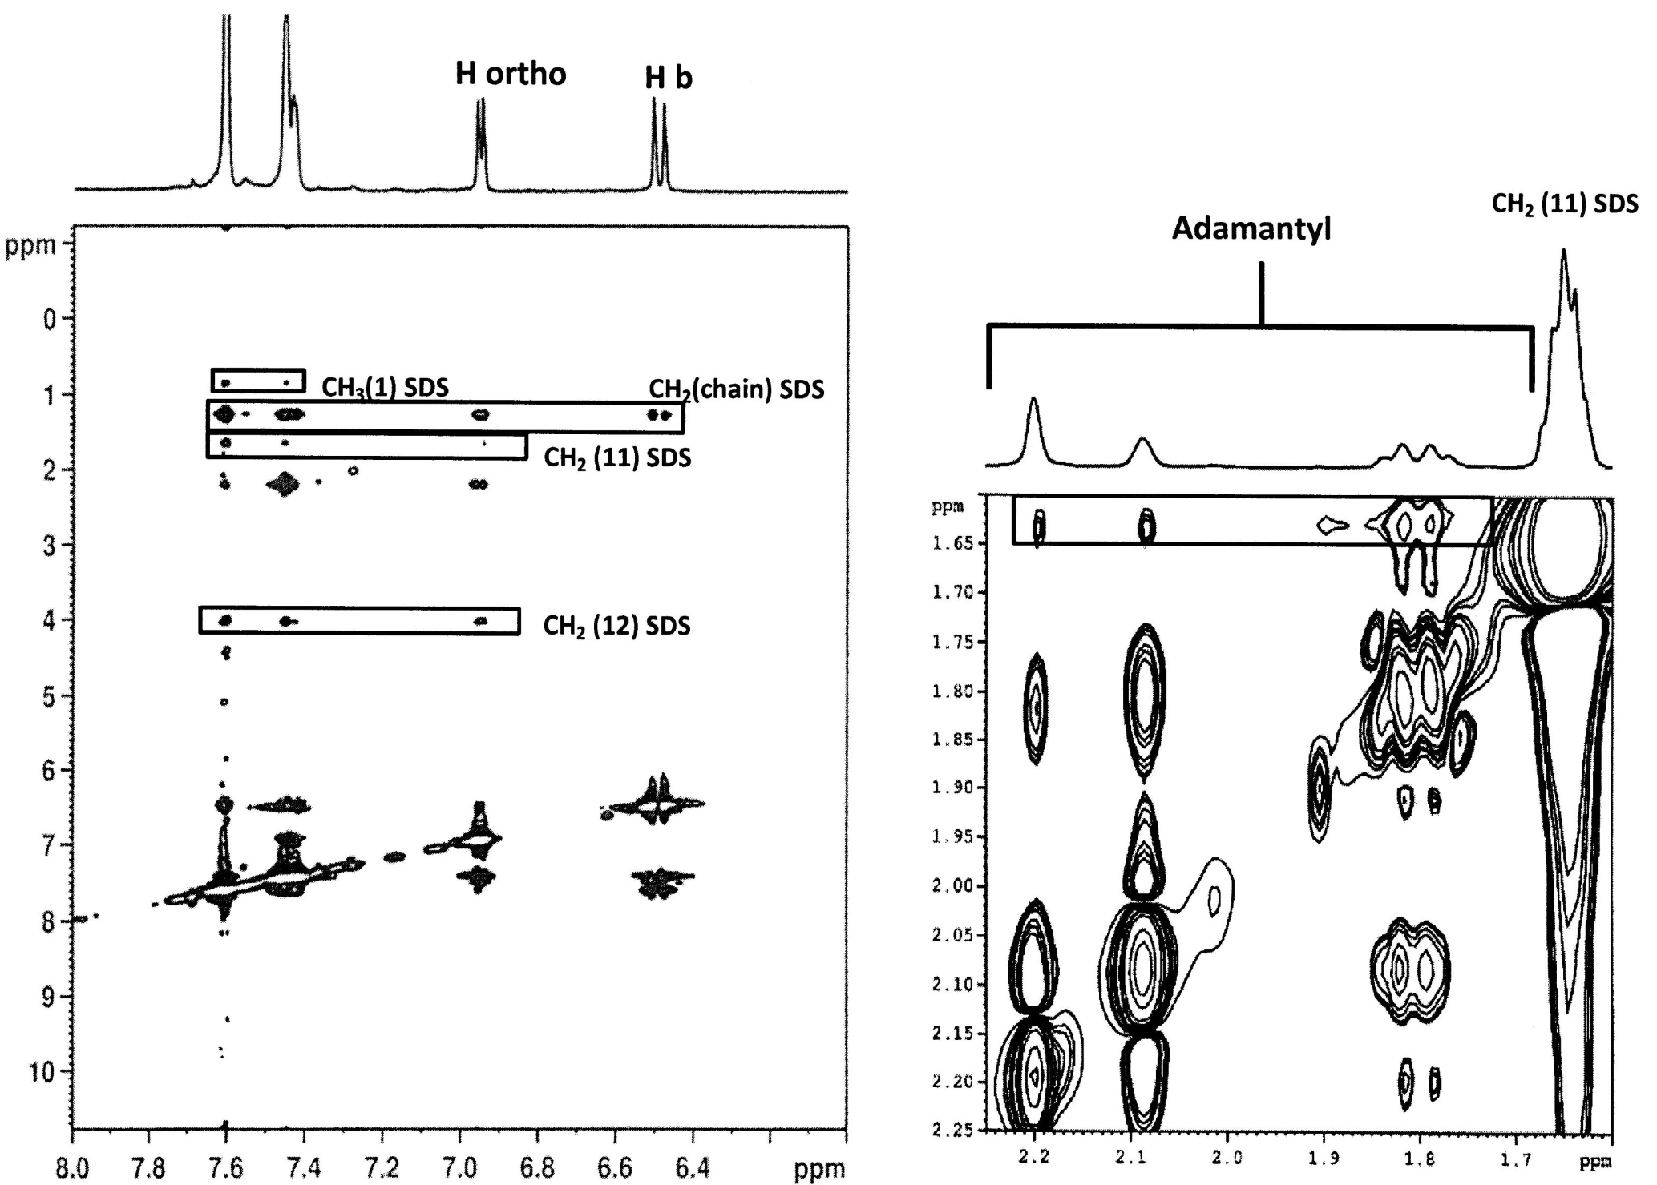
NMR studies on adarotene
Princiotto et al. Antibiotics, 2021, 126

Slide 7
In house library of adarotene analogues

Slide 8
Biological activity evaluation
 |  | MIC (µg/mL)
cpd | IC₅₀ (μM)ª | S. aureus Strain 1 | E. faecalis Strain 1
Adarotene | 0.23±0.08 | 8 | 1
1 | 30 | 64 | >256
2 | >10 | 256 | 128
3 | 7.8±0.7 | 32 | 128
4 | 8.3±1.4 | 128 | 32
5 | 1.1±0.6 | 64 | >256
6 | 6.6±0.5 | >256 | >256
7 | >3 | 4 | 4
8 | 7.19±1.27 | 2 | 1
9 | >10 | 2 | 1
10 | 48.42±0.88 | 16 | 16
11 | 0.52±0.07 | 16 | 8
12 | 0.23±0.07 | 4 | 2
13 | 1.24±0.07 | 8 | 4
14 | >10 | 8 | 4
15 | 1.64±0.03 | 64 | 64
16 | >10 | 4 | 2
17 | >10 | 4 | 8
18 | >10 | 128 | 128
19 | >10 | 32 | 32
20 | 3.2±0.2 | 2 | 8
 | MIC (µg/mL) |  | MIC (µg/mL)
cpd | S. aureus ATCC 25923 | S. aureus Strain 2 | E. faecalis ATCC 51299 | E. faecalis Strain 2
Adarotene | 8 | 4 | 2 | 4
2 | 256 | 256 | 64 | 128
16 | 2 | 2 | 2 | 2
17 | 2 | 4 | 8 | 8
ª tested IGROV-1 cancer cell line

Slide 9
New adarotene analogues

Slide 10
Structural modifications on acidic and phenolic portions
a) adamantan-1-ol, H₂SO₄/AcOH; b) Tf₂O, Py; c) bis(pinacolato)diboron, KOAc, PdCl₂(dppf); d) 22, Pd(PPh₃)₄, Na₂CO₃ 2 M, DME/EtOH 9:1; e) methyl acrylate, TOTP, Pd(OAc)₂, Et₃N; f) LiOH H₂O, THF/H₂O; g) CDI, DMF; h) WSC, HOBT, 1,2-phenylenediamine, CH₃CN/THF; i) 4-bromobutyl acetate, K₂CO₃, DMF; j) i. 0.7N NaOH, CH₃OH, reflux; ii. 1M HCl; k) acrylonitrile, tri(o-tolyl)phosphine, Pd(OAc)₂; l) acetic anhydride, PTSA

Slide 11
Substitutions on ring A
a) adamantan-1-ol, H₂SO₄/AcOH; b) bis(pinacolato)diboron, PdCl₂(dppf), KOAc, methyl p-bromocinnamate, Na₂CO₃ 2 M and PdCl₂(dppf); c) LiOH THF/H₂O; d) (CH₂O)_{n}, SnCl₄, 2,6-lutidine, toluene; e) Pd(OAc)₂, tri(o-tolyl)phosphine, Et₃N, tert-butyl acrylate; f) O-t-butyl hydroxylamine hydrochloride, pyridine, EtOH, reflux; g) TFA, dry CH₂Cl₂

Slide 12
Substitutions on ring B
a) Methyl acrylate, Pd(OAc)₂, TOTP, TEA; b) C₆H₅N(SO₂CF₃)₂, Et₃N, CH₂Cl₂; c) TBDMSCl, Et₃N, DMAP, DMF; d) bis(pinacolato)diboron, KOAc, PdCl₂(dppf), 27, Na₂CO₃ ; e) LiOH H₂O, THF/H₂O, 1:1; f) t-BuONH₂·HCl (16) or MeONH₂·HCl (17) or NH₂OCH₂COOH·1/2 HCl (18) or AllONH₂·HCl (45) or BnONH₂·HCl (46) py, EtOH, reflux; g) LiOH·H₂O THF/H₂O 1:1; h) pyridinium tribromide, CH₂Cl₂; i) t-BuONH₂·HCl, EtOH, pyridine, reflux; j) KOH, isopropanol, reflux

Slide 13
Substitutions on the cinnamic portion
a) PdCl₂(dppf)·CH₂Cl₂, KOAc, diboro-bis-pinacolate, dioxane; b) 22, Pd(PPh₃)₄, Na₂CO₃ 2 M, DME/EtOH 9:1; c) methyl acrylate, tri(o-tolyl)phosphine, Pd(OAc)₂, Et₃N; d) LiAlH₄, THF; e) i. CuI, PdCl₂(Ph₃P)₂, diisopropylamine, Et₃N; ii. propargyl alcohol; f) 4-Formylbenzeneboronic acid, Pd(Ph₃P)₄, Na₂CO₃, toluene; g) NaBH₄ in MeOH; h) KMnO₄, H₂O/acetone; i) TBDMSCl, Et₃N, DMAP, DMF; j) Ph₃PdC(CH₃)COOEt/CHCl₃/BuLi/THF (7) or EtOCOCHFPO(OEt)₂/BuLi/THF (8) or methyl cyanoacetate, β-alanine, EtOH; k) LiOH H₂O, DMF

Slide 14
Biological activity evaluation
 | MIC (µM)
cpd | S. aureus ATCC 25923 | E. coli ATCC 25922
Adarotene | 21 | -
16 | 4 | >128
30 | >128 | >128
31 | >128 | >128
32 | >128 | >128
33 | 64 | >128
34 | 16 | >128
35 | 64 | n.d.
36 | 16 | >128
37 | 4 | >128
38 | >128 | >128
39 | 16 | >128
40 | 8 | >128
41 | 4 | >128
42 | >128 | >128
43 | >128 | >128
44 | >128 | >128
45 | 4 | >128
46 | 8 | >128
47 | 32 | >128
48 | 32 | >128
49 | >128 | >128
50 | >128 | >128
51 | 128 | >128
52 | >128 | >128
53 | 8 | >128
Strain | Resistance profile | MIC (µM)
S. epidermidis ATCC 12228 | - | 4
S. aureus ATCC 43300 | MET - OXA | 2
S. aureus #2 | BEN – CLI – DAP – ERI – LEV -OXA -VAN | 4
S. aureus 13667073 | AZI – BEN – CIP – CLI – ERI – LEV – MOX - OXA | 4
S. aureus 02216108 | BEN – CIP – LEV – MOX - OXA | 2

Slide 15
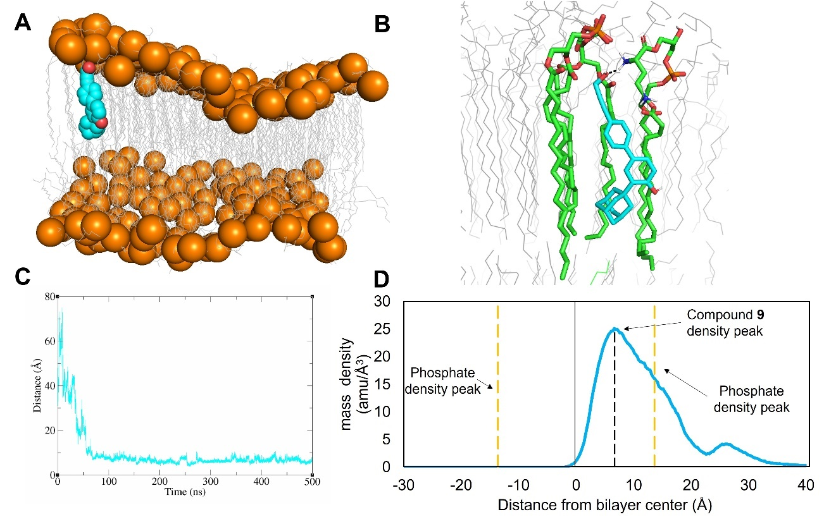
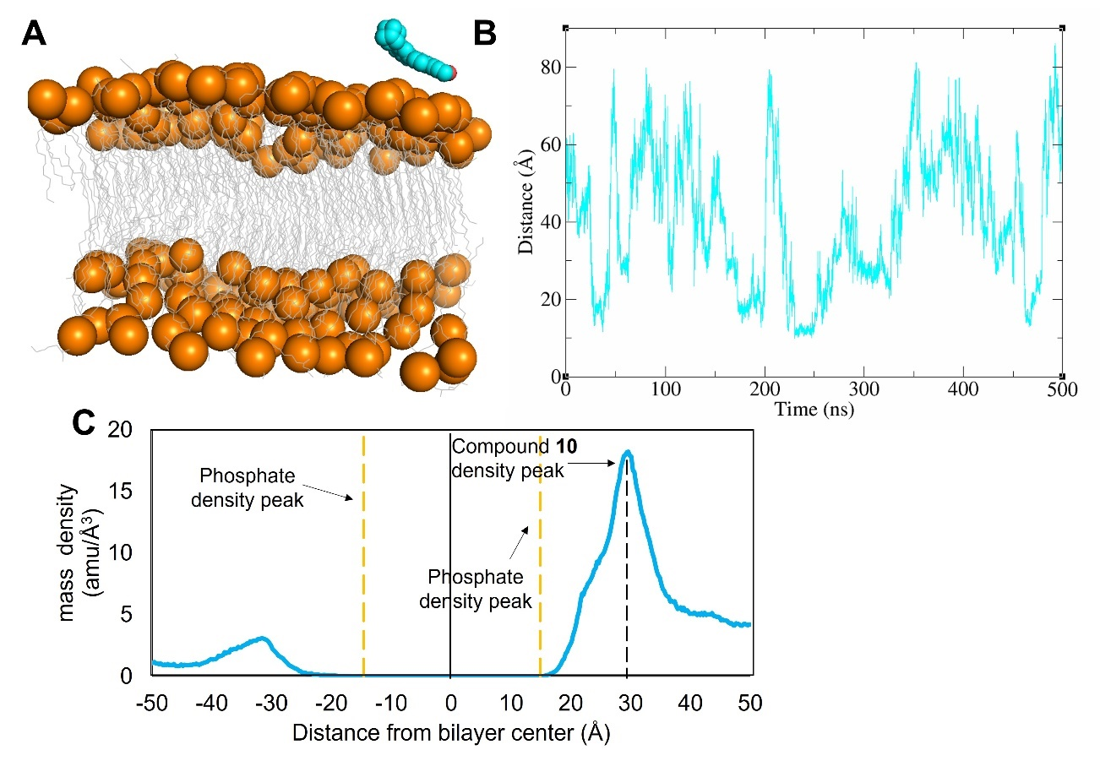
Molecular dynamic studies
37
38

Slide 16
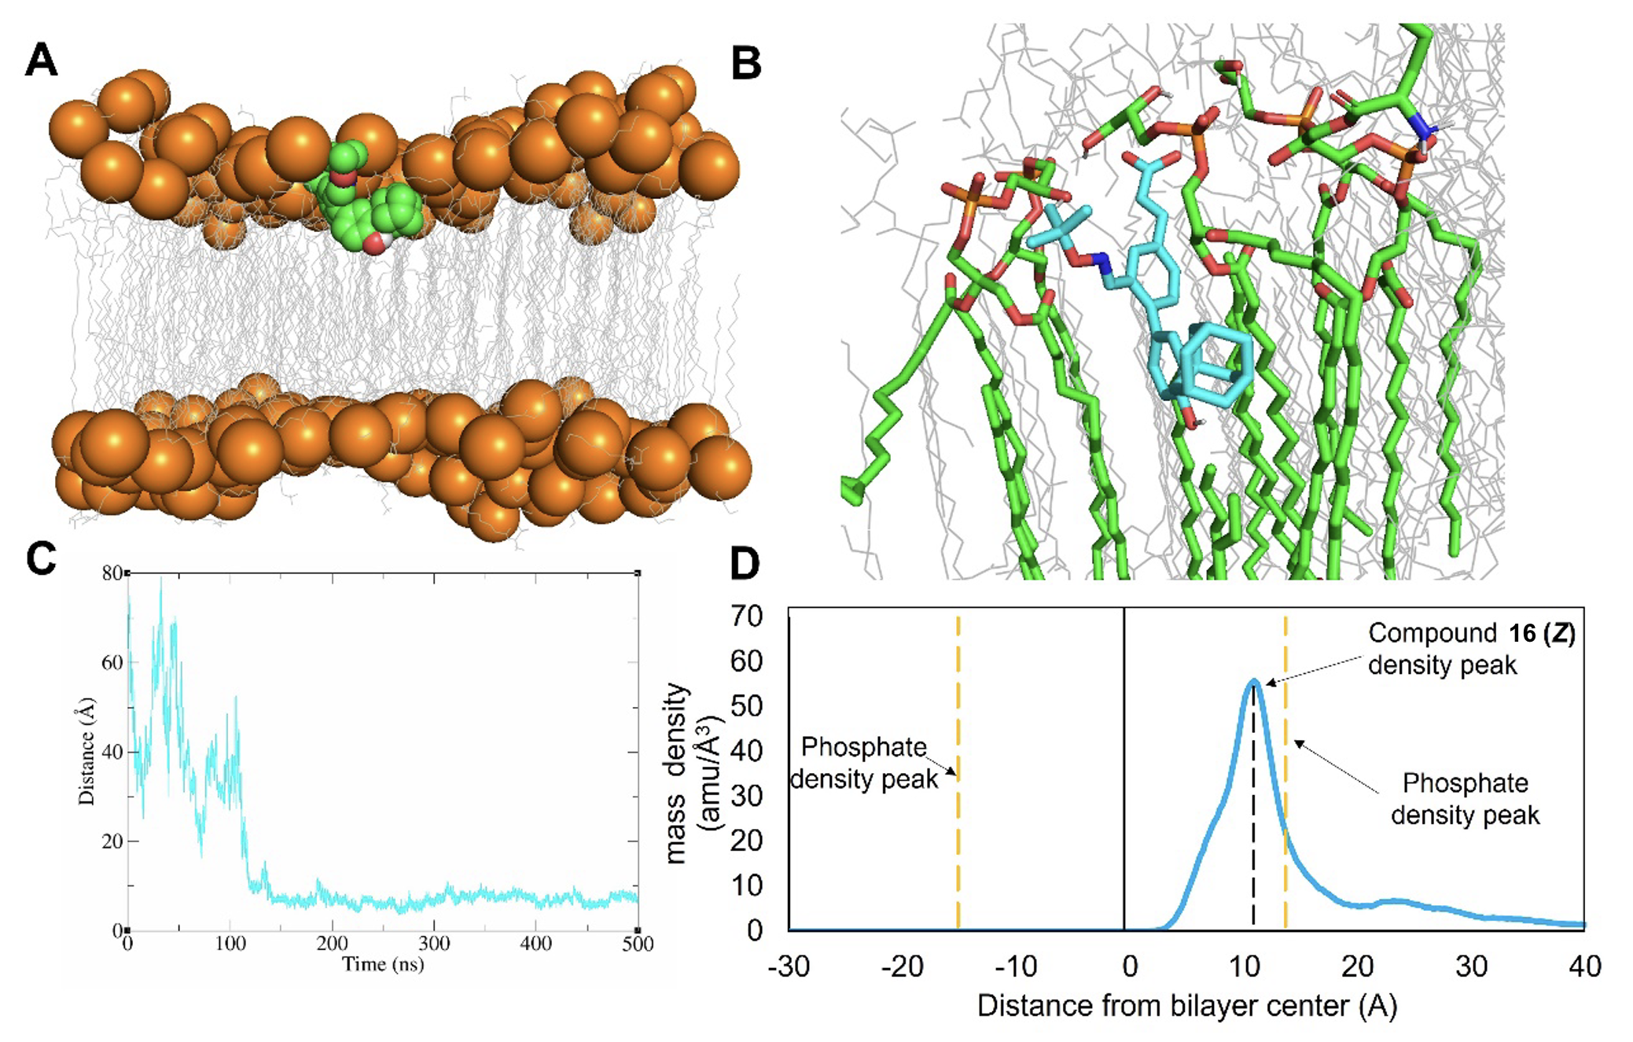
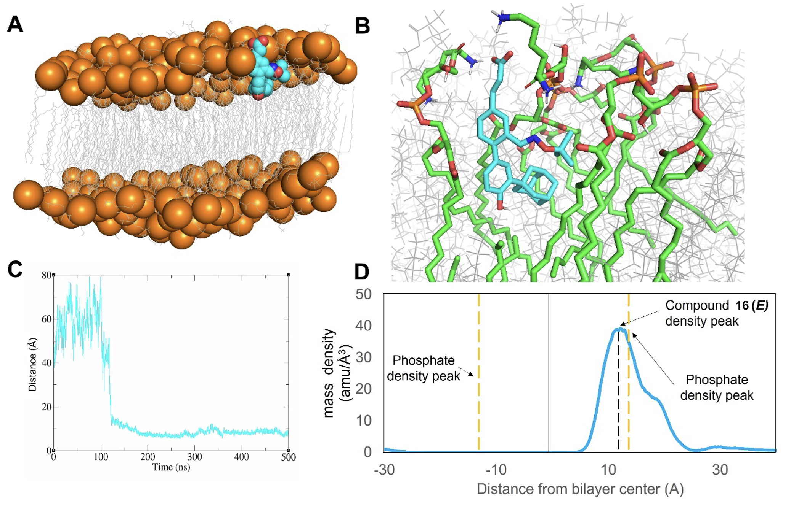
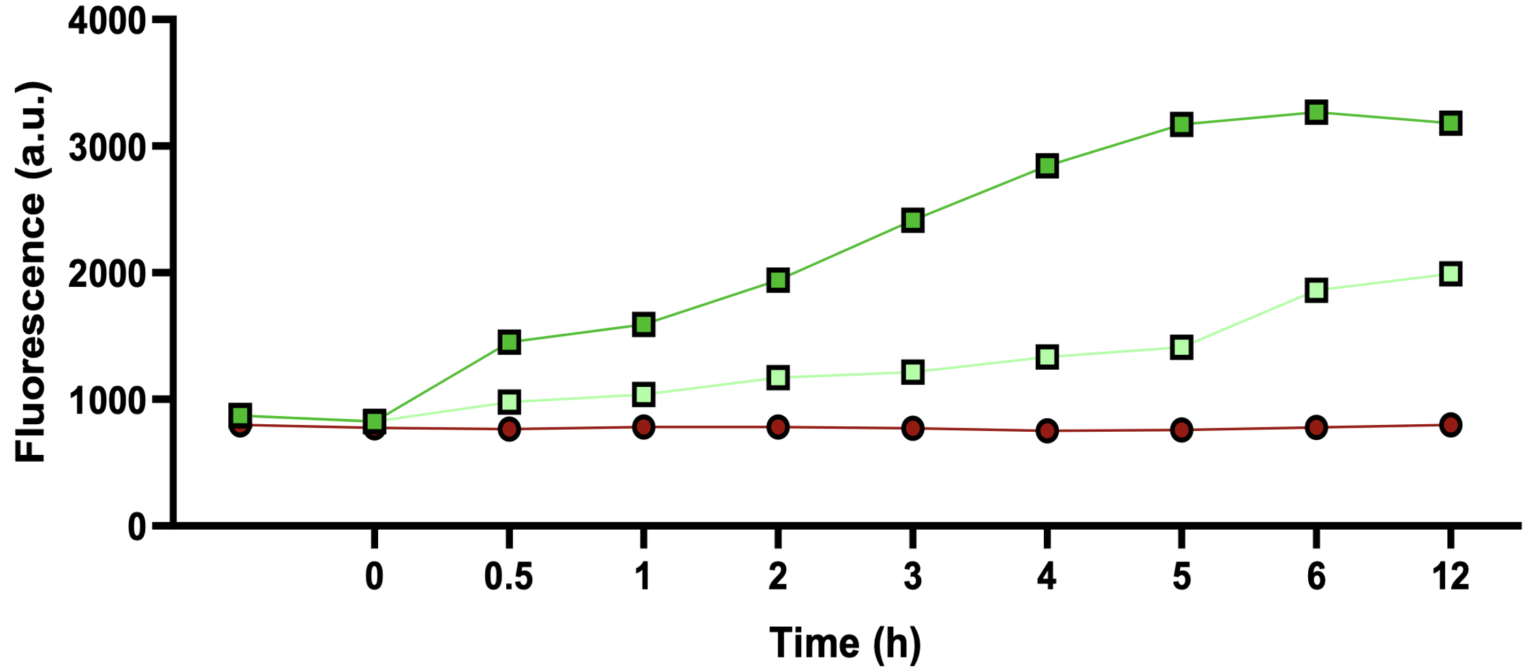
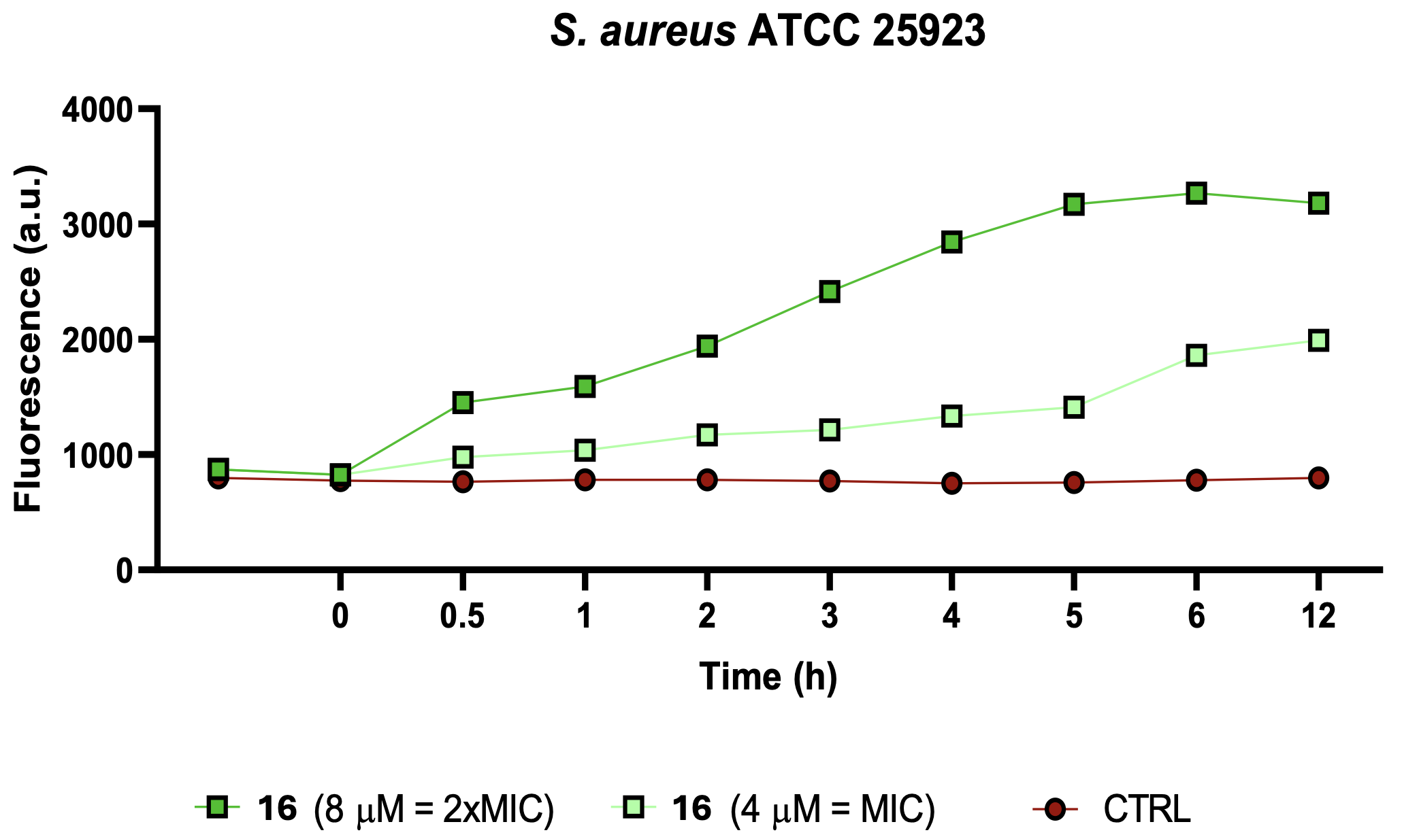
Molecular dynamic studies

Slide 17
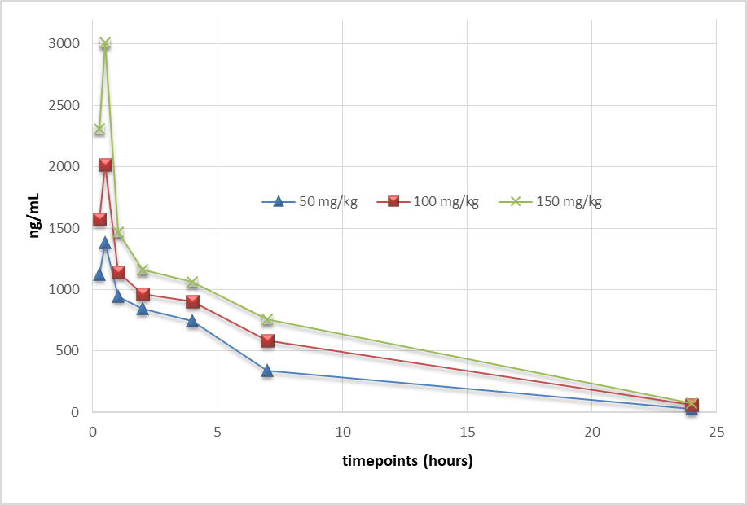
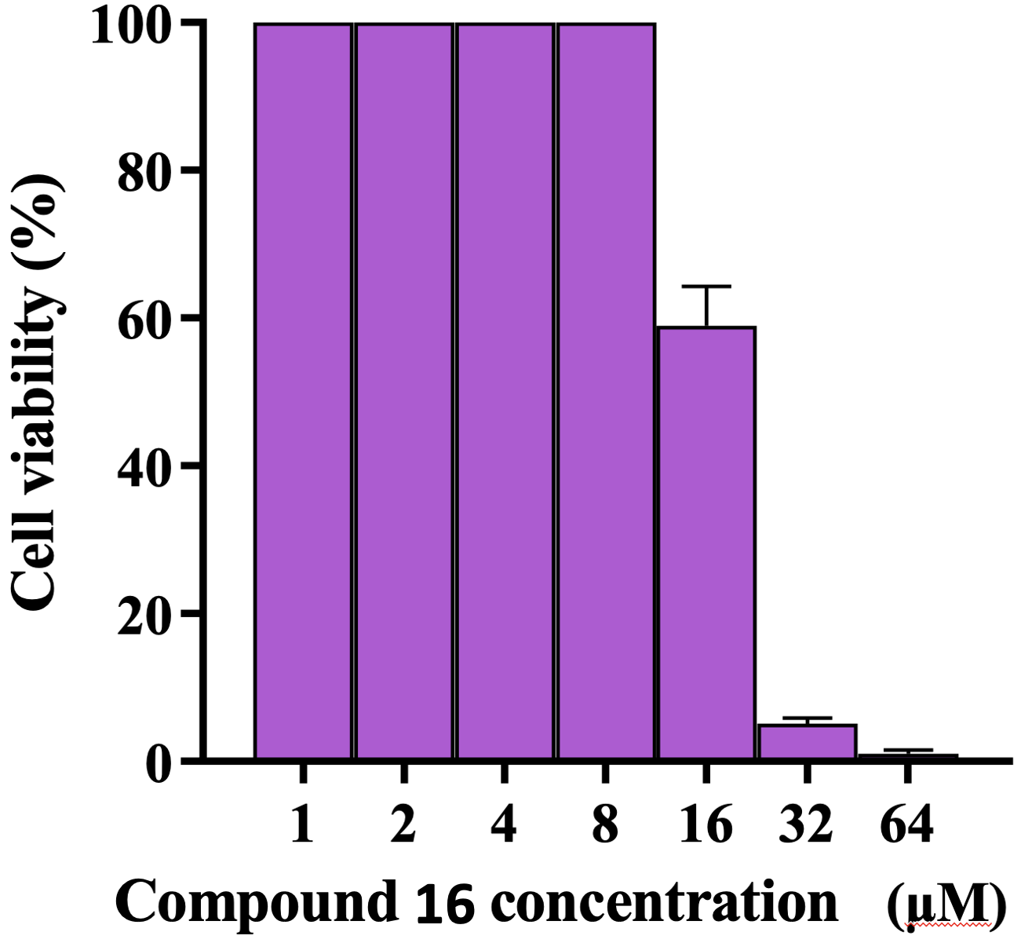
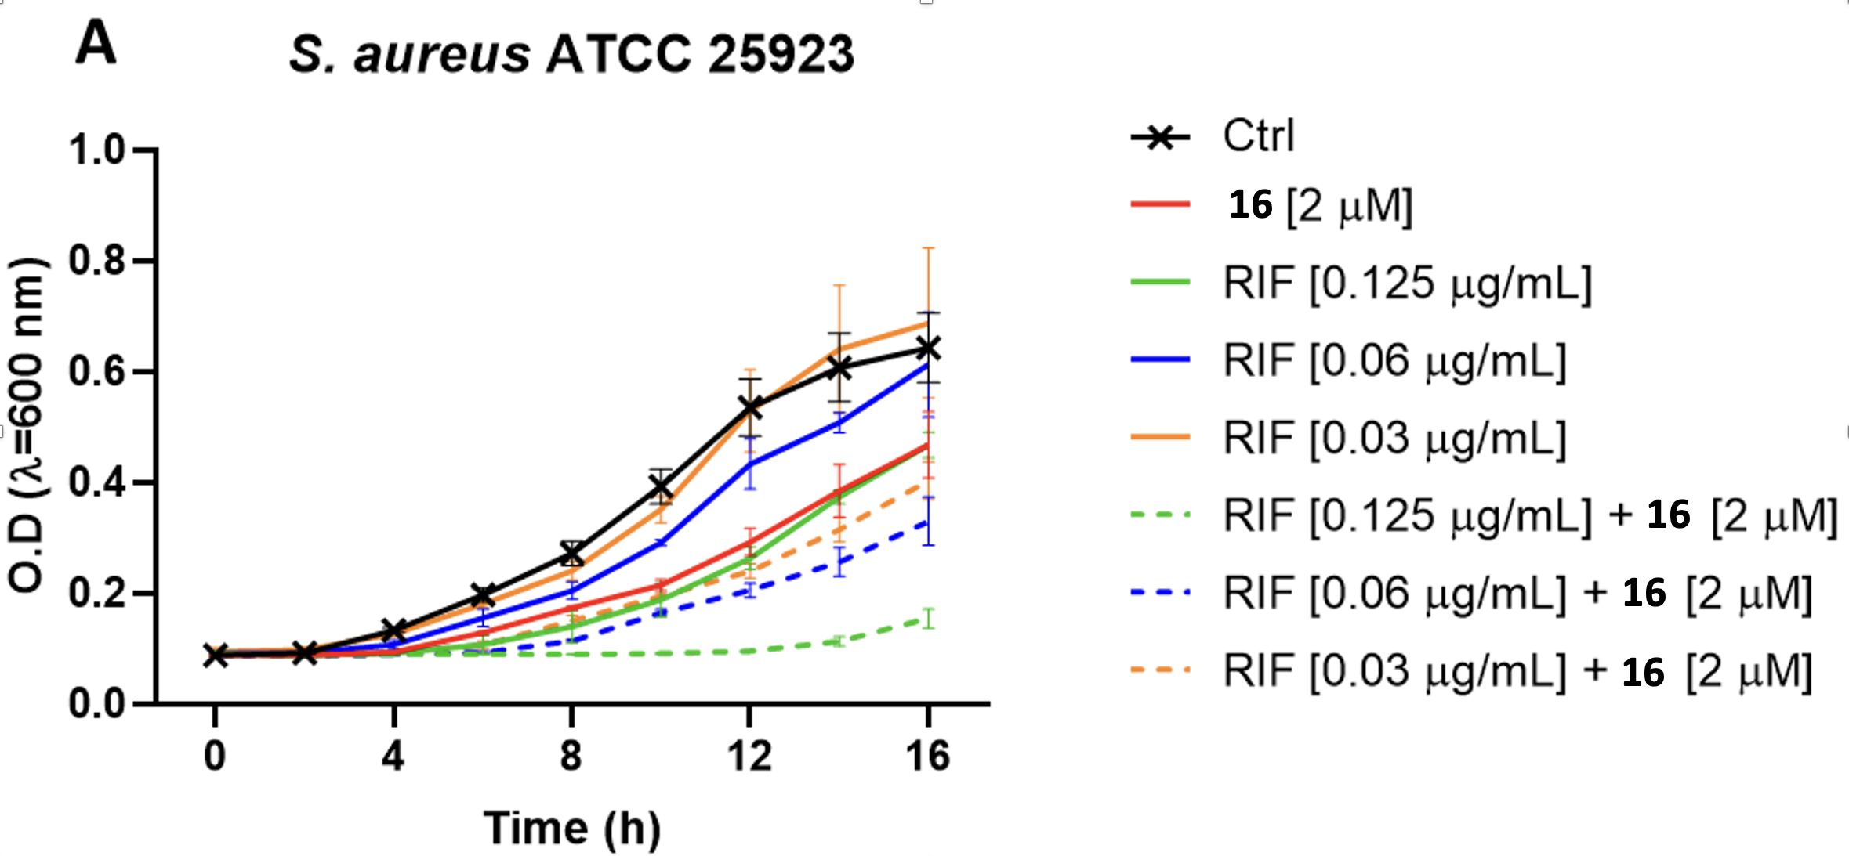
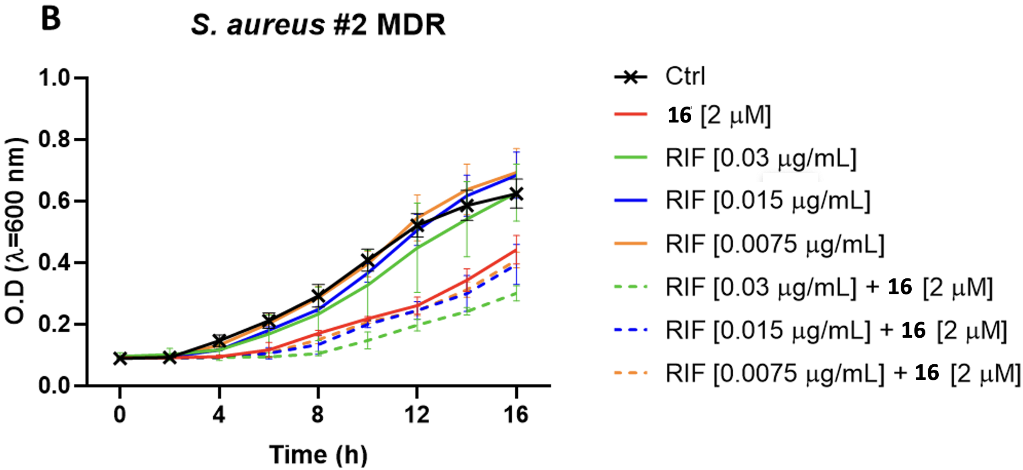
Pharmacokinetic studies and co-administration
Compound 16
Cell line | % Survival
HaCaT | 109
Fibroblasts | 88
AoSMC | 99
HUVEC | 88

Slide 18
Conclusions and future perspectives
A collection of variously substituted adarotene derivatives has been prepared
Preliminary structure-activity relationship studies indicated that:
  the substitution of phenolic OH and carboxylic acid decreases the antimicrobial activity;
  the functionalization of the cinnamic portion is tolerated;
  the introduction of substituents on ring B considerably enhances the activity.
Oxime 16 resulted as the most promising compound on several MDR strains of Gram + bacteria
Suitable substituents are under study for the obtainment of compounds active on MDR Gram – bacteria

Slide 19
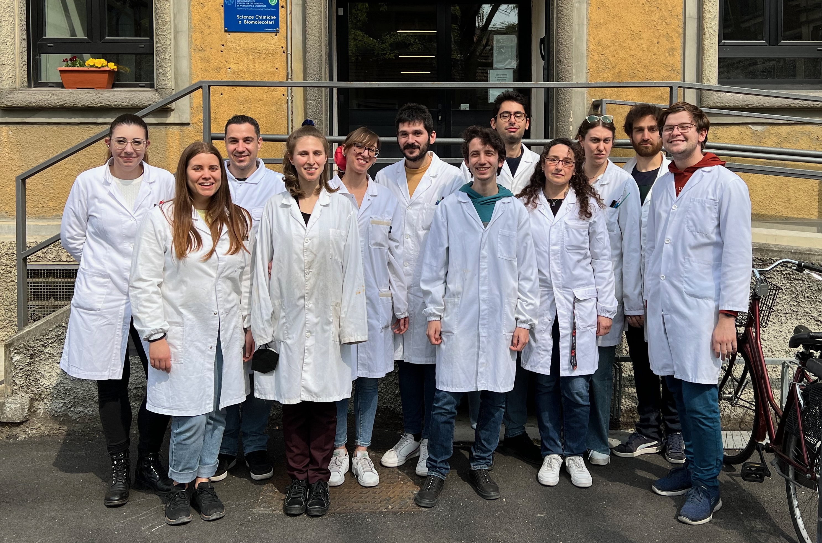



Acknowledgements
Prof. Sabrina Dallavalle
Dr. Loana Musso
Francesca Sacchi
Lucia Magnani
Luca Pozzi
Dr. Stefania Mazzini
Prof. Maria Luisa Mangoni
Dr. Claudio Pisano
Prof. Mattia Mori
Project fundings:
Special Product’s Line

