Slide 1
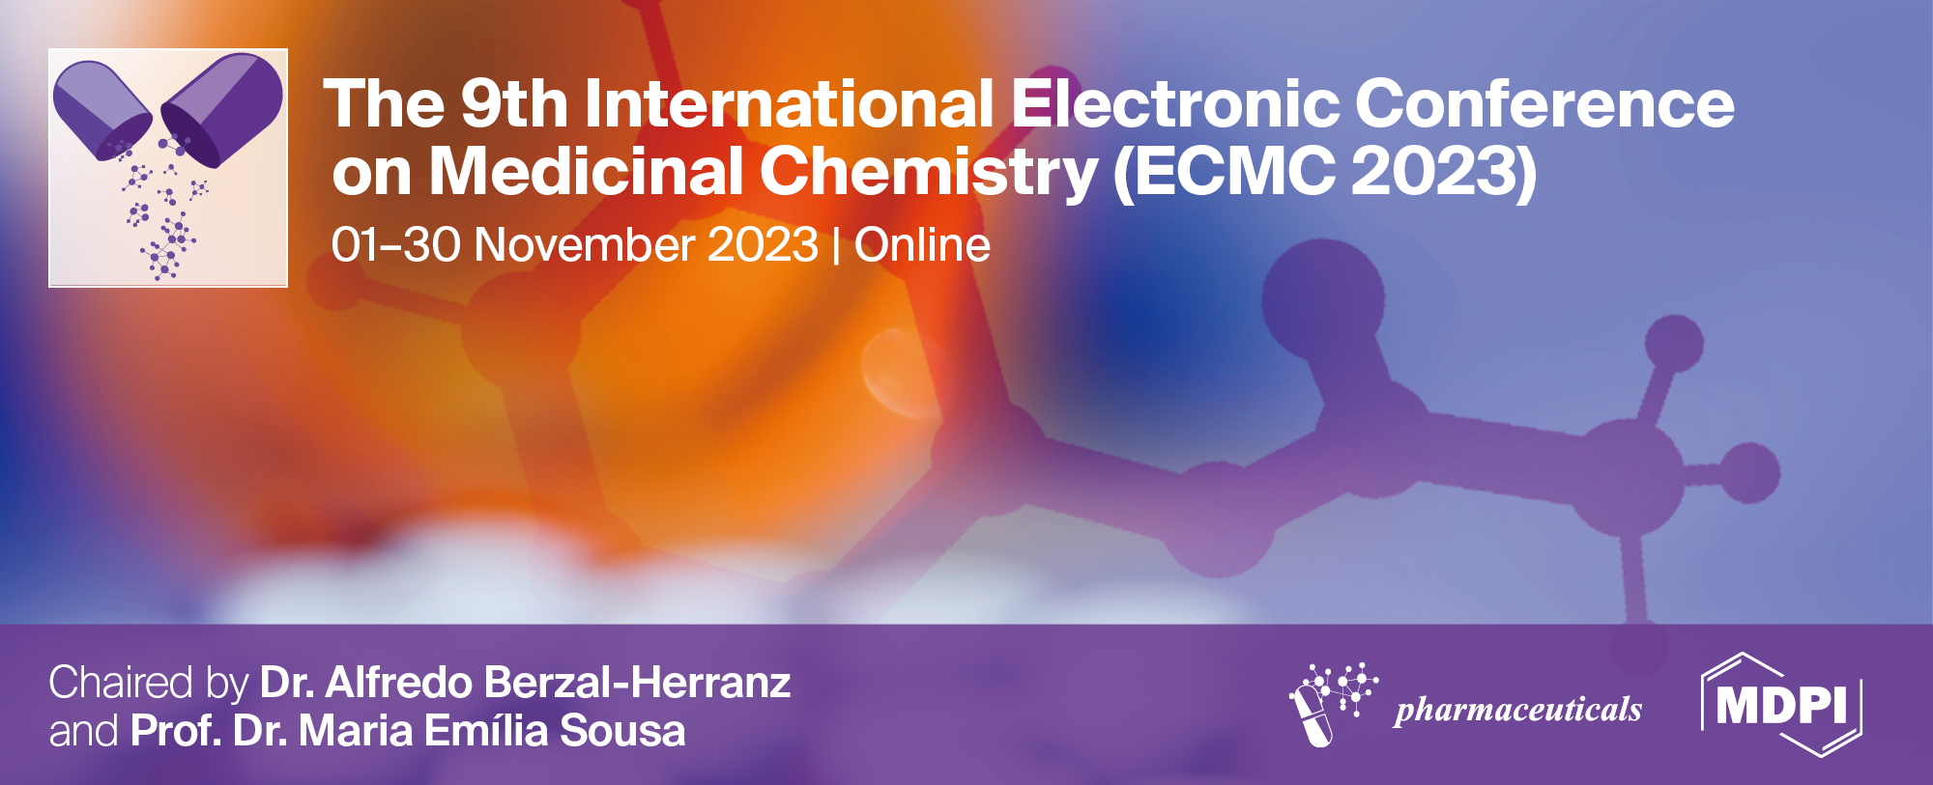
DNA/BSA binding study of phenothiazine and its N-methyl-substituted derivative
Bojana V. Pantović ^{1*} , Tina P. Andrejević ¹ , Violeta R. Marković ¹ , Darko P. Ašanin ² and Biljana. Đ. Glišić ¹
¹ Faculty of Science, University of Kragujevac, Radoja Domanovića 12, 34000 Kragujevac, Serbia; bojana.pantovic@pmf.kg.ac.rs, tina.andrejevic@pmf.kg.ac.rs, violeta.markovic@pmf.kg.ac.rs, biljana.glisic@pmf.kg.ac.rs
² Institute for Information Technologies Kragujevac, University of Kragujevac, Jovana Cvijića bb, 34000 Kragujevac, Serbia; darko.asanin@uni.kg.ac.rs
* Corresponding author: bojana.pantovic@pmf.kg.ac.rs

Slide 2
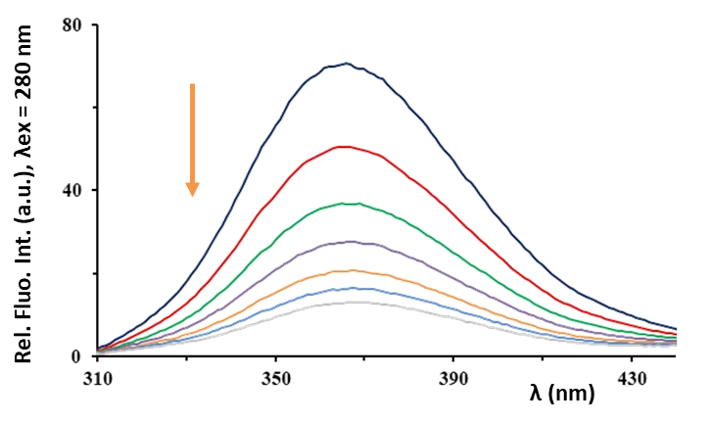
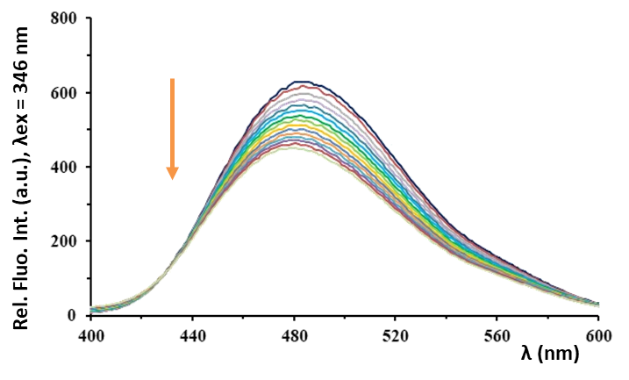
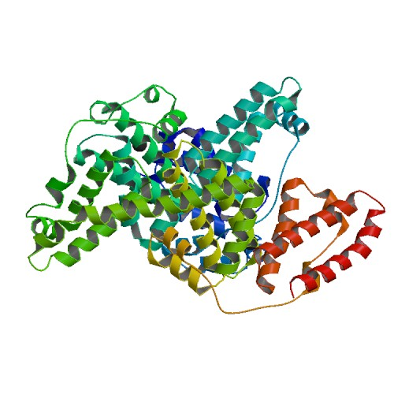
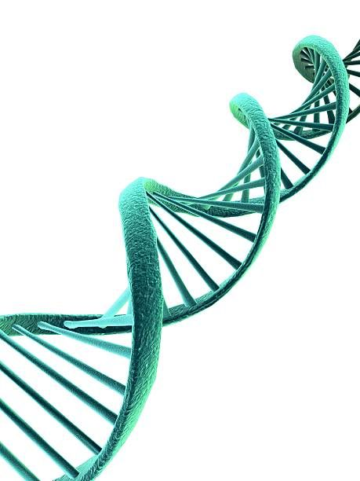
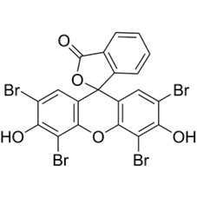
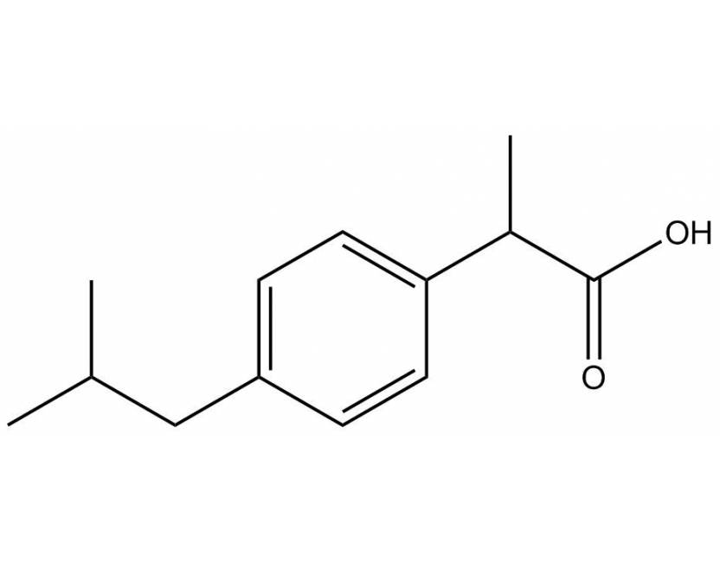
DNA/BSA binding study of phenothiazine and its N-methyl-substituted derivative
DNA/BSA BINDING STUDY

Slide 3
Abstract:
Previous studies have reported that different phenothiazine derivatives have shown a broad spectrum of antibacterial, anticancer and antiplasmid activities. In the present study, we investigated the interactions of phenothiazine (phtz) and its N-methyl-substituted derivative, N-methylphenothiazine (N-Mephtz) with bovine serum albumin (BSA) and calf thymus DNA (ct-DNA) by fluorescence emission spectroscopy to examine their binding affinity towards these biomolecules. Considering that serum albumin is divided into three domains (I–III), with each domain containing two subdomains (A and B), we have also performed fluorescence competition experiments with site markers for BSA to locate the binding site of the investigated compounds to this biomolecule. Eosin Y was used as a marker for site I (subdomain IIA), while ibuprofen was a marker for site II (subdomain IIIA). The obtained results and the values of binding constants (K_{A}) have indicated that both phtz and N-Mephtz can interact with BSA and ct-DNA, whereby N-Mephtz has higher binding affinity towards these biomolecules. On the other hand, K_{A} values of both investigated compounds are lower in the presence of eosin Y, while only a slight change was observed in the presence of ibuprofen. These results indicated that the binding of the investigated compounds should be mainly located within site I of BSA, and that the tested compounds had to compete with eosin Y to bind to this protein.
Keywords: BSA interaction; DNA interaction; N-methylphenothiazine; phenothiazine; site marker

Slide 4
Introduction
Previous studies have reported that different phenothiazine derivates have shown a broad spectrum of antibacterial, anticancer and antiplasmid activities
We investigated the interactions of phenothiazine (phtz) and N-methylphenothiazine (N-phtz) with bovine serum albumin (BSA) and calf thymus DNA (ct-DNA) by fluorescence emission spectroscopy

Slide 5
Synthesis of N-Mephtz
Fig. 1. Schematic presentation of the synthesis of N-methylphenothiazine (N-Mephtz)

Slide 6
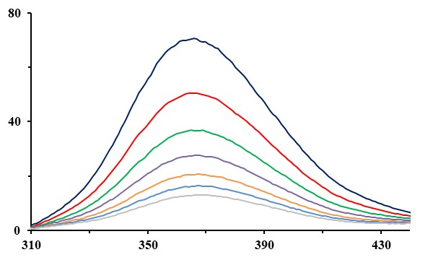
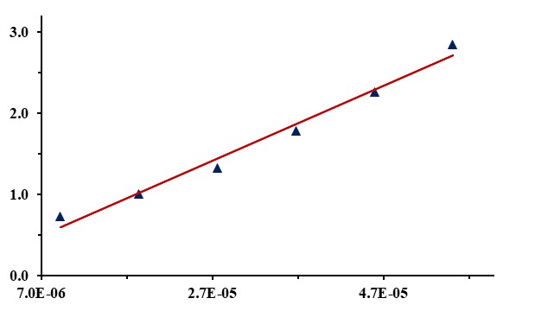
BSA binding study
[N-Mephtz] = 0 ‒ 55 μM, PBS (pH = 7.4)
[BSA] = 18.5 μM
F₀/F
Rel. Fluo. Int. (a.u.), λex = 280 nm
[N-Mephtz] (mol/dm³)
λ (nm)
Fig. 2. Fluorescence emission spectra of BSA in the presence of an increasing concentration of N-Mephtz. Arrow shows the intensity changes upon increased amount of N-Mephtz. Inserted graph: Stern-Volmer plot of F₀/F vs [N-Mephtz]

Slide 7
BSA binding study
Table 1. Values of the binding constants of phtz and N-Mephtz with BSA
 | K_{sv} (M⁻¹) | Hypochromism (%) |  | K_{q} (M⁻¹s⁻¹) | K_{A} (M⁻¹) | n
phtz | (3.65 ± 0.02) × 10⁴ | 70.5 | 3.65 × 10¹² |  | 1.36 × 10⁵ | 1.14
N-Mephtz | (2.69 ± 0.11) × 10⁵ | 74.4 | 2.69 × 10¹³ |  | 2.43 × 10⁶ | 1.35

Slide 8
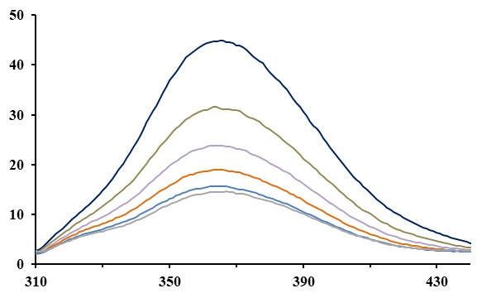
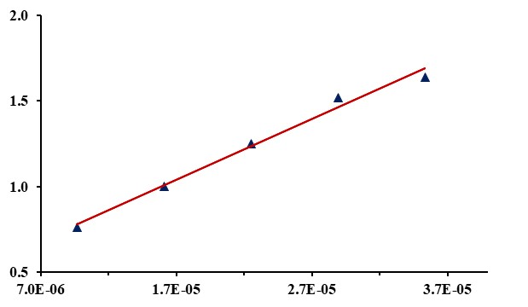
Competitive experiments with BSA and site markers
[N-Mephtz] = 0 ‒ 35 μM, PBS (pH = 7.4)
[BSA-Eosin Y] = 8 μM
F₀/F
Rel. Fluo. Int. (a.u.), λex = 290 nm
[N-Mephtz] (mol/dm³)
λ (nm)
Fig. 3. Fluorescence emission spectra of BSA-Eosin Y in the presence of an increasing concentration of N-Mephtz. Arrow shows the intensity changes upon increased amount of N-Mephtz. Inserted graph: Stern-Volmer plot of F₀/F vs [N-Mephtz]

Slide 9
Competitive experiments with BSA and site markers
Table 2. Values of the binding constants of phtz to BSA in absence and in presence of the site markers, eosin Y and ibuprofen
 | K_{sv} (M⁻¹) | Hypochromism (%) |  | K_{q} (M⁻¹s⁻¹) | K_{A} (M⁻¹) | n
phtz | (3.65 ± 0.02) × 10⁴ | 70.5 | 3.65 × 10¹² |  | 1.36 × 10⁵ | 1.14
Ibuprofen | (2.02 ± 0.01) × 10⁴ | 67.6 | 2.02 × 10¹² |  | 3.21 × 10⁴ | 1.05
Eosin Y | (1.66 ± 0.03) × 10⁴ | 64.2 | 1.66 × 10¹² |  | 2.16 × 10⁴ | 1.03

Slide 10
Competitive experiments with BSA and site markers
Table 3. Values of the binding constants of N-Mephtz to BSA in absence and in presence of the site markers, eosin Y and ibuprofen
 | K_{sv} (M⁻¹) | Hypochromism (%) |  | K_{q} (M⁻¹s⁻¹) | K_{A} (M⁻¹) | n
N-Mephtz | (2.69 ± 0.11) × 10⁵ | 74.4 | 2.69 × 10¹³ |  | 2.43 × 10⁶ | 1.35
Ibuprofen | (1.37 ± 0.03) × 10⁵ | 70.9 | 1.37 × 10¹³ |  | 3.33 × 10⁶ | 1.38
Eosin Y | (8.12 ± 0.06) × 10⁴ | 67.8 | 8.12 × 10¹² |  | 7.20 × 10⁵ | 1.23

Slide 11
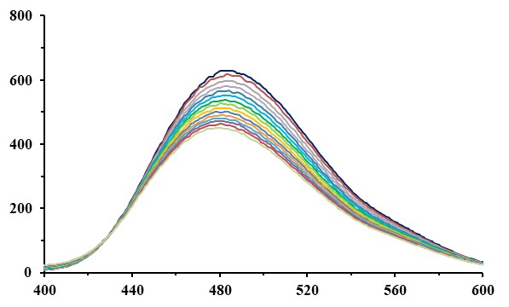
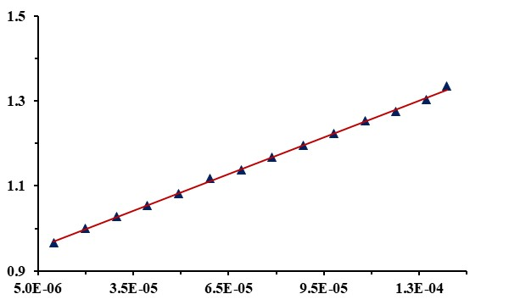
DNA binding study
[N-Mephtz] = 0 ‒ 135 μM, PBS (pH = 7.4)
[DNA] = 100 μM, [Hoechst] = 10 μM
F₀/F
Rel. Fluo. Int. (a.u.), λex = 346 nm
[N-Mephtz] (mol/dm³)
λ (nm)
Fig. 4. Fluorescence emission spectra of ct-DNA-Hoechst 33258 system in the presence of an increasing concentration of N-Mephtz. Arrow shows the intensity changes upon increased amount of N-Mephtz. Inserted graph: Stern-Volmer plot of F₀/F vs [N-Mephtz]

Slide 12
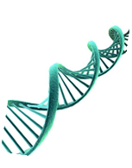
DNA binding study
Table 4. Values of the binding constants of phtz and N-Mephtz with ct-DNA-Hoechst 33258 system
 | K_{sv} (M⁻¹) | Hypochromism (%) | K_{q} (M⁻¹s⁻¹) | K_{A} (M⁻¹) | n
phtz | (1.96 ± 0.003) x 10³ | 20.4 | 1.96 x 10¹¹ | 3.08 x 10² | 0.79
N-Mephtz | (3.07 ± 0.002) x 10³ | 29.2 | 3.07 x 10¹¹ | 6.12 x 10³ | 1.08

Slide 13
Conclusions
The obtained results have indicated that both phtz and N-Mephtz can interact with BSA and ct-DNA, whereby N-Mephtz has higher binding affinity towards these biomolecules
K_{A} values of both investigated compounds are lower in the presence of eosin Y, while only a slight change was observed in the presence of ibuprofen
The binding of the investigated compounds should be mainly located within site I of BSA

Slide 14
Acknowledgments
This research was supported by the Science Fund of the Republic of Serbia, Grant No. 7730810, Value-added biologics through eco-sustainable routes – BioECOLogics. This research has also received funding from the Ministry of Science, Technological Development and Innovation of the Republic of Serbia (Agreements No. 451-03-47/2023-01/200122 and 451-03-47/2023-01/200378)

