Slide 1
Investigation of Polymeric Carrier Uptake and Passage within Cellular Spheroids Using Advanced Analytical Techniques
Blindman Maria, Marina Novoselova, Anatolii Abalymov

Slide 2
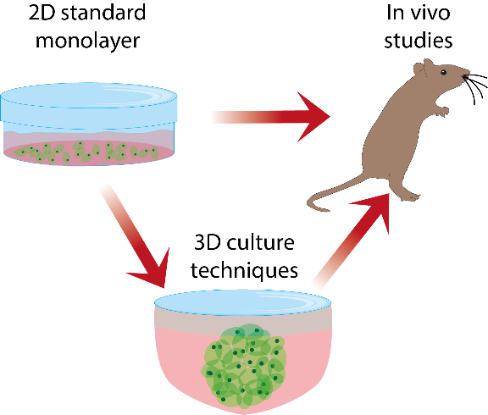
Advantages of using 3D cell cultures

Slide 3
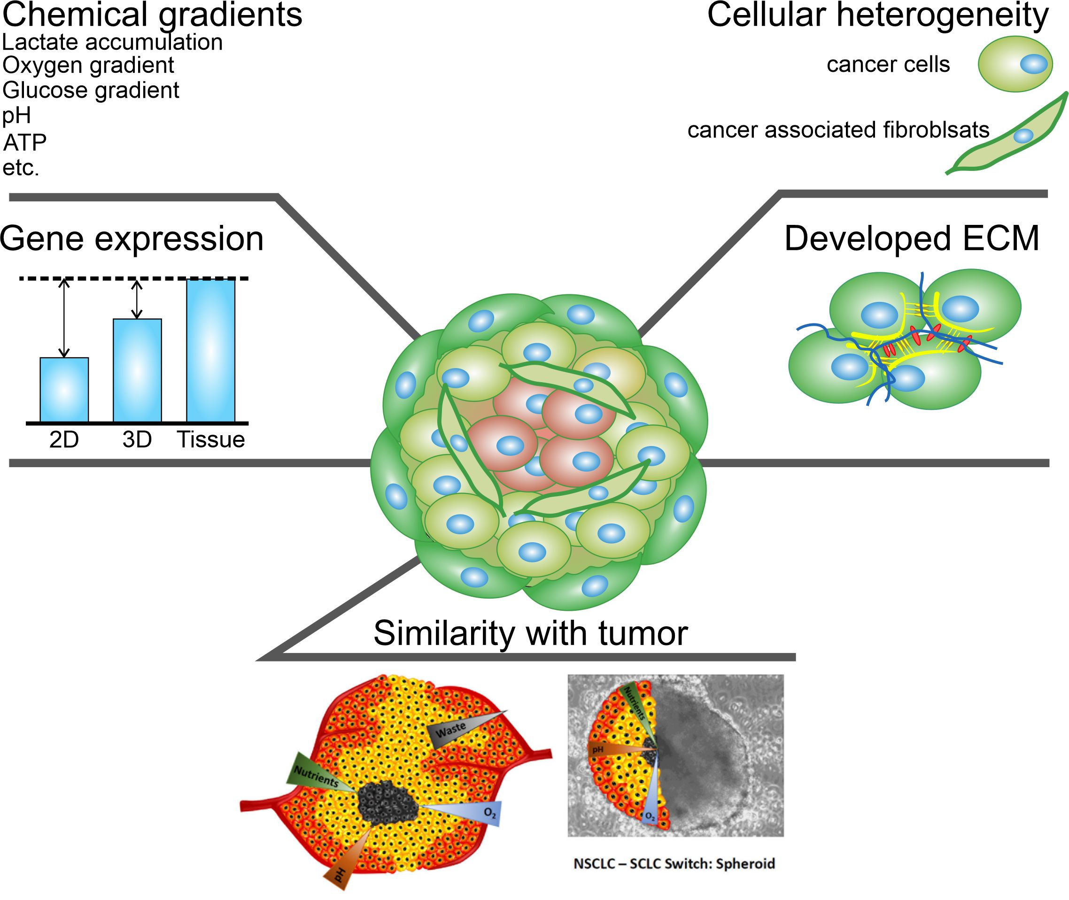
Advantages of using 3D cell cultures
Anisimov, R. A.; Gorin, D. A.; Abalymov, A. A. 3D Cell Spheroids as a Tool for Evaluating the Effectiveness of Carbon Nanotubes
as a Drug Delivery and Photothermal Therapy Agents. C 2022

Slide 4
3D cell cultures can be used for different approaches

Slide 5
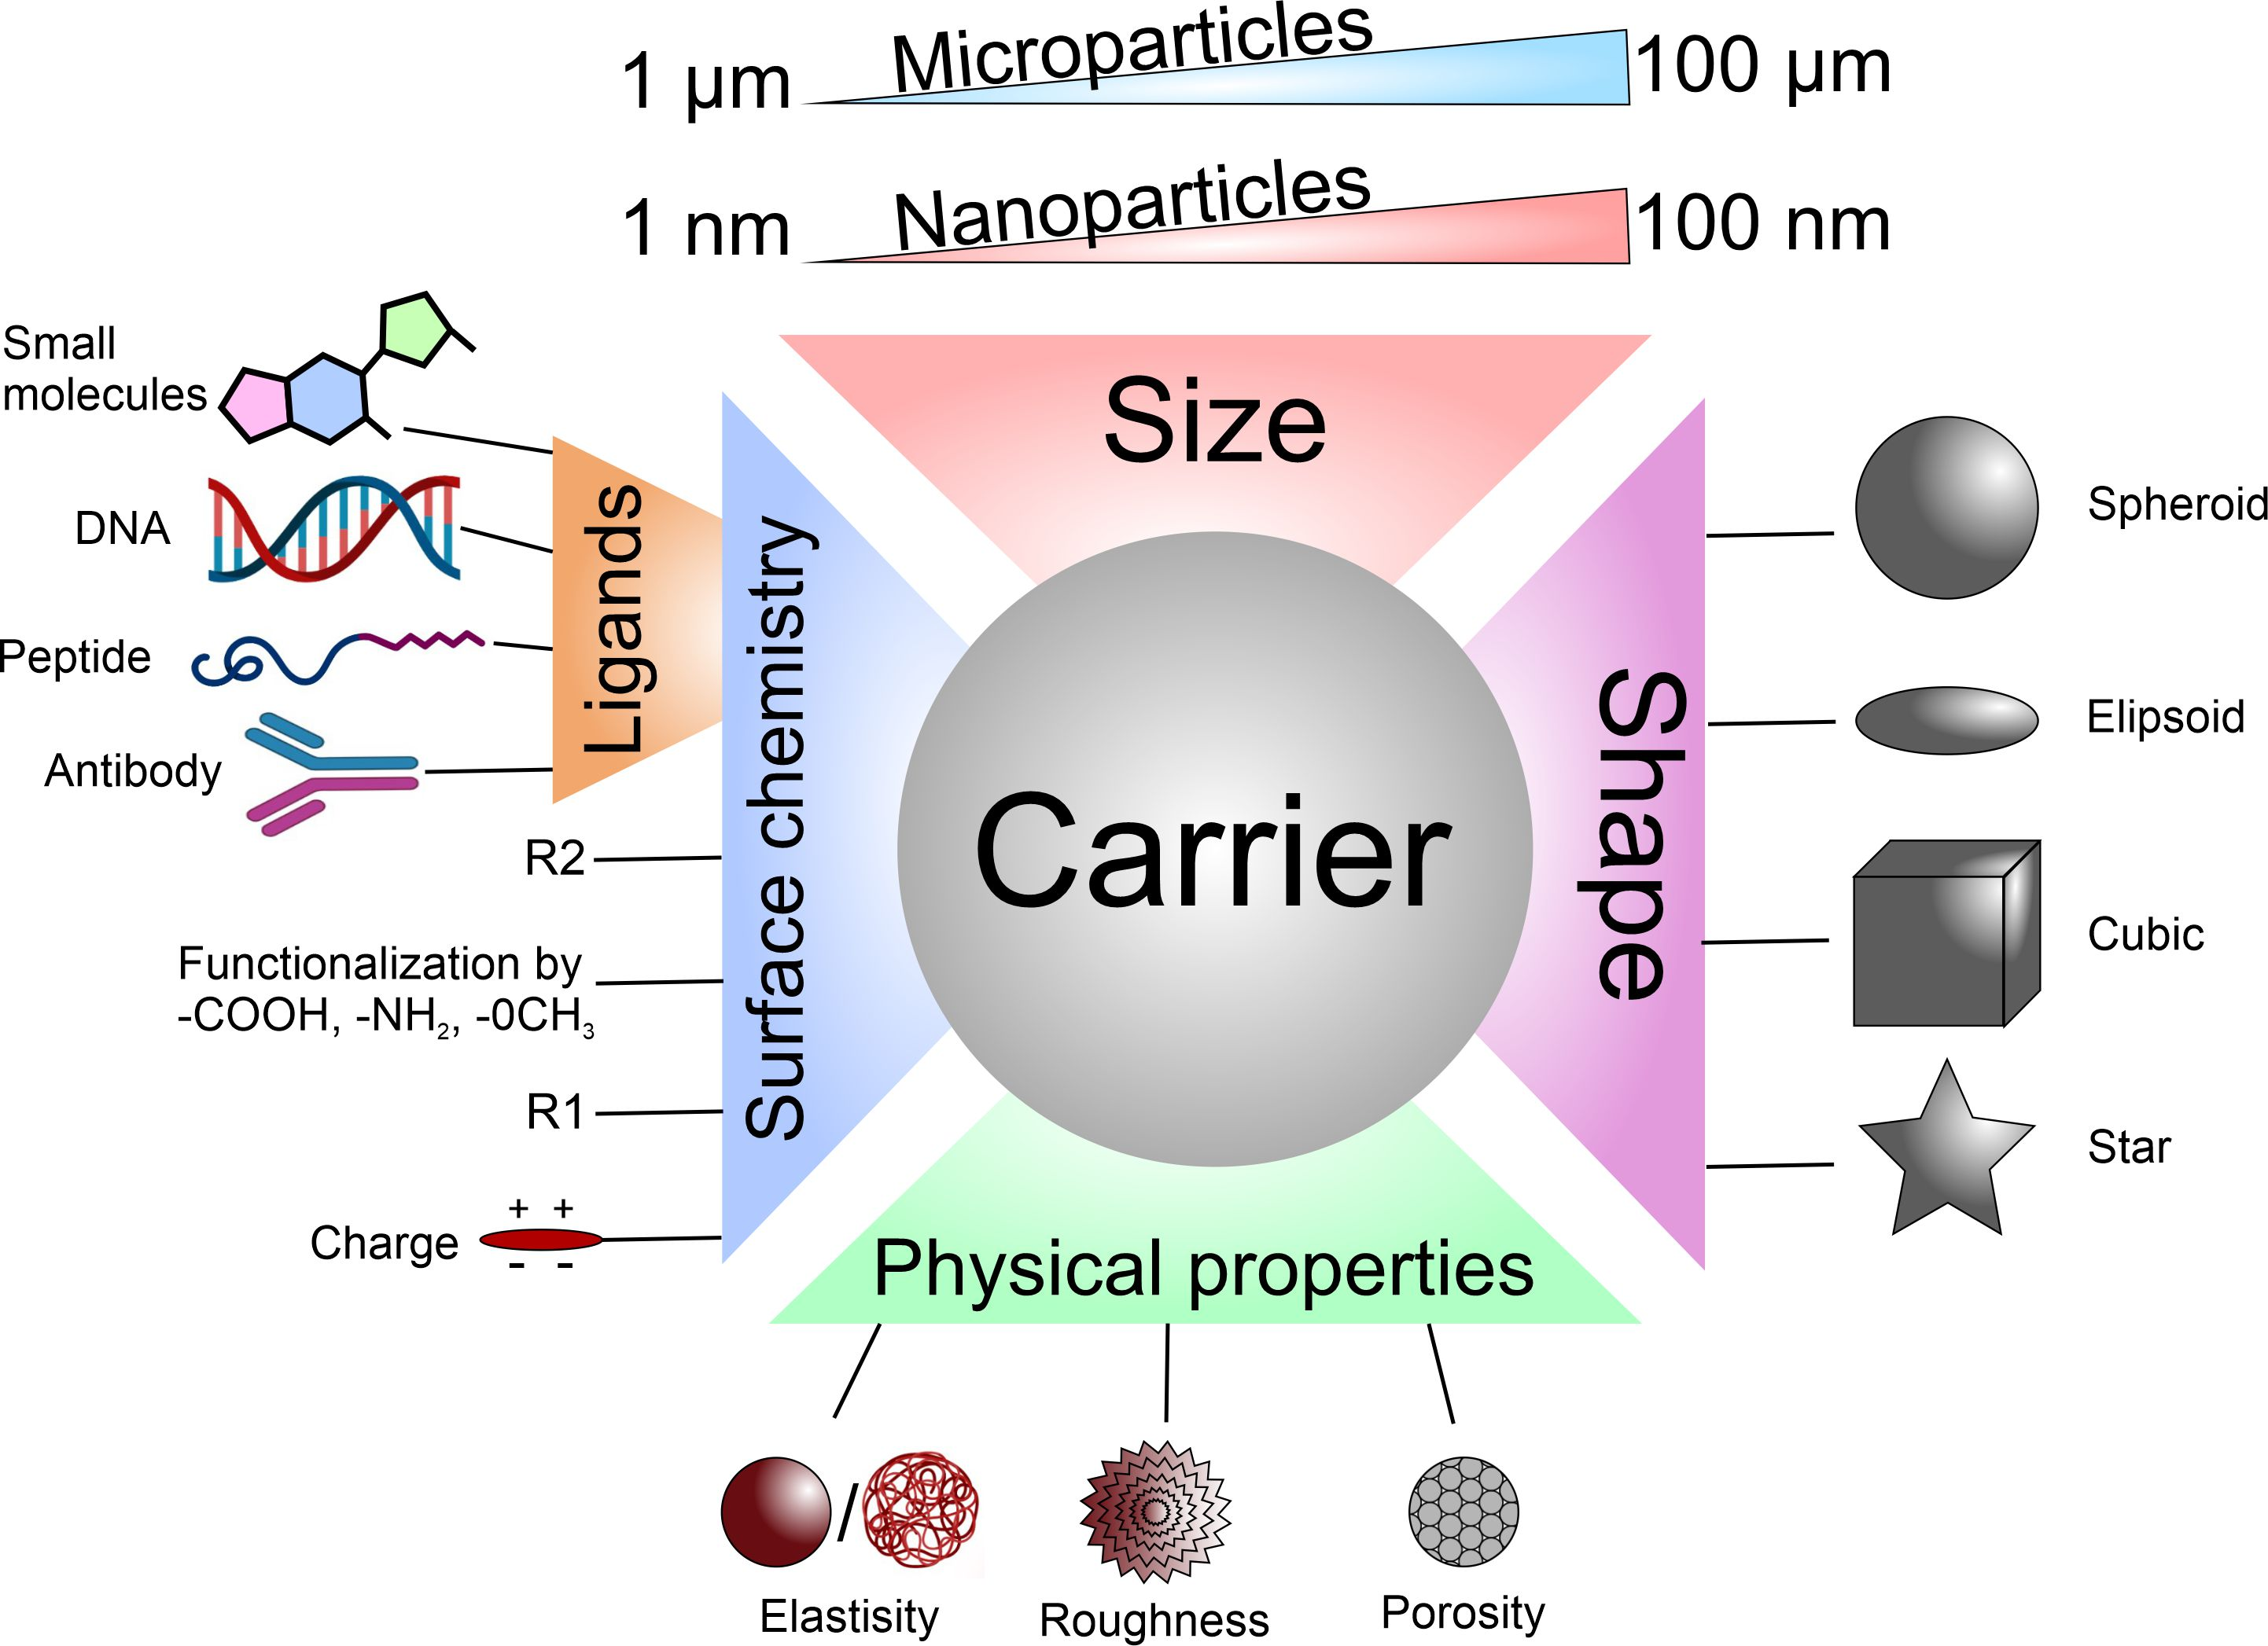
High amount of the carrier properties… Which combination is better?

Slide 6
High amount of the carrier properties… Which combination is better?

Slide 7
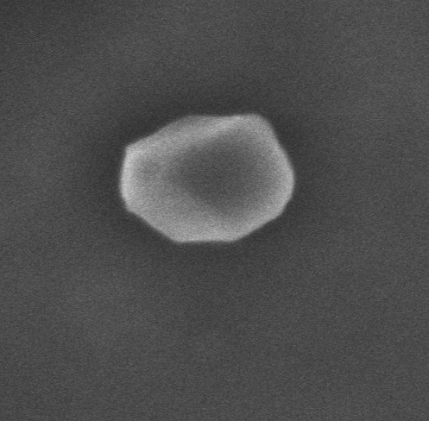
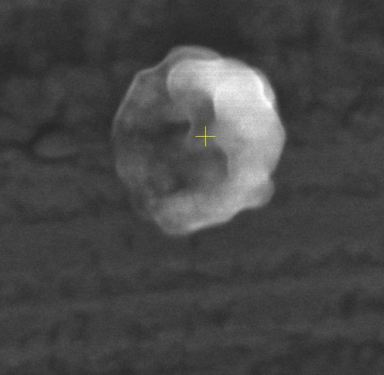
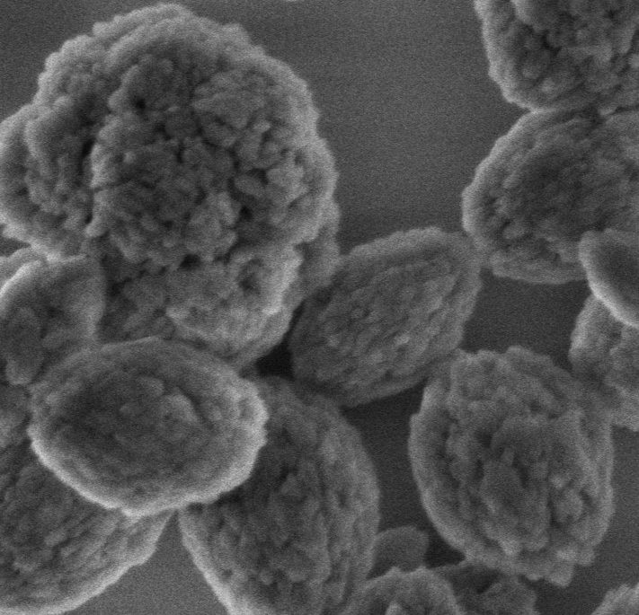
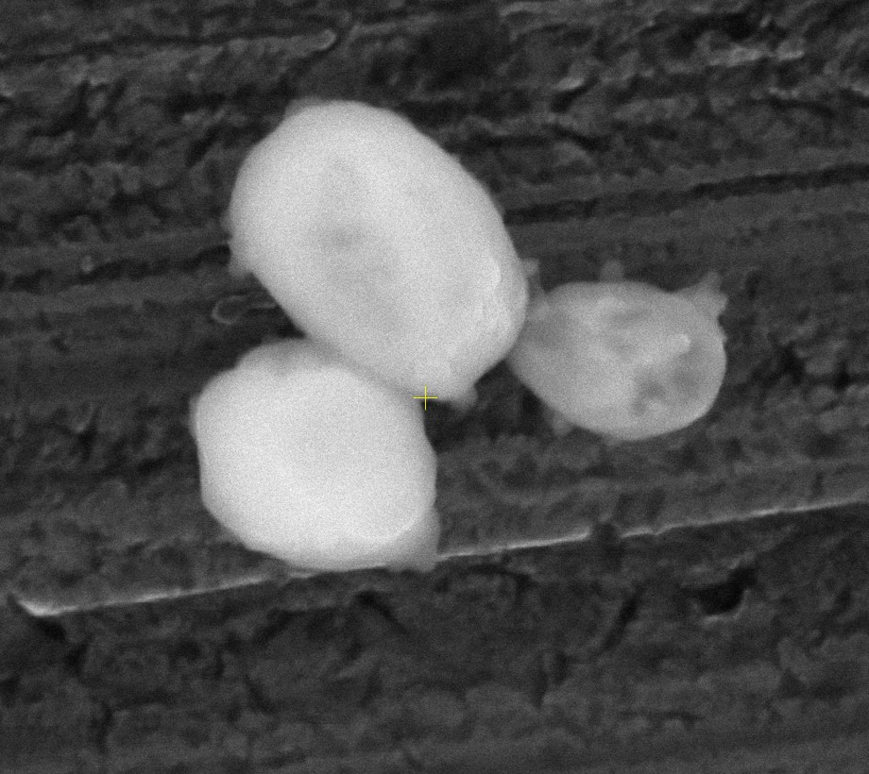
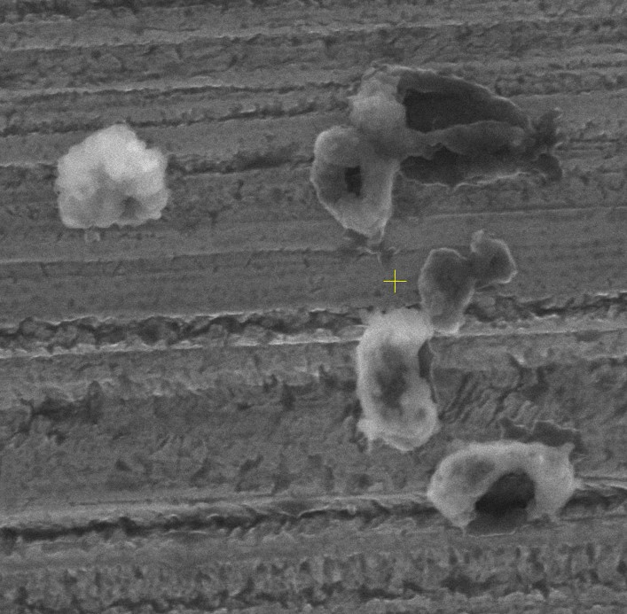
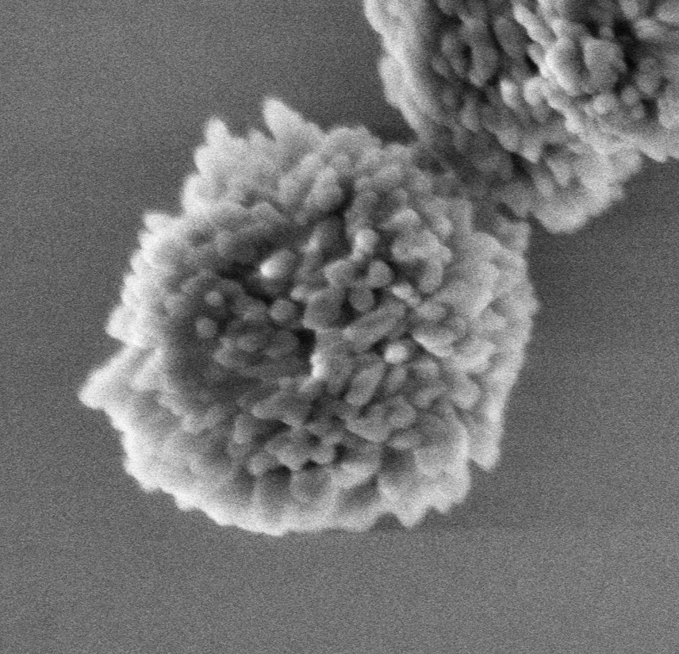
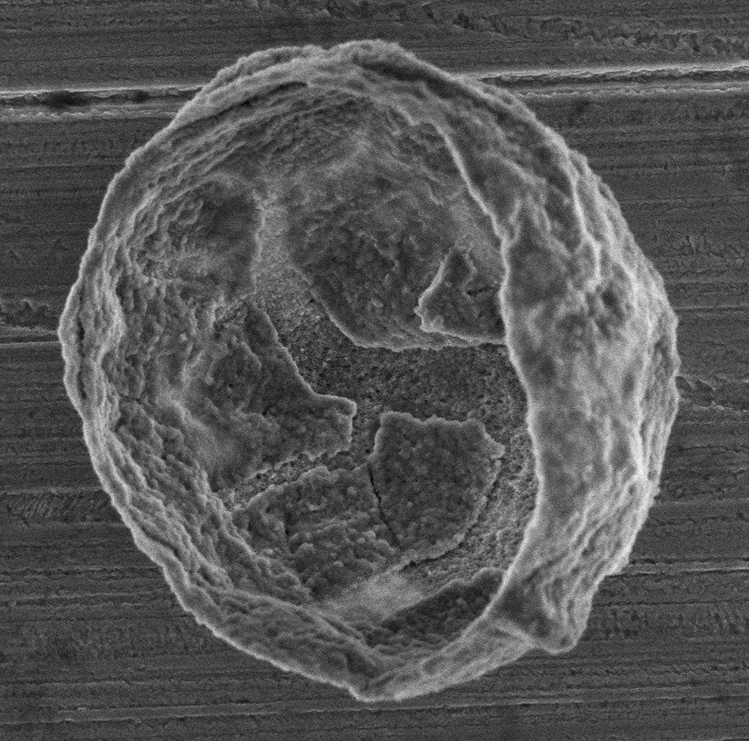
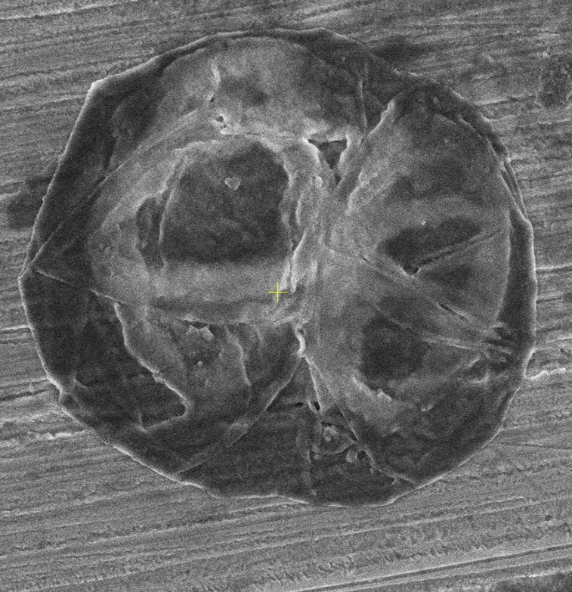
Synthesis of the carriers with different size, charge and stiffness
Stiff
Soft
300 nm
1 µm
500 nm
1 µm
1000 nm
200 nm

Slide 8
12 type of carriers + 2 type of spheroids
L929
(Fibroblast
cell line)
4T1
(Breast cancer
cell line)

Slide 9
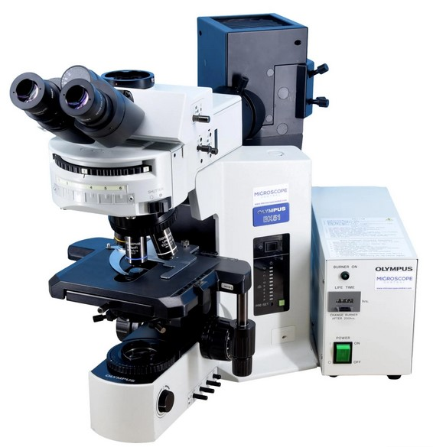
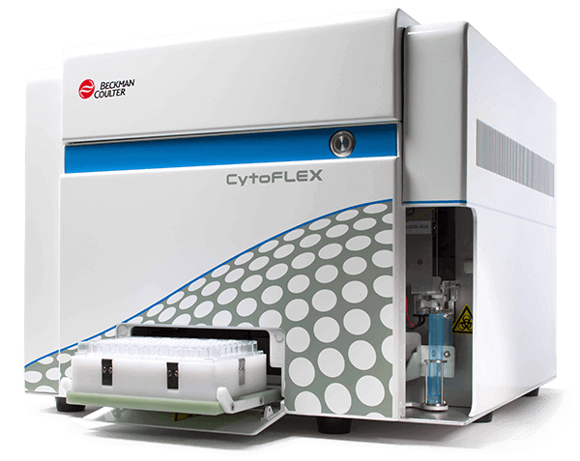
Methods of spheroids analysis

Slide 10
Flow cytometry results

Slide 11
Determination of
spheroids zones
Orthogonal projection

Slide 12
Carriers in proliferation zone
Best results:
For L929 – Negative, soft 500 nm particles
For 4T1 – Positive, soft 1000 nm particles

Slide 13
Carriers in static zone
Best results:
For L929 – Positive, soft 1000 nm particles
For 4T1 – Negative, stiff 500 nm particles

Slide 14
Principal component analysis

Slide 15
Thank you for your attention
This research was funded by a grant from the President of the Russian Federation
for junior postdocs No. MK-933.2022.3.
Anatolii Abalymov
Anatolii.Abalymov@gmail.com
+79873810265
+38669905927

