Slide 1
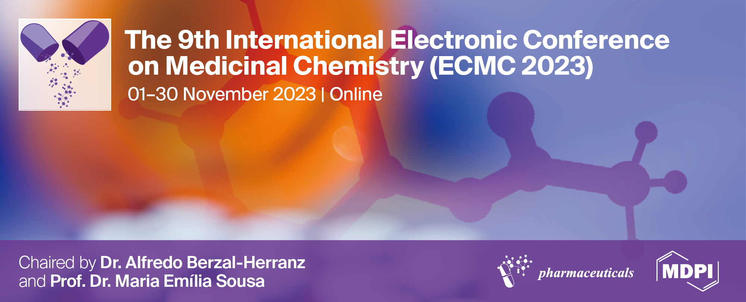
In vitro DNA protective potential of Chamaecyparis lawsoniana (A.Murray bis) Parl. and Thuja plicata Donn ex D.Don essential oils
Sanja Lj. Matić ^{1,*}, Vladimir J. Cvetković ², Biljana M. Nikolić ³, and Zorica S. Mitić ²
¹Department of Science, Institute for Information Technologies Kragujevac, University of Kragujevac, Jovana Cvijića bb, 34000 Kragujevac, Serbia;
²Department of Biology and Ecology, Faculty of Sciences and Mathematics, University of Niš, Višegradska 33, 18000 Niš, Serbia;
³Department of Genetics, Plant Breeding, Seed and Nursery Production, Institute of Forestry, Kneza Višeslava 3, 11000 Belgrade, Serbia;
* Corresponding author: sanjamatic@kg.ac.rs

Slide 2
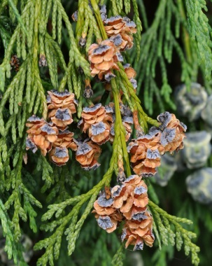
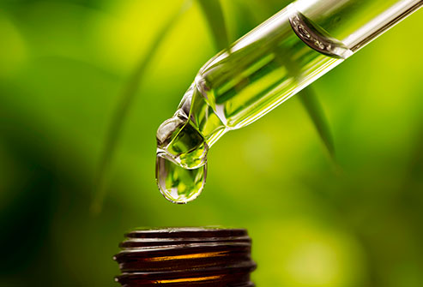
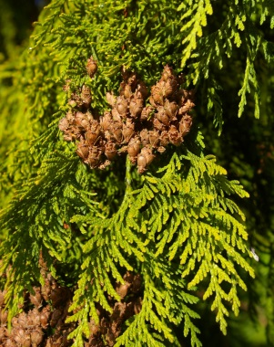
In vitro DNA protective potential of Chamaecyparis lawsoniana (A.Murray bis) Parl. and Thuja plicata Donn ex D.Don essential oils
Chamaecyparis lawsoniana
Essential oils
Thuja plicata

Slide 3
Abstract:
Chamaecyparis lawsoniana (A.Murray bis) Parl., known as Port Orford cedar or Lawson cypress and Thuja plicata Donn ex D.Don, also called giant arborvitae, are a species of the Cupressaceae family. Multiple significant biological activities of C. lawsoniana and T. plicata essential oils have been widely investigated but their genotoxic and/or antigenotoxic properties are not well established. In the present study, two in vitro antioxidant assays were performed to assess the possible DNA protective activity of five different concentrations (0.19, 0.38, 0.75, 1.5, and 3%) of essential oils against oxidative damage induced by hydroxyl and peroxyl radicals. According to the obtained results, both essential oils have a remarkable DNA protective activity against hydroxyl and peroxyl radicals induced DNA damage. These findings suggest that C. lawsoniana and T. plicata essential oils in tested concentrations could be valuable candidates for medicinal and pharmaceutical applications.
Keywords: Antigenotoxicity; Chamaecyparis lawsoniana; essential oils; hydroxyl radical; peroxyl radical;Thuja plicata.

Slide 4
Introduction
Medicinal potential of essential oils is usually associated with antimicrobial, antioxidative and antiviral effects [1].
Although many studies have been conducted on the various biological activity of C. lawsoniana (Figure 1) and T. plicata (Figure 2) essential oils, there are no studies on their genotoxic and antigenotoxic effects to our knowledge. According to these data, essential oils from C. lawsoniana and T. plicata wеrе tested for ability to protect DNA from oxidative damage induced by hydroxyl and peroxyl radicals.
Figure 1. Chamaecyparis lawsoniana
(https://plantmaterials.wordpress.com/portfolio/chamaecyparis-lawsoniana/)
Figure 2. Thuja plicata (https://www.treesandshrubsonline.org/articles/thuja/thuja-plicata/)
[1] J. Reichling, P. Schnitzler, U. Suschke, R. Saller, Essential oils of aromatic plants with antibacterial, antifungal, antiviral, and cytotoxic properties--an overview, Forsch Komplementmed, 16 (2009) 79-90.

Slide 5
Materials and methods
The protective effect of C. lawsoniana and T. plicata essential oils in concentrations of 3, 1.5, 0.75, 0.38, and 0.19% against hydroxyl and peroxyl radicals induced DNA damage was investigated in vitro using the salmon sperm DNA [2,3] and quercetin (0.01%) as a standard drug [4].
DNA bands on the agarose gels were visualized under UV light (UV transilluminator, Vilber Lourmat, France) at 365 nm, photographed, and analyzed using ImageJ software (version 1.48 for Windows, Softonic International, Barcelona, Spain).
Results were expressed as mean ± SD and statistical evaluation of data was analyzed with one-way analysis of variance (ANOVA) using SPSS statistical software package, version 13.0 for Windows. The significance level was set at p < 0.05.
[2] Y.W. Lin, Y.T. Wang, H.M. Chang, J.S.B. Wu, DNA protection and antitumor effect of water extract from residue of jelly fig (Ficus awkeotsang Makino) achenes, Journal of Food and Drug Analysis, 16 (2008) 63-69.
[3] L.L. Zhang, L.F. Zhang, J.G. Xu, Q.P. Hu, Comparison study on antioxidant, DNA damage protective and antibacterial activities of eugenol and isoeugenol against several foodborne pathogens, Food and Nutrition Research, 61 (2017), 1353356.
[4] C.A. Poorna, M. Resmi, E. Soniya, In vitro antioxidant analysis and the DNA damage protective activity of leaf extract of the Excoecaria agallocha linn Mangrove plant. In: Stoytcheva, M. (Ed.), Agricultural Chemistry. Intech, UK, 2013.

Slide 6
Results and discussion
The DNA protective activity of several concentrations of C. lawsoniana essential oil against the damage induced by hydroxyl and peroxyl radicals is shown in Figure 3.
There was no statistically significant difference in the relative electrophoretic band densities of the C. lawsoniana essential oil and intact DNA from salmon sperm as negative control. DNA protective activity was similar or stronger than quercetin, a well-known protective compound.
Figure 3. Protective potential of essential oil of Chamaecyparis lawsoniana against hydroxyl and peroxyl radicals-induced DNA damage. DNA from salmon sperm (1, negative control), DNA damage control (2, positive control), quercetin (3, 0.01%, standard), essential oil in concentrations of 3, 1.5, 0.75, 0.38, and 0.19% (4, 5, 6, 7, and 8).
*p < 0.05 when compared with the negative control, †p < 0.05 when compared with the standard, ‡p < 0.05 when compared with the positive control
C. lawsoniana essential oil, at the concentration range from 0.19 to 3%, demonstrated a strong protective effect against hydroxyl and peroxyl radicals induced DNA damage.

Slide 7
Results and discussion
No statistically significant differences in the relative electrophoretic band densities were observed between different concentrations of T. plicata essential oil and the respective negative control.
In lower concentration T. plicata essential oil almost completely protected DNA against hydroxyl radicals induced DNA damage (Figure 4).
Figure 4. Protective potential of essential oil of Thuja plicata against hydroxyl and peroxyl radicals-induced DNA damage.
DNA from salmon sperm (1, negative control), DNA damage control (2, positive control), quercetin (3, 0.01%, standard), essential oil in concentrations of 3, 1.5, 0.75, 0.38, and 0.19% (4, 5, 6, 7, and 8).
*p < 0.05 when compared with the negative control, †p < 0.05 when compared with the standard, ‡p < 0.05 when compared with the positive control
T. plicata essential oil reduced peroxyl radicals induced DNA damage in a concentration dependent manner compared to the negative and positive controls.
The observed activity was comparable to that of the well known antioxidant quercetin.

Slide 8
Results and discussion
Оbserved DNA protective ability of C. lawsoniana and T. plicata essential oils can be attributed to the dominant compounds in both oils.
According to the previous study by Nikolić et al. [5] the most dominant compound in essential oil of C. lawsoniana was limonene (Figure 5), while the major compound of T. plicata essential oil was α-thujone (Figure 6).
[5] B.M. Nikolić, S.D. Milanović, I.Lj. Milenković, M.M. Todosijević, I.Ž. Đorđević, N.Z. Brkić, Z.S. Mitić, P.D. Marin, V.V. Tešević, Bioactivity of Chamaecyparis lawsoniana (A. Murray) Parl. and Thuja plicata Donn ex D. Don essential oils on Lymantria dispar (Linnaeus, 1758) (Lepidoptera: Erebidae) larvae and Phytophthora de Bary 1876 root pathogens, Industrial Crops and Products, 178 (2022) 114550.

Slide 9
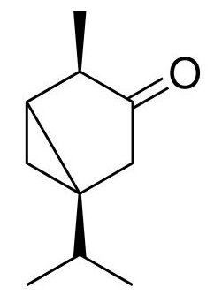
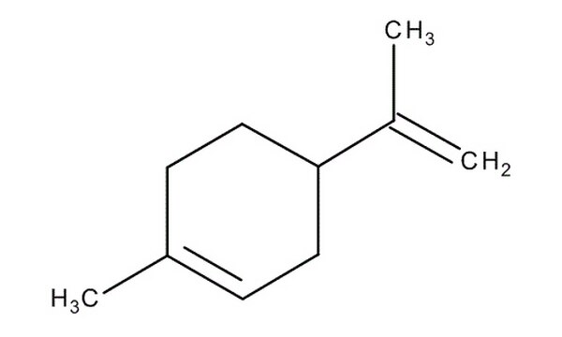
Results and discussion
Figure 5. Structure of limonene, the principal component of C. Lawsoniana essential oil
Figure 6. Structure of α-thujone, the principal component of T. plicata essential oil
Bearing in mind the previously published data [6, 7], on the absence of genotoxic potential of limonene and thujone in the lowest concentrations, presence of these compounds in tested essential oils may be responsible, at least in part, for their more significant DNA protective activity in lower concentrations than in the higher concentrations.
[6] M. Bacanli, A.A. Başaran, N. Başaran, The antioxidant and antigenotoxic properties of citrus phenolics limonene and naringin, Food and Chemical Toxicology, 81 (2015) 160-170.
[7] O. Pelkonen, K. Abass, J. Wiesner, Thujone and thujone-containing herbal medicinal and botanical products: toxicological assessment, Regulatory Toxicology and Pharmacology, 65 (2013) 100-107.

Slide 10
Conclusions
The results of our study show that both oils have a remarkable DNA protective activity against hydroxyl and peroxyl radicals induced damage.
This is the first study showing DNA protective effect of C. lawsoniana and T. plicata essential oils.
Further studies with in vivo biological models should provide a better understanding of the mechanisms underlying DNA protective ability of these two essential oils.

Slide 11
Acknowledgments
This research was supported by the Ministry of Science, Technological Development, and Innovation of the Republic of Serbia, (Grants: Nos. 451-03-47/2023-01/200378; 451-03-47/2023-01/200124, and 451-03-47/2023-01/200027.

