Slide 1

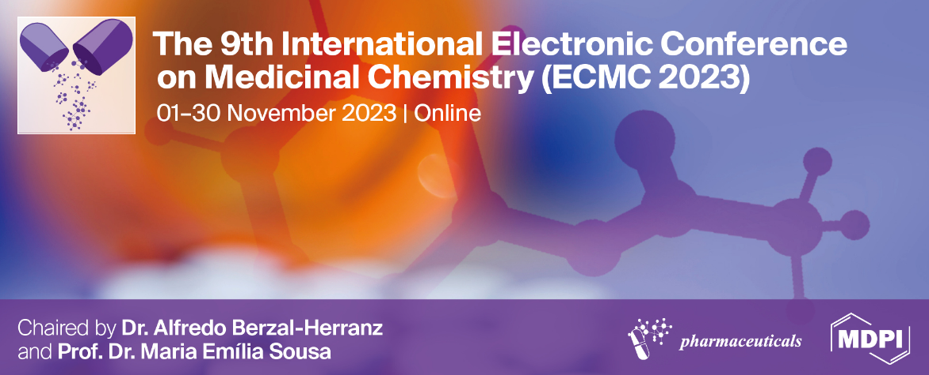

Phytochemical screening, Total Phenolic, Total Flavonoid, and Antioxidant Activity evaluation of extracts from Stachys mouretii Batt.Pit.
Abdelmoughite Ouakil¹, Soumaya El ismaili², Amal Maurady²,, and Mohammed Lachkar¹
¹Engineering Laboratory of Organometallic and Molecular Materials, Faculty of Sciences, Sidi Mohammed Ben Abdellah University, Po. Box 1796 (Atlas), 30000 Fez, Morocco.
²University Sidi Mohamed Ben Abdellah, Faculté Polydisciplinaire de Taza, B.P. 1223 Taza gare. Laboratoire Ressources Naturelles et Environnement, Morocco.
Objectives
results
We are particularly interested in :
Yield of crude extracts
Extraction of Stachys mouretti using two different methods (Soxhlet and maceration).
Preliminary phytochemical analysis
Evaluation total flavonoid and phenolic contents
Evaluation of antioxidant activity
Extraits | Extraction weight (g) | Colors | Yields (%)
n-H₆C₆ | 6.8 | Green | 4.3
EtOAc | 3.8 | Green | 2.4
MeOH | 36.3 | Yellow | 22.7
Extraits | Extraction weight (g) | Colors | Yields (%)
n-H₆C₆ | 2.7 | Green | 1.7
EtOAc | 10.4 | Green | 6.5
BuOH | 9.8 | Brown | 6.1
Table 1: Weight, Color, and Yield of the leaves extracts of St. mouretii obtained by Soxhlet
Table 2: Weight, Color, and Yield of the leaves extracts of St. mouretii obtained by maceration
Introduction
Phytochemical screening of St. mouretii extracts
The result of phytochemical screening revealed that there is a high presence of polyphenols and flavonoids in all extracts of St. mouretii leaves, as well as sterols and terpenes. While, tanins and alkaloids were absent in all extracts
The Lamiaceae family comprises around 200 and includes more than 300 species. The genus Stachys comprises 350 species. This number makes it the second-largest group of Lamiaceae plants. This genus is mainly widespread in tropical and subtropical countries. The number of species is particularly high in the Mediterranean region, Eastern Europe, and Chile, but it is absent in New Zealand Australia and the Arctic regions.
Stachys species have been used for centuries to treat a wide range of ailments, including ulcers, asthma, rheumatism, inflammatory tumours, coughs, spleen sclerosis and genital tumours. Several species of Stachys are also known as "mountain tea" and are often used in jelly, yoghurt, and spices. Certain members of the Stachys genus (extracts and/or their isolated compounds) have significant antibacterial, anti-inflammatory, antitoxic, antifungal, antiphlogistic, antioxidant and cytotoxic eﬀects and can be useful in cases of anoxia, hepatitis and nephritis. Furthermore, the genus Stachys contains a high level of phenolic and flavonoid metabolites, phenylethanoids, fatty acids, iridoids, triterpenoids, steroids...
We have selected Stachys mouretii as the subject of our study since no study has been carried out on this species so far.
Extraits | Polyphenols | Flavonoids | Tanins | Alcaloids | Saponines | Sterols & Terpenes
H_{m}-sox | +++ | - | - | - | - | +++
E_{m}-sox | +++ | +++ | - | - | - | -
M_{m}-sox | +++ | +++ | - | - | + | -
H_{m}-mac | +++ | - | - | - | - | +++
E_{m}-mac | +++ | ++ | - | - | - | -
B_{m}-mac | ++ | ++ | - | - | - | -
Table 3: Results of preliminary phytochemical screening of the leaves of St. mouretii
Significance of the symbols : +++ : Abundantly present ; ++ : moderately present ; + : weakly present ; - : Absent
Total phenolic content
The Total Phenolic Content of the various leaves extracts is expressed in terms of GAE (Gallic Acid Equivalent) using the following linear regression equation obtained from the standard plot of gallic acid:
y = 0,0171x + 0,2091
Where y is absorbance and x is the amount of gallic acid
Methods
Figure 1: Calibration curve of Gallic Acid
Total flavonoids content
Figure 2: Total phenolic content of different extracts of St. mouretii
Plant material
The leaves of Stachys mouretii were collected during its flowering stage from Talasmtane forest (Ouazzane, Morroco) in April 2018. The plant sample was authenticated by botanist Dr. Abdelmonaim Homrani Bakali
Extraction
The Soxhlet and maceration methods were used to extract Stachys mouretii. To do so, the leaves of the Stachys mouretii samples were separated from the other parts of the plant and finely powdered. The dried and powdered Stachys mouretii leaves were extracted using hexane, ethyl acetate, methanol and butanol. The obtained extracts were concentrated using a rotary evaporator.
Estimation of total polyphenols and Flavonoids content
The Folin-Ciocalteu reagent (FCR) was used to determine the total phenolic content (TPC) of different crude extracts Singleton et al 1999. Gallic acid was used as a reference standard. A 0.5 mL of the plant extract (0.1 mg/ mL) was mixed with 1.5 mL of FCR and diluted with 3 mL of 7.5% sodium carbonate solution. The contents were thoroughly mixed and kept in the dark at room temperature for 30 minutes. The colour was developed and absorbance of the blue color obtained was measured using a double-beam UV-Vis spectrophotometer (UV Analyst-CT 8200) at the fixed wavelength of 765 nm. The TPCs were calculated using the linear regression equation obtained from the standard curve for gallic acid. The results were expressed as mg gallic acid equivalent/mL of fresh weight material.
The total flavonoids content (TFC) in the crude extracts was determined by the procedure reported by Brighente et al 2007 with some modification. An aliquant of aluminum chloride (AlCl₃) solution 0.1 mL (10 %, w/v) was added to 1 mL of the test solution, then 0.1 mL of potassium acetate (1 M) and 2.8 mL of distilled water was added. The concentrations of the flavonoids standard solutions were 100 μM. The mixture was vigorously stirred and then, after 30 min incubation at room temperature, submitted to spectral analysis. The absorbance of the reaction mixture was measured at 430 nm using a double-beam UV-Vis spectrophotometer. The amount of AlCl₃ solution was replaced by the same amount of distilled water in blank. For the quantification analysis, quercetin ( with a concentration range of 25 to 100 μM) was used as the reference compound. The amount of TFC was calculated from the linear regression equation obtained from the quercetin calibration. The results were expressed as mg quercetin equivalent/mL of fresh weight material.
Evaluation of antioxidant activity
In order to evaluate the antioxidant capacity of our plant extracts obtained by Soxhlet and maceration (ethyl acetate, methanol and buthanol extracts), several methods of measuring the antioxidant activity with different mechanisms were carried out, namely: the 2,2-diphenyl-1-picrylhydrazyl free radical scavenging, commonly known as the DPPH method, the iron reducing power method (FRAP) and the phosphomolybdene method.
The Total Flavonoids Content of the various leaves extracts is expressed in terms of QE (Quercetin Equivalent) using the following linear regression equation obtained from the standard plot of Quercetin:
y = 1,6573x - 0,0317
Where y is absorbance and x is the amount of Quercetin
Figure 3: Calibration curve of quercetin
Figure 4: Total flavonoid content of different extracts of St. mouretii
Methanol and ethyl acetate extracts obtained by Soxhlet were found to contain the highest amount of phenolic compounds, while the highest amount of flavonoids was found in the butanol and ethyl acetate extracts obtained by maceration, and in the methanol extract obtained by Soxhlet.
Antioxidant activity
Figure 5: inhibition of DPPH radical by St. mouretii leaf extracts
Figure 7: Reducing power of St. mouretii leaf extracts
Figure 8: Total antioxidant capacity of St. mouretii leaves extracts
Based on these results, it can be seen that the extracts of the leaves of St. mouretii at different concentrations exhibited different degrees of antioxidant activity. In addition to increasing the concentration of the extract, the antioxidant activity of the extracts increases. Furthermore, the methanolic extract obtained by Soxhlet, as well as the ethyl acetate extract obtained by maceration showed a relatively stronger antioxidant capacity than butylated hydroxytoluene (BHT) at certain concentrations. This activity may be due to the presence of phenolic compounds, which are responsible for a number of biological activities such as antioxidants, antimicrobials and anti-inflammatories...
Conclusion
Ethyl acetate extract of Stachys moureti was found to contain the highest phenolic and flavonoids content
The phytochemical screening of Stachys mouretii leaves extracts revealed the richness of this plant in potentially bioactive compounds such as, polyphenols, flavonoids, sterols and terpens, and the separation of these compounds is currently in progress.
Stachys moureti is a rich source of phenolic compounds which have demonstrated their usefulness in potential biological activities such as antioxidants, antimicrobials, anti-inflammatories, anti-diabetics, anti-cancer agents, etc.
References
Stachys moureti leaves extracts showed a significant antioxidant activity, as well as, in certain concentrations, the ethyl acetate extract obtained by maceration and the methanol extract obtained by Soxhlet exhibited greater antioxidant capacity than BHT.
Brighente, I. M. C., Dias, M., Verdi, L. G., & Pizzolatti, M. G. (2007). Antioxidant activity and total phenolic content of some Brazilian species. Pharmaceutical biology, 45(2), 156-161.
Singleton, V. L., Orthofer, R., & Lamuela-Raventós, R. M. (1999). Analysis of total phenols and other oxidation substrates and antioxidants by means of folin-ciocalteu reagent. Methods in enzymology, 299, 152-178.
These results suggested that Stachys moureti can be used as a natural antioxidant source. It is then necessary to identify and isolate the compounds that are responsible to these antioxidant activities using various chromatographic and spectroscopic techniques such as HPLC, GC-MS, NMR….

