Slide 1
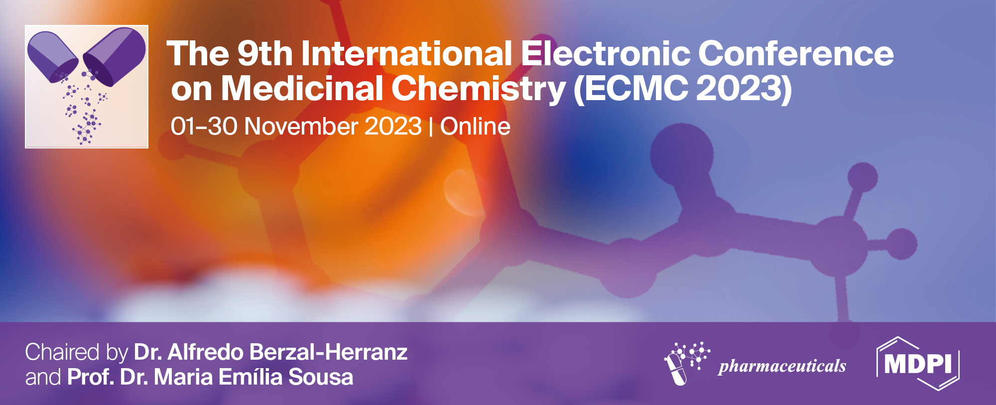
Abelmoschus esculentus (okra) in regulation of hyperglycaemia in pre-diabetic and type 2 diabetic patients: Meta-analysis
Kabelo Mokgalaboni¹, Sogolo L.Lebelo¹, Perpetua Modjadji², Saba Ghaffary³
¹ Department of Life and Consumer Sciences, University of South Africa, Address;
² Non-Communicable Disease Unit, South African Medical Research Council
³Hematology and Oncology research Center, Tabriz University of Medical Sciences
Corresponding author: mokgak@unisa.ac.za

Slide 2
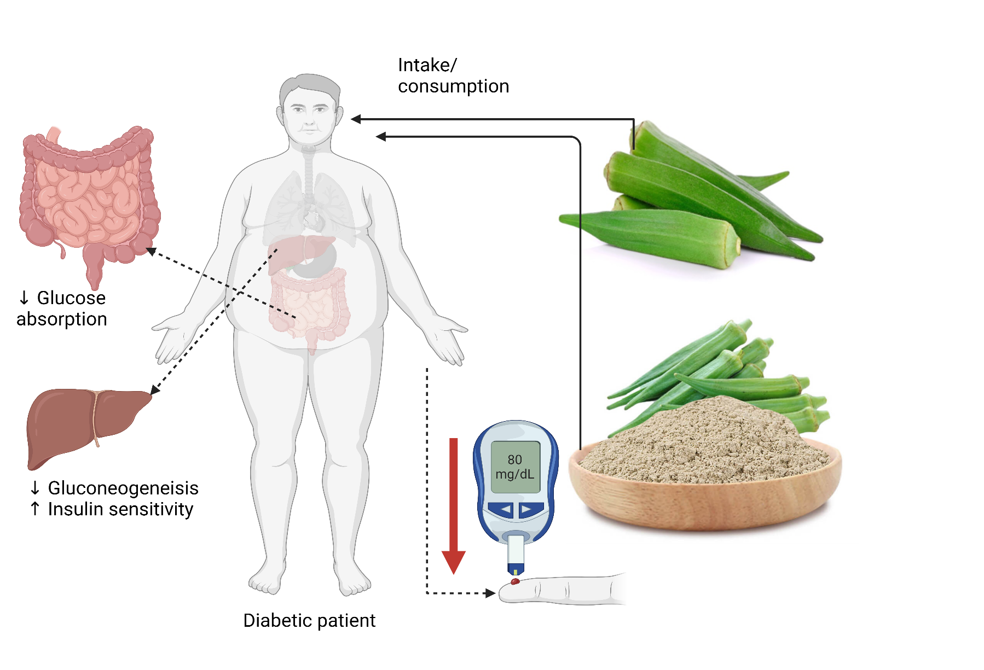
Abelmoschus esculentus (okra) in regulation of hyperglycaemia in pre-diabetic and type 2 diabetic patients: Meta-analysis

Slide 3
This study investigated the beneficial effects of okra on glycaemic control in pre-diabetes and type 2 diabetes mellitus (T2D).
MEDLINE and Scopus were searched for relevant studies. A search followed an updated preferred reporting items for systematic review and meta-analysis. Collected data were analyzed using Review Manager version 5.4 and meta-Hun and reported as mean difference and 95% confidence intervals (CI). Eight clinical studies, including 331 patients with pre-diabetes and T2D, were eligible. Our findings showed that okra treatment reduced the levels of fasting blood glucose, mean difference (MD) = −14.63 mg/dL; 95% CI (-25.25, −4.00, p = 0.007); I² = 33%, p = 0.17 compared to placebo. Glycated hemoglobin did not differ significantly between the groups: MD = 0.01%; 95%CI (-0.51, 0.54, p = 0.96); I² = 43%, p = 0.28. This study revealed improved glycemic control following okra treatment in pre-diabetes and T2D patients. The findings suggest that okra may be used as a supplemental dietary nutrient, especially in pre-diabetic and T2D patients, due to its potential to regulate hyperglycaemia.
Keywords: okra; antioxidant; type 2 diabetes; inflammation; hyperglycaemia; pre-diabetes

Slide 4
Introduction
T2D prevalence is rising nationally and globally.
In 2019, diabetes led to an estimated 2 million deaths (1).
T2D-associated cardiovascular complications also rising (2).
This is despite the available pharmacological drugs worldwide ie, metformin.
Other drugs result in adverse events.
Natural plant/fruits antihyperglycemic i.e., okra.
There is conflicting results from experimental and clinical trials
Therefore, we aimed to explore the benefits of okra in diabetes, focusing on glycemic control.

Slide 5
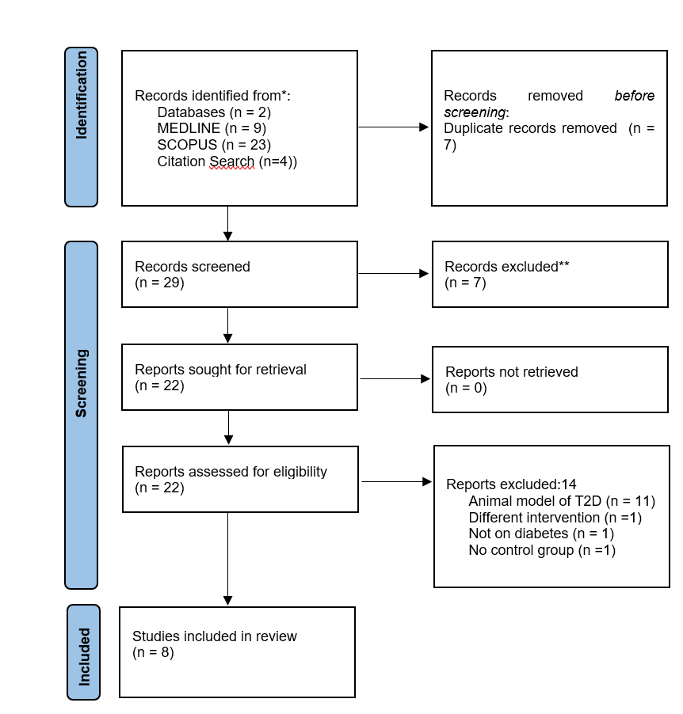
Results and discussion

Slide 6
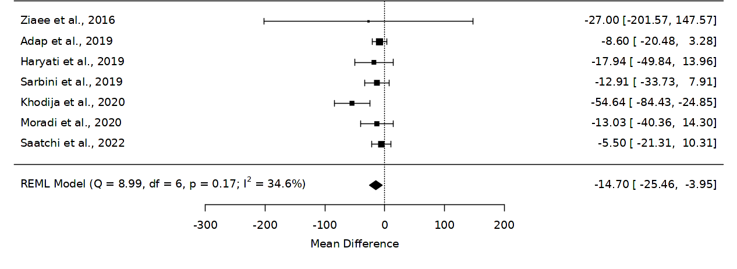
Results and discussion
Effect of Okra on FBG, Data reported as mean difference and 95%confidence interval, p= 0.9767

Slide 7
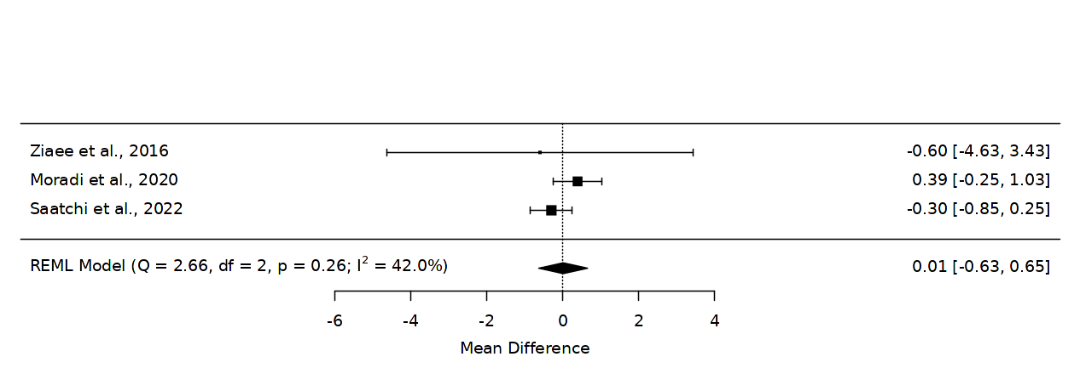
Results and discussion
Effect of okra on glycated hemoglobin, data reported as mean difference, 95%CI, p= 0.9767

Slide 8
Conclusions

Slide 9
Acknowledgments

Slide 10
Reference
https://www.who.int/news-room/fact-sheets/detail/diabetes
Einarson, T.R., Acs, A., Ludwig, C. et al. Prevalence of cardiovascular disease in type 2 diabetes: a systematic literature review of scientific evidence from across the world in 2007–2017. Cardiovasc Diabetol 17, 83 (2018). https://doi.org/10.1186/s12933-018-0728-6
Frandsen, T. F., Bruun Nielsen, M. F., Lindhardt, C. L., and Eriksen, M. B. (2020). Using the full PICO model as a search tool for systematic reviews resulted in lower recall for some PICO elements. J. Clin. Epidemiol. 127, 69–75. doi:10.1016/j.jclinepi.2020.07.005
Page, M. J., McKenzie, J. E., Bossuyt, P. M., Boutron, I., Hoffmann, T. C., Mulrow, C. D., et al. (2021). The PRISMA 2020 statement: An updated guideline for reporting systematic reviews. BMJ 372, n71. doi:10.1136/bmj.n71
Mokgalaboni K, Lebelo SL, Modjadji P and Ghaffary S (2023) Okra ameliorates hyperglycaemia in pre-diabetic and type 2 diabetic patients: A systematic review and meta-analysis of the clinical evidence. Front. Pharmacol. 14:1132650. doi: 10.3389/fphar.2023.1132650

