Slide 1
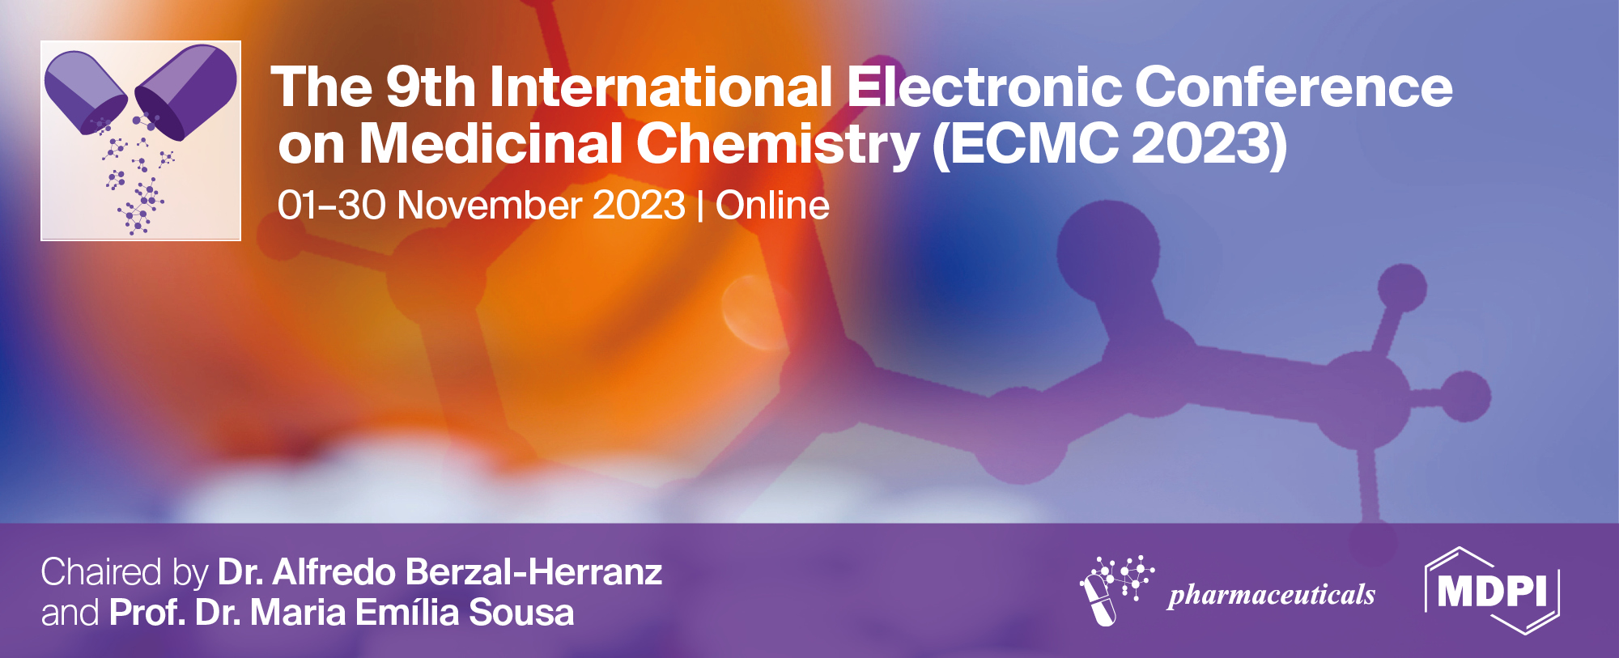
Synthesis and Characterization of Polystyrene-Based Cationic Hydrogels Enriched with Antibacterial Pyrazoles
Silvana Alfei *
¹ Department of Pharmacy (DIFAR), Section of Chemistry and Pharmaceutical and Food Technologies, University of Genoa, Viale Cembrano, 4, 16148 Genoa, Italy
* Corresponding author: alfei@difar.unige.it

Slide 2
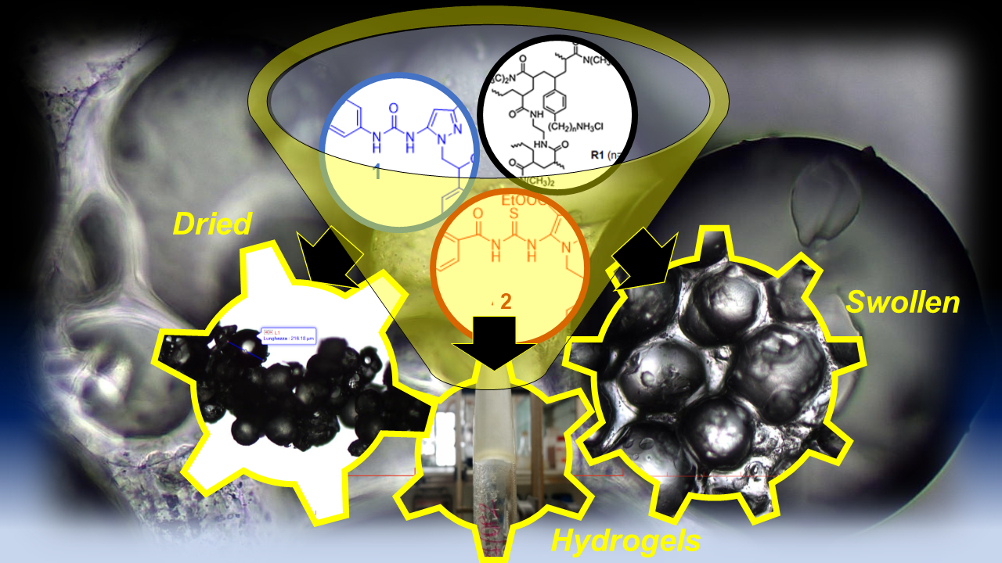
Synthesis and Characterization of Polystyrene-Based Cationic Hydrogels Enriched with Antibacterial Pyrazoles
Silvana Alfei

Slide 3
Abstract: Recently, we have reported on the antibacterial effects of two pyrazoles (here named 1 and 2) against Gram-positive bacteria. Now, aiming at developing new dermal treatments to cure skin infections sustained by staphylococci, 1 and 2 were formulated as hydrogels, using a synthetized and characterized polystyrene-based cationic resin as gelling agent.
The swelling capability and porosity of the obtained hydrogels were investigated by determining their equilibrium degrees of swelling (EDS) (765% and 675%) and equilibrium water content (EWC) (88% and 87%), which resulted very high, thus establishing for their capability to absorb exudate possibly present on infected skin. Chemometric-assisted ATR-FTIR analyses, as well as optical and scanning electronic microscopy evidenced the chemical structure of gels and their morphology, while the equivalents of NH₃⁺ groups reported to be responsible of antibacterial effects were determined by potentiometric titrations. Weight loss and equilibrium swelling rate, as well as stability studies over times, were also carried out. Rheological experiments were performed to evaluate the flow and dynamic behaviour of the gels, which resulted elastic pseudoplastic fluids, with good spreadability. Collectively, the obtained results support the pyrazole-base hydrogels reported here as new topical treatments to cure severe skin and wound infections sustained by MDR bacteria of Staphylococcus genus.
Keywords: antibacterial pyrazoles; cationic resin (R1); microsized composite hydrogels; high swelling capability; high porosity, pseudoplastic rheological behavior
Silvana Alfei

Slide 4
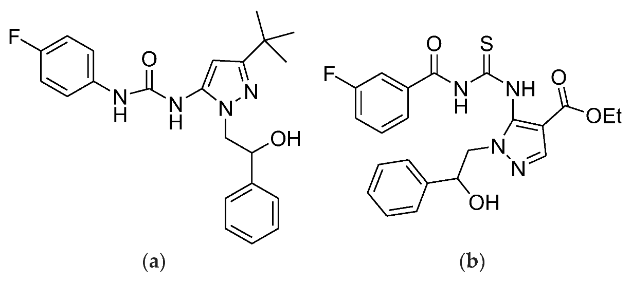
Introduction
Pyrazole derivatives have been widely reported to possess several biological activities, including interesting antimicrobial effects. Pyrazole-based compounds, clinically approved to be used in the treatment of certain pathologies, have subsequently demonstrated significant antimicrobial activity. In this context, we have recently synthesized two tri-substituted pyrazoles containing two phenyl rings and one fluorine atom (1 and 2, Figure 1) endowed with promising antibacterial effects, especially against multi drug resistant (MDR) clinical isolates of Gram-positive species (MICs = 32–64 µg/mL).
Figure 1. Structure of the antibacterial pyrazoles 1 (a) and 2 (b).
Silvana Alfei

Slide 5
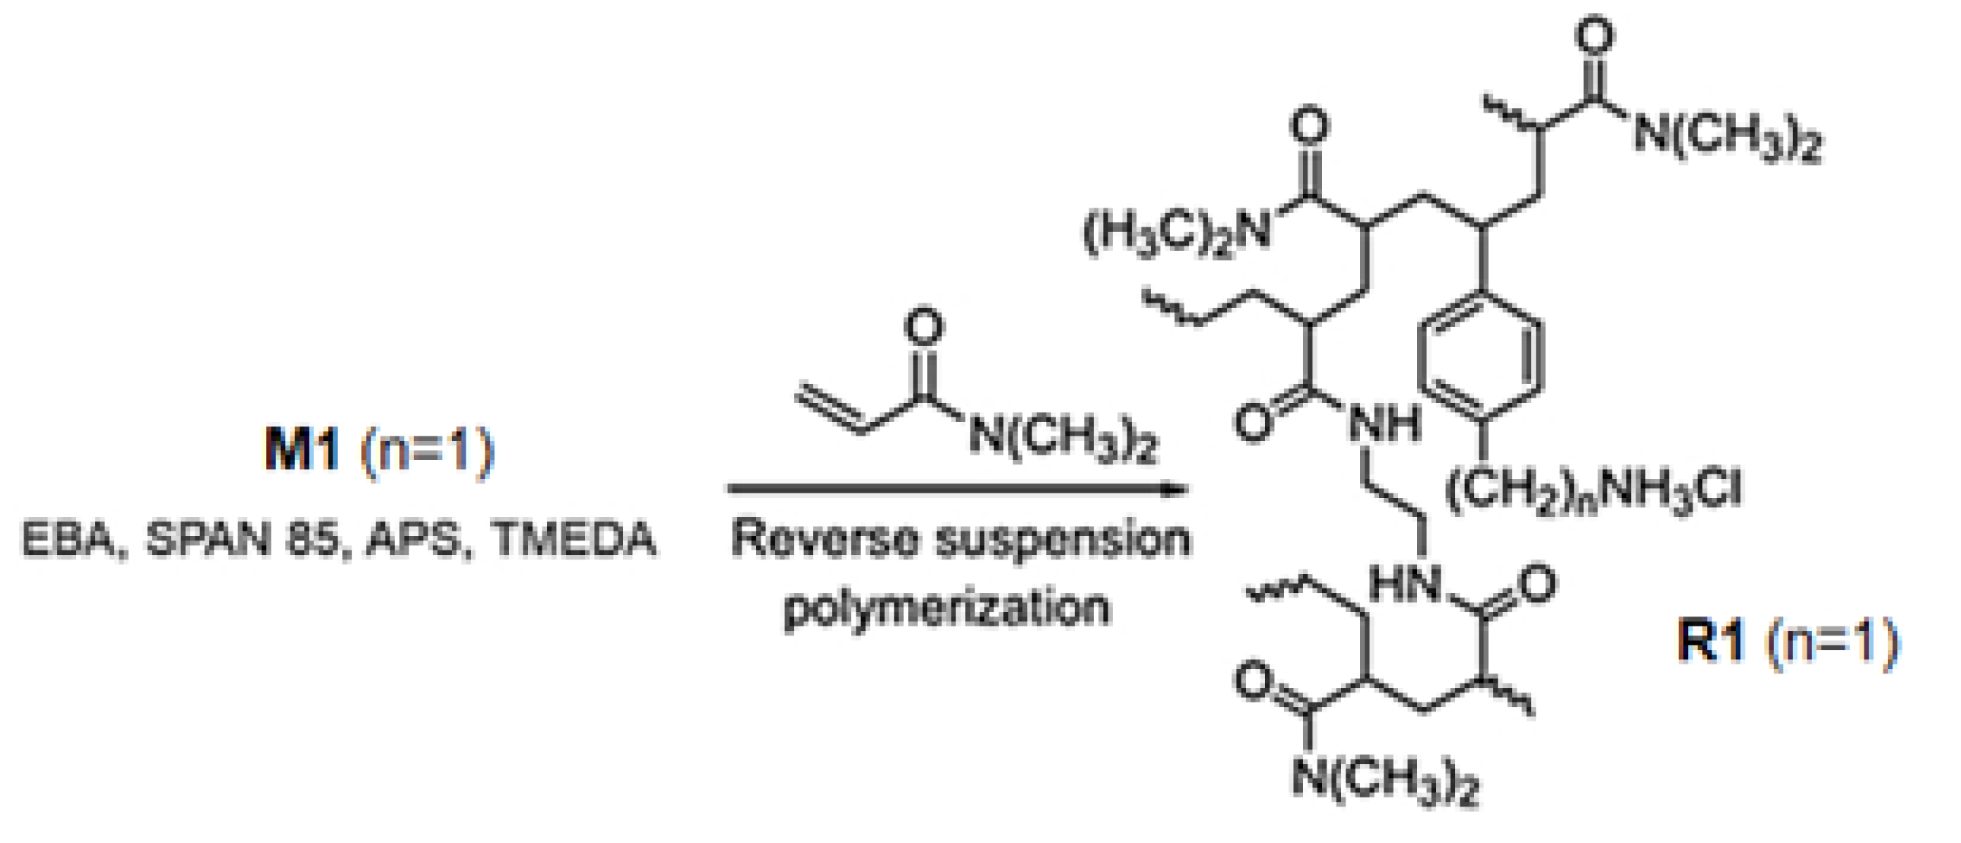
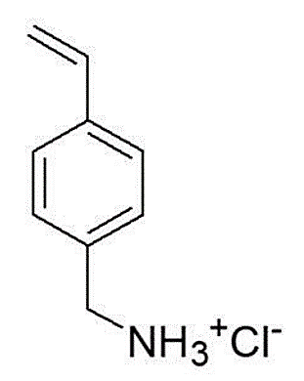
Here, aiming at exploiting the antibacterial properties of 1 and 2 and at preparing new dermal treatments to cure skin infections, we used them to obtain pyrazoles-based hydrogels. The polystyrene-based resin (R1) prepared copolymerizing the cationic polystyrene monomer (M1) with DMAA as described in the following Scheme, was used as gelling agent.
EBA = ethyl-bis acrylamide; APS = ammonium persulphate; TMEDA = trimethyl-ethylene diamine
Silvana Alfei

Slide 6
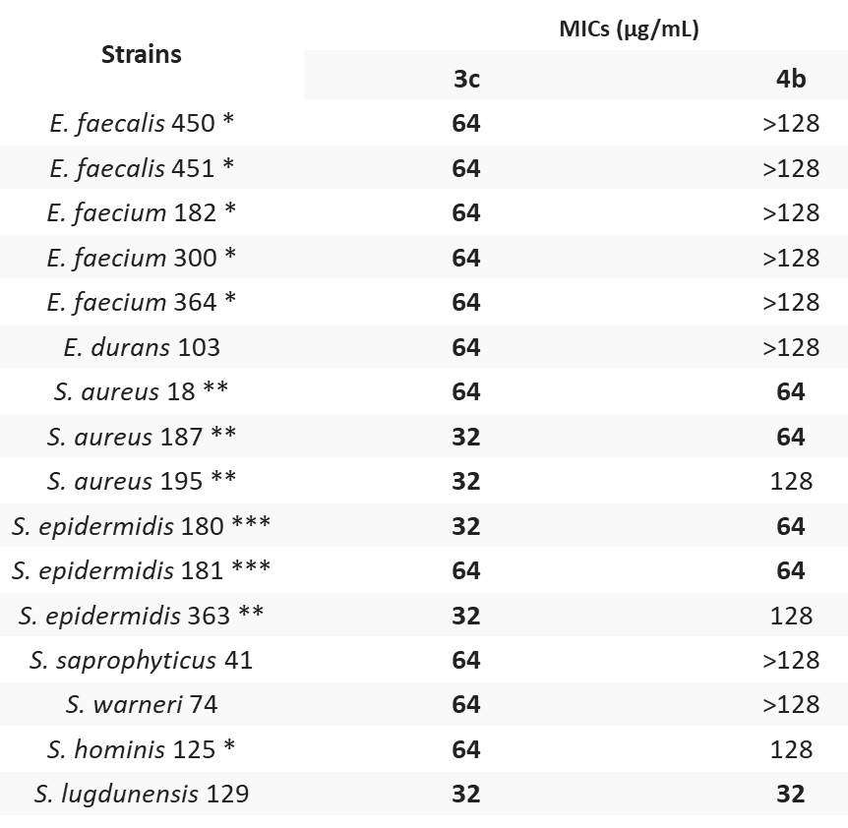
Results and discussion
Antibacterial Properties of 1 and 2
1
2
On the right, we have reported the MIC values (MICs) (µg/mL) of pyrazoles 1 and 2 against Gram-positive bacteria. MICs were obtained from experiments carried out at least in triplicate.
Accordingly, 1 demonstrated activity against vancomycin resistant (VRE) E. faecium and E. faecalis, methicillin resistant S. aureus (MRSA), and S. epidermidis (MRSE), while 2 exhibited antibacterial effects specifically against staphylococci.
* Vancomycin resistant; ** methicillin resistant; *** resistant toward both methicillin and linezolid. Promising antibacterial activity was evinced in bold.
Silvana Alfei

Slide 7
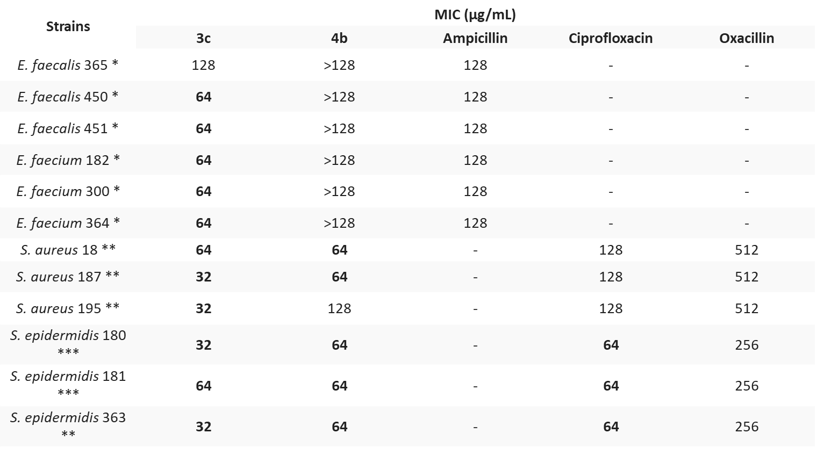
Antibacterial Properties of 1 and 2 with Reference Antibiotics
1
2
Silvana Alfei

Slide 8
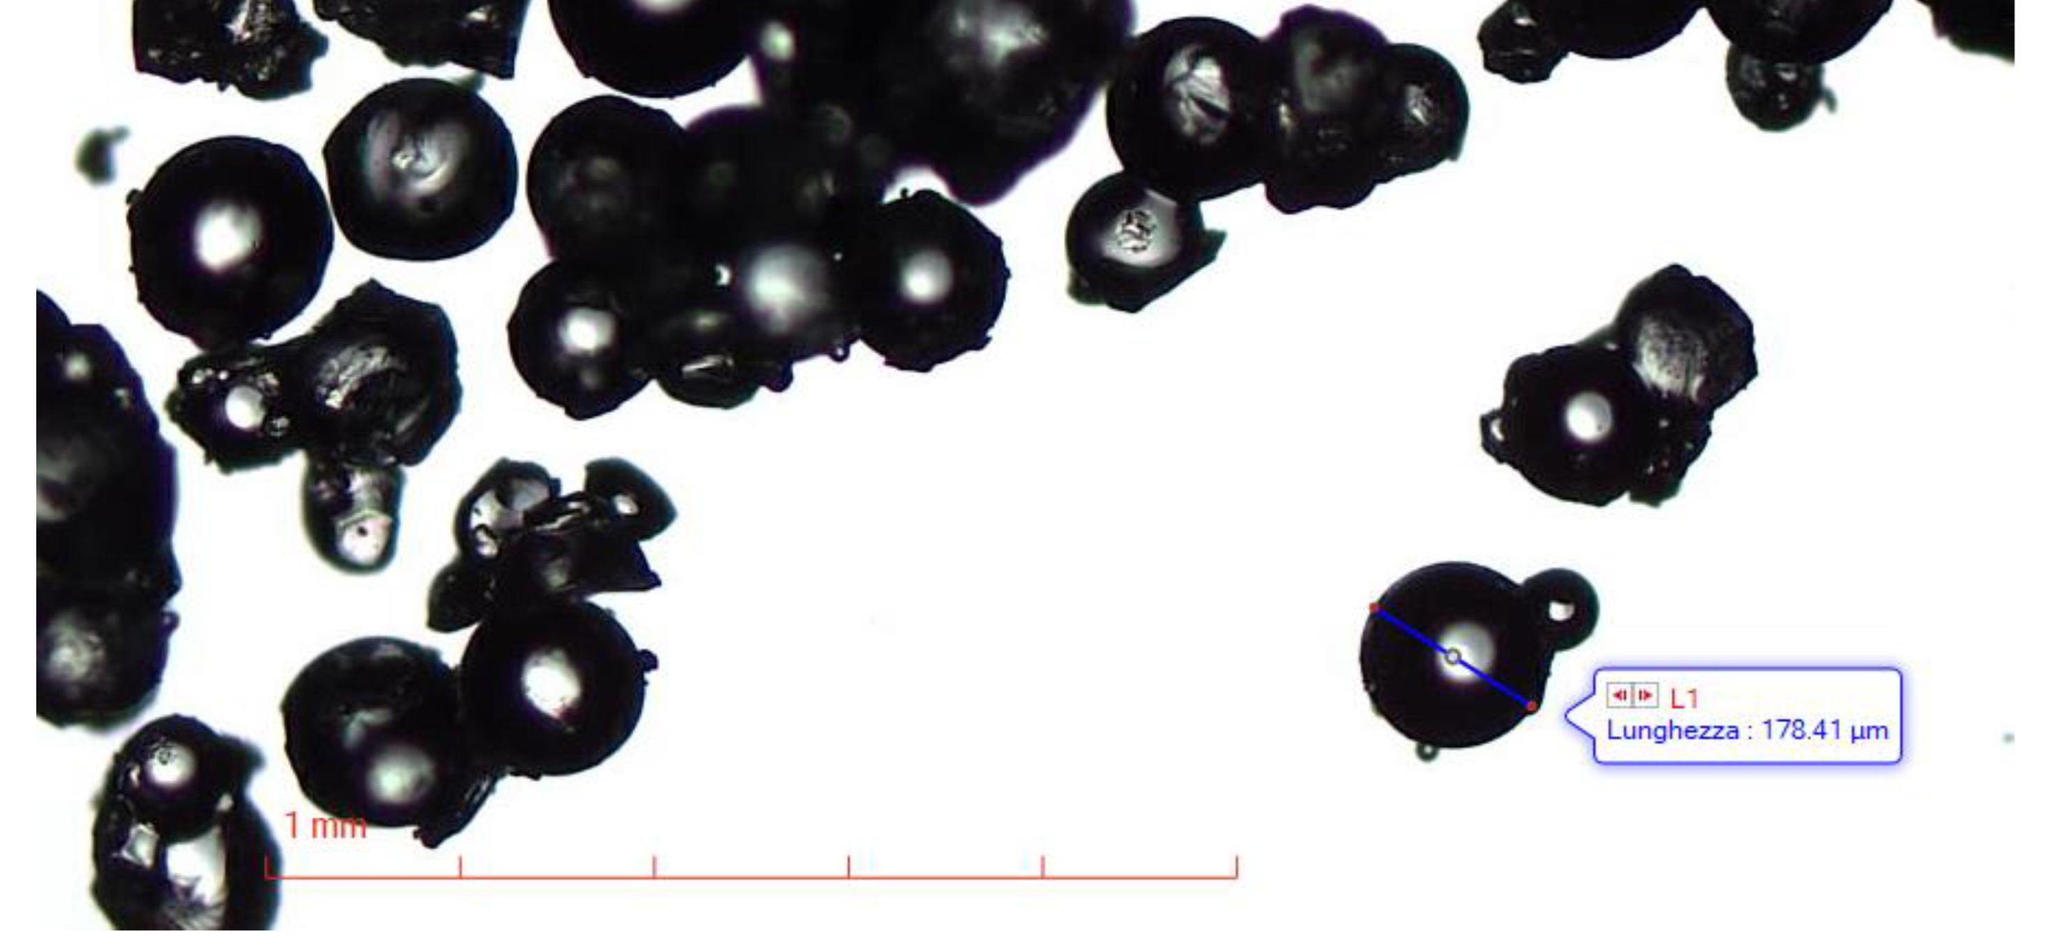
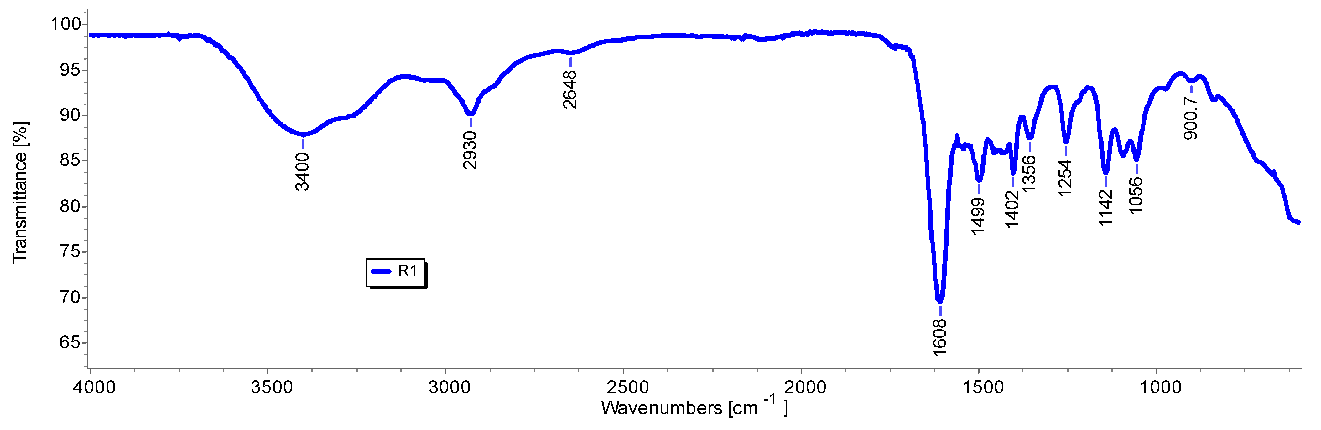
Optical Microscopy of R1 Particles
R1 particles demonstrated spherical morphology and microsized dimensions in the range 125–250 µm. The NH₂ equivalents per gram of R1 were determined by the method of Gaur and Gupta and resulted to be 10.22 ± 0.059 mmol/g. The ATR-FTIR spectrum of R1, confirming the presence of both M1 and DMAA is reported below.
ATR-FTIR
spectrum of R1
Silvana Alfei

Slide 9
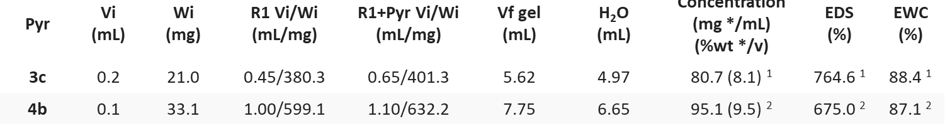
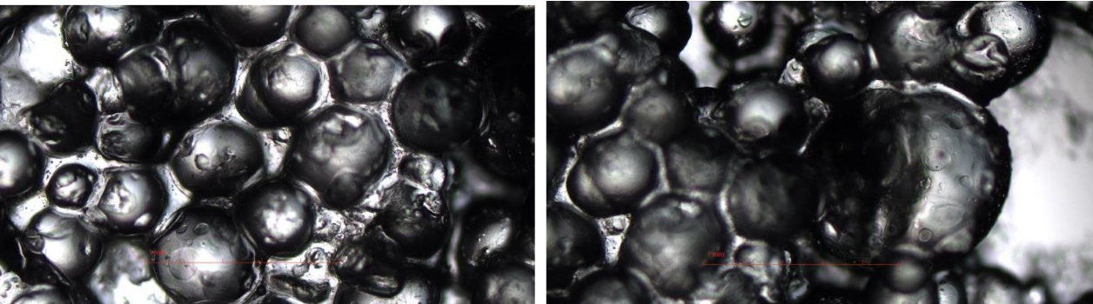
Preparation of R1HG-1 and R1HG-2 Hydrogels
Data concerning the preparation of pyrazole-enriched hydrogels R1HG-1 and R1HG-2.
1
2
Pyr = pyrazole; EDS = equilibrium degree of swelling; EWC = equilibrium water content; Vi = initial volumes of the compounds; Wi = initial weights of the compounds; Vf = volumes of the hydrogels; * weight of R1+pyrazole; ¹ refers to R1HG-1; ² refers to R1HG-2.
R1HG-1 and R1HG-2 were prepared at their maximum EDS by mixing pyrazoles and R1 in a centrifuge tube, adding an excess of water, stirring, degassing and sonicating. The not adsorbed water was separated by centrifugation and removed.
Spherical particles of swollen hydrogels as appear at optical microscopy.
Silvana Alfei

Slide 10
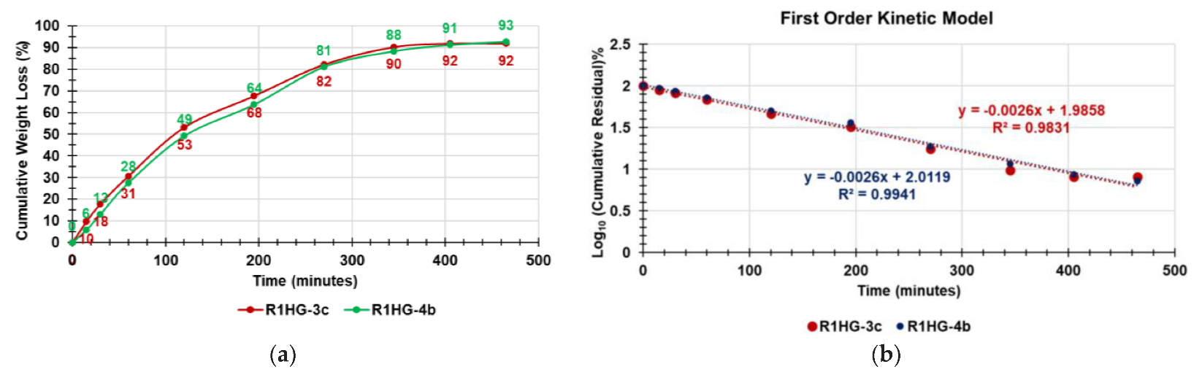
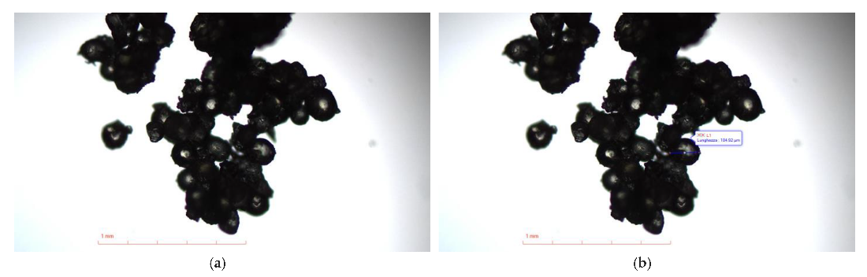
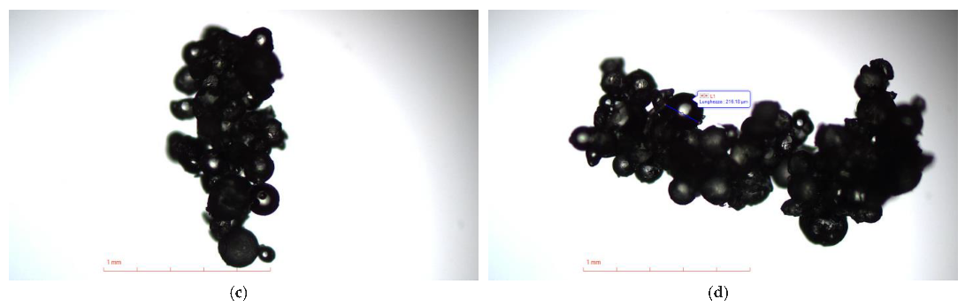
R1HG-1 and R1HG-2 Hydrogels Characterization: Water Loss
R1HG-1 (red line) R1HG-2 (green line)
R1HG-1 (red line) R1HG-2 (blue line)
Appearance of R1HG-1 (left) and of R1HG-2 (right)
Water loss experiments over time under heating revealed a quantitative release of water for both gels (a) governed by first order kinetics (b), while particles of fully dried gels were like those observed for R1 (below).
Optical micrographs of dried R1HG-1 (a,b) and of R1HG-2 (c,d).
Silvana Alfei and Chiara Brullo

Slide 11
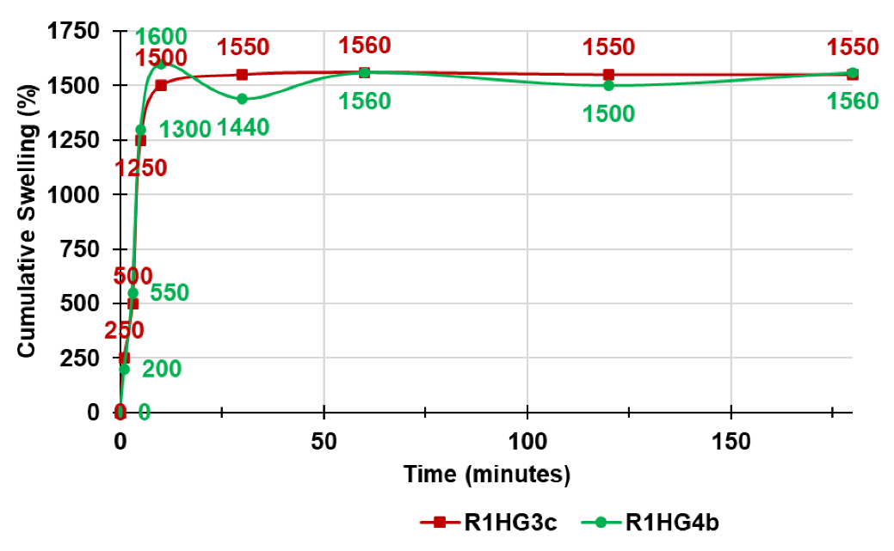
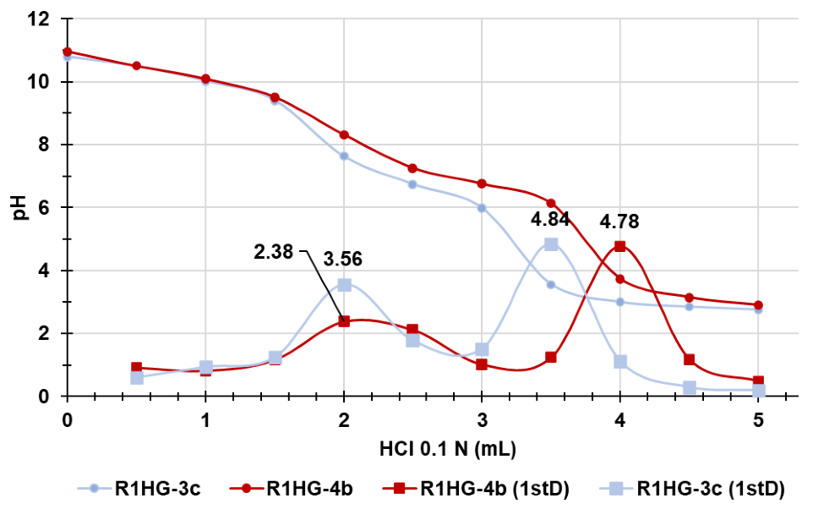
Equilibrium Swelling Rate
The equilibrium swelling rate (Q _{equil}), was reached after only 10 min by R1HG-2 (1600) and after 60 min by R1HG-1 (1560). Collectively, the equilibrium swelling rates of the two gels were comparable with each other and were like those already reported in literature.
The buffer capacity of both pyrazole-based hydrogels was high up to 1.5 mL of HCl 0.1 N added. According to the maxima of the first derivatives, both hydrogels evidenced two end points. The first ones corresponded to the titration the the excess of NaOH added, while the second ones (4.0 mL HCl for R1HG-2 (max 4.78) and 3.5 mL HCl for R1HG-1 (max 4.84) to the titration of the NH₂ groups. From these data we determined the NH₂ contents per gram of gel (0.728 mmol/g (R1HG-1) and 0.826 mmol/g (R1HG-2)).
R1HG-1 (red line) R1HG-2 (green line)
Potentiometric Titration
Titration curves and related first derivatives
R1HG-1 (light blue lines) R1HG-2 (red lines)
Silvana Alfei

Slide 12
Rheological Studies
The viscosity curves of R1HG-1 (left plot) and R1HG-2 (right plot) were obtained measuring their viscosity as a function of a shear rate applied and the results have been presented in logarithmic scale. Both viscosity profiles evidenced a decreasing of viscosity for increasing of shear rate, thus establishing that our hydrogels are non-Newtonian fluids with a shear thinning behaviour.
Using two different forms of the Cross equation and a reported hybrid methematical method we determined the shear stress values as a function of shear rate. The related plots are available in the next slide.
Silvana Alfei

Slide 13
Rheological Studies
The graphs show the plots of the shear stress (τ, Pa) vs. shear rate (γ, s⁻¹) of R1HG-1 (left) and R1HG-2 (right). According to the plots profiles, both gels were pseudoplastic fluids not having constant 𝜂 for shear rate values < 30. Over these values, their 𝜂 values were constant and they assumed a plastic Bingham behaviour (irreversible deformations). To have confirmation of the shear-thinning behaviour of R1HG-1 and R1HG-2 we modelled the data of shear stress vs. shear rate using the Herschel–Bulkley rheological model.
Silvana Alfei

Slide 14
Rheological Studies
Herschel–Bulkley rheological model is expressed by the equation: τ = τ_{o}H + κHγnH
where nH is the fluid flow behavior index, which indicates the tendency of a fluid to shear thin or thick, κH is the consistency coefficient, which serves as the viscosity indexes of the systems, and τ_{o}H is the Herschel–Bulkley yield stress point. When γ = 0, τ = τ_{o}.
Following, the Hershel–Buckley rheograms obtained by reporting in graph Log (τ − τ_{o}) vs. Log (γ) are shown.
Silvana Alfei

Slide 15
Rheological Studies
In the plots, Log k (corresponding to τ_{o}) and n were obtainable from the related linear regression equations, where Log k is the intercept and n is the slope. The k values were calculated accordingly.
Sample | Equation | n | Log₁₀K | K | R²
R1HG-1 | Y=0.8099+0.1251 | 0.8099 | 0.1251 | -0.9027 | 0.9641
R1HG-2 | Y=0.81+0.1466 | 0.8100 | 0.1466 | -0.8338 | 0.9640
In both cases 0<n<1 thus confirming a shear-thinning behaviour and the values of τ_{o} (yield stress) were very low, thus assuring that consistency of both gels could allow for easy spreading on the skin by applying a light massage, in a future topical administration.
Silvana Alfei

Slide 16
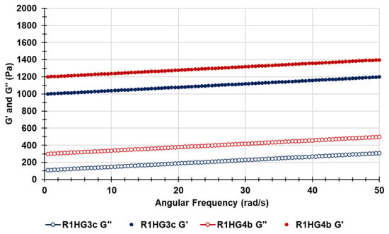
Frequency-Sweep Experiments
G’ R1HG-2
G’ R1HG-1
G’’ R1HG-2
G’’ R1HG-1
Frequency sweep experiments were performed to assess the viscoelastic characteristics of the network structure of R1HG-1 and R1HG-2 and to define the frequency dependence of the G′ and G″ moduli. Experiments were carried out at 1% strain (below the critical strain point of R1HG-1 and R1HG-2) and G′ and G″ values for R1HG-1 and for R1HG-2 were measured in the frequency range (ω) of 0.5–50 Hz. In such conditions, the values of G′ were always higher than those of G″ for both gels and almost independent on the angular frequency, thus establishing that the networks of both gels have an elastic behaviour.
Silvana Alfei

Slide 17



Conclusions
We have synthesized styrene-based cationic microspheres (R1) capable to provide hydrogels upon dispersion in water, by low-cost reverse suspension co-polymerization
Both hydrogels were characterized by PCA-assisted ATR-FTIR analyses, optic microscopy, weight loss experiments, equilibrium swelling rate studies, rheological experiments, while their structural stability was assessed over time at r.t.
R1 was characterized and used as gelling agent to formulate two antibacterial pyrazoles (1 and 2) as hydrogels (R1HG-1 and R1HG-2)
Silvana Alfei
Notes:
The observed antibacterial activity is attributable only to CD carriers and not to the presence and release of UOA.

Slide 18
Conclusions
Rheological studies established that R1HG-1 and R1HG-2 are both non-Newtonian Bingham pseudo-plastic fluids with low yield stress
Collectively, R1HG-1 and R1-HG-2 are promising as topical formulations to treat severe skin infections sustained by MDR Staphylococci
Frequency-sweep experiments established that both hydrogels have an elastic behavior
Silvana Alfei
Notes:
The observed antibacterial activity is attributable only to CD carriers and not to the presence and release of UOA.

Slide 19


Silvana Alfei *
Silvana Alfei
Notes:
Thank you in gialloooooo!!!!

