Slide 1
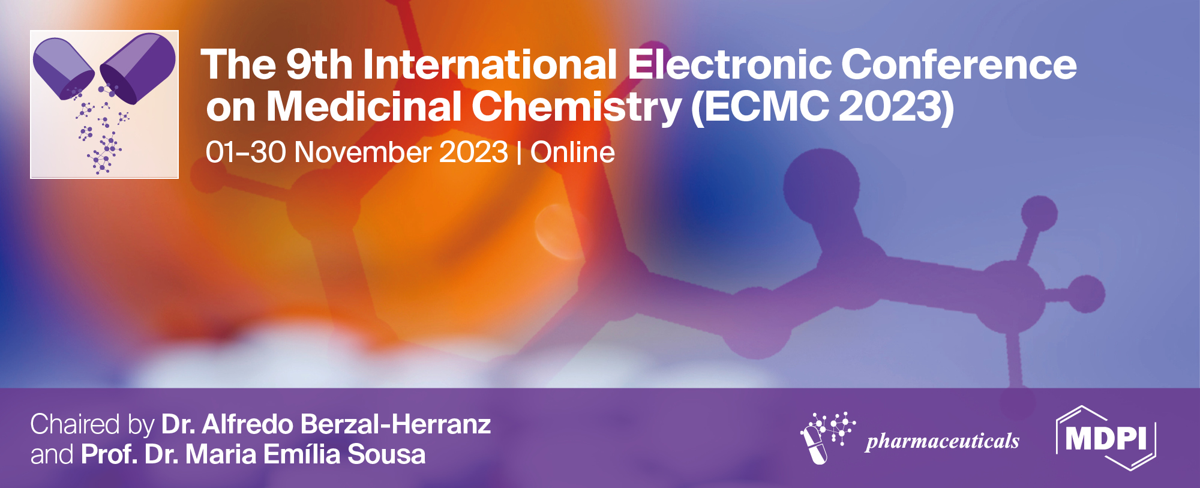



Lipophilic Ru(III)-based complexes
as potential anticancer drug candidates
Claudia Riccardi ^{1*}, Marialuisa Piccolo ², Maria Grazia Ferraro ², Raffaele Graziano ², Domenica Musumeci ¹, Marco Trifuoggi ¹, Carlo Irace ², Daniela Montesarchio ¹
¹ Department of Chemical Sciences, University of Naples “Federico II”, Via Cintia 21, 80126 Naples, Italy;
² Department of Pharmacy, University of Naples “Federico II”, Via D. Montesano 49, 80131 Naples, Italy .
* Corresponding author: claudia.riccardi@unina.it

Slide 2
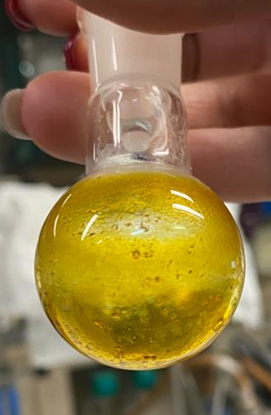
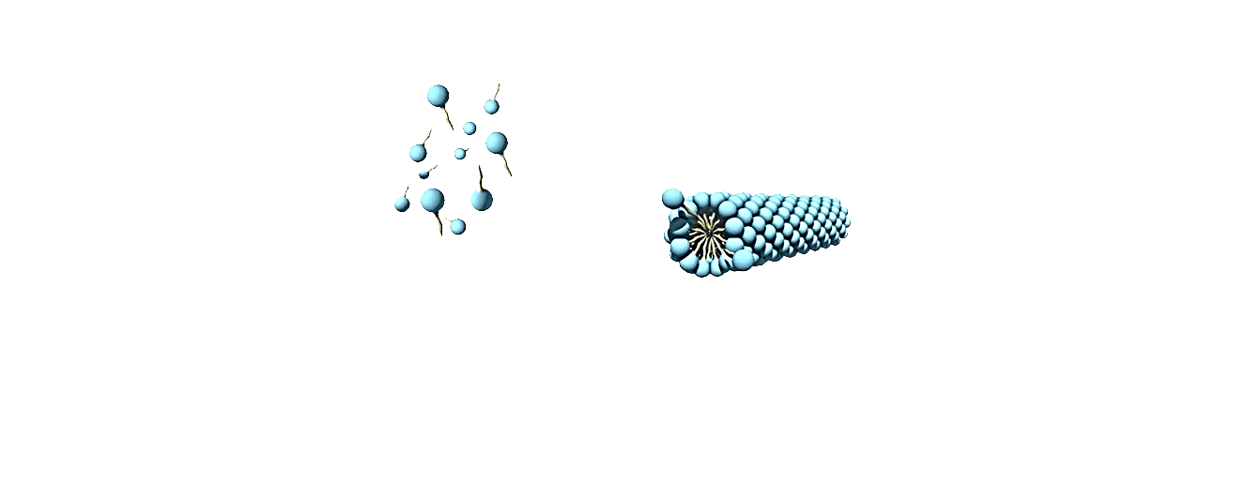
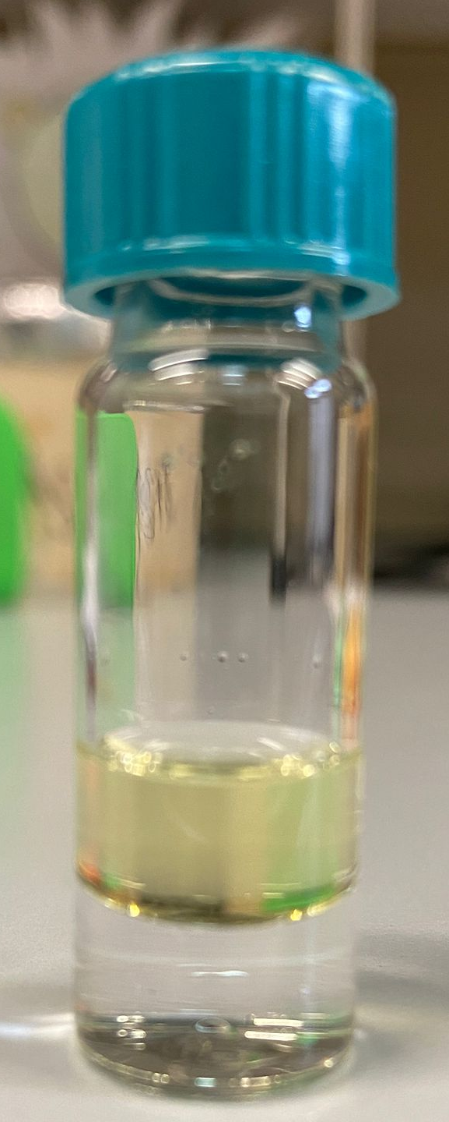
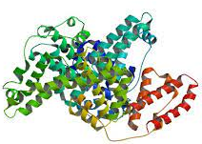
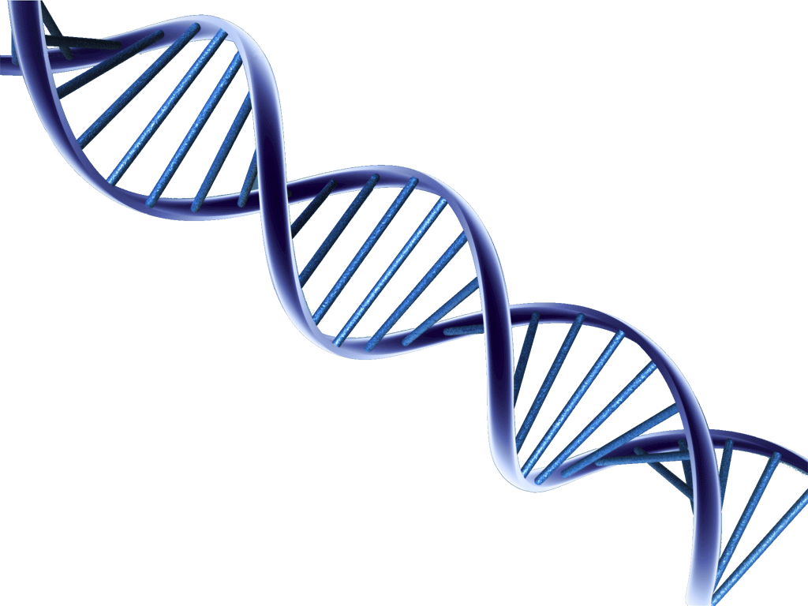
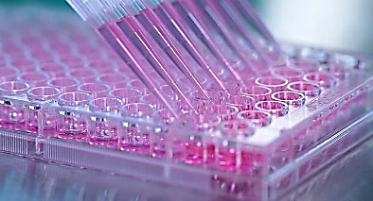
Graphical Abstract
Lipophilic Ru(III)-based complexes as potential anticancer drug candidates
Synthesis
Mini-library of lipophilic Ru(III) complexes
Self assembly
Ru
Lipophilicity
Cell uptake
DNA binding
n-octanol
BSA binding
Cell viability
Out
water
In

Slide 3
Abstract: Ru(III)-based complexes are attracting antitumor drugs for their remarkable anticancer and/or antimetastatic properties combined with general low toxicity , as well-demonstrated for two iconic Ru(III) compounds, KP1019 and NAMI-A. Intrigued by these properties, we studied a structurally-related NAMI-A compound, named AziRu, inserting it into nucleolipidic structures, which were further co-formulated with biocompatible lipids, thus forming stable liposomes featured by a significant antiproliferative activity and selectivity for cancer cells both in vitro and in vivo.
With the aim of enriching the arsenal of the available Ru(III) compounds, we designed a set of novel Ru(III) complexes characterized by lipophilic appendages decorating the pyridine ligand of the ruthenium ion of Aziru. The different lipid-functionalized Ru(III) complexes so obtained were then investigated for their molecular and self-assembling properties.
In vitro biological experiments proved that the lipophilic compounds carrying a palmitic and a stearic acid-based tail, named PalmiPyRu and StePyRu respectively, exhibited an interesting antiproliferative activity on specific breast cancer phenotypes without showing toxicity on normal cells. Further studies, aimed to the evaluation of their ability to interact with potential biomacromolecular targets, evidenced the unique ability of PalmiPyRu to interact with both bovine serum albumin (BSA) and two different G-quadruplex structures. In addition, PalmiPyRu exhibited a 20-fold enhanced cell uptake compared to AziRu in two breast cancer cell lines. Overall these results indicated PalmiPyRu as the best candidate in the designed series of lipid-conjugated Ru(III) complexes with marked improved cytotoxicity and cell uptake ability than AziRu.
Keywords: Ruthenium(III) complexes, Lipid conjugates, DNA/BSA binding study, Antiproliferative activity, Cell uptake

Slide 4

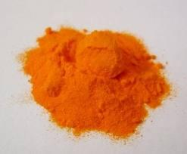
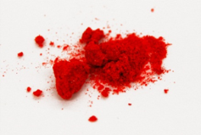
Introduction
Remarkable in vitro anticancer activity
Good pharmacological profile
Preferential accumulation in neoplastic masses
AziRu
KP1019
NAMI-A
L. Simeone et al. Bioconj. Chem. 2012, 33, 758-770;
M. I. Webb et al. Inorg. Chem. 2012, 51, 954–966.
Poor stability in aqueous media
Replacement of chloride ligands with water molecules or hydroxide ions
Formation of poly-oxo species which tend to precipitate
E. Alessio et al. Inorg. Chim. Acta 1993, 203, 205–217;
E. Alessio et al. Curr. Top. Med. Chem. 2004, 4, 1525–1535.
C. G. Hartinger et al. Inorg. Biochem. 2006, 100, 891-904.

Slide 5
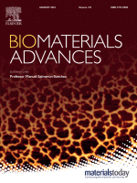
Results and discussion
A new design of Ru(III) complexes
Lipophilic AziRu analogues
Riccardi, C.; Piccolo, M.; Ferraro, M. G.; Graziano, R.; Musumeci, D.; Trifuoggi, M.; Irace, C.; Montesarchio, D.
Biomaterials Advances 2022, 139, 213016.

Slide 6
Results and discussion
HATU/DIPEA
anhydrous DMF
Carboxylic acid
20 h, r.t.
4-pyridine methanol
anhydrous CH₃CN
20 h, 40 °C
Ligand exchange reaction
R=
Myri
E. Alessio et al. Inorg. Chem. 1991, 30, 609–618;
E. Alessio et al. Inorg. Chim. Acta 1993, 203, 205–217.
R=
Palmi
R=
Ste
Synthesis
R=
Ole
R=
Chol

Slide 7

Results and discussion
MyriPyRu
PalmiPyRu
StePyRu
CholPyRu
OlePyRu
NMR (¹H, ¹³C, COSY, HSQC)
ESI-MS

Slide 8

Results and discussion
Lipophilicity
n-octanol
water

Slide 9
Results and discussion
UV-vis-monitored stability studies
1.0
PalmiPyRu
0.2
0.8
∼ 240 min
> 180 min
> 120 min
∼ 120 min
> 90 min
45 min
t_{1/2}
408 nm
StePyRu
CholPyRu
PalmiPyRu
OlePyRu
MyriPyRu
AziRu
0.6
0.1
Stability toward hydrolysis
Abs
Ligand-to-metal charge transfer transition for the Ru-Cl bonds
0.4
0
300
350
400
450
0.2
0
220
300
400
500
600
Wavelength (nm)
10 mM potassium phosphate, 100 mM NaCl, pH = 7.3

Slide 10
Results and discussion
Dynamic Light Scattering (DLS) measurements
Self assembly

Slide 11





Results and discussion
In vitro bioscreens on cancer and non-cancer cells
Cell viability
In collaboration with the research group of prof. C. Irace, Department of Pharmacy, University of Naples Federico II
IC₅₀ (μM) |  |  | IC50 (μM)
 | MCF-7 | MDA-MB-231 | A375 | HCT-116 | HaCaT | Enterocytes
AziRu | > 300 | > 300 | > 250 | > 300 | > 300 | > 300
MyriPyRu | > 300 | > 300 | > 250 | > 300 | > 300 | > 300
PalmiPyRu | 50 ± 3 | 25 ± 4 | > 200 | > 250 | > 300 | > 300
StePyRu | 55 ± 5 | 150 ± 15 | 200 ± 10 | > 300 | > 250 | > 300
OlePyRu | 85 ± 7 | 50 ± 5 | 250 ± 12 | > 300 | > 300 | > 300
CholPyRu | > 300 | > 300 | > 250 | > 300 | > 300 | > 300
epithelial-like endocrine-responsive (ER) breast adenocarcinoma MCF-7
mesenchymal-like triple-negative breast adenocarcinoma MDA-MB-231

Slide 12
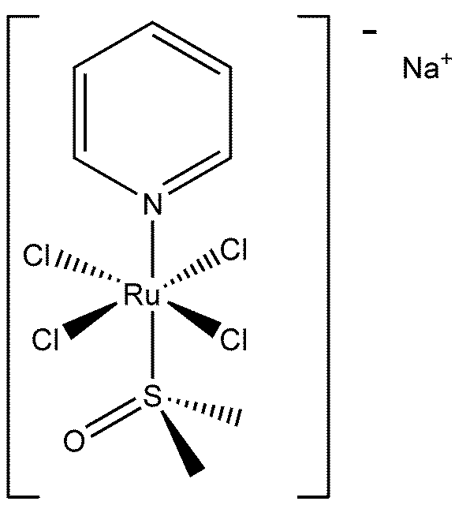
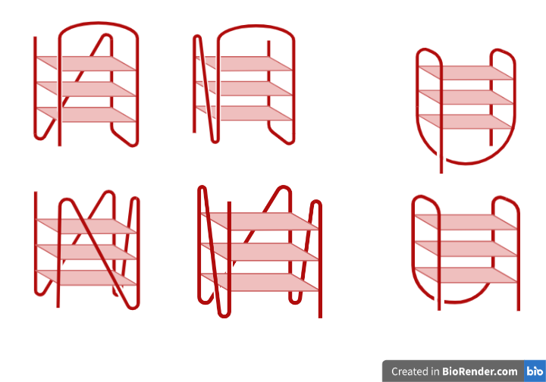
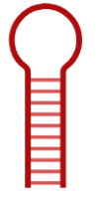
Results and discussion
Interaction studies with potential biomolecular targets
AziRu
PalmiPyRu
StePyRu
26-mer of sequence taken from the human telomeric DNA:
d(TTAGGGTTAGGGTTAGGGTTAGGGTT), tel₂₆
DNA binding
BSA binding
Hybrid
G-quadruplex
Bovine serum albumin (BSA):
very well characterized serum protein, sharing a high degree of homology with human serum albumin (HSA)
22-mer of sequence taken from c-myc promoter:
d(TGAGGGTGGGTAGGGTGGGTAA), PU22T14T23
Parallel
G-quadruplex
Duplex model:
d(CATGTGGTTCTG TTT CAGAACCACATG), duplexGG
duplexGG

Slide 13
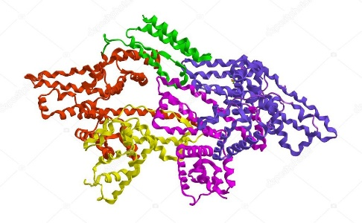
Results and discussion
Interaction studies with potential biomolecular targets performed by CD and fluorescence spectroscopy experiments
PalmiPyRu
tel₂₆
BSA
Hybrid
G-quadruplex

Slide 14

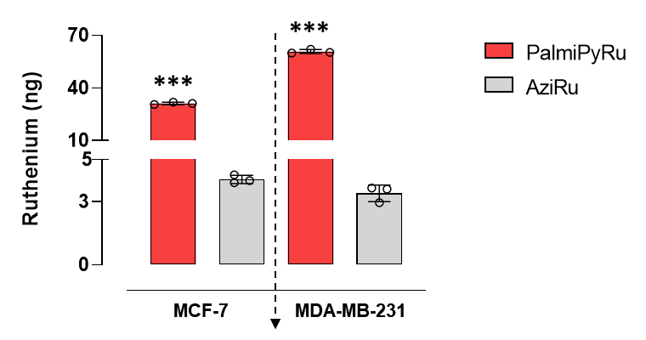
Results and discussion
Internalization in breast cancer cells
In collaboration with the research group of prof. M. Trifuoggi, Department of Chemical Sciences, University of Naples Federico II
Cell uptake
Out
In
The amount of Ru in the cellular pellets was determined via inductively coupled plasma-mass spectrometry (ICP-MS) analysis

Slide 15

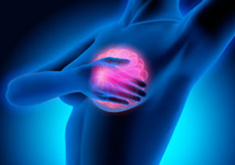

Conclusions
Improved citotoxicity
Improved cell uptake
than AziRu
PalmiPyRu
on breast cancer cells
Riccardi, C.; Piccolo, M.; Ferraro, M. G.; Graziano, R.; Musumeci, D.; Trifuoggi, M.; Irace, C.; Montesarchio, D.
Biomaterials Advances 2022, 139, 213016.
Identify the specific cell death pathway that PalmiPyRu is able to activate in breast cancer cells
Study the subcellular distribution of PalmiPyRu in vitro

Slide 16
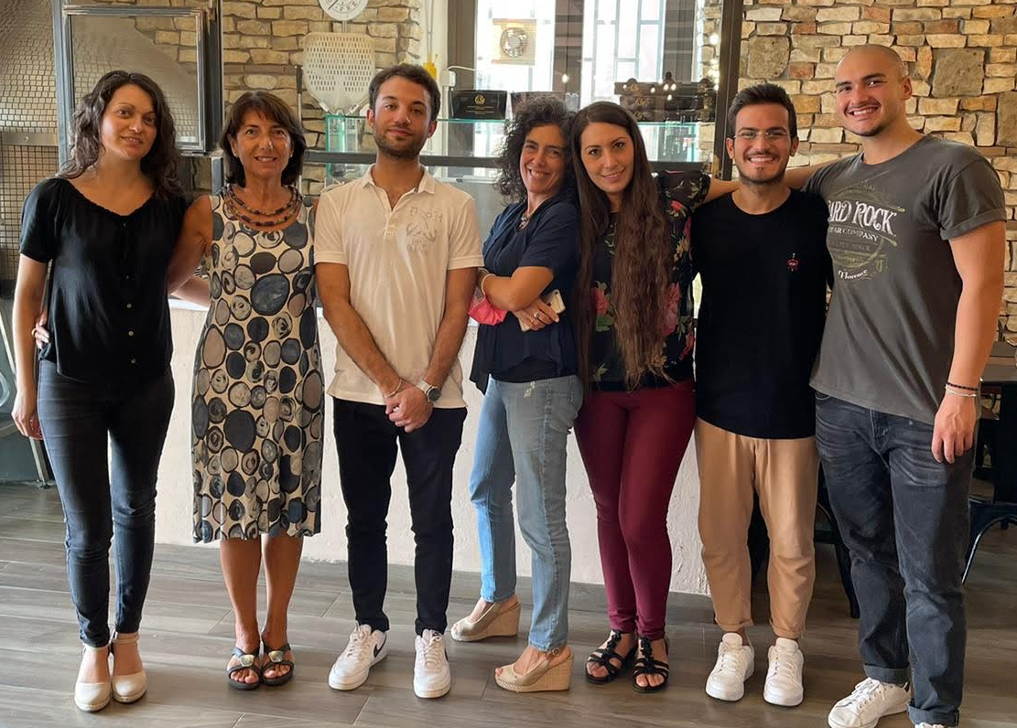



Acknowledgments
My research group:
Prof. Daniela Montesarchio
Prof. Domenica Musumeci
Dr. Chiara Platella
Dr. Ettore Napolitano
Dr. Andrea Criscuolo
MOM group =
Mimicking Organic Metabolites
Funded by AIRC
(IG2020 n. 25046 to D.M.) and
Fondazione Umberto Veronesi
Thank you for your kind attention

