Slide 1
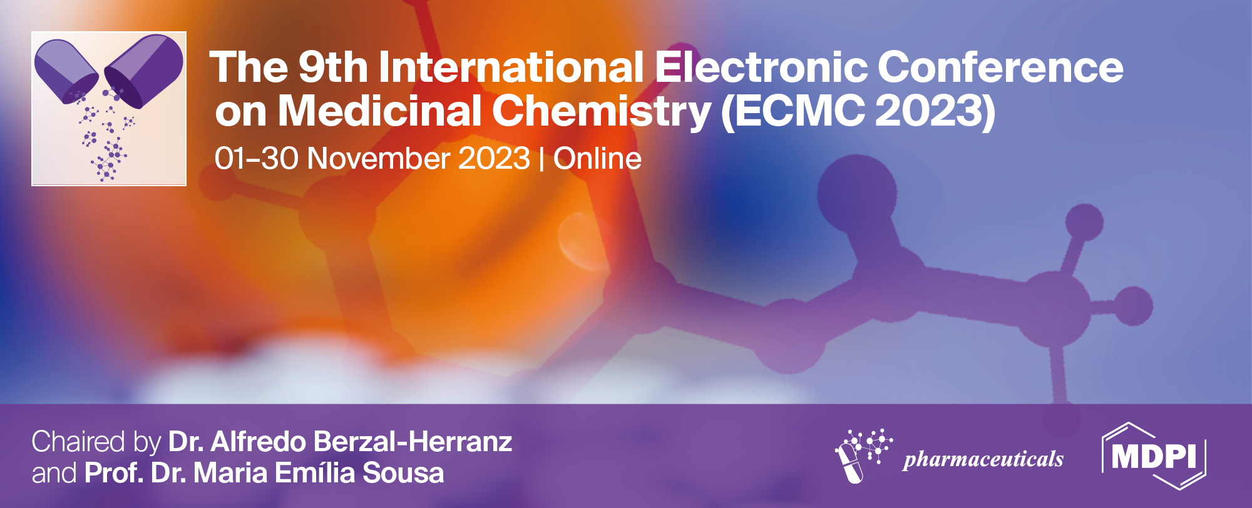
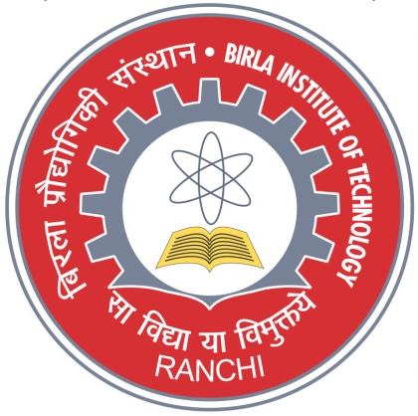
The potential of thymoquinone against vascular diseases: in silico evaluation
Ankit Majie and Bapi Gorain*
Department of Pharmaceutical Sciences and Technology, Birla Institute of Technology, Mesra, Ranchi 835215, India
* Corresponding author: bapi.gorain@bitmesra.ac.in

Slide 2
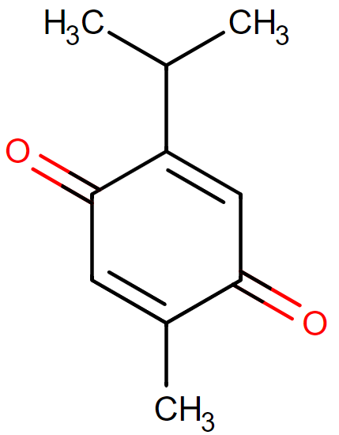
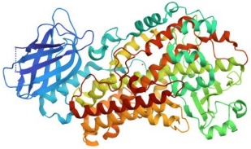
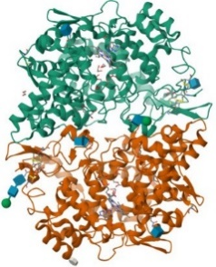
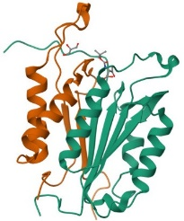
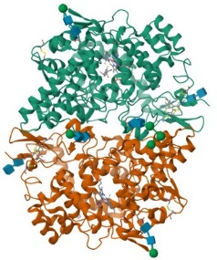
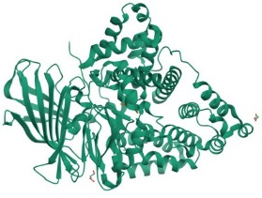
The potential of thymoquinone against vascular diseases: in silico evaluation
Thymoquinone (TQ)
ALOX5
Molecular docking
CASP3
Evaluation of binding energy & scoring
Visualization of binding interaction
PTGS2
PTGS1
LTA4H

Slide 3
Abstract:
An increase in secondary complications, hypercholesterolemia, diabetes mellitus, and blood pressure leads to an increase in the risk of vascular diseases (VDs), causing more mortality and morbidity globally. VDs include the abnormal functioning of coronary, carotid, vertebral, cervical, visceral, abdominal, aortic, and peripheral vessels. Complications of microcirculation due to peripheral vascular insufficiency have received considerable attention owing to venous and arterial diseases. In such complicated situations, LTA4H, CASP3, ALOX5, PTGS1, and PTGS2 are considered significant protein targets. For example, LTA4H and ALOX5 are associated with atherosclerotic plaque formation, inflammation, and instability; CASP3 is involved in the apoptosis of vascular smooth muscle cells, while PTGS is involved in peripheral vascular resistance, platelet aggregation, vascular inflammation, and vasoconstriction. Thus, targeting expressions of these proteins could provide beneficial effects in combating the complications of vascular diseases. Thymoquinone (TQ) is one such active phytoconstituent found in the seeds of Nigella sativa, which possesses anti-inflammatory, antioxidant, antimicrobial, immunomodulatory, analgesic, anticancer, and antipyretic effects; however, it has not been explored for its activity in vascular complications. Accordingly, an in-silico investigation has been designed to evaluate the activity of TQ on the expression of proteins involved in VDs using molecular docking approaches. The findings suggested a strong molecular interaction between TQ and the set targets. The docking profile depicted the binding affinity of TQ with LTA4H, CASP3, ALOX5, PTGS1, and PTGS2 having energies of -7.4 to -5.7 kcal/mol. Therefore, it can be concluded that TQ can be a potential phytoconstituent for vascular complications; however, more in-vitro and in-vivo studies are required.
Keywords: vascular diseases; atherosclerosis; thymoquinone; binding energy; microcirculation; molecular docking

Slide 4
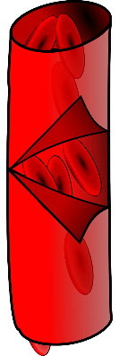
Introduction
Complications of vascular diseases [3]
Vasoconstriction
Peripheral vascular resistance
Platelet aggregation
Vascular inflammation
Atherosclerotic plaque formation
Anti-inflammatory
Analgesic
Antioxidant
Nephroprotective
Neuroprotective
LTA4H, CASP3, ALOX5, PTGS1, and PTGS2 are involved in various pathophysiological complications of vascular diseases.
These proteins control apoptosis of smooth muscles, platelet aggregation, inflammation, plaque formation, instability, and vascular resistance. [3]
TQ
Antimicrobial
Anticancer
Immunomodulatory
Figure 1. Biological activities of thymoquinone [1,2]
Despite having a wide range of biological activities, TQ is not widely explored for vascular diseases.

Slide 5
Materials and methodology
Retrieval of target protein
The 3-dimensional structures of PTGS1 (PDB ID: 3N8W) [4], PTGS2 (PDB ID: 5F19) [5], ALOX5 (PDB ID: 3O8Y) [6], LTA4H (PDB ID: 3B7S) [7], and CASP3 (PDB ID: 3GJR) [8] were retrieved from RCSB Protein Data Bank.
Retrieval of ligand
The 3-dimensional chemical structure of Thymoquinone molecule was downloaded from PubChem database in PDB format.
Preparation of target protein
The protein structure was cleaned using AutoDock Tools [9] by,
Deleting the water molecules
Adding polar hydrogen
Assigning the Kollman Charges
Saving the protein in .pdbqt format

Slide 6
Materials and methodology
Identification of the active binding site
The active site was identified by analyzing the proteins’ binding site through PyMOL software [10].
Assessment of binding energy and interactions
Grid box was assigned on the proteins’ active site.
Molecular docking was performed using AutoDock Vina based on scoring functions.
Scoring and ranking were based on binding energies of the docked ligand-protein poses.
The binding site was visualized and binding interactions with the residues were studied using BIOVIA Discovery Studio Visualizer [11].

Slide 7
Result and discussion
Table 1. Binding energies and hydrogen-bonding interaction of TQ with the target receptors. The binding energies are in the range of -7.4 to -5.7, which suggests strong binding interaction between the compound and the protein targets.
Compound | Target | PDB ID | Binding energy (kcal/mol) | H-bonding
TQ | PTGS1 | 3N8W | -7.4 | Leu352, Ile523, Gly526, Ala527, Ser530
TQ | PTGS2 | 5F19 | -7.2 | Ala199, Ala202, Gln203, Thr206, His207, Phe210, Tyr385, His386, Trp387, His388
TQ | ALOX5 | 3O8Y | -6.6 | Arg370, Ala453
TQ | LTA4H | 3B7S | -6.3 | Gly268, Gly269, His295, Gln296, Tyr383, Arg563
TQ | CASP3 | 3GJR | -5.7 | Lys137, Tyr195, Tyr197

Slide 8
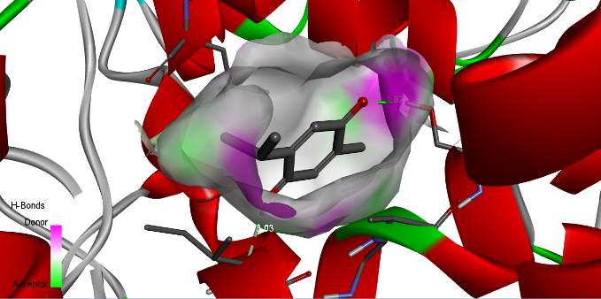
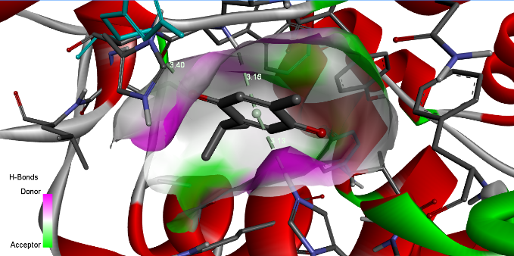
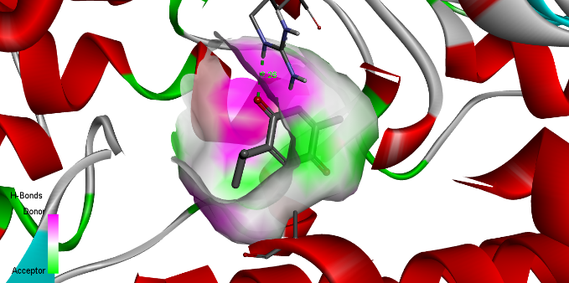
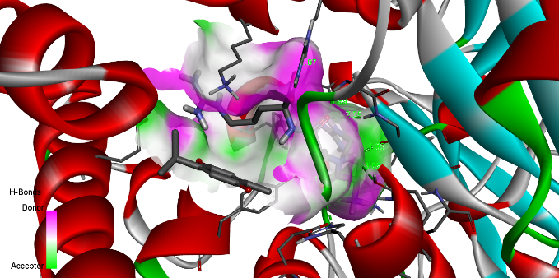
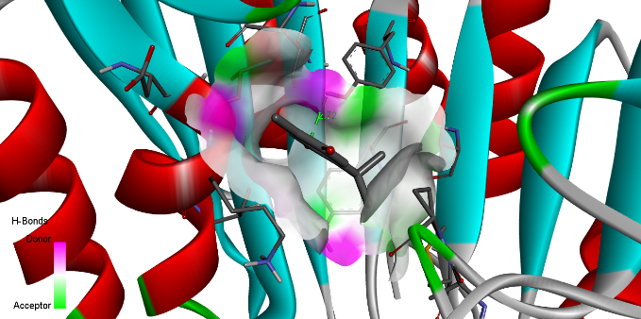
Result and discussion
(a)
(b)
(c)
(d)
(e)
Figure 2. Binding interaction between TQ and (a) PTGS1 (b) PTGS2 (c) ALOX5 (d) LTA4H (e) CASP3, showing the binding pockets of the protein targets and the H-bond interactions.

Slide 9
Conclusion
The molecular interaction between TQ and the identified target proteins of vascular diseases shows good binding energy.
However, TQ suffers from low bioavailability and permeability, which is required to be optimized for formulation development toward improvement of bioavailability.
Formulating nanocarriers of the hydrophobic TQ might solve the drug delivery issues.
Molecular docking study revealed a strong interaction of the drug to the set targets for the treatment of VD.
To establish the efficacy of TQ on VDs, further in-silico evaluation of the pharmacodynamic potential of the agent would be useful.
Furthermore, in-vitro and in-vivo research findings are required to validate the results.

Slide 10
References
Silva AFC, Haris PI, Serralheiro ML, Pacheco R. Mechanism of action and the biological activities of Nigella sativa oil components. Food Biosci. 2020;38(100783):100783. http://dx.doi.org/10.1016/j.fbio.2020.100783
Talebi M, Talebi M, Farkhondeh T, Samarghandian S. Biological and therapeutic activities of thymoquinone: Focus on the Nrf2 signaling pathway. Phytother Res [Internet]. 2021;35(4):1739–53. http://dx.doi.org/10.1002/ptr.6905
Donnelly R. ABC of arterial and venous disease: Vascular complications of diabetes. BMJ. 2000;320(7241):1062–6. http://dx.doi.org/10.1136/bmj.320.7241.1062
Sidhu RS, Lee JY, Yuan C, Smith WL. Comparison of cyclooxygenase-1 crystal structures: cross-talk between monomers comprising cyclooxygenase-1 homodimers. Biochemistry. 2010;49(33):7069–79. http://dx.doi.org/10.1021/bi1003298
Lucido MJ, Orlando BJ, Vecchio AJ, Malkowski MG. Crystal structure of aspirin-acetylated human cyclooxygenase-2: Insight into the formation of products with reversed stereochemistry. Biochemistry. 2016;55(8):1226–38. http://dx.doi.org/10.1021/acs.biochem.5b01378
Gilbert NC, Bartlett SG, Waight MT, Neau DB, Boeglin WE, Brash AR, et al. The structure of human 5-lipoxygenase. Science. 2011;331(6014):217–9. http://dx.doi.org/10.1126/science.1197203
Tholander F, Muroya A, Roques B-P, Fournié-Zaluski M-C, Thunnissen MMGM, Haeggström JZ. Structure-based dissection of the active site chemistry of leukotriene A4 hydrolase: implications for M1 aminopeptidases and inhibitor design. Chem Biol. 2008;15(9):920–9. http://dx.doi.org/10.1016/j.chembiol.2008.07.018
Fang B, Fu G, Agniswamy J, Harrison RW, Weber IT. Caspase-3 binds diverse P4 residues in peptides as revealed by crystallography and structural modeling. Apoptosis. 2009;14(5):741–52. http://dx.doi.org/10.1007/s10495-009-0333-y
Trott O, Olson AJ. AutoDock Vina: improving the speed and accuracy of docking with a new scoring function, efficient optimization, and multithreading. J Comput Chem. 2010;31(2):455–61. http://dx.doi.org/10.1002/jcc.21334
Schrödinger L, DeLano W. PyMOL. 2020. Available from: http://www.pymol.org/pymol
SYSTÈMES D. BIOVIA Discovery Studio. Dassault Syst mes BIOVIA, Discovery Studio Modeling Environment, Release 2017. San Diego: Dassault Syst mes; 2016. Available from: http://accelrys.com/products/collaborative-science/biovia-discovery-studio/

Slide 11
Acknowledgements
Ankit Majie is highly thankful to Birla Institute of Technology, Mesra for the provision of the Institute Research Scholarship and to Dr. Bapi Gorain, Assistant Professor, BIT Mesra for his support and guidance.

