Slide 1
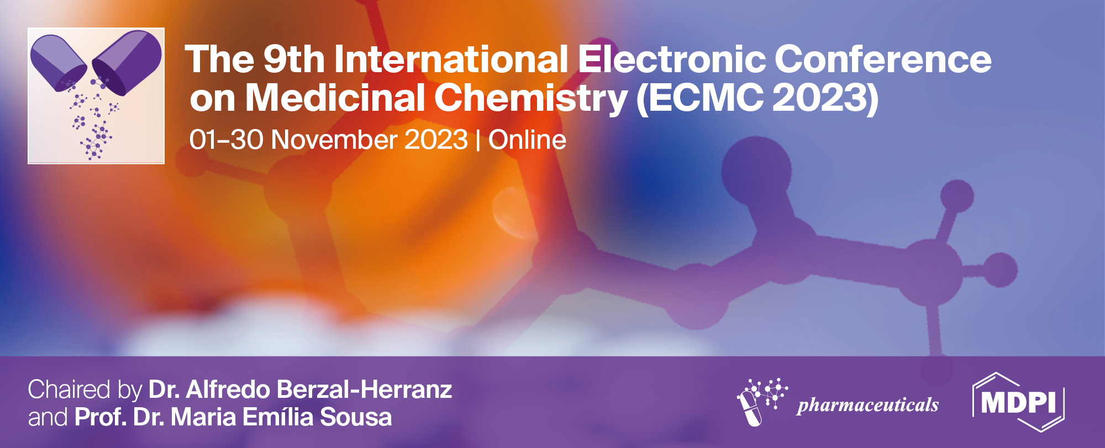
Bioavailability Amelioration of Zaleplon by developing self emulsifying drug delivery systems
Rajasekhar Reddy Poonuru^{1,}*, Sashidhar bagum²
^{1,2} Dept. of Pharmaceutics, St. Peter’s Institute of Pharmaceutical Sciences, Hanumakonda, Telangana, India, 506001
* Corresponding author: yuppieraj@gmail.com

Slide 2
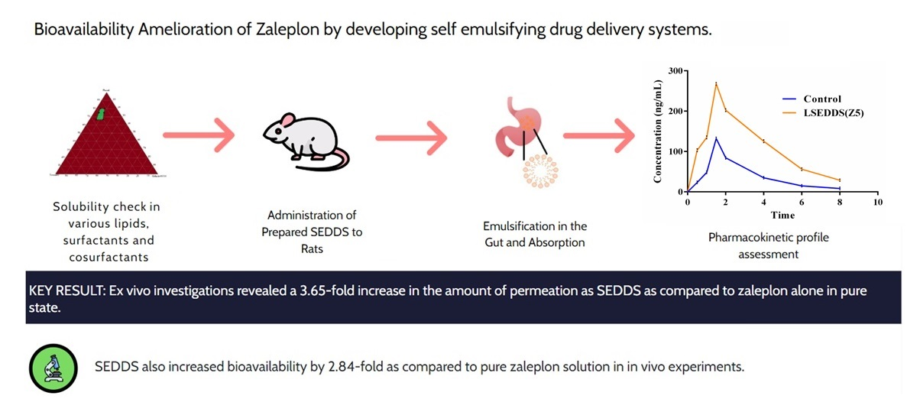
Bioavailability Amelioration of Zaleplon by developing self emulsifying drug delivery systems
Graphical Abstract

Slide 3
Abstract: The goal of the current study is to create zaleplon-loaded self-emulsifying drug delivery systems (SEDDS) utilising different ratios of the lipid, Phosal® 53 MCT, surfactant, Tween 80, and cosurfactant Gelucire 44/14. With a droplet size of 289 ± 5 nm and a charge of +13.9 ± 1.5 mV, the preparation consisting of Phosal, Tween 80, and Gelucire 44/14 at levels of 80%, 12%, and 8% correspondingly was shown to be thermodynamically stable. The optimised formulation's dispersion parameters, such as particle size, viscosity, and pH, were also tested. Diffusion experiments demonstrated that the majority of the medication is encapsulated in the emulsion, resulting in the greatest absorption capability. The better in vitro dissolving behaviour of zaleplon from SEDDS over control was found, indicating that SEDDS has a greater ability to hold zaleplon in soluble state. Ex vivo investigations revealed a 3.65-fold increase in the amount of permeation as SEDDS as compared to zaleplon alone in pure state. SEDDS also increased bioavailability by 2.84-fold as compared to pure zaleplon solution in in vivo experiments. The preceding SEDDS data demonstrate SEDDS's capabilities as acceptable carriers for enhancing zaleplon oral bioavailability.
Keywords:, Bioavailability; Gelucire 44/14; Phosal 53 MCT; Self emulsifying drug delivery systems; Zaleplon.

Slide 4
Introduction
Insomnia is the most frequent sleeping condition which can happen alone or in conjunction with any of the psychiatric illnesses. Benzodiazepines have been the standard therapy for insomnia due to their demonstrated safety and effectiveness research.
We are employing Zaleplon, a pyrazolopyrimidine medication that operates on the gamma aminobutyric acid type A (GABAA) receptors in the brain.
It belongs to a novel family of medications known as non-benzodiazepine hypnotics, often known as Z drugs.
Because of its limited water solubility and dissolving rate, zaleplon has a reported 30% bioavailability.
Zaleplon is presented as SEDDS in present investigation where an increased bioavailability was observed with use of novel lipid carriers that can tolerate dispersion, dilution, and digestion in the gastro-intestinal tract.

Slide 5
Results and discussion
Solubility studies
Formula | Lipid : S_{mix} | Surfactant: co-surfactant (S_{mix}) | Drug (mg) | Lipid (mg) | Surfactant (mg) | Co-surfactant (mg)
Z1 | 2:1 | 3:2 | 5 | 300 | 90 | 60
Z2 | 2:1 | 4:1 | 5 | 300 | 120 | 30
Z3 | 3:1 | 3:2 | 5 | 450 | 90 | 60
Z4 | 3:1 | 4:1 | 5 | 450 | 120 | 30
Z5 | 4:1 | 3:2 | 5 | 600 | 90 | 60
Z6 | 4:1 | 4:1 | 5 | 600 | 120 | 30
Table 1: Formulations of SEDDS with different ratios of lipid, surfactant, co surfactant and fixed amount of drug

Slide 6
Results and discussion
Assessment of self-emulsification time
The increase in lipid proportion was found to increase emulsification time, indicating that the increase in lipid proportion decreases the rate of emulsification, which may be responsible for the prolonged emulsification time.
Z1, Z2, Z3, Z4, Z5 and Z6 formulations showed emulsification times of 2min 43sec±1sec, 2min 52sec±3sec, 3min 7sec±1sec, 3min 16sec±4sec, 3min 23sec±3sec and 3min 52sec±2sec respectively.
Because the Z5 and Z6 formulations did not exhibit any drug aggregation, they were extended for further characterization.
Cloud point measurement
The cloud points of stable formulations Z5 and Z6 were found to be 72.6±3.42 and 68.1±4.056 respectively indicating the stability of these SEDDS formulations in the GIT temperature.

Slide 7
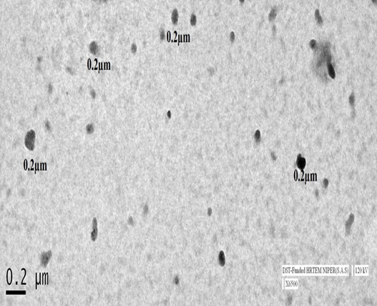
Results and discussion
Globule size and Zeta potential
When dispersed in SGF, the Z5 formulation exhibited a positive zeta potential with a poly-dispersibility index of 0.257±0.032, indicating a homogeneous dispersion.
The globule size was 289±5 nm and Zeta potential value was found to be +13.9±1.5 mV.
Figure 2: TEM images of globules from SEDDS (Z5)
Dispersion properties (Viscosity, Particle size and pH)
The dispersion properties of the Z5 formulation were within acceptable ranges exhibiting a particle size of 2.5±0.3 µm, viscosity of 594±5 cPs and a pH of 6.15 ± 0.09.

Slide 8
Results and discussion
The drug release rate from SEDDS was 83.57±3.4 % in 1 hour, which was significantly higher than the control (36.84±2.3%) (p<0.001).
When zaleplon was formulated into SEDDS, its dissolution efficiency improved, as shown in Tables 2. (P<0.001).
Formulation | Q₁₅ (%) | Q₆₀ (%) | DE (%) | MDT (min) | MDR
Control | 22.20±2.7 | 36.84±2.3 | 25.13±1.7 | 34.76±1.1 | 0.59±0.08
Z5 | 44.73±2.2 | 83.57±3.4٭٭٭ | 55.3±2.1٭٭٭ | 28.60±1.3 | 1.23±0.09
Table 2: Dissolution parameters of zaleplon from SEDDS in SGF (pH1.2) (mean ± SD; n=3).
*** indicates significant difference at p<0.001 against control

Slide 9
Results and discussion
In vitro drug release of pure zaleplon was found to be 54.72% after 24 hours, while Formulation Z5 showed 28.89% after 24 hours.
Drug release from SEDDS was lower, indicating maximum drug encapsulation within the formed globules, which leads to complete absorption of the formulation.

Slide 10
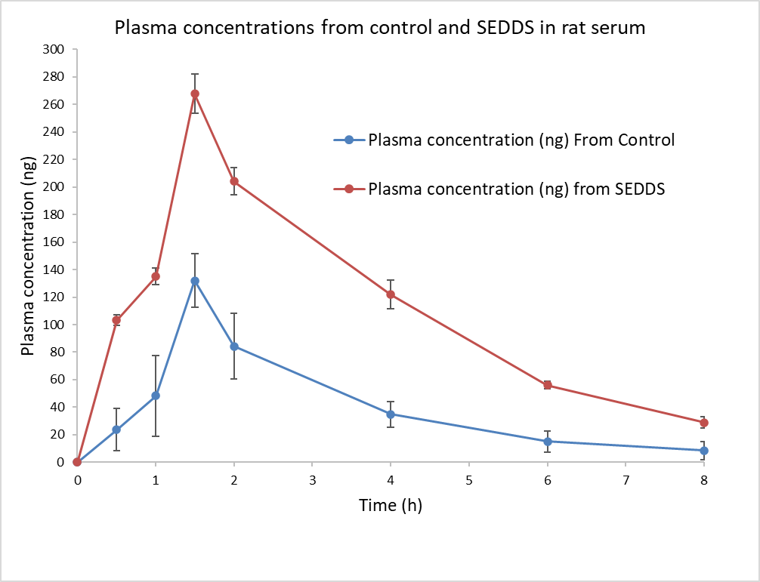
Results and discussion
The effective permeability coefficient in rats (Peffrat) of the control and SEDDS were 7.11 x10⁻⁴ and 25.98 x10⁻⁴ cm/sec, respectively, and the enhancement ratio (ER) was 3.65.
This could be due to the possibility of SEDDS reusing the gastrointestinal tract's barrier properties, favouring transport across the GIT via a variety of mechanisms.
Tween 80 has the ability to modulate membrane fluidity and enhance permeation enhancers, which were even reflected in the obtained results
Formulation | Pharmacokinetic Parameters
 | C_{max} (ng/ml) | T_{max} (h) | T_{1/2} (h) | AUC_{0-∞} (ng h ml⁻¹) | MRT_{0-∞} (h) | F
Control | 132.02±17.46 | 1.5±0.0 | 1.78±0.21 | 315.27±30.56 | 2.74±0.17 | -
SEDDS | 267.74±23.54٭٭ | 1.5±0.0 | 1.88±0.12 | 897.99±42.13٭٭٭ | 3.01±0.25 | 2.84±0.36
Table 3: Pharmacokinetic parameters of zaleplon in rat serum following oral administration of SEDDS and control oral suspension (mean ± SD, n=3). MRT- Mean residence time; AUC - Area under the curve and F- Relative bioavailability ٭٭- and٭٭٭ indicates significant difference at p<0.01and p<0.001 respectively against control

Slide 11
Conclusions
Zaleplon-loaded SEDDS were created by optimizing the concentrations of tween 80, Gelucire 44/14, and Phosal® 53 MCT, yielding stable emulsions at a 1:4 Smix: lipid ratio.
Z5 was found to contain a homogenous distribution of 289 nm spherical particles.
There was no indication of phase separation after 24 hours, indicating that these formulations were more stable.
The optimized formulation had the lowest invitro drug release compared to the pure drug, indicating that the majority of the medicine was encapsulated in the emulsion.
Ex vivo permeation tests revealed that SEDDS had a 3.65-fold higher Peff value than pure medicine.
The FT-IR spectra indicated that no chemical reactions occurred. NMR spectra confirmed this much further.
When compared to the control, the bioavailability of SEDDS (Z5) formulation was increased 2.84 times, indicating that SEDDS have the potential to be regarded as a viable formulation providing improved efficiency and stability.

Slide 12
Acknowledgments
We thank the management of St. Peter’s Institute of Pharmaceutical Sciences for providing the platform for the research to be executed with all the laboratory support and supplies.
References
[1] G. Editorial, Guest Editorial Issues and challenges in implementing clinical practice guideline for the management of chronic insomnia, J Sleep Res. 26 (2017) 673–674. https://doi.org/10.1111/jsr.12639.
[2] A. Castelnovo, B. Graziano, F. Ferrarelli, A. D'Agostino. Sleep spindles and slow waves in schizophrenia and related disorders: main findings, challenges and future perspectives, Eur J Neurosci. 48 (2018) 2738-2758. https://doi.org/10.1111/ejn.13815
[3] A.B. Hassinger, N. Bletnisky, R. Dudekula, A.A. El-solh, A.B. Hassinger, N. Bletnisky, R. Dudekula, A.A. El-solh, Expert Opinion on Pharmacotherapy Selecting a pharmacotherapy regimen for patients with chronic insomnia, Expert Opin. Pharmacother. 00 (2020) 1–9. https://doi.org/10.1080/14656566.2020.1743265.
Thank you

