Slide 1
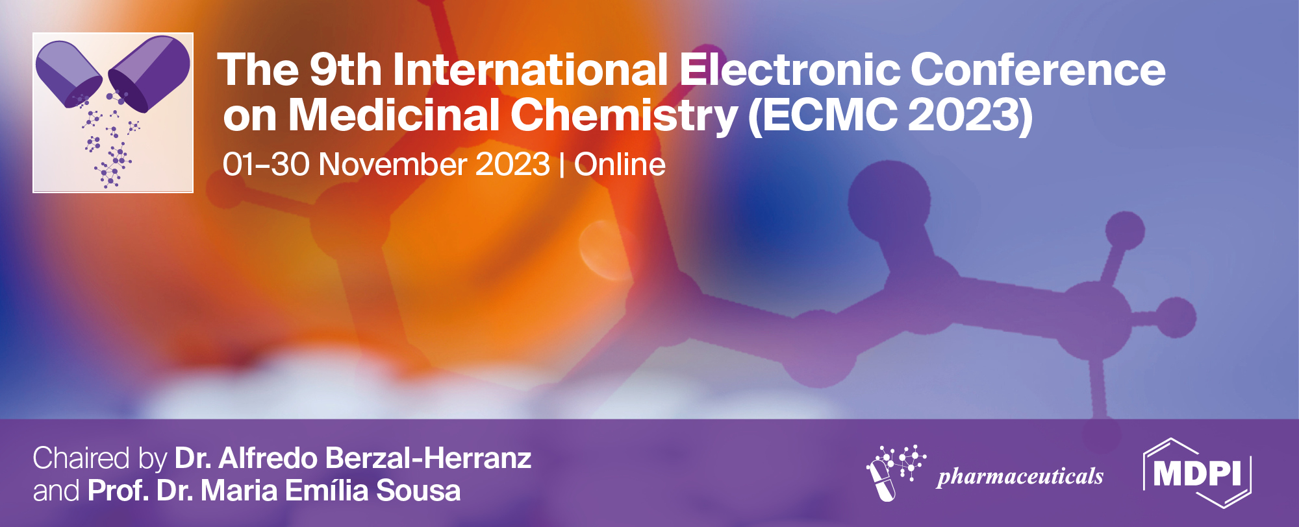

In vitro antigenotoxicity of novel heterometallic dinuclear complexes
Majda Kolenović Serezlić ¹, Sanja Lj. Matić ², Biljana Šmit ² , and Tanja Soldatović ^{1,}*
¹ Department of Natural-Mathematical Sciences, State University of Novi Pazar, Vuka Karadžića 9, 36300 Novi Pazar, Serbia;
² Department of Science, Institute for Information Technologies Kragujevac, University of Kragujevac, Jovana Cvijića bb, 34000 Kragujevac, Serbia.
* Corresponding author: tsoldatovic@np.ac.rs

Slide 2
In vitro antigenotoxicity of novel heterometallic dinuclear complexes
.OH
.OOH

Slide 3
Abstract: Four novel dinuclear complexes, derived from mononuclear [ZnCl(terpy-Cl)], [{cis-PtCl(NH₃)₂(μ-4,4′-bipyridyl)ZnCl(terpy-Cl)}](ClO₄)₂, [{trans-PtCl(NH₃)₂(μ-4,4′-bipyridyl)ZnCl(terpy-Cl)}](ClO₄)₂, [{cis-PtCl(NH₃)₂(μ-pyrazine)ZnCl-(terpy-Cl)}]-(ClO₄)₂ and [{trans-PtCl(NH₃)₂(μ-pyrazine)ZnCl(terpy-Cl)}](ClO₄)₂, (where terpy-Cl = 4’-chloro-2,2′:6′,2′′-terpyridine) were synthesized and characterized. The possible DNA-protective effects of these complexes at different concentrations against hydroxyl and peroxyl radicals-induced DNA damage were determined using two in vitro antioxidant assays. All complexes showed the significant DNA-protective effects at the concentrations tested, indicating scavenging activity on hydroxyl and peroxyl radicals generated by FeSO₄, H₂O₂, and AAPH. The presence of the chloride in the structure of newly synthesized complexes increase the electronic density on Zn center and, thus, decrease its nucleophilicity, which could be an explanation of their behavior. This data could be useful for further in vitro and in vivo biological evaluations of these antioxidative compounds
Keywords: cisplatin; Zn(II) complexes; terpy ligand; DNA protective potential

Slide 4
Introduction
Design of novel heteronuclear platinum(II)-zinc(II) complexes has potential as metal-based anticancer agents. The complexes of these two metal ions have different coordination geometry, affinity and reactivity as well as biological activities. These two metals have different Lewis acidity causing dissimilar reactivity of such complexes which result in various coordination modes of biomolecules and thus have influence on their biological activities.

Slide 5
Experimenatal
Synthesis of trans- or cis-Pt(II)-Zn(II) complexes.

Slide 6
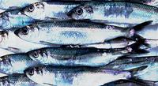
The ability of novel complexes to protect DNA in concentrations of 25, 50, 100, 200, and 400 μg/mL against hydroxyl and peroxyl radicals induced damage was estimated in vitro using deoxyribonucleic acid from herring sperm (Sigma Aldrich, St Louis, MO, USA). In both assays, quercetin (100 μg/mL) was used as a standard drug
The level of DNA protection was assessed by determining the relative electrophoretic band densities of the tested compounds compared to negative and positive controls.

Slide 7
Results and discussion
Four new dinuclear complexes of general formula Pt(II)-L-Zn(II) are sinthezised from trans- or cisplatin and parent mononuclear [ZnCl₂(terpy-Cl)] complex (where terpy-Cl = 4’-chloro-2,2′:6′,2′′-terpyridine, and L = bridging ligand, 4,4’-bipyridyl or pyrazine).
Structure of mononuclear [ZnCl₂(terpy-Cl)] complex

Slide 8
[{cis-PtCl(NH₃)₂(μ-4,4′-bipyridyl)ZnCl(terpy-Cl)}](ClO₄)
C1
[{trans-PtCl(NH₃)₂(μ-4,4′-bipyridyl)ZnCl(terpy-Cl)}](ClO₄)
C2
Structures of the investigated dinuclear cis- and trans-platinum(II)-zinc(II) complexes with adopted abbreviations.

Slide 9
[{cis-PtCl(NH₃)₂(μ-pyrazine)ZnCl(terpy-Cl)}](ClO₄)
C3
[{trans-PtCl(NH₃)₂(μ-pyrazine)ZnCl(terpy-Cl)}](ClO₄)
C4
Structures of the investigated dinuclear cis- and trans-platinum(II)-zinc(II) complexes with adopted abbreviations.

Slide 10
[ZnCl₂(terpy-Cl)]
C2
The DNA protective potential of [ZnCl₂(terpy-Cl)], C1 and C2 complexes against hydroxyl and peroxyl radicals-induced DNA damage
DNA from herring sperm (1, negative control), DNA damage control (2, positive control), quercetin (3, 100 μg/mL, standard).
Novel complexes at the concentrations of 25, 50, 100, 200, and 400 μg/mL (4-8).
*p < 0.05 when compared with the negative control group; †p < 0.05 when compared with the positive control group.
C1

Slide 11
Results and discussion
The DNA protective activity of [ZnCl₂(terpy-Cl)] against DNA damage induced by both radicals was dose-dependent, increasing with higher concentrations.
The complex C1 show significant DNA protective activity against DNA damage at low concentrations, whereas the complex C2 at high concentrations had a weaker scavenging activity on peroxyl radicals.
The complex C3 showed effective reduction in the DNA damage induced by both radicals at low concentrations, while the significant DNA protective potential against peroxyl radical was obtained for the complex C4.

Slide 12
C3
C4
The DNA protective potential of C3 and C4 complexes against hydroxyl and peroxyl radicals-induced DNA damage
DNA from herring sperm (1, negative control), DNA damage control (2, positive control), quercetin (3, 100 μg/mL, standard).
Novel complexes at the concentrations of 25, 50, 100, 200, and 400 μg/mL (4-8).
*p < 0.05 when compared with the negative control group; †p < 0.05 when compared with the positive control group.

Slide 13
Conclusions
The significant DNA protective potential was obtained for the tested complexes. The presence of the chloride in the structure terpyridine ligand increase the electronic density on Zn center and, thus, decrease its nucleophilicity, which could be an explanation of their behavior. This data could be useful for further in vitro and in vivo biological evaluations of these antioxidative compounds.

Slide 14
Acknowledgments
The authors gratefully acknowledge financial support from the Ministry of Science, Technological Development and Innovation of the Republic of Serbia (Agreement No. 451-03-47/2023-01/200378 and 451-03-47/2023-01/200252).

