Slide 1
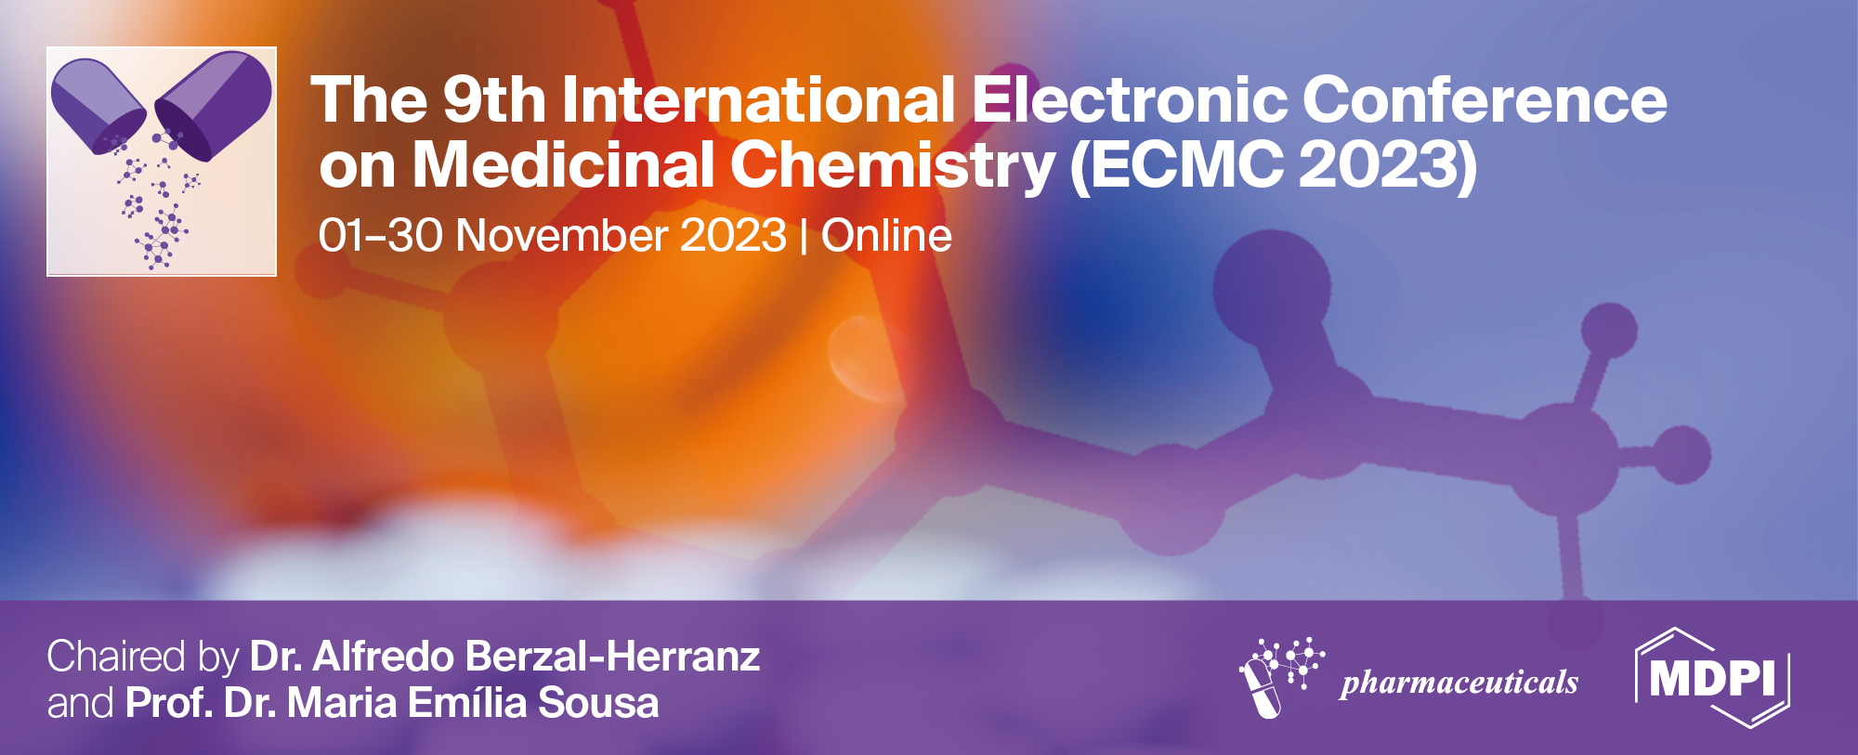
Inhibition of Tumor-Promoting Effects of Nicotine by the Sesquiterpene Lactone Parthenolide in Lung Cancer
Wamidh Talib ^{1,}*, and Lina Al Kury ^{2,}*
¹ Faculty of Allied Medical Sciences, Applied Science Private University, Amman 11931-166, Jordan. ² Department of Health Sciences, College of Natural and Health Sciences, Zayed University, P.O. Box 144534, Abu Dhabi, United Arab Emirates.
Corresponding author: w_talib@asu.edu.jo; lina.alkury@zu.ac.ae
Notes:
(w_talib@asu.edu.jo) * 1
Lina Al Kury (lina.alkury@zu.ac.ae) * 2
¹ Faculty of Allied Medical Sciences, Applied Science Private University, Amman 11931-166, Jordan ² Department of Health Sciences, College of Natural and Health Sciences, Zayed University, Abu Dhabi

Slide 2
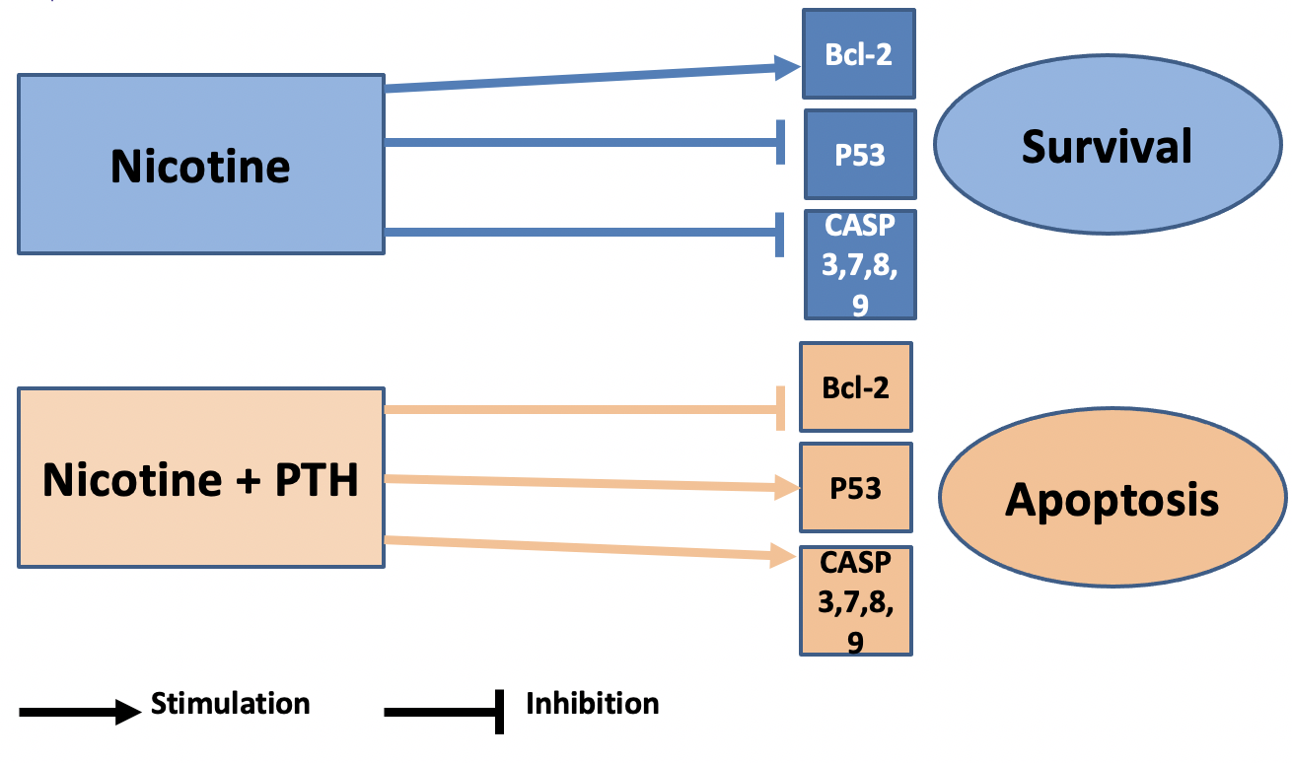
Inhibition of Tumor-Promoting Effects of Nicotine by the Sesquiterpene Lactone Parthenolide in Lung Cancer

Slide 3
Abstract:
The connection between cigarette smoking and the development of non-small cell lung cancer is widely recognized. Nicotine, the active component in cigarettes, has direct effects that include promoting cell growth, inducing angiogenesis, and preventing apoptosis. This study investigated the potential of Parthenolide (PTH), a sesquiterpene lactone known for its anti-cancer properties, to counteract the proliferative impact of nicotine on lung cancer cell lines. To assess this, MTT assays were conducted to examine cell survival in A549 and H526 cells exposed to nicotine, PTH, or a combination of both. The study also evaluated angiogenesis inhibition and apoptotic effect of PTH using a VEGF detection kit and caspase-3 activity test, respectively. The results revealed that PTH inhibited lung cancer cells in a concentration-dependent manner and mitigated nicotine-induced proliferation. Caspase-3 activity and VEGF assays provided evidence of PTH's pro-apoptotic and angiogenesis inhibiting effects. Real-time PCR analysis demonstrated that PTH downregulated the expression of Bcl-2 and upregulated the expression of E2F1, P53, GADD45, BAX, BIM, and CASP 3, 7, 8, 9, indicating the activation of the P53-dependent apoptotic pathway. Notably, the activity of this pathway continued even in the presence of nicotine, suggesting PTH's ability to counteract nicotine's anti-apoptotic effects. These findings illustrate that PTH effectively inhibits nicotine-induced proliferation in lung cancer and exerts its anti-cancer effects through angiogenesis inhibition and activation of the P53-dependent apoptotic pathway. PTH emerges as a promising natural product for remedying nicotine-associated lung cancer, although further research is required to fully understand its mechanism of action.
Keywords: Apoptosis; Lung cancer; Natural products; Parthenolide; P53.

Slide 4
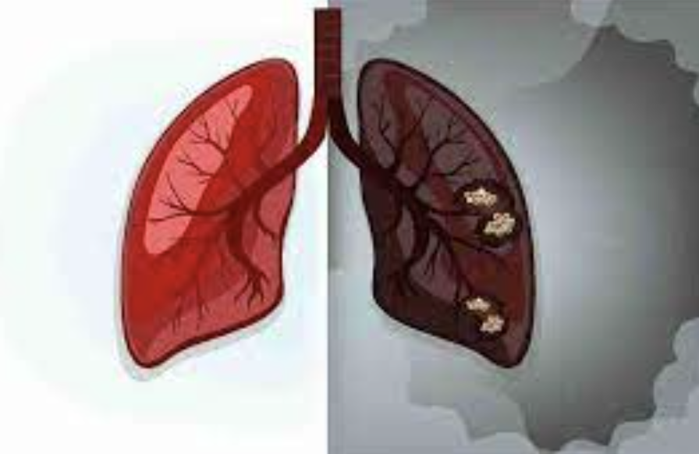
Introduction
Nicotine is the principal addictive component of cigarettes and contributes directly to lung carcinogenesis
Nicotine enhances proliferation, angiogenesis induction, and resistance to apoptosis.

Slide 5
Nicotine
Proliferation
Angiogenesis
Growth Factors & Receptors
Hypoxia-inducible factor-1a (HIF-1α)
VEGF
HGF
VEGF-C
TGF-β
PDGF
TGF-α
VEGFR-2
HGFR
EGFR

Slide 6
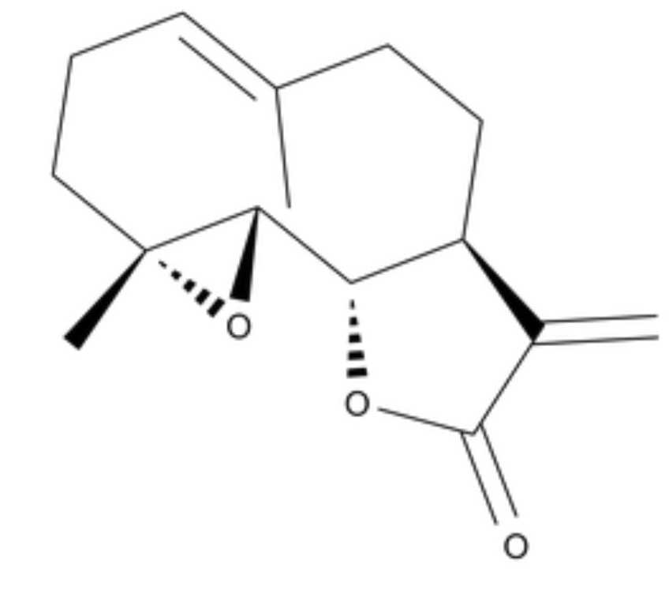
Parthenolide (PTH)
Sesquiterpene lactone
Tanacetum parthenium
(Feverfew)
Biological effects
Anti-inflammatory
Antioxidant
Antitumor

Slide 7
The therapeutic effect of PTH in presence of cancer promoting agents (e.g., nicotine) is unknown.

Slide 8
Aim of the study:
To explore how PTH hinders the proliferative impact of nicotine in both small and non-small cell lung adenocarcinoma.

Slide 9
Results and Discussion

Slide 10
1. Inhibition of lung cancer cells by PTH in the presence and absence of nicotine
A549 cells
H526 cells
Fig. 1. Antiproliferative effect of PTH, nicotine, and their combination on the survival
of A549 cells (left) and H526 cells (right).

Slide 11
2. PTH-induced apoptosis in lung cancer cells by augmenting capsase-3 activity
A549 cells
Fig. 2. Caspase- 3 activity in A549 cells after treatment with PTH, nicotine, and doxorubicin.

Slide 12
3. PTH-induced inhibition of angiogenesis in lung cancer cells
Fig. 3. Vascular Endothelial Growth factor (VEGF) in A549 cells levels after treatment with PTH, nicotine, and doxorubicin.

Slide 13
4. PTH induces P53 mediated caspase-dependent apoptosis
Fig. 4. Relative RNA expression of target genes in A549 cells treated for 48 h with PTH (50 μM), nicotine (100 nM), and their combination.

Slide 14
Fig. 5. Relative RNA expression of target genes in H526 cells treated for 48 h with PTH (50 μM), nicotine (100 nM), and their combination.

Slide 15
PTH inhibited cell proliferation and induced apoptosis in A549 and H526 cells through activation of P53-mediated caspase-dependent apoptosis and inhibition of angiogenesis.
PTH altered the proliferation promoting effect of nicotine by up-regulating proapoptotic and down-regulating antiapoptotic members in P53-mediated apoptotic mechanism.

Slide 16
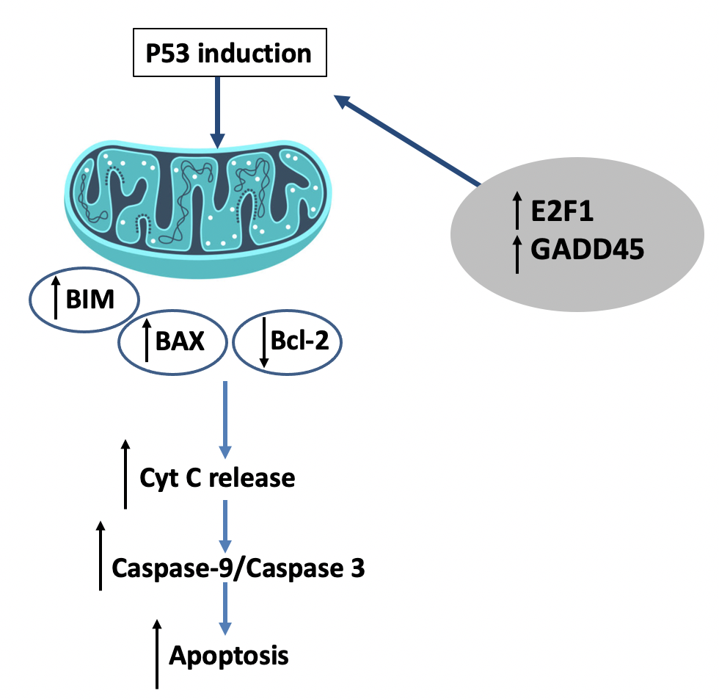

Slide 17
Conclusions
PTH demonstrates its ability to efficiently inhibit the proliferation induced by nicotine in lung cancer. It achieves its anti-cancer effects by inhibiting angiogenesis and triggering the P53-dependent apoptotic pathway. Consequently, PTH emerges as a potential natural solution for inhibiting and treating nicotine-related lung cancer, though more research is required to comprehensively understand its mechanisms of action.

Slide 18
Acknowledgments
The authors extend their appreciation to the Applied Science Private University in Amman, Jordan, and Zayed University in Abu Dhabi, United Arab Emirates, for their generous financial support provided for this research project.

