Slide 1
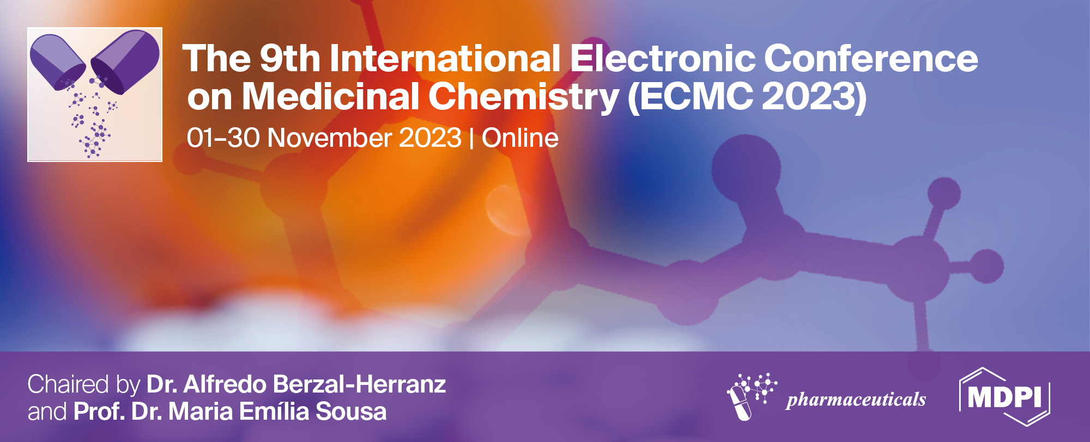
Coaxial wet-spun fibers loaded with essential oils for the treatment of chronic wounds
Catarina S. Miranda¹, Elina Marinho¹, Susana P. G. Costa², Natália C. Homem³ and Helena P. Felgueiras^{1,}*
¹Centre for Textile Science and Technology (2C2T), University of Minho, Guimarães, Portugal;
²Centre of Chemistry (CQ), University of Minho, Braga, Portugal;
³ Simoldes Plastics S.A., Oliveira de Azeméis, Portugal.
* Corresponding author: helena.felgueiras@2c2t.uminho.pt

Slide 2
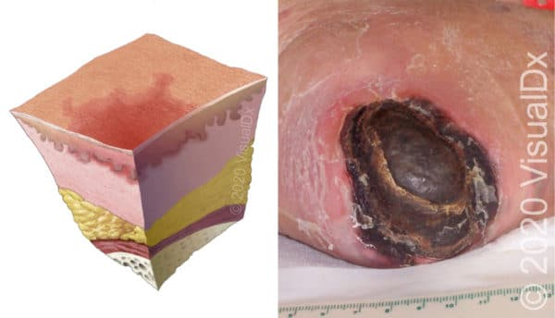
Motivation
Chronic wounds (CWs)
Wounds that have failed to progress by an appropriate period of time of repair.
Increased resistance
to antibiotics
High
prevalence
Great impact on patients’ health and quality of life
It is estimated that 1% of the developed countries population will experience a CW during their lifetime, related with bacterial infections.
Järbrink, K. et al. (2016) Car Syst. Rev. 5, 1–6

Slide 3
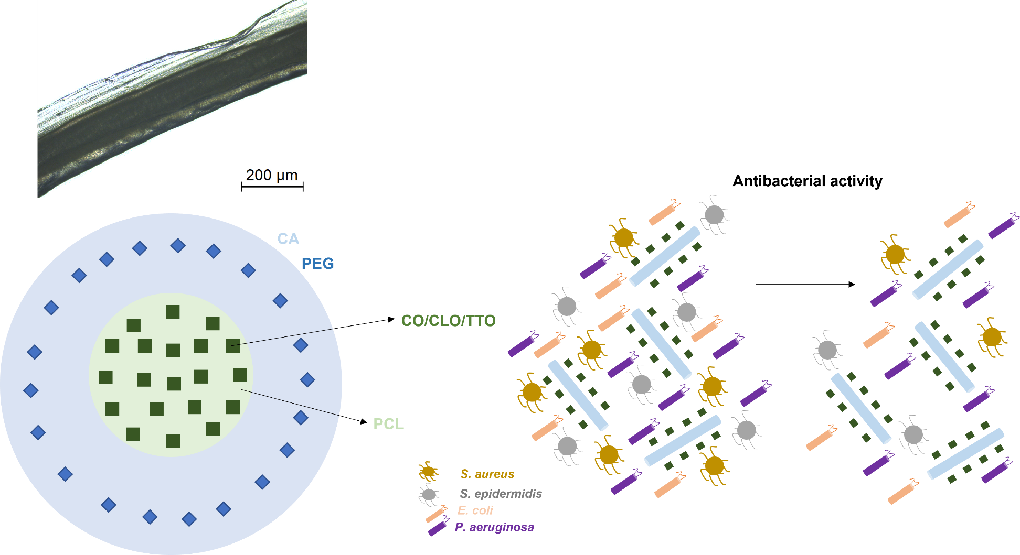
Coaxial wet-spun fibers loaded with essential oils for the treatment of chronic wounds

Slide 4
Abstract: Chronic wounds (CWs) are frequently associated with bacterial infections. The development of antibiotic-resistant microorganisms makes it crucial to think of alternative solutions. Considering these issues, a drug delivery system made of coaxial wet-spun fibers loaded with essential oils (EOs) was proposed. Coaxial structures were produced using the wet-spinning technique, in which 10% w/v polycaprolactone (PCL, a synthetic polymer with excellent mechanical properties and elastic behavior) was used to produce the core and loaded with three EOs, Clove Oil (CO), Cinnamon Leaf Oil (CLO) and Tea Tree Oil (TTO) at 2×Minimum Bactericidal Concentration (MBC). The shell was made of a blend of 10% w/v cellulose acetate (CA, a natural polymer which has been reported to offer good structural integrity) and 10% w/v polyethylene glycol (PEG, a synthetic polymer often used as a plasticizer), mixed at a ratio of 90/10 v/v, respectively, so pores could be opened in the outer layer, allowing for a sustained release of the EOs loaded at the fibers’ core overtime. The formation of coaxial structures was confirmed by Brightfield Microscopy. Coaxial fibers exhibited high maximum elongations at break (≈350%). EO-loaded fibers were effective against S. aureus, S. epidermidis, E. coli and P. aeruginosa, the most common bacteria present in CWs. Results confirmed the potential of the engineered coaxial wet-spun fibers for wound healing applications. Still, further characterization on the fibers is necessary, including cytocompatibility tests to assure non-toxic profiles of the fibers when in contact with fibroblasts and keratinocytes.
Keywords: antimicrobial effectiveness; core-shell fibers; therapeutic natural extracts.

Slide 5
Essential Oils (EOs)
Strong anti-inflammatory and analgesic properties
Strong anti-oxidant properties
Antimicrobial properties
Mixtures of aromatic, volatile, lipophilic biomolecules extracted from several regions of plants
Low stability in physiological media
Incorporation in polymeric structures
Felgueiras, H. P. et al. Biomolecules (2020). https://doi.org/10.3390/biom10081129

Slide 6
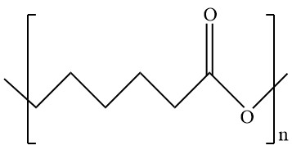
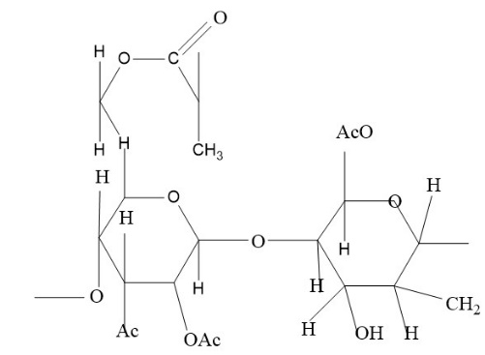
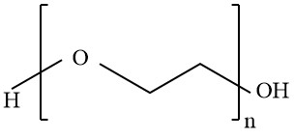
Polymers
Polycaprolactone (PCL)
Cellulose acetate (CA)
Polyethylene glycol (PEG)
Synthetic polymer;
Excellent mechanical properties;
Slow degradation rate.
Synthetic polymer;
Hydrophylic;
Plasticizer.
Very abundant and renewable biopolymer;
Good mechanical stability;
Promoter of cell adhesion and growth.
Plotczyk, M. et al. Elsevier. 1 (2019)
Eskandarinia, A. et al. Scientific Reports. (2020)
Halib, N. et al. (2017) Materials (Basel). 10; Rahmani Del Bakhshayesh et al. (2018) Artif. Cells, Nanomedicine Biotechnol. 46

Slide 7
Wet-spinning
Technique based on a non-solvent-induced phase inversion process, in which a polymeric solution is extruded into a coagulation bath composed of a poor solvent or a non-solvent, giving rise to a continuous polymeric fiber, with a diameter of tens to hundreds of micrometers.
Miranda, C. et al. Pharmaceutics, 2022, 14. 164

Slide 8
Coaxial spinneret
Core-sheath fibers
Sheath
Core
Hollow fibers
Two polymer solutions are injected together into a co-axial spinneret and co-extruded towards a coagulation bath, generating a core-shell structure. In case of hollow fibers, air or coagulation bath is introduced through the innermost port.
Sheath
Hollow interior
Mirabedini, A. (2017). A thesis submitted in the fulfilment of the. 1–235.
Gao, L., Zhou, Y., Peng, J., Xu, C., Xu, Q., Xing, M., & Chang, J. (2019). NPG Asia Materials, 11(1), 66.
McKeen, L. W. (2012). Permeability Properties of Plastics and Elastomers, 59–75.

Slide 9
Goal
Engineer Essential Oil (EOs)- loaded microfibers via wet-spinning for bacteria inhibition.

Slide 10
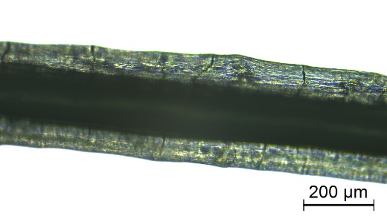
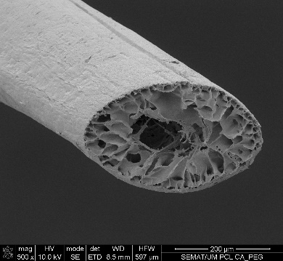
Coaxial fibers
Cellulose acetate
CA
Clove oil/Cinnamon leaf oil/
Tea Tree Oil
CO/CLO/TTO
Produced fibers:
CA hollow (core: coagulation bath; shell: CA);
CA-PEG hollow (core: coagulation bath; shell: CA combined
with PEG);
PCL (core: PCL; shell: coagulation bath);
PCL-CO/CLO/TTO (core: PCL combined with CO/CLO/TTO; shell: coagulation
bath);
PCL-CA (core: PCL; shell: CA);
PCL-CO/CLO/TTO-CA (core: PCL combined with CO/CLO/TTO; shell: CA);
PCL-CA-PEG (core: PCL; shell: CA combined with PEG);
PCL-CO/CLO/TTO-CA-PEG (core: PCL combined with CO/CLO/TTO; shell: CA combined with PEG).
Schematic Representation
Polycaprolactone
PCL
Polyethylene glycol
PEG
Microscopical Observations

Slide 11
Mechanical Testing
- Determination of fibers’ maximum elongations at break and breaking strengths
Fiber typology | Maximum elongations at break (%)
PCL | 337.50 ± 34.26
PCL-CO | 338.95 ± 28.58
PCL-CLO | 342.32 ± 20.12
PCL-TTO | 323.62 ± 36.92
PCL-CA | 358.97 ± 14.69
PCL-CA-PEG | 333.02 ± 32.50
PCL-CO-CA | 343.52 ± 30.97
PCL-CLO-CA | 341.78 ± 1.30
PCL-TTO-CA | 315.21 ± 67.64
PCL-CO-CA-PEG | 360.16 ± 0.36
PCL-CLO-CA-PEG | 349.61 ± 17.32
PCL-TTO-CA-PEG | 328.08 ± 35.79
All wet-spun fibers showed elongations at break superior to 300% (presence of PCL, a polymer endowed with excellent elastic properties).

Slide 12
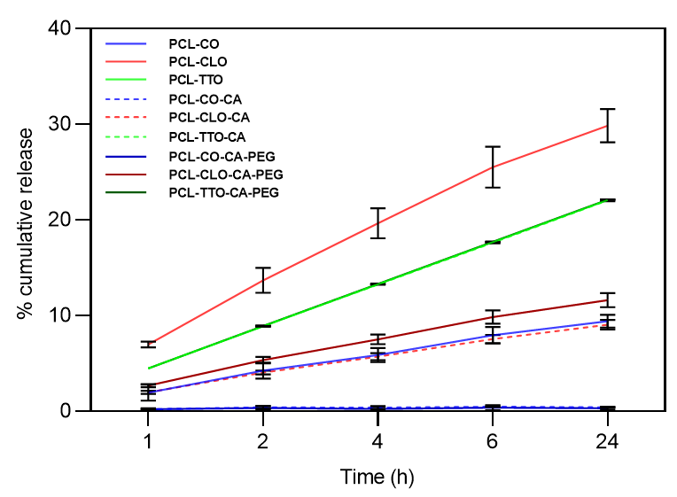
EOs Release Kinetics
The release kinetics of CO, CLO and TTO was mapped after 1, 2, 4, 6 and 24 h of incubation from all
wet-spun fibers in PBS at 37 ºC and pH 7.4
Release rates from monolayer fibers were superior to the coaxial (the shell main function in the coaxial fibers was to work as a barrier, restricting the liberation of the EOs entrapped at the fibers’ core);
CLO-containing fibers experienced the highest release kinetics.

Slide 13
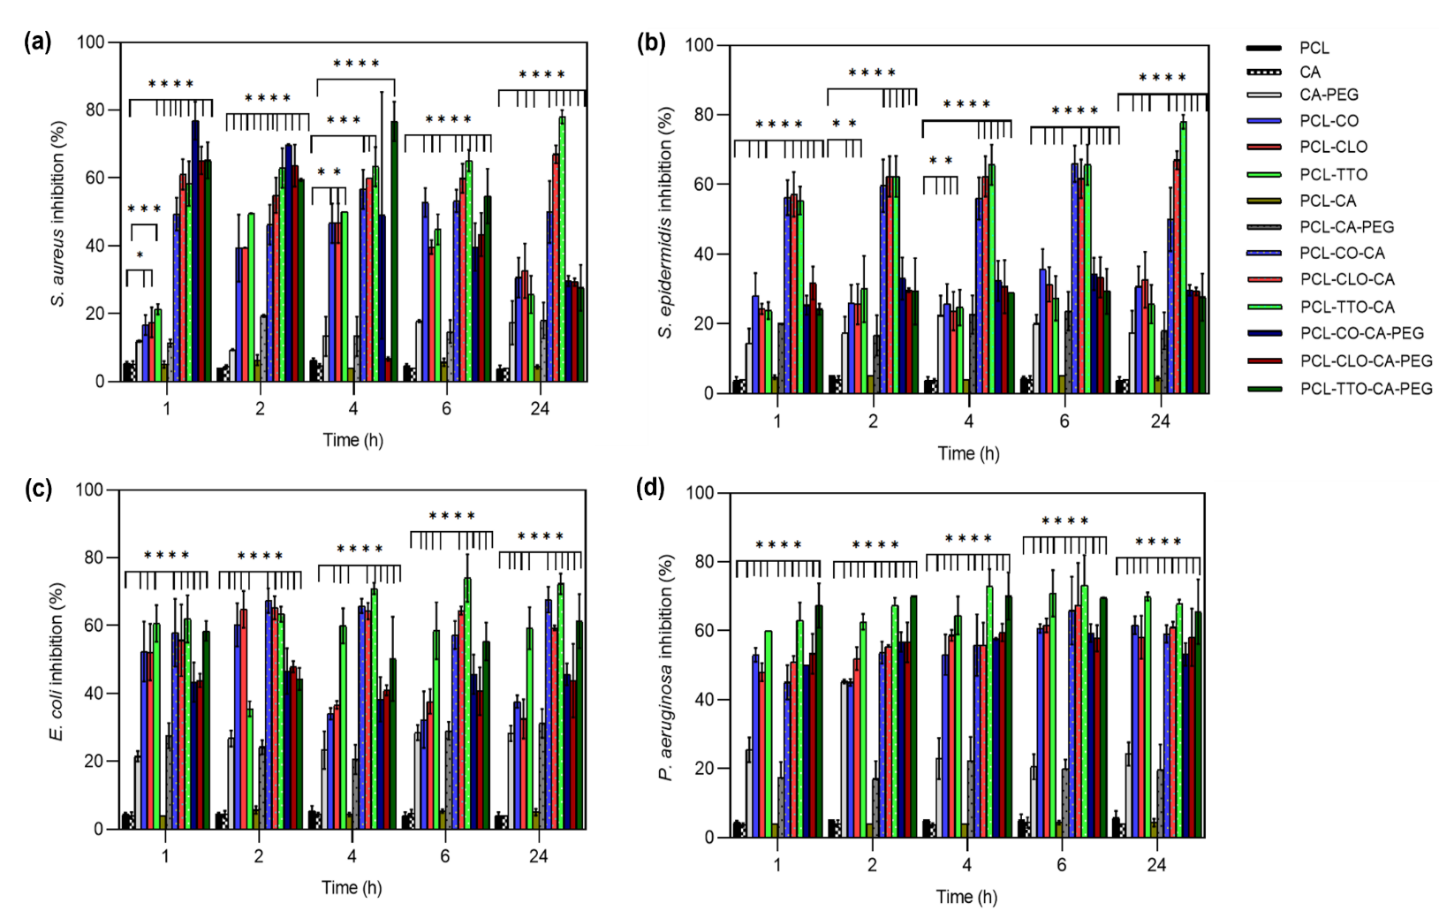
Bacteria Inhibition
The growth inhibition of Staphylococcus aureus, Staphylococcus epidermidis, Escherichia coli and Pseudomonas aeruginosa
induced by EO-loaded and unloaded fibers was assessed after 1, 2, 4, 6 and 24 h of incubation in MHB at 37 ºC.
EOs-loaded fibers were the most antibacterial from the group.

Slide 14
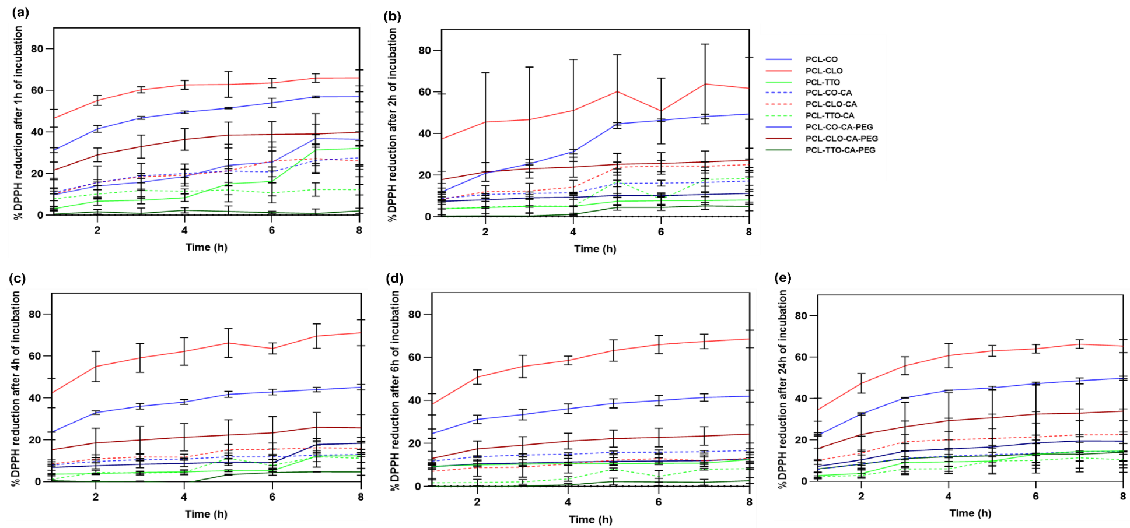
Antioxidant activity
*DPPH radical scavenging activity assay was applied to evaluate the antioxidant activity of EO-loaded fibers. Samples were
immersed in absolute ethanol during 1, 2, 4, 6 and 24 h and their antioxidant properties were monitored continuously during 8 h
(absorbances red at 515 nm).
CLO-loaded fibers presented the
highest antioxidant activities.
*DPPH - 1,1-diphenyl- 2 picrylhydrazy

Slide 15
Conclusions
The potential of the engineered coaxial fibers to serve as controlled release platforms for EOs was demonstrated.
The EOs antibacterial activities against S. aureus, S. epidermidis, E. coli and P. aeruginosa were also established.
Data confirmed the potential of this system to function as a multi-action delivery platform, suitable for prospective wound healing applications.

Slide 16
Acknowledgments

