Slide 1
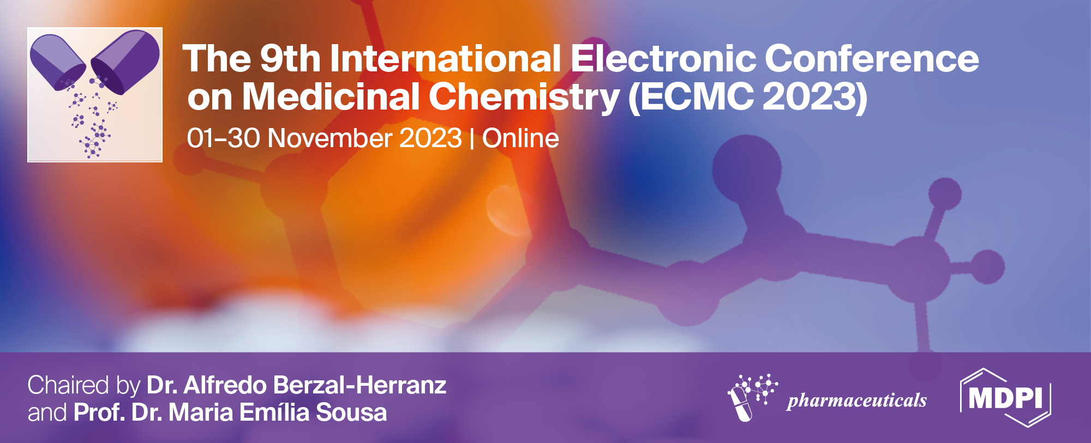
Title of the Presentation
Omoboyowa Damilola Alex^{1,}*, and Bodun Damilola Samuel ¹
¹ Phyto-medicine and Computational Biology Lab, Department of Biochemistry, Adekunle Ajasin University, Nigeria;
* Corresponding author: damilola.omoboyowa@aaua.edu.ngl

Slide 2
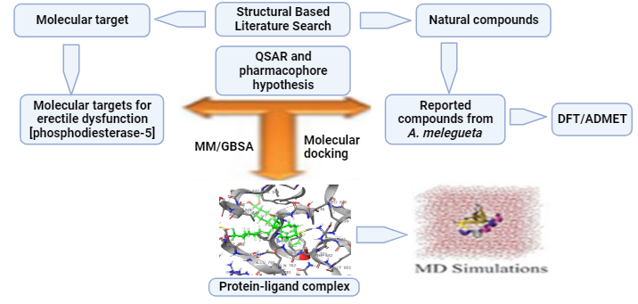
Computational Analysis of Phosphodiesterase-5 antagonists from Aframomum melegueta against Erectile Dysfunction

Slide 3
Abstract
Erectile dysfunction is a condition of insufficient ability of man to maintain erection for sexual performance.
Active molecules from Aframomum melegueta were docked against the target via maestro suite, 2017-1. The hit molecules in comparison with sildenafil were validated by MD-simulation at 100 ns with Desmond tool.
The result of this study revealed nine (9) hit molecules as potent antagonists of PDE-5 with 1,7-bis(3,4-dihyroxy-5-methoxyphenyl)heptane-3,5-diyldiacetate (-11.522 kcal/mol) having the best binding affinity comparable with standard drug (sildenafil = -11.872 Kcal/mol).
The result of the QSAR and pharmacophore models validation confirmed the hit molecules as inhibitors of the target with pIC50 range of 3.835 to 7.976 µM and fitness score of 0.754 to 2.605 respectively.
The hit molecules obeyed Lipinski’s rule of five with good pharmacokinetic profile. The stability of the hit molecule complex with PDE-5 was confirmed by MD-simulation analysis which was comparable with sildenafil-PDE-5 complex.
Overall, this study predicted phytochemicals from A. melegueta as inhibitors of PDE-5 for further experimentally validation for erectile dysfunction management.
Keywords: Sildenafil; Erection; Schrodinger; Phosphodiesterase-5; Inhibitors

Slide 4
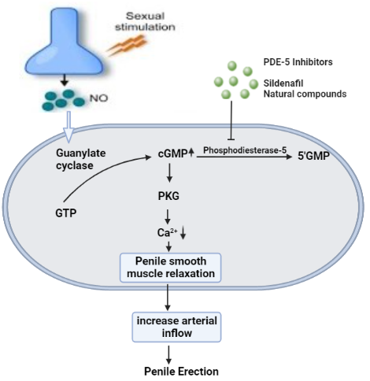
Introduction
Fig. 1: Signaling mechanism of erectile process with inhibitors

Slide 5
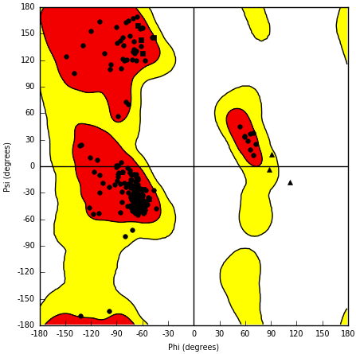
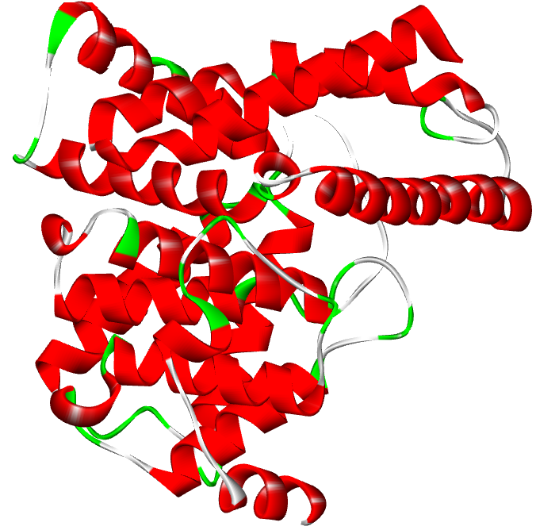
Results and discussion
Fig. 2: Crystal structure of PDE-5 and Ramachandran plot of residues distribution

Slide 6
Figure 3: Superimposition of sildenafil at the active site of PDE-5

Slide 7
Fig. 4: Binding affinity and Binding Energies of the hit compound
Fig. 5: presentation of extra precision binding of all hit compounds

Slide 8
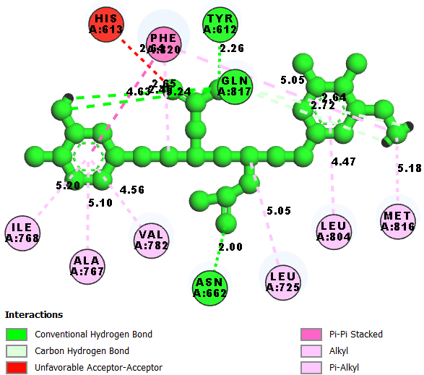
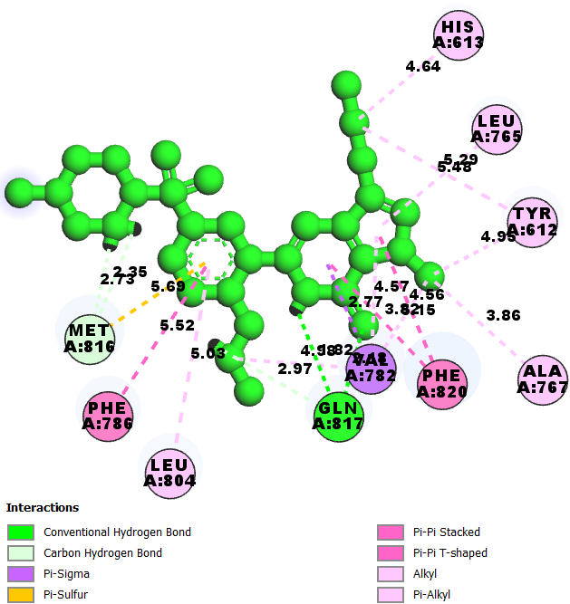
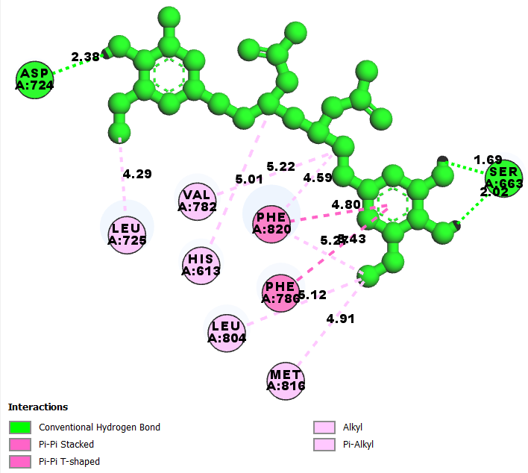
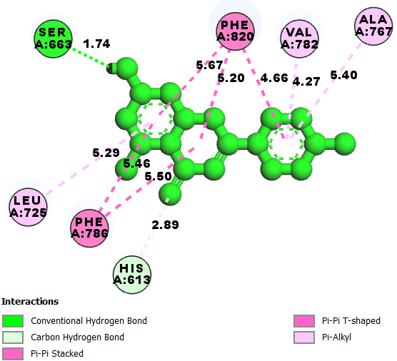
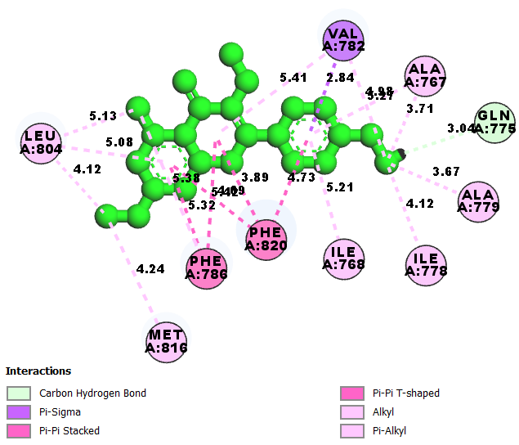
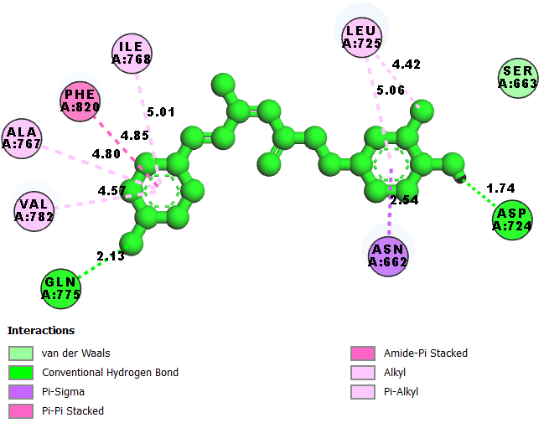
CO-LIGAND CMPD 1 CMPD 2
CMPD 3 CMPD 4 CMPD 6

Slide 9
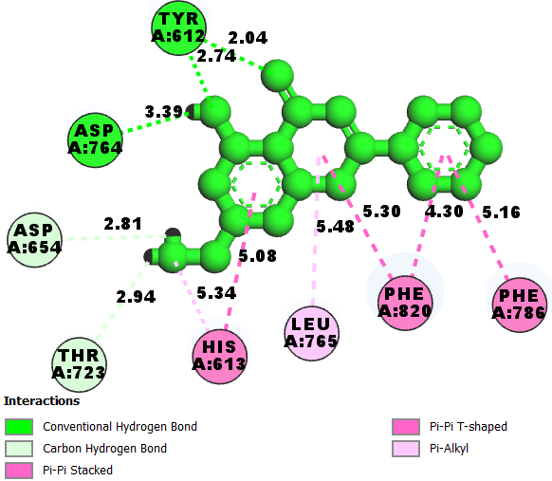
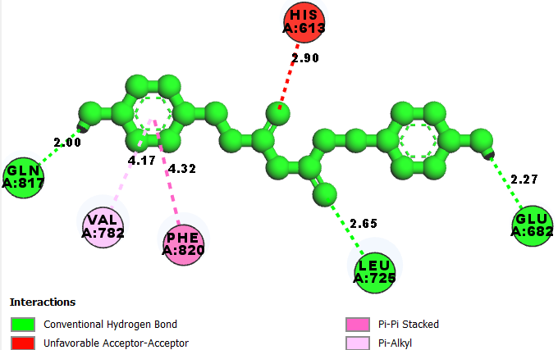
CMPD 7
CMPD 8
CMPD 9

Slide 10
Fig. 5: Pharmacophore Hypothesis Generation
Fig. 7: Scatter plot from AutoQSAR modeling

Slide 11
Compound Name | Fitness Score | Predicted pIC50 (µM)
Sildenafil | 2.605 | 7.976
1,7-bis(3,4-dihydroxy-5-methoxyphenyl)heptane-3,5-diyldiacetate | 1.187 | 5.592
1-(3,4-dihydroxy-5-methoxyphenyl)-7-(3,4-dihdroxyphenyl)heptane-3,5-diyldiacetate | 0.754 | 3.835
Apigenin | 1.908 | 4.765
quercetin-3,7,3,4-tetramethylether | 1.904 | 6.536
letestuianin A | 1.483 | 6.167
kaempferol-3,7,4-trimethylether | 1.355 | 5.742
Buplerol | 1.247 | 5.706
Letestuianin C | 1.312 | 5.727
5-hydroxy-7-methoxyflavone | 1.986 | 5.459

Slide 12
Compound Name | MW | HBD | HBA | TPSA | RO5
Sildenafil | 474.58 | 1.00 | 11.75 | 119.09 | 0
1,7-bis(3,4-dihydroxy-5-methoxyphenyl)heptane-3,5-diyldiacetate | 492.52 | 4.00 | 8.50 | 169.85 | 0
1-(3,4-dihydroxy-5-methoxyphenyl)-7-(3,4-dihdroxyphenyl)heptane-3,5-diyldiacetate | 462.50 | 6.00 | 7.75 | 190.70 | 1
Apigenin | 270.24 | 2.00 | 3.75 | 100.03 | 0
quercetin-3,7,3,4-tetramethylether | 296.28 | 0.00 | 4.75 | 89.04 | 0
letestuianin A | 324.38 | 2.00 | 3.25 | 87.36 | 0
kaempferol-3,7,4-trimethylether | 324.38 | 0.00 | 2.75 | 28.35 | 0
Buplerol | 372.42 | 1.00 | 6.00 | 85.35 | 0
Letestuianin C | 312.37 | 2.00 | 5.50 | 95.15 | 0
5-hydroxy-7-methoxyflavone | 268.27 | 0.00 | 3.00 | 63.25 | 0
Molecular weight (MW), Hydrogen bond donor (HBD), Hydrogen bond acceptor (HBA), topological surface area (TPSA), Rule of five (RO5)

Slide 13
Sildenafil
Compound 1
Fig. 8: Evaluation of RMSD of protein-ligand complex for 100 ns

Slide 14
Compound 1
Sildenafil
Fig. 9: Representation of the Root mean square fluctuation (RMSF) of complex over 100 ns simulation

Slide 15
Sildenafil
Compound 1
Fig. 10: Complex protein-Ligand interaction mapping

Slide 16
Conclusions
Overall, this study predicted phytochemicals from A. melegueta as inhibitors of PDE-5 for further experimentally validation for erectile dysfunction management.

Slide 17
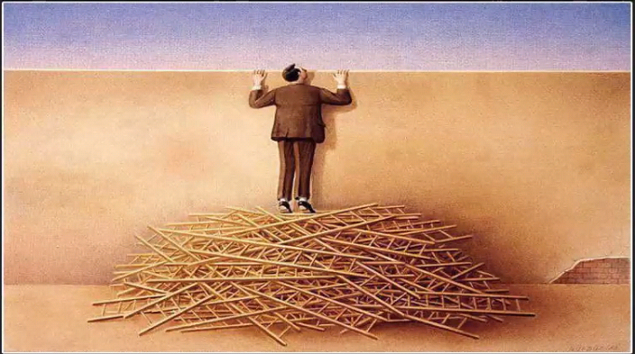
It doesn’t matter how many resources you have
THANK YOU
FOR
LISTENING
If you don’t know how to use them, it will never be enough

