Slide 1
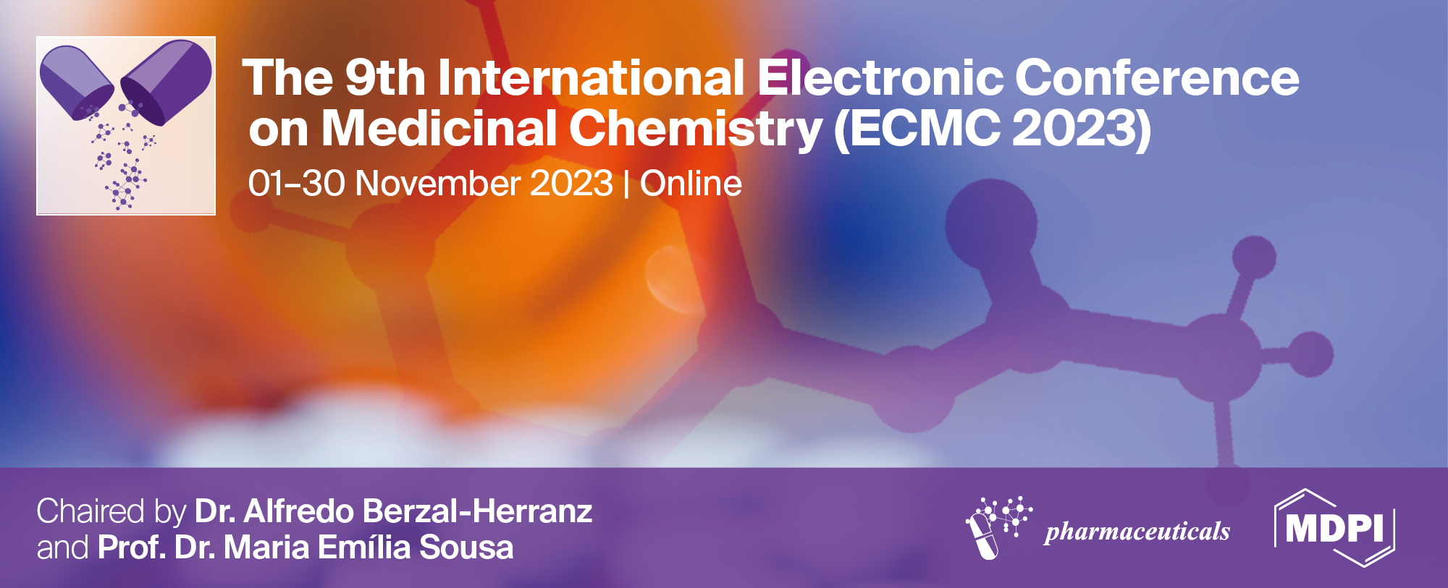
Highly sensitive voltammetric sensors based on selenium dioxide nanoparticles for the quantification of colorants in pharmaceutical dosage forms
Guzel Ziyatdinova*, and Liya Kavieva
Analytical Chemistry Department, Kazan Federal University, Kremleyevskaya, 18, Kazan, 420008, Russia
* Corresponding author: Ziyatdinovag@mail.ru

Slide 2
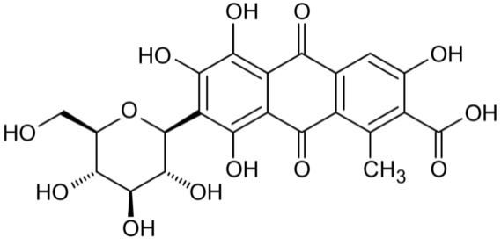
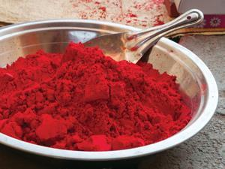
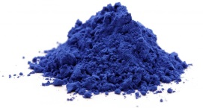
Highly sensitive voltammetric sensors based on selenium dioxide nanoparticles for the quantification of colorants in pharmaceutical dosage forms
Carminic acid
+
+
+
+
+
+
+
+
+
+
SeO₂
+
+
+
+
+
+
+
+
SeO₂
+
+
+
SeO₂
SeO₂
SeO₂
SeO₂
Indigotine
Glassy carbon electrode
+
+
+
+
+
+

Slide 3
Abstract:
Colorants, in particular, carminic acid and indigotine are widely used in pharmaceutical industry. High concentration of these colorants affect human health that require a control of their content in pharmaceutical dosage forms. In current work, novel voltametric sensors based on glassy carbon electrodes modified with selenium dioxide nanoparticles dispersed in surfactant media have been developed for the determination of carminic acid and indigotine. Combination of selenium dioxide nanoparticles with surfactant media provides stabilization of nanoparticles dispersion by suppression of their aggregation as well as action of the surfactant as a co-modifier of the electrode surface, i.e. as a part of sensing layer of the electrode. The effect of surfactant nature (cationic, nonionic, and anionic) and concentration on the colorants' voltammetric characteristics has been investigated. The best response of colorants has been obtained in the case of selenium dioxide nanoparticles dispersed in cationic surfactants (0.10 mM cetyltriphenylphosphonium bromide for carminic acid and 1.0 mM cetylpyridinium bromide for indigotine). The sensors developed have been used under conditions of differential pulse voltammetry in acidic medium. A linear dynamic ranges of 0.010‒2.5 and 2.5‒10 μM of carminic acid and 0.025–1.0 and 1.0–10 µM of indigotine with the detection limits of 3.4 and 4.3 nM, respectively, have been achieved that are the best ones among the methods reported to date. Another advantage of the sensors developed is a simple one-step fabrication as well as easy and fast preparation of the modifier. Sensors have been successfully applied in the analysis of pharmaceutical dosage forms (vitamin tablets, capsules, and lozenges for sore throat treatment) and validated with spectrophotometry. The direct analysis of colorants in various pharmaceutical dosage forms confirms versatility of the sensors developed that can be used as an alternative method for the quality control of the pharmaceutical products.
Keywords: voltammetric sensors; modified electrodes; selenium dioxide nanoparticles; surfactants; colorants; carminic acid; indigotine; pharmaceutical analysis

Slide 4
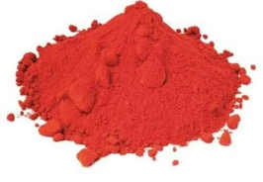
Introduction
Colorants in pharmaceutical industry
Carminic acid (Е120)
The acceptable daily intake is
2.5 mg/kg bw/day
5.0 mg/kg bw/day
Negative health effects
allergic reactions of various severity including anaphylactic reaction
side effects in the liver, central nervous system, kidneys, and eyes
mutagenic effects leading to oncogenesis
Indigotine (E132)
Control of colorants in pharmaceutical dosage forms is required

Slide 5
Introduction
Electrochemical determination of colorants
Various types of polarography
Voltammetry on traditional electrodes (Pt, glassy carbon)
Voltammetry on chemically modified electrodes
Non-metal oxide nanoparticles (SiO₂ and SeO₂) are perspective electrode surface modifiers but did not get enough attention
The aim of the work is development of a novel sensitive voltammetric sensors based on the glassy carbon electrode modified with SeO₂ nanoparticles and surfactants for the carminic acid and indigotine determination

Slide 6
Results and discussion
Sonication for 20 min
SnO₂
SeO₂ powder
(Aldrich, USA)
1 mg mL⁻¹ dispersion
Surfactant
Drop-casting of nanoparticles dispersion
SeO₂
SeO₂
+
+
SeO₂
SeO₂
Glassy carbon electrode
SeO₂
SeO₂
Glassy carbon electrode

Slide 7
Surfactants
Anionic
Non-ionic
Sodium dodecyl sulfate (SDS)
Brij® 35
Sodium lauroyl sarcosinate (SLS)
Triton X-100
Cationic
Cetyltrimethyl ammonium bromide (CTAB)
Cetylpyridinium bromide (CPB)
Cetyltriphenylphosphonium
bromide (CTPPB)

Slide 8
Cyclic voltammetry of colorants at the glassy carbon (GCE) and
SeO₂-modified electrodes
10 µМ carminic acid
50 µМ indigotine
Supporting electrolyte – Britton-Robinson buffer рН 2.0. υ=100 mV/s.
Supporting electrolyte – phosphate buffer рН 7.0. υ=100 mV/s.
Sensitivity of colorants’ response at the modified electrode is still insufficient

Slide 9
Effect of surfactants nature and concentration in modifier dispersion on the voltammetric characteristics of colorants
10 µМ carminic acid
Dispersion of SeO₂
in 0.10 mM CTPPB
50 µМ indigotine
Dispersion of SeO₂
in 1.0 mM CPB

Slide 10
Morphology of the electrode surface based on the scanning electron microscopy data
GCE
SeО₂-H₂O/GCE
Aggregates
of 30-200 nm
SeО₂-CTPPB/GCE
SeО₂-CPB/GCE
spheroid nanoparticles of 37-45 nm
spheroid nanoparticles of 39–55 nm

Slide 11
Effect of pH on the voltammetric characteristics of colorants at the SeO₂ nanoparticles modified electrodes
50 µМ carminic acid
pH = 2.0
Equal number of electrons and protons on the first step
Supporting electrolyte – Britton-Robinson buffer. υ=100 mV/s.
50 µМ indigotine
Protons participate in the oxidation
pH = 5.0
Supporting electrolyte – phosphate buffer. υ=100 mV/s.

Slide 12
Differential pulse voltammetry of colorants
Carminic acid
Indigotine
Supporting electrolyte – Britton-Robinson buffer рН 2.0. ΔE_{pulse} = 75 mV, t_{pulse} = 25 ms, υ = 10 mV/s.
Supporting electrolyte – phosphate buffer рН 5.0. ΔE_{pulse} = 100 mV, t_{pulse} = 25 ms, υ = 10 mV/s.
Analytical capabilities of the voltammetric sensors
Colorant | Sensor | Detection limit, nM | Linear range, μM
Carminic acid | SeО₂-CTPPB/GCE | 3.4 | 0.010-2.5 and 2.5-10
Indigotine | SeО₂-CPB/GCE | 4.3 | 0.025-1.0 and 1.0-10

Slide 13
Analytical characteristics of voltammetric sensors for the colorants
Sensor | Method | Detection limit, μM | Linear range, μM | Reference
Carminic acid
Electrodeposition of Pd–Au bimetallic nanoparticles/Polypyroline/Graphite electrode | SWV | 0.0059 | 0.010-1.0 | J. Electroanal. Chem., 2016, 760, 32-41.
Polymethionine/Reduced graphene oxide/SPCE | AdADPV | 0.036 | 1-20; 20-60 | Molecules, 2021, 26, 2312.
SeO₂ nanoparticles-Cetyltriphenylphosphonium bromide/GCE | DPV | 0.0034 | 0.010-2.5; 2.5-10 | This work
Indigotine
4-(4-Nitrophenilazo)N-benzyl,N-ethylaniline—CPE | DPV | 0.36 | 1–100 | Talanta, 2017, 173, 60–68
Polyarginine/CPE | DPV | 0.0253 | 0.2–1.0; 1.5–3.5 | J. Electrochem. Sci. Eng., 2021, 11, 87–96.
Polyglycine/CPE | CV | 0.011 | 2–10; 15–60 | J. Food Drug Anal., 2018, 26, 292–299.
Chiral amine bis(phenolate) boron complex containing N,N-diethyl-p-phenylenediamine—carboxylated MWNT/GCE | SWV | 0.019 | 0.1–30 | Dye. Pigment., 2022, 197, 109921.
SeO₂ nanoparticles—CPB/GCE | DPV | 0.0043 | 0.025–1.0; 1.0–10 | This work

Slide 14
Results of voltammetric determination of colorants in model solutions (n=5; P=0.95)
Colorant | Sensor | Added, µg | Found, µg | RSD, % | R, %
Carminic acid | SeО₂-CTPPB/GCE | 0.0246 | 0.025±0.001 | 3.7 | 101±3
 |  | 0.246 | 0.245±0.006 | 2.0 | 99±2
 |  | 1.85 | 1.85±0.03 | 1.4 | 100±1
 |  | 12.3 | 12.3±0.2 | 1.4 | 100±1
 |  | 24.6 | 24.6±0.2 | 0.78 | 100±1
Indigotine | SeО₂-CPB/GCE | 0.0583 | 0.058 ± 0.001 | 1.0 | 99 ± 1
 |  | 0.233 | 0.23 ± 0.01 | 1.8 | 100 ± 2
 |  | 1.75 | 1.74 ± 0.03 | 1.3 | 99 ± 2
 |  | 11.7 | 11.7 ± 0.3 | 2.1 | 100 ± 2
 |  | 23.3 | 23.3 ± 0.2 | 0.65 | 99.8 ± 0.8

Slide 15
Selectivity of the sensors developed
Interference | Tolerance level
 | Carminic acid (0.10 μM) | Indigotine (0.50 µM)
K⁺, Mg²⁺, Ca²⁺, NO₃ˉ, Clˉ and SO₄²⁻ ions | 1000-fold excess | 1000-fold excess
glucose, sucrose, rhamnose | 100-fold excess | 100-fold excess
ascorbic acid | 1000-fold excess | ≤ 10µM
quinoline yellow | — | 100-fold excess
riboflavin | — | 1000-fold excess
Menthol, aspartame, benzydamine hydrochloride | — | 1000-fold excess
Sensors are applicable in pharmaceutical dosage forms analysis

Slide 16
Determination of colorants in real samples (P=0.95)
Colorant | Sample Type | № | Labelled amount (mg) | Found by voltammetry (mg) | RSD (%) | Found by spectrophotometry (mg) | RSD (%) | t-Test | F-Test
Carminic acid | Lozenges for sore throat treatment | 1 | – | 245±6 | 2.0 | 249±12 | 2.0 | 0.840* | 1.04*
 |  | 2 | – | 242±6 | 2.2 | 245±17 | 2.9 | 0.792* | 1.79*
Indigotine | Vitamin tablets |  | – | 0.0047 ± 0.0003 | 4.4 | 0.0051 ± 0.0003 | 4.5 | 1.97 | 1.21
 | Lozenges for symptomatic local treatment of the mouth and throat | 1 | 0.015 | 0.0150 ± 0.0004 | 2.3 | 0.0148 ± 0.0003 | 1.5 | 0.976 | 2.07
 |  | 2 | 0.031 | 0.0311 ± 0.0009 | 2.3 | 0.0313 ± 0.0009 | 2.4 | 0.559 | 1.12
 | Capsules of non-steroidal anti-inflammatory drug |  | – | 0.055 ± 0.002 | 3.7 | 0.053 ± 0.002 | 2.7 | 1.31 | 0.810
*t_{crit} = 2.45 at α = 0.05 and f = 6. *F_{crit} = 19.25 at α = 0.05 and f₁= 4, f₂=2.
t_{crit} = 2.31 at α = 0.05 and f = 8. F_{crit} = 6.39 at α = 0.05 and f₁ = f₂ = 4.

Slide 17
Conclusions
SeO₂ nanoparticles dispersed in cationic surfactant media have been shown as an effective sensing layer of the voltammetric sensors for the colorants used in pharmaceutical industry. Indigo carmine and indigotine have been considered as an analytes. 0.10 mM cetyltriphenylphosphonium bromide and 1.0 mM cetylpyridinium bromide have been used as dispersive media for SeO₂ nanoparticles as far as provide the best voltammetric response of carminic acid and indigotine, respectively.
The analytical characteristics of colorants on the sensors developed are the best ones among electrochemical sensors based on various nanomaterials. Simplicity of sensors fabrication, high selectivity and sensitivity of response as well as reliability of the results obtained are the main advantages of the sensors developed. The versatility of the sensors based on the SeO₂ nanoparticles and cationic surfactants functioning under differential pulse voltammetry has been confirmed by direct analysis of the pharmaceutical dosage forms. A good agreement with the independent method data allows consider voltammetric sensors developed as an alternative method for the pharmaceutical products quality control.

