Slide 1
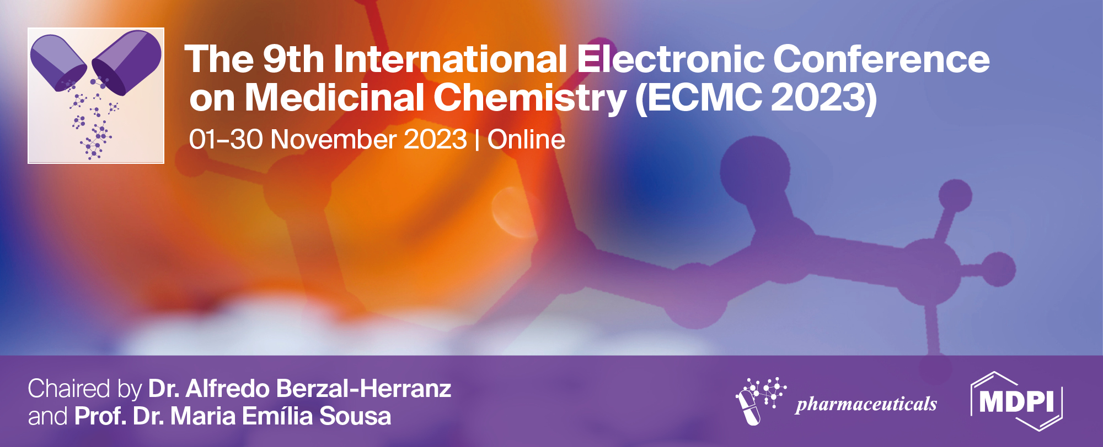

Metabolomic profiling of Smilax zeylanica, its in vitro and in silico screening for antilipidemic activity.
Dr. Rosaline Mishra¹
Professor, Metro College of Health Sciences and Research Greater Noida
* Corresponding author: rosalinemishra3@gmail.com

Slide 2
Title of the Presentation
Graphical Abstract
Use one slide

Slide 3
Abstract: One slide, maximum 250 words without figure
Smilax zeylanica is a medicinal plant native to Southeast Asia that has been used for centuries to treat a variety of ailments, including hyperlipidemia. However, the mechanisms underlying its antilipidemic effects are not fully understood. In this study, we performed metabolomic profiling of S. zeylanica roots extracts and screened for potential antilipidemic compounds using in vitro and in silico methods.
Metabolomic analysis using spectral and Chromatographic techniques such as GSMS and HPLC revealed that S. zeylanica roots contain a variety of metabolites, including flavonoids, phenolic acids namely gallic acid, chlorogenic acid, Quercetin and several other potent phytoconstituents. In vitro pancreatic lipase assays, HMGCoA reductase assay showed that S. zeylanica root extract significantly showed inhibitory potential at par with the standard drug orlistat and atorvastatin respectively. Molecular docking studies showed that several of the metabolites identified in S. zeylanica roots, including quercetin, kaempferol, and gallic acid, etc bind to the HMG-CoA reductase enzyme, a key enzyme in cholesterol biosynthesis. These findings suggest that S. zeylanica may exert its antilipidemic effects by inhibiting HMG-CoA reductase activity.
Overall, this study provides new insights into the metabolomic profile of S. zeylanica and its potential antilipidemic activity. Further studies are needed to elucidate the specific mechanisms underlying its antilipidemic effects and to confirm its safety and efficacy profiles.
Keywords: anti lipidemic, cholesterol, Hmg CoA reductase

Slide 4
Introduction
Obesity is a widespread issue which happens due to a number of factors such as nutritional factors genetic and environmental factors. Combating it has become a prime concern in developed and developing countries. Therefore treatment with anti lipidemic agents can be an option in adjunct to exercise and diet for overweight and obese individuals struggling with weight issues. However, the issue is all these anti hyperlipidemic drugs are allied with severe side effects. Hence medicinal plants are being focussed due to their efficiency and biocompatibility. Hence our present study. The therapeutic usage of anti-obesity drugs has adverse negative sides, like sibutramine was the first-ever anti-obesity drug that will get from the market in unfavourable reactions of cardiovascular stroke and events so, there is demand for searching natural alternatives with fewer or no side effects, especially phytochemicals. Phytochemicals delineate a wide array of bioactive compounds procured from plants with optimistic human health benefits . Most studied phytochemicals are alkaloids, flavonoids, terpenoids, saponins, tannins, and phenolics (Barnett J et al, 2013).

Slide 5
Methodology
Smilax zeylanica root was obtained from the Yamuna Biodiversity park, New Delhi. It was then authenticated formally at the ‘Department of Botany Ch.Charan Singh University’, Meerut by Dr. Bhawana. S .Bajpai. It was allotted a voucher number B01-PB565/1/2/2017.
500 g of dried sample was subjected to successive extraction thrice with 3000ml of solvents of increasing polarity ie petroleum ether, ethyl acetate, and ethanol for 72 h. The obtained extract was filtered using whattman filter paper and was then concentrated with the help of rotary evaporator, the pressure was maintained low and temperature around 40 ⁰ C. The dry extract obtained was weighed. The samples were stored at 10ºC till further use.
The three extracts were then subjected to Phytochemical screening, Total phenolic content determination , DPPH free radical scavenging assay, pancreatic lipase assy.
The extract which showed the best activity was further subjected to column chromatography. The fractions obtained were then analysed through spectral techniques. The identified phytochemicals were then screened to identify potential lead molecules through insillico screening technique.
Results
General Phytochemical analysis, Total phenolic content determination, DPPH free radical assay revealed that the methanolic extract was the most potent with presence of phenolic molecules, Flavonoids.
Total phenolic content determined through gallic acid assay was 203.11±0.110µgm/mg.
At a concentration of 100 (μg/ml) Smilax zeylanica methanolic extract showed a %inhibition of 76% with an IC50 value of 54(μg/ml) where as the standard ascorbic acid showed a % inhibition of 81% with a IC50 value of 36 (μg/ml).

Slide 6
Results and discussion
Pancreatic Lipase inhibitory potential of all the three extracts of Smilax zeylanica was determined, by taking orlistat as standard.
Maximum inhibition was seen in Smilax zeylanica ethanolic extract 76.07±0.77% which was close to the inhibitory potential shown by standard orlistat which was 81%
Fig1 Pancreatic lipase inhibitory potential of SZ phytoextract

Slide 7
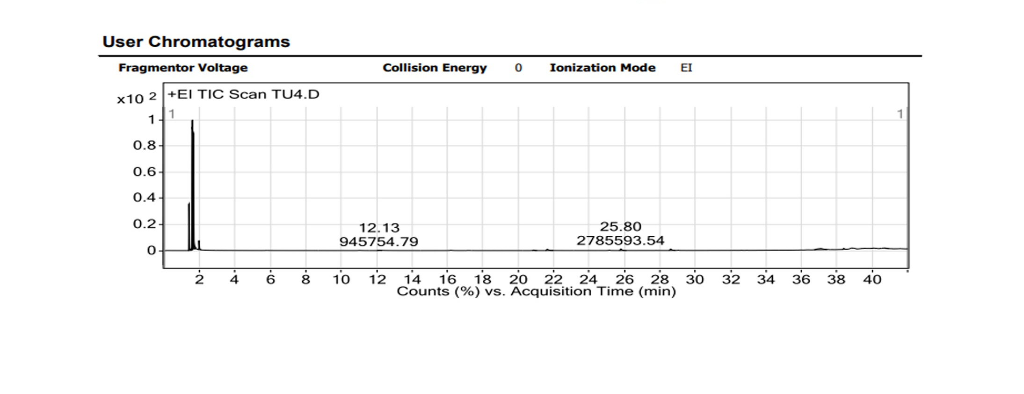
Results and discussions
Based on several factors and results obtained Smilax zeylanica methanolic extract was subjected to column chromatography and Fraction 1 was obtained, it contained maximum phytocostituents as identified through thin layer chromatography.
Obtained fraction 1 was then further characterised using GCMS technique.
Several constituents were identified and subjected to insillico screening.
Fig 2 GCMS user Chromatogram

Slide 8
Results
- Identified phytoconstituents were screened insillico for the inhibition of HMG Co A reductase. Atorvastatin was used as standard

Slide 9
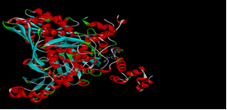
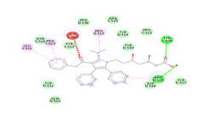
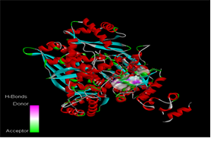
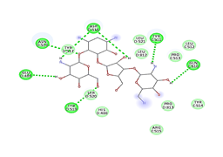
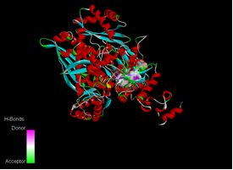
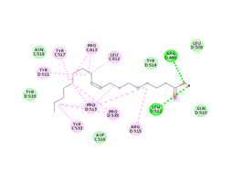
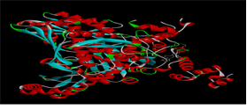
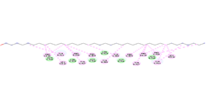
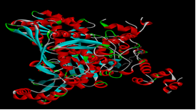
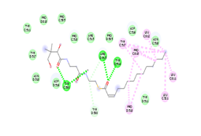
Name of Phytoconstituents | 3D Docking confirmation
Atorvastatin
Parmomycin
Oleic Acid
1-Heptatriacontanol
2-Myristynoyl pantetheine
Fig: 3 In sillico docking study

Slide 10
Conclusions
We could conclude on the basis of all the invitro and insillico studies that the phyto constitutes present in the SZM fraction has potential to act as efficient anti lipidemic agents. It can be concluded that the visible actions may be due to multiple phyto components; showing synergistic activity at numerous sites of actions. This work can be taken up further towards screening for in-vivo activity.

Slide 11
THANK YOU

