Slide 1
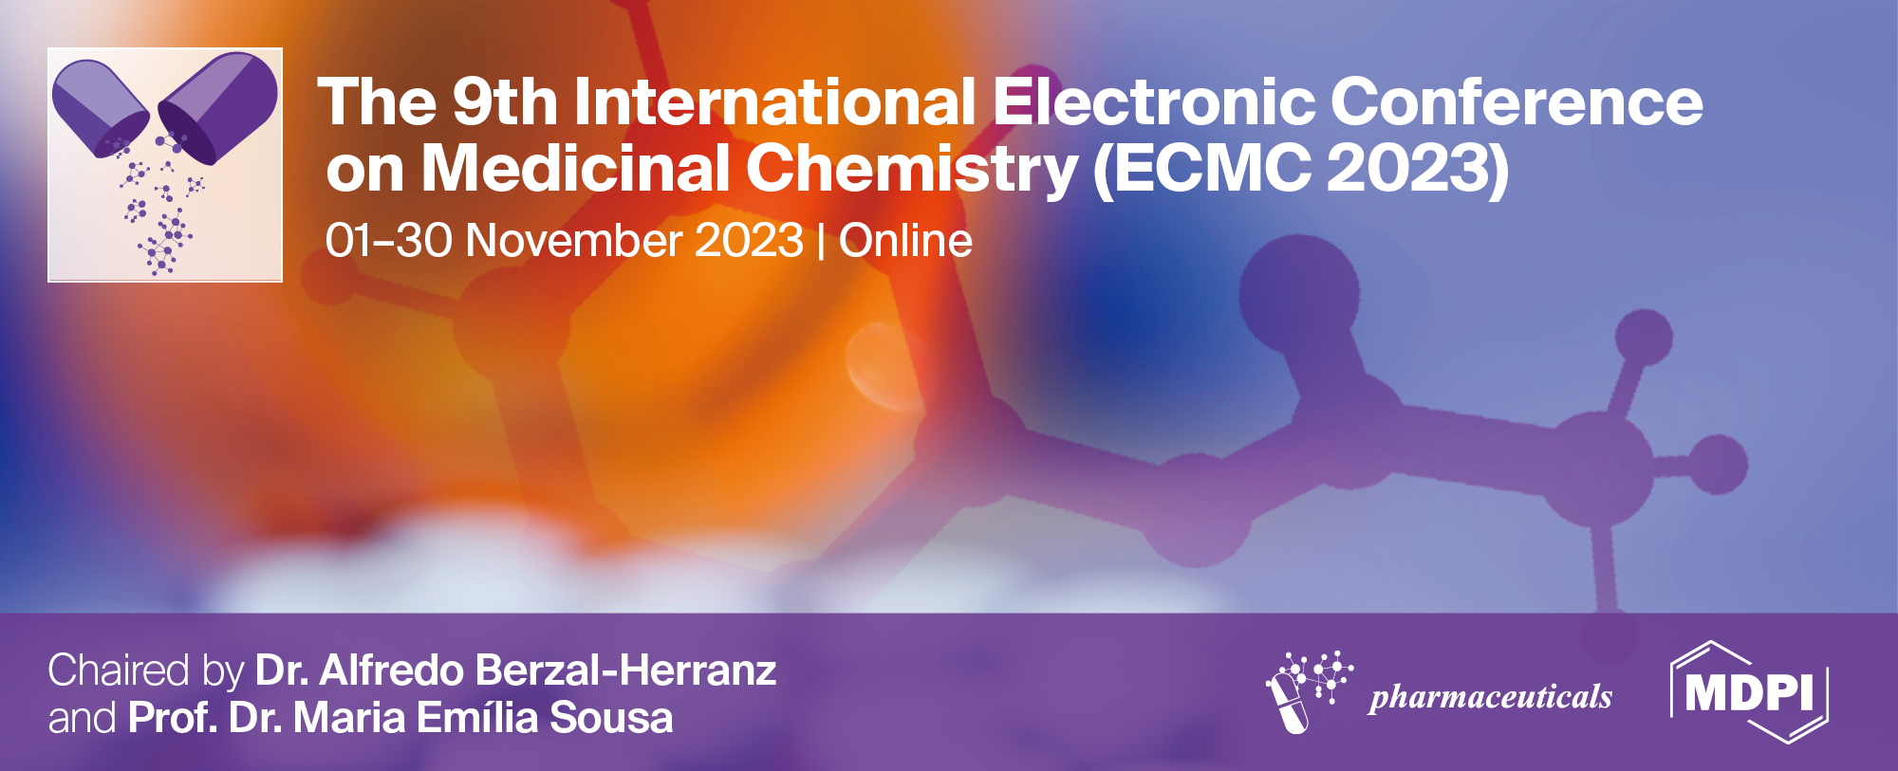
Rapid and synchronized dormancy-breaking effect of jumbo leek bulb powder supplementation on increased liver glutathione production contributing to biological defense
Toshihiro Ona ^{1,2,}*, and Junko Johzuka ^{2,1}
¹ Graduate School of Bioresource and Bioenvironmental Sciences, Kyushu University, Kasuga, Fukuoka, Japan;
² O'Atari Inc., Onojo, Fukuoka, Japan.
* Corresponding author: ona@agr.kyushu-u.ac.jp, ona@oatari-inc.com

Slide 2
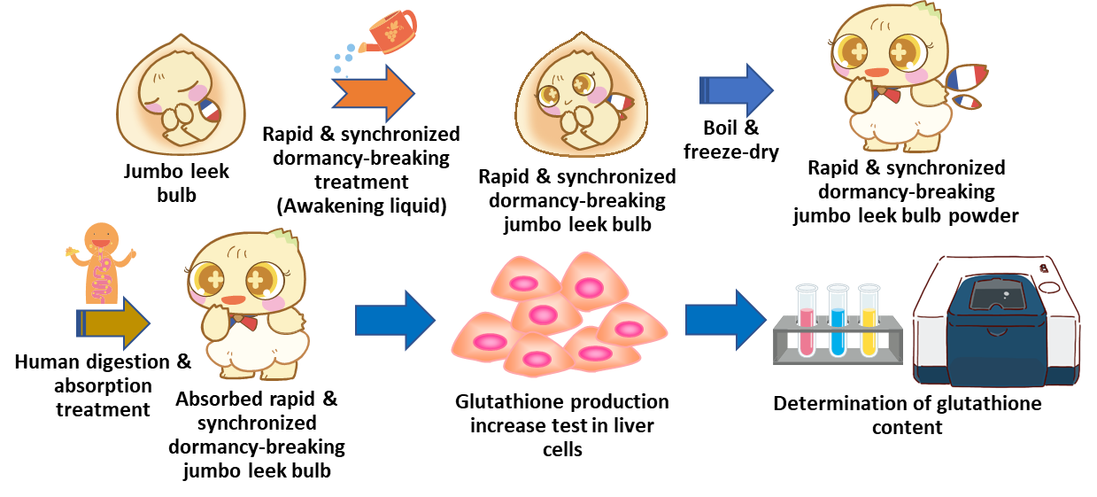
Rapid and synchronized dormancy-breaking effect of jumbo leek bulb powder supplementation on increased liver glutathione production contributing to biological defense
Graphical Abstract

Slide 3
Abstract:
Diseases resulting from inadequate elimination of oxidative stress due to aging and the entry of nanoparticles such as particle matters and plastics into the body have been on the rise in recent years. The importance of glutathione as a method of eliminating oxidative stress and nanoparticles has been recognized. The use of foods and nutrients has gained attention as a way to increase or support the maintenance of optimal levels of glutathione in the body. In the present study, the effects of increasing glutathione production in the liver of jumbo leek bulb powder were examined using samples that were heat-treated after rapid and synchronized dormancy-breaking to promote phase transition of the contents. The heat- and freeze-dried samples without rapid and synchronized dormancy-breaking (untreated) showed a 9-fold increase in total glutathione compared to the control. In contrast, the rapid and synchronized dormancy-breaking sample showed an even greater increase, approximately 35-fold over the control and 4-fold over the untreated sample, indicating a significantly higher increase. This suggests that ingestion of rapid and synchronized dormancy-breaking jumbo leek bulb powder will promote the alleviation of oxidative stress in the body and the removal of nanoparticles due to the increase in the amount of glutathione in the liver. Therefore, it is expected to prevent or improve (anti-aging) cerebral infarction, cancer, wrinkles, and blemishes caused by these factors, as well as to prevent obesity and diabetes, as reported last year.
Keywords: glutathione; biological defense; supplement; jumbo leek; dormancy-breaking

Slide 4
Introduction
The number of diseases that derive from a lack of ability to eliminate oxidative stress in the body has increased dramatically in recent years, probably due to aging and the entry of nanoparticles, such as plastics, into the body (Fig. 1). In medicine, glutathione injections are given as a treatment method against oxidative stress (Fig. 2). On the other hand, detoxification with glutathione has also been reported as a method of removing nanoparticles (Fig.3). Therefore, methods to support the increase and maintenance of glutathione in the body to optimal levels are attracting attention. In particular, the intake of foods and nutrients containing cysteine, the rate-limiting step in glutathione production in the body, has been proposed. In this study, we investigated the efficacy of jumbo leek bulb powder to enhance glutathione production in the liver as a dietary supplement by using the sample that was heat-treated after promoting phase transition of its contents by rapid and synchronized dormancy-breaking.

Slide 5
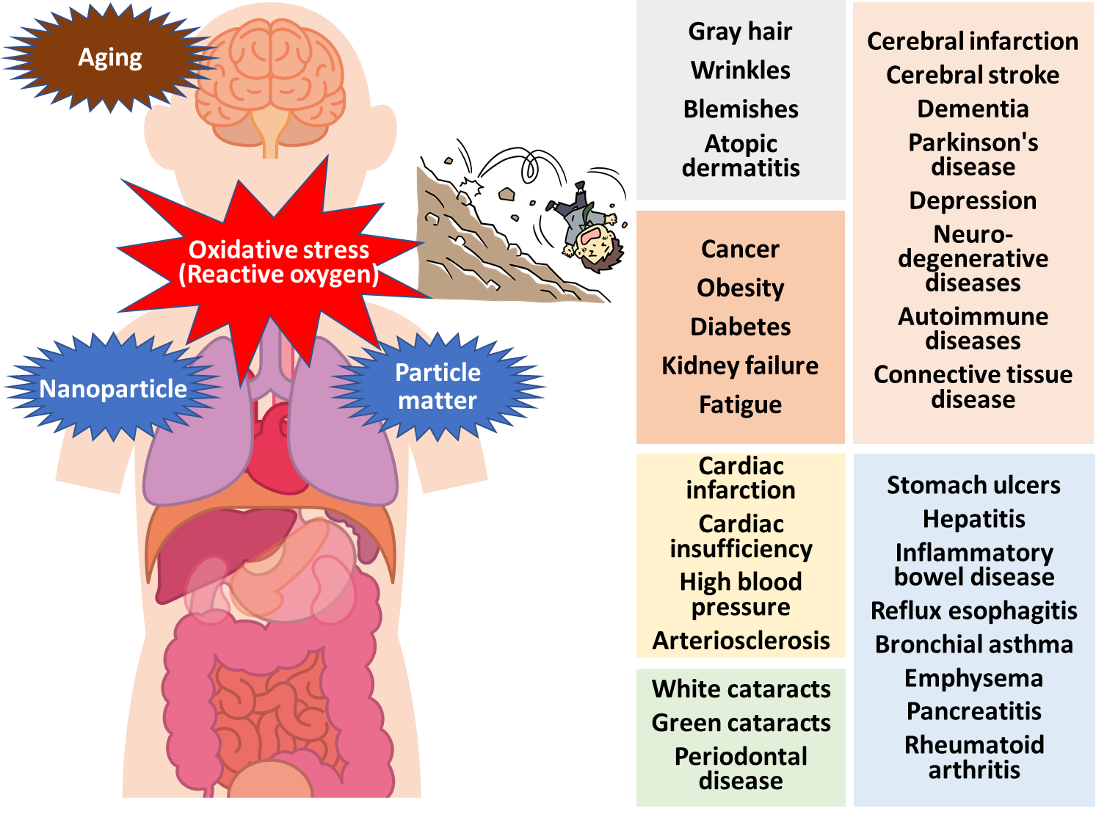
Introduction
Fig. 1 Diseases resulting from oxidative stress.

Slide 6
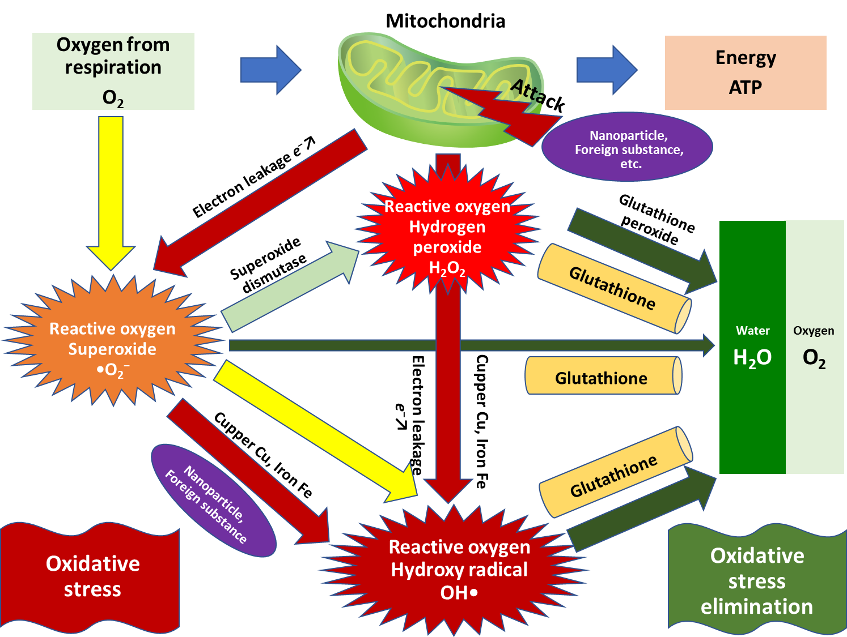
Introduction
Fig. 2 Oxidative stress scavenging effect of glutathione.

Slide 7
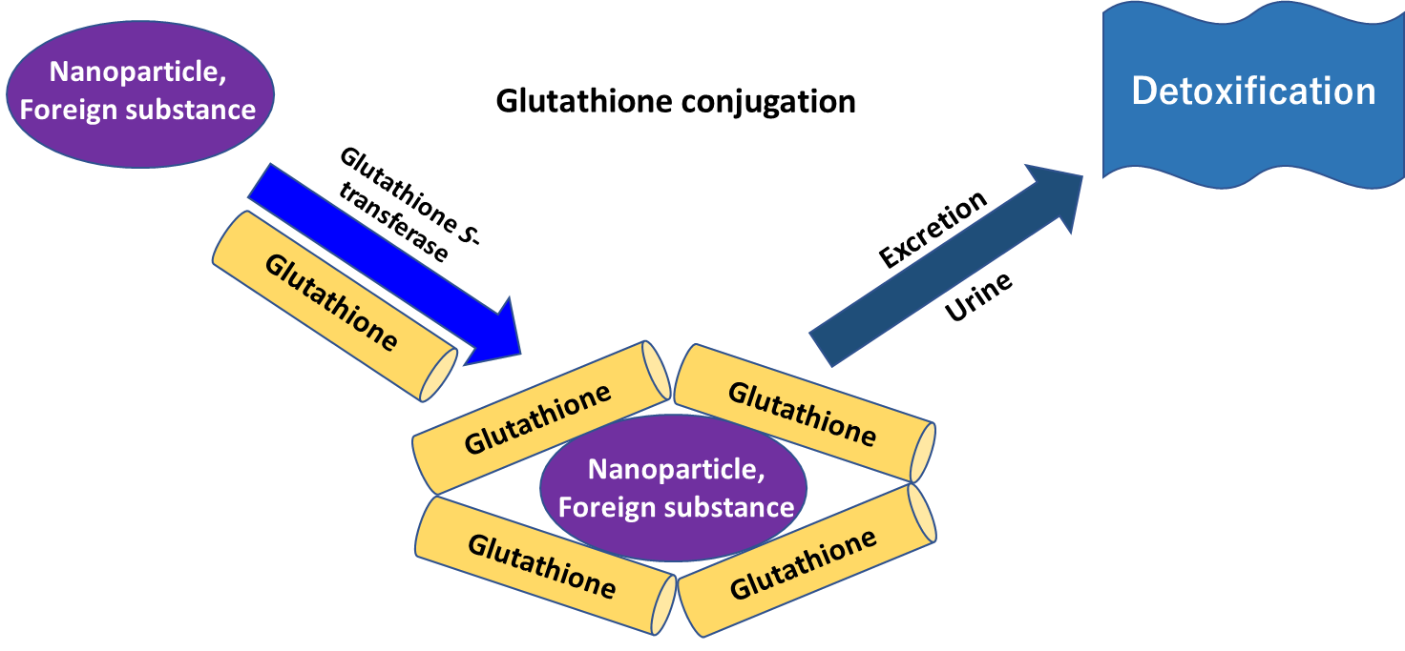
Introduction
Fig. 3 Glutathione conjugation to eliminate nanoparticle and foreign substance.

Slide 8
Method (Fig. 4)
A human liver cancer cell line, Hep G2, was used as cells, and jumbo leek bulbs, a pesticide-free cultivar grown in Shimabara, Nagasaki Prefecture, Japan were used as samples. The samples were awakened with an Awakening liquidTM (O’Atari Inc., Onojo, Japan), then heated and freeze-dried. After digestion in the stomach and duodenal steps using enzymes, molecular weights of 10,000 or less were used for the assay. Cells were co-cultured with untreated or treated samples for 24h and further cultured for 48h after replacement with medium. After this, the total glutathione content was calculated by measuring the absorbance of the reduced product of Ehrman's reagent in liver cells.

Slide 9
Method
Fig. 4 Experimental scheme.

Slide 10
Results and discussion
The heated and freeze-dried samples without rapid and synchronized dormancy-breaking (untreated) showed a 9-fold increase in total glutathione production compared to the control (Fig. 5). In contrast, the rapid and synchronized dormancy-breaking samples showed even greater enhancement, approximately 35-fold higher than the control and 4-fold higher than the untreated samples, indicating a significantly higher promotion. This suggests that when rapid and synchronized dormancy-breaking jumbo leek bulb powder is ingested as a supplement, it may efficiently alleviate oxidative stress in the body and remove (detoxify) nanoparticles by promoting the production of glutathione in the liver (Fig. 6, 7). Therefore, it is expected to prevent and improve aging phenomenon, cancer, cardiovascular diseases, and lifestyle-related diseases caused by oxidative stress, as well as to prevent obesity and diabetes, as reported in the previous year.

Slide 11
Results and discussion
Fig. 5 Change of glutathione production in liver by rapid and synchronized dormancy-breaking treatment.

Slide 12
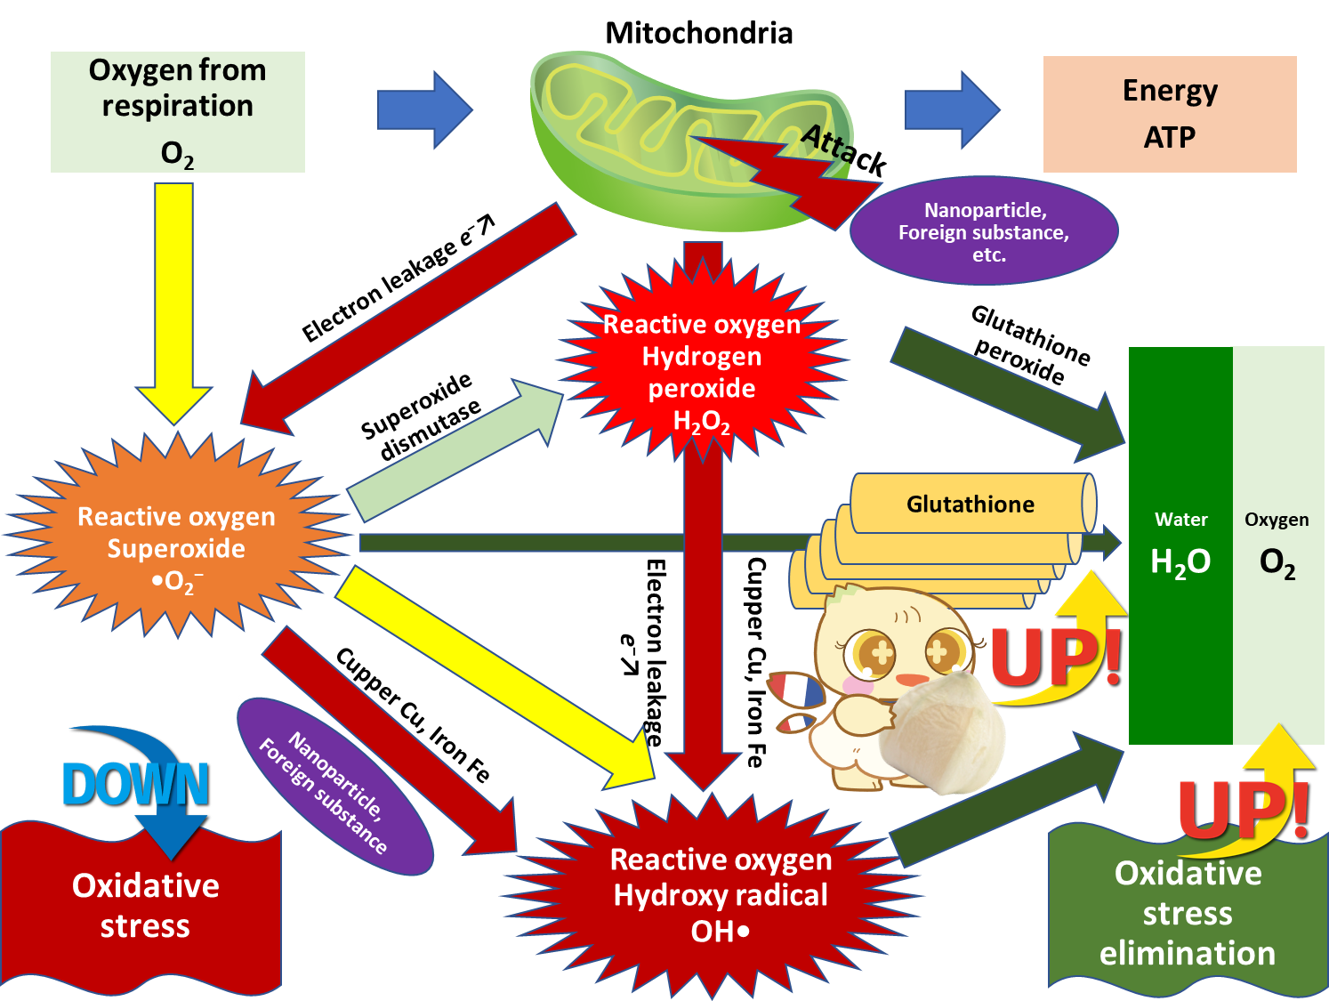
Results and discussion
Fig. 6 Oxidative stress scavenging effects of rapid and synchronized dormancy-breaking jumbo leek bulb powder.

Slide 13
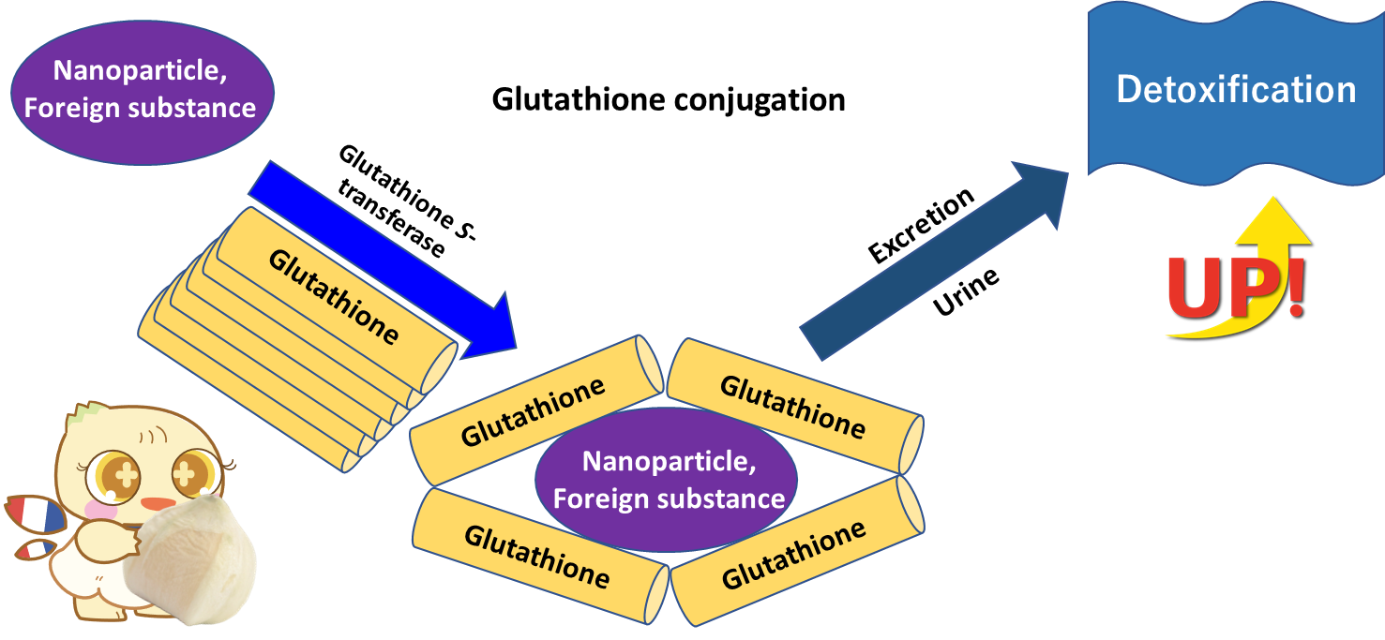
Results and discussion
Fig. 6 Detoxification effects of rapid and synchronized dormancy-breaking jumbo leek bulb powder.

Slide 14
Conclusions
Rapid and synchronized dormancy-breaking jumbo leek bulb powder showed two things:
Suitable for increase hepatic glutathione production, which contributes to biological defense by oral administration.
Suitable for prevention and improvement (anti-aging) are expected in cerebral infarction, cancer, wrinkles, and blemishes caused by nano particles, foreign substances and oxidative stress in the body by oral administration.
Consequently, rapid and synchronized dormancy-breaking jumbo leek bulb powder is suitable for functional food supplement.

Slide 15
Acknowledgments
This research was supported by O’Atari Inc. and Kyushu University.
O’Atari Inc.

