Slide 1
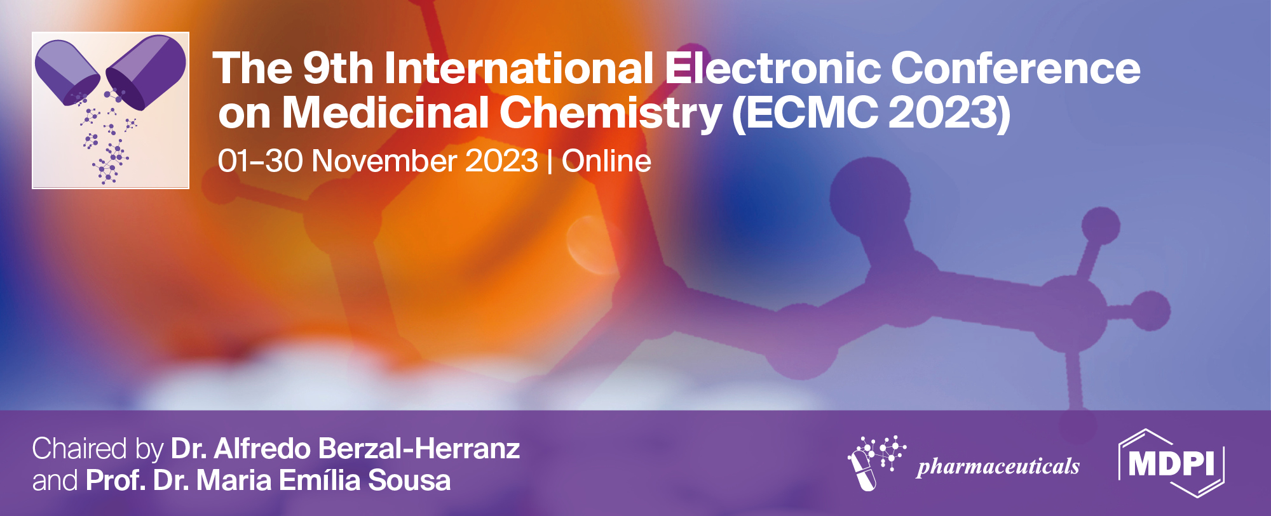




Solvatochromism of Norfloxacin and Sulfadiazine
Cecilia D. Avila ^{1,} *, Salome Chosson¹ and Graciela Pinto Vitorino¹
¹ GQM-CRIDECIT, Facultad de Ciencias Naturales y Ciencias de la Salud, Universidad Nacional de la Patagonia San Juan Bosco, Km. 4, (9000), Comodoro Rivadavia, Chubut. Argentina.
*Corresponding author: avilaceciliadaniela@gmail.com

Slide 2
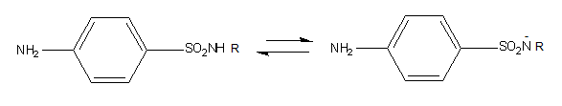
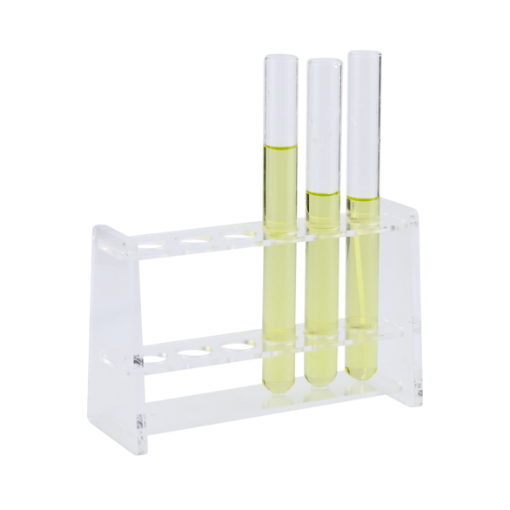
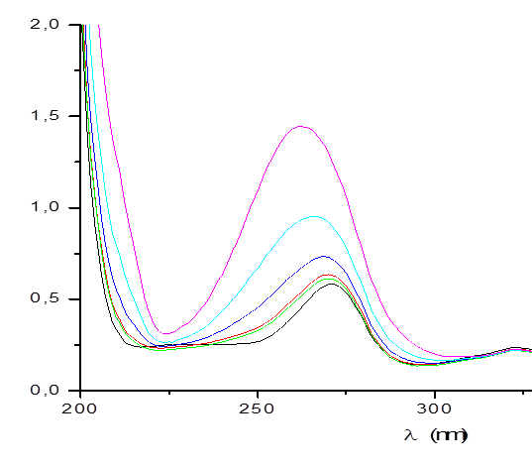
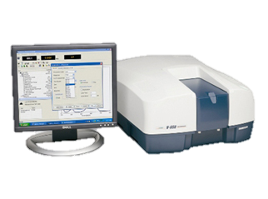
Solvatochromism of Norfloxacin and Sulfadiazine

Slide 3
Abstract: Fluoroquinolones (FQ) and sulfonamides (SA) are antibacterial substances used in therapeutics. Both are Active Pharmaceutical Ingredients (APIs) of low solubility. The solute-solvent interactions allow understanding of the drug´s absorption and the interactions involved in molecular recognition. This research aims to study Norfloxacin (NOR) and Sulfadiazine (SDZ) solvent interactions in pure solvents through experimental solvatochromism. Three apolar aprotic and six polar protic solvents were selected for this study. Multiparametric statistical analysis was performed with the methods of linear solvation energy relationship of Kamlet and Taft, Catalán, and Laurence. The results were analyzed by taking as reference the aprotic solvent, acetonitrile. In the case of SDZ, a shift towards shorter wavelengths (hypsochromic shifts) was observed when switching to nonpolar aprotic solvents, whereas in polar and some nonpolar protic solvents, the shifts were bathochromic (towards longer wavelengths). In the case of NOR, hypsochromic shifts were observed in most of the solvents tested, except 1-propanol, which exhibited a bathochromic shift. The Catalán and Laurence equation revealed that the highest relative contribution to NOR's behavior was attributed to the polarizability (π parameter). At the same time, for SDZ, it was the β parameter, representing hydrogen bond accepting capacity towards functional groups such as –NH₂, –SO₂NH, and –N, as indicated by the Kamlet and Taft and Catalán equations. The identification of key parameters contributing to these behaviors enhances our understanding of the solubility and molecular recognition of these antibacterial compounds.
Keywords: solvatochromism; norfloxacin; sulfadiazine; multiparametric analysis.

Slide 4
Introduction
Active pharmaceutical ingredients (APIs) interact with multiple environments throughout the entire manufacturing process and subsequent assimilation by the body. Therefore, it is essential to know the properties of APIs in different microenvironments to predict their pharmacokinetic and pharmacodynamic behavior and to provide valuable information for all pharmaceutical steps.
It is well known that solvent plays an important role in physical and chemical processes. The presence of specific and non-specific interactions between the solvent and the solute molecules is responsible for the change in several properties like the molecular geometry, the electronic structure, and the dipolar moment of the solute. These interactions affect the electronic absorption spectrum of the solute and this phenomenon is referred to as solvatochromism.
To distinguish between specific and nonspecific solute-solvent interactions it is necessary to consider quantitative measures of polarity.

Slide 5
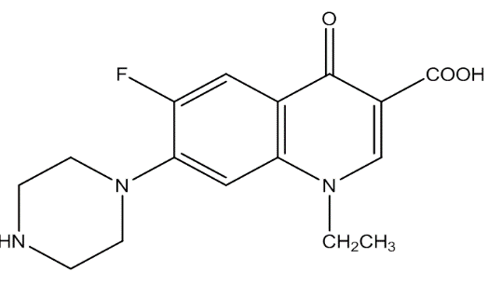

Thus, several multiparametric equations have been developed that combine two or more solvent parameters to explain the aspects of the solvent effect on a given compound, among them, those of Kamlet and Taft (Ec.1), Catalán (Ec.2) and Laurence (Ec.3) are the most employed.
A = A₀ + aα + bβ + sπ* (Ec. 1)
A = A₀ + a_{SA}SA + b_{SB}SB + c_{SP}SP + d_{SdP}SdP (Ec.2)
A = A₀ + diDI + eES + a₁α₁ + b₁β₁ (Ec.3)
To study the solute-solvent interactions of a representative of the antibacterial sulfonamide family (SA), sulfadiazine (SDZ), and one from the fluoroquinolone family (FQ), norfloxacin (NOR), in pure solvents through experimental solvatochromism with multiparametric statistical analysis.
The Aim
Figure 2. SDZ
Figure 1. NOR

Slide 6
Results and discussion
The results were analyzed by the following methods: Kamlet and Taft, Catalán, and Laurence. The wavenumber of maximum absorption (v_{max}), was related to the empirical solvent parameters of Kamlet-Taft equation: α, β, π*, Catalán equation: SA, SB, SP, SdP, and Laurence equation: DI, ES, α1, β1. The correlation study was carried out using multiparameter linear regression data analysis, taking v_{max} as the dependent variable and the former parameters as independent variables (Table 1).
Table 1. Nature and empirical solvatochromic parameters of solvents
 |  | Kamlet-Taft |  |  | Catalán |  |  |  | Laurence
Solvent | Nature | α | β | π | SA | SB | SP | SdP | DI | ES | α1 | β1
Cy | apolar | 0 | 0 | 0 | 0 | 0,073 | 0,683 | 0 | 0,78 | 0,00 | 0,00 | 0,00
nHex | aprotic | 0 | 0 | -0,11 | 0 | 0,056 | 0,616 | 0 | 0,71 | 0 | 0 | 0
AcN |  | 0,19 | 0,4 | 0,75 | 0,044 | 0,286 | 0,645 | 0,974 | 0,65 | 0,97 | 0,04 | 0,29
MeOH | protic | 0,98 | 0,66 | 0,6 | 0,605 | 0,545 | 0,608 | 0,904 | 0,61 | 0,90 | 0,61 | 0,55
EtOH |  | 0,86 | 0,75 | 0,54 | 0,4 | 0,658 | 0,633 | 0,783 | 0,63 | 0,78 | 0,40 | 0,66
1PrOH |  | 0,84 | 0,9 | 0,52 | 0,367 | 0,782 | 0,658 | 0,748 | 0,72 | 0,77 | 0,68 | 0,65
nButOH |  | 0,84 | 0,84 | 0,47 | 0,341 | 0,809 | 0,674 | 0,655 | 0,74 | 0,75 | 0,65 | 0,67
1OcOH |  | 0,77 | 0,81 | 0,4 | 0,299 | 0,923 | 0,713 | 0,454 | 0,78 | 0,63 | 0,66 | 0,74
Water |  | 1,17 | 0,47 | 1,09 | 1,062 | 0,025 | 0,681 | 0,997 | 0,65 | 0,89 | 1,54 | 0,37
Cy: cyclohexane; nHex: n-hexane; AcN: acetonitrile; MeOH: methanol; EtOH: ethanol;1PrOH: 1-propanol; nButOH: n-butanol; 1OcOH: 1-Octanol; α: the acidic capacity of the solvent; β: the basic capacity of the solvent; π*: polarity-polarizability of the solvent;
SA: solvent acidity; SB: solvent basicity; SP: solvent polarizability; SdP: dipolarity; DI: dispersion and induction interactions; ES: electrostatic interactions; α1: hydrogen-bond acidity of solvent; β1: hydrogen-bond basicity of solvents.

Slide 7

Figure 3. UV-Vis spectra of NOR in different organic solvents
Figure 4. UV-Vis spectra of SDZ in different organic solvents
Table 2. NOR and SDZ experimental values of wavelength and wavenumber.
 | NOR |  | SDZ
Solvent | λ_{max}(nm) | ν_{max}(cm⁻¹) | λ_{max}(nm) | ν_{max}(cm⁻¹)
Cy | 267,6 | 37,37 | 267,5 | 37,38
nHex | n.s | - | 266 | 37,59
AcN | 284,5 | 35,15 | 269 | 37,17
MeOH | 282 | 35,46 | 269,9 | 37,05
EtOH | 281,9 | 35,47 | 266,9 | 37,47
1PrOH | 285 | 35,09 | 271,1 | 36,89
nButOH | 283 | 35,34 | 271,1 | 36,89
1OcOH | 283 | 35,34 | 269 | 37,17
Water | 275,9 | 36,25 | 265,1 | 37,72

Slide 8
Norfloxacin
Table 3. Estimated coefficients and standard errors, correlations, significance, and the relative contributions percentage of the parameter’s coefficients for multiple linear regression analysis of NOR experimental data.
In the Kamlet and Taft analysis of NOR, it is observed the following contributions of the solvents (in descending order): hydrogen bond accepting capacity, originating from the -NH and -COOH groups of NOR; hydrogen bond donating capacity involving the -NH, -O, -COOH, and -N groups; and solvent polarity-polarizability in the presence of NOR, as depicted in Figure 1.
The results obtained from the Catalán analysis show that solvent polarizability represents the highest relative contribution. Similar findings were achieved with the Laurence analysis which shows a greater contribution from the DI parameter.
NOR
Kamlet and Taft
A₀ | a | b | s |  | R²
37,3±0,23 | 1,59±0,40 | -3,26±0,44 | -1,42±0,38 |  | 0,97
 | 25,36% | 51,99% | 22,65%
Catalán
A₀ | a_{sa} | b_{sb} | c_{sp} | d_{SdP} | R²
39,41±0,96 | 0,85±0,14 | -1,42±0,11 | -2,83±1,38 | -2,11±0,17 | 0,99
 | 11,79% | 19,70% | 39,25% | 29,26%
Laurence
A₀ | a₁ | b₁ | di | e | R²
40,41±1,13 | 0,67±0,13 | -1,29±0,32 | -3,89±1,42 | -2,49±0,39 | 0,99
 | 8,03% | 15,47% | 46,64% | 29,86%
A₀: property of the solute to be correlated. Correlation coefficients of polarity-polarizability of the solvent (s), acidity (a) and basicity (b) of the solvent in Kamlet and Taft analysis. Correlation coefficients of solvent polarizability (cSP), dipolarity (dSdP), solvent acidity (aSA), solvent basicity (bSB) in Catalán analysis. Regression coefficients of dispersion and electronic induction interactions (di), electrostatic interactions (e), acidity (a1) and basicity (b1) of the solvent in Laurence analysis; R2 : coefficient of determination.

Slide 9
Sulfadiazine
Table 4. Estimated coefficients and standard errors, correlations, significance, and the relative contributions percentage of the parameter’s coefficients for multiple linear regression analysis of SDZ experimental data.
In Kamlet and Taft analysis of SDZ, only the parameters α and β (solvent's ability to act as a donor and acceptor of hydrogen bond interactions) contribute to the solvatochromic effect. Considering both signs and magnitudes, the hydrogen bond accepting capacity (toward functional groups -NH₂ and -SO₂NH) emerges as the most critical parameter in the solvatochromism of this substance. The Catalán equation further reinforces the theory that the most significant parameter is the basicity of the solvents or their capacity to accept hydrogen bonds.
SDZ
Kamlet and Taft
A₀ | a | b | s |  | R²
37,5±0,13 | 0,57±0,27 | -1,11±0,34 |  |  | 0,8
 | 33,93% | 66,07%
Catalán
A₀ | a_{sa} | b_{sb} | c_{sp} | d_{SdP} | R²
37,54±0,12 |  | -0,62±0,21 |  |  | 0,74
 |  | 100%
Laurence
A₀ | a₁ | b₁ | di | e | R²
40,07±1,29 | 0,34±0,21 |  | -3,48±1,68 | -0,9±0,34 | 0,77
 | 0,63% |  | 73,73% | 19,07%
A₀: property of the solute to be correlated. Correlation coefficients of polarity-polarizability of the solvent (s), acidity (a) and basicity (b) of the solvent in Kamlet and Taft analysis. Correlation coefficients of solvent polarizability (cSP), dipolarity (dSdP), solvent acidity (aSA), solvent basicity (bSB) in Catalán analysis. Regression coefficients of dispersion and electronic induction interactions (di), electrostatic interactions (e), acidity (a1) and basicity (b1) of the solvent in Laurence analysis; R2 : coefficient of determination;.

Slide 10
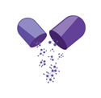
Conclusions
In this study, it was possible to analyze the solute-solvent interactions of norfloxacin and sulfadiazine in three apolar aprotic and six polar protic pure solvents, through experimental solvatochromism.
Multiparametric statistical analysis was performed with the method of linear solvation energy relationship of Kamlet and Taft, Catalán, and Laurence.
The highest relative contribution to NOR's behavior was attributed to the polarizability (π parameter). At the same time, for SDZ, it was the β parameter, representing hydrogen bond accepting capacity of the solvent.
The identification of key parameters contributing to these behaviors enhances our understanding of the solubility and molecular recognition of these antibacterial compounds.

Slide 11
Acknowledgments
The authors thank Vannier Laboratory for the donation of SDZ.
The authors acknowledge the financial support from CONICET and SCyT-UNPSJB.
All experimental procedures were performed at the laboratory of the GQM-CRIDECIT at the Facultad de Ciencias Naturales y Ciencias de la Salud of the UNPSJB.

