Slide 1
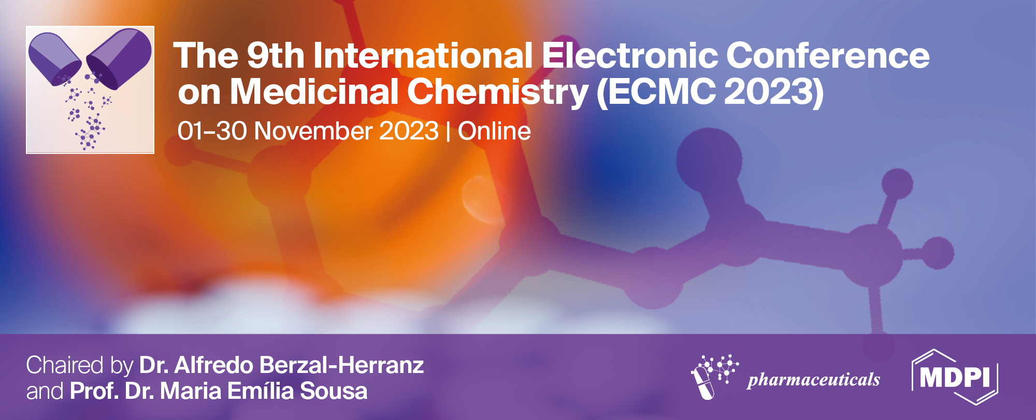
Substituted bifunctional Au(III)-2.2'-bipyridine complexes as potential PARP inhibitors
Svetlana Jeremić¹, Ana Kesić ², Jelena Đorović Jovanović², Biljana Petrović³
¹State University of Novi Pazar, University of Novi Pazar, Vuka Karadžića 9, 36300 Novi Pazar, Serbia
²University of Kragujevac, Institute for Information Technologies, Jovana Cvijića bb, 34000 Kragujevac, Serbia
³University of Kragujevac, Faculty of Science, R. Domanovića 12, 34000 Kragujevac, Serbia
*Correspondence: sjeremic@np.ac.rs

Slide 2
Substituted bifunctional Au(III)-2.2'-bipyridine complexes as potential PARP inhibitors

Slide 3
ABSTRACT:
INTRODUCTION
Cancer represents one of the most serious diseases today, with a high mortality rate. Chemotherapy is a primary therapeutic method for the treatment of many cancers. In the middle of the last century, following the discovery that cis-diaminedichloroplatinum (II) (cisplatin) inhibited Escherichia coli (E .coli) cell division, platinum chemotherapeutics played a key role in the treatment of a wide range of malignancies. Although the use of these drugs in chemotherapy has shown success, it has been proven that platinum-based therapy shows many side effects, including severe neurotoxicity. Inhibition of poly(ADP-ribose) polymerase (PARP), a nuclear enzyme activated upon DNA damage, represents one of the basic approaches to cancer treatment by applying targeted therapy. Platinum complexes are also widely used for this purpose. Finding new, less toxic drugs based on metal complexes would make a significant contribution to the treatment of malignancies. In this sense, the potential of the bifunctional Au(III) complexes to inhibit PARP was examined.
METHODOLOGY
In this sense, the potential of the bifunctional Au(III) complexes to inhibit PARP was examined. For that purpose, [AuCl2(bipy)]⁺ (bipy = 2.2'-bipyridine) complex, then complexes in which one and both Cl-atoms are substituted with L-cysteine are examined. The inhibitory activity of these gold complexes was compared with the inhibitory activity of cisplatin and oxyplatinum. Applied molecular docking analysis performed using.
RESULTS AND DISCUSSION
AutoDock 4.0 program indicated that the highest inhibition potency possess monosubstituted Au(III)(bipy) complex (ΔG_{bind}= -8.74 kcal/mol, K_{i}= 0.40 μM), while somewhat lower inhibition potency has disubstituted Au(III)(bipy) complex (ΔG_{bind}= -7.19 kcal/mol, K_{i}= 5.40 μM) and initial [AuCl₂(bipy)]⁺ complex (ΔG_{bind}= -6.84 kcal/mol, K_{i}= 9.73 μM). The appropriate thermodynamical parameters that illustrates the inhibition potency of oxyplatinum are ΔG_{bind}= -7.12 kcal/mol, K_{i}= 6.01 μM, and of cisplatin those are ΔG_{bind}= -4.46 kcal/mol, K_{i}= 535.61 μM. This indicates that the investigated Au(III) complexes have the potential to be used for targeted therapy and that it would be important to investigate their biological activity in vitro and in vivo in detail.
KEYWORDS:
Molecular docking, inhibition potential, Au(III)-2.2'-bipyridine complexes, substituted complexes, oxyplatinum, cisplatin.

Slide 4
INTRODUCTION
Cancer represents one of the most serious diseases today, with a high mortality rate. Chemotherapy is a primary therapeutic method for the treatment of many cancers.
In the middle of the last century, following the discovery that cis-diaminedichloroplatinum (II) (cisplatin) inhibited Escherichia coli (E .coli) cell division, platinum chemotherapeutics played a key role in the a wide range of malignancies [1].
Although the use of these drugs in chemotherapy has shown success, it has been proven that platinum-based therapy shows many side effects, including severe neurotoxicity.
Inhibition of poly(ADP-ribose) polymerase (PARP), a nuclear enzyme activated upon DNA damage, represents one of the basic approaches to cancer treatment by applying targeted therapy. Platinum complexes are also widely used for this purpose.
In recent years, a lot of research has been done on gold complexes as potential antitumor agents [2.3].
In this sense, the potential of the bifunctional Au(III) complexes to inhibit PARP was examined.
C. Zhu, J. Raber, L. A. Eriksson (2005) J. Phys. Chem B. 109 (24) 11006.
G. Moreno-Alcántar, P. Picchetti, A. Casini (2023) Angew. Chem. Int. Ed. 62 (22) e202218000 .
S. Yue, M. Luo, H. Liu, S. Wei (2020) Front. Chem. 8, 543.

Slide 5
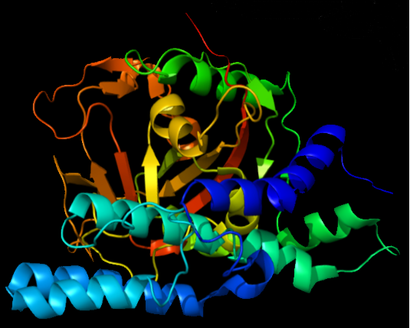
Figure 1. poly(ADP-ribose) polymerase (PARP)
Inhibition of poly(ADP-ribose) polymerase (PARP), a nuclear enzyme activated upon DNA damage, represents one of the basic approaches to cancer treatment by applying targeted therapy [4,5].
4. A. Chen (2011) Chin J. Cancer. 30 (7) 463–471.
5. J. S. Brown, B. O’Carrigan, S. P. Jackson, T. A. Yap (2017) Cancer Discov. 7 (1), 20–37.

Slide 6
[AuCl₂(bipy)]⁺
[AuCl(bipy)(Cys)]⁺
[Au(bipy)(Cys)₂]⁺
Figure 2. Optimized 3D structures (up) and 2D structures (down) of the evaluated gold-based ligands

Slide 7
cisplatin
oxyplatinum
Figure 3. Optimized 3D structures (up) and 2D structures (down) of the evaluated platinum-based ligands

Slide 8
METHODOLOGY
The DFT method M06-2X/6-311++G(d,p) (Gaussian 09 program package) is used for the optimization of the ligand structures [6].
Protein Data Bank (PDB ID: 6NTU) - three-dimensional (3D) crystal structure of human PARP-1 polymerase [7].
Discovery Studio Visualizer 4.0 - protein is released from the co-crystallized ligand, water molecules, and co-factors.[8].
AGFR (AutoGridFR) software – establishing the affinity maps of the target protein [9].
AutoDock 4.0 software – molecular docking simulations [10].
BIOVIA Discovery Studio - analysis of molecular docking simulation results and visualizations of predicted protein-ligand interactions [7].
6. M. J. Frisch, G. W. Trucks, H. B. Schlegel, G. E. Scuseria, M. A. Robb, et al. (2010) Gaussian 09. Revision C.01, Gaussian Inc, Wallingford.
7. L. Zandarashvili, M.F. Langelier, U.K. Velagapudi, M.A. Hancock, J.D. Steffen, et al. (2020) Science 368 (6486) 46.
8. D. S. Biovia (2017) Discovery studio modeling environment.
9. Y. Zhang, S. Forli, A. Omelchenko, M. F. Sanner (2019) J. Comput. Chem. 40 (32) 2882–2886.
10. G. M. Morris, R. Huey, W. Lindstrom, M. F. Sanner, R. K. Belew, et al. (2011) J. Comput. Chem. 30 (2009) 2785-2791.

Slide 9
RESULTS AND DISCUSSIONS

Slide 10
Table 1. Thermodynamic parameters corresponding to the most stable conformation of the protein-ligand complex obtained by docking analysis. The inhibition constant values (K_{i}) are presented in micromolars (μM), while all energy values are presented in kcal/mol (ΔG_{bind} - free energy of binding; ΔG_{inter}- final intermolecular energy; ΔG_{vdw+hbond+desolv}- sum of energy of dispersion and repulsion, hydrogen-bond energy, and desolvation energy; ΔG_{tor}- torsional free energy).
PARP-ligand complex | ΔG_{bind} | K_{i} | ΔG_{inter} | ΔG_{vdw+hbond+desolv} | ΔG_{tor}
PARP-[AuCl₂(bipy)]⁺ | -6.84 | 9.73 | -6.84 | -6.80 | 0.00
PARP-[AuCl(bipy)(Cys)]⁺ | -8.74 | 0.40 | -10.53 | -9.63 | 1.79
PARP-[Au(bipy)(Cys)₂]⁺ | -7.19 | 5.40 | -10.77 | -9.86 | 3.58
PARP-cisplatin | -4.46 | 535.61 | -5.06 | -2.84 | 0.60
PARP-oxyplatinum | -7.12 | 6.01 | -7.12 | -6.69 | 0.00

Slide 11
AGFR software predicted box with dimensions 98.799Å x 35.214Å x 55.068Å in -x, -y, and -z directions, and with spacing of 0.375 Å
AutoDock4 calculations: ten different conformations of protein-ligand complexes are set for molecular docking simulations.
A different number of conformations has been achieved at the final protein-ligand complex depending of the ligand rigidity.
The complete rigidity of the cisplatin structure gives only one complex conformation.
Figure 4. The location of the most probable binding site of PARP for all estimated ligands

Slide 12
That the highest inhibition potency possesses monosubstituted [AuCl(bipy)(Cys)]⁺ complex (ΔG_{bind} = -8.74 kcal/mol, K_{i} = 0.40 μM). It is the consequence of the strong intamolecular bonds (ΔG_{inter} = -10.53 kcal/mol)
Somewhat lower inhibition potency has been achieved with the disubstituted [Au(bipy)(Cys)₂]⁺ complex (ΔG_{bind} = -7.19 kcal/mol, Ki = 5.40 μM). The reason for the decrease in inhibitory activity is steric distraction, which is reflected in the increase in torsional energy (ΔG_{tor} = 3.58 kcal/mol).
[AuCl₂(bipy)]⁺ and oxyplatinum are rigid ligands, which is why they have a lower possibility of stabilizing the resulting complex by intramolecular bonds.
PARP-cisplatin is the weakest complex, and cisplatin is the weakest inhibitor of all considered here. This is due to the fact that in the case of the formation of the PARP-cisplatin complex, the smallest contribution to the stabilization of the complex comes from the energy of intramolecular interactions (ΔG_{inter} = -5.06 kcal/mol), as well as from the sum of energy of dispersion and repulsion, hydrogen-bond energy, and desolvation energy (ΔG_{vdw + hbond + desolv} = -2.84 kcal/mol). The calculated values of the mentioned energies are most likely a consequence of the rigidity of cisplatin, and the inability of this molecule to take any more favorable conformation that would allow for stronger intramolecular interactions to occur.

Slide 13
a
b
c
Figure 5. Docking positions of the PARP with [AuCl₂(bipy)]⁺ (a), [AuCl(bipy)(Cys)]⁺ (b), and [Au(bipy)(Cys)₂]⁺ (c) as ligands

Slide 14
d
e
Figure 6. Docking positions of the PARP with cisplatin (d), and oxyplatinum (e) as ligands

Slide 15
The most important types of interactions are:
Attractive charges
Conventional hydrogen bonds
Carbon hydrogen bonds
π – π stacking
π – anion interaction
The number of ligand-protein interactions is not the only parameter that affects the strength of inhibition, but it is also the type of interactions (hydrogen bonds, and interactions that include π - electrons).

Slide 16
CONCLUSIONS
AutoDock 4.0 program indicated that the highest inhibition potency possesses monosubstituted Au(III)(bipy) complex (ΔG_{bind} = -8.74 kcal/mol, K_{i} = 0.40 μM), while somewhat lower inhibition potency has disubstituted Au(III)(bipy) complex (ΔG_{bind} = -7.19 kcal/mol, K_{i} = 5.40 μM) and initial [AuCl₂(bipy)]⁺ complex (ΔG_{bind} = -6.84 kcal/mol, K _{i}= 9.73 μM).
The appropriate thermodynamical parameters that illustrate the inhibition potency of oxyplatinum are ΔG_{bind} = -7.12 kcal/mol, K_{i} = 6.01 μM, and of cisplatin, those are ΔG_{bind} = -4.46 kcal/mol, K_{i} = 535.61 μM.
This indicates that the investigated Au(III) complexes have the potential to be used for targeted therapy and that it would be important to investigate their biological activity in vitro and in vivo in detail.

Slide 17
ACKNOWLEDGMENTS
The authors are grateful to the Ministry of Education, Science and Technological Development of the Republic of Serbia (Agreement No. 451-03-47/2023-01/200252, No. 451-03-47/2023-01/200378, and No. 451-03-47/2023-01/200122).
STATE UNIVERSITY OF NOVI PAZAR
INSTITUTE FOR INFORMATION TECHNOLOGIES KRAGUJEVAC
UNIVERSITY OF KRAGUJEVAC, FACULTY OF SCIENCE
17

