Slide 1
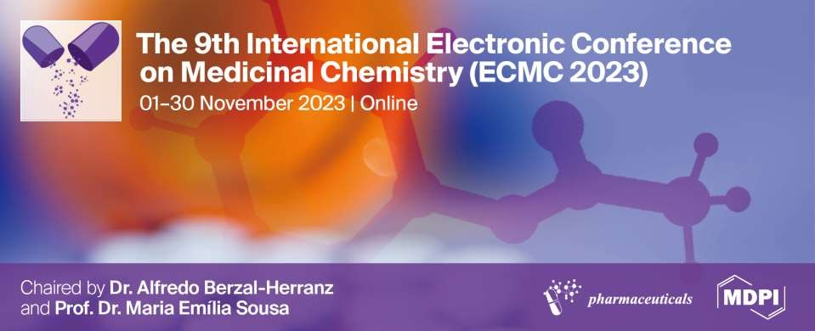
In Silico Investigation Of Novel Compounds Of Marine Origin As Potential Migrastatics: Molecular Docking And Molecular Dynamics Studies
Sunday Okafor ¹, Amarachi Njoku ^{2,}*, and Chibuike Okeke ¹
Department of Pharmaceutical and Medicinal Chemistry, University of Nigeria Nsukka
410001, Enugu State Nigeria;
Department of Pharmacology and Toxicology, University of Benin, P.M.B. 1154 Benin- City 300001, Edo State, Nigeria.
* Corresponding author: dramarachihelen@gmail.com

Slide 2
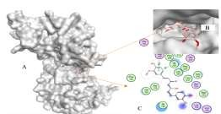
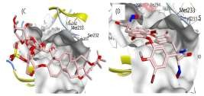
In Silico Investigation Of Novel Compounds Of Marine Origin As Potential
Migrastatics: Molecular Docking And Molecular Dynamics Studies
Graphical Abstract:
H C
Br
3
O
OH
Br
Br
O
_{N} O
Br
HN
O
Br
O
Br
O
O
N
NH
HO
N
OH O
Br
HO
OH
HO
Br
HO
CH₃
O
Marine compounds
Bastadin A, a potential migrastatics

Slide 3
Abstract:
Metastatic cancer has continued to be a global concern. Invasion and metastasis are the hallmarks of cancer responsible for most cancer morbidity and mortality. Studies have suggested that an attack against these processes could cause a major breakthrough in cancer therapeutics. Our conventional anti-cancer drugs are mainly cytotoxic (targeting cell proliferation) with lots of drawbacks like the emergence of resistance. Modern computational tools have played significant roles in drug discovery processes. This research aimed at building the dataset of marine compounds reported to have effects on invasion and metastasis and investigating their binding interactions and stability with dual-specificity tyrosine regulated kinase 2 (DYRK2) through rigid receptor molecular docking and molecular dynamics studies. Various pharmacokinetic and toxicity parameters were equally profiled for each of the compounds. 51 chemical compounds from 28 different species of marine organisms were reported to have migrastatic activity in vitro/vivo. 4 compounds with high binding affinity, stability in the binding cavity of DYRK2 and low toxicity were selected, of which compound 5, normonanchoidine H, an alkaloid isolated from Monanchora pulchra and compound 26, Bastadin A from Lanthella basta were the most promising lead molecules. Therefore, compounds of marine origins have significant migrastatic activity both in silico and in vitro and can be investigated further.
Keywords: marine organisms; migrastatics; molecular docking; molecular dynamics

Slide 4
Introduction
Cancer refers to abnormal and uncontrolled cell proliferation which has the tendency to invade and metastasize to other parts of the body.
The ability of a tumor cell to expand into a nearby cell is known as
invasion.
Metastasis is the dissemination of a tumor cell from a site of primary
origin to a distant secondary site.
Metastasis of cancer is the most significant characteristic of cancer
malignancy, and it is responsible for 85% of cancer-related deaths.

Slide 5
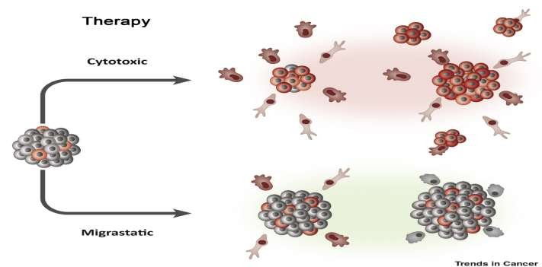
Migrastatics are drugs that interfere with all modes of cancer cell invasiveness and, consequently, with their ability to metastasize (inhibiting not only local invasion, but also extravasation and metastatic colonization).
https://www.cell.com/trends/cancer/fulltext/S2405-8033%2819%2930204-3

Slide 6
Tremendous breakthroughs have been made in drug discovery with the invention of computer-aided drug design (CADD).
CADD explores computational techniques to study the pharmacokinetic and toxicity profile of compounds, and the drug- receptor interactions to determine the binding potential and affinity of a given compound.
With a significant reduction in time and expense, the CADD technique has been crucial in the discovery and optimization of prospective lead compounds.

Slide 7
Results and Discussion
The compounds isolated from these organisms were mainly alkaloids and peptides, phenolics and polysaccharides with varying physicochemical, pharmacokinetic and toxicity properties.
Four compounds with high binding affinity, stability at the binding cavity of DYRK2, and low toxicity were selected, of which compound 5, normonanchoidine H, an alkaloid isolated from Monanchora pulchra, and compound 26, Bastadin A from Lanthella basta were the most promising lead molecules.

Slide 8
Compd No | Compound Name | Source | Activity (IC50/MIC) | In vitro cell model
5 | Normonanchocidine H (alkaloid) | Monanchora pulchra | 3.8μM | Human cervical carcinoma (HeLa cells)
26 | Bastadin A | Lanthella basta | 0.0523μM | HUVEC cells

Slide 9
Compd no | Water Solubility | Intestinal Absorption | VDss | BBB Permeability | CYP3A4 | Total Clearance | MRTD
5. | -3.199 | 73.328 | -0.603 | -2.171 | Yes | 1.164 | -0.084
26. | -3.505 | 100 | -0.846 | -2.229 | Yes | -1.559 | 0.169

Slide 10
Normonanchoidine H and Bastadin A have high intestinal permeability. A compound with absorbance less than 30% is considered to have poor intestinal absorption.
The volume of distribution at steady state (VDss) evaluates a drug’s ability to be distributed in the body. The higher the VD is, the more of a drug is distributed in the tissue than plasma. It is considered high if > 2.81L/kg (log VDss >0.45) and low if below 0.71L/kg (log VDss <-0.15). Normonanchoidine H and Bastadin A both have values below <-0.15 and are considered to have a high plasma to tissue distribution.
A compound is considered to readily cross the BBB if log BB> 0.3 and poorly distributed if LogBB <-1. The two compounds of interest also have low BBB permeability.
The maximum recommended tolerated dose (MRTD) gives an estimate of
toxic dose threshold of chemicals in humans. It is predicted to be high if
>0.477 and low if ≤ 0.477 log(mg/kg/day). The two compounds have
values ≤ 0.477 log(mg/kg/day) and are considered safe.

Slide 11
S/N | Compound | London dG | GBV/WSA
1. | Normonanchoidine H | -10.63 | -13.91
2. | Bastadin A | -11.03 | -13.12

Slide 12
The binding free energy, ∆G (kcal/mol) was calculated using two
different scoring functions: London dG and GBV/WSA
The ∆G data obtained after the docking studies showed that the tested compounds interacted favorably within the active site of target protein.
Normonanchoidine H and Bastadin A showed very low free energy (high binding affinity) after London dG scoring as well as rescoring with GBV/WSA.
Normonanchoidine H and Bastadin A demonstrated strong binding affinities of -10.63 and -11.03 respectively (London dG) when compared to the reference, curcumin (-8.26).

Slide 13
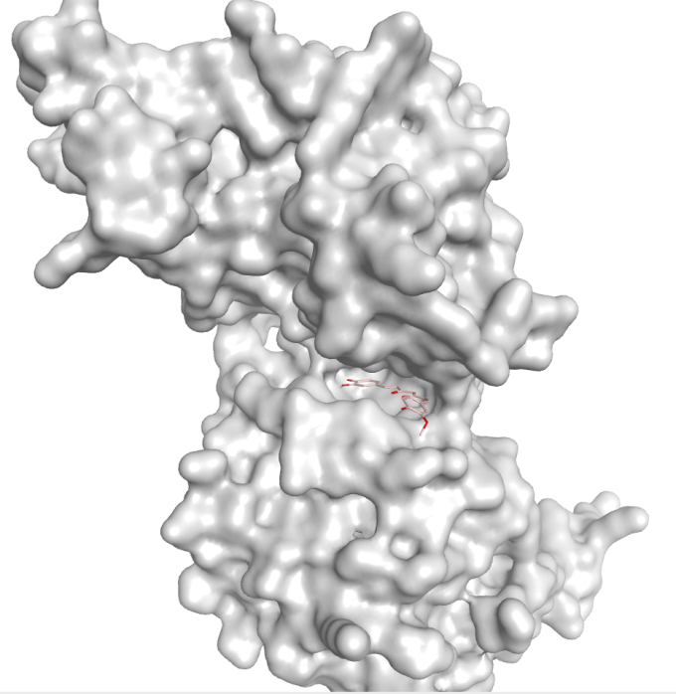
Structure of DYRK2 complexed with curcumin (A) Curcumin occupies the ATP-binding pocket of DYRK2. Curcumin atoms are shown in stick representation. DYRK2 is shown in a surface representation (white) (B) A zoomed area showing the curcumin in the active binding site of DYRK2 (C) Detailed 2D interactions between DYRK2 and curcumin.

Slide 14
Conclusions
We found that 51 chemical compounds from 28 different species of marine organisms were reported in literature to have migrastatic activity in vitro/vivo.
Both molecular docking and molecular dynamics studies corroborated the in vitro/in vivo studies.
Bastadin A and Normonanchoidine H, due to their high binding affinity to DYRK2, good pharmacokinetic profiles, low risks of toxicity, and high stability at the binding site of the protein, can serve as potential lead molecules for the development of effective and safe migrastatics.

Slide 15
Acknowledgments
We acknowledge the Young Researchers’ Forum of Nigeria (YRFN) for their training and mentoring.

Slide 16
References
Siegel, R. L., Miller, K. D., Fuchs, H. E., & Jemal, A. (2022). Cancer statistics, 2022. CA: A Cancer Journal for Clinicians, 72(1), 7–33. https://doi.org/10.3322/caac.21708
Bhardwaj, N., Goel, B., Tripathi, N., Sahu, B., & Jain, S. K. (2022a). A comprehensive review on chemistry and pharmacology of marine bioactives as antimetastatic agents. European Journal of Medicinal Chemistry Reports, 4, 100023. https://doi.org/10.1016/j.ejmcr.2021.100023
Hanahan D, Weinberg RA. Hallmarks of cancer: the next generation. Cell. 2011 Mar 4; 144(5):646-74.
Gandaloviˇcová, A.; Rosel, D.; Fernandes, M.;Vesely, P.; Heneberg, P.; Cerm ˇ ák, V.; Petruzelka, L.; Kumar, S.; Sanz-Moreno,V.; Brábek, J. Migrastatics-Anti-metastatic and Anti-invasion Drugs: Promises and Challenges. Trends Cancer 2017, 3, 391– 406.
Okafor, S. N., Angsantikul, P., & Ahmed, H. (2022). Discovery of Novel HIV Protease Inhibitors Using Modern Computational Techniques. International Journal of Molecular Sciences, 23(20). https://doi.org/10.3390/ijms232012149

