Slide 1
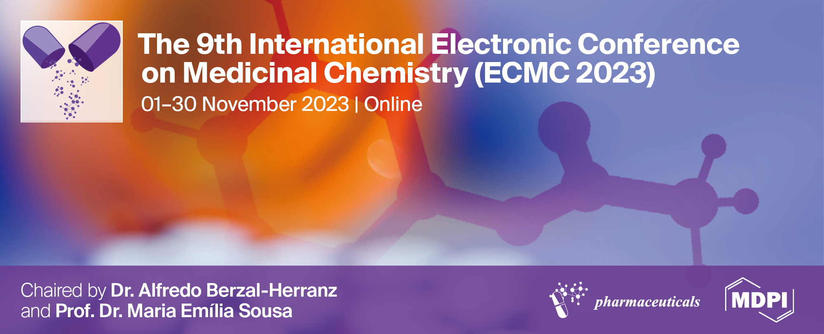
Title of the Presentation
Khaoula Mkhayar^{(a)}, Kaouakeb El khattabi ^{(b)} and Souad El khattabi ^{(a)}
a Laboratory of Engineering, Systems and Applications, National School of Applied Sciences, Sidi Mo-hamed Ben Abdellah-Fez University, Fez, Morocco.
b Department of Fundamental Sciences, Faculty of Medicine Dentistry, Mohammed V University, Rabat, Morocco.
* Corresponding author:*Corresponding Authors: K. Mkhayar: Khaoula.mkhayar@usmba.ac.ma S. Elkhattabi: souad.elkhattabi@usmba.ac.ma
In Silico Investigation of 2-Aryloxy-1,4-Naphthoquinone Derivatives as Potential Antibacterials Against Escherichia coli
Engineering, Systems and Applications Laboratory (LISA) National School of Applied Sciences, Sidi Mohamed Ben Abdellah-Fez

Slide 2
Abstract: In this research, a comprehensive analysis was conducted on 30 derivatives of naphthoquinone using computational methods such as 3D-QSAR modeling, assessment of drug similarity, ADMET analysis, molecular docking, and molecular dynamics simulations. The primary aim was to establish robust 3D-QSAR models employing CoMFA, aiming to identify potential novel antibacterial agents targeting Escherichia coli. The QSAR models exhibited strong predictive capabilities, as demonstrated by their assessments (Q2 = 0.613, R2 = 0.902, SEE = 0.063). Utilizing the QSAR model predictions, we devised four novel molecular structures. These structures were subsequently evaluated for drug likeness and ADMET predictions, with two compounds displaying exceptional ADMET predictions and drug likeness. Molecular docking was utilized to explore the interactions between the recently designed molecules, denoted as molecules 1 and 2, and the intended protein target. Of these, compound 2 displayed considerable stability based on the results obtained. To validate this stability, extensive molecular dynamics simulations were performed for 100 nanoseconds at three distinct temperatures, affirming the observed high stability.
Keywords: E. coli; QSAR; ADMET; Drug-likness; Molecular dynamics

Slide 3
Outline
1
Introduction
Generality of 3D-QSAR study and Molecular Docking, dynamics studies
2
3
Simulation Results
4
Conclusion
Notes:
The plan of our presentation is organized as follows:
*First, an introduction is given.
* Then, we briefly describe the 2D-QSAR and Molecular Docking techniques used in this work.
*Then the analysis of the results obtained
* and we will finish with a conclusion and perspectives

Slide 4
1-Introduction
100 molecules tested
10 drug candidates
1 drug candidate
10000 screened molecules
Commercialisation
2-3 years
1-2 years
10-12 years
1-2 years
The pharmaceutical industry is oriented towards new research methods based on molecular modeling, which permit to predict the biological activity and pharmacokinetics of compounds before synthesis
Notes:
On average, for every 10,000 molecules synthesized, evaluated and tested for their pharmacological properties, one molecule reaches the market as an innovative drug.The development of a drug generally requires more than ten years of research before it can be marketed.In order to reduce time, testing and cost, the pharmaceutical industry is moving towards new research methods based on molecular modeling, which allow the prediction of the biological activity of the molecule and its pharmacokinetics before synthesis.Translated with www.DeepL.com/Translator (free version)

Slide 5
Introduction
3D QSAR
Comparative molecular field analysis (CoMFA) studies are adopted to perform an analysis of steric and electrostatic effects in order to find the correct model. Steric and electrostatic interactions were calculated using at each intersection point an ordered divergent grid of 2 Å , and a default cut-off energy value of 30 kcal/mol

Slide 6
Develop 3D-QSAR models
Series of 38 derivative of 2-aryloxy-1,4-naphthoquinone
design new molecules
Molecular Docking
ADMET properties
Molecular dynamics
Notes:
In this context, the objective of this work is to develop 2D-QSAR models for a series of 38 molecules of 1,3-cyclohexane dione derivatives, in order to design new molecules and improve their potential biological activity against non-small cell lung cancer and to do molecular docking for the designed molecules with a study of ADMET properties to determine the molecule that can be considered as a c-met inhibitorTranslated with www.DeepL.com/Translator (free version)

Slide 7
2-aryloxy-1,4-naphthoquinone derivatives*
Notes:
Here is the series of 38 molecules of cyclohexane1,3 dione derivatives synthesized by Mohareb on which we performed 2D-QSAR and molecular docking studies in this work

Slide 8
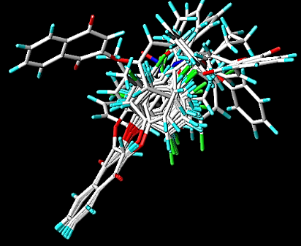
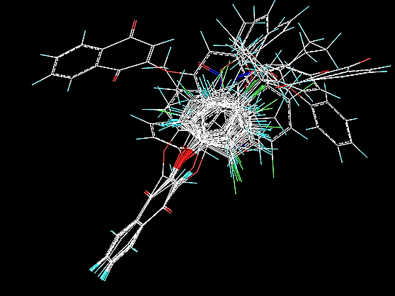
Results & Discussions
Alignement of molecules
Molecular alignment is a critical step in the development of any 3D-QSAR study. Figure 1 shows the alignment of the 17 molecules, with molecule 5b chosen as the model molecule to align the compounds in the series.
Figure 1: Alignement of molecules

Slide 9
Results & Discussions
PLS results Statistics of CoMFA
Model | R² | Q² | SEE | N | R_{ext}² | Fractions
 |  |  |  |  |  | Ster | Elec
CoMFA | 0.902 | 0.613 | 0.063 | 3 | 0.761 | 0.551 | 0.449
Ster: Steric
Elec: Electric
R²: Non-cross-validated correlation coefficient
Q²: Cross-validated correlation coefficient
Scv: Standard error of the estimate
N: Optimum number of components
R_{ext}²: External validation correlation coefficient
Notes:
The results obtained from the comparative molecular field analysis model (CoMFA) (R²=0.91; Q²=0.542) are significant,

Slide 10
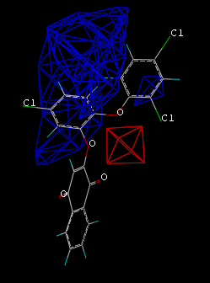
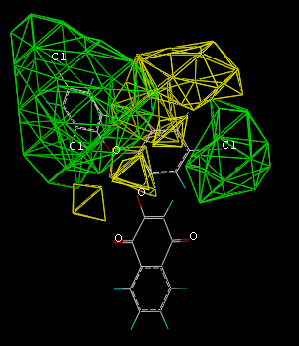
Results & Discussions
CoMFA contours maps
Figure 2: Std* coeff. contour maps of CoMFA analysis for antibacterial activity with 2 Å grid spacing in combination with compound. Electrostatic fields
Figure 3: Std* coeff. contour maps of CoMFA analysis for antibacterial activity with 2 Å grid spacing in combination with compound 5b. Steric fields
Notes:
followed by the analysis of contour maps to better analyze the steric and electrostatic fields that influence the activity. Using the structural characterizations obtained via the developed 3D-QSAR Pharmacophore model, new molecules derived from 1,2,3-triazole were designed and their biological inhibitory activities against breast cancer improved.

Slide 11
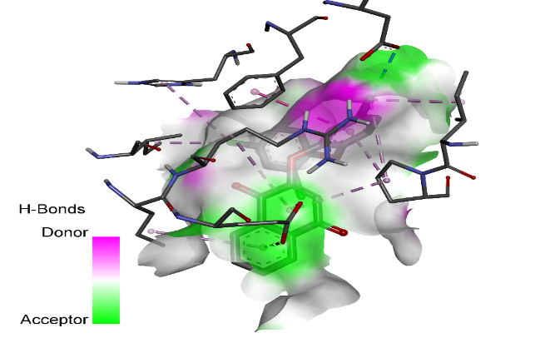
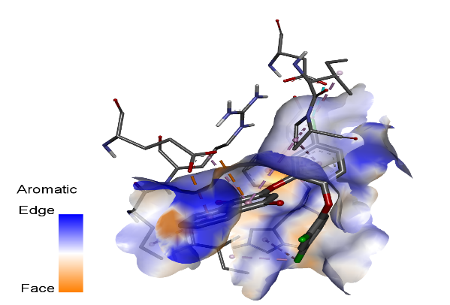
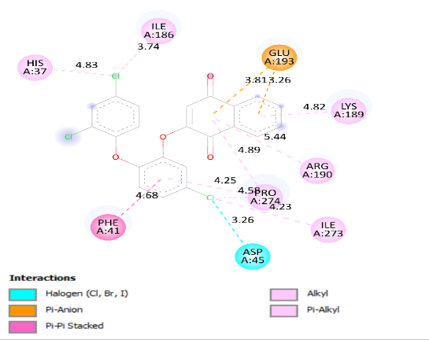
Results & Discussions
Fig 4: 3d and 2d interactions of reference 22 with receptor (pdb id code: 4WUB)
Notes:
. Molecular docking (Mkhayar et al. 2022) is applied to selected designed molecules to study the interactions and binding modes between the ligand (designed molecules) and the target. As a result, the designed molecules and the protein c-met (PDB code: 4WKQ) are linked by hydrophobic and hydrogen sites actives. (figure 2 and 3). The designed molecules might be used as new leads for the development of potent inhibitors of tyrosine kinase.

Slide 12
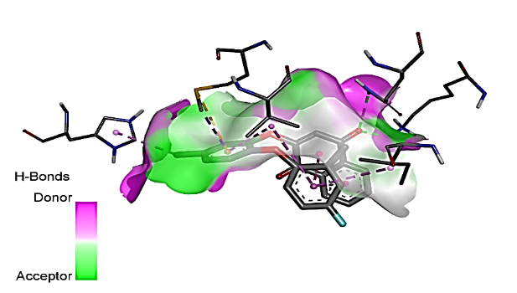
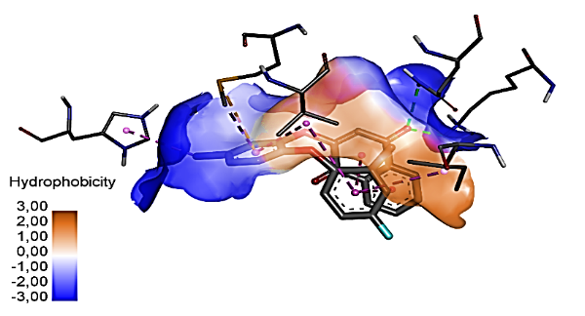
Results & Discussions
Fig 5: 3d and 2d interactions of ligand 1 with receptor (pdb id code: 4WUB)
Notes:
. Molecular docking (Mkhayar et al. 2022) is applied to selected designed molecules to study the interactions and binding modes between the ligand (designed molecules) and the target. As a result, the designed molecules and the protein c-met (PDB code: 4WKQ) are linked by hydrophobic and hydrogen sites actives. (figure 2 and 3). The designed molecules might be used as new leads for the development of potent inhibitors of tyrosine kinase.

Slide 13
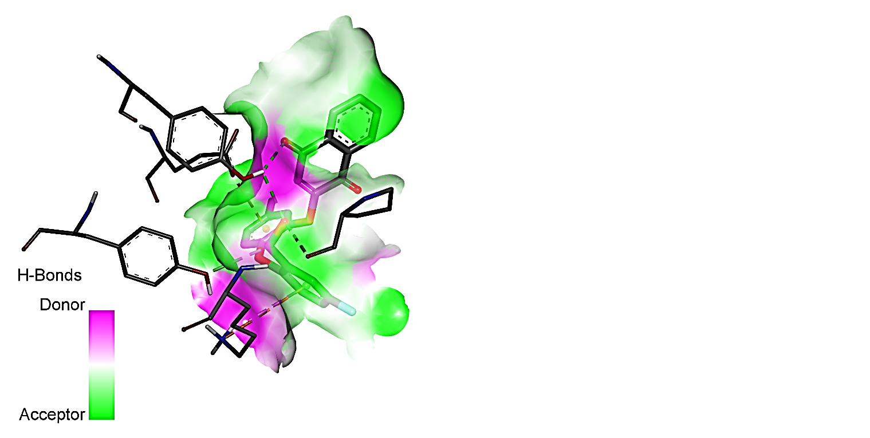
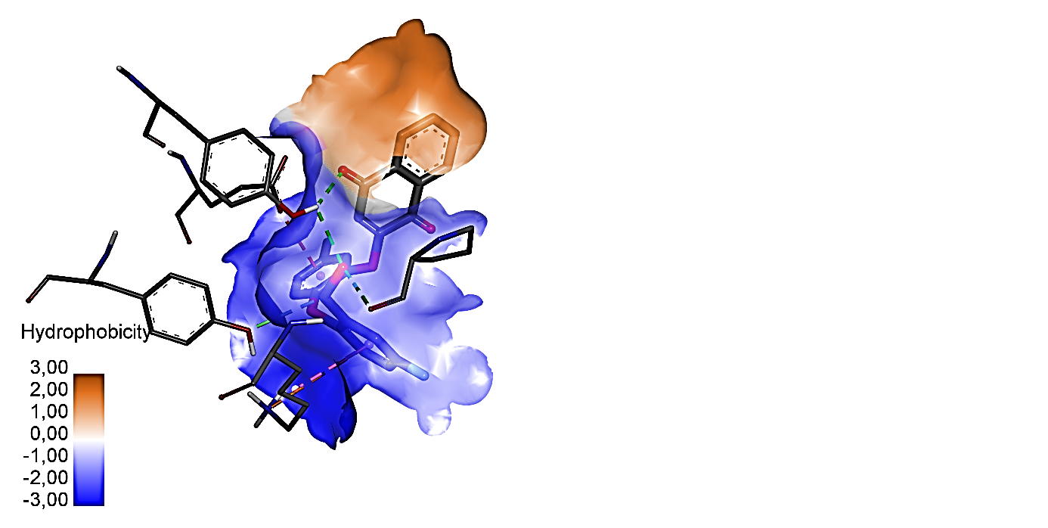
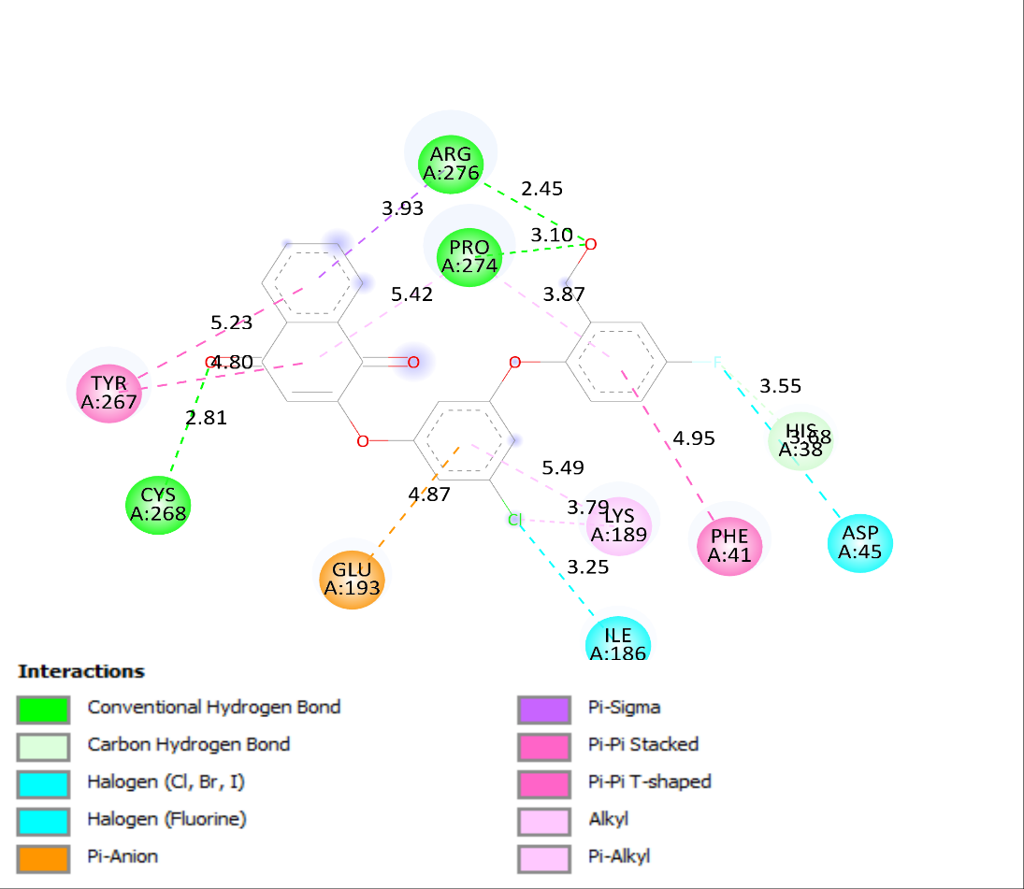
Results & Discussions
Fig 6: 3d and 2d interactions of ligand 2 with receptor (pdb id code: 4WUB)
Notes:
. Molecular docking (Mkhayar et al. 2022) is applied to selected designed molecules to study the interactions and binding modes between the ligand (designed molecules) and the target. As a result, the designed molecules and the protein c-met (PDB code: 4WKQ) are linked by hydrophobic and hydrogen sites actives. (figure 2 and 3). The designed molecules might be used as new leads for the development of potent inhibitors of tyrosine kinase.

Slide 14
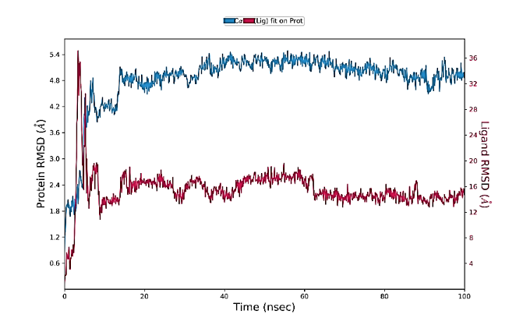
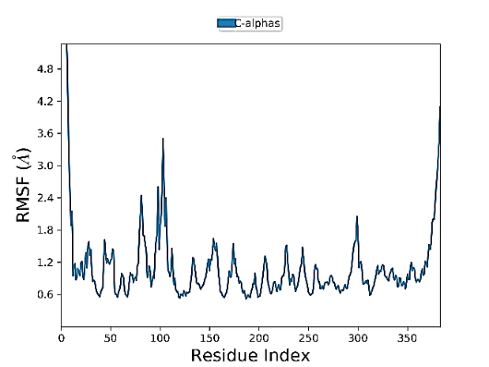
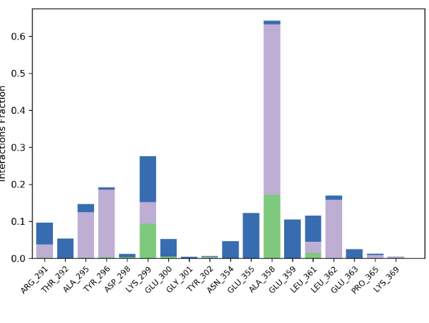
Results & Discussions
A
B
C
Fig 7: Molecular dynamics simulation of complex 2 at 300K (A) RMSD for 100 ns (B) RMSF (C) Protein (pdb:4WUB)-ligand interaction

Slide 15
Conclusions
In this work, we developed model 3D QSAR for 2-Aryloxy-1,4-Naphthoquinone Derivatives series as Potential Antibacterials Against Escherichia coli
We have designed 4 molecules based on the molecule that has the highest biological activity.
Among the four molecules designed, one molecules with high activities desmontred strong binding with the protein.
This molecule can be considered as a drug after conducting additional in vivo and in vitro investigations before the clinical trial procedure.
Notes:
Après l’evalution des proprietes ADMET prédites in silico pour les composés 2et 13 nous pouvons attirer que Le composé 13 peut etre considerer comme un medicament pour le traitement du cancer du poumon non à petites cellules (NLCSC) en inhibiant l’activité enzymatique de la protéine c-met.
En conclusion : dans ce travail, nous proposons le composé 13 comme nouveau inhibiteur de inhibiant l’activité enzymatique de la protéine c-met.
basés sur la structure des dérivés du cyclohexane 1,3dione. par l'intégration d'études moléculaires 2D-QSAR et Docking Moléculaire.
Les évaluations de drug-like indiquent que les molécules Xcomposé 13 peut être utilisé comme agent médicamenteux pour le NSCLC.
Les résultats de ce travail peuvent être adoptés pour examiner la stabilité du composé 13 proposées dans la poche de la protéine c-met par la simulation de la dynamique moléculaire.

Slide 16
Title of the Presentation
Graphical Abstract
Use one slide

