Slide 1
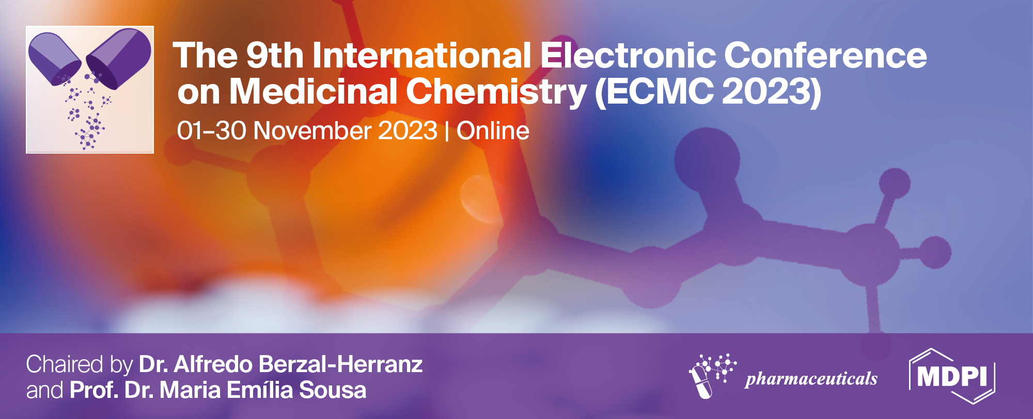
Со-encapsulation of doxorubicin and vorinostat in polymeric nanoparticles for the breast cancer therapy
Ivan Gulyaev ^{1,2,*}, Maria Sokol ^{1,*}, Mariia Mollaeva ¹, Maksim Klimenko ^{1,2}, Nikita Yabbarov ¹, Margarita Chirkina ¹, and Elena Nikolskaya ^{1,*}
¹ N.M. Emanuel Institute of Biochemical Physics, Russian Academy of Sciences, 4, Kosygina Str., 119334 Moscow, Russia
² Mendeleev University of Chemical Technology of Russia, 125047 Moscow, Russia
* Corresponding authors: 191900@muctr.ru (I.G.); msokol@sky.chph.ras.ru (M.S.); nikolskaya_ed@sky.chph.ras.ru (E.N.)

Slide 2
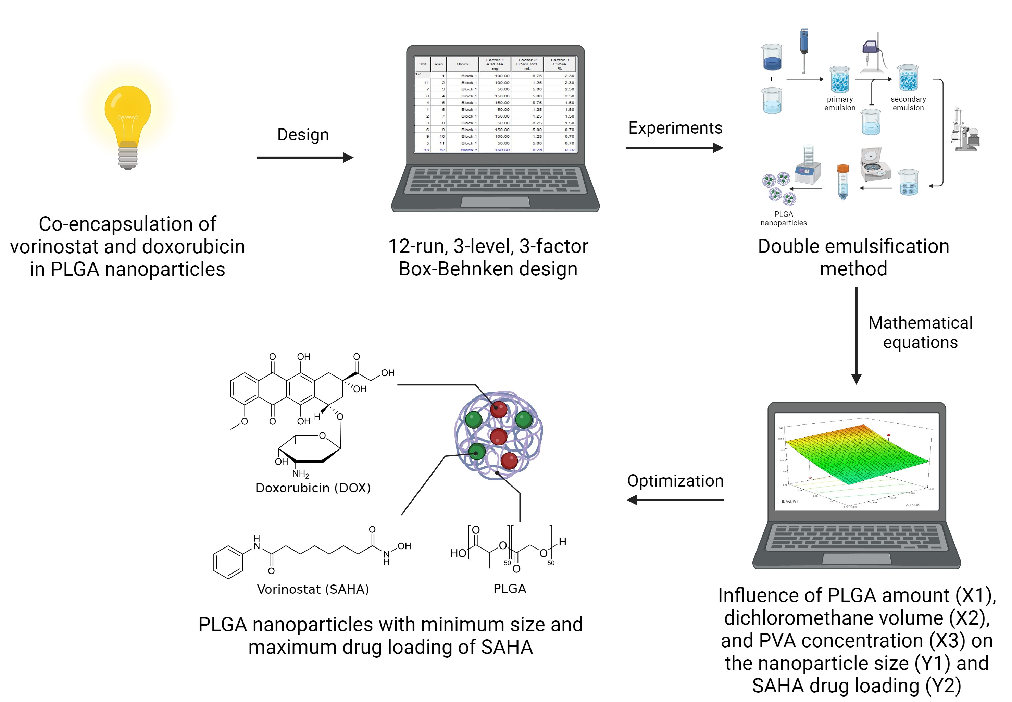
Со-encapsulation of doxorubicin and vorinostat in polymeric nanoparticles for the breast cancer
Graphical Abstract

Slide 3
Abstract: Recent data revealed that the combined administration of histone deacetylase inhibitors such as vorinostat (suberoylanilide hydroxamic acid, SAHA), with genotoxic agents, such as doxorubicin (DOX), enhances the antitumoral effects of both drugs against solid tumors. Herein we designed nanoparticles based on copolymer of lactic and glycolic acids (PLGA) simultaneously loaded with DOX and SAHA to provide synergy against tumor cells. We obtained the nanoparticles via double emulsion solvent evaporation technique with dichloromethane as the organic solvent and polyvinyl alcohol (PVA) as the emulsion stabilizer. To optimize the nanoformulation, a 12-run, three-factor, three-level Box-Behnken design was used. We investigated the influence of PLGA amount (X1), dichloromethane volume (X2), and PVA concentration (X3) on the nanoparticle size (Y1) and SAHA drug loading (Y2). Next, we optimize the factors via desirability function. After optimization the calculated values for nanoparticle size was 203 nm and for SAHA drug loading was 0.5 %. Experimental data revealed that optimized conditions provided the nanoparticles with a size of 207±8 nm and SAHA drug loading of 0.9 %, which is close to calculated data. Besides these parameters nanoparticles had ζ-potential of -18.0±4.6 mV and DOX drug loading of 2.1 %. The optimization approach used in this work allowed the determination of the factors required to produce nanoparticles with minimum size and maximum drug loading of SAHA. Furthermore, the calculated responses were close to the experimental data. Thus, the obtained dual-drug loaded PLGA nanoparticles had suitable physical properties for promising further studies in vitro and in vivo.
Funding: This study was supported by the Russian Science Foundation research grant No. 22-25-00293, https://rscf.ru/project/22-25-00293/
Keywords: vorinostat; doxorubicin; PLGA; breast cancer, Box-Behnken design

Slide 4
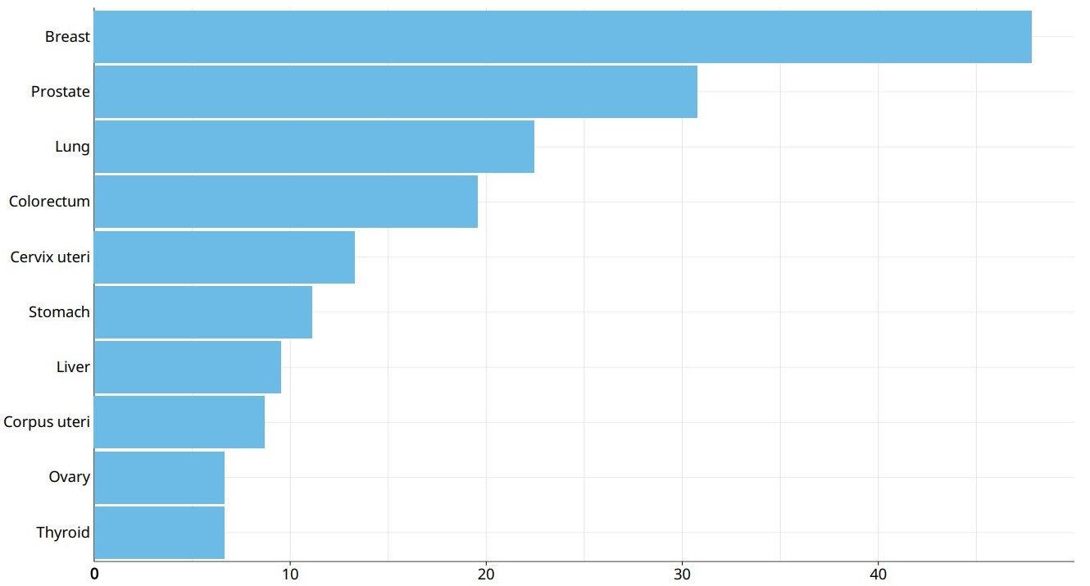
Introduction
Estimated age-standardized incidence rates in 2020, World, both sexes, all ages (excl. Non-Melanoma Skin Cancer) [1]
ASR (World) per 100 000
[1] Data source: Globocan 2020 Graph production: Global Cancer Observatory (http://gco.iarc.fr)

Slide 5
Introduction
Vorinostat is a histone deacetylase inhibitor, an FDA-approved antitumor agent for the treatment of T-cell lymphoma that can enhance anthracycline type II topoisomerase inhibitor cytotoxicity through chromatin decondensation.
Doxorubicin is an anthracycline antibiotic, a cytostatic drug approved by the FDA for the treatment of solid tumors. Its antitumor activity is due to its ability to intercalate into the DNA helix and/or covalently bind to proteins involved in DNA replication and transcription.
In a phase I clinical trial, Munster et al. found that the combination of doxorubicin and vorinostat was promising and safe in the treatment of solid tumors [2].
Chemical structure of vorinostat (SAHA)
Chemical structure of doxorubicin (DOX)
[2] Munster, P., Marchion, D., Thomas, S. et al. Phase I trial of vorinostat and doxorubicin in solid tumours: histone deacetylase 2 expression as a predictive marker. Br J Cancer 101, 1044–1050 (2009). https://doi.org/10.1038/sj.bjc.6605293

Slide 6
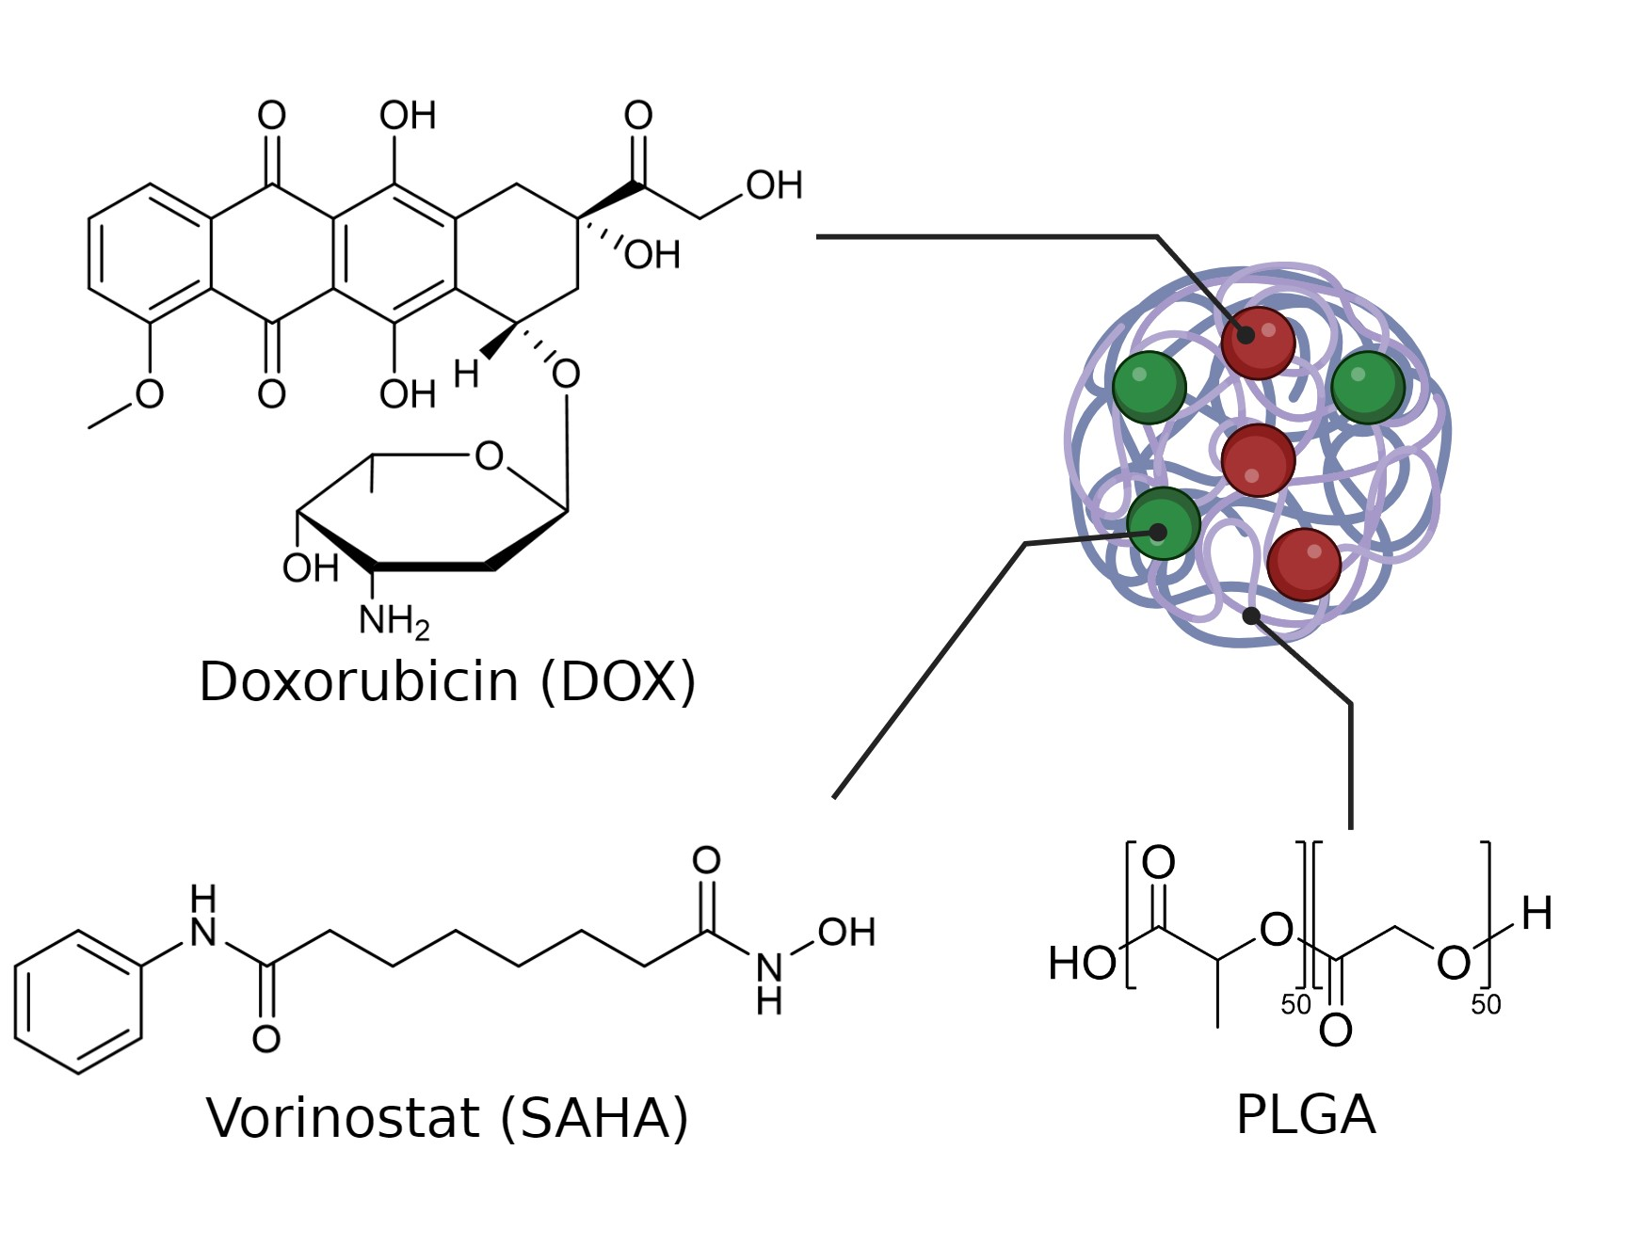
Introduction
Poly(lactic-co-glycolic acid) (PLGA) is a biocompatible and biodegradable polymeric material approved by the FDA for clinical use.
Chemical structures of the polymer matrix and anticancer drugs
Hydrolysis of PLGA [4]
The aim of this work was to develop a method for the synthesis of PLGA nanoparticles loaded with doxorubicin and vorinostat for the combination therapy of triple-negative breast cancer
[3] Danhier, F., Ansorena, E., Silva, J. M., Coco, R., Le Breton, A., & Préat, V. (2012). PLGA-based nanoparticles: An overview of biomedical applications. Journal of Controlled Release, 161(2), 505–522. doi:10.1016/j.jconrel.2012.01.043

Slide 7
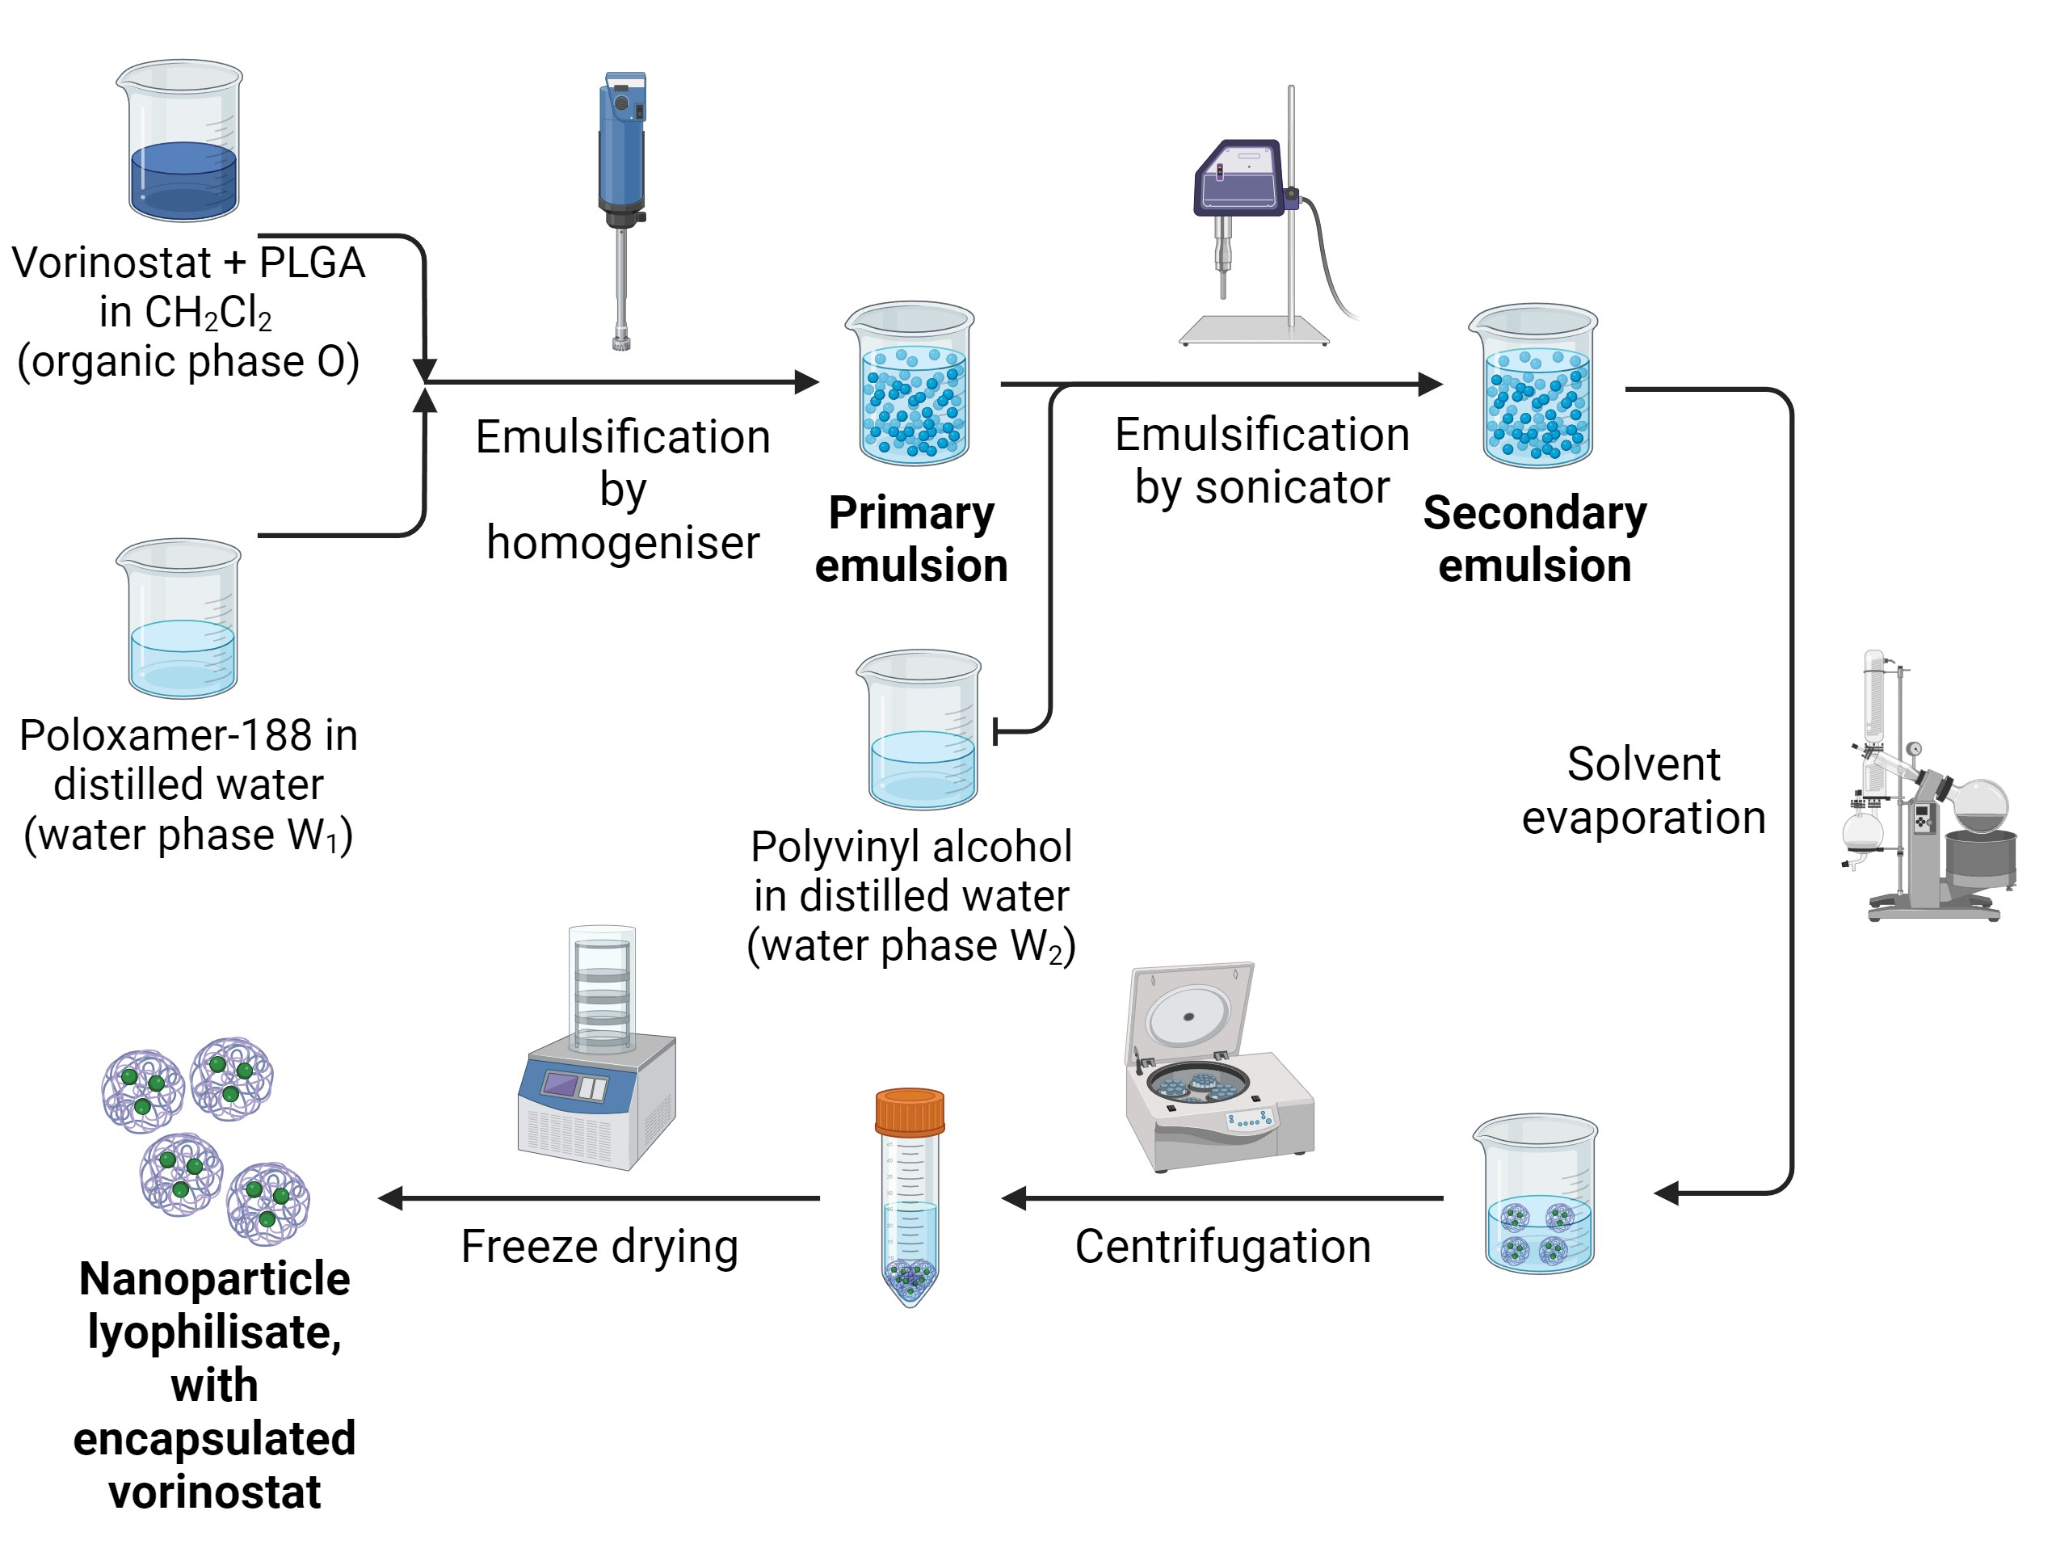
Results and discussion
Variables and constrains in Box–Behnken experimental design
 | Levels
 | -1 | 0 | 1
Independent variables
X1: PLGA amount, mg | 50 | 100 | 150
X2: CH₂Cl₂ volume, ml | 1.25 | 5 | 8.75
X3: PVA concentration, % | 0.7 | 1.5 | 2.3
Dependent variables | Constraints
Y1: Nanoparticle size (PS), nm | Minimize
Y2: Drug loading of vorinostat (DL), % | Maximize
Double emulsion solvent evaporation method used in this work

Slide 8
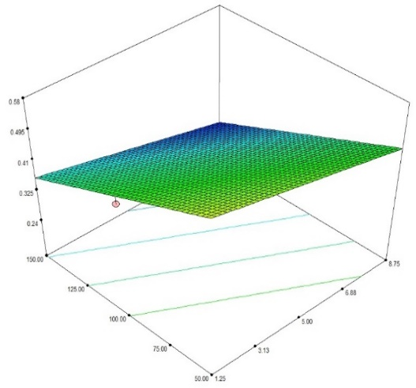
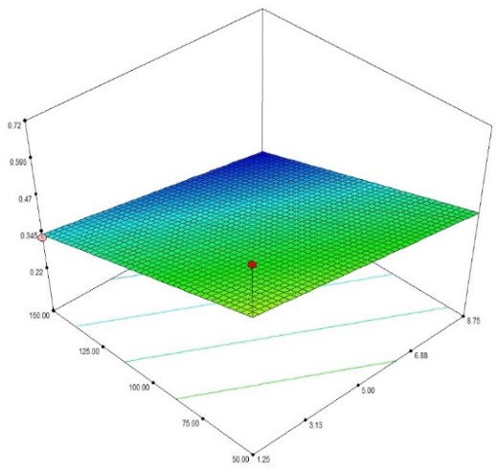
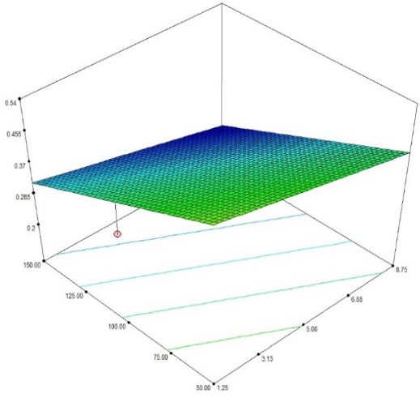
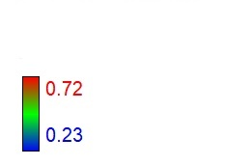
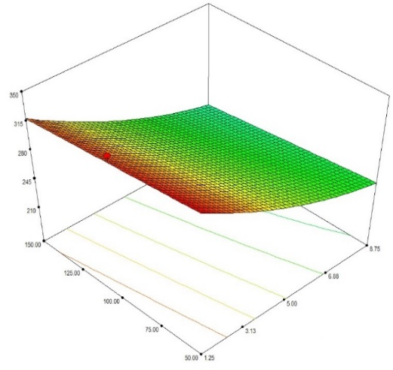
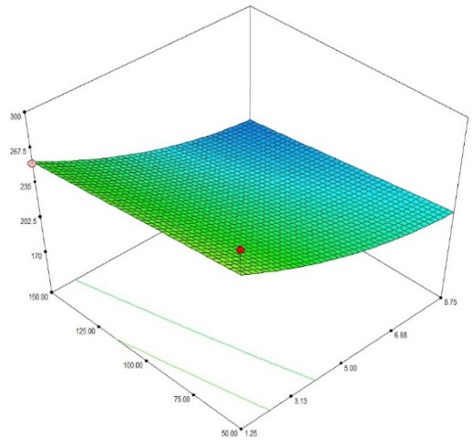
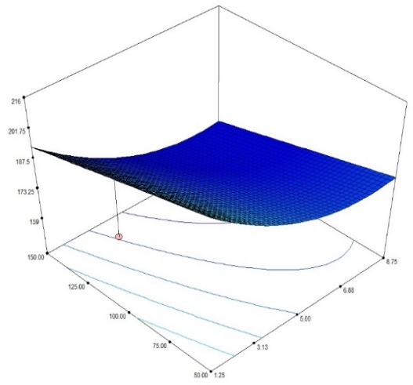
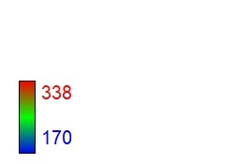
Results and discussion
A
B
C
SAHA DL, %
SAHA DL, %
SAHA DL, %
Design-Expert® Software
Drug loading of SAHA,
%
PLGA, mg
CH₂Cl₂, ml
PLGA, mg
CH₂Cl₂, ml
PLGA, mg
CH₂Cl₂, ml
D
E
F
PS, nm
PS, nm
PS, nm
PS, nm
Design-Expert® Software
Particle size, nm
PLGA, mg
CH₂Cl₂, ml
PLGA, mg
CH₂Cl₂, ml
PLGA, mg
CH₂Cl₂, ml
Response surface plots of SAHA drug loading (A-C) and particle size (D-F) as a function of PLGA mass and dichloromethane volume at constant values of PVA concentration
(A, D - 0.7 %; B, E - 1.5 %; C, F - 2.30 %)

Slide 9
Results and discussion
A maximum desirability corresponded to the conditions:
Value of desirability function [4] | Amount of PLGA (X₁), mg | Dichloromethane volume (X₂), ml | PVA concentration (X₃), % | Expected particle size (Y₁), nm | Expected SAHA DL (Y₂), %
0,653 | 50 | 2,5 | 2,3 | 203 | 0,51
[4] George Derringer & Ronald Suich (1980) Simultaneous Optimization of Several Response Variables, Journal of Quality Technology, 12:4, 214-219, DOI: 10.1080/00224065.1980.11980968

Slide 10
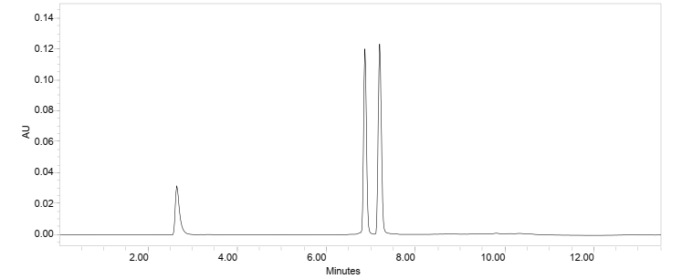
Results and discussion
DOX
SAHA
DMSO
The chromatogram of standard mixture solution containing 25 μg/mL of DOX and 25 μg/mL of SAHA. The separation was performed using a Nucleodur C-18 Gravity column (250 mm × 4.6 mm × 5 µm) Determination wavelength 240 nm; Flow rate 1.08 ml/min; Gradient elution mode (time, min/%B) 0/10, 8/74, 8.5/10, and 13.5/10); Injection volume 10 µl; Mobile phase A – 10 mM potassium dihydrogen phosphate solution (pH 3.9) in milli-Q H2O, B – acetonitrile [5]
[5] Sokol M, Gulyaev I, Mollaeva M, Kuznetsov S, Zenin V, Klimenko M, Yabbarov N, Chirkina M, Nikolskaya E. Box-Behnken assisted development and validation of high-performance liquid chromatography method for the simultaneous determination of doxorubicin and vorinostat in polymeric nanoparticles. J Sep Sci. 2022;1–13. https://doi.org/10.1002/jssc.202200731

Slide 11
Results and discussion
Physico-chemical parameters of PLGA nanoparticles obtained by an optimized technique loaded with vorinostat and a combination of vorinostat and doxorubicin
Antitumor drugs | Drug loading of SAHA, % | Drug loading of DOX,% | Particle size, nm | PDI | Zeta potential, mV
SAHA | 0.91 (Expected value 0.51) | - | 197±77 (Expected value: 203) | 0.100 | -14.4±4.01
SAHA and DOX | 0.89 | 2.11 | 207±82 | 0.096 | -18.0±4.63

Slide 12
Conclusions
In this work, a method for the preparation of PLGA nanoparticles loaded with vorinostat was developed and optimized.
Based on the developed method, PLGA nanoparticles loaded with a combination of doxorubicin and vorinostat were obtained.
The obtained dual-drug loaded PLGA nanoparticles had suitable physical properties for promising further studies in vitro and in vivo

Slide 13
Acknowledgments
Some of the figures in this presentation were created with the help of BioRender.com

