Slide 1
The 4th International Electronic Conference on Applied Sciences
27 Oct–10 Nov 2023 Online
Investigation of the structural and optical properties of ACZTS solid solution
Presented By:
KOUACI Khaled
Authors: Kouaci Khaled^{*1, 2}, Belkhettab Ilyas², Tablaoui Meftah², Derbal Mourad¹, Khelfane Amar², Latreche Slimane³.
Session: Applied Physical Science

Slide 2
Presentation outline
Introduction
Experimental details
Results and discussion
Conclusion
1
Notes:
This presentation is structured as follows....

Slide 3
Introduction
Quaternary Chalcogenide Cu₂ZnSnS₄ material: Made from ecofriendly and abundant elements.
Large absorption coefficient ~ 10⁴ cm⁻¹. Direct band gap energy of about 1,5 eV.
Wide tunability of its structural and optical properties through elements substitution.
To focus on the effect of substituting Cu with Ag on the structural and optical properties of the solid solution (Ag_{x}Cu_{1-x})₂ZnSnS₄ (ACZTS).
Elements from Group :
Ⅰ
Ⅱ
Ⅲ
Ⅳ
Ⅴ
Ⅵ
(Ⅳ): Si
Iindirect bandgap
Intensive purification process
Diamond cubic
(Ⅱ-Ⅵ): ZnS, CdTe
Toxicity of Cd
Scarcity and cost of Te
Zinc blende
(Ⅰ-Ⅲ-Ⅵ₂): Cu(In,Ga)Se₂
Scarcity and cost
of In and Ga
Chalcopyrite
(Ⅰ₂-Ⅱ-Ⅳ-Ⅵ₄): Cu₂ZnSn(S,Se)₄
Kesterite
Path from Si to quaternary chalcogenide (Ⅰ₂-Ⅱ-Ⅳ-Ⅵ₄) compound Semiconductors
2

Slide 4
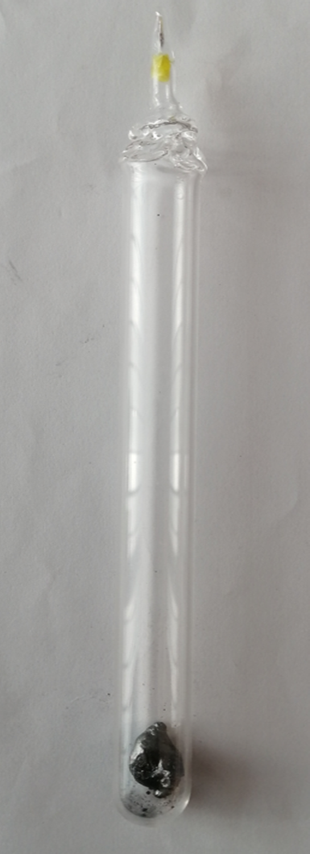
Experimental details
Polycrystalline (Ag_{x}Cu_{1-x})₂ZnSnS₄ x = 0.0 (AC00), 0.25 (AC25), 0.50 (AC50), 0.75 (AC75), 1 (AC100) have been synthesized via solid state reaction as follows :
Sealing a fused quartz ampoule loaded with raw material mixtures under vacuum
Heating the sealed ampoules to above the melting point of the compounds (980-1100°C)
Cooling the ampoule in a controlled manner by lowering the furnace temperature
retrieving the synthesized material
(ACZTS)
AC75 sample
Obtained ingot
The temperature profile programmed in the electrical tubular furnace
3

Slide 5
Results and discussion
For x=0 (CZTS), a distinct diffraction lines with the presence of main peaks at (112), (200), (220), (132) and (116) corresponding to the Kesterite CZTS structure.
The position of diffraction line shifts toward a low angles with the increase of Ag content.
As x=0.71, the (200), (220) and (312) start splitting up.
The dominant phase with a kesterite (CZTS) type-structure is gradually shifted into perquitasite-AZTS type structure.
As x=1 (AZTS), the (004), (204) and (116) peaks associated with tetrahedral perquitasite AZTS type structure appear.
Secondary phases, mainly (ZnS) in all compositions and others such as CuS, CTS in x=0 and SnS, SnS2 in x=1, are also revealed by XRD analysis.
XRD powder analysis of the five synthesized
(Ag_{x}Cu_{1-x})₂ZnSnS₄ ( 0 ≤ x ≤ 1) samples
4

Slide 6
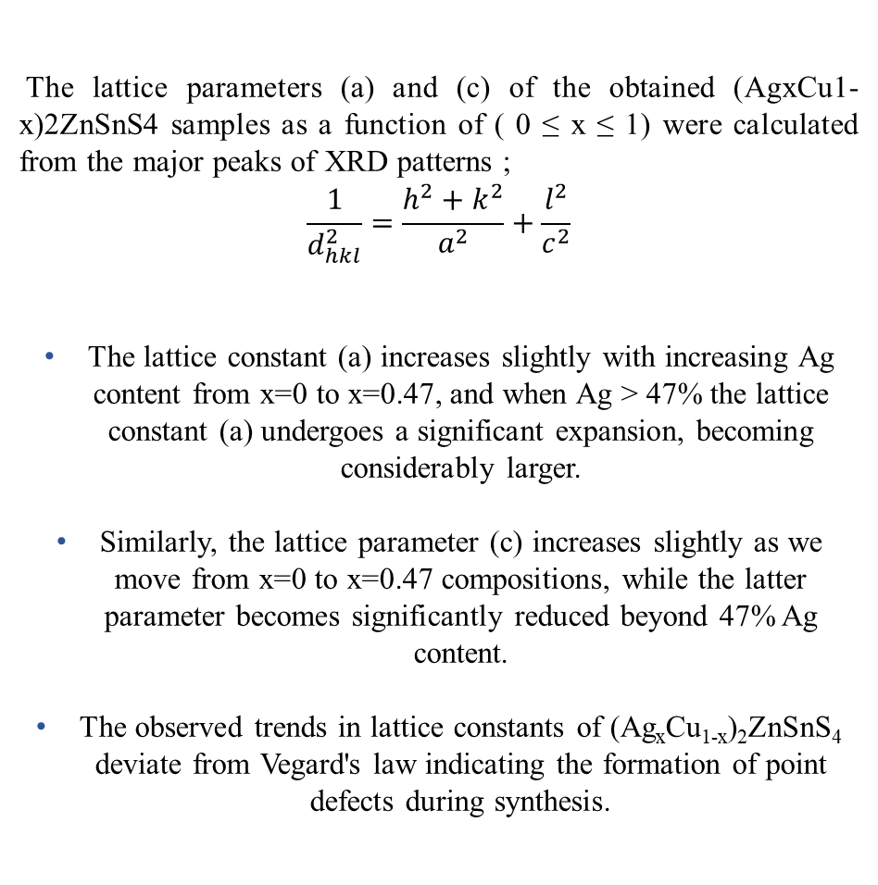
Results and discussion
The lattice parameters (a) and (c) of the obtained (AgxCu1-x)2ZnSnS4 samples as a function of ( 0 ≤ x ≤ 1) were calculated from the major peaks of XRD patterns ;
$$\frac{1}{d_{hkl}^{2}}=\frac{h^{2}+k^{2}}{a^{2}}+\frac{l^{2}}{c^{2}}$$
The lattice constant (a) increases slightly with increasing Ag content from x=0 to x=0.47, and when Ag ˃ 47% the lattice constant (a) undergoes a significant expansion, becoming considerably larger.
Similarly, the lattice parameter (c) increases slightly as we move from x=0 to x=0.47 compositions, while the latter parameter becomes significantly reduced beyond 47% Ag content.
The observed trends in lattice constants of (Ag_{x}Cu_{1-x})₂ZnSnS₄ deviate from Vegard's law indicating the formation of point defects during synthesis.
Lattice parameters trend of the obtained
(AgxCu1-x)2ZnSnS4 samples
5

Slide 7
Results and discussion
Optical properties of (Ag_{x}Cu_{1-x})₂ZnSnS₄, performed by UV-Vis diffuse reflectance measurements.
The optical properties could be tuned by varying the Ag content.
Due to the presence of secondary phases and points defects, the variation of the band gap does not depend linearly on Ag concentrations
Band gaps of (Ag_{x}Cu_{1-x})₂ZnSnS₄ from diffuse reflectance spectroscopy measurements
6

Slide 8
Conclusion
The objective of this study was to prepare solid solutions of ACZTS by carefully following the steps of the solid state synthesis aiming to investigate the impact of the partial and total substitution of Cu by Ag on the properties of the CZTS absorber properties.
XRD powder analysis showed a noticeable pattern variation in the structural characteristics of the CZTS lattice. The diffraction lines are slightly shifted to lower angles with increasing Ag content, the perquitasite type AZTS structure peaks appeared in fully substituted compounds, implying that substitution of the Cu site by Ag occurs.
The lattice constants exhibit non-linear trends that deviate from Vegard's law as a consequence of defects formation during the synthesis, indicating that the formation of a solid solution within the (Ag_{x}Cu_{1-x})₂ZnSnS₄ material did not occur as expected.
UV-Vis diffuse reflectance measurements showed that optical properties could be tuned by varying the Ag content, however, due to the presence of secondary phases, the variation of the band gap does not depend linearly on Ag concentrations.
Our results provide valuable insights into the effect of Ag substitution on the structural and optical properties of CZTS, and offer directions for further research into the nature of the defects observed in our samples, including additional characterization techniques namely XPS (X-ray photoelectron spectroscopy) and PL (photoluminescence)…
7
7

Slide 9
THANK YOU

Slide 10
References :
M. Tablaoui, M. Derbal, and K. Lebbou, “Discussion on the purity and the crystallization of CZTS compound,” J Cryst Growth, vol. 452, pp. 131–134, Oct. 2016, doi: 10.1016/j.jcrysgro.2016.04.008.
S. Alee, M. Asemi, M. Soltanmohammadi, and M. Ghanaatshoar, “Phase evolution studies of mechanochemical-prepared Cu2ZnSnS4powder via comprehensive annealing and milling investigation,” Powder Diffr, vol. 37, no. 1, pp. 22–33, Mar. 2022, doi: 10.1017/S0885715621000646.
Y. E. Romanyuk et al., “Doping and alloying of kesterites,” JPhys Energy, vol. 1, no. 4, Oct. 2019, doi: 10.1088/2515-7655/ab23bc.
A. Khelfane, M. I. Ziane, M. Tablaoui, M. Hecini, D. Ouadjaout, and M. Derbal, “Composition dependence of the optical band gap and the secondary phases via zinc content in CZTS material,” Inorg Chem Commun, vol. 151, p. 110639, May 2023, doi: 10.1016/j.inoche.2023.110639.

