Slide 1
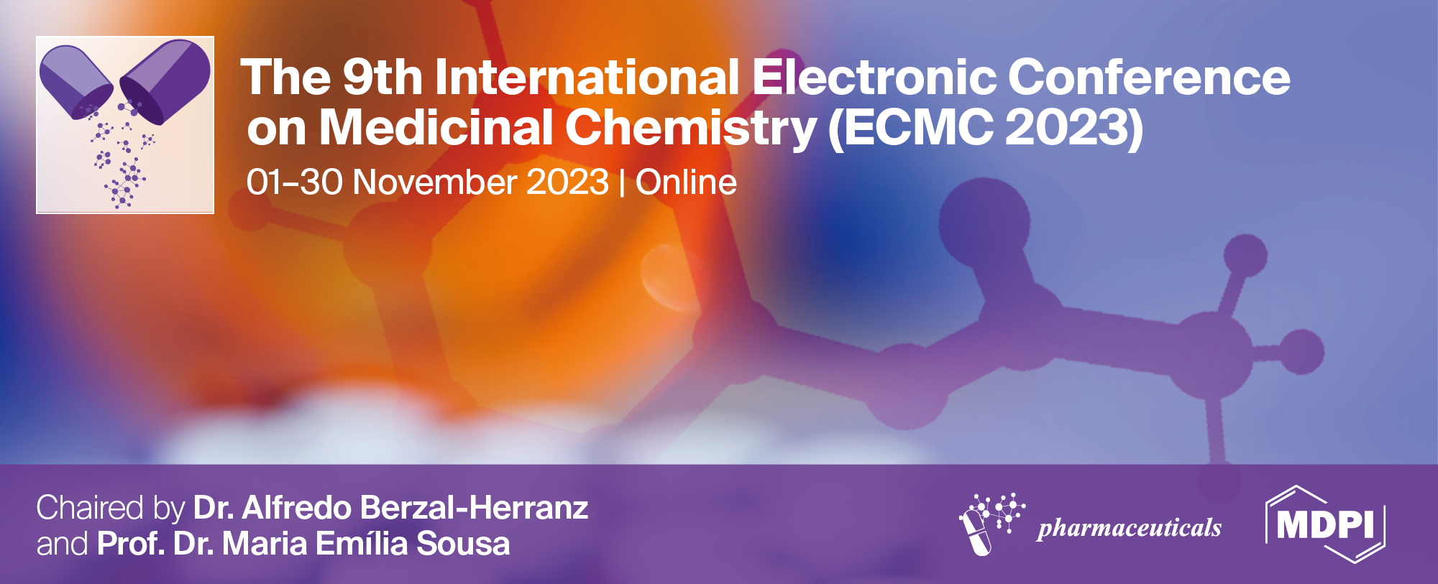
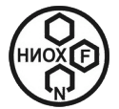
Soloxolone amide sg-650 as new promising small molecule P-glycoprotein inhibitor: in silico prediction and in vitro verification
Arseny D. Moralev * ^{1,2}, Oksana V. Salomatina ^{1,3}, Marina A. Zenkova ¹, Nariman F. Salakhutdinov ³, Andrey V. Markov ¹
¹ Institute of Chemical Biology and Fundamental Medicine, Siberian Branch of the Russian Academy of Sciences, Lavrent’ev Avenue, 8, 630090 Novosibirsk, Russia;
² Faculty of Natural Sciences, Novosibirsk State University, Pirogova Str., 1, 630090 Novosibirsk, Russia;
³ N.N. Vorozhtsov Novosibirsk Institute of Organic Chemistry, Siberian Branch of the Russian Academy of Sciences, Lavrent’ev Avenue, 9, 630090 Novosibirsk, Russia
* Corresponding author: arseniimoralev@gmail.com

Slide 2
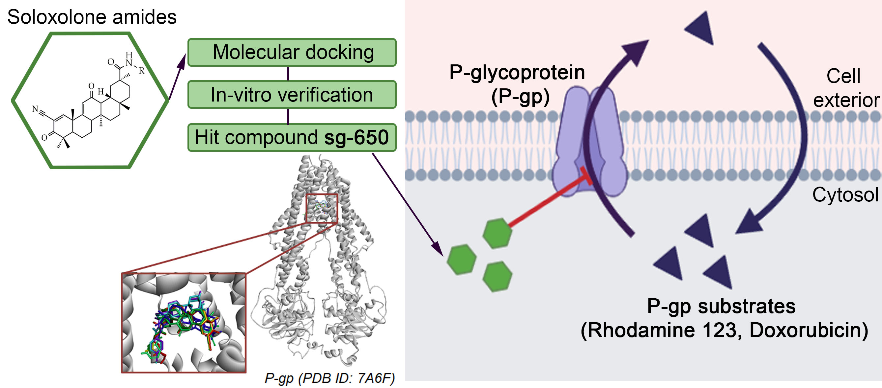
Soloxolone amide sg-650 as new promising small molecule P-glycoprotein inhibitor: in silico prediction and in vitro verification

Slide 3
Multidrug resistance (MDR) remains a significant challenge in cancer therapy, primarily due to the overexpression of transmembrane drug transporters, with P-glycoprotein (P-gp) encoded by the human ABCB1/MDR1 gene being a central focus. Reduced intracellular drug levels lead to decreased chemosensitivity of cancer cells, culminating in drug resistance. Consequently, the development of P-gp inhibitors has emerged as a promising strategy to combat MDR. In this study, we evaluated eight soloxolone amides for their potential to inhibit P-gp-mediated efflux in MDR tumor cells. Using molecular docking, all compounds were shown to have a direct interaction with the P-gp transmembrane domain characterized by low binding energies (< -9 kcal/mol). Validation of P-gp inhibitory activity was performed on KB-8-5 human cervical cancer cells and RLS40 murine lymphosarcoma cells with P-gp-mediated MDR. The lead compound sg-650 at non-toxic concentration of 40 μM significantly increased the intracellular accumulation of the P-gp substrates rhodamine-123 and doxorubicin by 10.4- and 1.5-fold, respectively, in KB-8-5 cells. Kinetic studies demonstrated an uncompetitive manner of doxorubicin efflux inhibition. In addition, sg-650 synergistically enhanced doxorubicin cytotoxicity in a dose-dependent manner, demonstrating MDR reversal activity. Similar effects were observed in sg-650-treated RLS40 cells. These results underscore the potential of sg-650 as a potent small molecule P-gp inhibitor that holds promise for overcoming MDR in cancer treatment.
Keywords: Multidrug resistance; pentacyclic triterpenoids; p-glycoprotein; soloxolone.

Slide 4
The development of multidrug resistance (MDR) to chemotherapy remains a major challenge in the treatment of cancer. Resistance exists against the majority of anticancer drug and can develop by numerous mechanisms.
Efflux transport (ABC-family proteins)
Robey R. W. et al., 2018
DNA-damage response
Bukowski K. et al., 2020
Mechanisms of multidrug resistance in cancer
Drug metabolism
Gillet J. P. et al., 2010

Slide 5
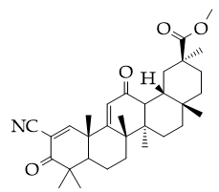
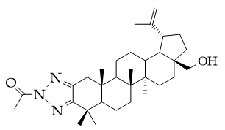
Low molecular weight P-gp inhibitors as perspective drugs for tumors with MDR
1st generation: verapamil, cyclosporine А
2nd generation: dexverapamil, dexniguldipine
3rd generation: tariquidar, zosuquidar, elacridar
Natural compounds: flavonoids, terpenoids, saponins
Structure of P-gp
(PDB ID: 7A6F)
Soloxolone methyl
Betulinic acid derivatives
Salomatina O. V. et al., 2022
Rybalkina E. Y. et al., 2021

Slide 6
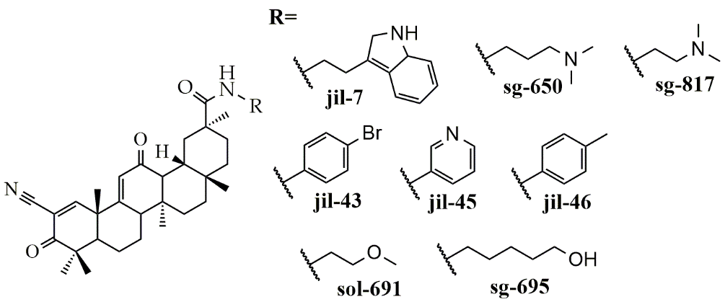
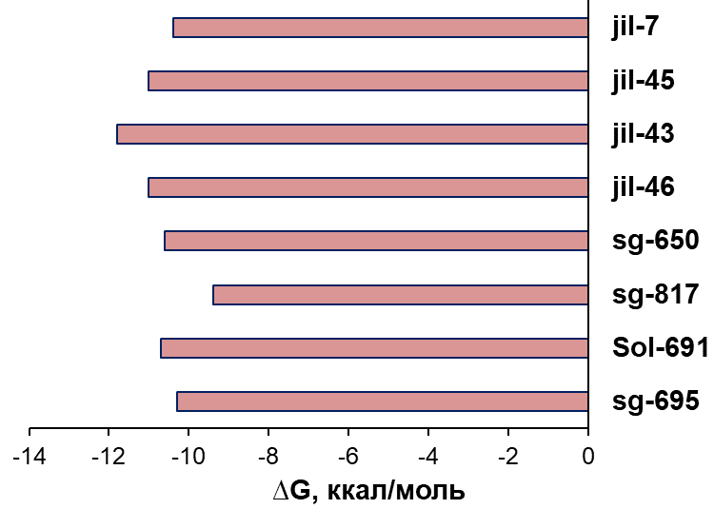
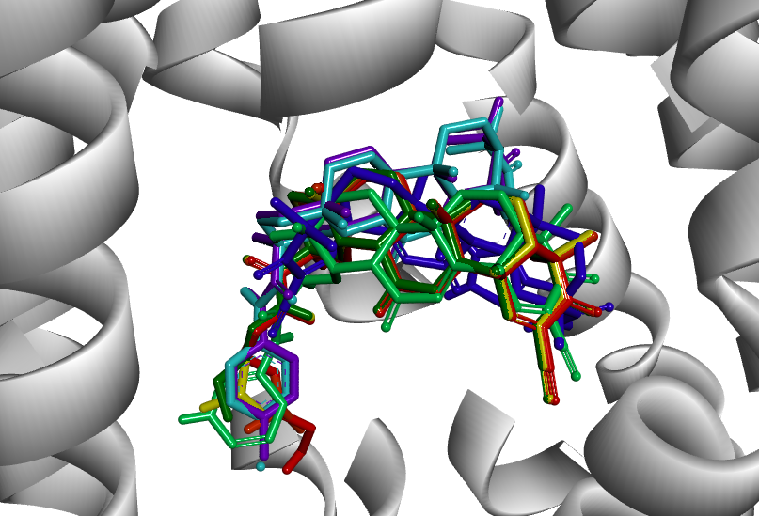
Investigated library of soloxolone amides. In silico P-gp binding modeling.
Cytotoxicity against tumor cells
Ability to inhibit P-gp was predicted in silico (web-tools)
Molecular docking was performed using AutoDock vina
Markov A.V. et al., 2022
∆G, kkal/mol
P-gp (PDB ID: 7A6F)

Slide 7
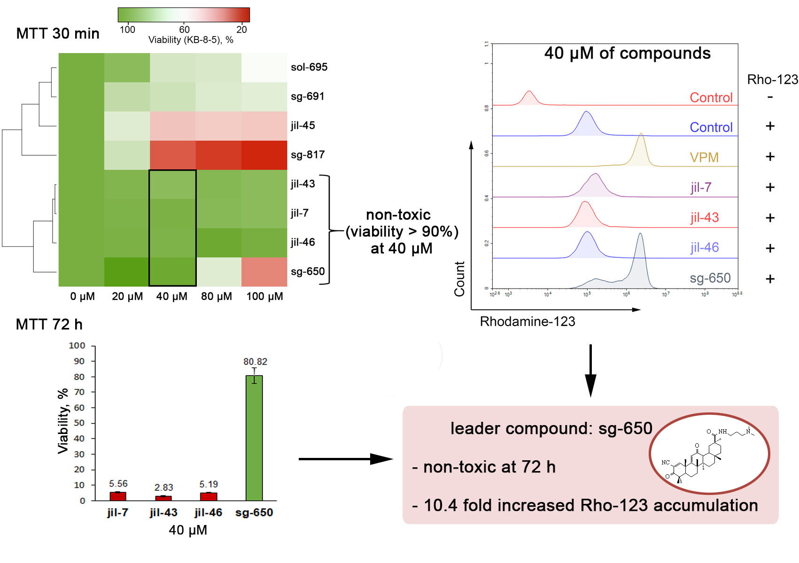
In-vitro screening of P-gp inhibiting activity of investigated compounds.
A
B
(A) Cell viability: MTT-test of KB-8-5 cells after incubation with triterpenoids for 30 min and 72 h.
(B) Intracellular Rhodamine-123 accumulation in KB-8-5 cells.. 30 min of incubation with triterpenoids (40 μM)

Slide 8
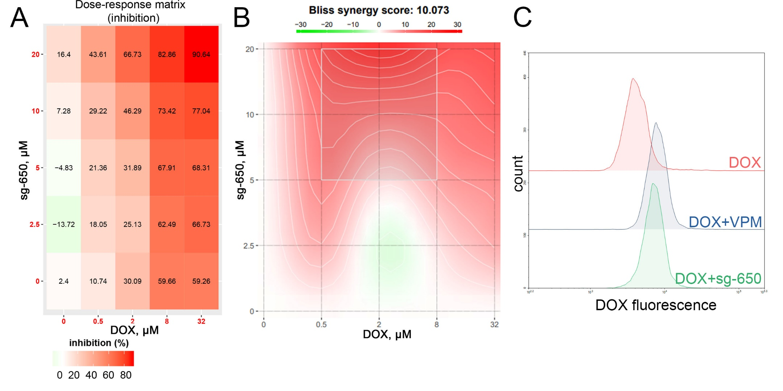
Sg-650 induced Doxorubicin accumulation in KB-8-5 cells and increased its toxicity
A
B
C
MTT-test of KB-8-5 cells after incubation with DOX in combination with sg-650 for 72 h: dose response (A) and synergy matrix (B).
(C) DOX accumulation in KB-8-5 cells after 2 h incubation with VPM (50 μM) and sg-650 (40 μM).

Slide 9
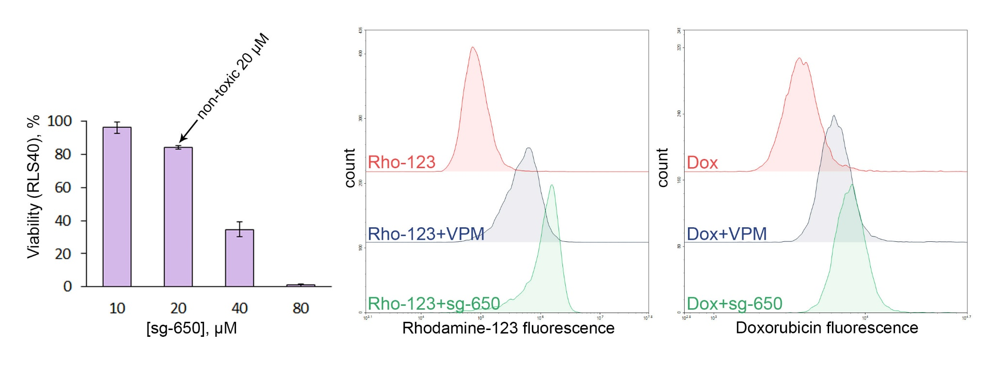
Sg-650 induced Doxorubicin and Rhodamine-123 uptake in RLS40 cells with MDR phenotype.
A
B
C
(A) MTT-test of RLS40 cells after incubation with sg-650 for 72 h
(B) Rhodamine-123 accumulation in RLS40 cells after 30 min incubation with VPM (50 μM) and sg-650 (20 μM)
(C) Doxorubicin accumulation in RLS40 cells after 2h incubation with VPM (50 μM) and sg-650 (20 μM).

Slide 10
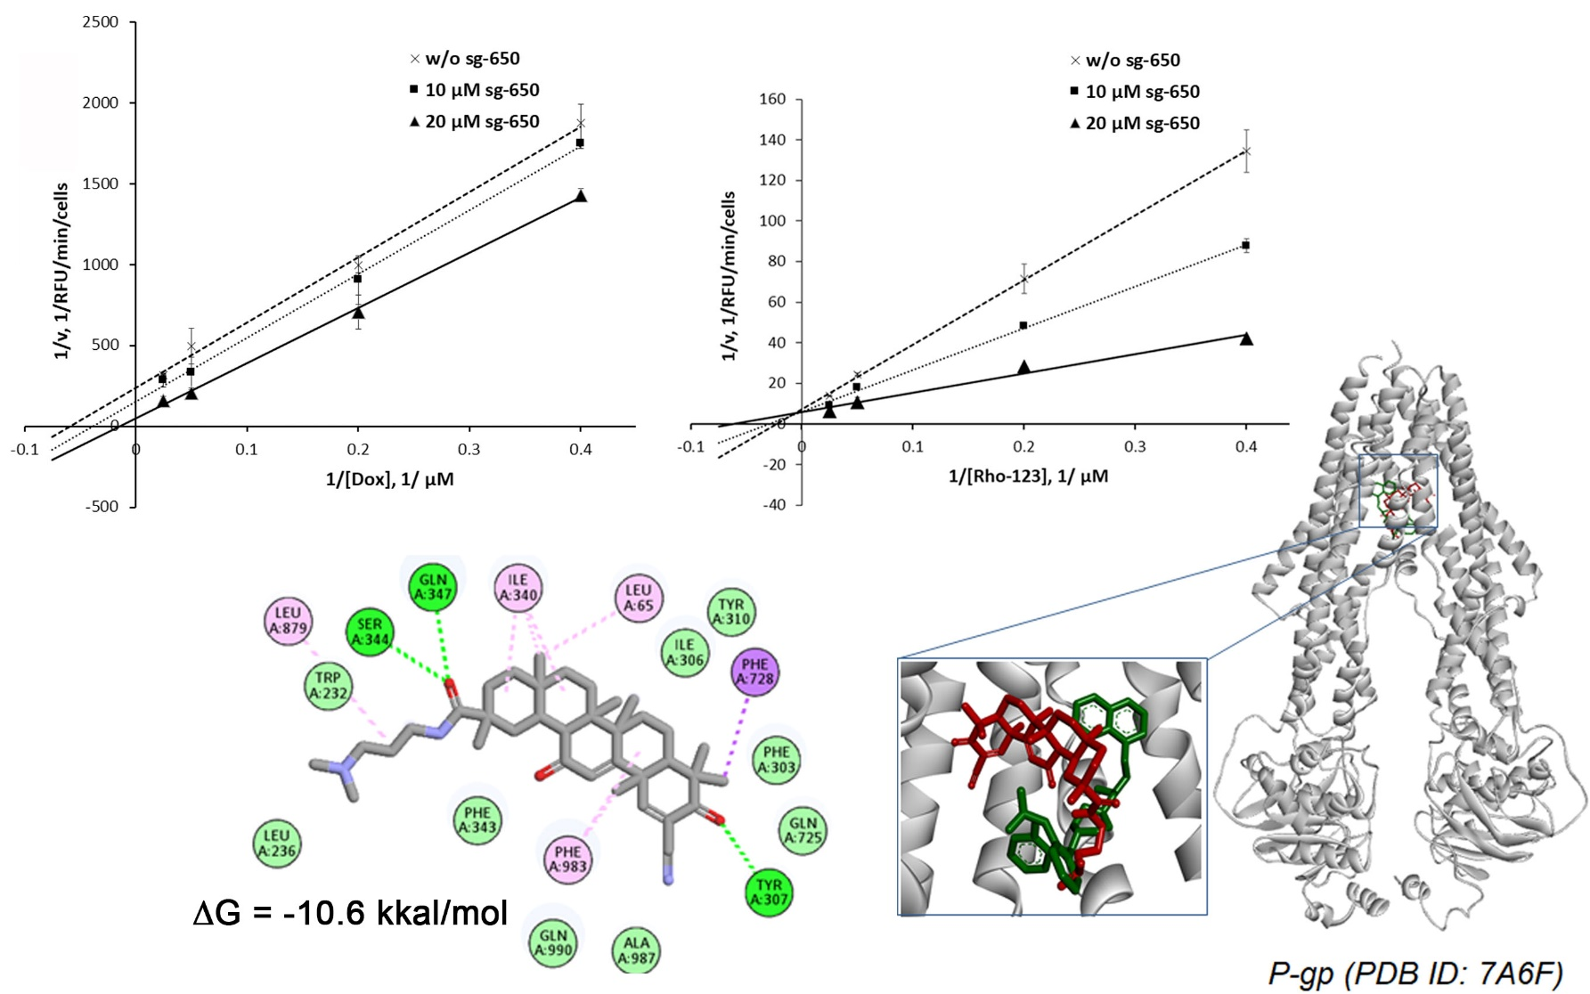
Sg-650 binds R-site (Rhodamine-123) of P-gp transmembrane domain
A
B
(A) Kinetic of Dox accumulation with or without sg-650
(B) Kinetic of Rho-123 accumulation with or without sg-650
(C) Binding site of sg-650 in P-gp
uncompetitive
competitive
C

Slide 11
Conclusion
N,N-dimethylamine-containing soloxolone amide sg-650 was investigated to bind transmembrane domain of P-gp and effectively inhibit its efflux function in КВ-8-5 and RLS40 cells.
MDR-reversal activity of sg-650 was validated: it increased Doxorubicin cytotoxicity in KB-8-5 cells
Triterpenoid scaffold is considered as perspective platform for designing P-gp inhibitors

Slide 12
Acknowledgments
This work was supported by the Russian Science Foundation (grant no. 23-14-00374).

