Slide 1
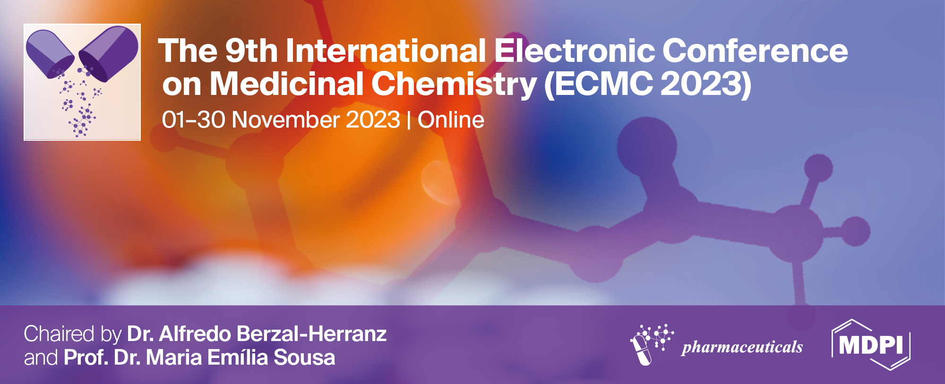
Single or Mixed edge activators: a Shift in transfersomes properties?
João Vieira ^{1,2}*, Jéssica Castelo³ , Íris Guerreiro^{1,2}, Marta Martins^{1,2}, Marta Rodrigues⁴, Ana Sofia Fernandes¹, Nuno Saraiva¹, Catarina Rosado¹, Catarina Pereira-Leite^{1,5}
¹ CBIOS, Universidade Lusófona´s Research Center for Biosciences & Health Technologies, Campo Grande 376, 1749-024, Lisbon, Portugal
² Department of Biomedical Sciences, University of Alcalá, Ctra. Madrid-Barcelona Km. 33.600, Alcalá de Henares, 28871, Madrid, Spain
³ School of Health Sciences and Technologies, Universidade Lusófona– Centro Universitário de Lisboa, Campo Grande 376, 1749-024, Lisbon, Portugal
⁴ School of Psychology and Life Sciences, Universidade Lusófona – Centro Universitário de Lisboa, Campo Grande 376, 1749-024, Lisbon, Portugal
⁵ LAQV, REQUIMTE, Departamento de Ciências Químicas, Faculdade de Farmácia, Universidade do Porto , R. de Jorge Viterbo Ferreira 228, 4050-313, Porto, Portugal
* Corresponding author: joao.manuel.vieira@ulusofona.pt

Slide 2
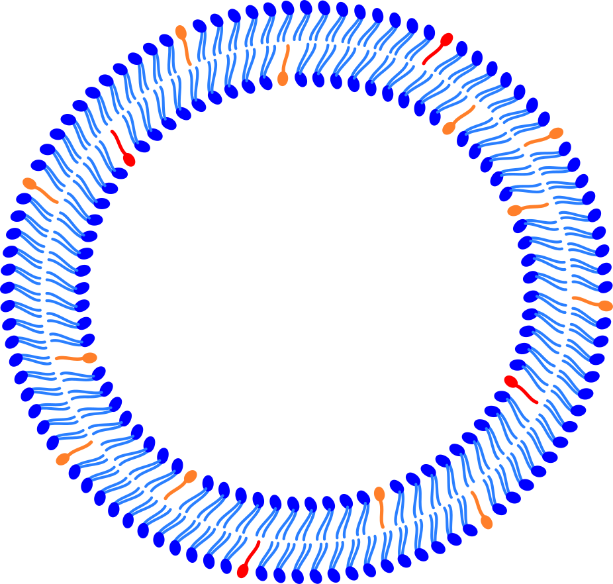
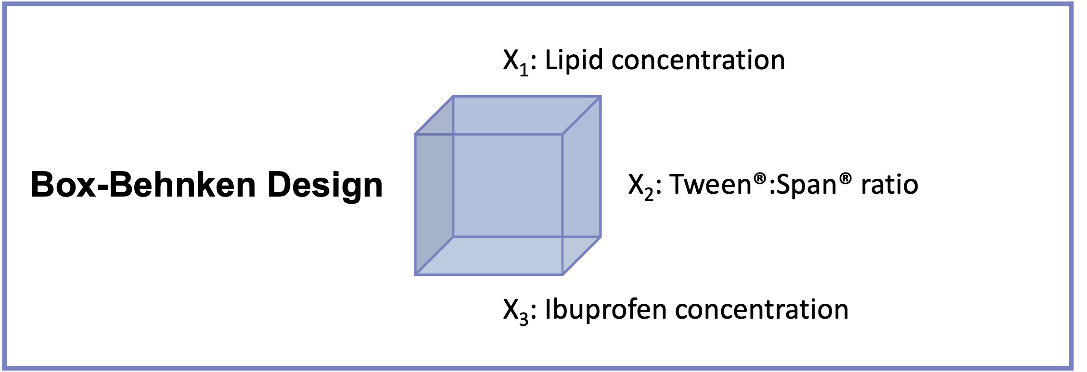
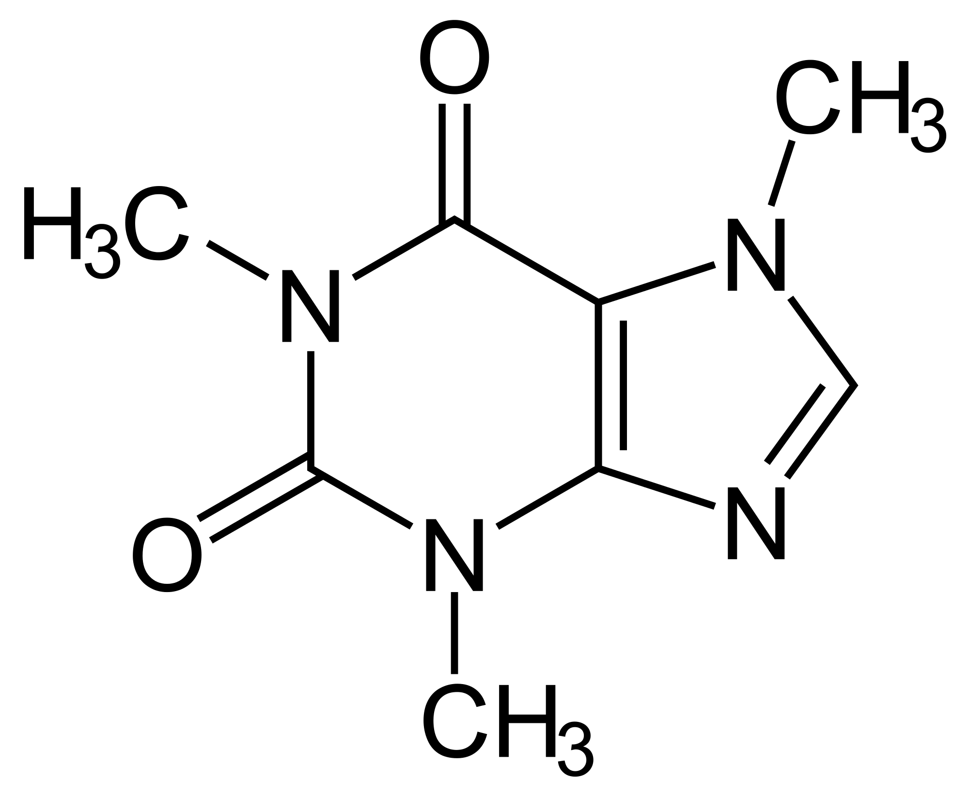
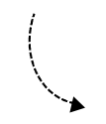
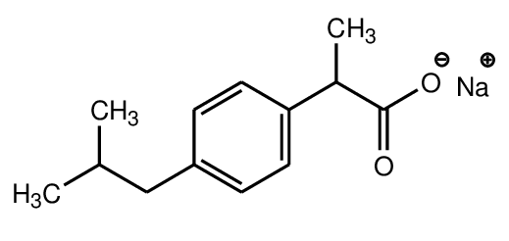
Single or Mixed edge activators: a shift in transfersomes properties?
A
Preliminary Study
B
Mixed Edge Activators – An innovative optimization
Tween® 80
Span® 80
Caffeine
x
Potential for skin delivery
Proper vesicle size and PDI
Suitable storage stability
Biocompatible
Ibuprofen sodium salt
Optimized formulation

Slide 3
Abstract:
Transfersomes, a novel lipid-based vesicular system, have revolutionized drug delivery by improving the skin delivery of bioactive compounds. These deformable lipid vesicles are composed of phospholipids and edge activators (EA), which play a crucial role in conferring flexibility and deformability to the vesicles, thereby enabling efficient drug loading as well as an improved drug transport across biological barriers. Traditionally, transfersomes have a single EA; however, recent research suggests the benefits of mixing different edge activators to optimize their performance. Quality-by-design strategies, like Box-Behnken factorial design (BBD) offer a valuable manner to develop new formulations. This study aimed to assess the impact of single or mixed EA on transfersomes´ physicochemical properties and their cytotoxicity profile. Transfersomes were prepared with and without two model drugs, ibuprofen sodium salt (IBU) and caffeine. The effect of EA on transfersomes physicochemical properties was evaluated by measuring vesicle size (Vs), polydispersity index (PDI), encapsulation efficiency (EE), and loading capacity (LC) during 60 days of storage. Moreover, In vitro cytotoxicity studies were performed using HaCaT cells. All formulations whether composed of single or mixed EA, presented interesting results (Vs < 300 nm, and PDI < 0.3), considering the cutaneous delivery target. IBU exhibited good EE and LC, while caffeine encapsulation requires improvement. These results remained stable under refrigerated conditions for at least 30 days. Additionally, cell viability assays indicated transfersomes´ compatibility with human keratinocytes. Overall, by combining the distinct physicochemical properties of diverse edge activators it was possible to tailor transfersomes as skin delivery carriers, enhancing their characteristics and addressing challenges related to the colloidal stability.
Keywords: transfersomes; nanovesicular systems; edge activators; physicochemical properties; cytotoxicity.

Slide 4
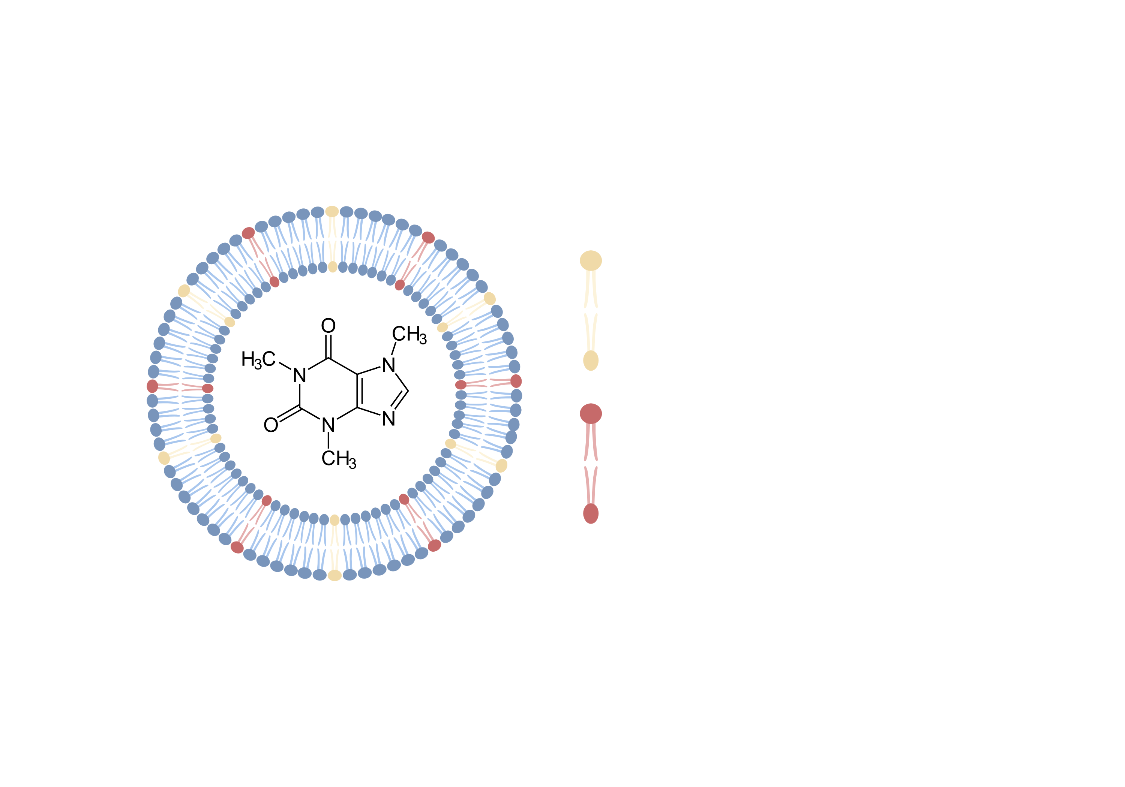
Introduction
Preliminary study
Aim: Evaluate edge activators ratio impact on transfersomes
Starting point: pre-optimized formulation
New defined ratios
Tween®80 : PC (w/w) | Span®80 : PC (w/w)
15:85 | -
7.5:85 | 7.5:85
- | 15:85
Span®80
Tween®80
Caffeine
Created using biorender.com
EA:Lipid ratio (15:85)
Analysis
- Physicochemical characterization (Vs and PDI) - Storage stability studies - Cytotoxicity assay

Slide 5
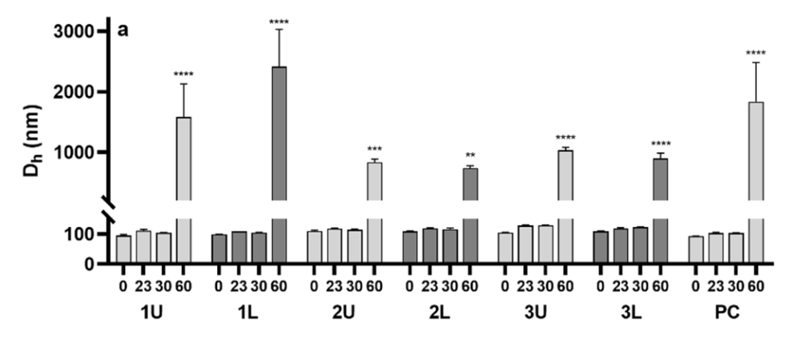
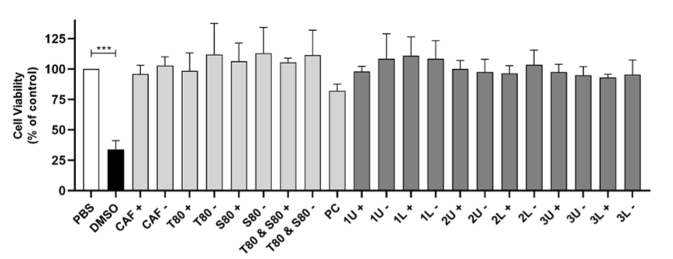
Results and discussion
Preliminary study
Physicochemical Properties
Vs varied according to the type of EA used
Storage stability
Properties remained stable for 1 month
Cytotoxicity
All formulations were compatible with HaCaT cells upon 24 h treatment
Doi:10.19277/bbr.18.2.267
Vs: Vesicle Size

Slide 6
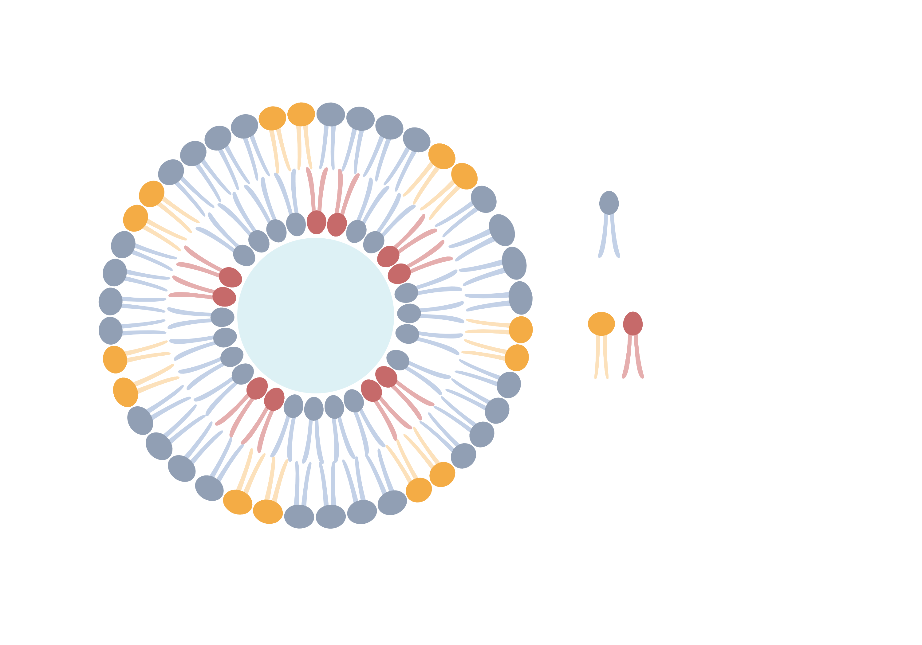
Conclusions
Question: Single or Mixed edge activators?
Transfersomes = 2 compartments
Lipid
Aqueous
Lipidic
Edge Activators
Created using biorender.com
Is there potential in combining both moieties?
Explore the possibility of mixing EA!

Slide 7
Introduction
Aim: Mixed edge activators – An innovative optimization
Box-Behnken design (BBD) strategy
Optimization of a ibuprofen-loaded transfersomal formulation
Experimental validation of BBD theoretical predicitions
Cytotoxicity in a 3D HaCaT cultures
Storage stability
Optimized content | Evaluated Factors
[Pc] % (w/v) | EA ratio | [Ibu] % (w/v)
4 | 2.5:12.5 | 0.125
Doi:10.3390/pharmaceutics15041209
Pc: Soy Phosphatidylcholine | EA: Edge Activator | Ibu: Ibuprofen

Slide 8
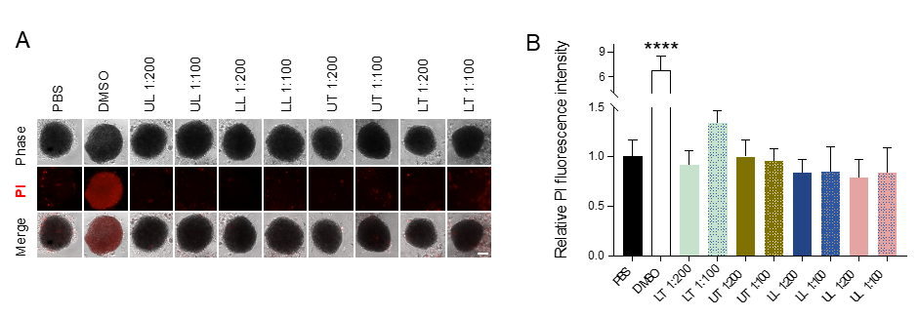
Results and discussion
Model validation
Experimental results validated BBD model
BBD responses (Theoretical vs Experimental) | Responses (Theoretical vs Experimental)
 | Size | PDI | EE | LC
Theoretical | 153.1 | 0.19 | 34 | 1.1
Experimental | 166 ± 20 | 0.23 ± 0.03 | 34 ± 9 | 1.1 ± 0.3
Cytotoxicity:
Transfersomes did not impact cell death
Storage stability:
Stable for 2 months
Doi:10.3390/pharmaceutics15041209
UL: Unloaded Lipossomes | LL: Loaded Lipossomes | UT: Unloaded Transfersomes | LT: Loaded Transfersomes
Doi:10.19277/bbr.18.2.267

Slide 9
Conclusions
Box Benhken design
Viability Studies
Skin permeation studies
1
3
5
2
4
Optimized formulation
Stability Studies

Slide 10
Acknowledgments
THANKS!
Any questions?
You can find me at:
joao.manuel.vieira@ulusofona.pt
This research was funded by national funds through FCT – Foundation for Science and Technology, I.P., under the EXPL/BTM-MAT/0112/2021, UIDB/04567/2020, and UIDP/04567/2020 projects attributed to CBIOS and by the research grants attributed to J.V, M.M. (UI/BD/151424/2021) and I.G. (2020.07813.BD). The APC was funded by FCT – Foundation for Science and Technology, I.P., EXPL/BTM-MAT/0112/2021 project.

