Slide 1
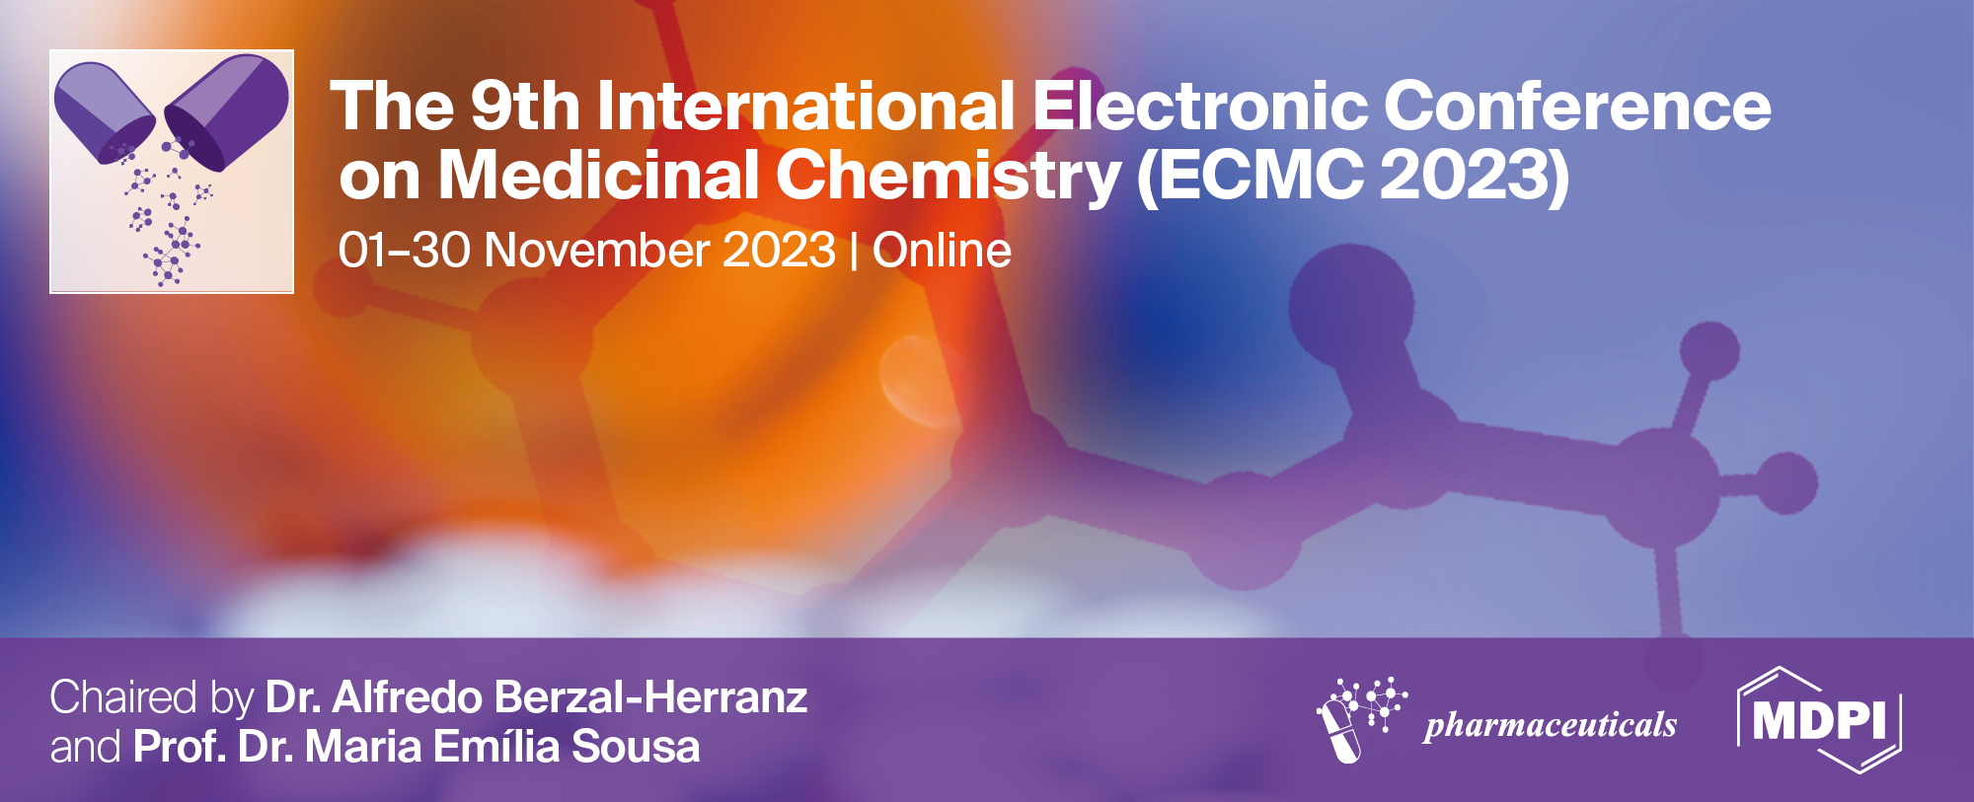
Lead Optimization of Top compounds targeting Eg5
Damilola Bodun ^{1,}* and Damilola Omoboyowa ¹
¹ Department of Biochemistry, Adekunle Ajasin Univerisity, Akungba-Akoko
* Corresponding author: dbodun56@gmail.com

Slide 2
Graphical Abstract
Lead Optimization of Top compounds targeting Eg5

Slide 3
Cancer remains a paramount global health challenge with multifaceted mechanisms driving its proliferation. One pivotal target in this complex landscape is the Mitotic kinesin Eg5, a key player during cell division. Inhibiting this protein holds immense potential to combat cancer effectively. Building on a recent breakthrough, our study aims to enhance the inhibitory efficacy against Eg5 by optimizing a promising novel compound identified in our previous research, which has shown superior inhibitory properties compared to a standard treatment. As we progress through the drug discovery funnel, our focus shifts to lead optimization. We seek to elevate the binding affinity of the lead compound while simultaneously enhancing its Absorption, Distribution, Metabolism, Excretion, and Toxicity (ADMET) properties. This optimization phase is critical for ensuring the compound's therapeutic efficacy, safety, and potential for clinical translation. Our proposed research aligns with the urgent need for innovative cancer treatments and addresses a vital aspect of drug development. By refining the lead compound's molecular interactions and ADMET profile, we endeavor to contribute to the advancement of targeted cancer therapy, potentially bringing us closer to a transformative solution in the battle against cancer.
Keywords: Lead Optimization; Medicinal Chemistry; QSAR

Slide 4
Introduction

Slide 5
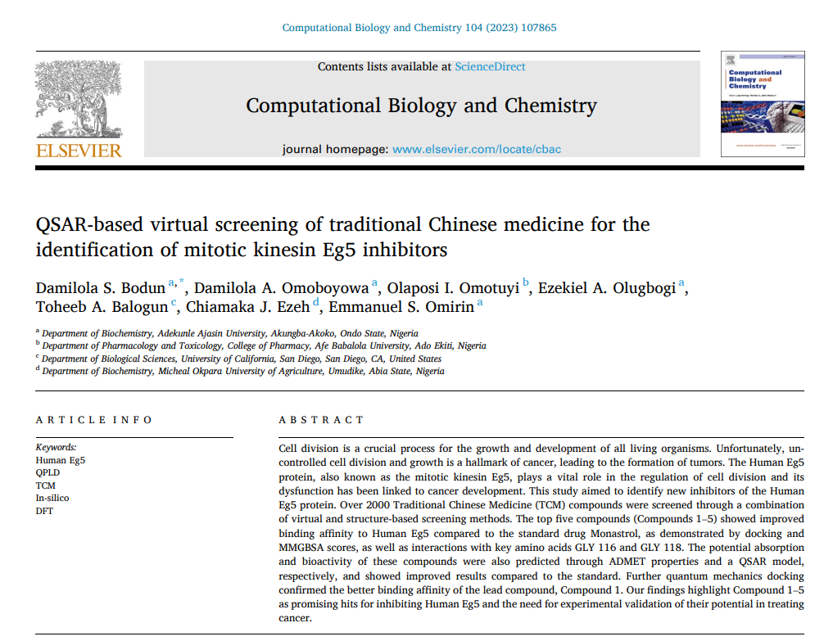
Introduction
Figure 1: Snapshot of the previous study

Slide 6
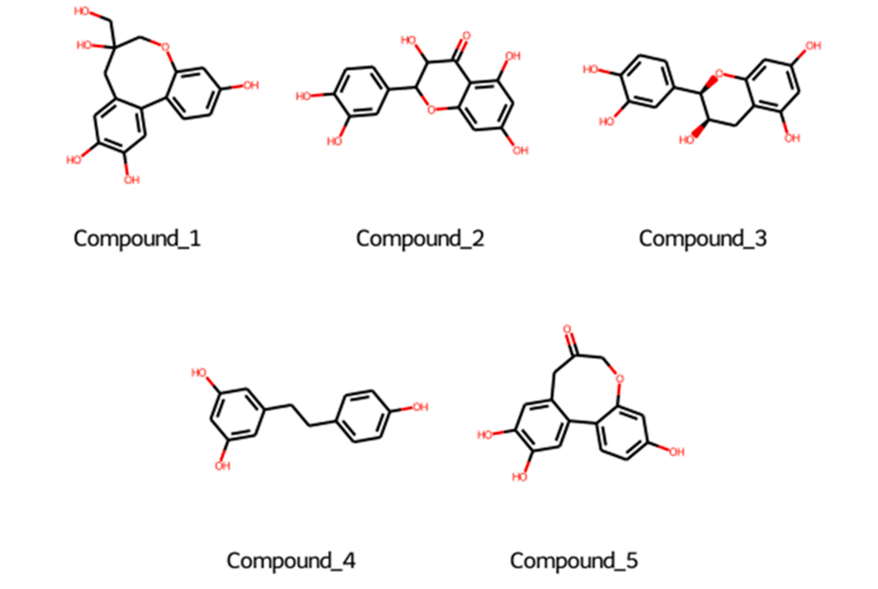
Introduction
Figure 2: Top compounds from the Prior Study.

Slide 7
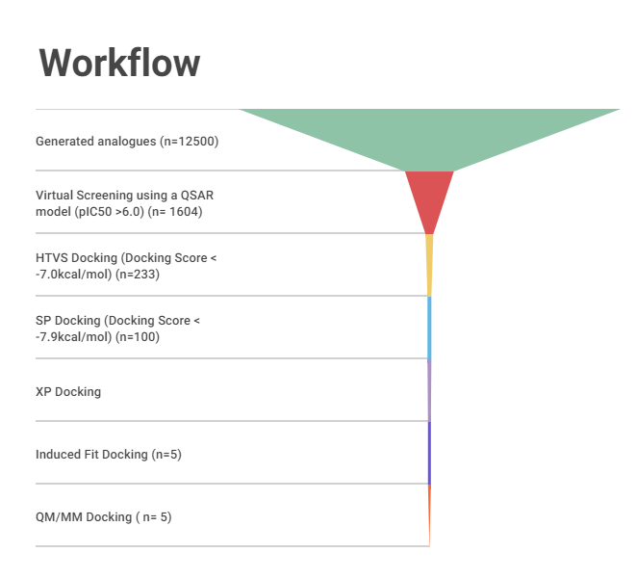
Materials and Methods
Figure 3 : Workflow of this study.

Slide 8
Using a Deep learning platform, we generated 12500 analogues of the top 5 compounds from the prior study (Figure 2)
The generated analogues had a better binding affinity compared to the co-crystallized ligand.
The better binding affinity were confirmed using free energy calculations (MM-GBSA), Induced fit docking and Quantum based Docking (Table 2-4).
Also a detailed QSAR model was built using the list of ChembL inhibitors. The model predicted the better inhibitory potential of the compounds compound to the standard (Table 1).

Slide 9
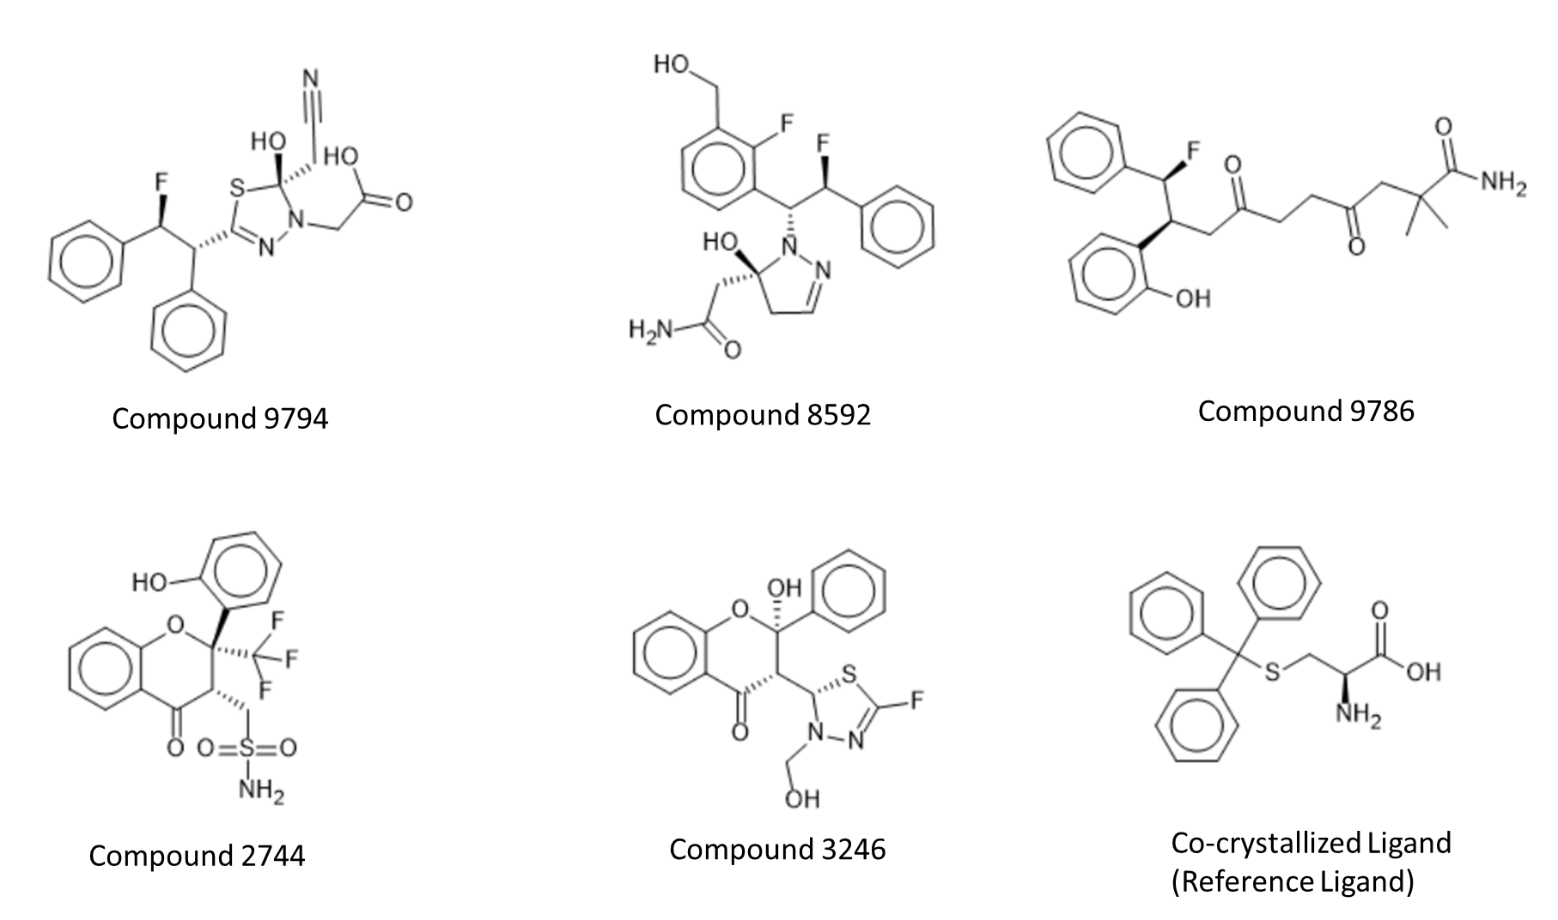
Results and Discussion
Figure 4: Top compounds from this study compared to the co-crystallized ligand (Reference Ligand).

Slide 10
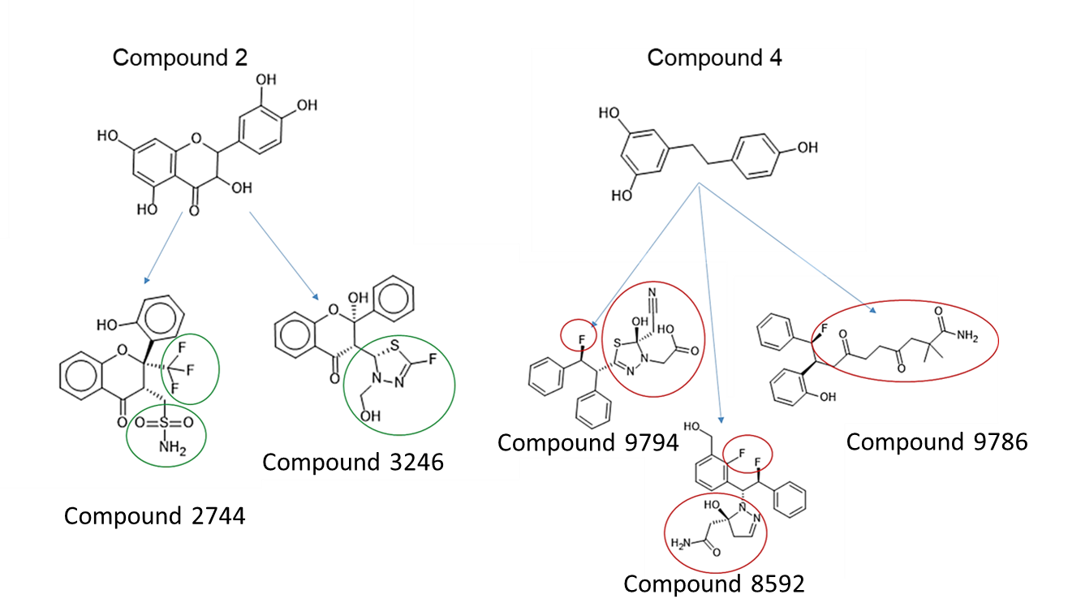
Figure 5: Optimized part of the analogues

Slide 11
Table 1: Top compounds and their predicted pIC50 values
Compound | Pred Y
Compound 9794 | 6.267
Compound 8592 | 6.298
Compound 9786 | 6.080
Compound 2744 | 6.056
Compound 3246 | 6.248
Co-crystallized Ligand (Standard) | 5.893

Slide 12
Table 2: Docking and MMGBSA scores of the top compounds
Compound | XP docking | MMGBSA
Compound 9794 | -8.559 | -66.9
Compound 8592 | -8.557 | -59.44
Compound 9786 | -8.517 | -56.76
Compound 2744 | -8.356 | -60.1
Compound 3246 | -8.354 | -59.3
Co-crystallized Ligand (Standard) | -8.323 | -76.98

Slide 13
Table 3: Docking and IFD scores of the top compounds after Induced fit docking
Compound | Docking score | IFD score
Compound 9794 | -8.529 | -717.4
Compound 8592 | -7.948 | -716.93
Compound 9786 | -9.15 | -721.33
Compound 2744 | -8.799 | -719.78
Compound 3246 | -8.094 | -717.07
Co-crystallized Ligand (Standard) | -8.821 | -718.16

Slide 14
Table 4: Docking and Glide eModel scores of top compounds after Quantum based docking .
Compound | Docking score | Glide eModel
Compound 9794 | -8.678 | -70.735
Compound 8592 | -9.268 | -58.405
Compound 9786 | -9.15 | -76.568
Compound 2744 | -8.279 | -63.953
Compound 3246 | -8.327 | -55.717
Co-crystallized Ligand (Standard) | -9.017 | -87.309

Slide 15
Conclusions
The results of this study confirms the better binding affinity of the optimized analogues compared to the co-crystallized ligand after Rigid docking, Induced Fit Docking and Quantum based docking. However a more detailed calculation which involves MD simulation will be done. Also these compounds should be tested for both in vitro and in vivo test for their efficacy.

Slide 16
Acknowledgments

