Slide 1

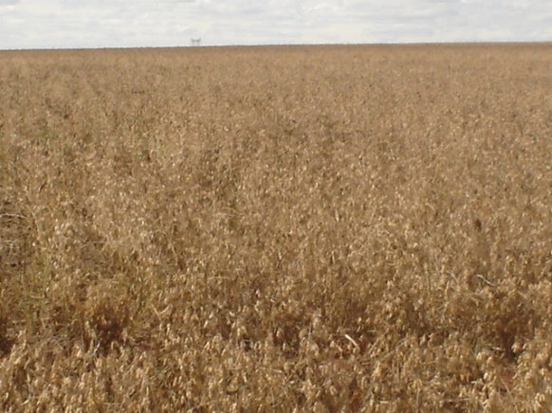
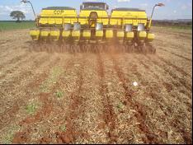
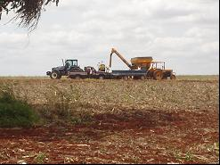
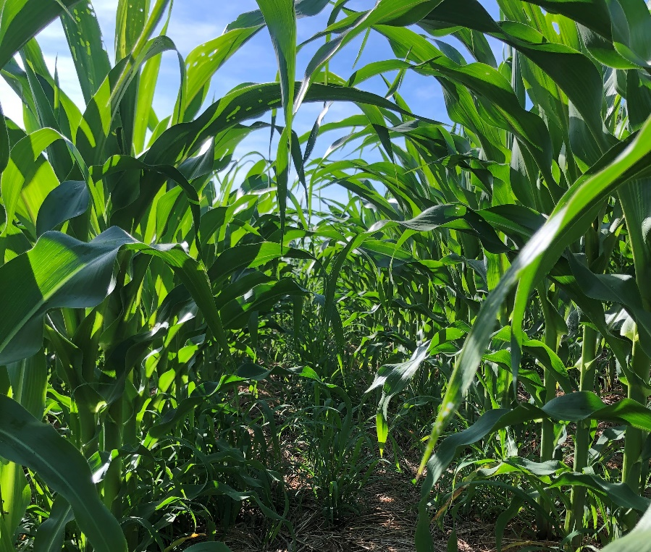
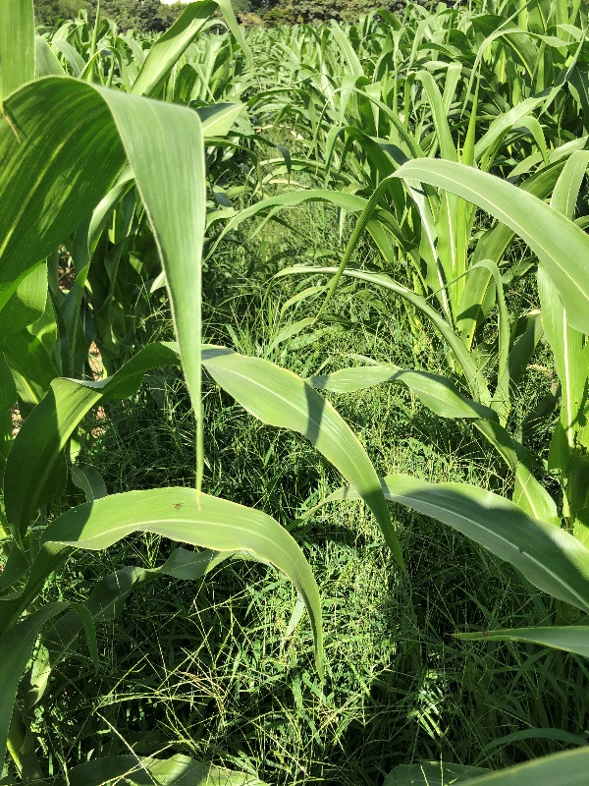
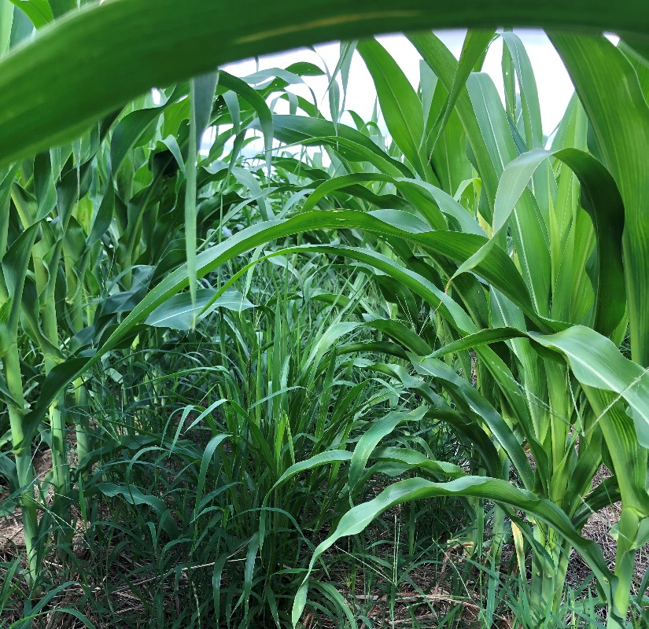

Cropping system and nitrogen supply interfere in sustainability of maize production in the dry season
Karina Batista^{1,*}, Alessandra Aparecida Giacomini¹, Luciana Gerdes¹ and Waldssimiler Teixeira de Mattos¹
¹Instituto de Zootecnia – IZ, Agência Paulista de Tecnologia dos Agronegócios – APTA, Secretaria de Agricultura e Abastecimento do Estado de SP – SAASP, 56 Heitor Penteado St. Centro, Zip Code: 13.380-011, Nova Odessa, SP, Brazil.
*Correspondence: batistakarin@gmail.com
Introduction
succession
Objective
assess
Plant height, Cob height, and Grain yield of maize
as function
Cropping systems
x
Nitrogen rates applied as side-dressing
Material and Methods
Instituto de Zootecnia, Nova Odessa city, São Paulo state, Brazil (22°42´S, 47°18´W, and 570 m altitude) (Figure1).
Red-Yellow Argisol – Ultisol of medium texture.
Randomized complete block design in a split plot scheme, with four replications
Main plots: maize monoculture; maize intercropped with Congo grass (Urochloa ruziziensis cv. Comum); and maize intercropped with Aruana Guinea grass (Megathyrsus maximus cv. Aruana))
Subplots (0; 50; 100 and 150 kg ha⁻¹ of nitrogen rates applied as side-dressing in the maize and grasses rows) in an experimental block.
Figure 1. Maximum and minimum temperatures and rainfall in the period.
Results and Discussion
The lowest plant height (138.36 cm) in maize intercropped with Congo grass occurred at the nitrogen rate of 125.71 kg ha⁻¹ (Table 2, Figure 2a).
The cob height of the maize decreased as the nitrogen rates increased in maize intercropped with Congo grass (Table 2, Figure 2b).
Grain yield of maize monoculture decreased linearly as the nitrogen rates applied as side-dressing increased (Table 2, Figure 2c).
Grain yield increased linearly as the nitrogen rates applied as side-dressing increased in the maize intercropped with Aruana Guinea grass (Table 2, Figure 2d).
Table 2. Plant height, cob height and grain yield of maize at the time of its physiological maturity.
Cropping systems | N rates (kg ha⁻¹) |  |  |  | Means | F test for regression
 | 0 | 50 | 100 | 150 |  | Linear | Quadratic
Pant height (cm)
MM | 171.50a | 158.00a | 182.00a | 151.00a | 165.63a | 0.6089 | 0.7665
M+A | 168.75a | 151.50a | 160.75a | 176.00a | 164.25a | 0.6857 | 0.5881
M+C | 184.25a | 176.00a | 121.50b | 146.00a | 156.94a | 0.0168 | 0.0327
Means | 174.83 | 161.83 | 154.75 | 157.67 |  | 0.1575 | 0.2556
CV% | 10.35**
Cob height (cm)
MM | 80.50a | 72.75a | 75.00a | 67.25a | 73.87 | 0.2689 | 0.9554
M+A | 67.00a | 62.75a | 69.50ab | 81.25a | 70.12 | 0.2190 | 0.3193
M+C | 90.00a | 85.25a | 52.50b | 67.50a | 73.81 | 0.0380 | 0.0774
Means | 79.17 | 73.58 | 65.67 | 72.00 |  | 0.2117 | 0.2406
CV% | 12.63**
Grain yield of maize (kg/ha)
MM | 1933.06a | 1025.53b | 1562.09a | 602.42b | 1280.77a | 0.0190 | 0.0709
M+A | 1106.02a | 1433.14ab | 1348.75ab | 1899.18a | 1446.77a | 0.0545 | 0.1532
M+C | 1341.82a | 1825.44a | 733.39b | 1138.45ab | 1259.78 | 0.2033 | 0.4551
Means | 1460.30 | 1428.04 | 1214.74 | 1213.35 |  | 0.2231 | 0.4781
CV% | 5.55*
Maize monoculture
Maize + Aruana Guinea grass
(a)
(b)
(c)
(d)
MM: maize monoculture; M+A: Maize + Aruana Guinea grass; M+C: Maize + Congo Guinea grass. Means followed by different lowercase letters in the columns differ from each other by Tukey's test at the 5% level. Coefficient of variation referring to data transformed to *log(X) and **square root (X
Maize + Congo grass
Figure 2. Plant height (a), cob height (b) and grain yield (c, d) of maize at the time of its physiological maturity as function cropping system and nitrogen rates applied as side-dressing.
Conclusions
When maize is intercropped with Congo nitrogen supply interfered in plant height and cob height.
In conditions, high nitrogen supply occurred low cob height.
When maize is intercropped with Congo grass is necessary high nitrogen supply for high grain yield.
Maize intercropped with tropical grasses is more nitrogen-demanding than maize monoculture.
Acknowledgments
The authors are grateful to FAPESP (São Paulo State Research Support Foundation) for providing financial support (process 2017/50339-5 and process 2019/02387-6).

