Slide 1
Normalized Burn Ratio and Land Surface Temperature in Pre- and Post- Mediterranean forests Fire
The 5th International Electronic Conference on Remote Sensing
UNIVERSITY ABDELMALEK ESSAÂDI
07 – 21 NOV 2023
S3 – Remote sensing applications
Authors :
Fatima Ezahrae Ezzaher ¹, Nizar Ben Achhab ¹, Naoufal Raissouni ² , Hafssa Naciri ¹, Asaad Chahboun ¹
¹ Mathematics and Intelligent Systems (MASI), University Abdelmalek Essaâdi, Morocco.
² Remote Sensing, Systems and Telecommunications (TST), Abdelmalek Essaadi University, Morocco

Slide 2
INTRODUCTION

Slide 3
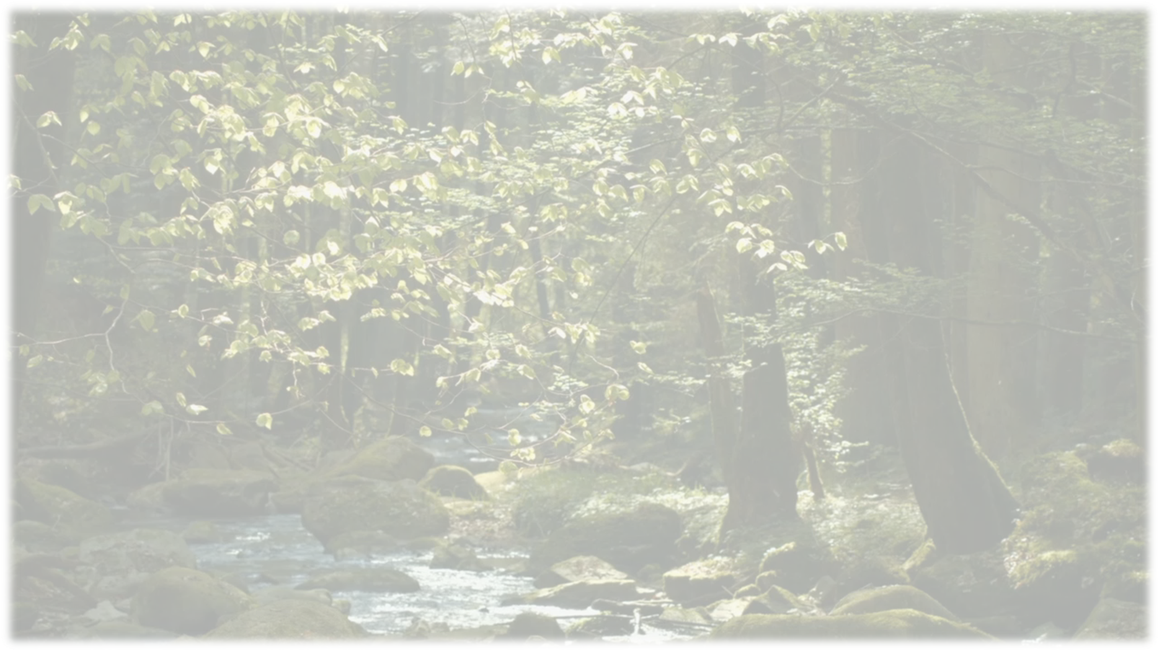
Aim
Context
Forests are considered one of Earth pillars
Preserve the Earth’s balance
Protect us from natural disasters
Improve our overall quality of life

Slide 4
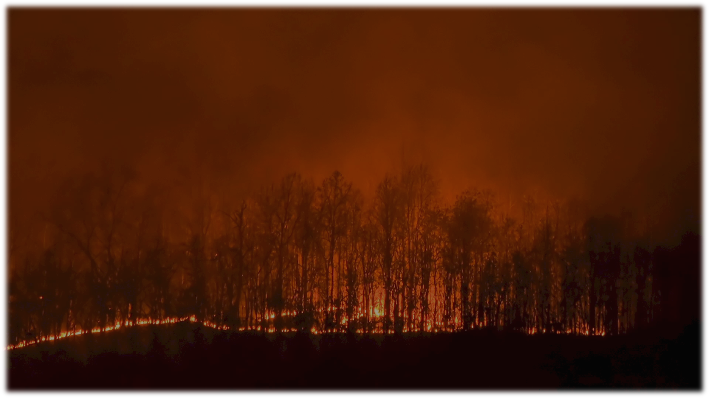
Aim
Context
Disrupts the stability of flora and fauna.
Alters the landscape’s physical and ecological characteristics.

Slide 5
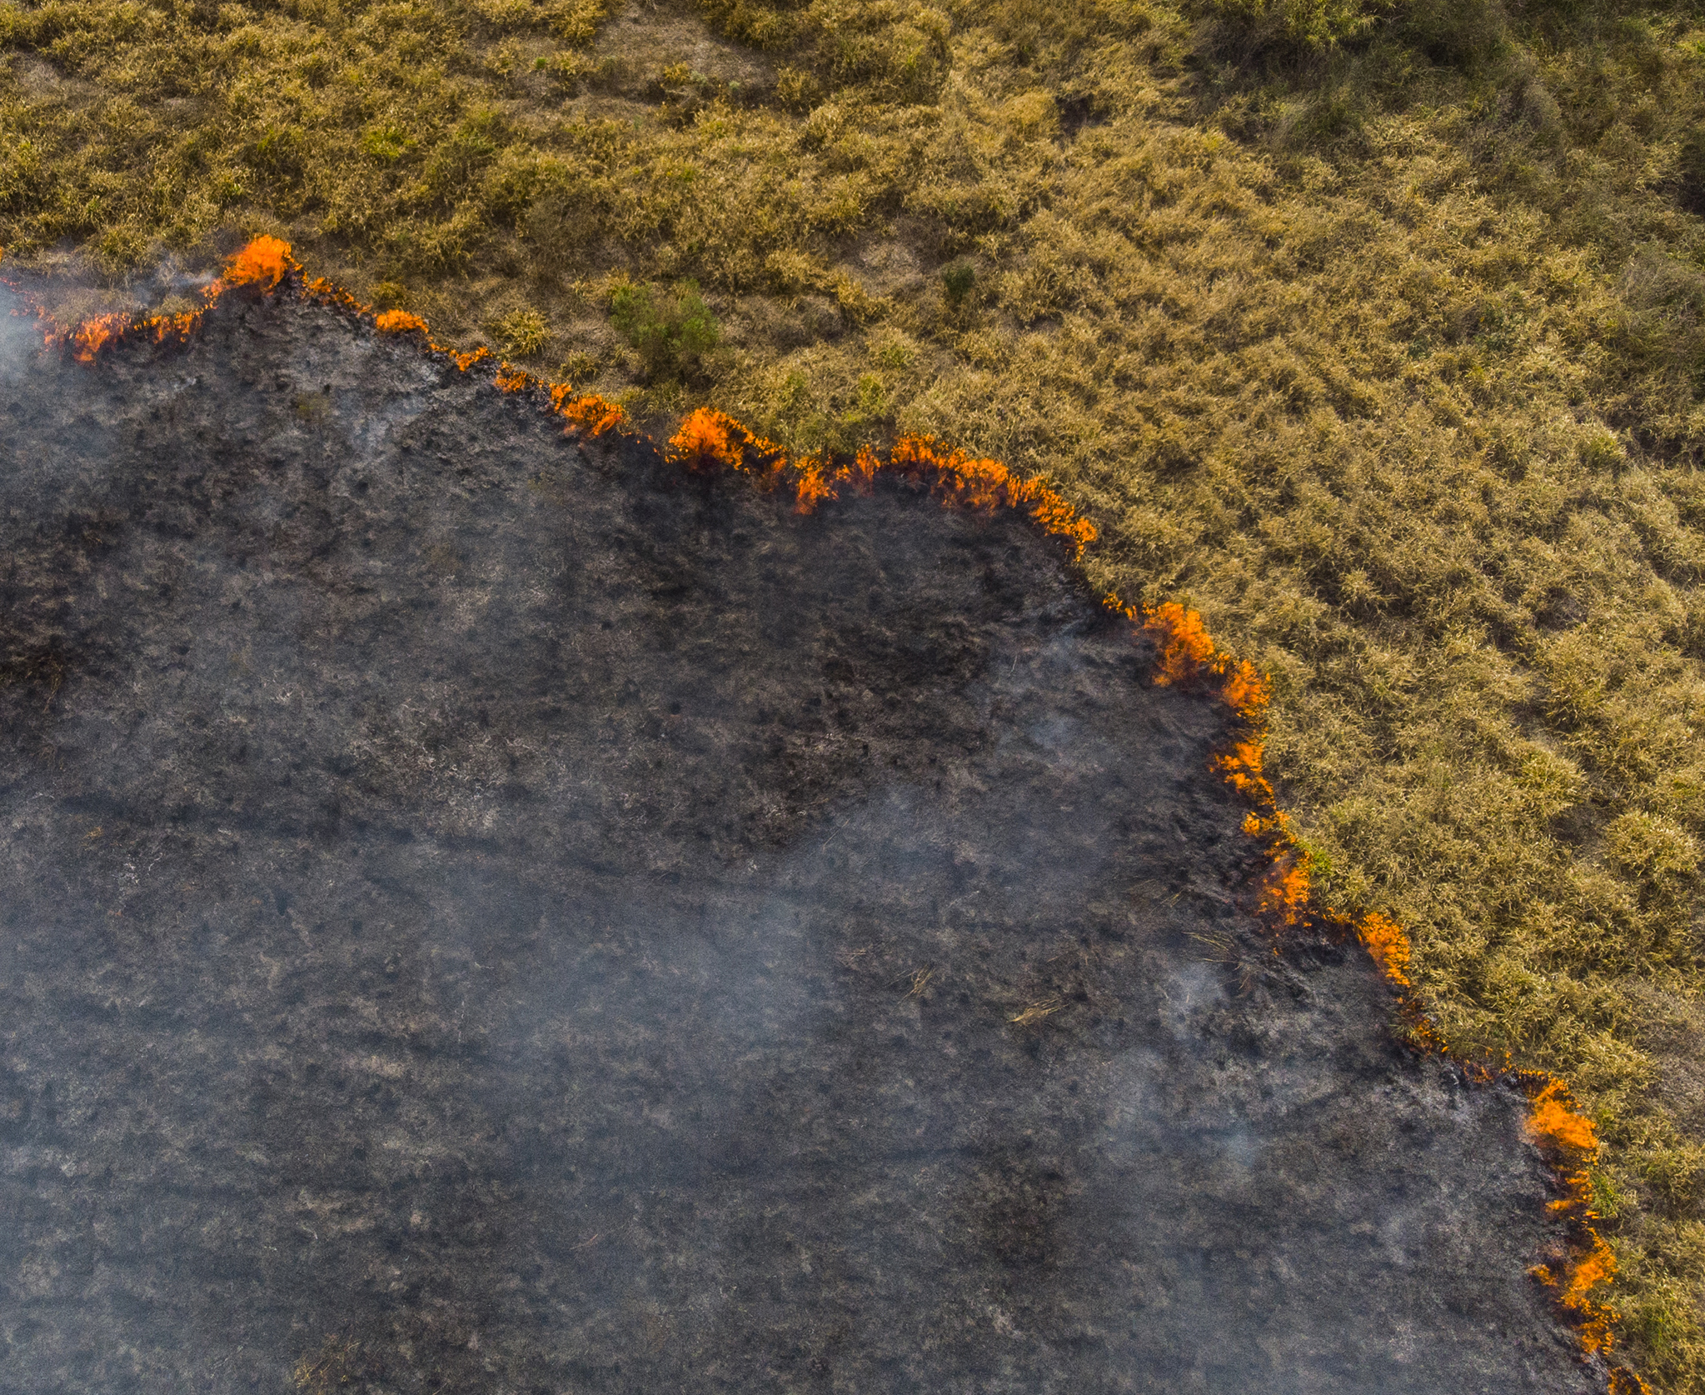
Aim
Context
Burned area
Land surface temperature
Normalized Burn Ratio
NBR
Land Surface Temperature
LST

Slide 6
MATERIALS AND METHODS

Slide 7
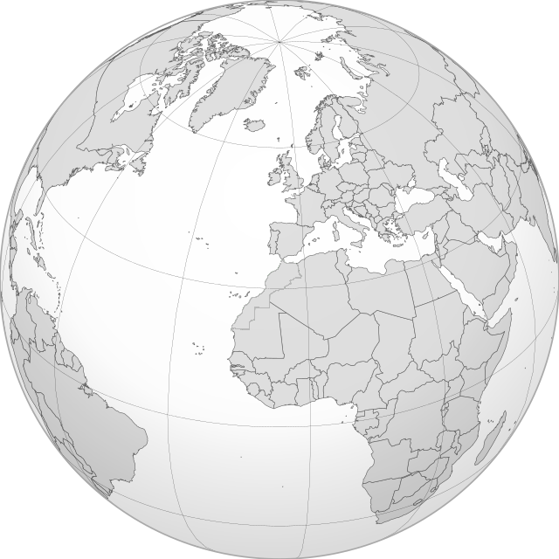
Satellite data
Study area
Algorithms

Slide 8
Satellite data
Study area
Algorithms
(a)
35.1167° N, 5.7754° W
308 Km²
(b)

Slide 9
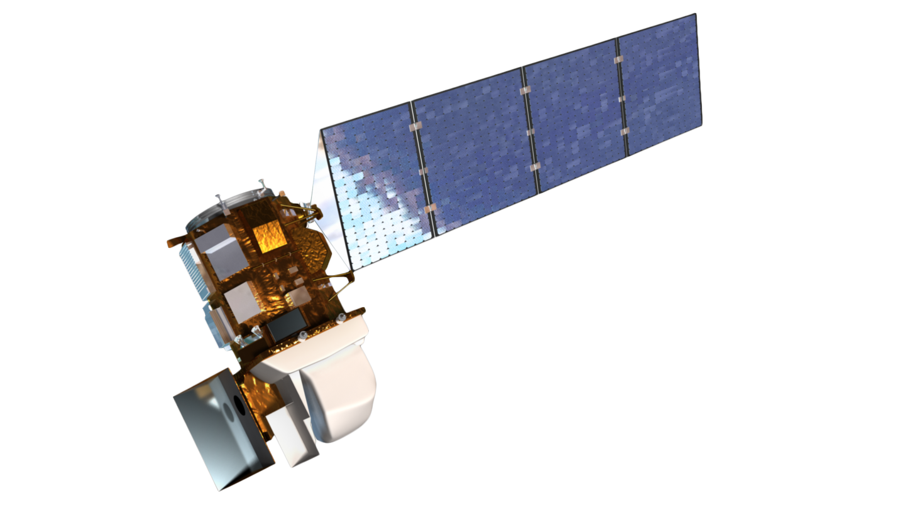
Algorithms
Satellite data
Landsat-8
Study area
Band description | Band number | Wavelength (µm) | Resolution (m)
Red | Band 4 | 0.64 - 0.67 | 30
Near-Infrared (NIR) | Band 5 | 0.85 - 0.88 | 30
Shortwave Infrared (SWIR 2) | Band 7 | 2.11 - 2.29 | 30
TIRS 1 | Band 10 | 10.6 - 11.19 | 100
Year | Month | Downloaded image id
2021 | Winter | LC08_L2SP_201036_20210112_20210308_02_T1
 | Spring | LC08_L2SP_201036_20210504_20210508_02_T1
 | Summer | LC08_L2SP_201036_20210808_20210819_02_T1
2022 | Summer | LC09_L2SP_201036_20220819_20230402_02_T1
2023 | Winter | LC09_L2SP_201036_20230126_20230313_02_T1
 | Spring | LC08_L2SP_201036_20230510_20230518_02_T1
 | Summer | LC08_L2SP_201036_20230814_20230814_02_RT

Slide 10
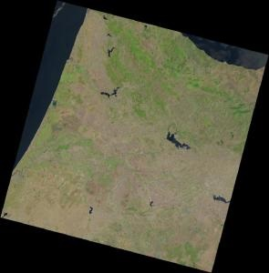
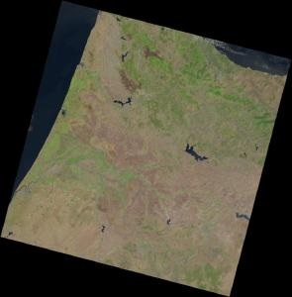
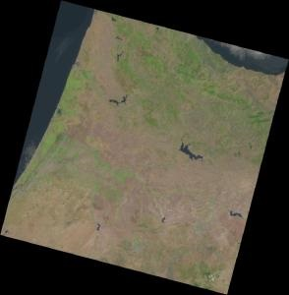
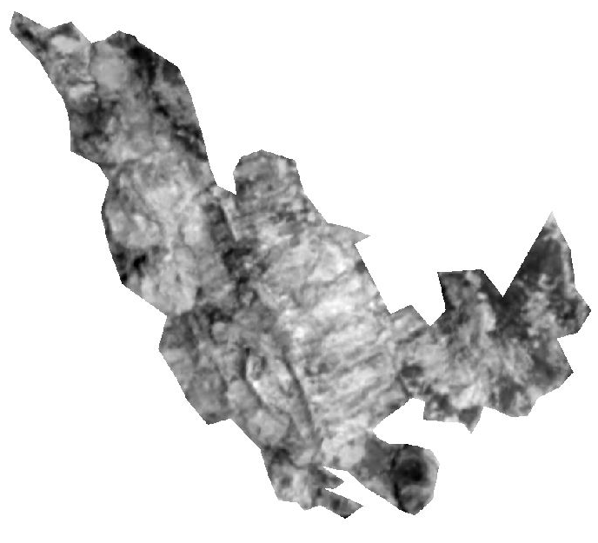
Algorithms
Satellite data
Landsat-8
Study area
Band description | Band number | Wavelength (µm) | Resolution (m)
Red | Band 4 | 0.64 - 0.67 | 30
Near-Infrared (NIR) | Band 5 | 0.85 - 0.88 | 30
Shortwave Infrared (SWIR 2) | Band 7 | 2.11 - 2.29 | 30
TIRS 1 | Band 10 | 10.6 - 11.19 | 100
Red band (B4)
NIR band (B5)
…
…
Scaling
Resampling
SWIR2 band (B7)
TIRS1 band (B10)
…
…
Clipping by mask layer

Slide 11
Study area
Algorithms
Satellite data
Normalized Burn Ratio:
NBR$=\frac{Band 5−Band 7}{Band 5+Band 7}$
Land Surface Temperature:
$$Pv={\left(\frac{NDVI−NDVImin}{NDVImax−NDVImin}\right)}^{2} ε=\text{0.004 }× \text{Pv}\text{ + 0.986}$$
LST= $\frac{Band 10}{(1+\left(\frac{0.00115×Band 10}{1.4388}\right)×\operatorname{Ln}\left(ε\right))}$
Band description | Band number | Wavelength (µm) | Resolution (m)
Red | Band 4 | 0.64 - 0.67 | 30
NIR | Band 5 | 0.85 - 0.88 | 30
SWIR 2 | Band 7 | 2.11 - 2.29 | 30
TIRS 1 | Band 10 | 10.6 - 11.19 | 100

Slide 12
RESULTS & ANALYSIS

Slide 13
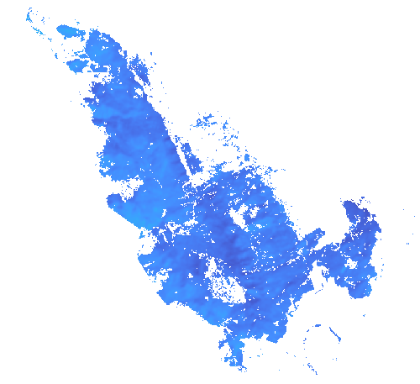
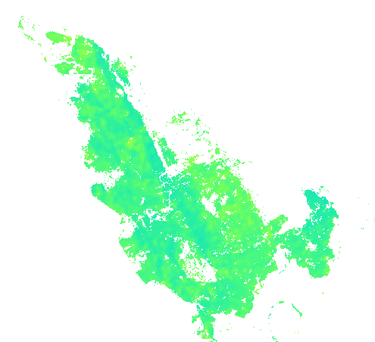
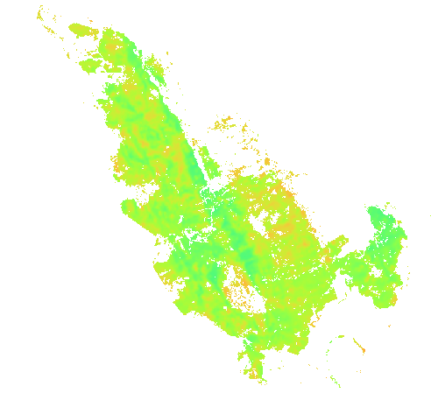
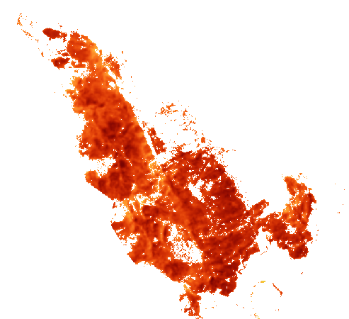
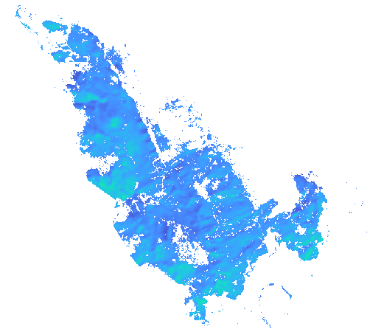
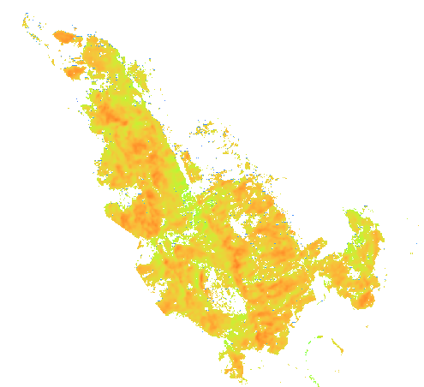
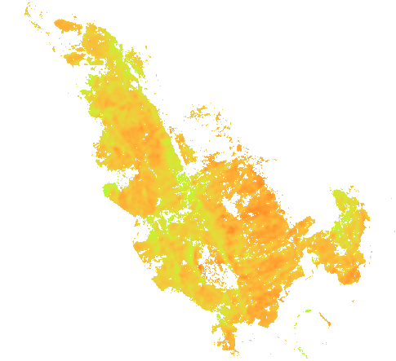
Results and Analysis
Land Surface Temperature
Pre-fire
Fire period
58°C
Winter 2021
Spring 2021
Summer 2021
Post-fire
Summer 2022
0°C
Winter 2023
Spring 2023
Summer 2023

Slide 14
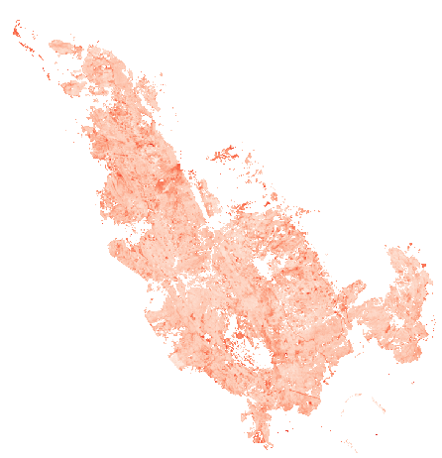
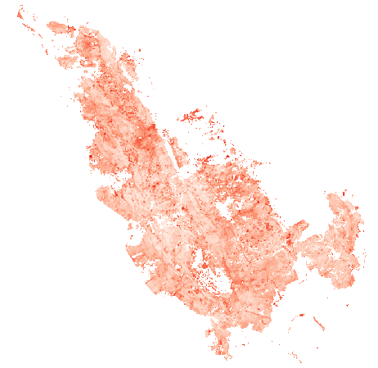
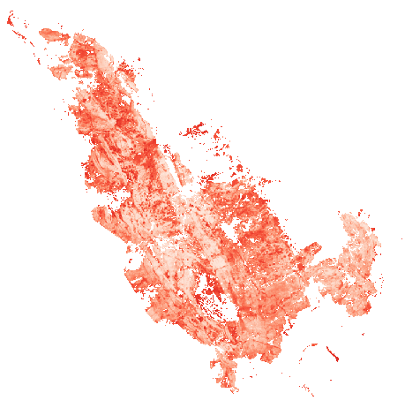
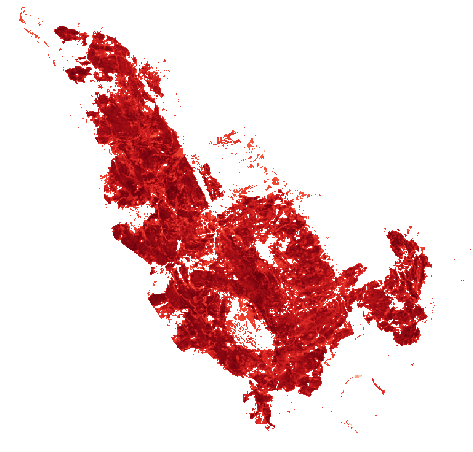
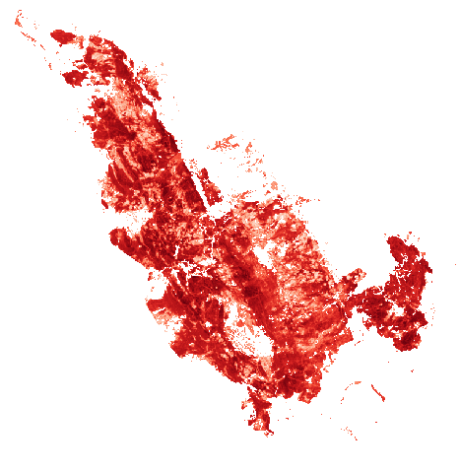
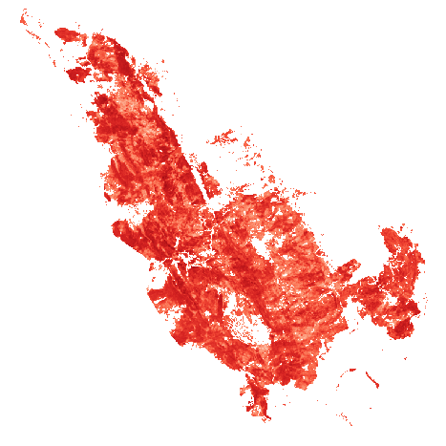
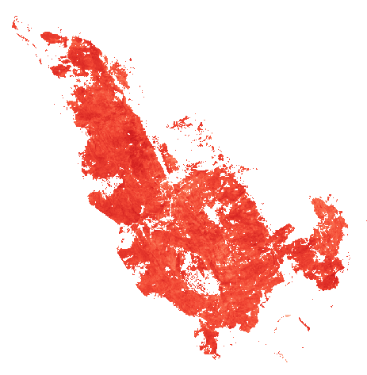
Results and Analysis
Normalized Burn Ratio
Pre-fire
Fire period
0.81
Winter 2021
Spring 2021
Summer 2021
Post-fire
Summer 2022
-0.45
Winter 2023
Spring 2023
Summer 2023

Slide 15
Results and Analysis

Slide 16
CONCLUSIONS

Slide 17
CONCLUSION
1
NBR and LST show negative correlation before and during fire period in Mediterranean forest ecosystems, based on Bou Jedyane forest case study.
2
NBR increases steadily after fire, indicating vegetation recovery, while LST varies seasonally
Using NBR and LST can improve the assessment of fire impacts.
3

