Slide 1
同济大学，测绘与地理信息学院
College of Surveying and Geo-informatics, Tongji University
Recovery ice stream: a linked subglacial water system with bifurcated flow path
Yangyang Chen^{1, 2}, Tiantian Feng^{1, 2}
¹College of Surveying and Geo-informatics
²Center for Spatial Information Science and Sustainable Development Applications,
Tongji University
Notes:
Good afternoon, everyone. It’s my pleasure to share our work today.
I am Chen Yangyang,
I will present on the topic: "Recovery Ice Stream: A Linked Subglacial Water System with a Bifurcated Flow Path"

Slide 2
同济大学，测绘与地理信息学院
College of Surveying and Geo-informatics, Tongji University
Research Background
Content
Implementation and Results
Conclusions and Outlooks
Notes:
from three aspects as below

Slide 3
同济大学，测绘与地理信息学院
College of Surveying and Geo-informatics, Tongji University
Research Background
Content
Implementation and Results
Conclusions and Outlooks
Notes:
First part is Research Background.

Slide 4
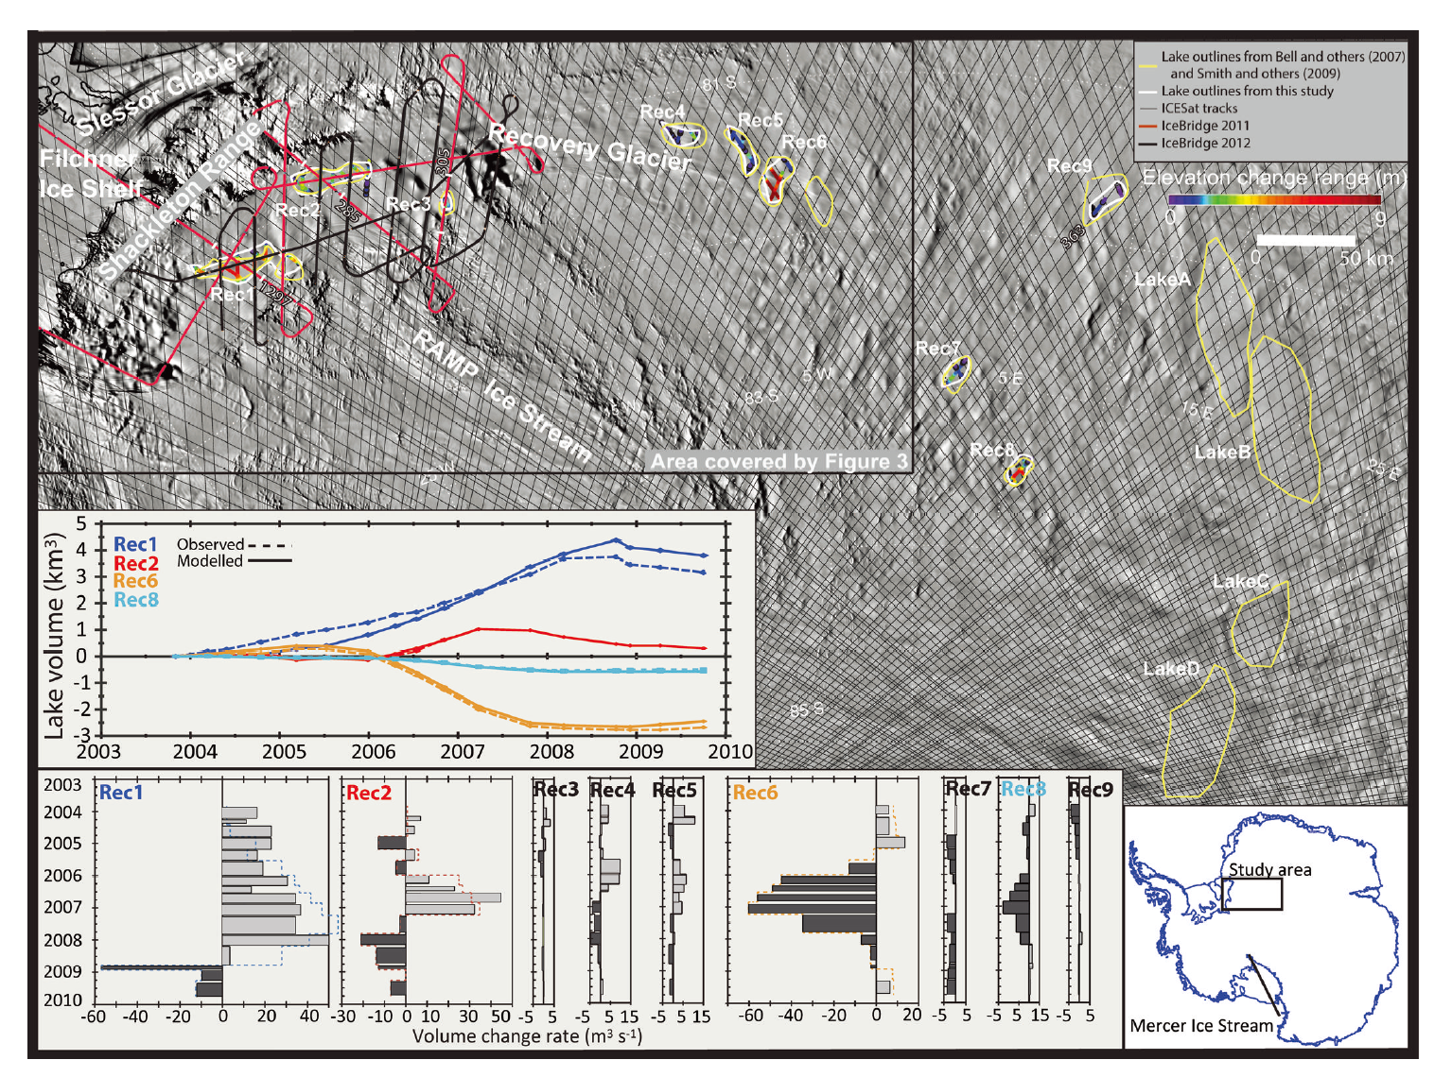
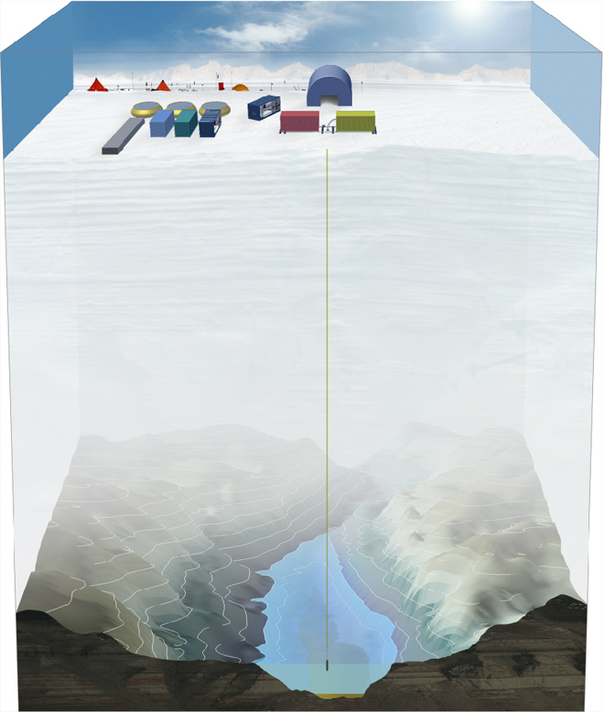
Research Background
同济大学，测绘与地理信息学院
College of Surveying and Geo-informatics, Tongji University
Recovery Ice Stream Subglacial lakes
terrains
mountains
dynamic subglacial water networks
lakes
Subglacial environment[1]
All known active and static lakes in Recovery Ice Stream , including Bell and others (2007) lakes and Smith and others (2009) lakes and the locations of active subglacial lakes found in this study. [2]
[1] https://earthsky.org/earth
[2] Siegfried et al., JOG, 2014
Research Background
Implementation and Results
Conclusions and Outlooks
Notes:
As we can see from the left picture, Antarctica is ice-covered. But what hidden beneath the kilometers of ice sheets are a rich diversity of terrains, mountains, lakes and dynamic subglacial water networks.
So is recovery ice stream.
Previous research based on surface structure characteristics and radio-echo sounding (RES), has revealed a significant number of subglacial lakes at the ice stream onset . The four large lakes are closely associated with the development and rapid movement of the RIS.
Ever since scientists discovered that ice sheet surface elevation change resulting from subglacial lake activity, numerous active have also been captured by ICESat data.
They are depicted as yellow polygons in the right picture.
And the latest Recovery active subglacial lake inventory derived from ICESat and ICEBridge are depicted as white polygon.

Slide 5
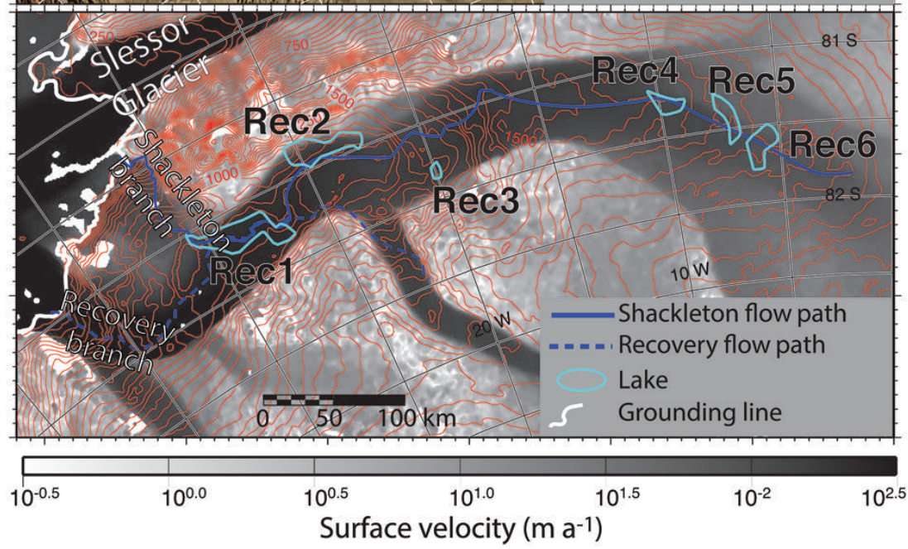
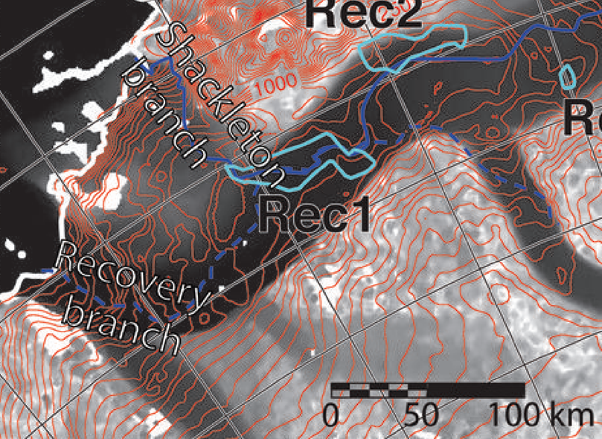
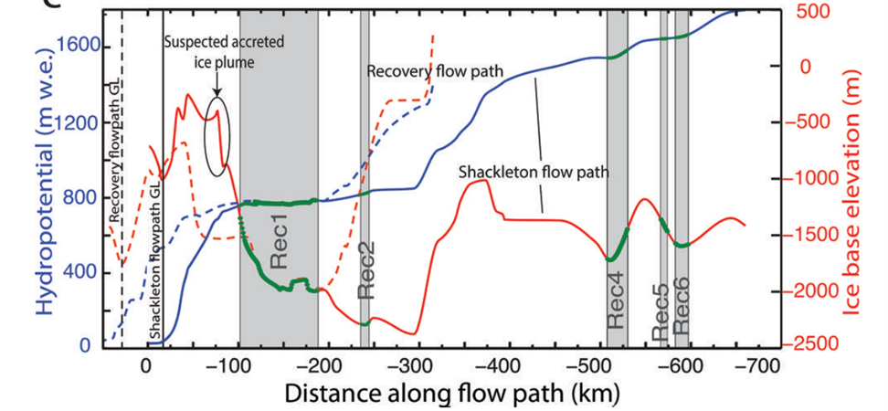
Research Background
同济大学，测绘与地理信息学院
College of Surveying and Geo-informatics, Tongji University
Recovery Ice Stream
The primary hydrologic
Flow path (solid line) leaves Rec1 and passes over a saddle in the
Shackleton Range (Shackleton branch); secondary flowline follows
the ice flow direction (Recovery branch).[1]
[1] Siegfried et al., JOG, 2014
Research Background
Implementation and Results
Conclusions and Outlooks
Notes:
Also, in this paper, the author give a significant assumption. The subglacial water flow path is bifurcated.
Look at the left picture, the solid line leaves Rec1 and passes over a saddle in the Shackleton Range, that is Shackleton branch;
secondary flowline follows the ice flow direction, that is Recovery branch.

Slide 6
同济大学，测绘与地理信息学院
College of Surveying and Geo-informatics, Tongji University
Research Background
Content
Implementation and Results
Conclusions and Outlooks
Notes:
The second part is implementation and results

Slide 7
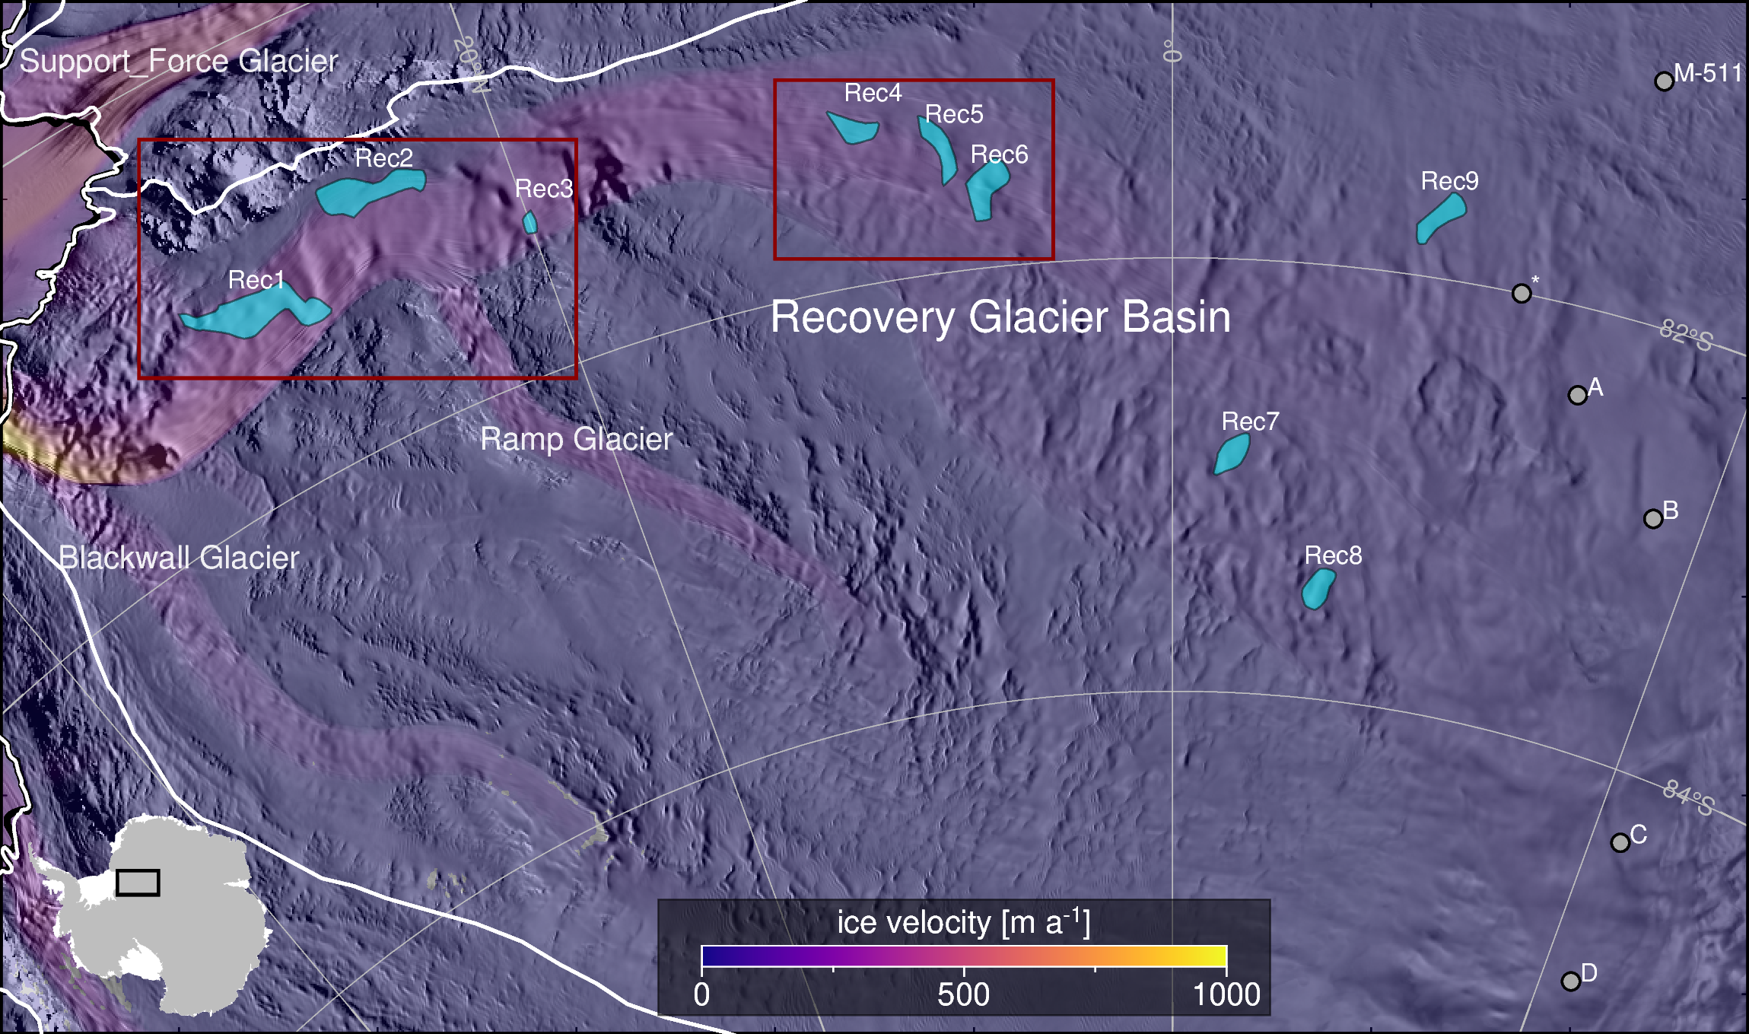
Implementation and Results
同济大学，测绘与地理信息学院
College of Surveying and Geo-informatics, Tongji University
Study area
Research Background
Implementation and Results
Conclusions and Outlooks
Notes:
This picture is a map of subglacial lakes of RIS and our study area.
Cyan polygons indicate hypothesized locations of active subglacial lakes.
and gray-filled circles represent stable subglacial lakes.
The area within the dark red box is the area of the figure will appear later.

Slide 8
Implementation and Results
同济大学，测绘与地理信息学院
College of Surveying and Geo-informatics, Tongji University
Experiment implementation
ICESat-2 ATL06 data
100m DEM
Differentiate measure points from DEM to calculate height anomaly[1]
[1] Siegfried et al., GRL, 2021
Research Background
Implementation and Results
Conclusions and Outlooks
Notes:
We follow the method proposed by Siegfried
download complete ICESat-2 from October two thousand and eighteen to July two thousand and twenty two for subglacial lake detection.
Use them to generate a 100m-resolution DEM for each lake.
Then Differentiate measure points from DEM to calculate height a
And collect height anomaly by month interval and calculate subglacial lake mean height anomaly

Slide 9
Implementation and Results
同济大学，测绘与地理信息学院
College of Surveying and Geo-informatics, Tongji University
Rec3
Rec2
Rec1-2
Rec1-1
Research Background
Implementation and Results
Conclusions and Outlooks
Notes:
This is a video depict the downstream monthly surface-height anomaly

Slide 10
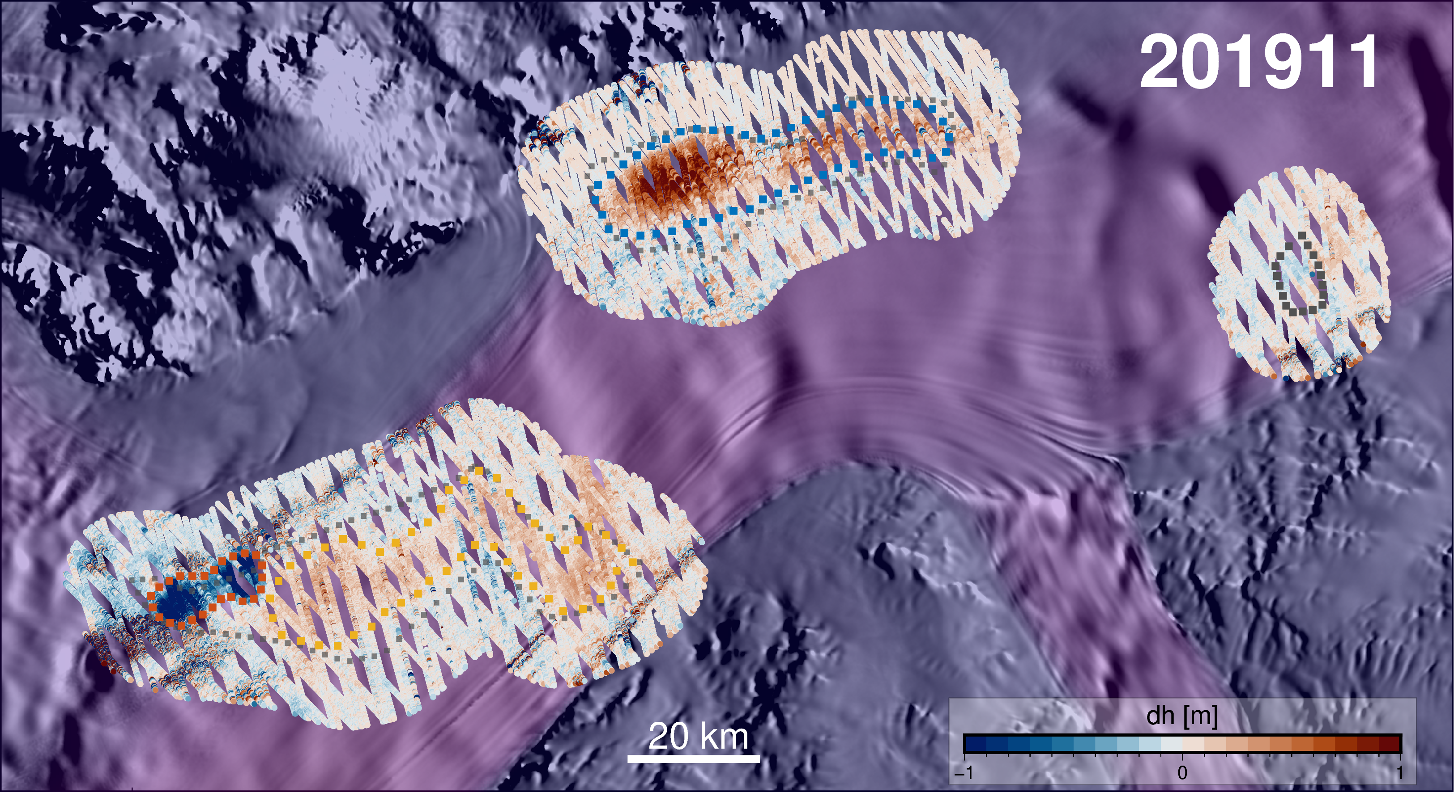
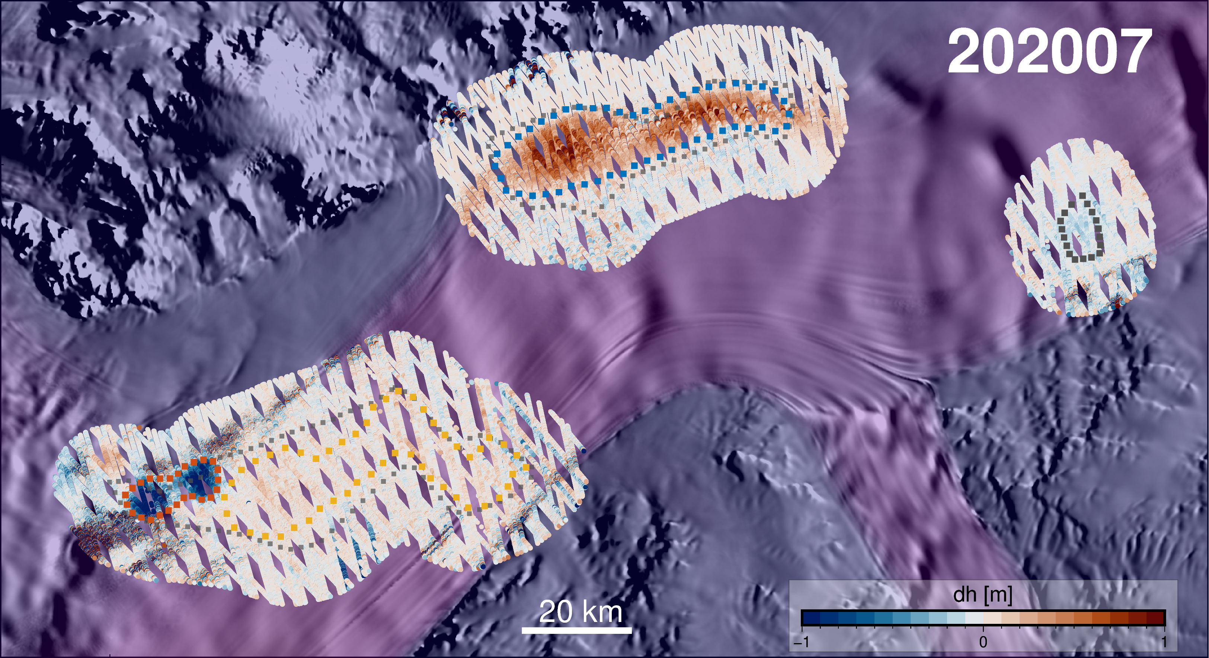
Implementation and Results
同济大学，测绘与地理信息学院
College of Surveying and Geo-informatics, Tongji University
Slow down
Slow down
Rec2
Rec3
Rec1-2
Rec1-1
Rec2
Rec3
Rec1-2
Rec1-1
Research Background
Implementation and Results
Conclusions and Outlooks
Notes:
Siegfried et al. noted in their study that Rec1 lake's subglacial water has two outlets, one leading north to the Shackleton Range and the other leading southwest to the Fichlner-Ronne ice shelf.
Based on this idea,
Lets’ read this line chart, (1-2 one dash two).
Firstly, water is released from Rec2 towards Rec1-2 in early 2019.
Simultaneously, Rec2 is receiving subglacial water from the upstream, creating a sufficient hydraulic head to overcome the hydraulic barrier and transport subglacial water further to Rec1-2.
We hypothesize that this subglacial water rapidly opened the southwest channel of Rec1, discharging the subglacial water, and swiftly closed in May 2020.
At this point, all subglacial water from Rec2 and Rec1-2 entered Rec1-1.
Furthermore, the surface uplift of Rec2 in 2022 appears to correspond to the surface depression of Rec4. Simultaneously, the water storage rate in Rec1-1 has correspondingly decreased.

Slide 11
Implementation and Results
同济大学，测绘与地理信息学院
College of Surveying and Geo-informatics, Tongji University
Rec4
Rec5
Rec6
Research Background
Implementation and Results
Conclusions and Outlooks
Notes:
This is a video depict the upstream monthly surface-height anomaly

Slide 12
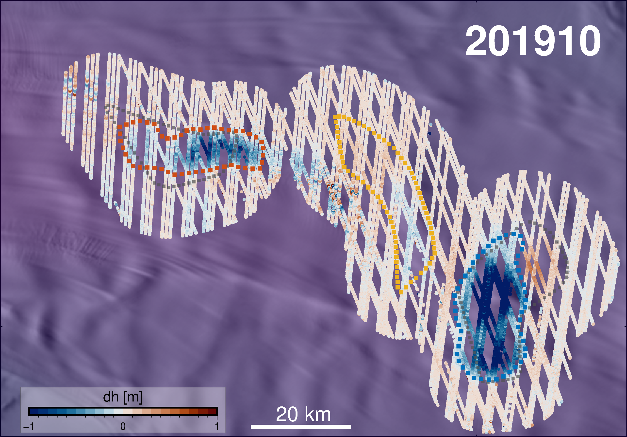
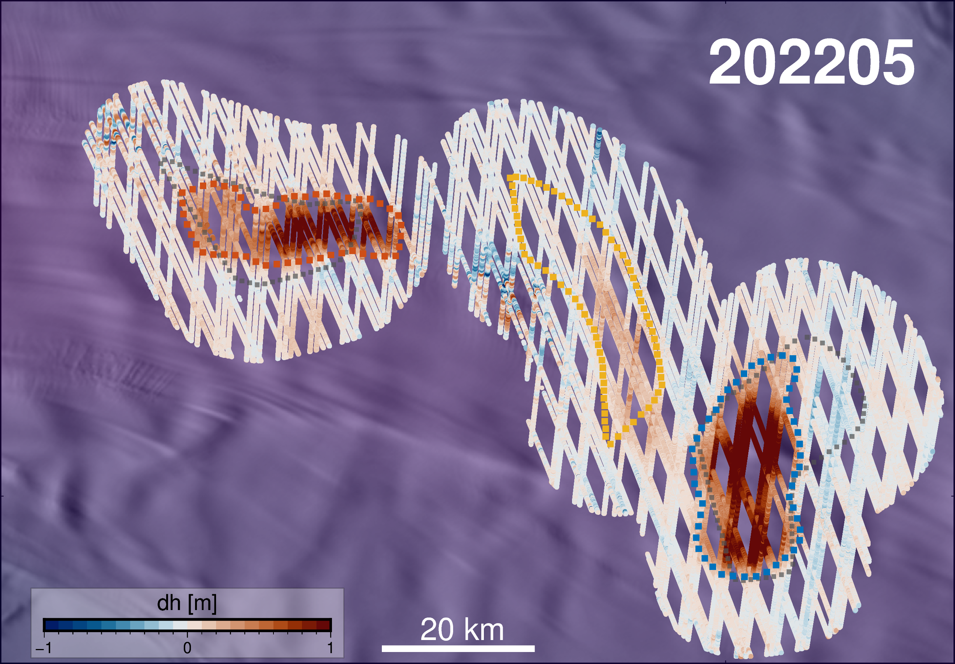
Implementation and Results
同济大学，测绘与地理信息学院
College of Surveying and Geo-informatics, Tongji University
Rec4
Rec5
Rec6
Rec4
Rec5
Rec6
Research Background
Implementation and Results
Conclusions and Outlooks
Notes:
The three upstream subglacial lakes show typical characteristics of connected subglacial lakes.
When rec6 discharging at early 2019 at a rapid rate, rec5 and rec4 are discharging too. But at a slower rate.
And a few month after rec4 begin to discharge, rec6 start to discharge too.

Slide 13
同济大学，测绘与地理信息学院
College of Surveying and Geo-informatics, Tongji University
Research Background
Content
Implementation and Results
Conclusions and Outlooks
Notes:
The three part is Conclusions and Outlooks

Slide 14
Conclusions and Outlooks
同济大学，测绘与地理信息学院
College of Surveying and Geo-informatics, Tongji University
Conclusions
Recovery ice stream is a linked subglacial water system
RIS’s subglacial water flow path seems to bifurcate in lake Rec1
Outlooks
Seeding more direct evidence for the existence of the bifurcation in the subglacial water flow
[1] Siegfried et al., GRL, 2021
Research Background
Implementation and Results
Conclusions and Outlooks
Notes:
We derived two main conclusions,
Recovery ice stream is a linked subglacial water system
and RIS’s subglacial water flow path seems to bifurcate in lake Rec1.
And we hope to find more direct evidence for the existence of the bifurcation in the subglacial water flow in future work

Slide 15
同济大学，测绘与地理信息学院
College of Surveying and Geo-informatics, Tongji University
Thanks!
Q&A
Notes:
that’s all!

