Slide 1
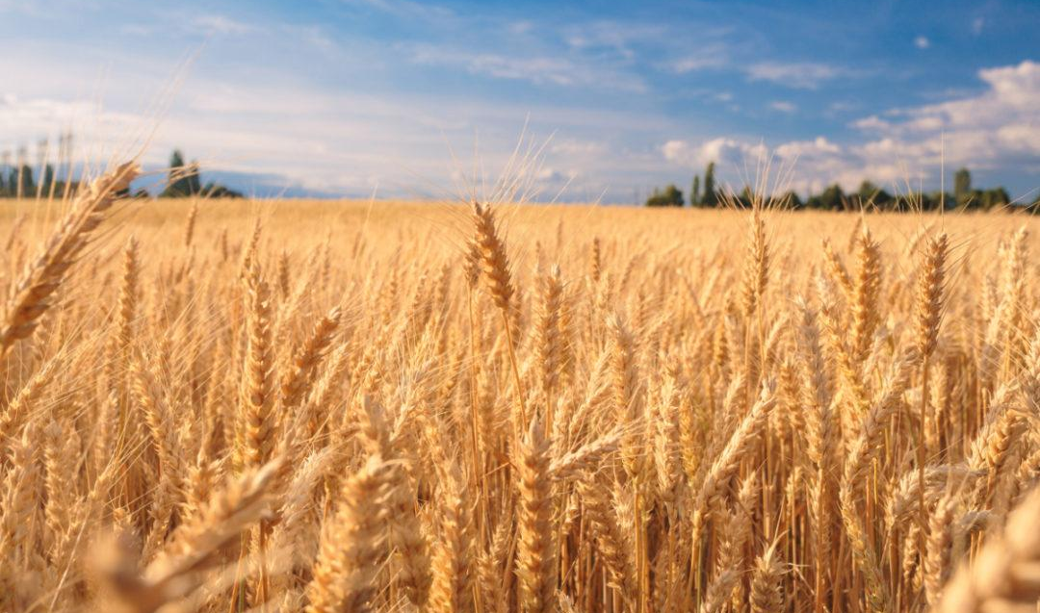
INTEGRATION OF OBJECT-ORIENTED REMOTE SENSING AND MACHINE LEARNING TO CREATE FIELD MODEL FOR OPTIMIZED REGIONAL AGRICULTURAL MANAGEMENT
Emine SENKARDESLER
METU – GGIT
2023

Slide 2
01
State of Art
03
Materials and Methods
05
Introduction
Approach
Results and Discussion
02
04

Slide 3
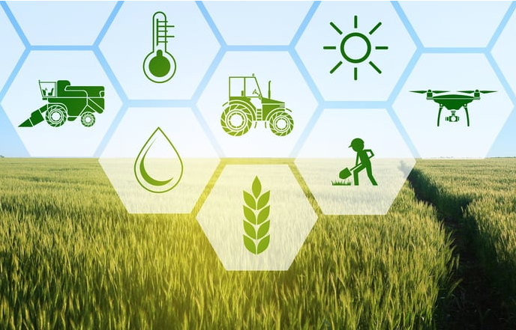
Introduction
Precision Agriculture
To meet nutritional needs of increasing population
To get greater yield than traditional production
Understanding field variability and extracting information
Decision making
Controlling precision area
Operation and result evaluation
https://farmingparadise.com/precision-agriculture-farming-guide/
Help of Remote Sensing

Slide 4
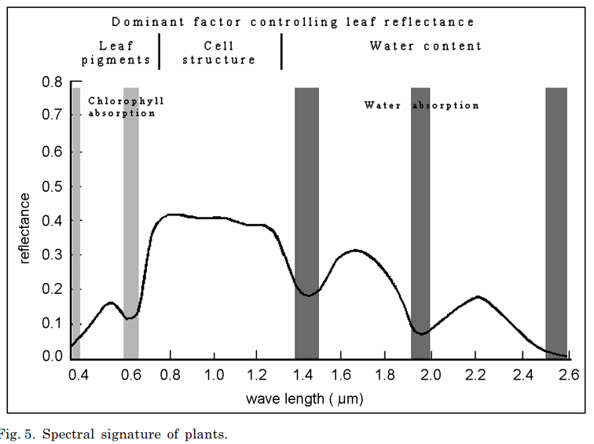
Introduction
Remote Sensing of Vegetation
Electromagnetic Spectrum Reflectance of Vegetation
Mainly used;
Visible (R, G, B)
Near - Infrared (NIR)
Shortwave - Infrared (SWIR)
Plants show distinct spectral signatures
Jakomulska, 2002
Electromagnetic reflectance of crop can help to understand vegetation cover

Slide 5
State of Art
Soil Management Zoning
Weed Sensing
Disease Detection
Yield Estimation
Temporal Analysis
Optical and Radar Satellite Images
Representation
Satellite Images
RS for Vegetation
Use Areas
Agricultural Applications
Phenology
Remote Sensing of Vegetation
Vegetation Index
Phenology
Fertilization
Irrigation
Disease Interference

Slide 6
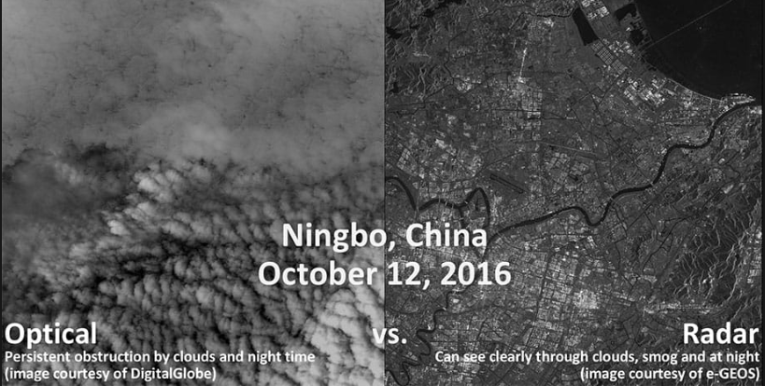
Satellite Images
Optical
Human eye can see
Measure reflected solar light
Radar
SAR - Synthetic Aperture Radar
Transmits microwaves towards the surface
Waits for the radar echo (reflected)
Not affected from clouds
https://apogeospatial.com/a-killer-app-for-sats/

Slide 7
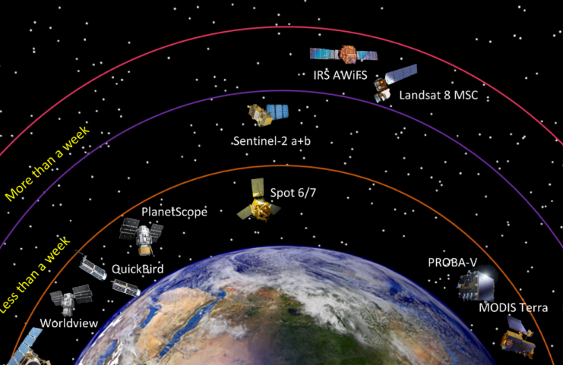
State of Art
Satellite Technology
Planet
Worldview
Modis
Landsat
Sentinel
Sentinel 2 Images are used
Gao, F., Zhang, X.(2021). Mapping Crop Phenology in Near Real-Time Using Satellite
Remote Sensing: Challenges and Opportunities. Journal of Remote Sensing

Slide 8
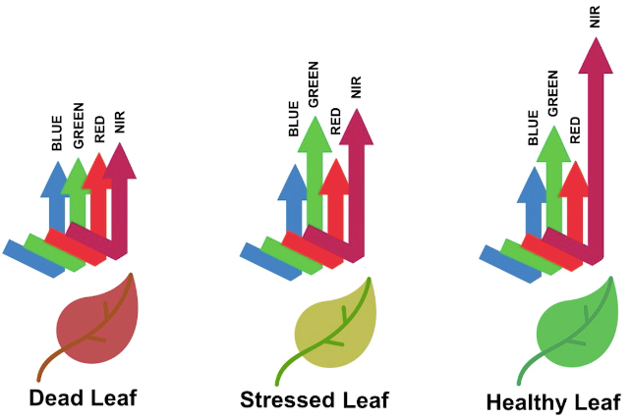
State of Art
Remote Sensing of Vegetation
Spectral imaging transformation of two or more image bands
To enhance the contribution of vegetation properties
Photosynthetic activity and canopy structural variations
https://github.com/px39n/Awesome-Vegetation-Index
Ratio Vegetation Index = R/NIR (1969)

Slide 9
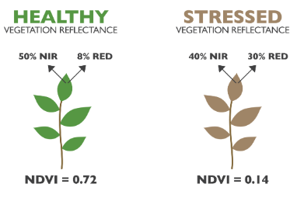
State of Art
Remote Sensing of Vegetation
NDVI is the very common index
Monitor crop development
NDSI (Normalized Difference Salinity Index): Soil Salinity
MSAVI (Modified Soil Adjusted Vegetation Index): Early development monitoring
https://www.agricolus.com/en/vegetation-indices-ndvi-ndmi/
Normalized Difference Vegetation Index = (NIR - R) / (NIR + RED)

Slide 10
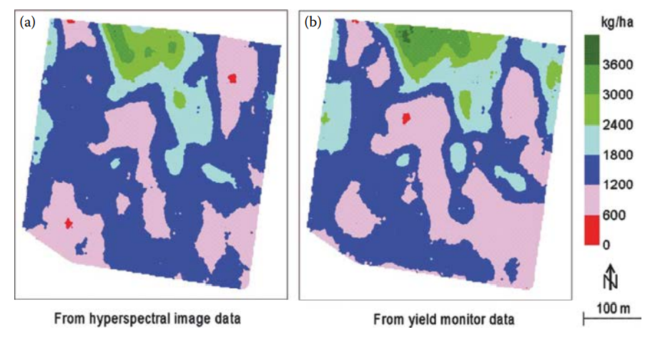
State of Art
Use Areas
Soil Management Zoning
Weed Sensing
Crop Herbicide Damage Detection
Crop Nitrogen Stress Detection
Crop Yield Estimation
Pest and Disease Detection
Phenology Estimation
Huete, A., Lyon, G., John, Thenkabail, S.,Prasad, Hyperspectral remote sensing of vegetation. Volume IV, Advanced applications in remote sensing of agricultural crops and natural vegetation-CRC Pr

Slide 11
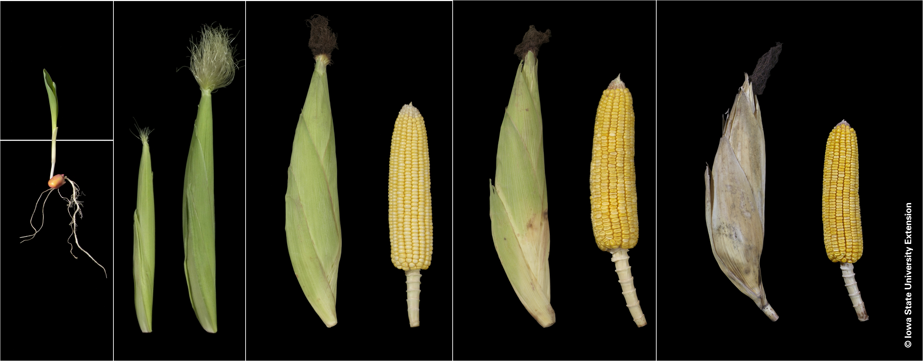
State of Art
Agricultural Applications
Phenology
Fertilization
Irrigation
Disease Interference
Corn Growth Stages | Integrated Crop Management (iastate.edu)
Knowing the important time to apply agricultural events is substantial for Precision Agriculture

Slide 12
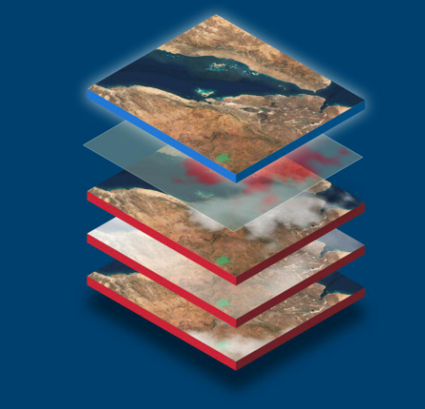
Approach
Regional scale → Field Scale
Combination of different Vegetation Index for different stages
Site specific solutions
https://eox.at/2019/05/eoxcloudless-sentinel-1-and-sentinel-2-analysis-ready-data/

Slide 13
Start Questions
How satellite data can help improving agricultural production?
What VI should be used for different stages of crop?
How to create a Field Model to be site specific?
Precision Agriculture
Vegetation Index (VI)
Combination of VI
Being Site Specific
Application on Field
How Vegetation Index and values interpreted?
Does a field have its own properties even inside?

Slide 14
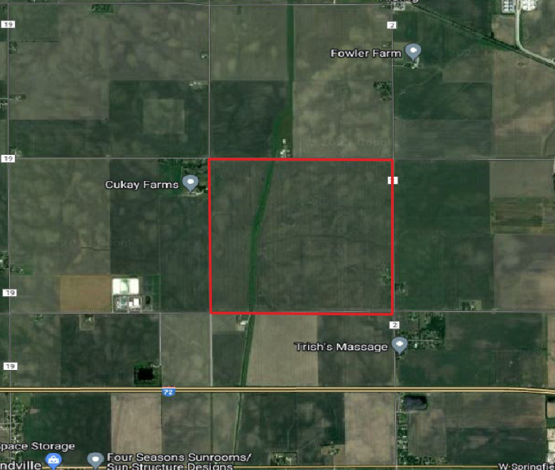
Materials
Study Area - Corn field – located at Illinois, United States Data 2017 - 2022 Sentinel 2 satellite images CPR (USDA – NASS)
Study area – corn field

Slide 15
Methods TS Pre - Processing
Methods Threshold and Slope Phenology Estimation
Methods Field Model
1. Combination of MSAVI and NDVI
MSAVI values greater than 0.6 are replaced with NDVI values for the same dates
2. TS Pre - Processing
i. Median Filter
ii. Savitzky – Golay Filter
3. Depending on threshold and slope methods:
- Emergence
- Silking
- Dough
- Dent
- Mature
- Harvest stages are estimated
4. Raster Mosaic
5. Standard deviation
6. K-Means Clustering

Slide 16
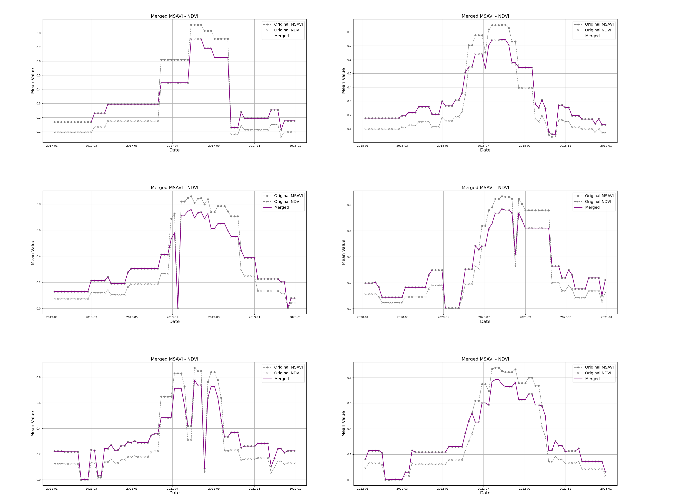
Methods TS Pre - Processing
1. Combination of MSAVI and NDVI
MSAVI values grester than 0.6, are replaced with NDVI values for the same dates
2. TS PHENOLOGICAL PRE - PROCESSING
i. Median Filter
ii. Savitzky – Golay Filter

Slide 17
Methods TS Pre - Processing
Pre – Processing is important to eliminate noises which can be caused by atmospheric illumination conditions, clouds, shadows or snow etc.

Slide 18
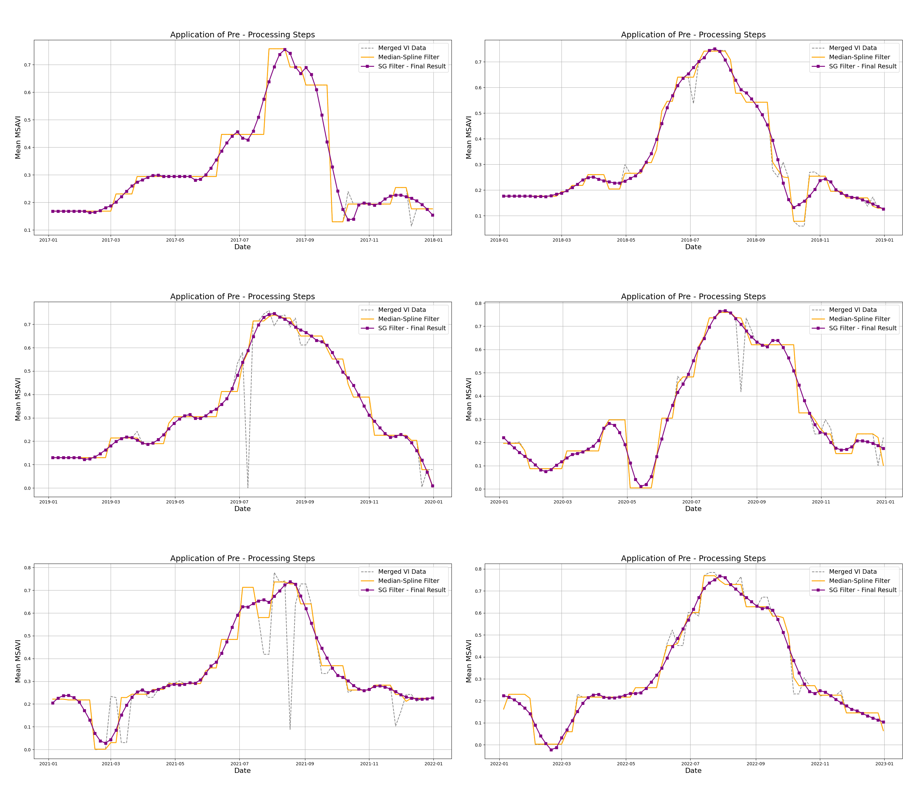
Methods TS Pre - Processing
1. Combination of MSAVI and NDVI
MSAVI values grester than 0.6, are replaced with NDVI values for the same dates
2. TS PHENOLOGICAL PRE - PROCESSING
i. Median Filter
ii. Savitzky – Golay Filter

Slide 19
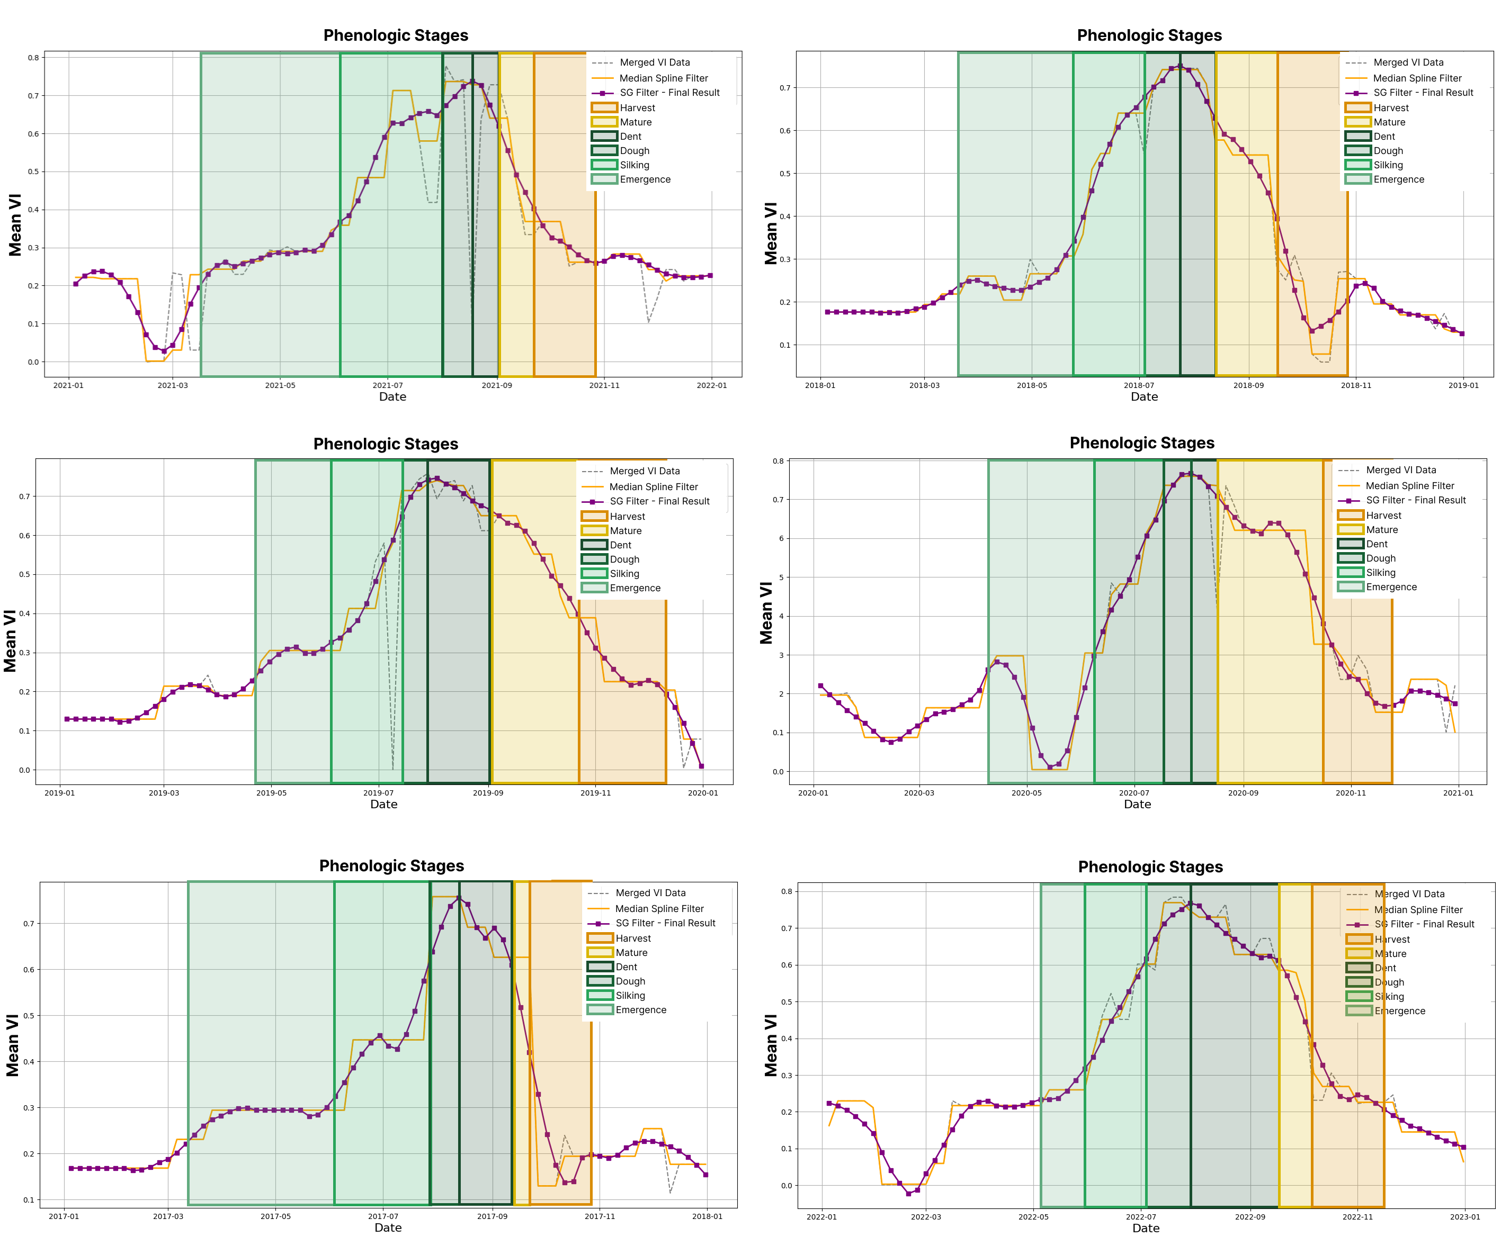
Methods Threshold - Slope
Depending on threshold and slope methods, phenological stages are estimated

Slide 20
Methods - Threshold - Slope
RMSE for estimating corn phenological stages is 124 calculated as 7.44 days
Highest error occurs in the Emergence stage 5.58 days,
Lowest error is found in the Silking 126 stage with an RMSE of 1.67 days

Slide 21
Methods – Standard Deviation of Pixels and K-Means Clustering
Clusters are created depending on the pixel level standard deviation values. These clusters named as object - based field characteristics for decision makers to understand field more precise

Slide 22
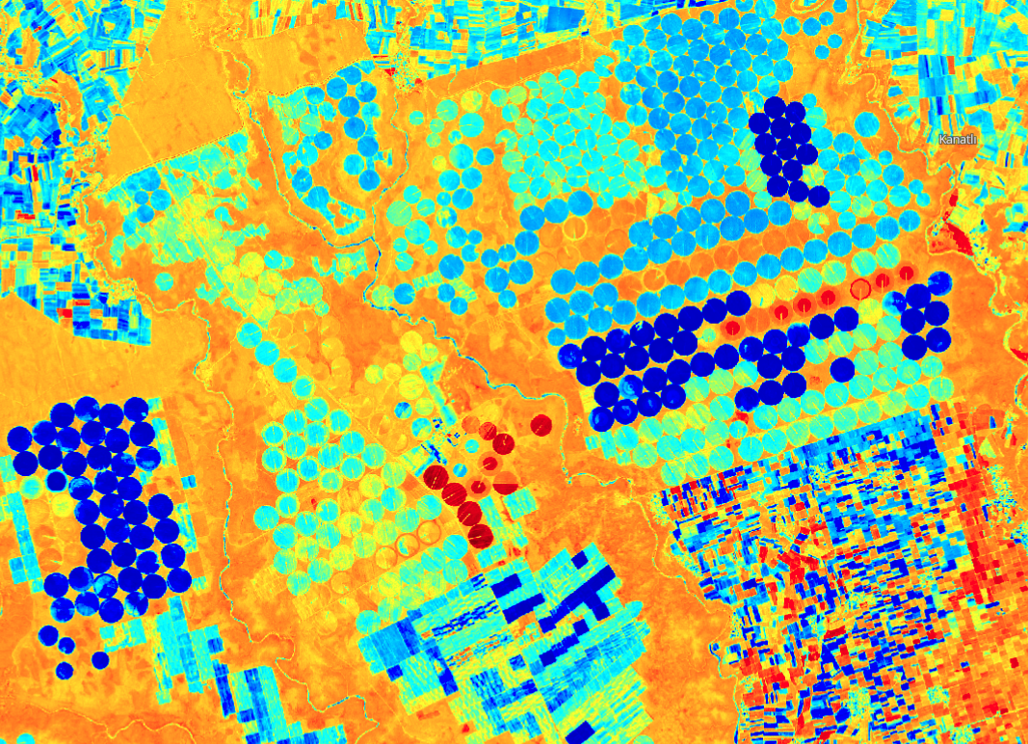
Conclusion
Phenology estimation Right Time Field model as related to phenology estimation, Right Source Right Place Right Rate
Sentinel - Ceylanpinar/Sanliurfa NDMI - 2022-06-21

Slide 23
Future Work
Emergence stage estimation Ground Observations Meteorological data
Sentinel - Ceylanpinar/Sanliurfa NDMI - 2022-06-21

Slide 24
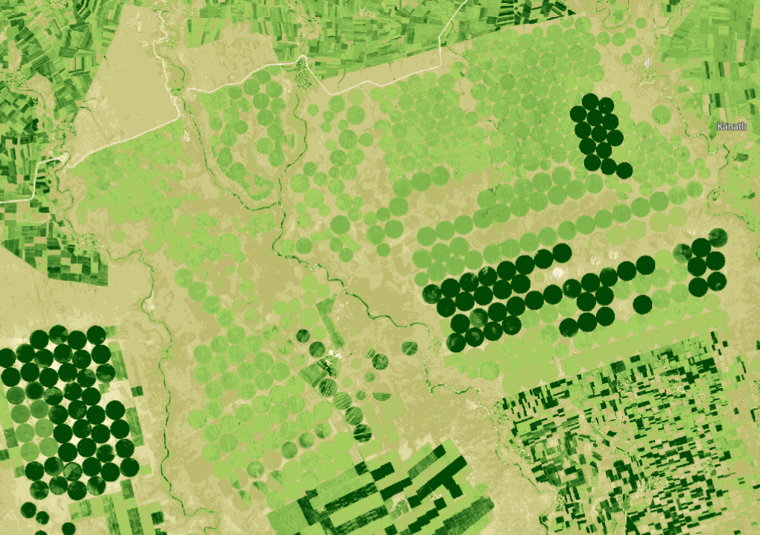
References
https://docs.google.com/document/d/1vaWgoSuXT3DwRH4TritUkML6QHRmWTzjSAF5Mxi7vBA/edit?usp=sharing
Sentinel - Ceylanpinar/Sanliurfa NDVI Map - 2022-06-21

