Slide 1
Spatiotemporal Analysis of Land Surface Temperature in Response to Land Use and Land Cover Changes: A Remote Sensing Approach
The 5th International Electronic Conference on Remote Sensing
Gulam Mohiuddin
Jan-Peter Mund
Eberswalde University for Sustainable Development
07 – 21 November 2023

Slide 2
Content
Introduction
Material and methods
Results
Discussion
Conclusion

Slide 3
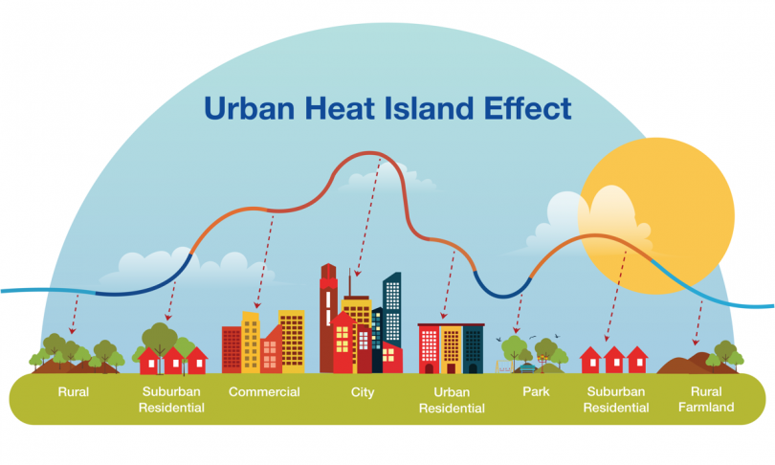
Introduction
Public health [1]
Local climate [2 , 3]
Urban ecosystem and biodiversity [4]
Atmospheric
pollutions [5]
Source: https://instacoat.com/2022/10/17/what-is-the-urban-heat-island-effect/
Figure 1: Urban heat island (UHI) its effect
LST is widely used to understand and monitor UHIs including develop and implement effective mitigation strategies [6, 7].

Slide 4
Introduction
The present study investigates the LST dynamics and their urban planning implications. It deciphers urban LST spatiotemporal patterns and evaluates the correlation between LULC and LST.
The specific objectives are:
- to obtain an overview of LST distribution and ranges during 2000 - 2021
- to observe the seasonal variation and trend of LST and identify possible hotspots
- to examine the identified hotspots and observe how LST responds in different LULC
- to examine the statistical relationship between LST and LULC classes
(vegetation, water and built-up areas)

Slide 5
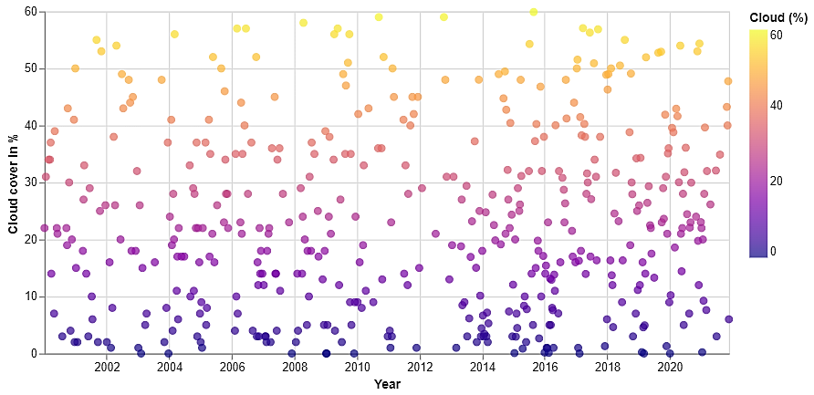
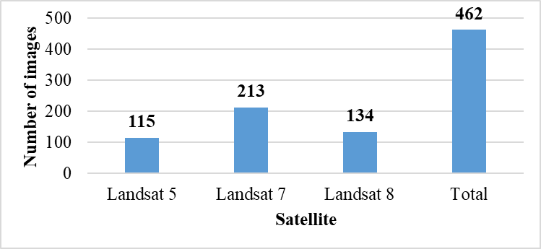
Material and methods: Remote sensing data
Figure 2: Satellite-wise number of Landsat images for the period of 2000 to 2021 (60% maximum cloud filter applied)
Figure 3: Cloud coverage in the Landsat images selected for the study
(maximum cloud cover threshold is 60% for this study)

Slide 6
Material and methods: Data processing platforms
Figure 4: Softwares and platforms used in the study

Slide 7
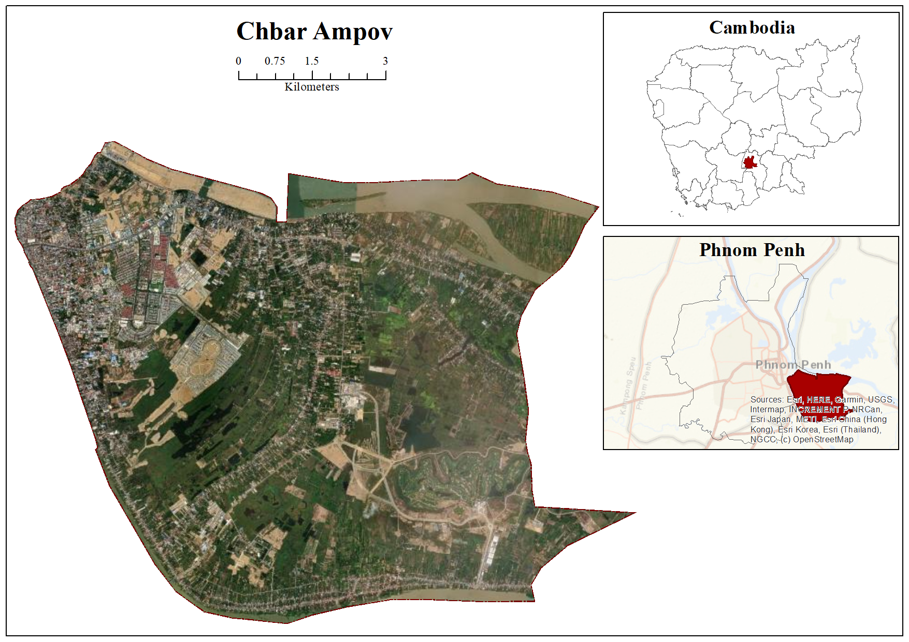
Material and methods: Study area
Figure 5: Location of the study area

Slide 8
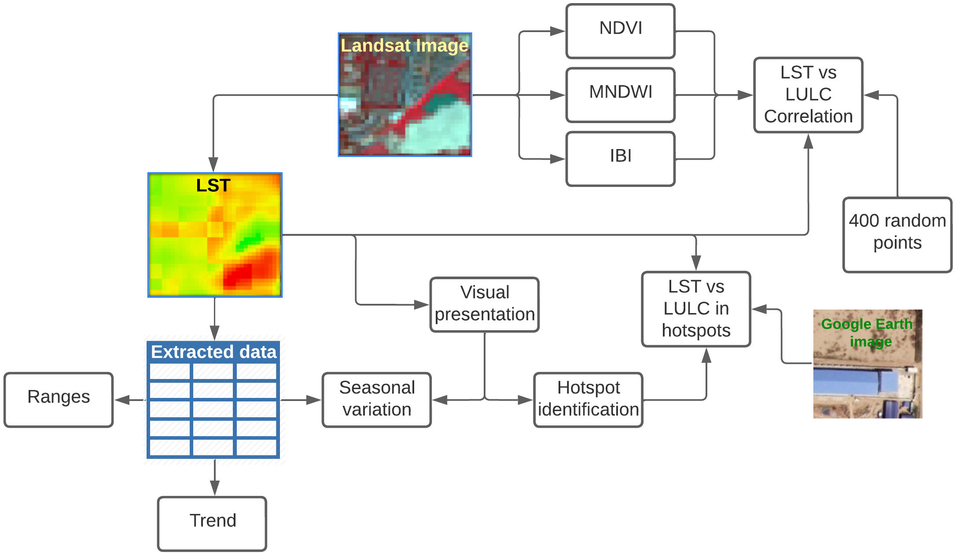
Material and methods: Overview of the workflow
Single-Channel (SC) algorithm
[8, 9]
NDVI = Normalised difference vegetation index; MNDWI = Modified normalised difference water index, IBI = Indices-based built-up index
Figure 6: Graphical overview of methodical workflow

Slide 9
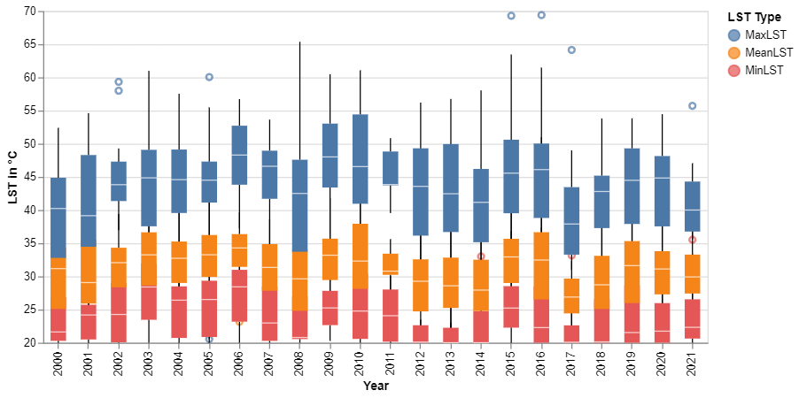
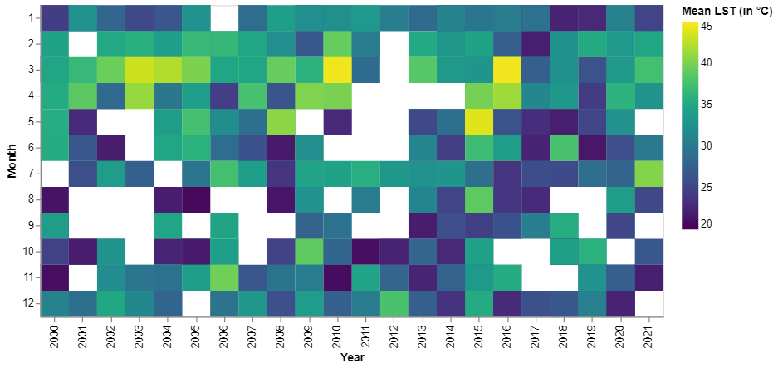
Results: Temporal LST ranges and distribution
White boxes = no data
Figure 7: Boxplot of yearly minimum, mean & maximum LST
Figure 8: Calendar heatmap of mean LST
Overall range is 20 – 69.40 °C, cyclic pattern
Maximum LST having the widest range
2003, 2008, 2015 and 2016 have wider range
Presence of outliers denotes extreme values
November (February) – April: dry season
Recurrence of high temperature in every 6th or 7th year (March- 2003, 2010, 2016)

Slide 10
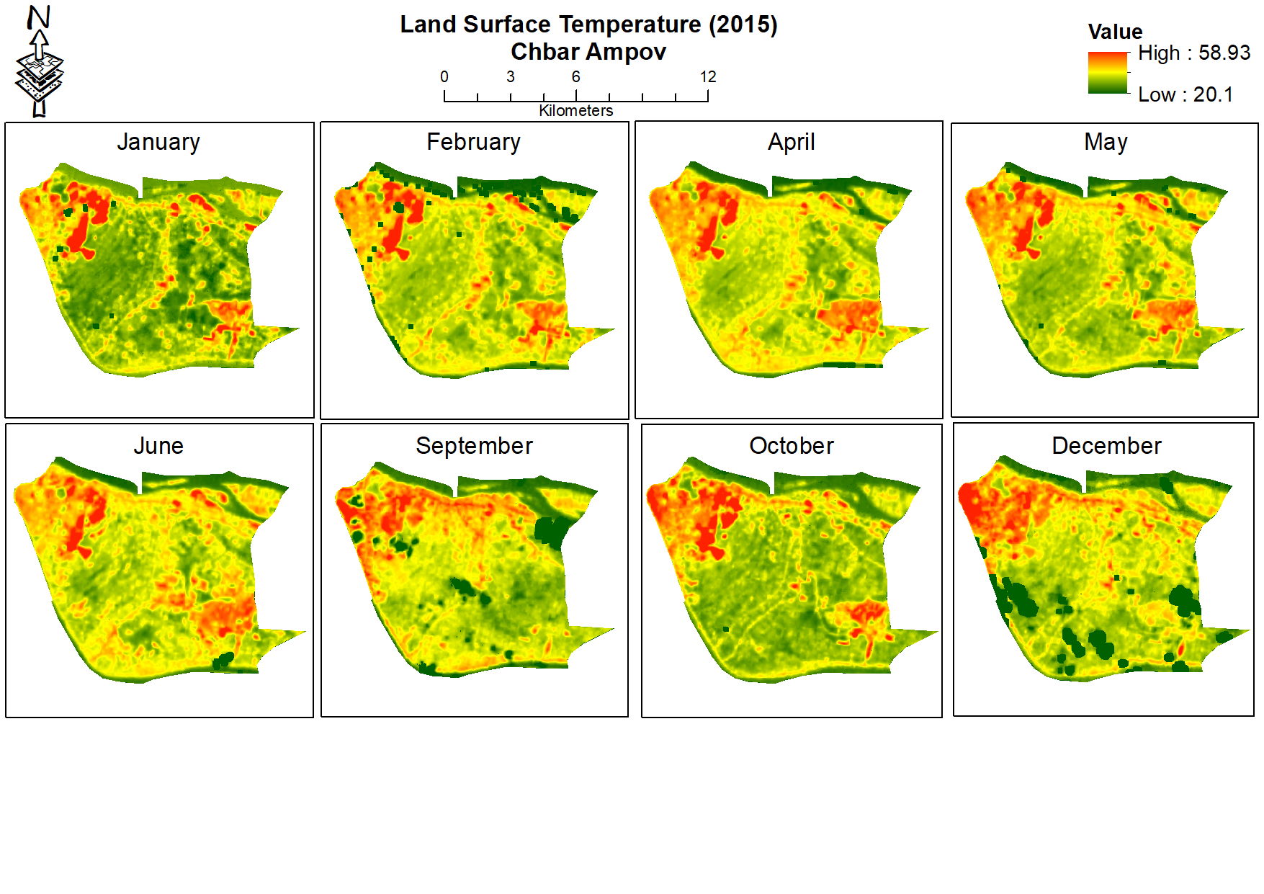
Results: Seasonal variation
Maximum LST = 38.15
Maximum LST = 45.02
Maximum LST = 54.49
Maximum LST = 47.31
Maximum LST = 49.54
Maximum LST = 33.6
Maximum LST = 46.41
Maximum LST = 34.13
Figure 9: LST in different months from same year

Slide 11
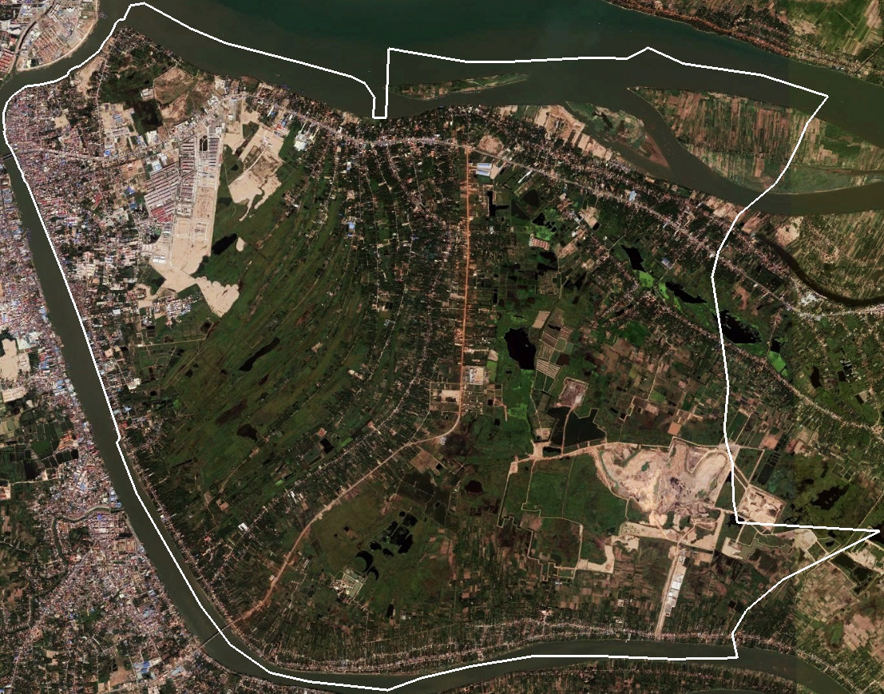
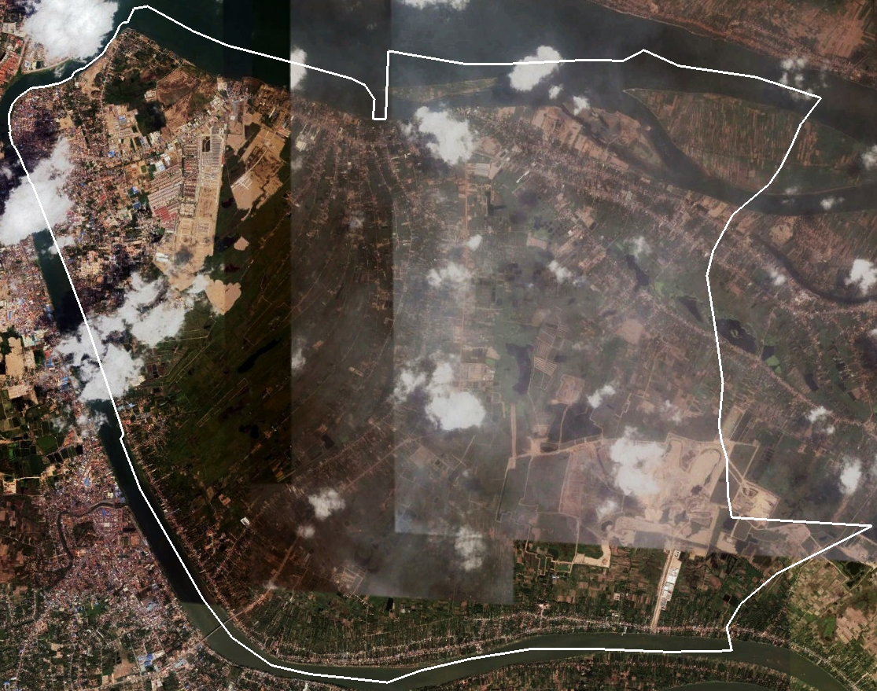
Results: Seasonal variation
LST (January 2015)
LST (April 2015)
No noticeable LULC changes but changes in LST
Maximum LST difference between January and April in 2015 is 16.34 °C
RGB (January 2015)
RGB (April 2015)
Figure 10: Illustration of seasonal variation of LST
Maximum LST = 38.15
Maximum LST = 54.49

Slide 12
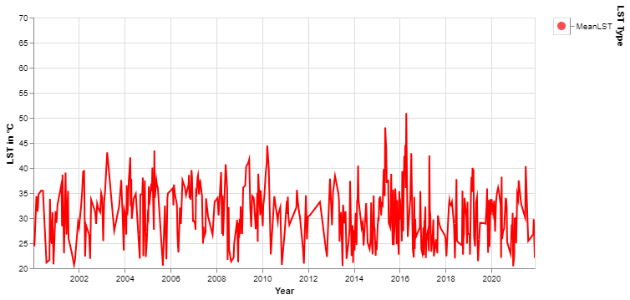
Results: Trend of LST
Figure 11: Time series of mean LST (2000 - 2021)
Regular fluctuation due to seasonal variation
No long-term trend

Slide 13
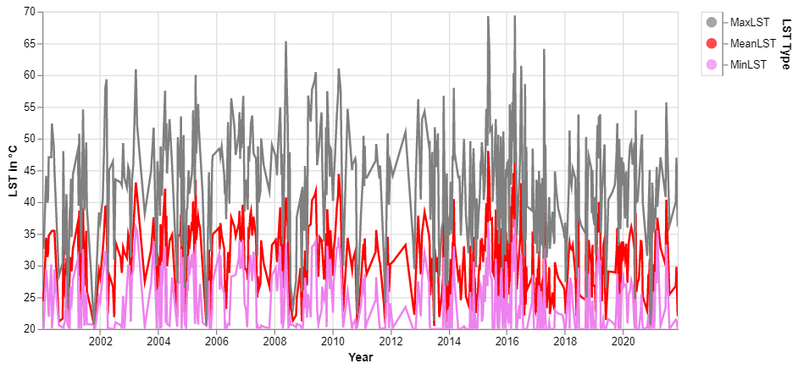
Results: Trend of LST
Figure 12: Total time series of minimum, mean & maximum LST (2000 - 2021)
20 °C flatline at the bottom due to temperature mask
Apprarently symmetrical spikes

Slide 14
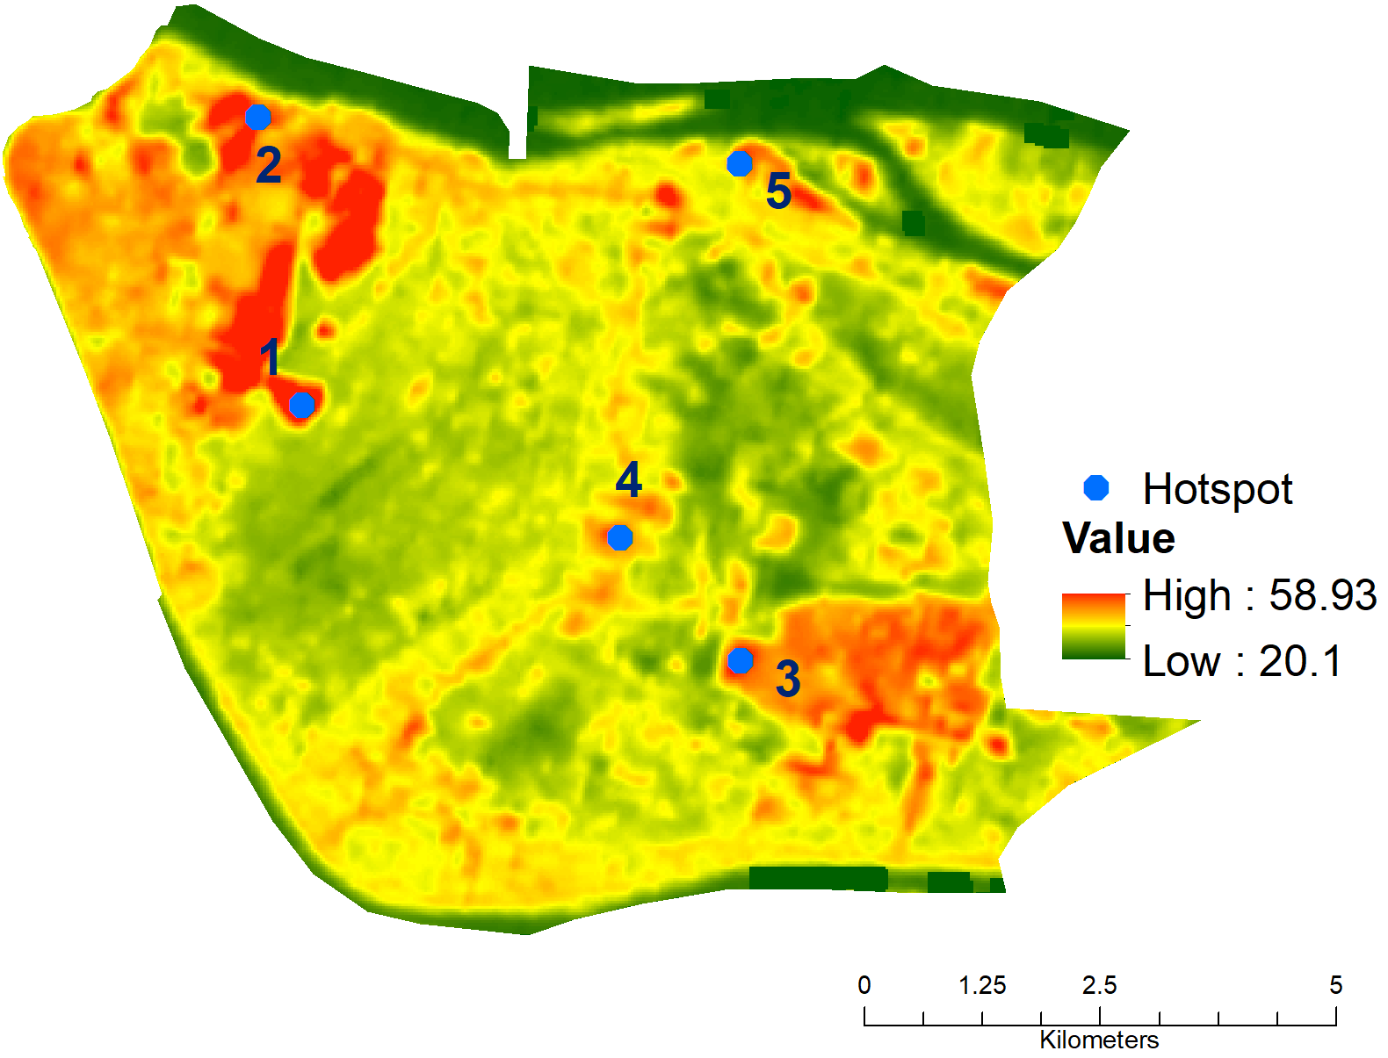
Results: LST hotspots
RGB (April 2015)
LST (April 2015)
Figure 13: Location of identified 5 hotspots (background image is LST (in °C) from April 2015)
Marked five points on the maps are consistently warmer spots which are identified as hotspots
Point 4 is elaborated further as an example how LST responds to different LULC within the study period

Slide 15
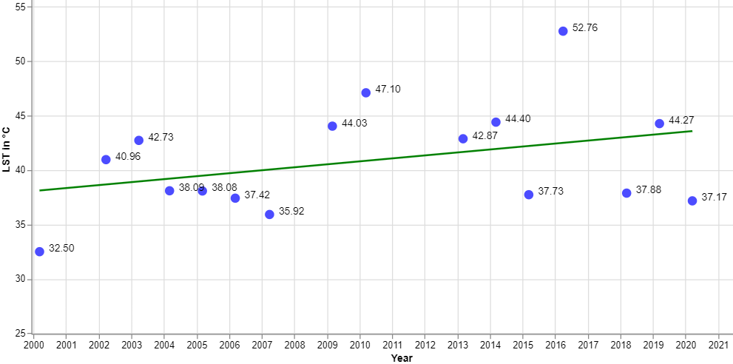
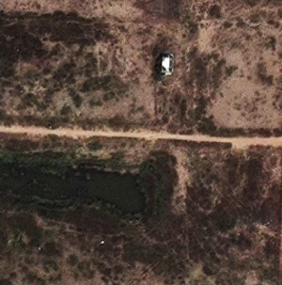
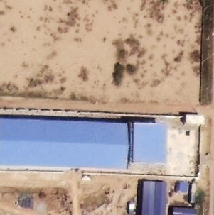
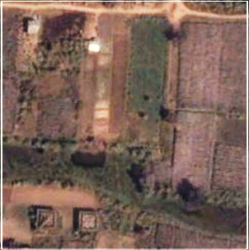
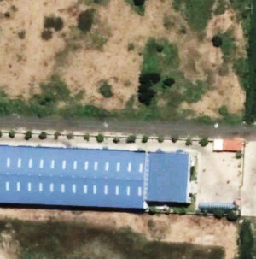
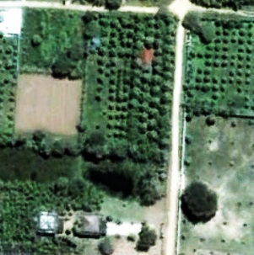
Results: LST & LULC in hotspot 4
2016, January
2010, February
2003, February
2018, June
2008, July
Figure 14: LST and LULC changes in hotspot 4

Slide 16
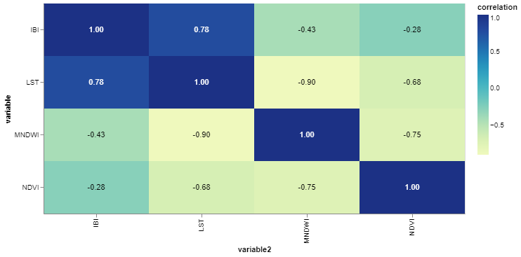
Results: LST & LULC Correlation
Figure 15: Correlation matrix between LST, IBI, MNDWI & NDVI

Slide 17
Discussion: Data, methods & results
Key findings from the study include:
- an evident seasonal influence on LST; similar findings in other studies [10, 11],
- despite noticeable fluctuations, no long-term trends were visible in terms of descriptive statistics,
- in specific points, upon LULC changes, trend is observed
- visual connection between LST and LULC,
- strong correlation between LST and different LULC classes; aligned with other studies [12, 13].

Slide 18
Discussion: Limitations and outlook
Difficulties in obtaining same-day images yearly due to cloud, revisit time of satellites that may results in potential inconsistency in terms of absolute temperature measurement
The study did not factor in local climate or climate anomalies, and LST changes cannot be solely attributed to LULC changes
Absence of long-term trend, potentially due to limited study time frame
Future study can consider longer period in the same area or other part of the city to observe if there is any long term trend appears or not
Besides spectral indices, detailed LULC might provide deeper insights which requires high resolution satellite images in larger scale and thermal drones can provide even finer dynamics in smaller scale.

Slide 19
Conclusion
The study supports the widely accepted theory that urbanisation and LULC changes are closely related to LST variations [10, 14].
Methodology used in the study can be applied to other areas and timeline
The study highlights the importance of considering local context and specific LULC changes when examining LST dynamics.
Understanding this relationships can guide urban planners, policymakers, researchers towards sustainable, resilient urban environments.

Slide 20
References
Kovats, R.S.; Hajat, S. Heat Stress and Public Health: A Critical Review. Annu. Rev. Public Health 2008, 29, 41–55.
Santamouris, M. On the Energy Impact of Urban Heat Island and Global Warming on Buildings. Energy and Buildings 2014, 82, 100–113.
Zhang, P.; Imhoff, M.L.; Wolfe, R.E.; Bounoua, L. Characterizing Urban Heat Islands of Global Settlements Using MODIS and Nighttime Lights Products. Canadian Journal of Remote Sensing 2010, 36, 185–196.
Grimm, N.B.; Faeth, S.H.; Golubiewski, N.E.; Redman, C.L.; Wu, J.; Bai, X.; Briggs, J.M. Global Change and the Ecology of Cities. Science 2008, 319, 756–760.
Pickett, S.T.A.; Cadenasso, M.L.; Grove, J.M. Resilient Cities: Meaning, Models, and Metaphor for Integrating the Ecological, Socio-Economic, and Planning Realms. Landscape and Urban Planning 2004, 69, 369–384.
Nagler, P.; Glenn, E.; Nguyen, U.; Scott, R.; Doody, T. Estimating Riparian and Agricultural Actual Evapotranspiration by Reference Evapotranspiration and MODIS Enhanced Vegetation Index. Remote Sensing 2013, 5, 3849–3871.
Metz, M.; Andreo, V.; Neteler, M. A New Fully Gap-Free Time Series of Land Surface Temperature from MODIS LST Data. Remote Sensing 2017, 9, 1333.
Jimenez-Munoz, J.C.; Cristobal, J.; Sobrino, J.A.; Soria, G.; Ninyerola, M.; Pons, X.; Pons, X. Revision of the Single-Channel Algorithm for Land Surface Temperature Retrieval From Landsat Thermal-Infrared Data. IEEE Trans. Geosci. Remote Sensing 2009, 47, 339–349.

Slide 21
References
Jimenez-Munoz, J.C.; Sobrino, J.A.; Skokovic, D.; Mattar, C.; Cristobal, J. Land Surface Temperature Retrieval Methods From Landsat-8 Thermal Infrared Sensor Data. IEEE Geosci. Remote Sensing Lett. 2014, 11, 1840–1843.
Weng, Q. A Remote Sensing?GIS Evaluation of Urban Expansion and Its Impact on Surface Temperature in the Zhujiang Delta, China. International Journal of Remote Sensing 2001, 22, 1999–2014.
Zhou, Y.; Yang, G.; Wang, S.; Wang, L.; Wang, F.; Liu, X. A New Index for Mapping Built-up and Bare Land Areas from Landsat-8 OLI Data. Remote Sensing Letters 2014, 5, 862–871.
Xu, H. Modification of Normalised Difference Water Index (NDWI) to Enhance Open Water Features in Remotely Sensed Imagery. International Journal of Remote Sensing 2006, 27, 3025–3033.
Zomer, R.J.; Trabucco, A.; Bossio, D.A.; Verchot, L.V. Climate Change Mitigation: A Spatial Analysis of Global Land Suitability for Clean Development Mechanism Afforestation and Reforestation. Agriculture, Ecosystems & Environment 2008, 126, 67–80.
Oke, T.R. The Energetic Basis of the Urban Heat Island. Quart J Royal Meteoro Soc 1982, 108, 1–24.

Slide 22
Acknowledgement
This research was funded by the Build4People Project under the funding priority SURE, Sustainable Development of Urban Regions, of the German Federal Ministry of Education and Research (BMBF), funding support code (FKZ): 01LE1908D1.

Slide 23
Thank you!
Contact:
Gulam Mohiuddin
Eberswalde University for Sustainable Development
Schicklerstraße 5,
16225 Eberswalde,
Germany
Gulam.Mohiuddin@hnee.de
https://www.researchgate.net/profile/Gulam-Mohiuddin

