Slide 1



Assessment of Outdoor Thermal Comfort during the last decade Using Landsat 8 Imageries with Machine Learning Tools over the Three Metropolitan Cities of India
P S Hari Prasad
Under guidance of
Dr. A. N. V. Satyanarayana
Canter for Ocean, River, Atmosphere and Land Sciences
Indian Institute of Technology Kharagpur
Kharagpur – 721302

Slide 2
Introduction
In the view of rapid urban growth and increase in drastic urban population, the necessity of estimation of LULC changes are highly needed.
The LULC Changes are crucial in predicting the Outdoor thermal comfort.
The drastic changes in the land cover changes will influence the meteorological conditions of the region.
Leads to have profound impact on the health of urban population, such as increase in dehydration, eye strain, dizziness, accelerated respiration and cardiovascular problems.
It is essential to understand the influence of change in urban built up and associate meteorological factors on the outdoor thermal comfort which eventually affects the urban health.

Slide 3
Literature review
Mohan et al., (2013) | Significant changes in thermal comfort over five megacities of India using point location synoptic meteorological data and compared the thermal comfort levels over different seasons in different cities and ranked the cities according to maximum discomfort.
Ali & Patnaik, (2018) | Reported that the PET of the urban canopy is 2.40⁰ C higher than normal conditions over Bhopal, India, and the perceived thermal sensation was significantly affected by the availability of shade.
Sobrino et al., (2013) | Investigated the impact of LULC using remote sensing methods and synoptic weather station data over Madrid city in estimating outdoor thermal comfort using Landsat data and available synoptic weather stations observations
Kikon et al., (2016) | Studied the impact of indices such as normalized difference vegetation index (NDVI), normalized difference built-up index (NDBI), and surface albedo and concluded that the major changes in LST are due to changes in properties of impervious areas because of urbanization.
Mijani et al., (2020) | Implemented multiple regression models based on least square adjustment for the generation of thermal comfort index maps over the city of Tehran. They also noticed that LULC parameters such as surface brightness and greenness, wetness play a major role in modifying thermal comfort.

Slide 4
Study Area
Hyderabad, at 570 m above mean sea level with Topical wet and dry weather climate
May - Hottest month, Mean temperature 33 ℃
December - coldest month, Mean temperature of 22 ℃
Highest relative humidity in August (69%), Lowest in April (28%)
City has large urban landscape with a population of about 9,482,000 (The World’s Cities in 2018)
Bangalore is a tropical savanna climatic zone. It is the moderately comfortable city.
The hottest month is April, with an average temperature of about 35 ℃, and the coolest month is January, with a mean temperature of about 15.0 ℃.
The average peak relative humidity is about 71%. in August, and the lowest average is 41% in March.
It is one of the top 50 highly air-polluted cities in India, with a population of around .84 crores.
Jaipur has a monsoon-influenced hot semi-arid climate with long, extremely hot summers and short, mild to warm winters.
The hottest month is May, with an average temperature of about 41.0 ℃, and the coolest month is January, with a mean temperature of about 17.0 ℃.
The average peak relative humidity in July, and the lowest average is in April.
It is one of the top 50 highly air-polluted cities in India, with a population of around 42 Lakhs.

Slide 5
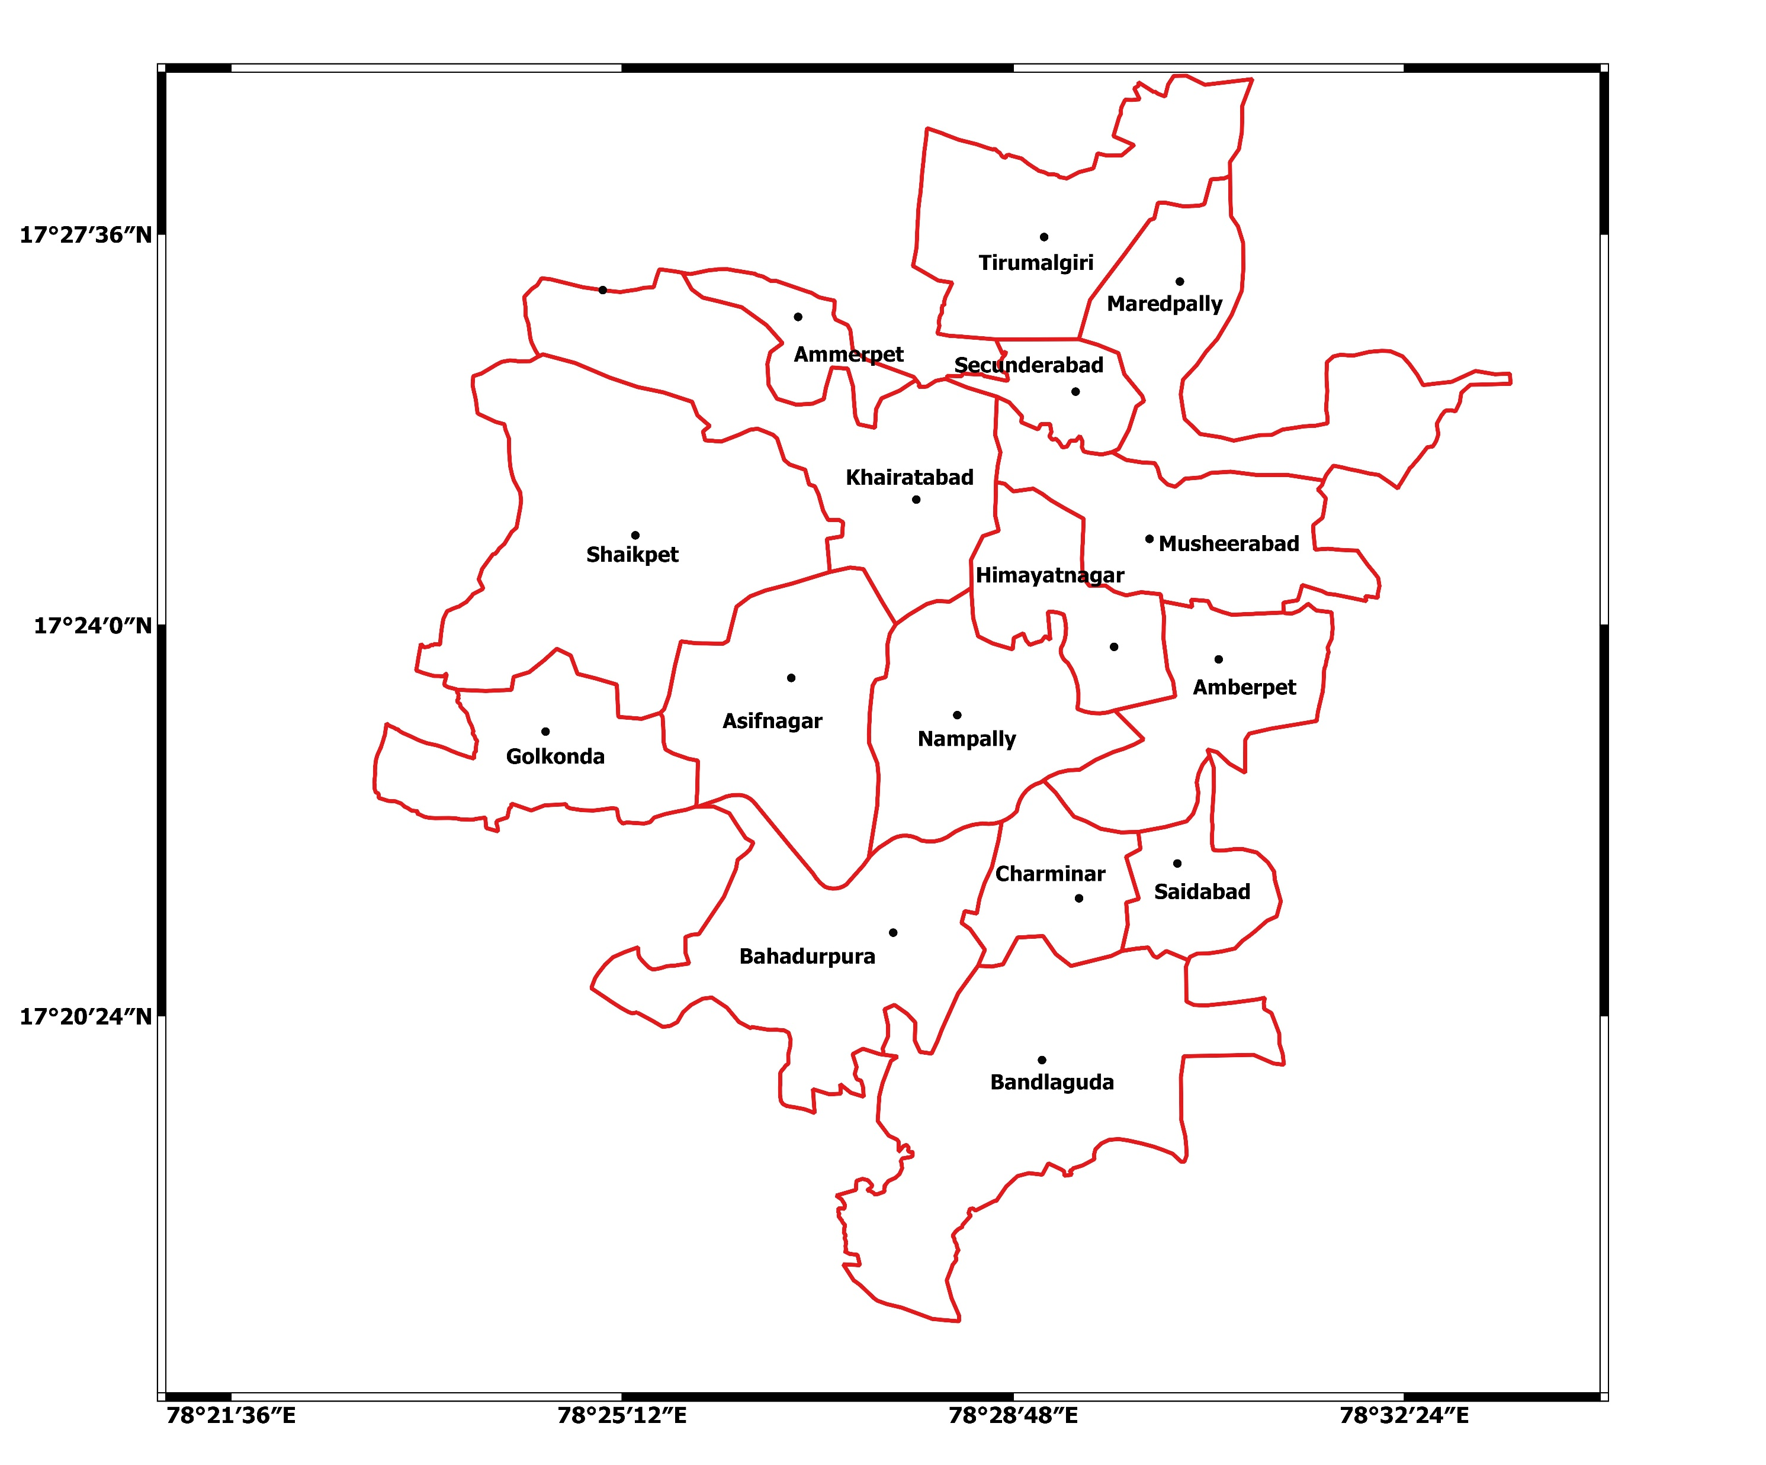
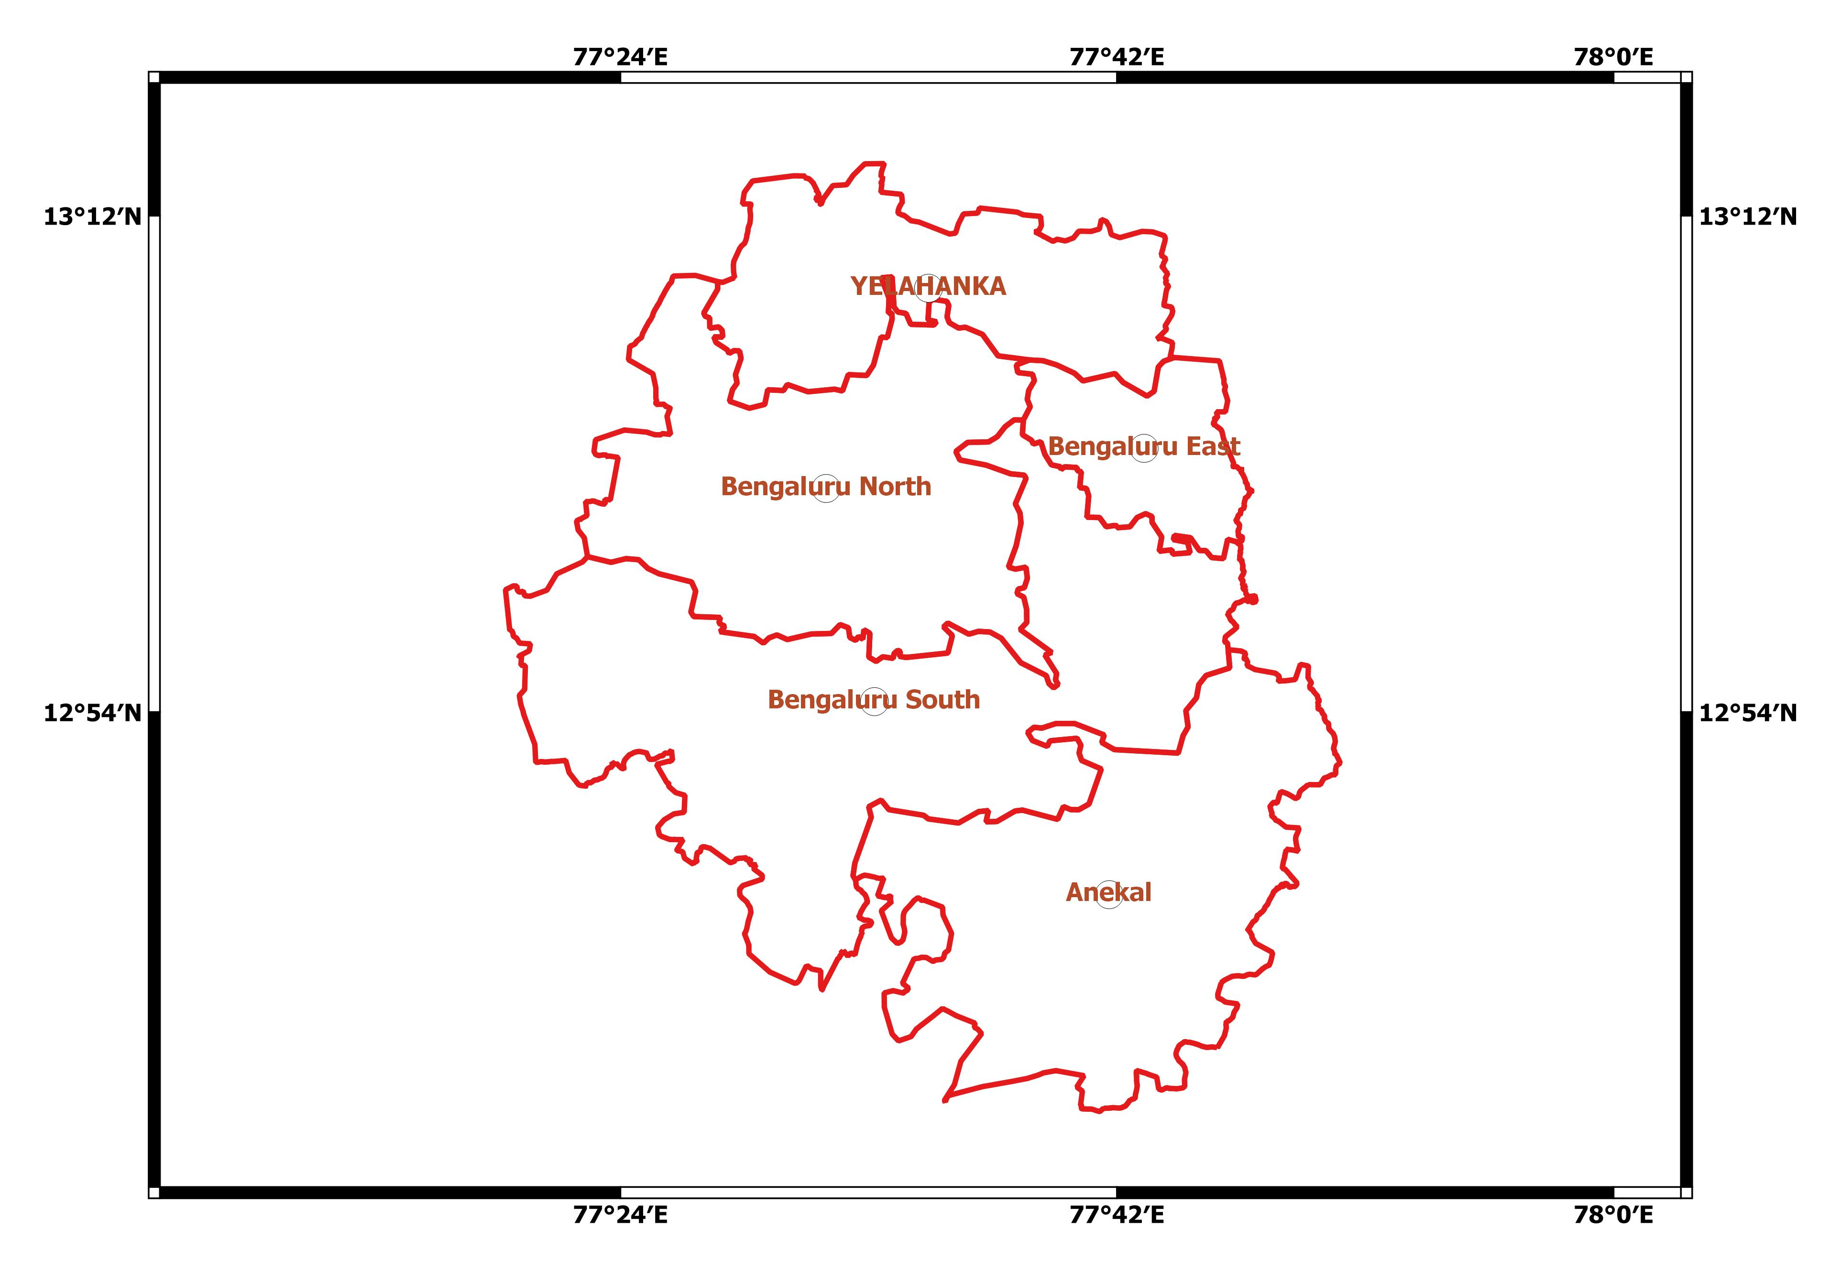
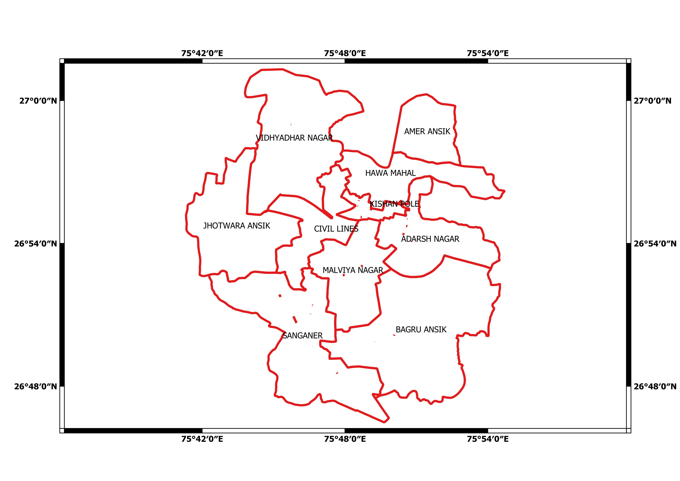
Since it is very difficult to analyze spatial variation of outdoor thermal comfort over entire city, so we have chosen subdivisions of every city as per the administrative boundaries of the local government.
Hyderabad has 16 mandals with in city and Bangalore has 5 subdivisions within city and Jaipur has 10 ward levels.
Subdivisional data was collected from (https://data.humdata.org/dataset/geoboundaries-admin-boundaries-for-india)
https://github.com/datameet/Municipal_Spatial_Data/tree/master/Jaipur

Slide 6
Data
Synoptic station data
  The observed synoptic station data for the period of 2009-2020
  The data contains daily level Temperature, relative humidity and wind speed at the air ports
  India Meteorological Observations comprises of wind speed, wind direction, temperature, relative humidity and (https://doi.org/10.34740/KAGGLE/DSV/1129180)
  The daily observed meteorological data consists of maximum and minimum values of temperature Ta (C), relative humidity RH (%), and wind speed V (ms-1) of 16 Mandals of Hyderabad city The meteorological data is collected from an open data source: https://data.telangana.gov.in/
Satellite Data
  The Landsat multispectral bands are used for the period of 2009-2020 with resolution 30m×30m with cloud cover less than 20%.
  The above data sets are obtained from USGS Earth Explorer user Interface (https://earthexplorer.usgs.gov/)

Slide 7
Landsat 8 - Satellite Imageries
Hyderabad
Bangalore
Jaipur
Year | Summer | Winter
2009 | 02-Apr-2009 | 31-Jan-2010
2014 | 31-Mar-2014 | 14-Feb-2014
2019 | 14-Apr-2019 | 02-Feb-2020
Year | Summer | Winter
2009 | 17-Mar-2009 | 31-Jan-2010
2014 | 31-Mar-2014 | 14-Feb-2014
2019 | 29-May-2019 | 02-Feb-2020
Year | Summer | Winter
2009 | 17-Marr-2009 | 31-Jan-2010
2014 | 31-Mar-2014 | 14-Feb-2014
2019 | 29-May-2019 | 02-Feb-2020

Slide 8
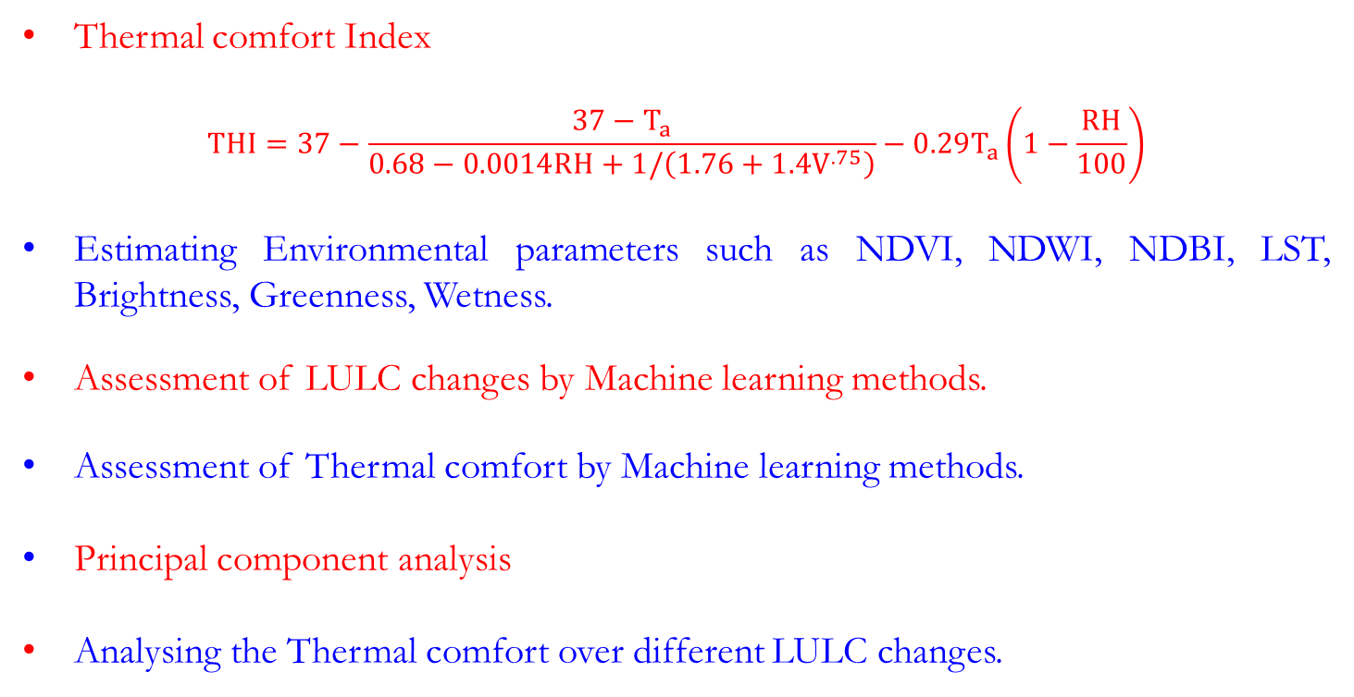
Methodology
Thermal comfort Index
$$THI=37−\frac{37−T_{a}}{0.68−0.0014RH+1/\left(1.76+1.4V^{.75}\right)}−0.29T_{a}\left(1−\frac{RH}{100}\right)$$
Estimating Environmental parameters such as NDVI, NDWI, NDBI, LST, Brightness, Greenness, Wetness.
Assessment of LULC changes by Machine learning methods.
Assessment of Thermal comfort by Machine learning methods.
Principal component analysis
Analysing the Thermal comfort over different LULC changes.

Slide 9
Satellite Image Processing Techniques - LULC classification
Maximum likelihood classification
  The Maximum likelihood classification tool considers both the variances and covariances of the class signatures when assigning each cell to one of the classes represented in the signature file.
Machine learning based LULC classification
  Machine learning algorithm such as support vector machines (SVMs)/Random Forest are supervised learning algorithms based on statistical learning theory, which are considered as heuristic algorithms.

Slide 10
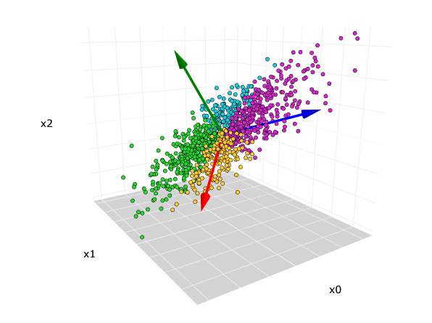

Multicollinearity and Principal Component Analysis
multicollinearity refers to a condition in which the independent variables are correlated to each other. Multicollinearity can cause problems when you fit the model and interpret the results. The variables of the dataset should be independent of each other to overdue the problem of multicollinearity.
Multicollinearity may cause
Getting very high standard errors for regression coefficients
The overall model is significant, but none of the coefficients are significant
Large changes in coefficients when adding predictors
High Variance Inflation Factor (VIF) and Low Tolerance
The solution for multicollinearity is usage of PCA
Principal component analysis (PCA) is a technique
that transforms high-dimensions data into lower-dimensions
while retaining as much information as possible.
Notations,
λ: eigenvalue
d: number of dimension of original dataset
k: number of dimensions of new feature space

Slide 11
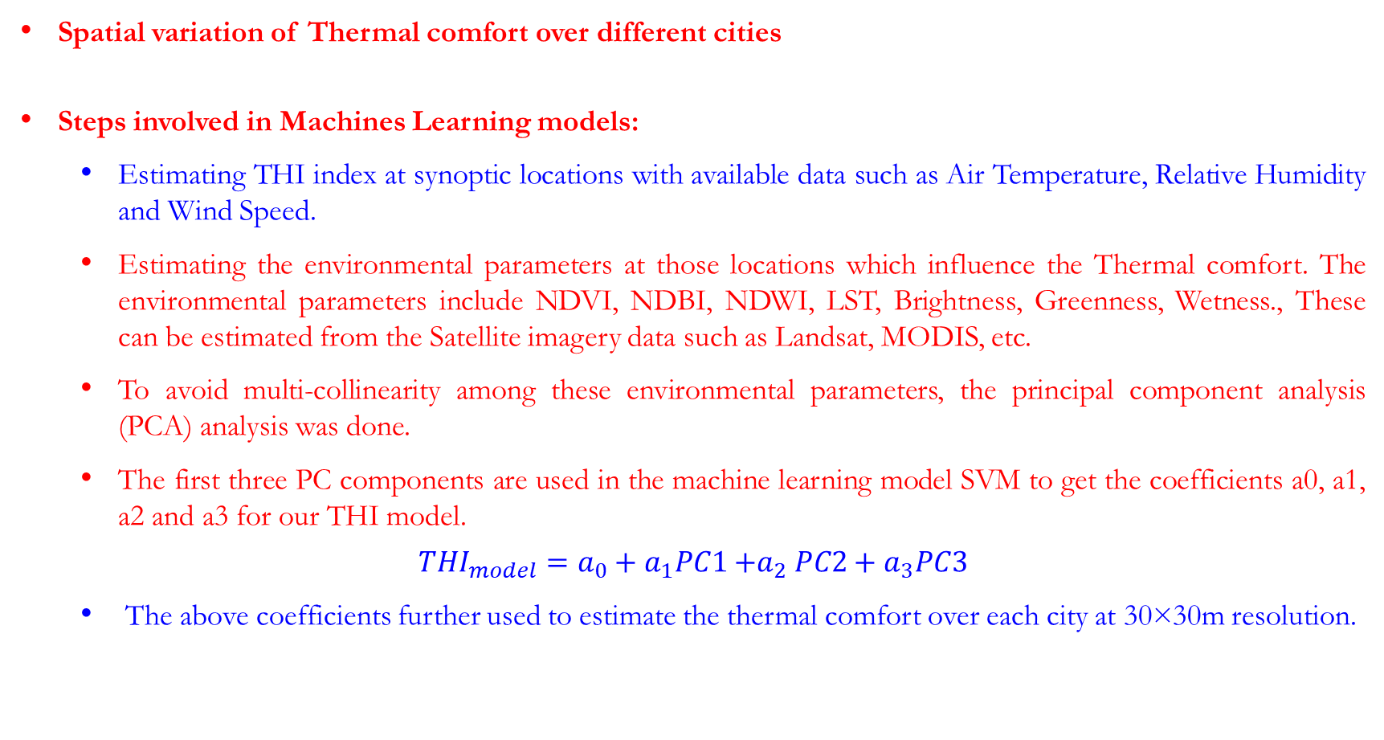
Spatial variation of Thermal comfort over different cities
Steps involved in Machines Learning models:
  Estimating THI index at synoptic locations with available data such as Air Temperature, Relative Humidity and Wind Speed.
  Estimating the environmental parameters at those locations which influence the Thermal comfort. The environmental parameters include NDVI, NDBI, NDWI, LST, Brightness, Greenness, Wetness., These can be estimated from the Satellite imagery data such as Landsat, MODIS, etc.
  To avoid multi-collinearity among these environmental parameters, the principal component analysis (PCA) analysis was done.
  The first three PC components are used in the machine learning model SVM to get the coefficients a0, a1, a2 and a3 for our THI model.
$$THI_{model}=a_{0}+a_{1}PC1{+a}_{2}PC2+a_{3}PC3$$
  The above coefficients further used to estimate the thermal comfort over each city at 30×30m resolution.

Slide 12
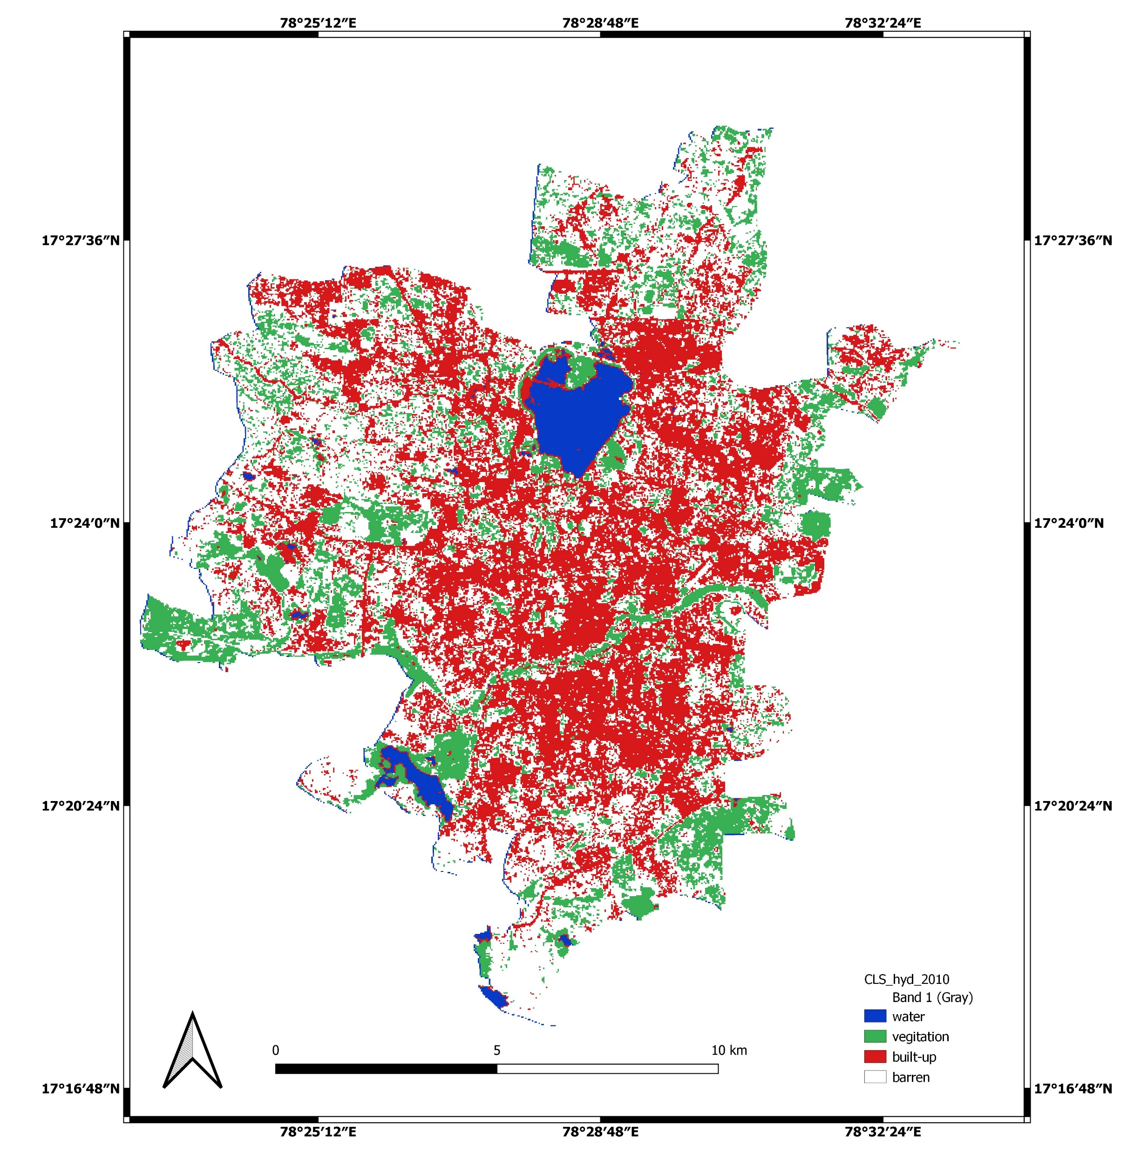
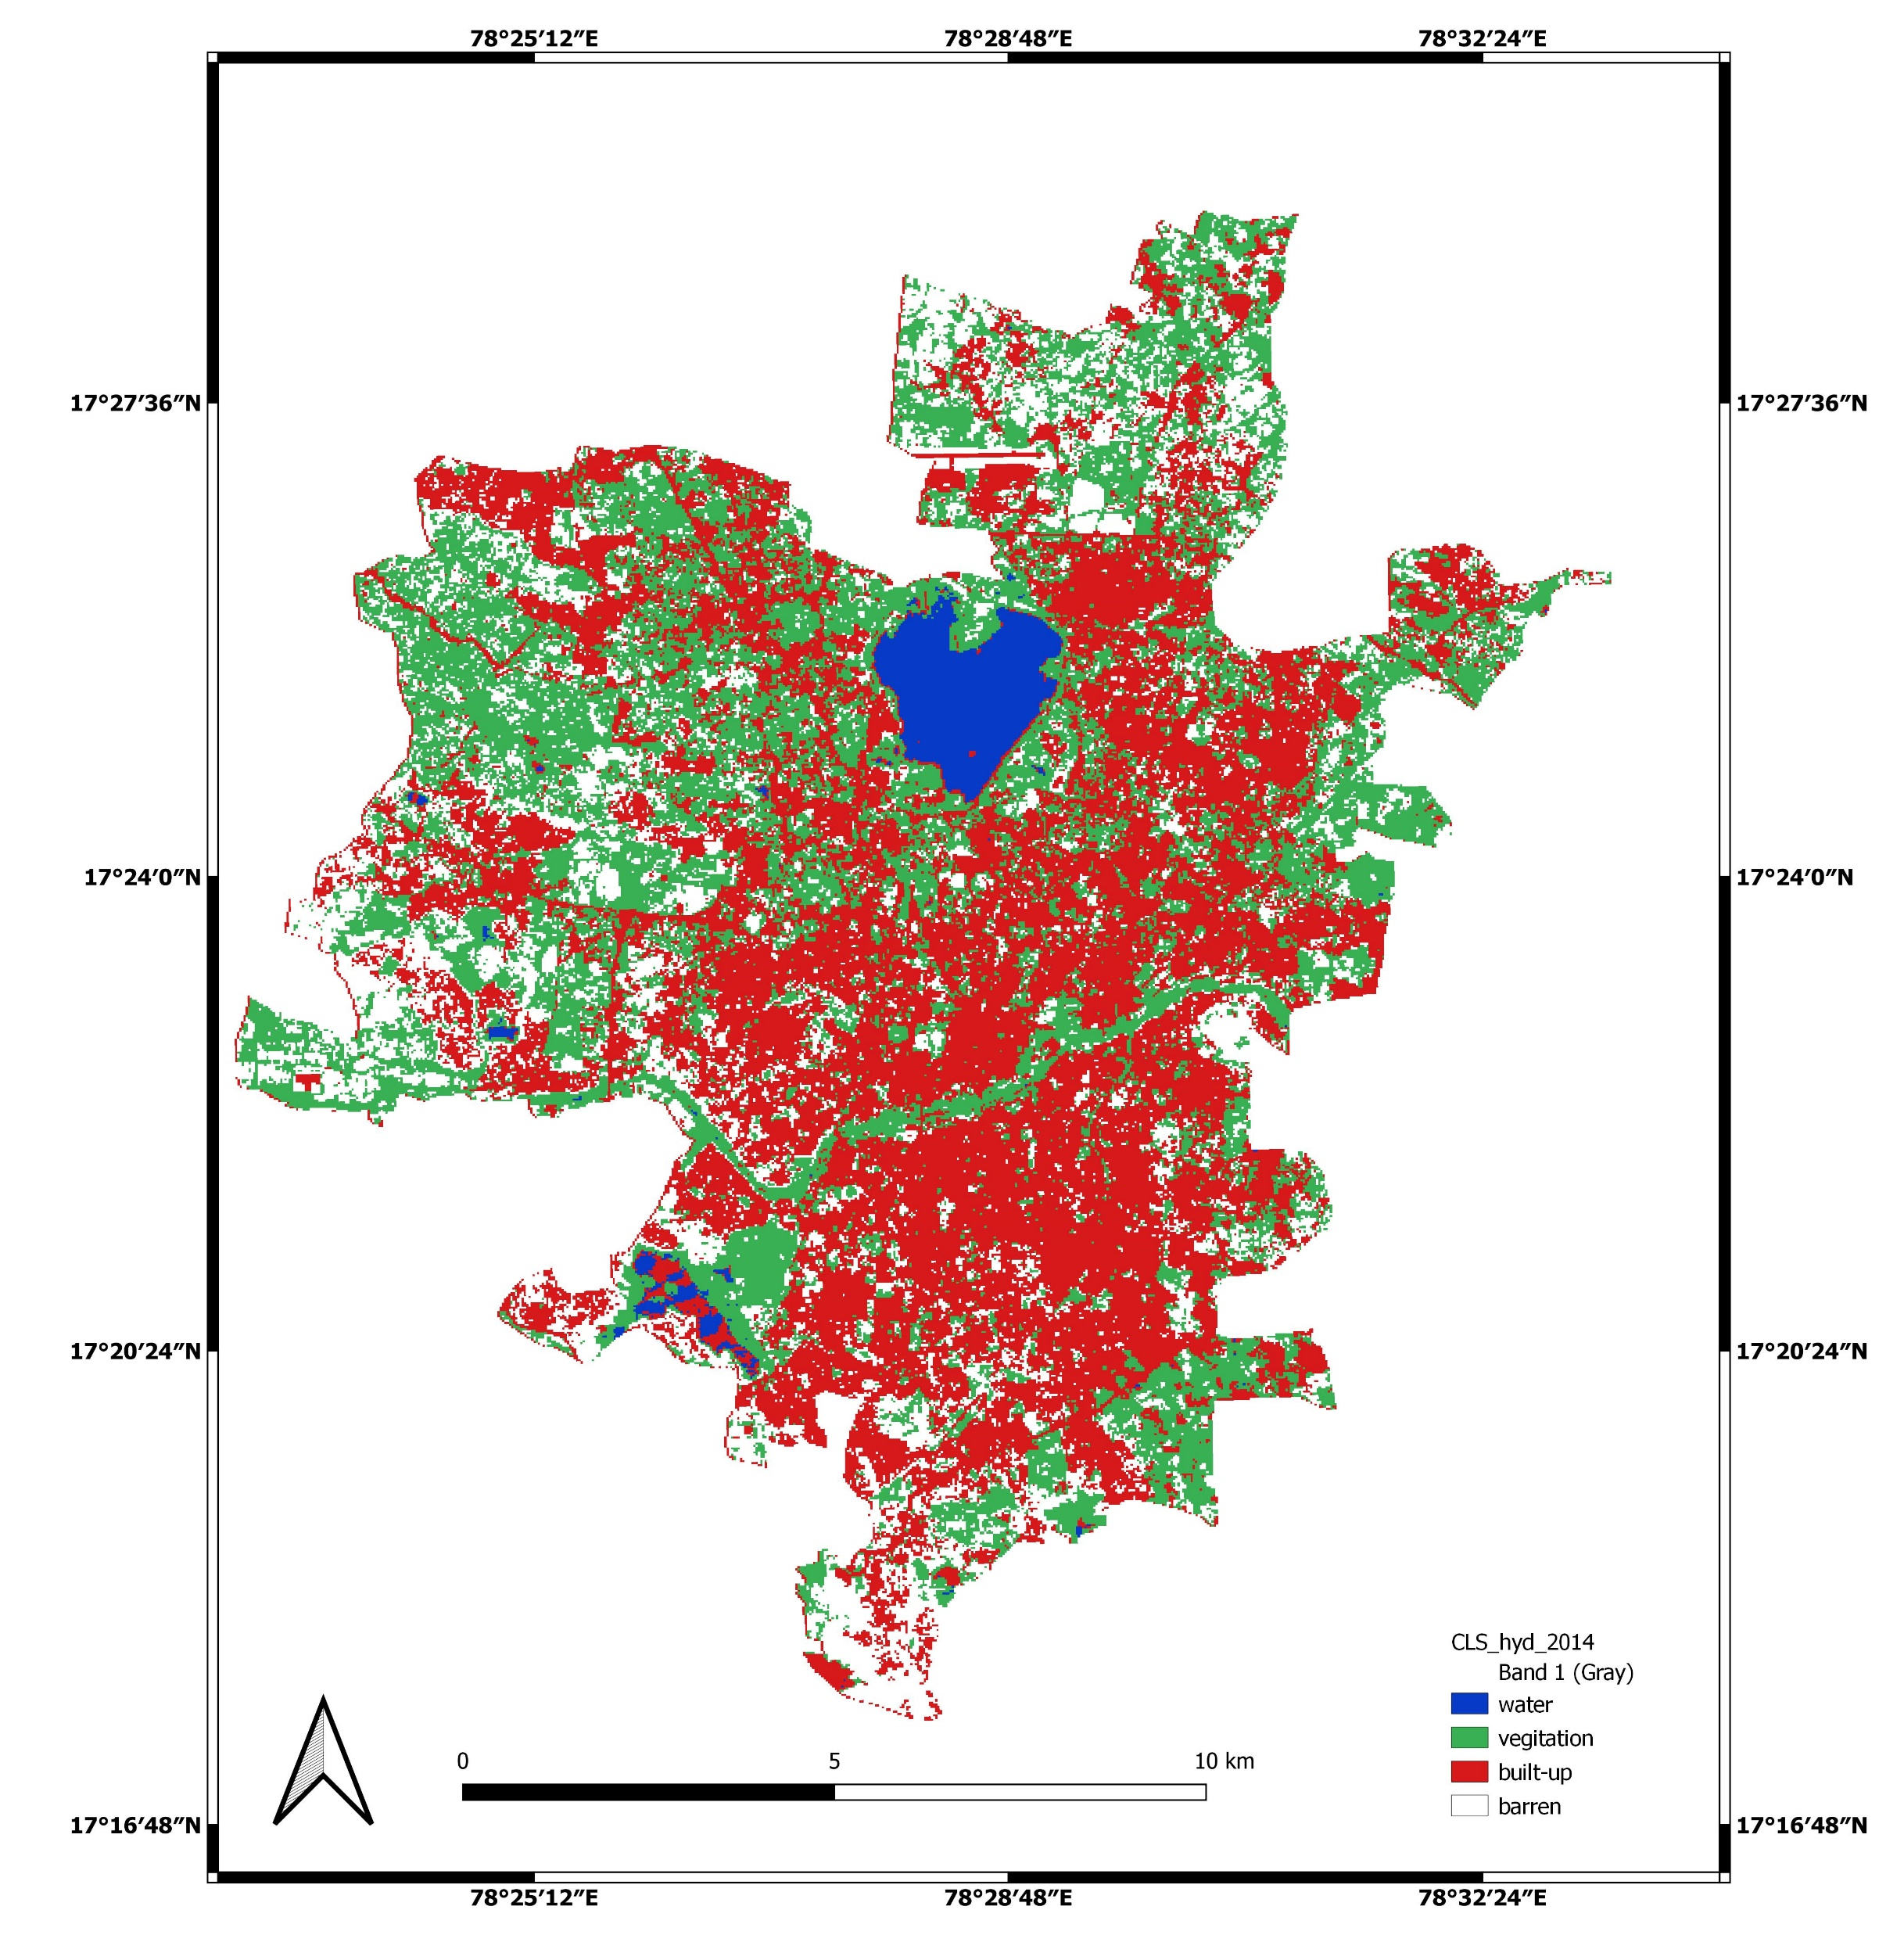
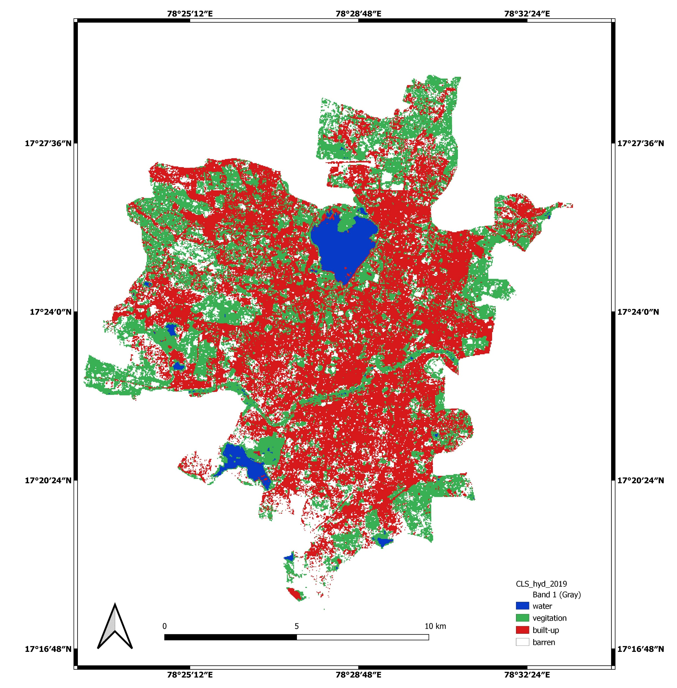
LULC change from 2009-2019
2009
2014
2019
The Hyderabad’s built-up was increases from 37% to 48% in 2009 to 2019. Substantially there is a decrement in the barren lands 42% to 18% in 2009 to 2019.
The water bodies percentages are almost same with an area of 3% occupied in the city. Interestingly there is an increment in the vegetation from 20% to 30%.
In over-all north-western part of Hyderabad became more vegetative Lands and southern Hyderabad became more urbanized.

Slide 13
Mandal wise LULC and Thermal Comfort
Hyderabad-Summer-Thermal comfort
Ameerpet, Musheerabad-Turened from neutral condition to modereately discomfort
Presence of vegetation and water bodies
Secunderabad-Highest comfort due to large water body Hussen sagar
Hyderabad-LULC
Charminar-Highest discomfort in 2009 and 2019
Presence of high urban area about 60-70%

Slide 14
Subdivisional wise LULC and Thermal Comfort
Hyderabad-Winter-Thermal comfort
Golkonda, Ameerpet, Khairatabad has maximum comfort in 2009 and neutral in 2019
Hyderabad-LULC

Slide 15
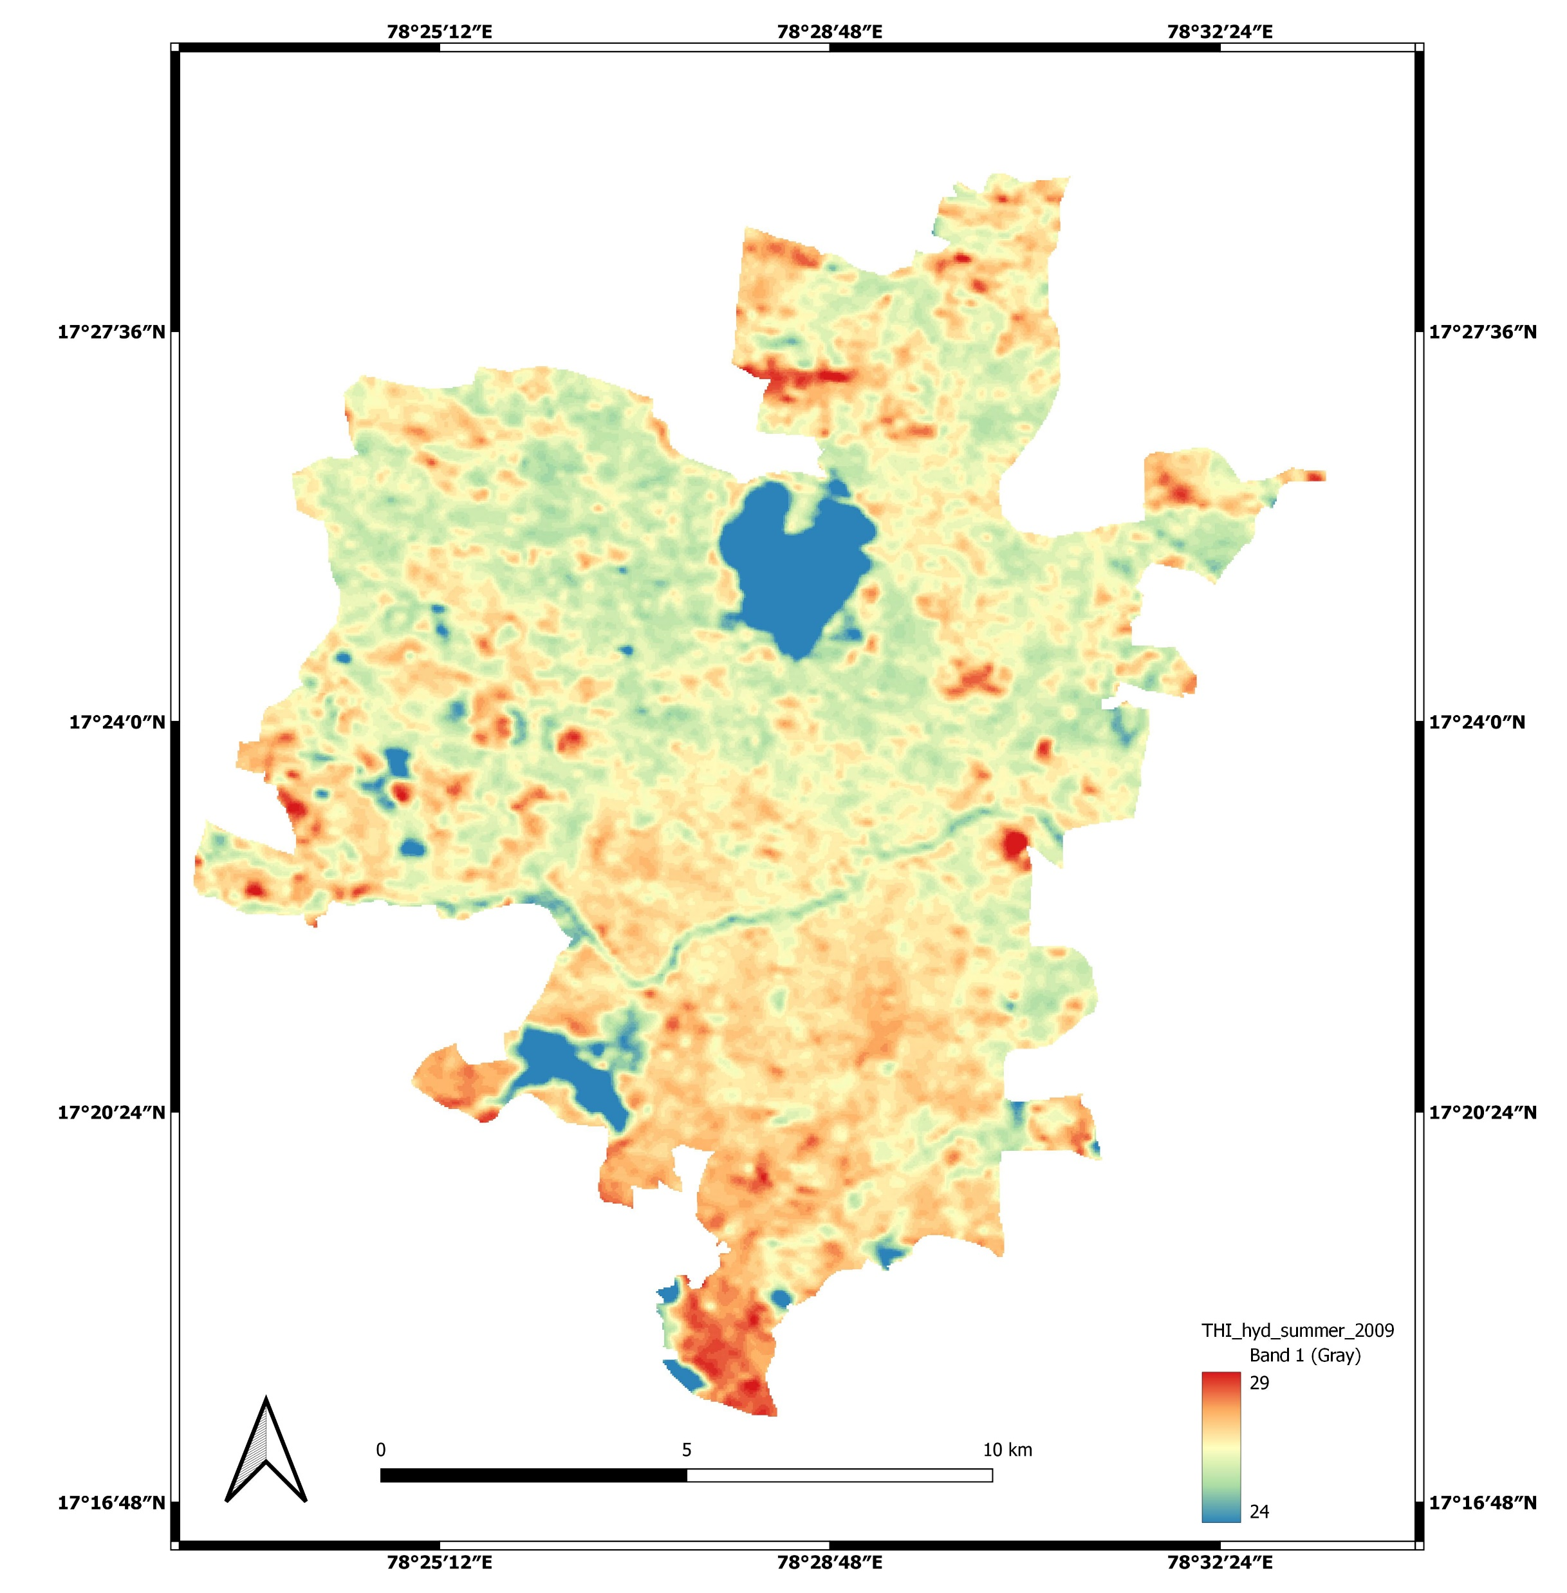
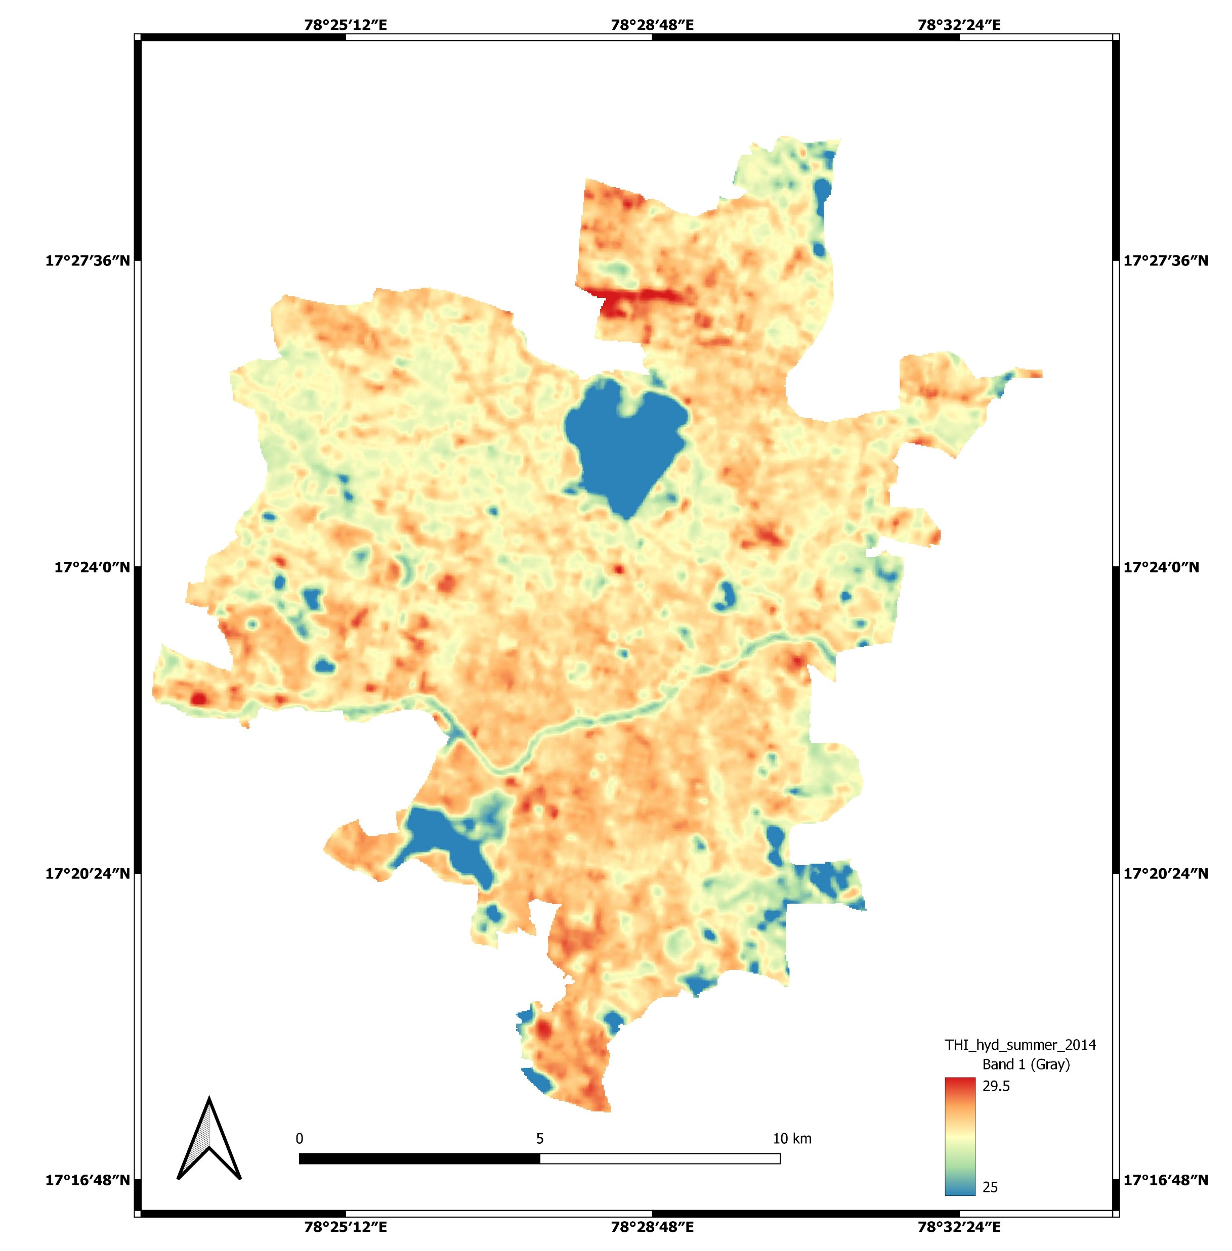
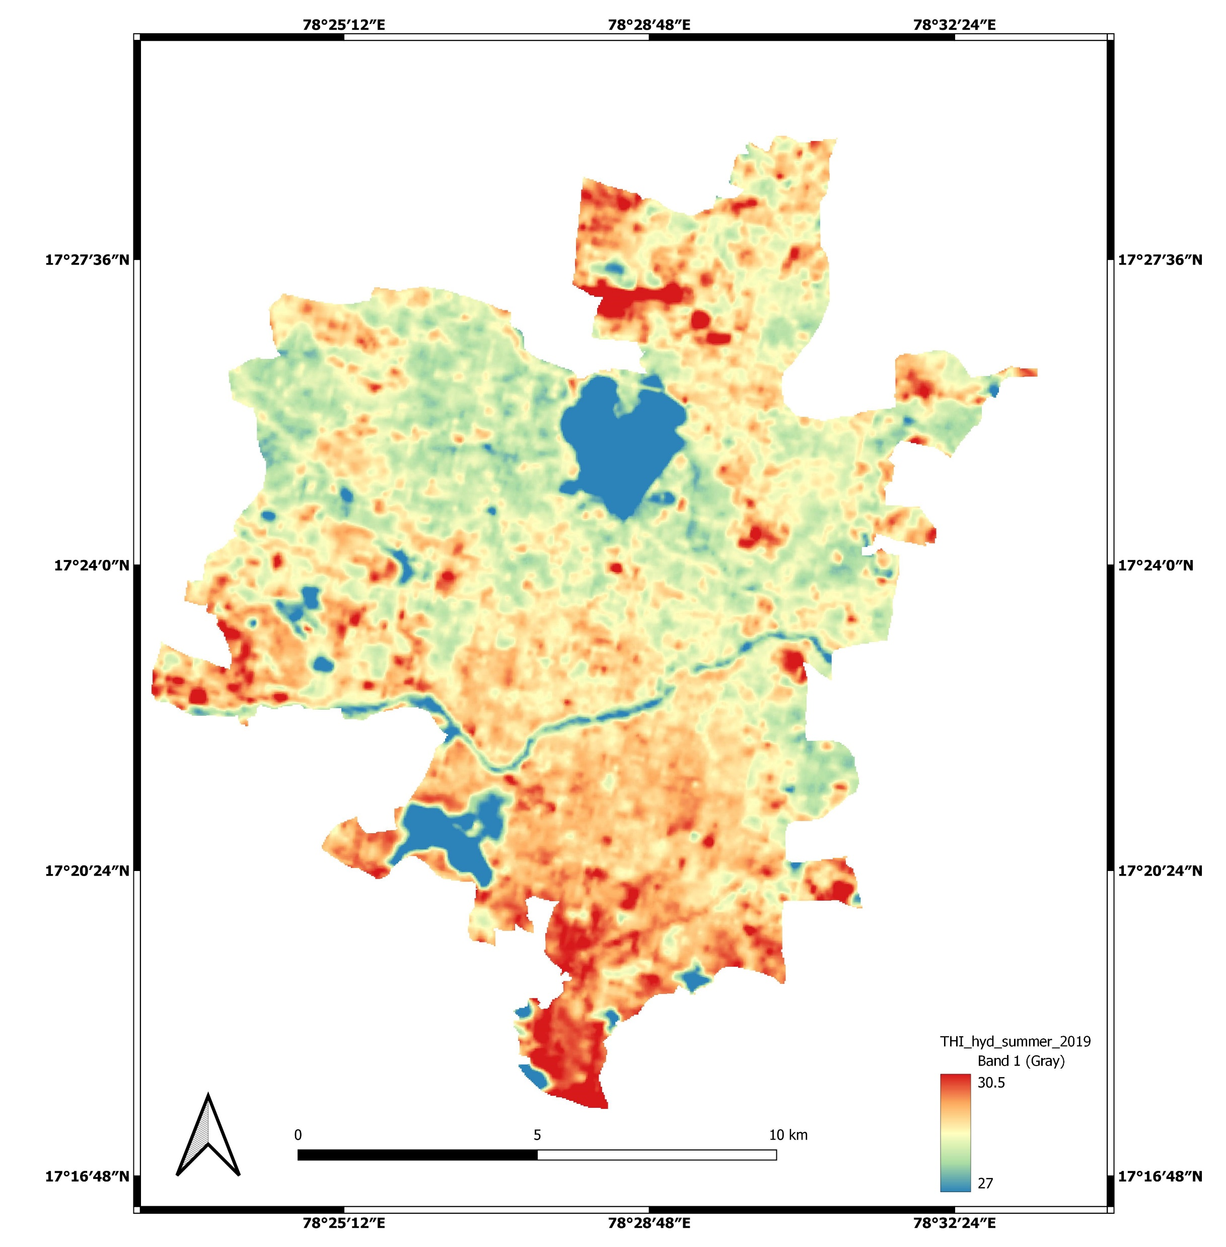
THI maps-Hyderabad-summer
2009
2014
2019
There is a substantial increment observed in discomfort during study period.
Overall mean discomfort changed from neutral to moderately discomfort in summer seasons.
The positive association of discomfort was observed with respect to built-up increment

Slide 16
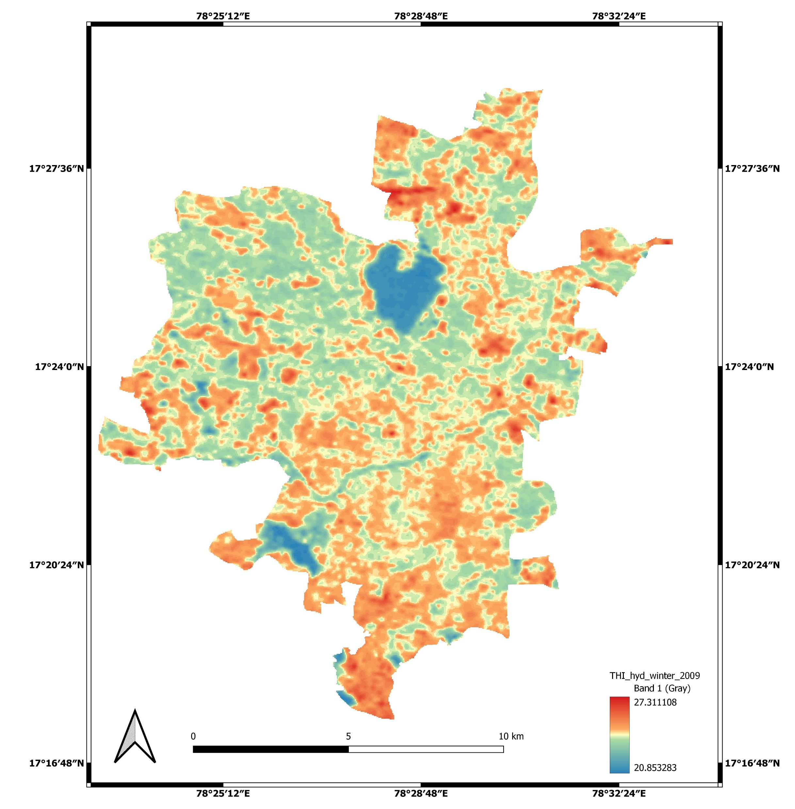

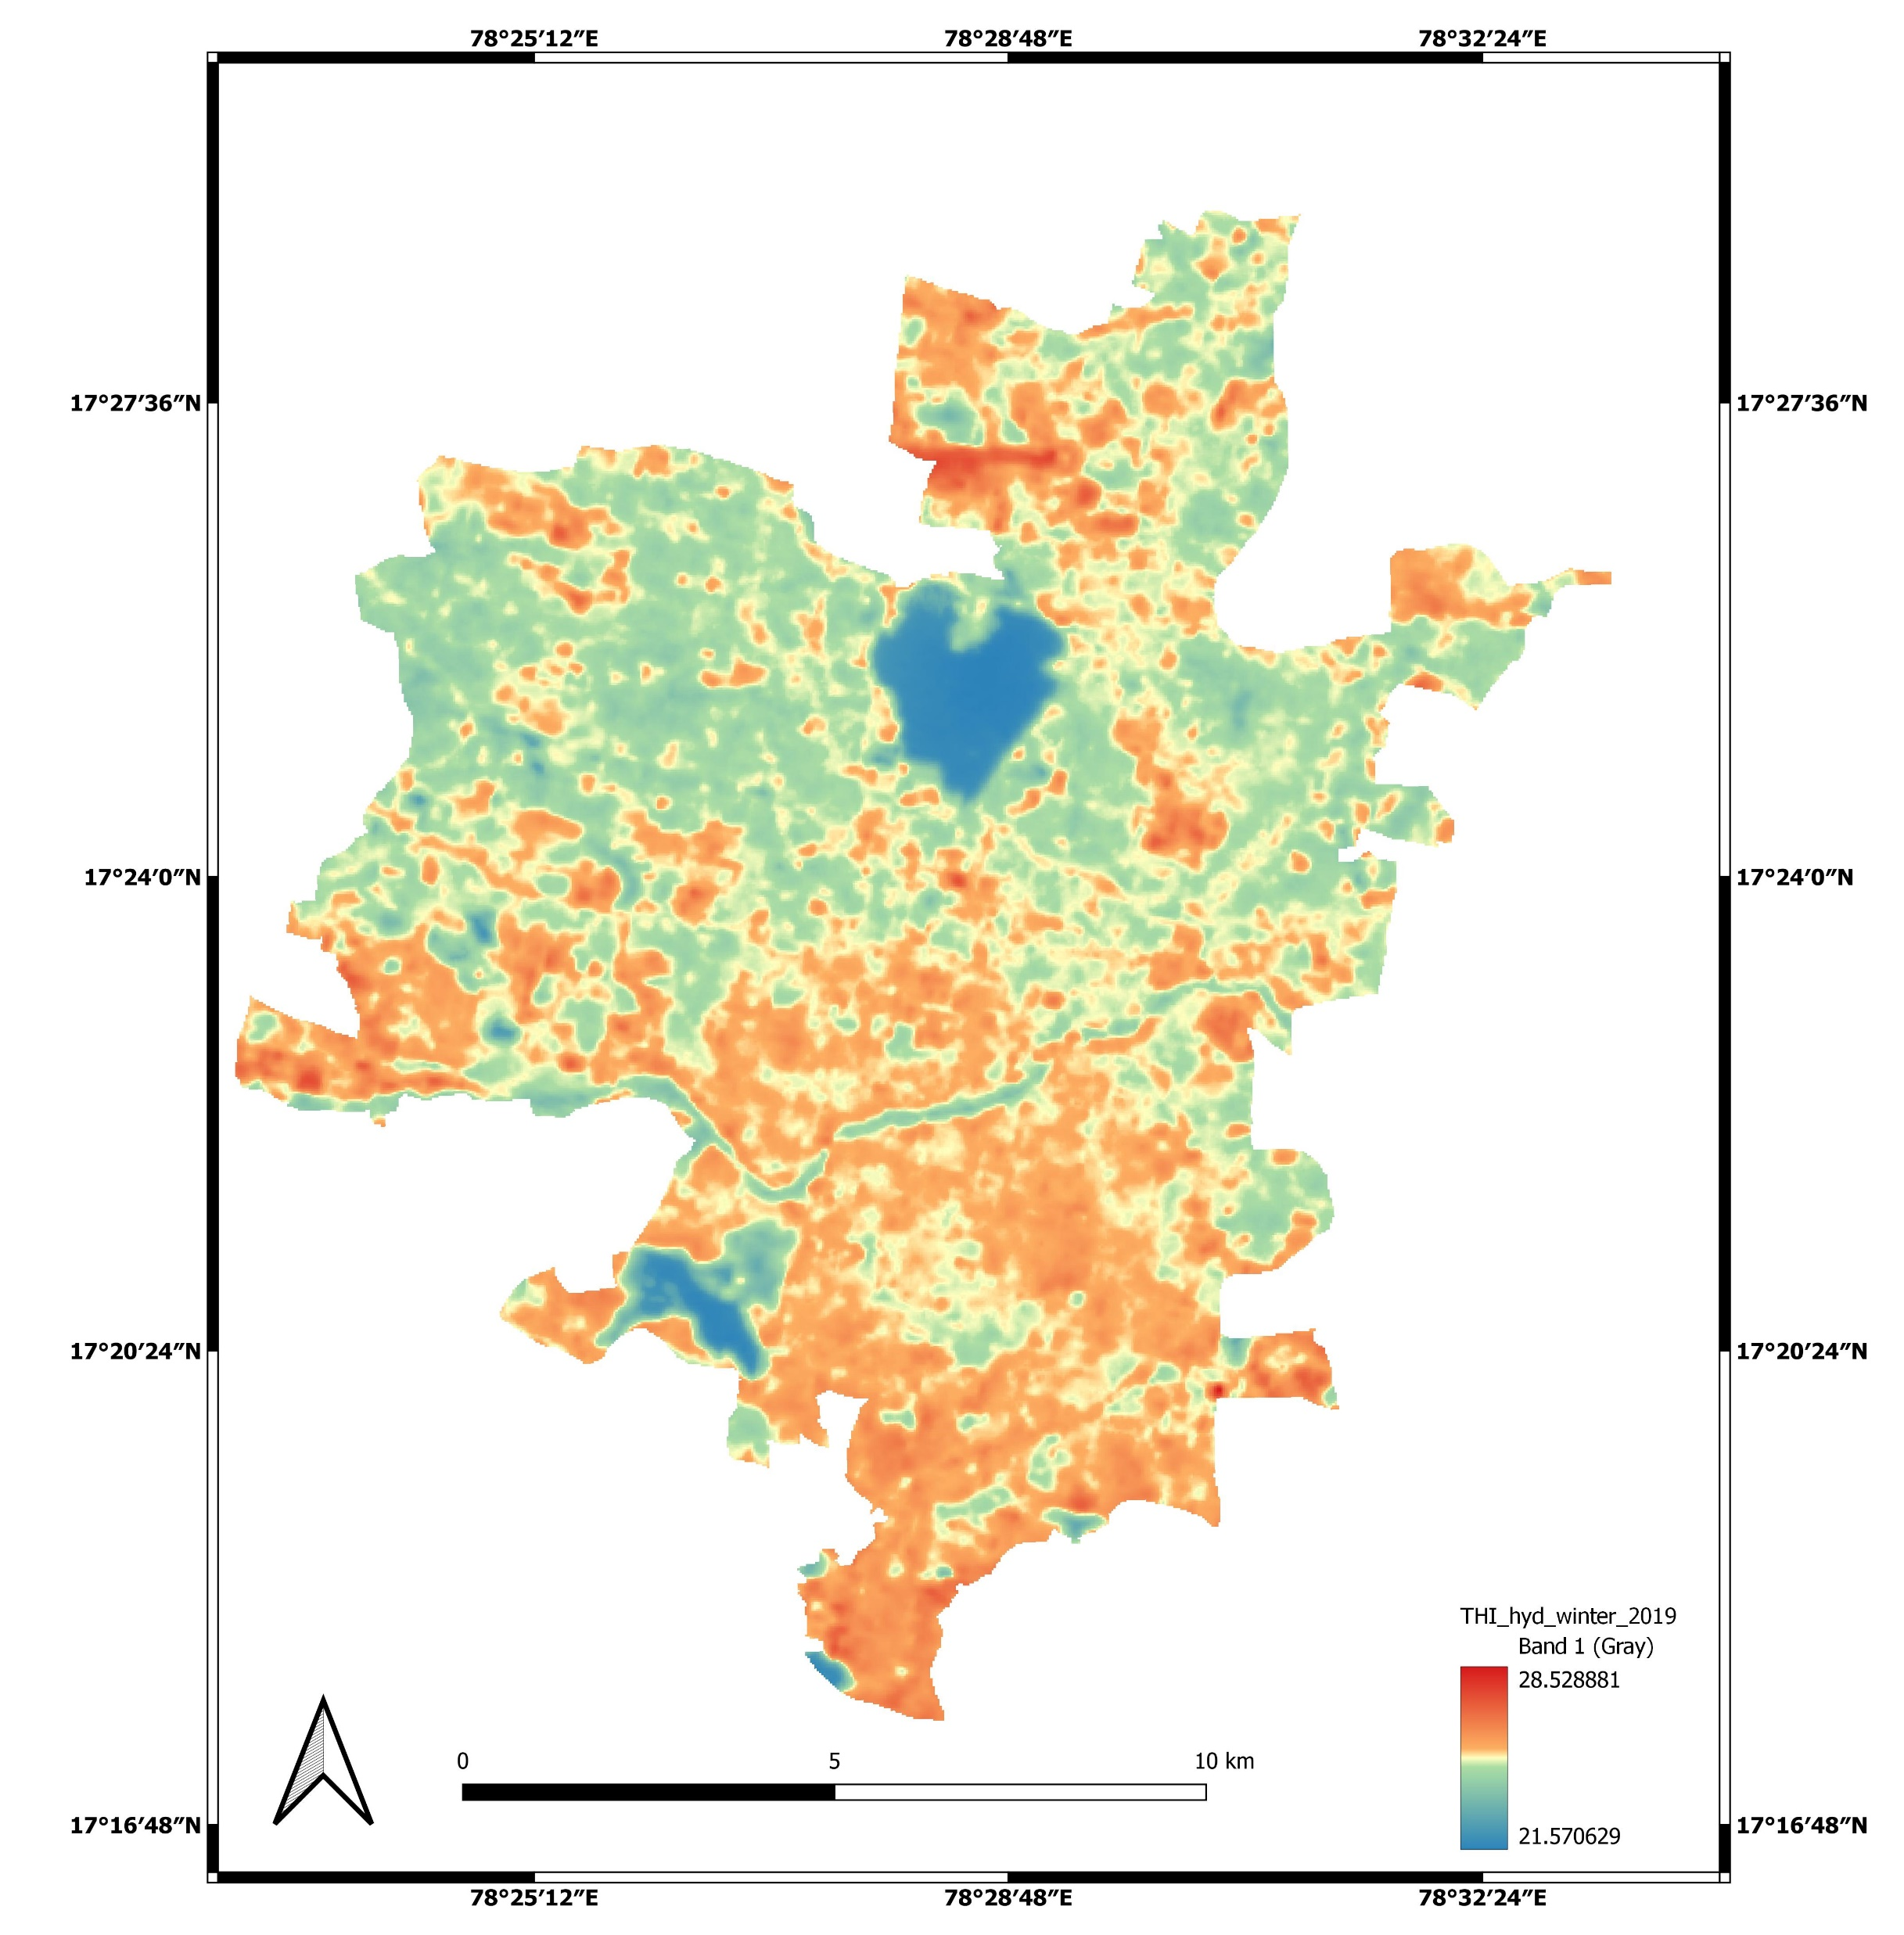
THI maps-Hyderabad-winter
2009
2014
2019
The mean discomfort was increased but the trend is not linear with built-up as observed in the summer seasons.
Overall discomfort was almost neutral from 2009-2019.
Since the one day observation is attributed for total winter, so there might be local weather events on that day influence the overall discomfort.
Mostly neutral

Slide 17
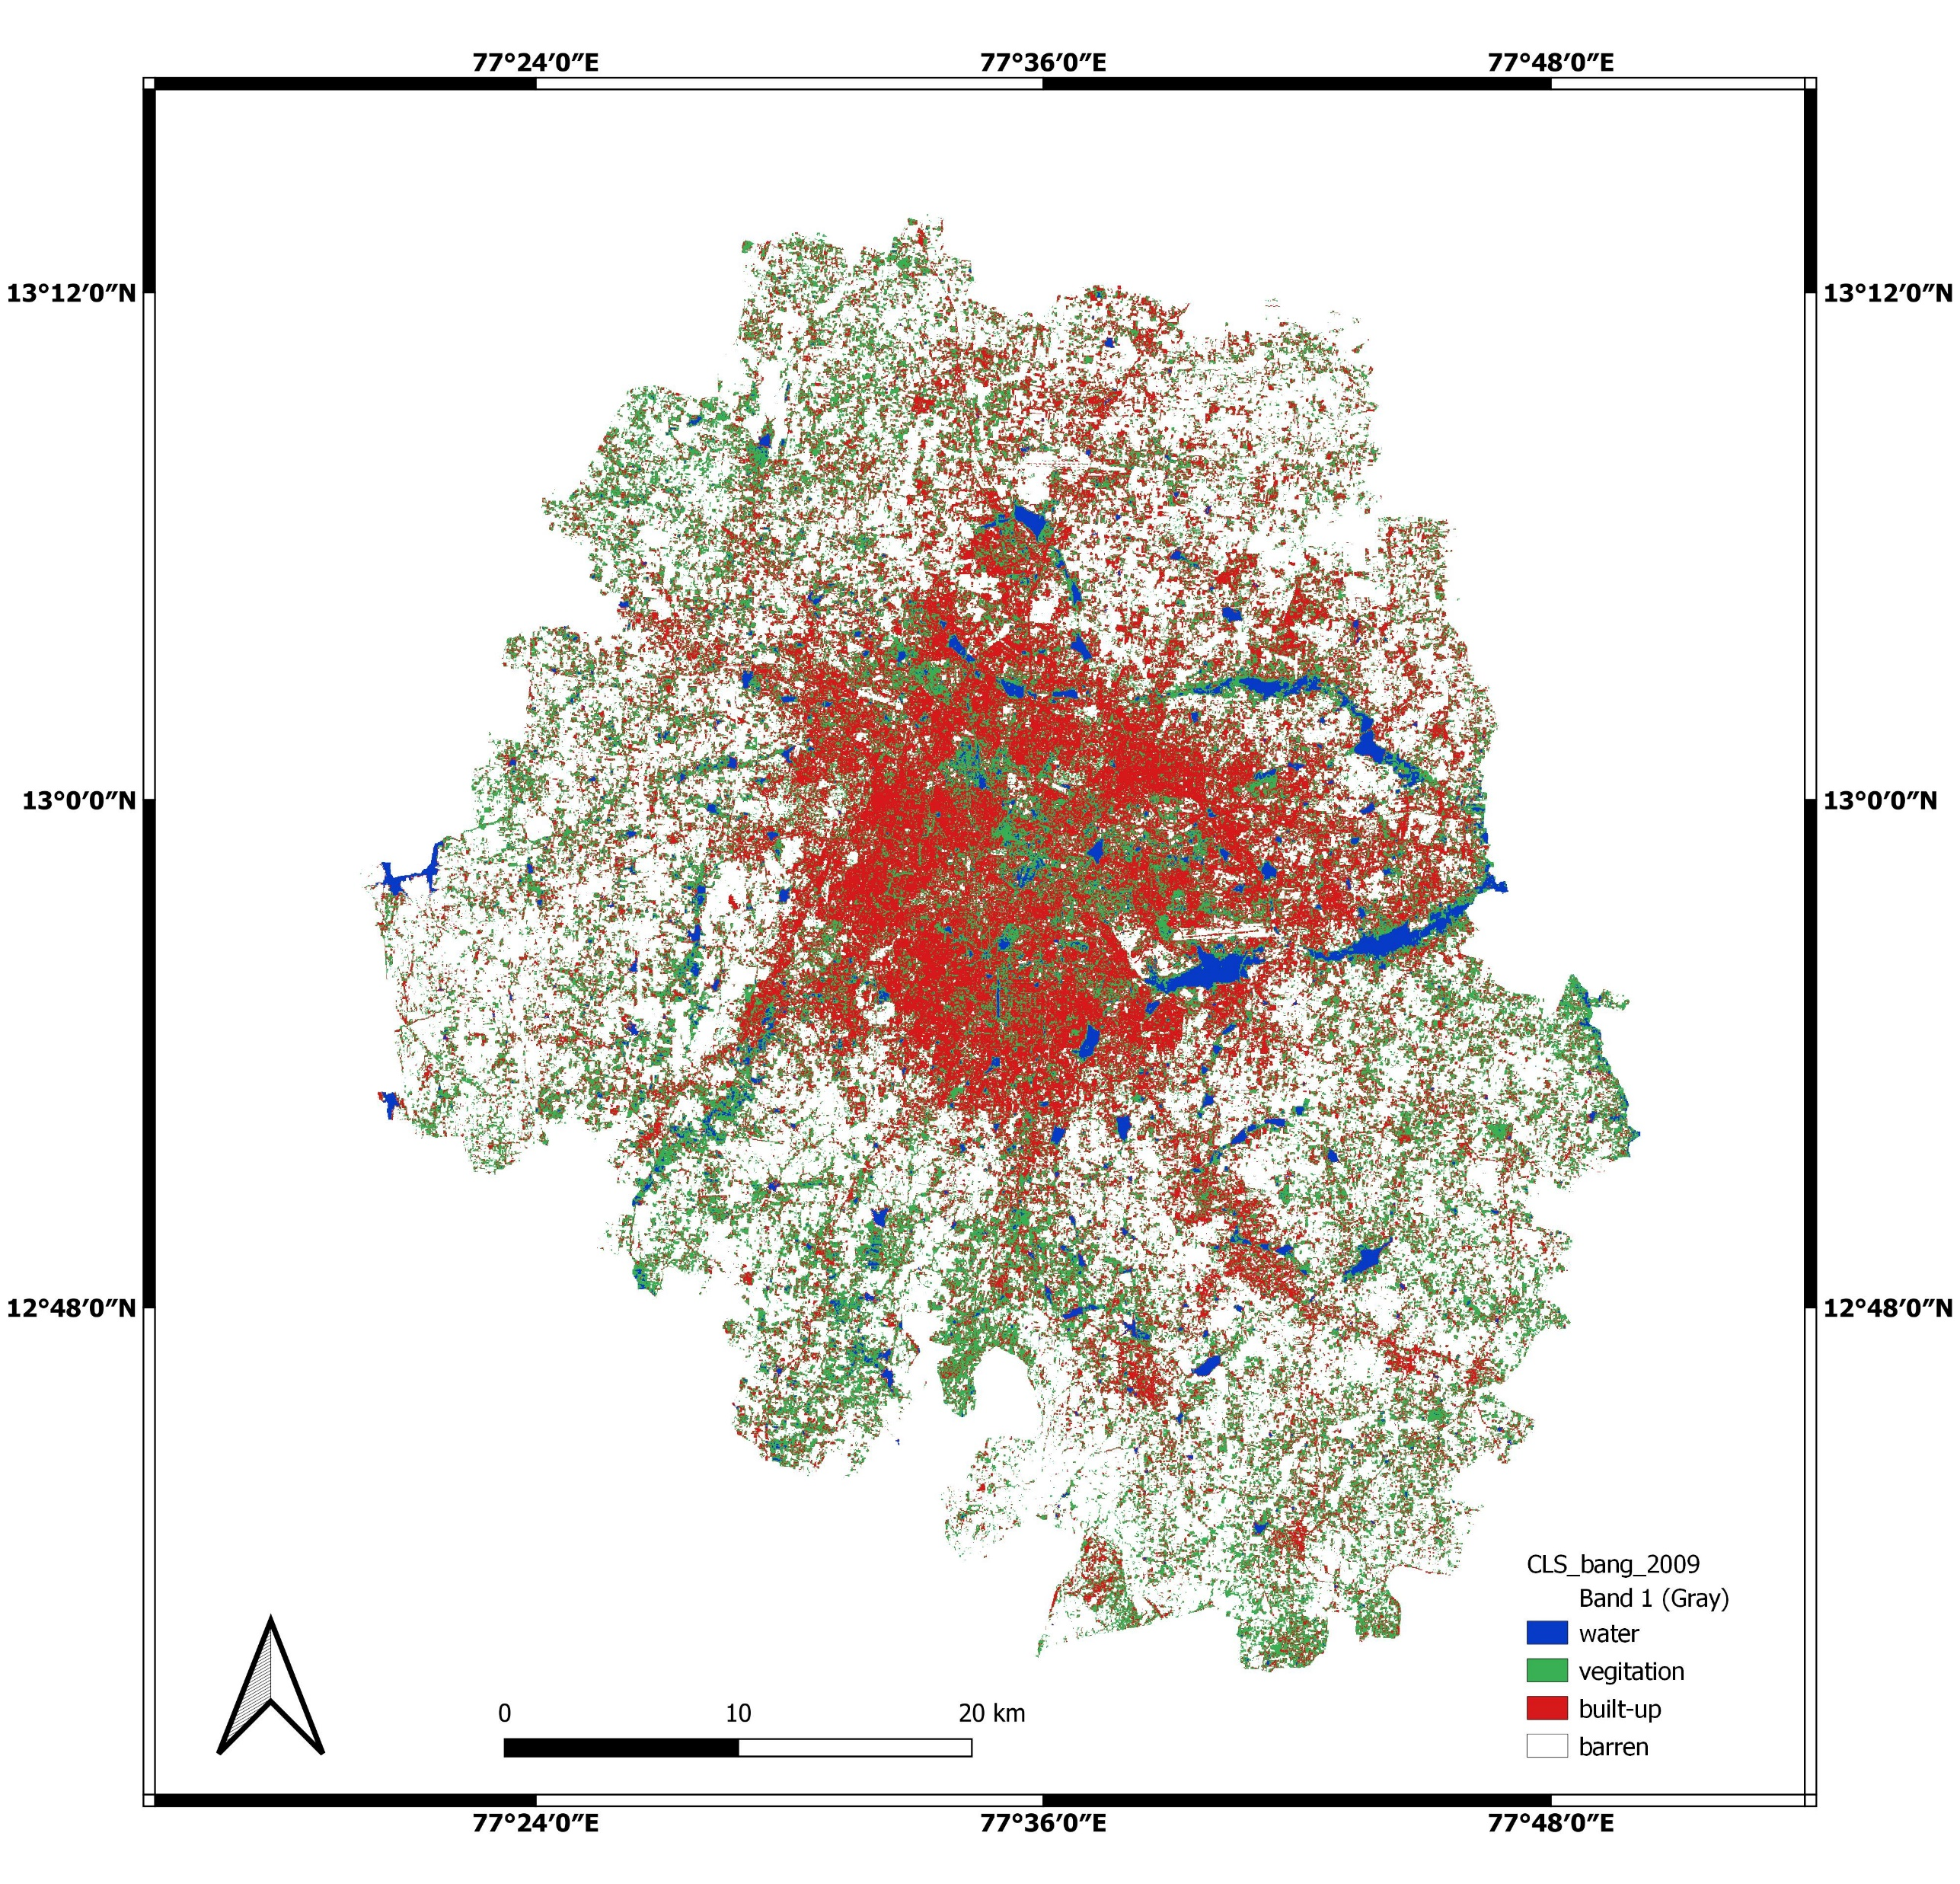
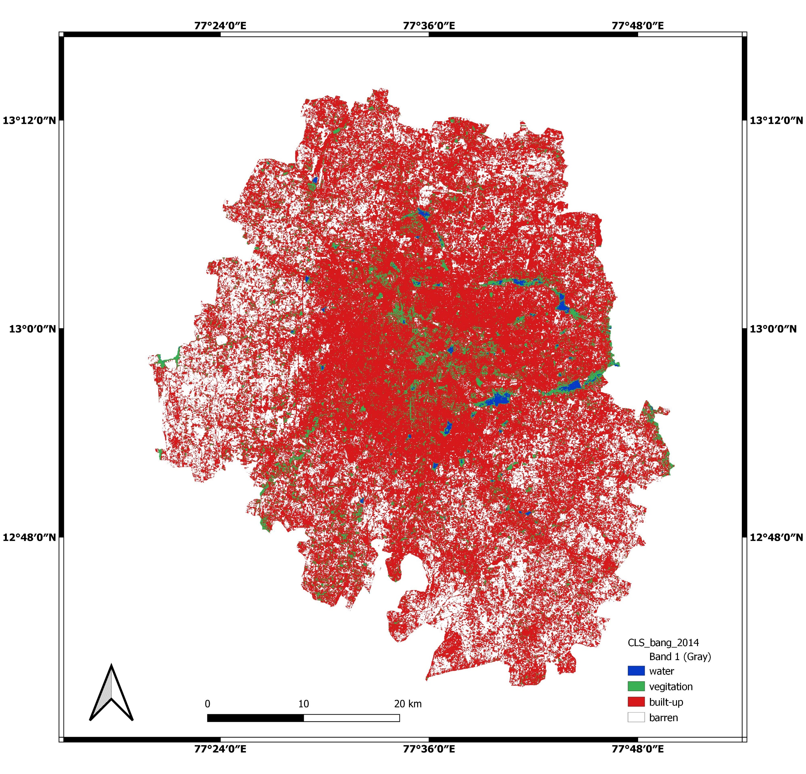
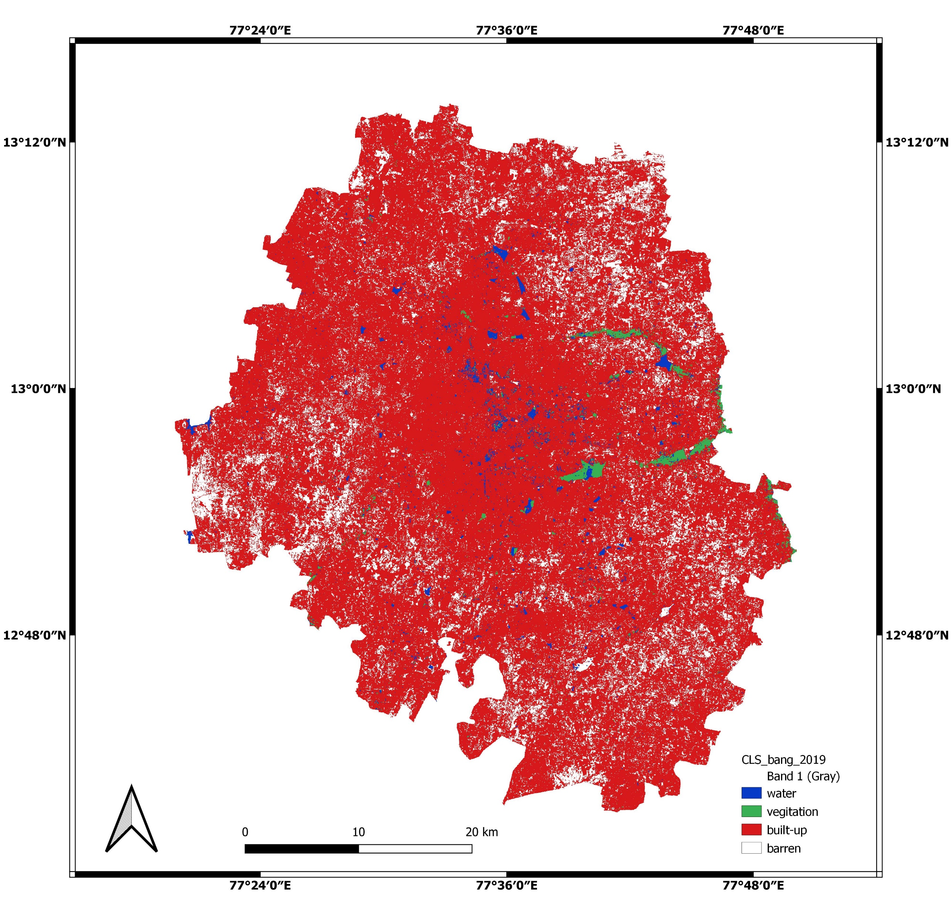
LULC change from 2009-2019
2009
2014
2019
The Bangalore built-up was increased from 25% to 80% in 2009 to 2019.
The vegetation was decreased from 25% to 2% and bare lands decreased from 50% to 18%. There is a huge vegetation loss was observed.
There is a slight decrement in water bodies with in during the study period.

Slide 18
Subdivisional wise LULC and Thermal Comfort
Bangalore-Summer-Thermal comfort
Only few portions of Bangalore is covered with water bodies results in poor discomfort in most areas from 2009 to 2019
Bangalore-LULC

Slide 19
Mandal wise LULC and Thermal Comfort
Bangalore-Winter-Thermal comfort
Interestingly Bangalore winter is mostly neutral to moderately comfort irrespective of urbanization, the probable reasons could be geographic location (high elevation) lead to more comfort in winter
Bangalore-LULC

Slide 20
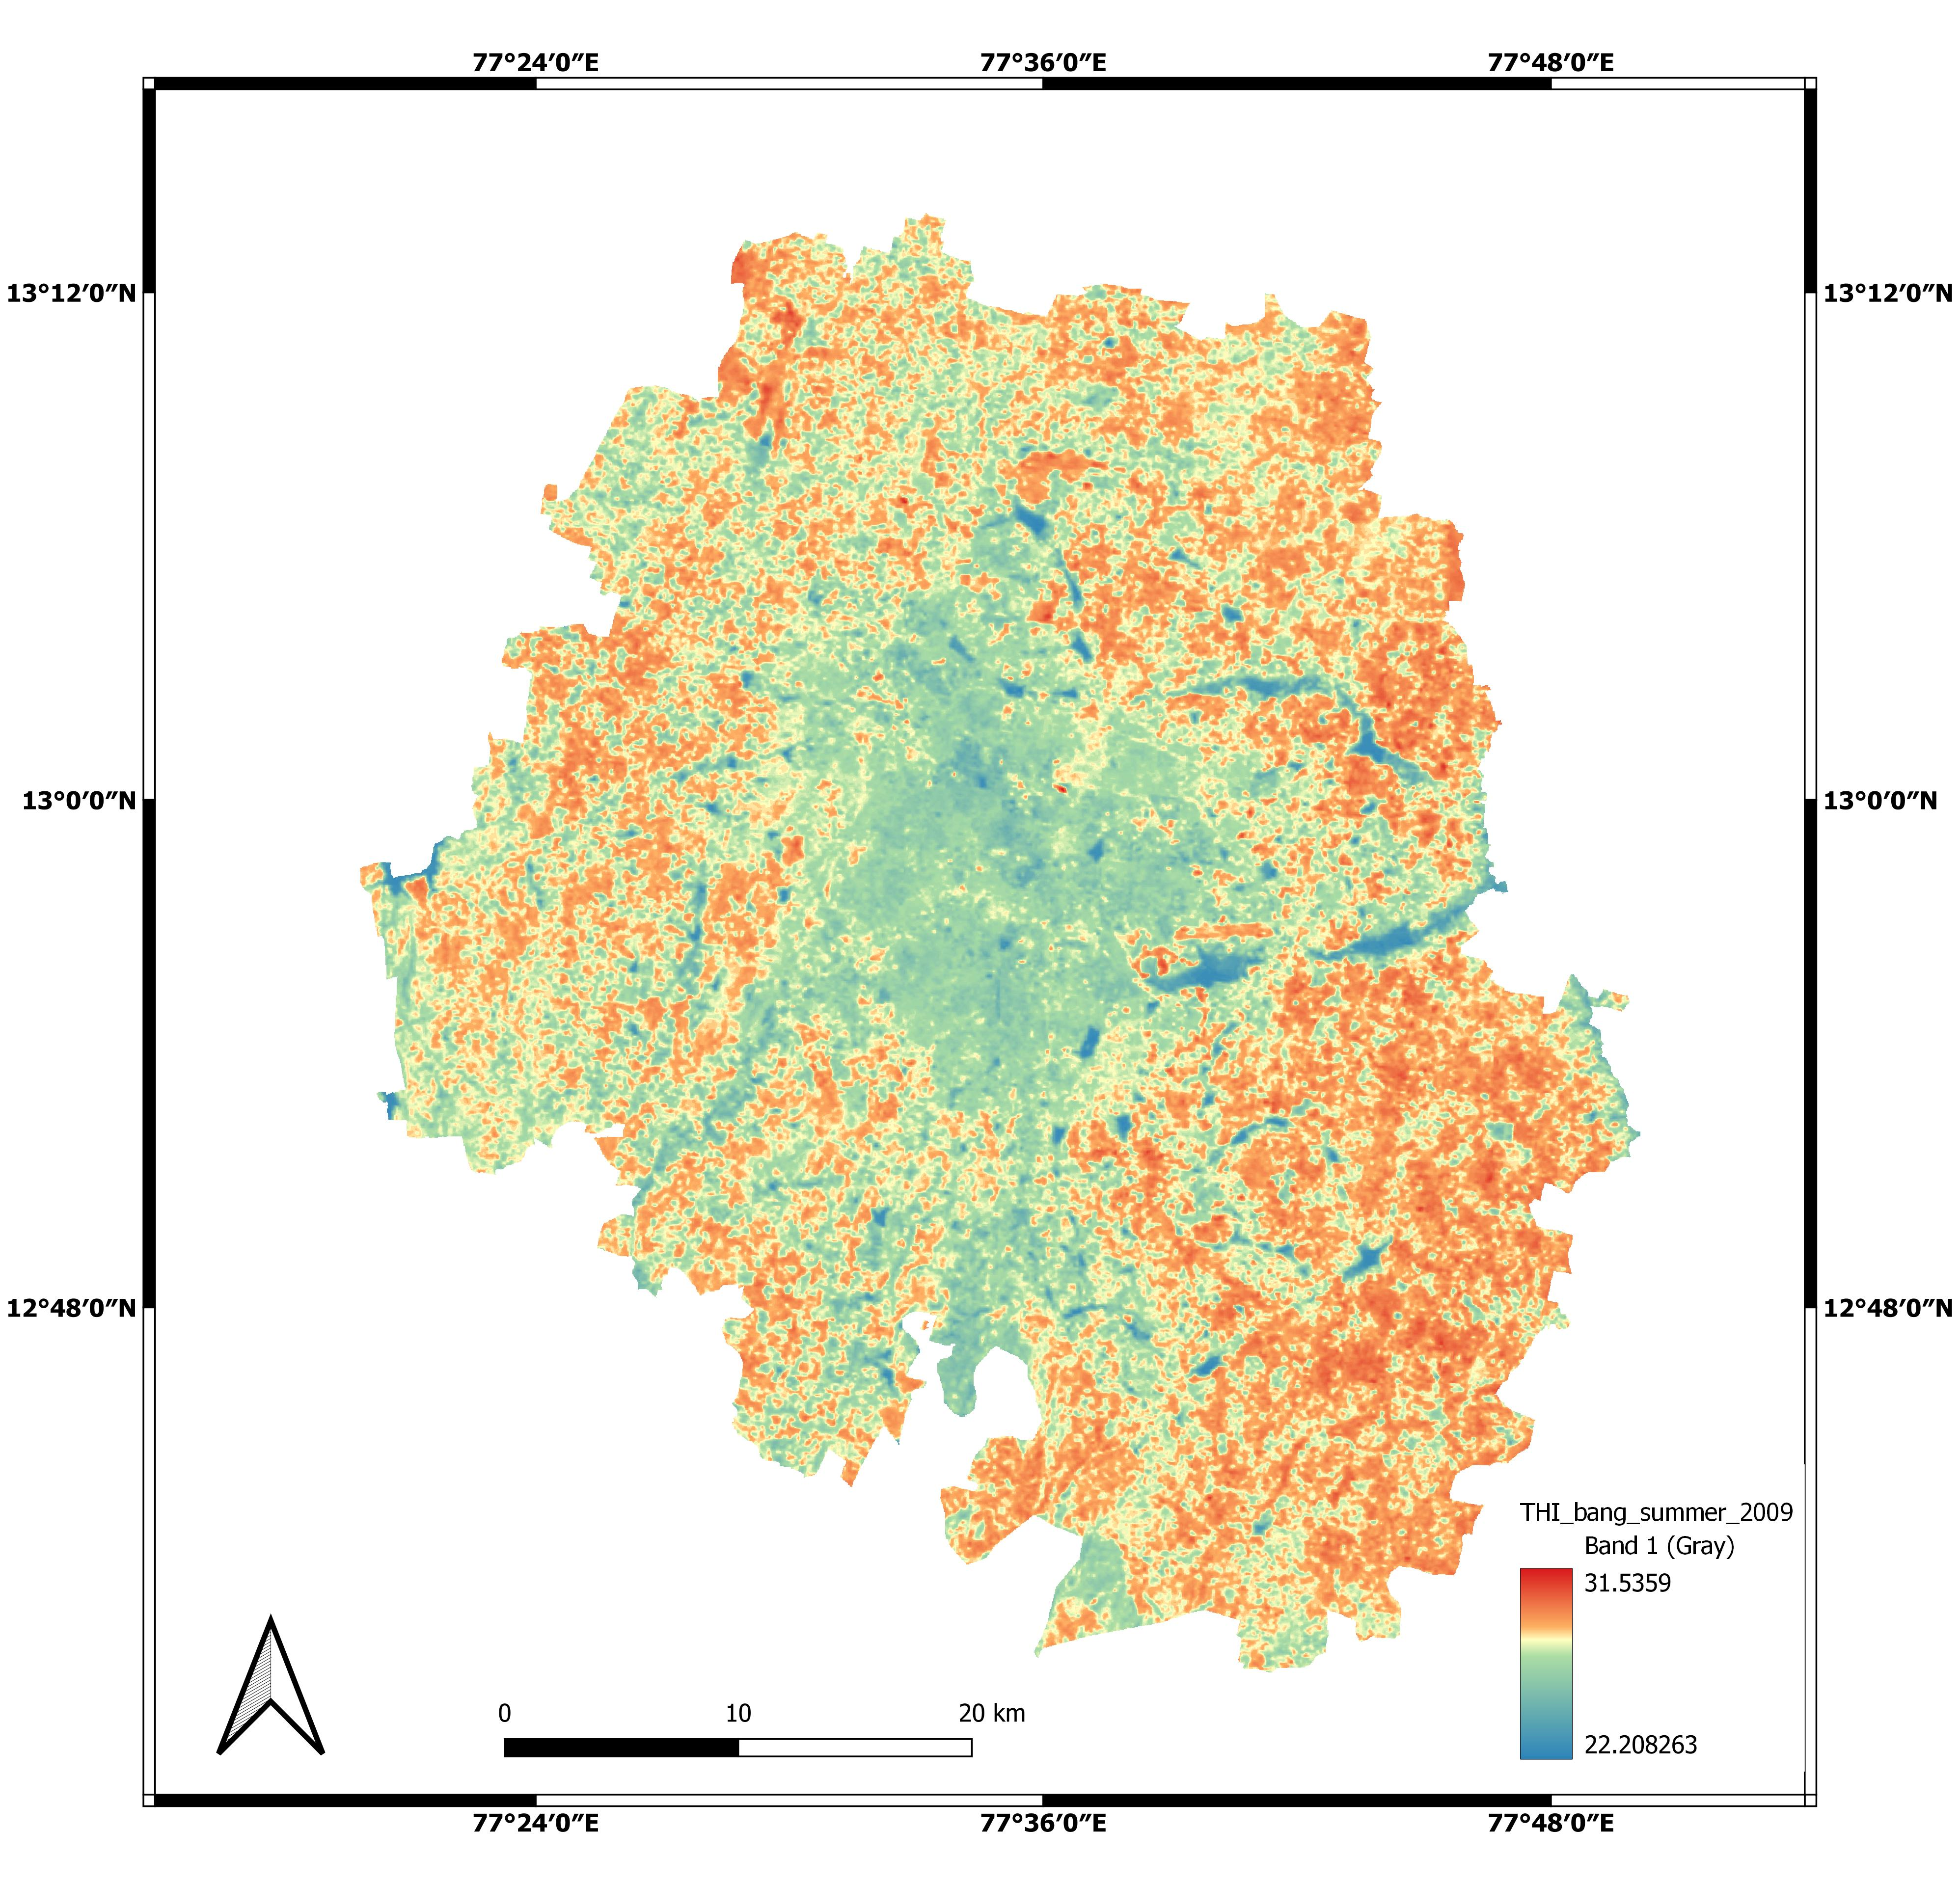
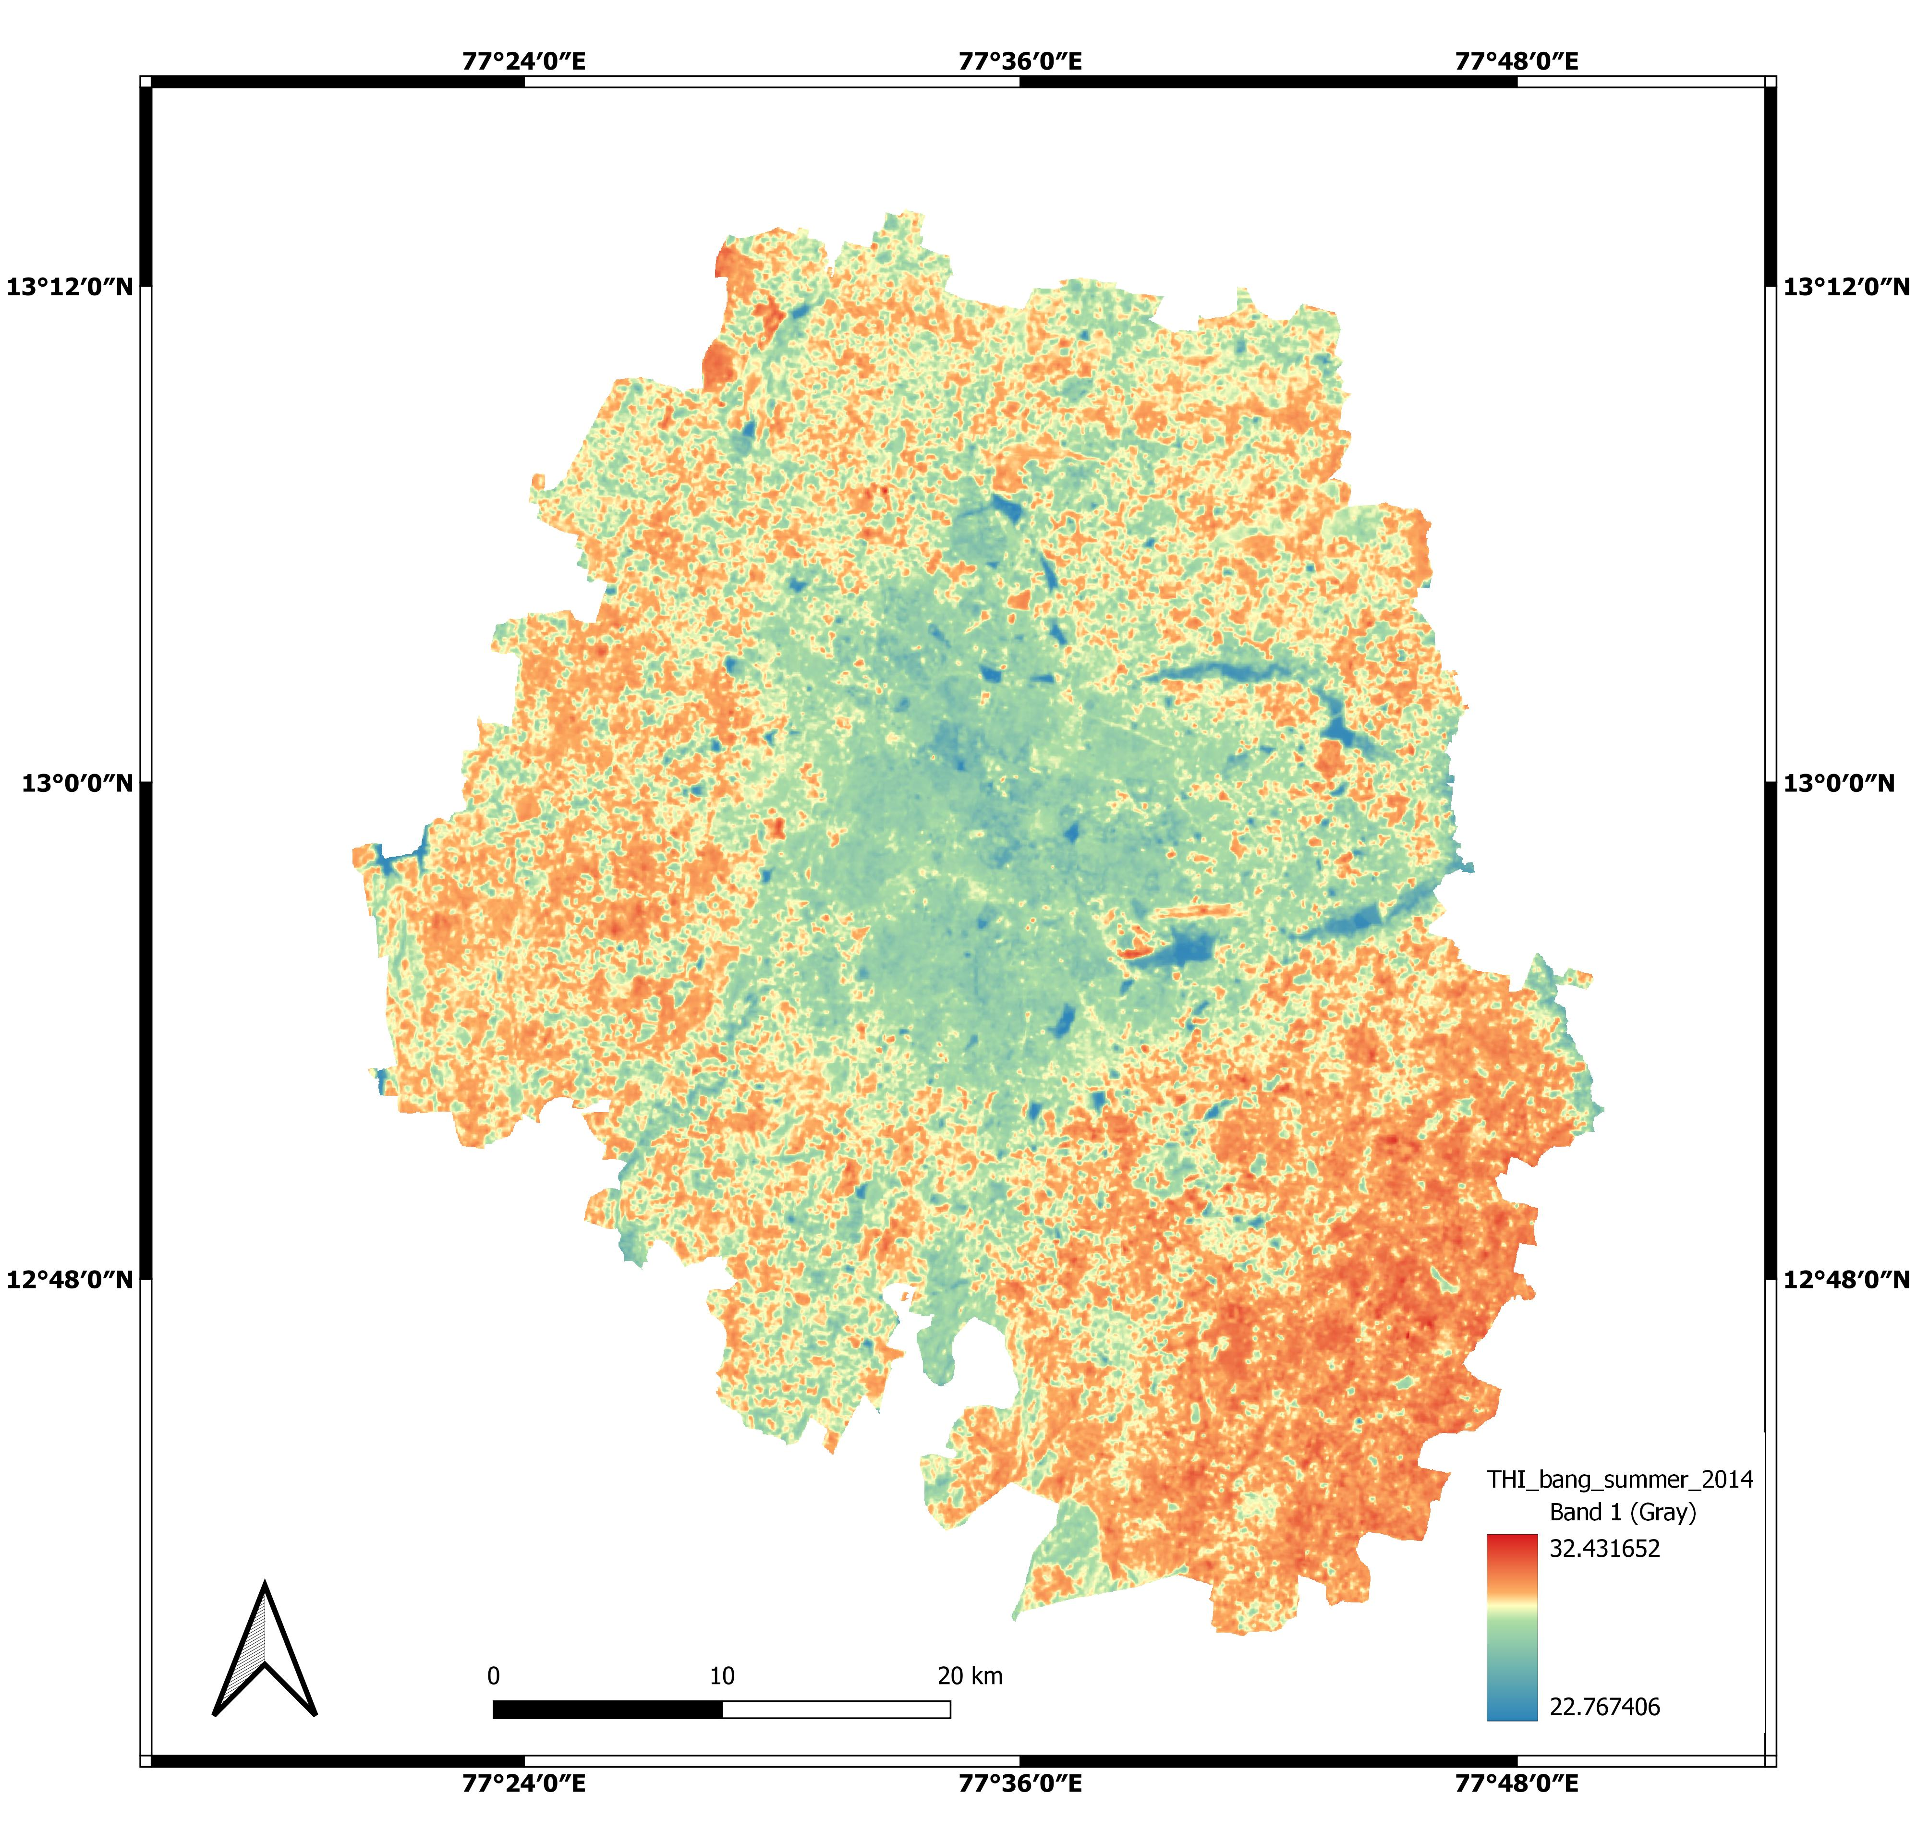
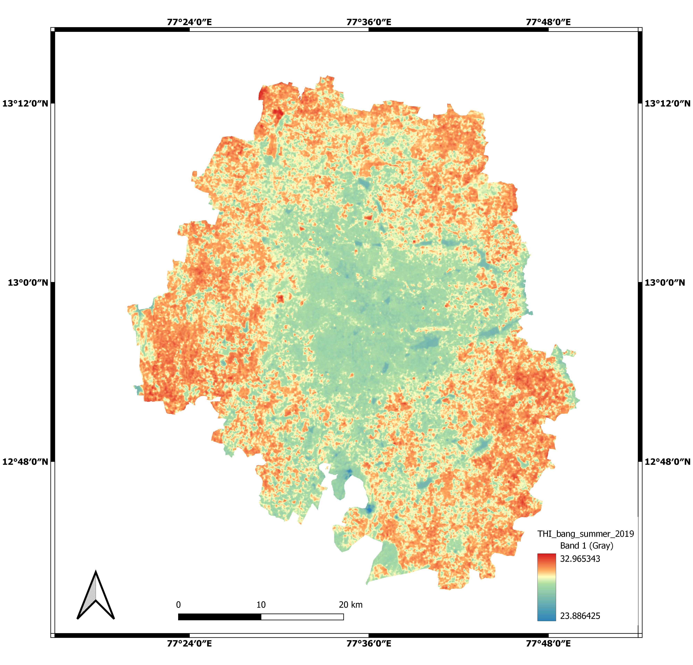
THI maps-Bangalore-summer
2009
2014
2019
There is a substantial increment observed in discomfort during study period.
Overall mean discomfort was moderately discomfort in summer seasons.
The positive association of discomfort was observed with respect to built-up increment
Moderately discomfort to discomfort

Slide 21
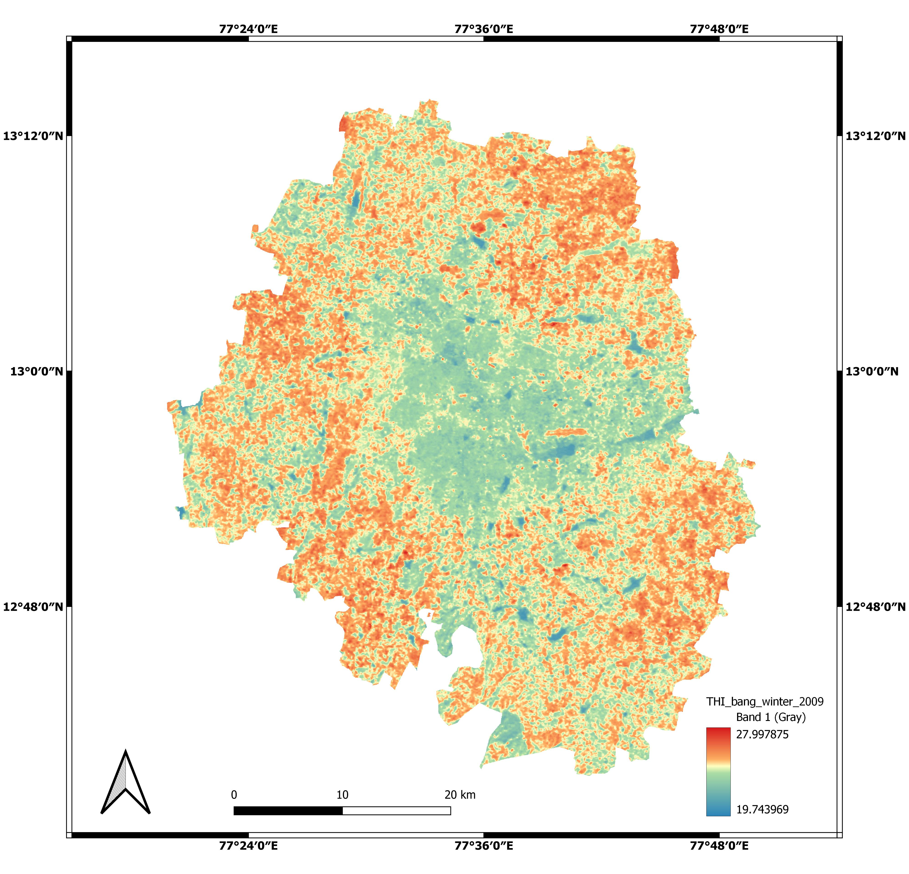
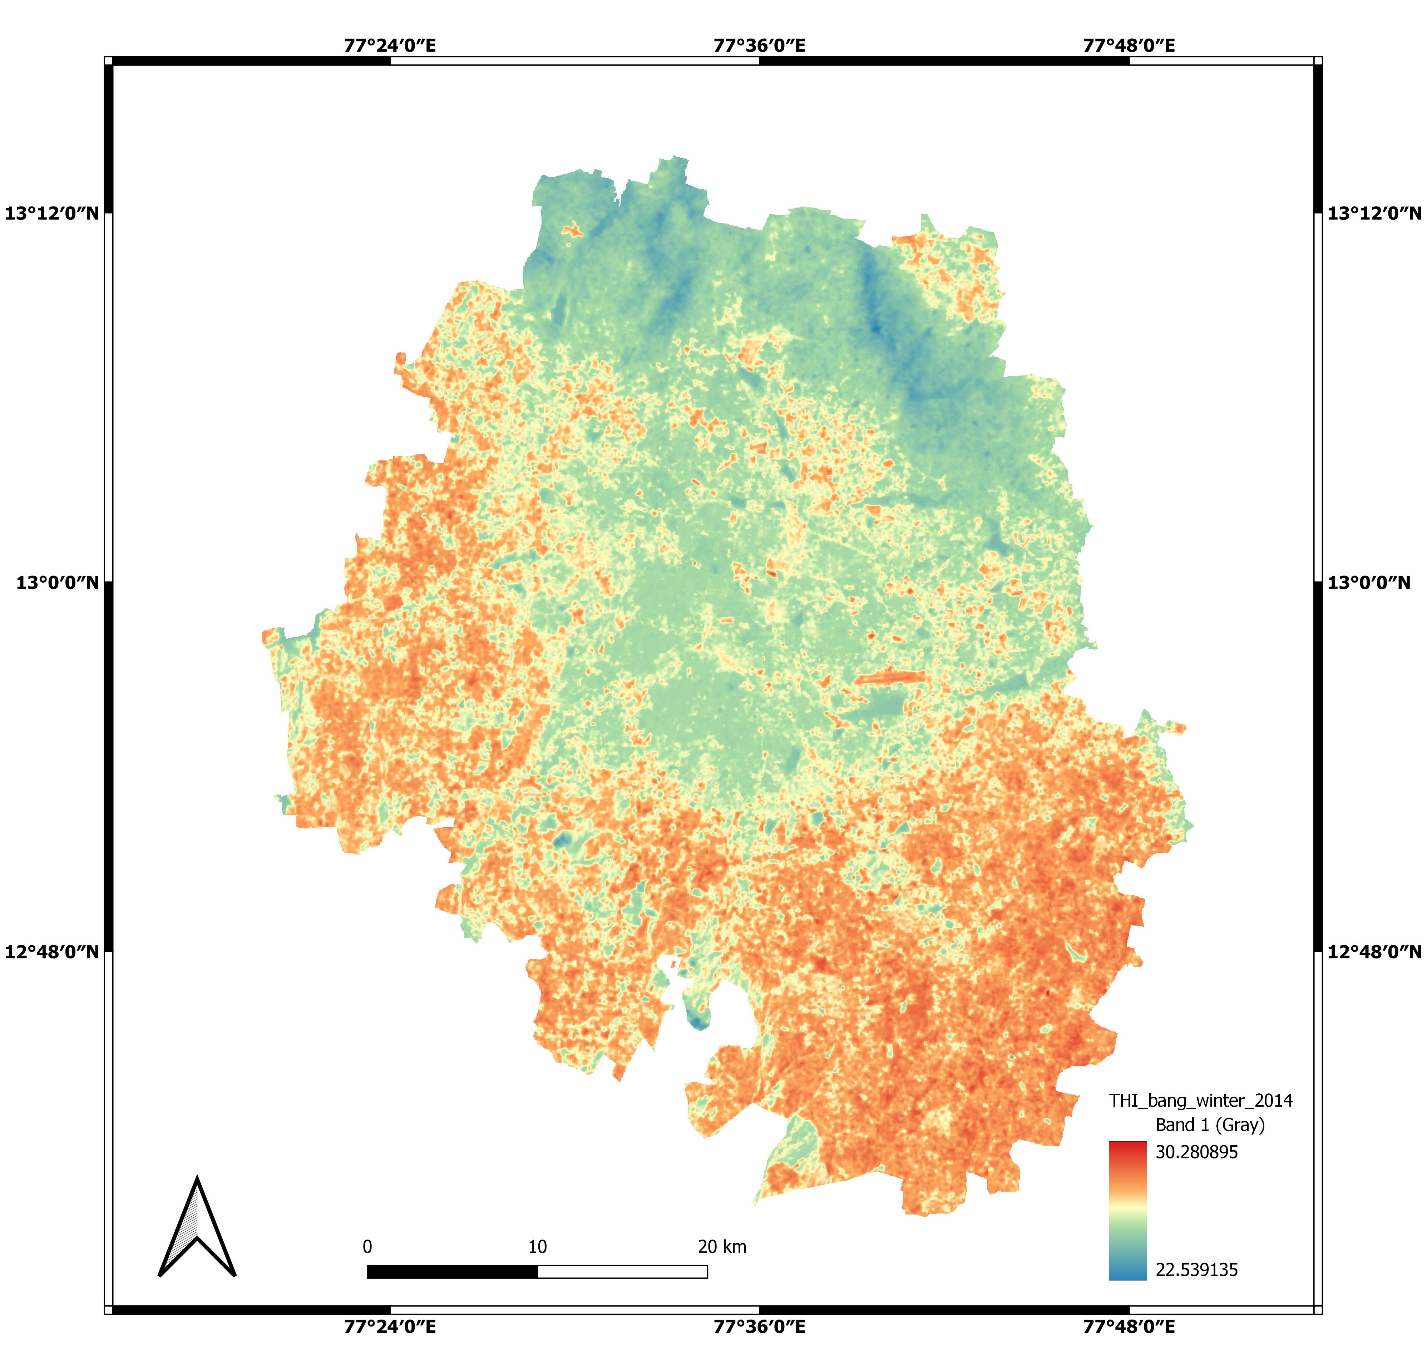
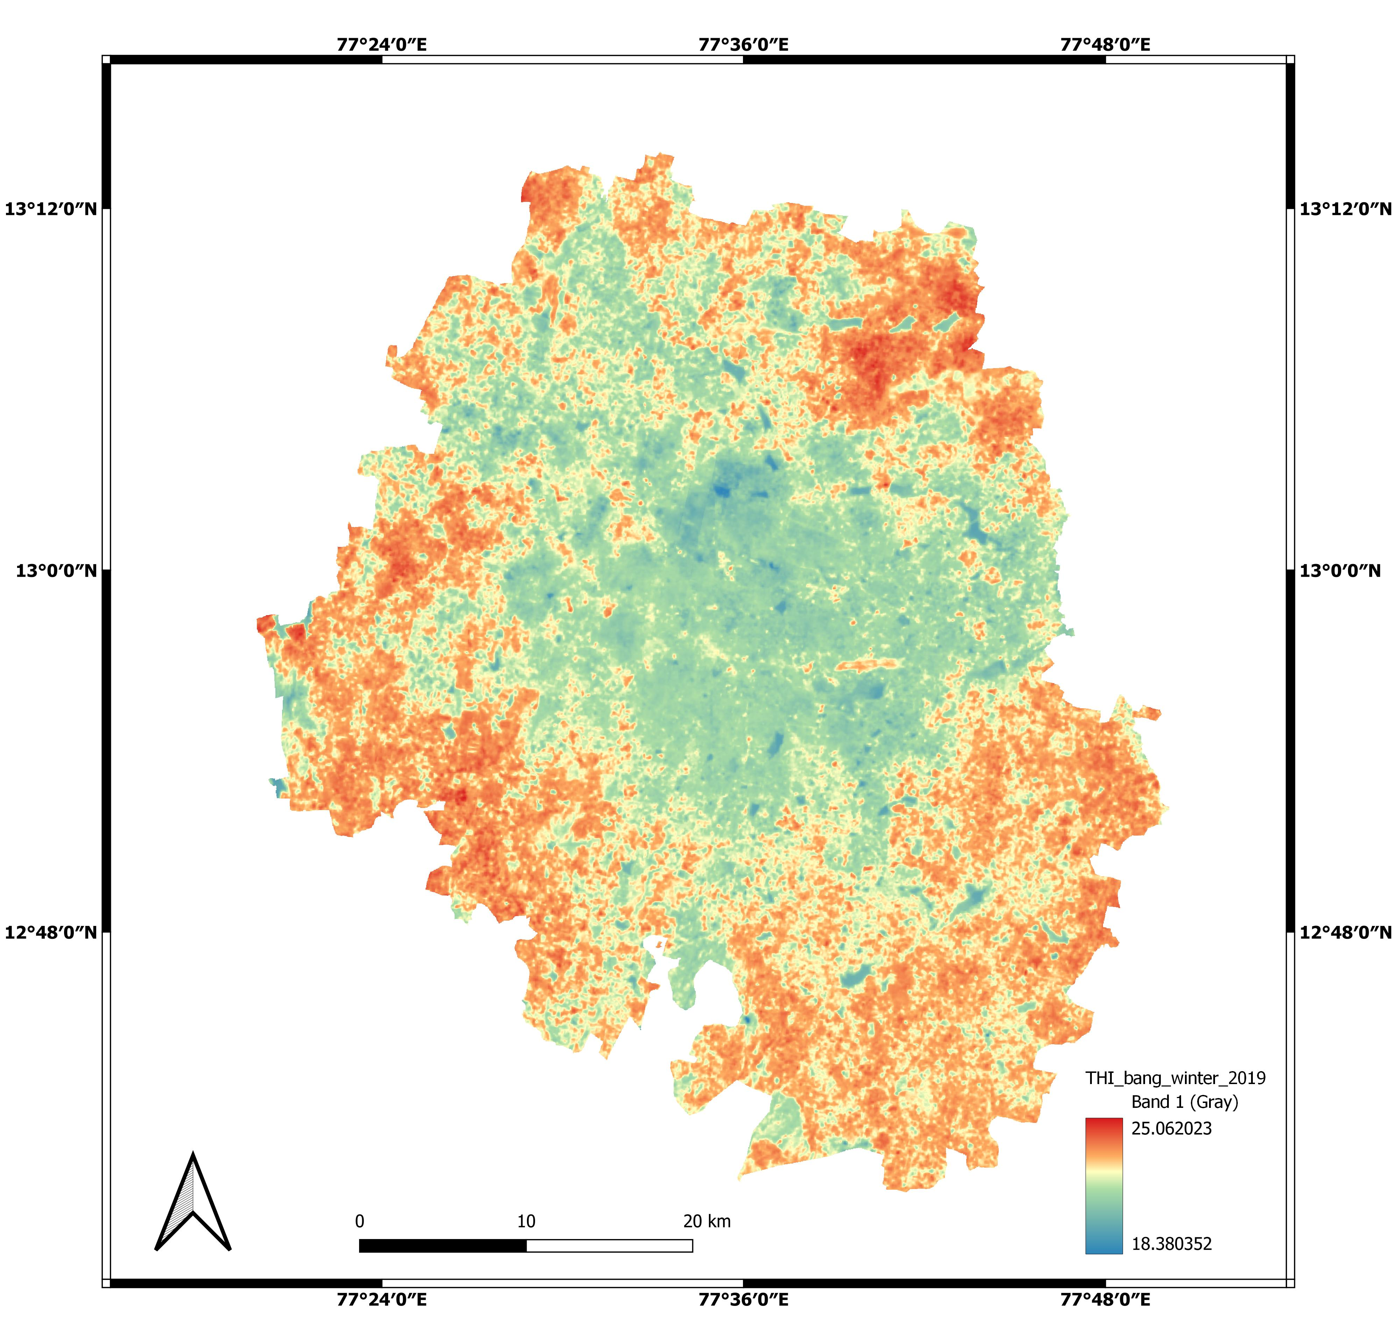
THI maps-Bangalore-winter
2009
2014
2019
The mean discomfort was decreased.
Overall discomfort was changed from neutral to comfortable.
Though these trends highly dependent on date of satellite data quired but there is a consistency in the spatial patterns of discomfort.
The south-east Bangalore is highly discomfort region.
Mostly neutral
Mostly comfort

Slide 22
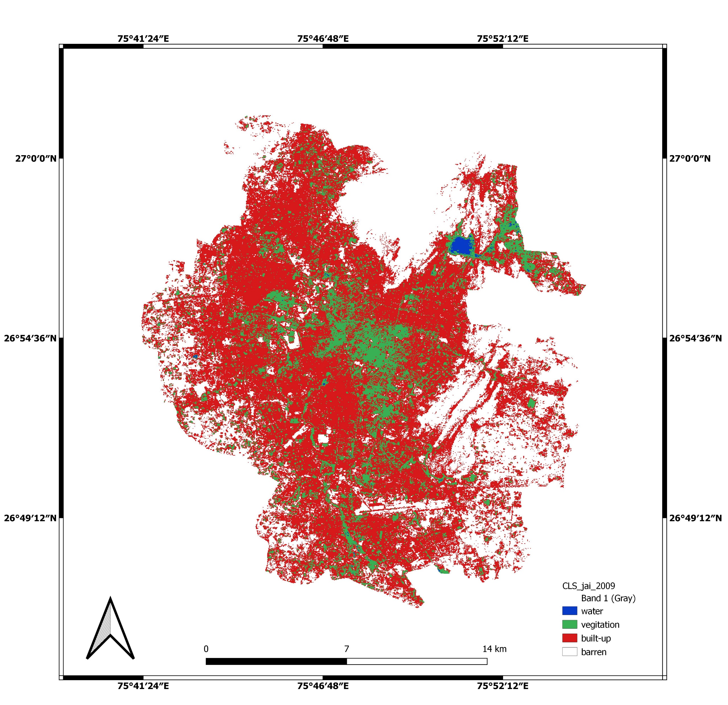
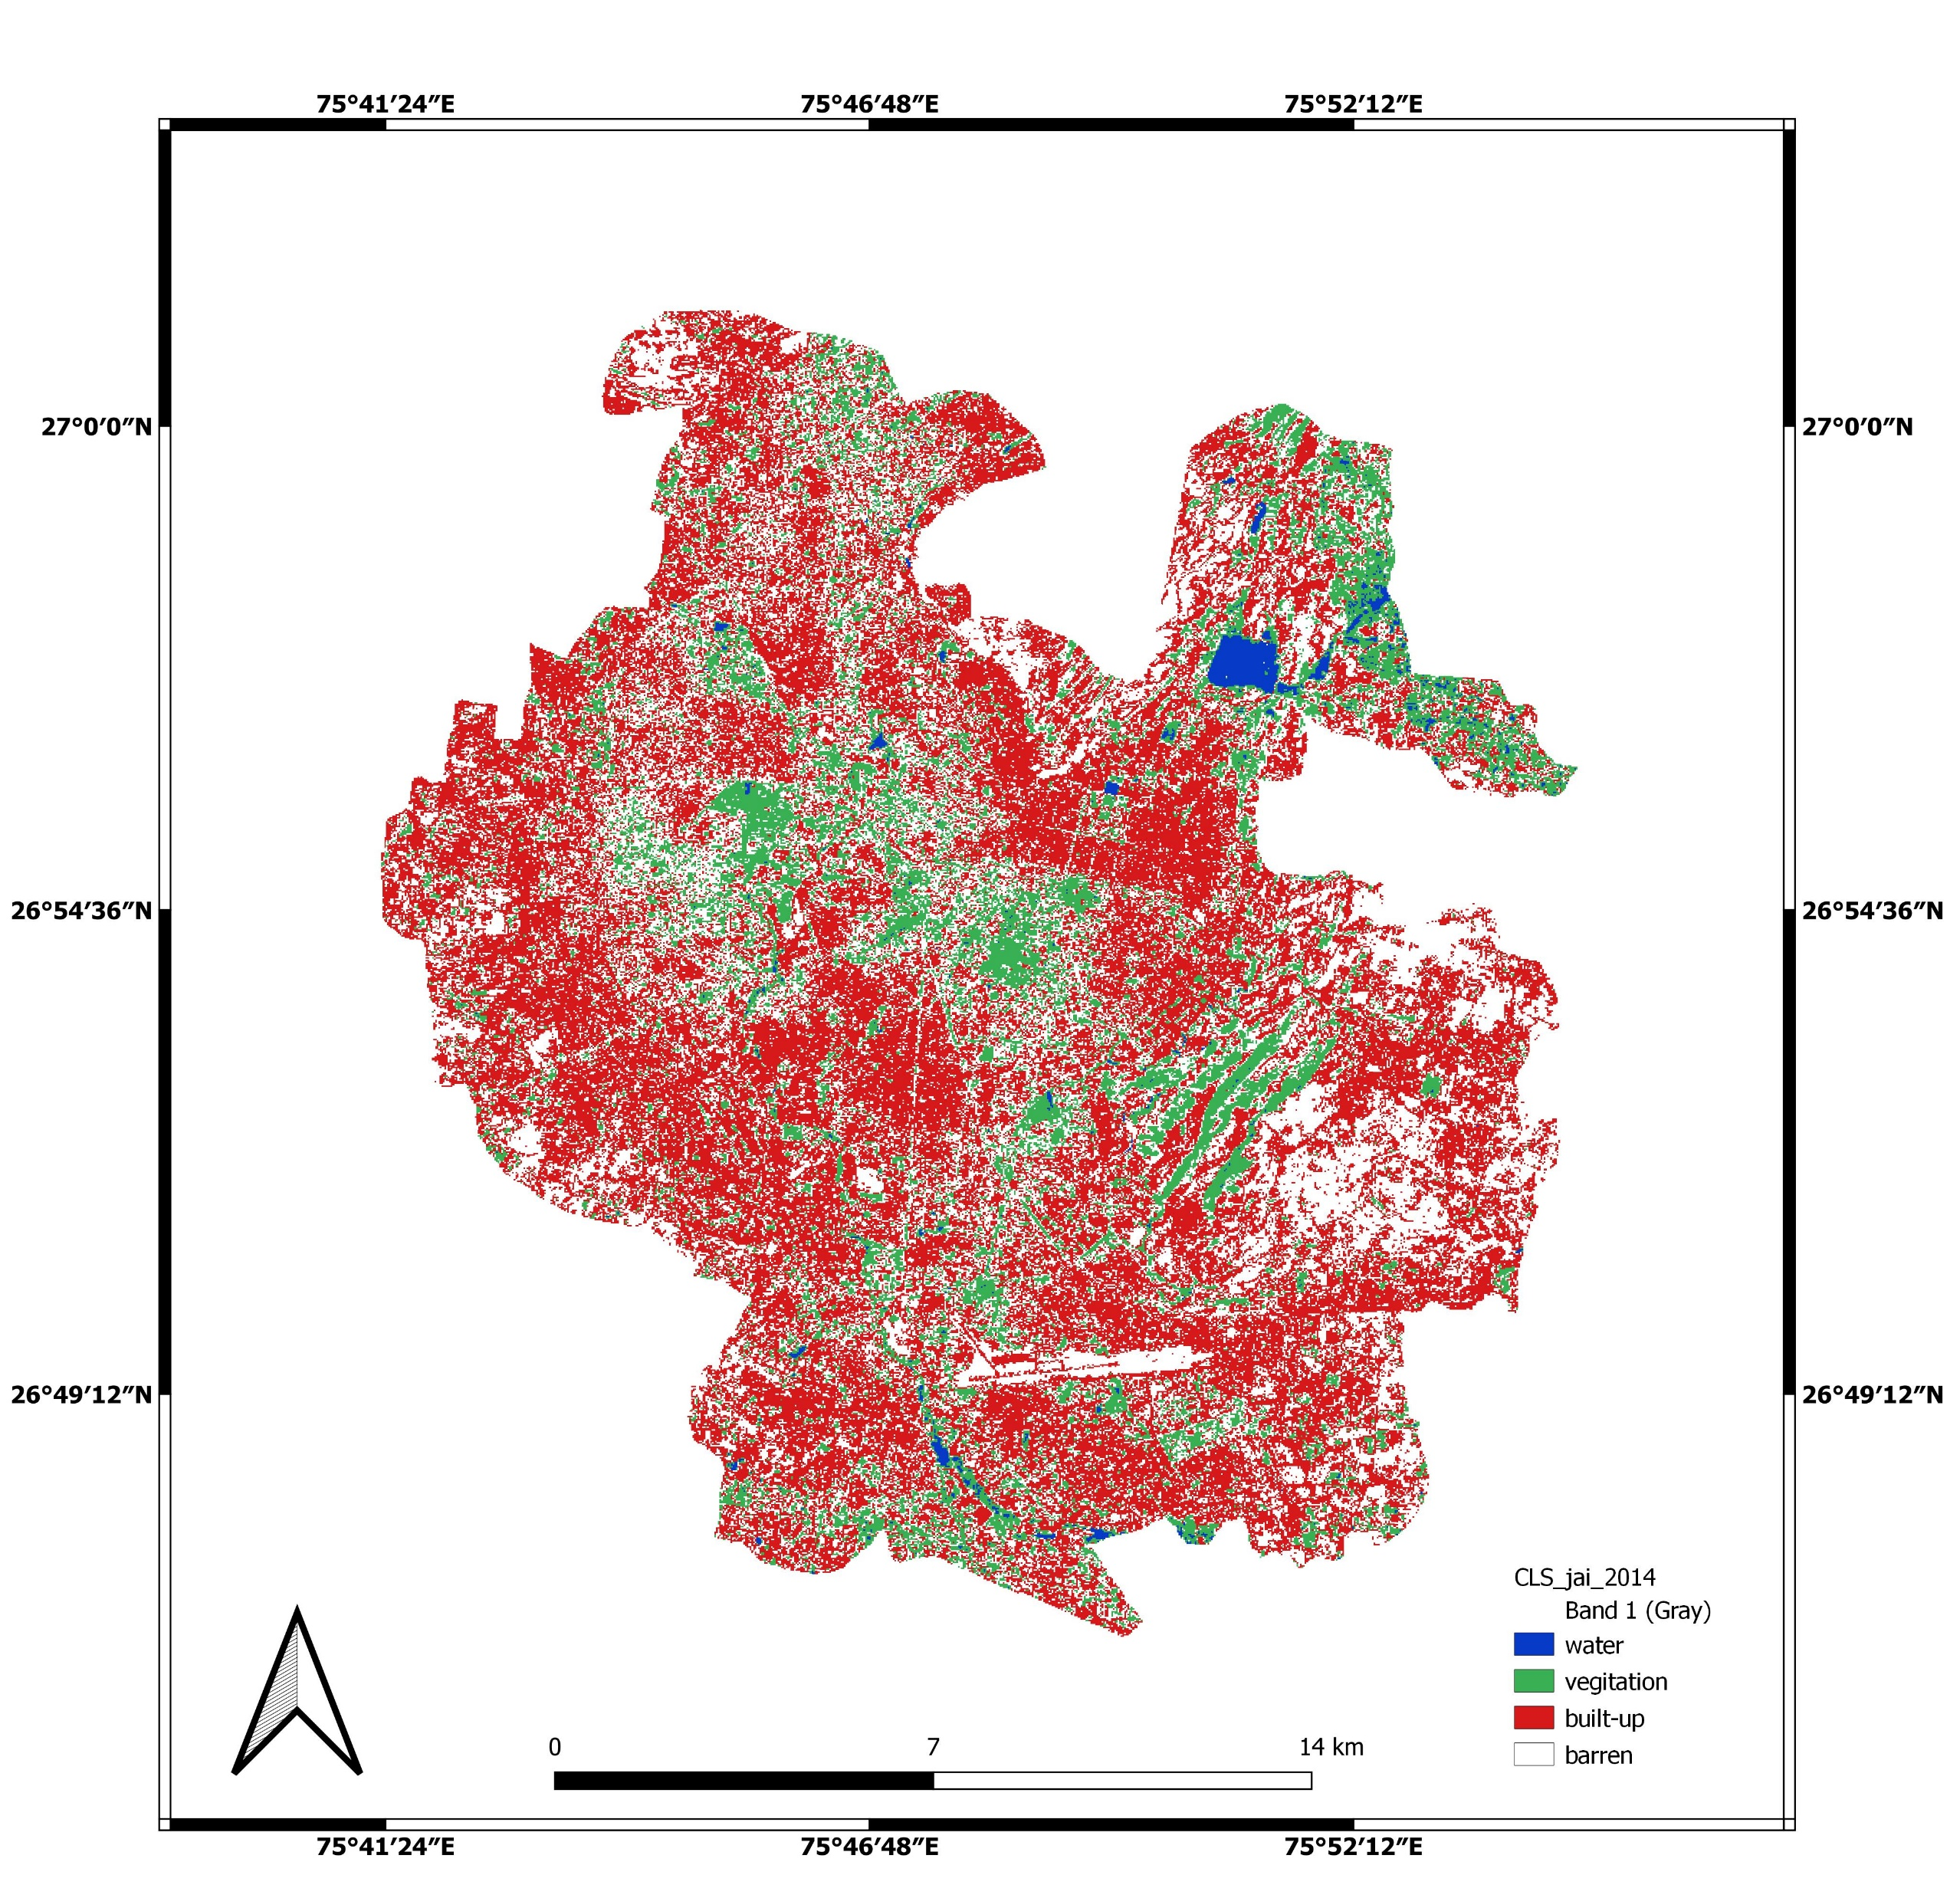
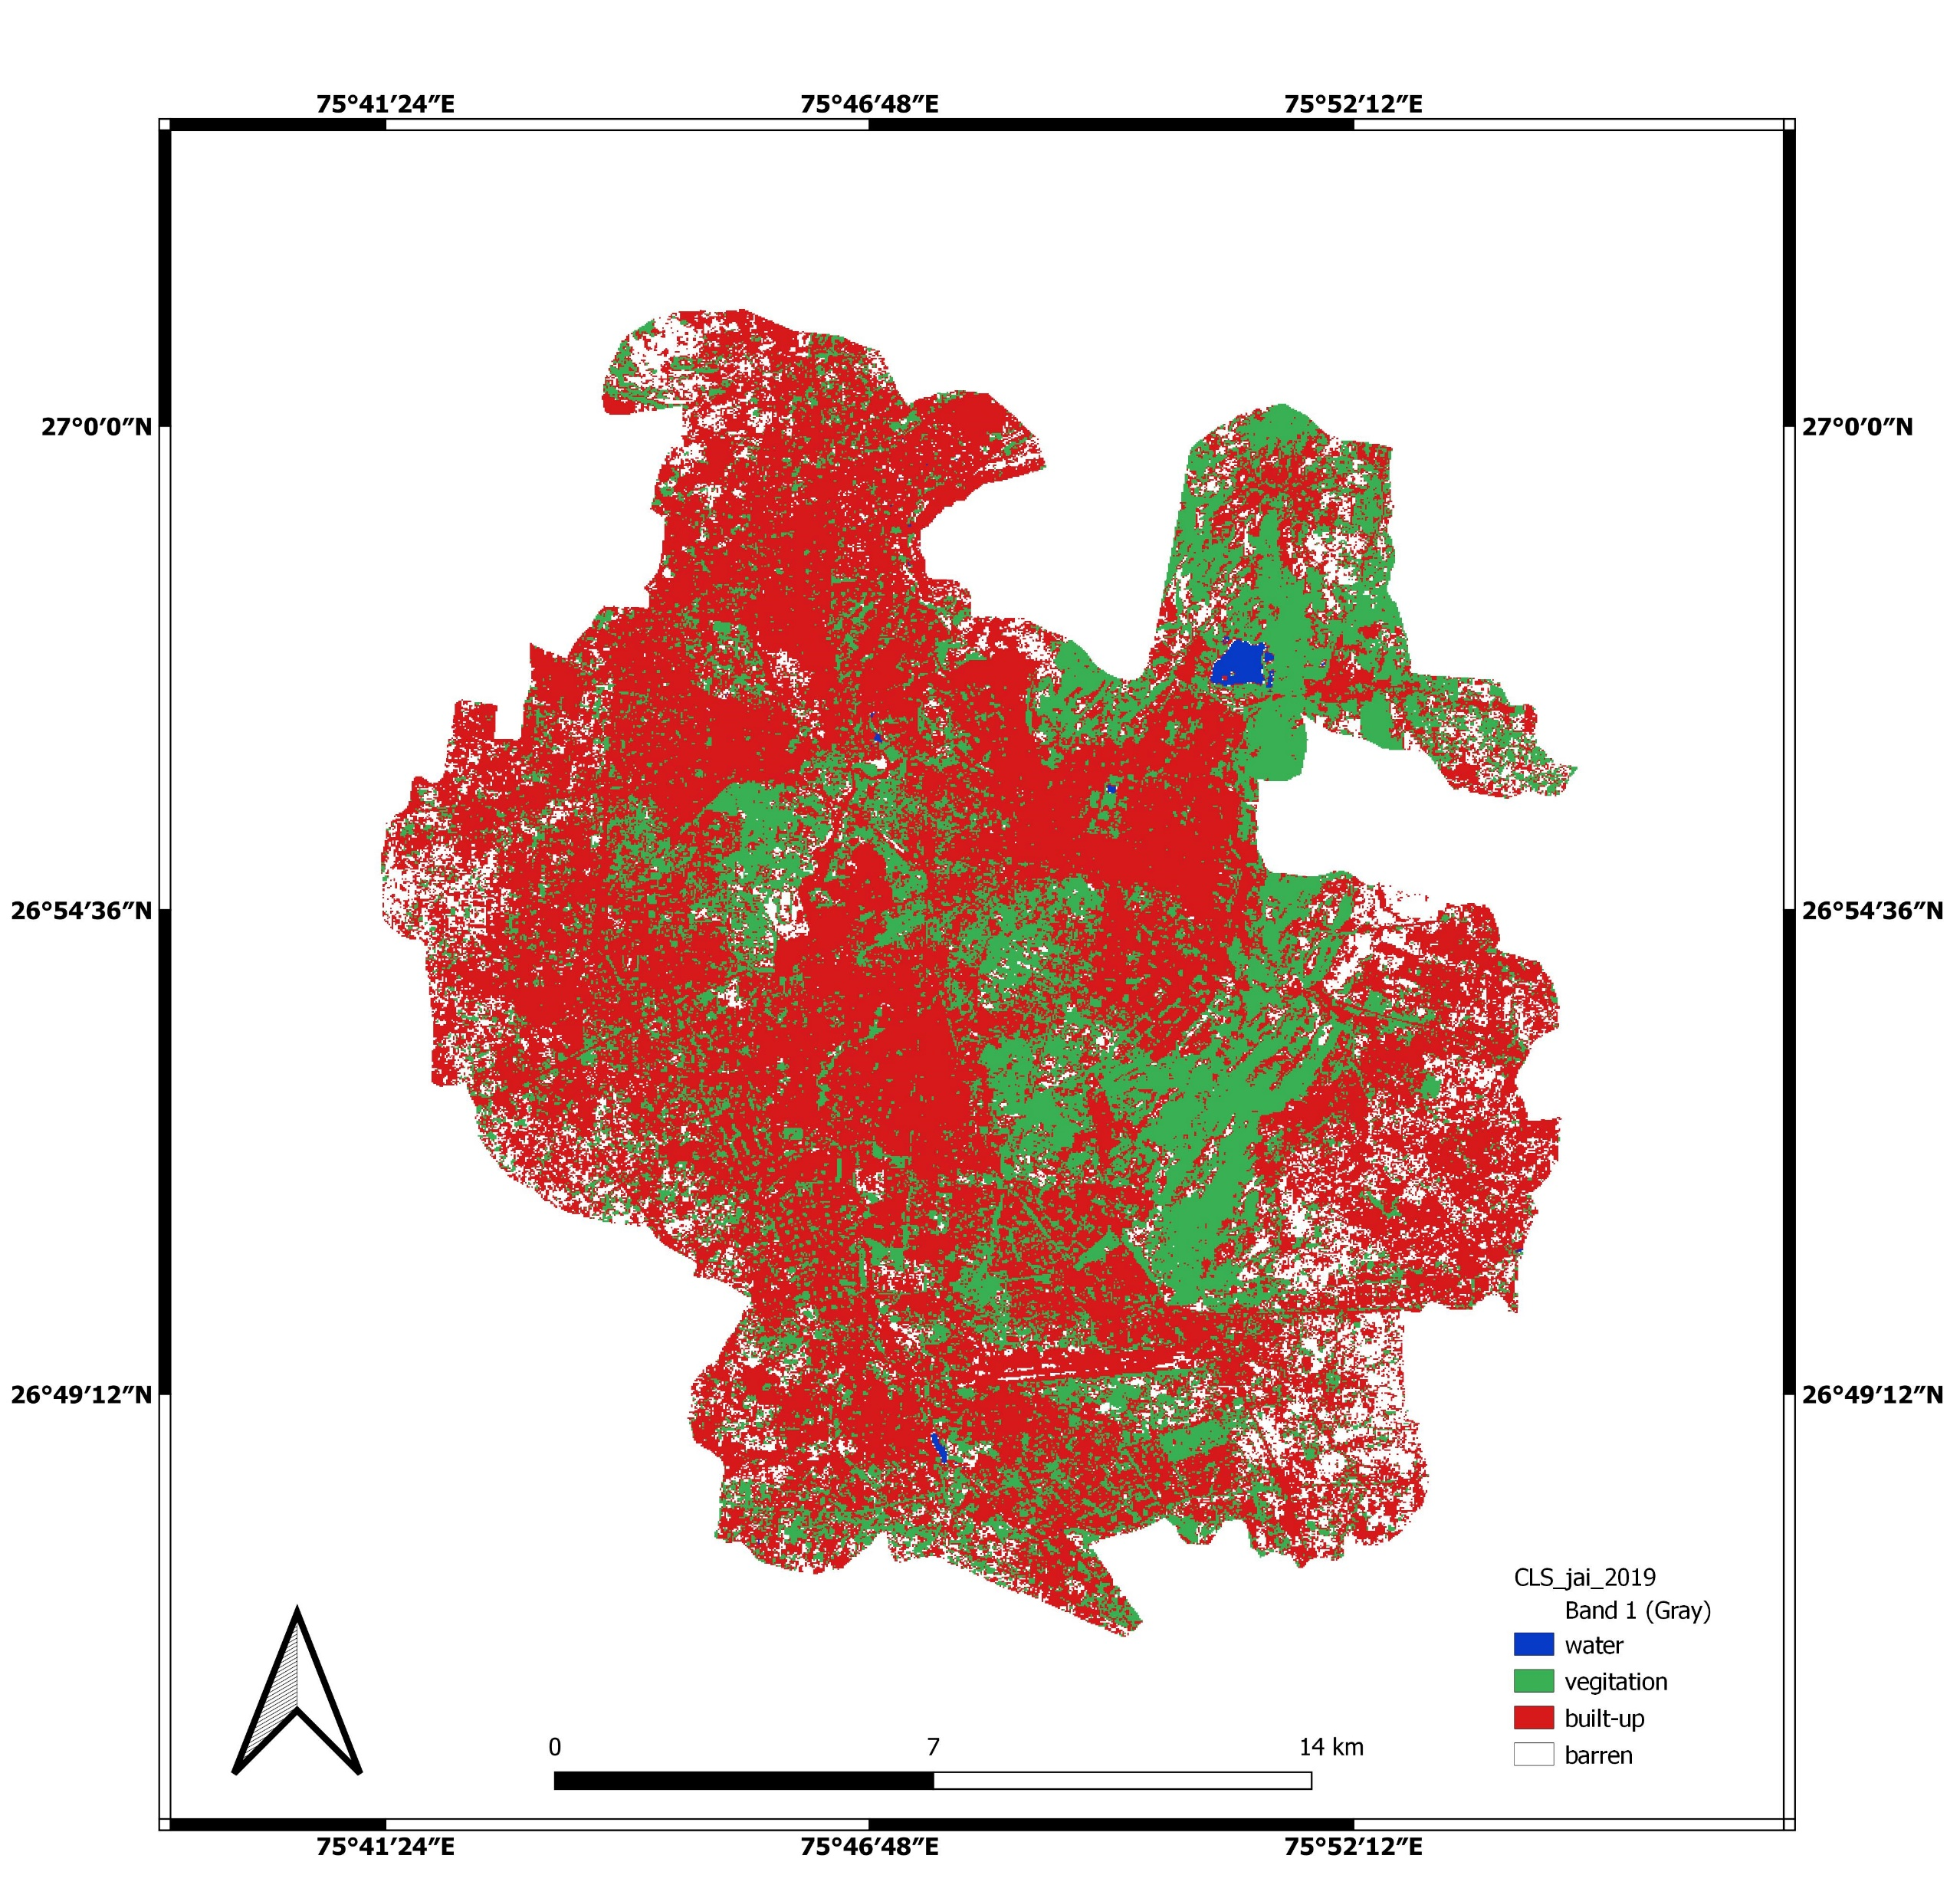
LULC change from 2009-2019
2009
2014
2019
The built-up increased about 12%
The slight of greenery increment observed.
The water bodies are almost negligible within the city.

Slide 23
Ward wise LULC and Thermal Comfort
Jaipur-Summer-Thermal comfort
Jhotwara and Kishan pole witnessed maximum built-up and associated maximum discomfort
Jaipur-LULC

Slide 24
Ward wise LULC and Thermal Comfort
Jaipur-Summer-Winter comfort
Jhotwara and Malviya nagar has maximum comfort in 2009 and turned to be neutral in 2019
Jaipur-LULC

Slide 25
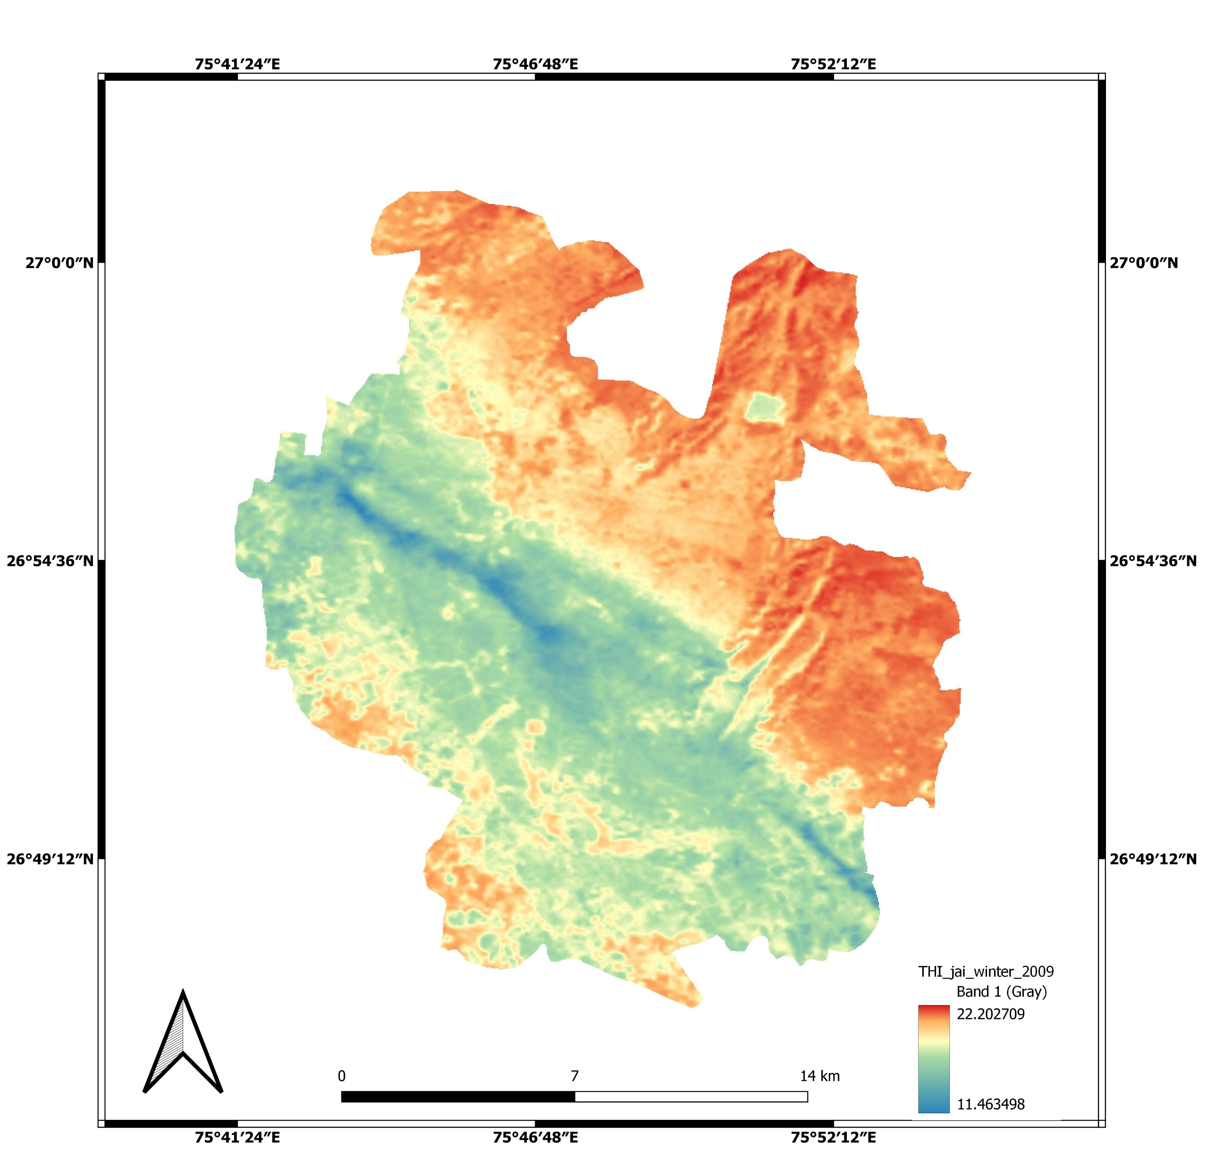
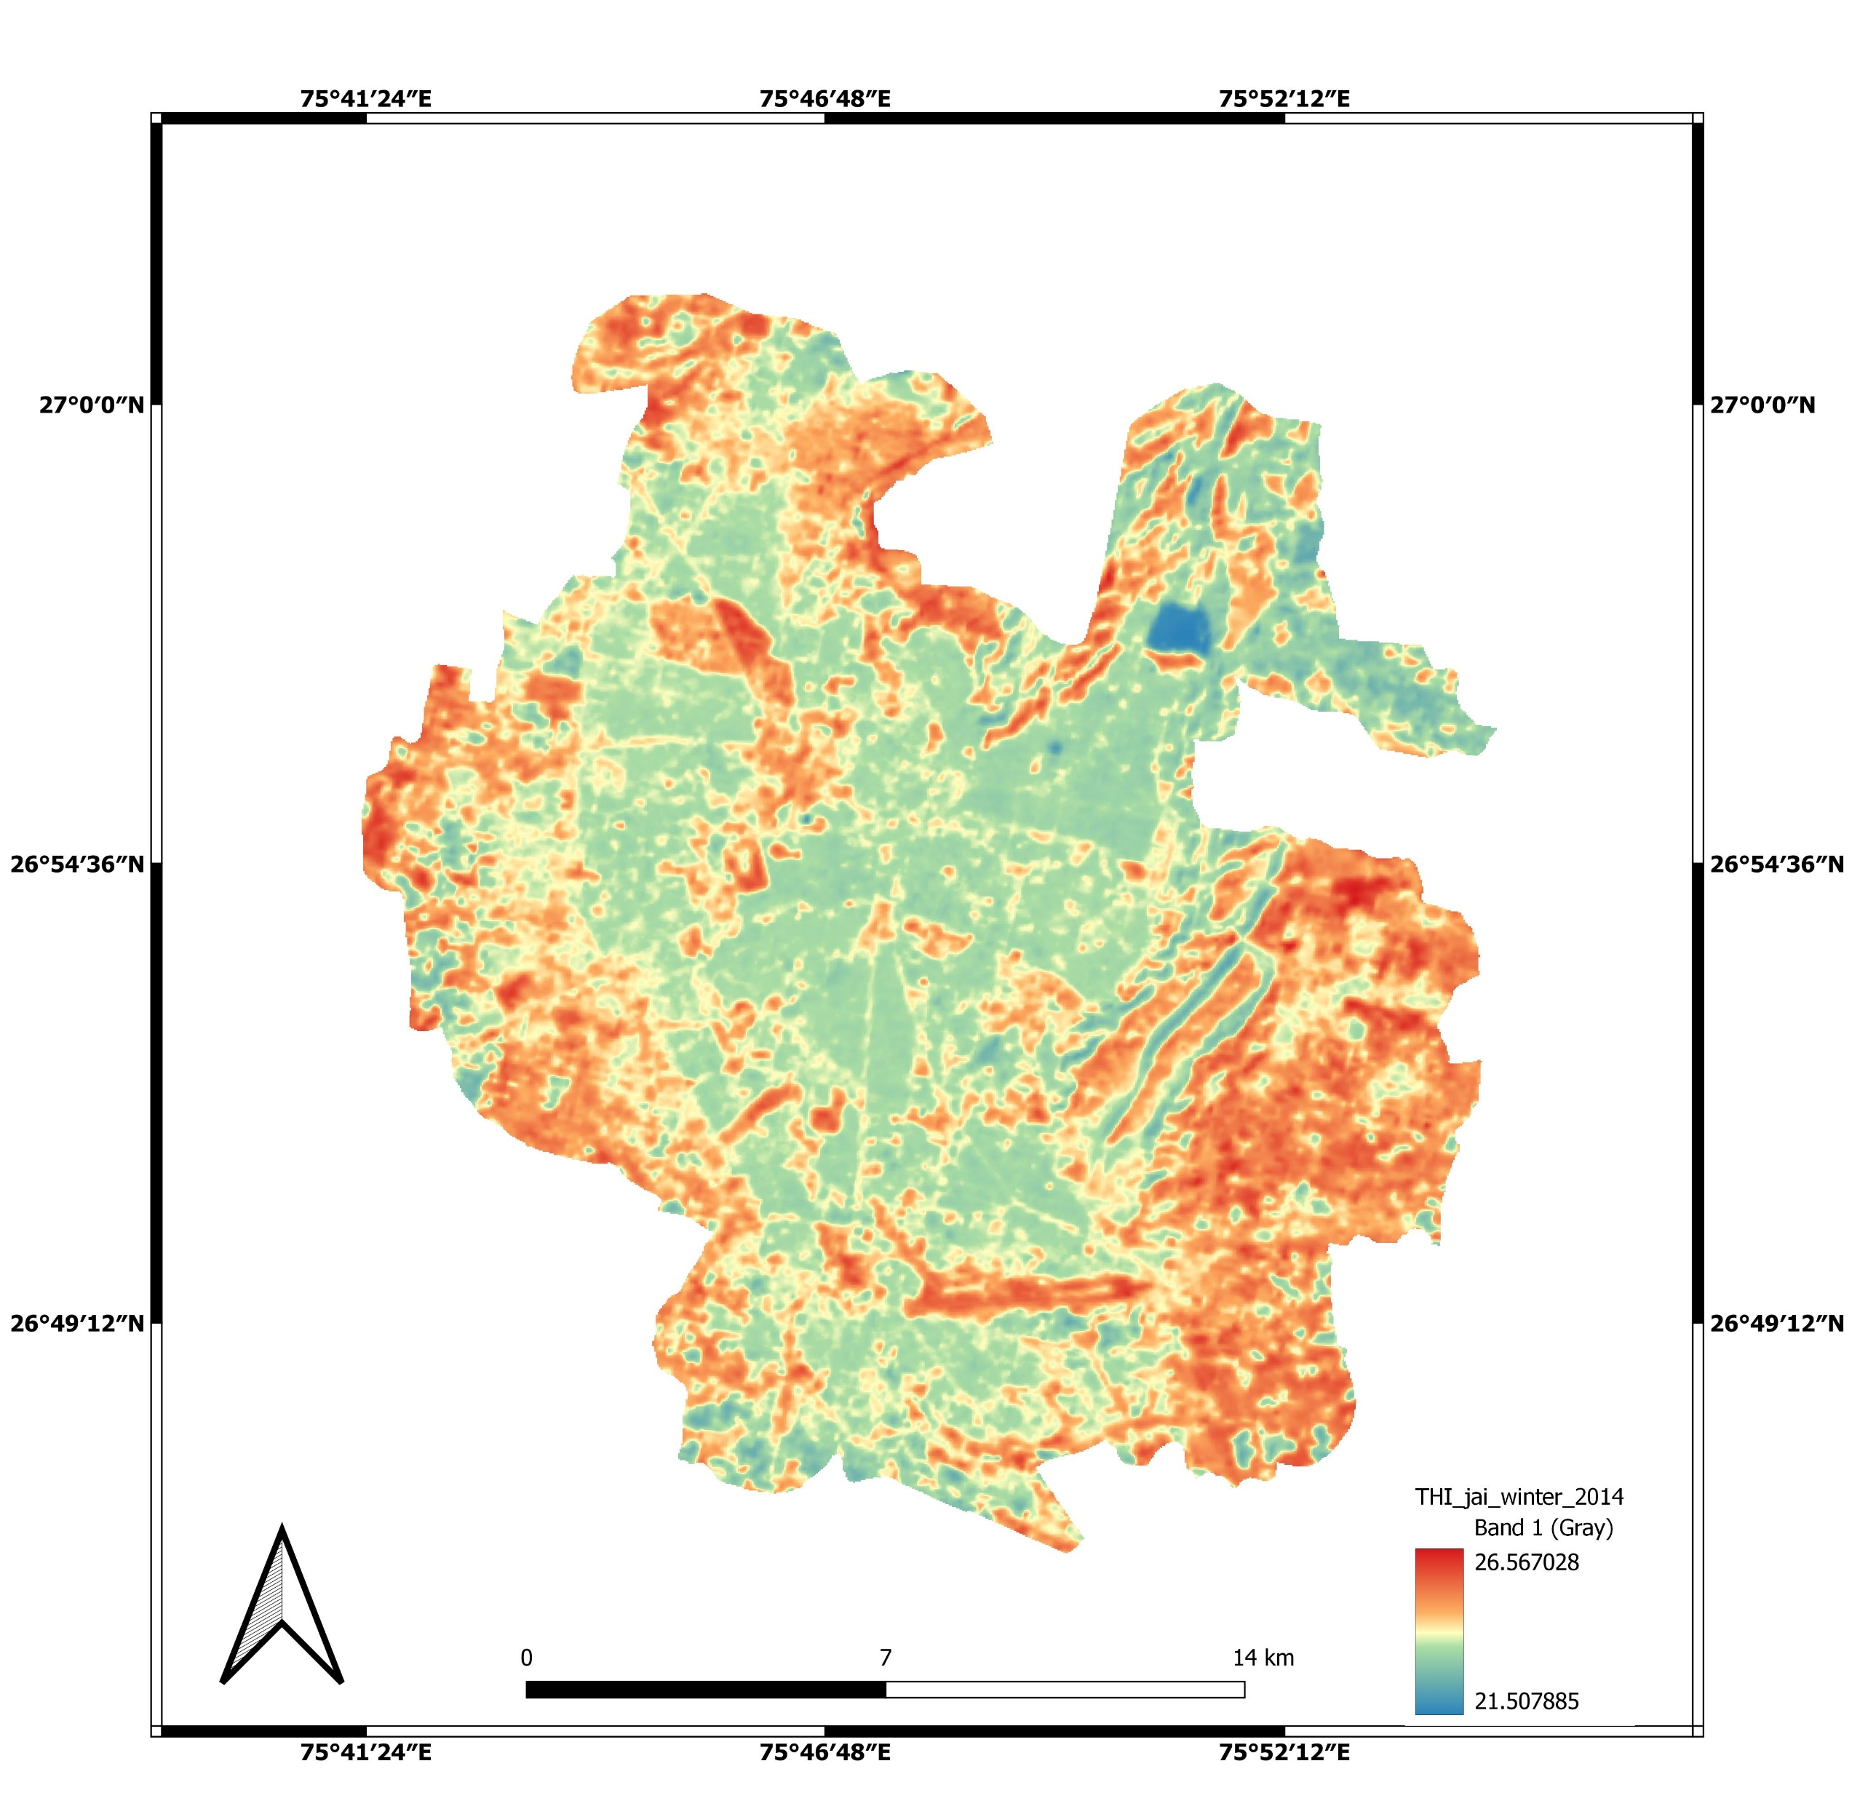
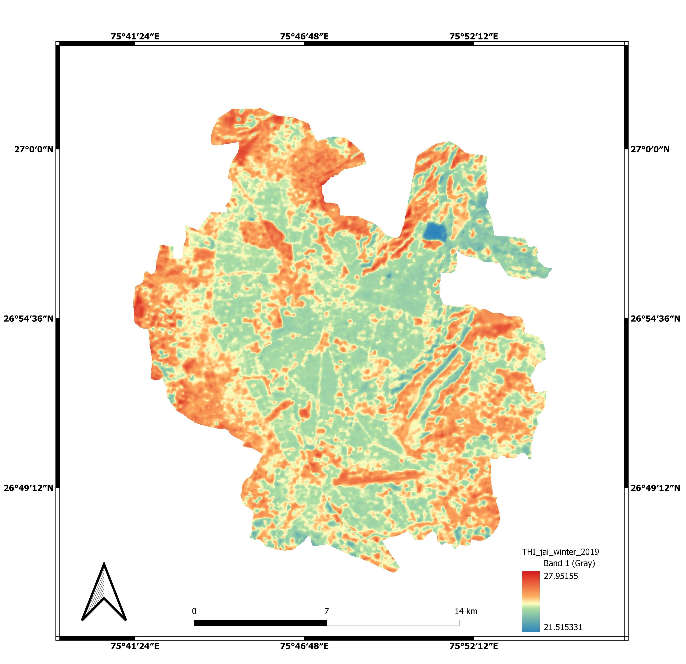
THI maps-Jaipur-summer
2009
2014
2019
There is a substantial increment observed in discomfort during study period.
Overall mean discomfort was most discomfort in summer seasons.
The positive association of discomfort was observed with respect to built-up increment
Most discomfort

Slide 26
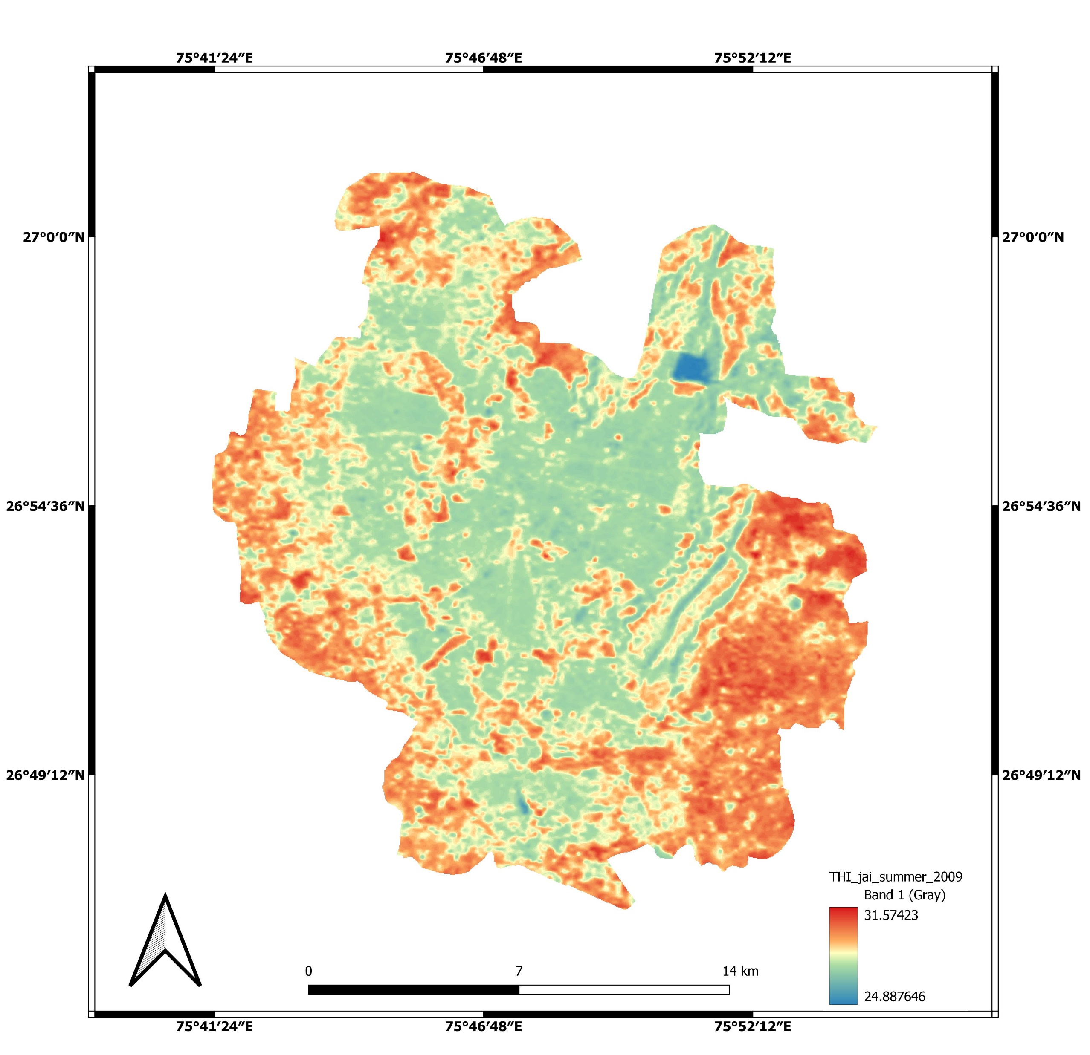
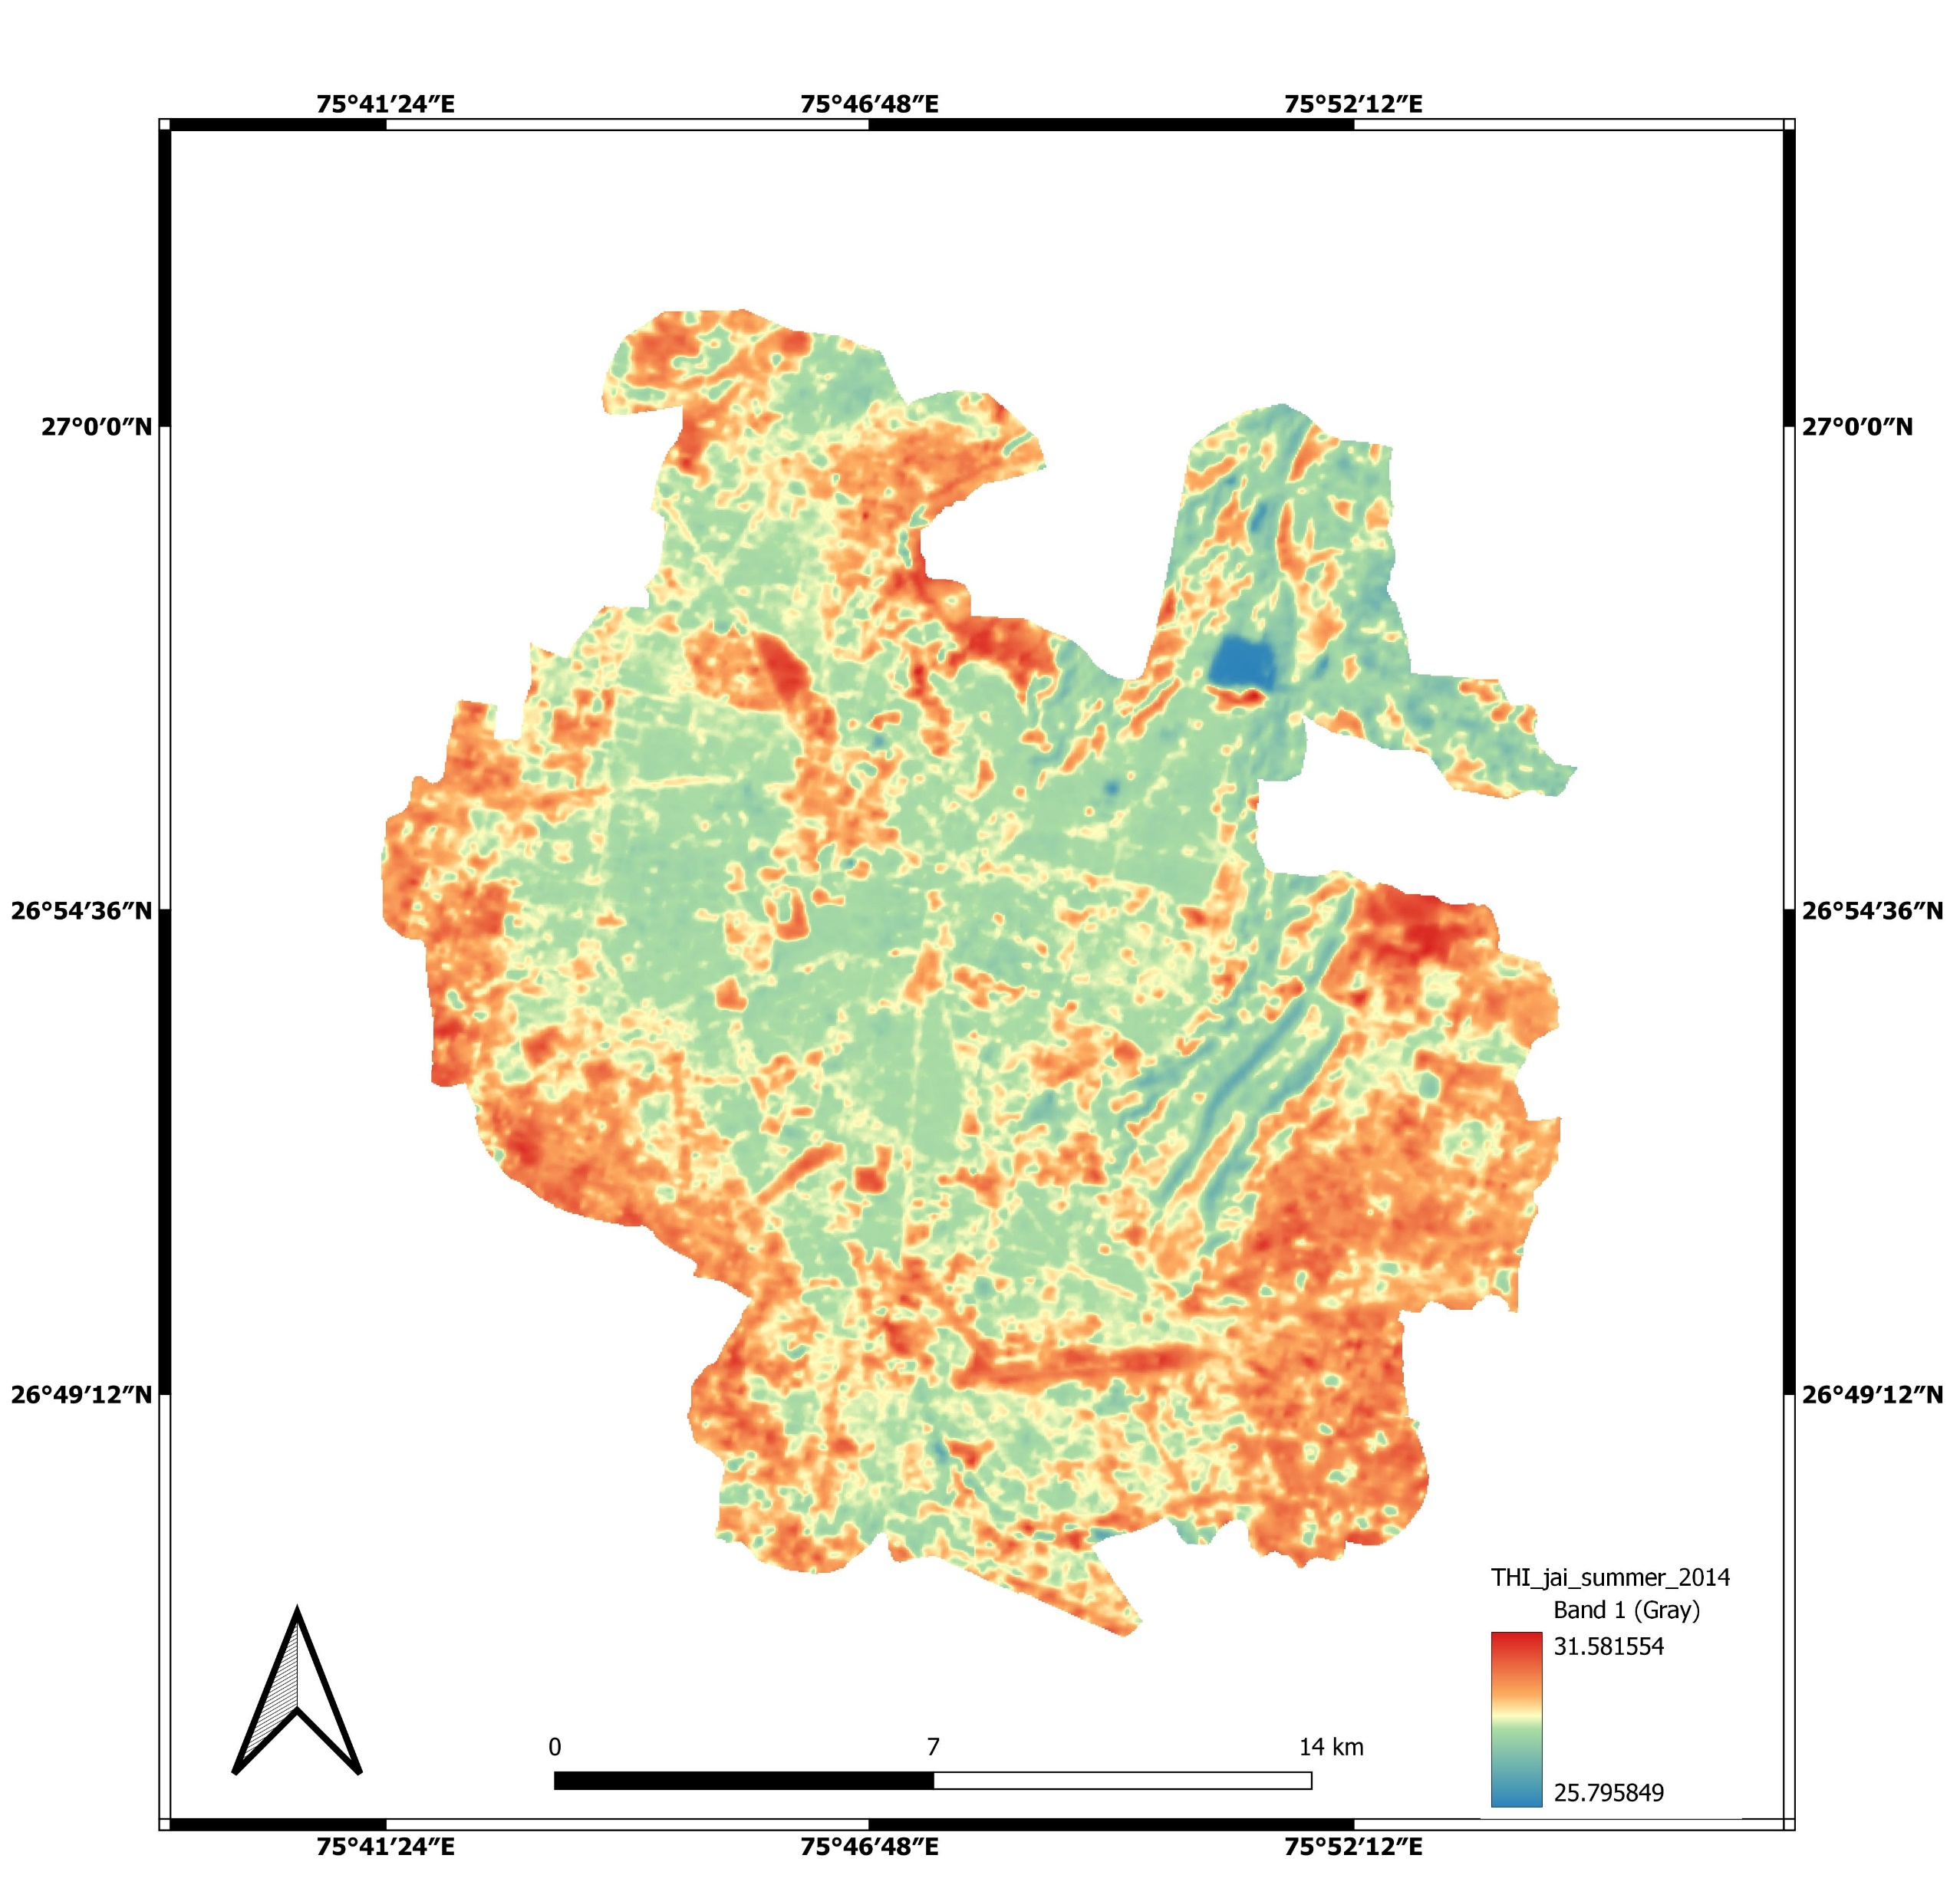

THI maps-Jaipur-winter
2009
2014
2019
The winter also observed an increasing trend in discomfort
Overall mean discomfort was moderately comfort to comfort in winter seasons.
The positive association of discomfort was observed with respect to built-up increment
Mostly neutral

Slide 27
Brief summary
The present study mainly focused on the assessment of outdoor thermal comfort due to the change in land cover during 2009 to 2019 over Hyderabad, Bangalore and Jaipur.
In this study, available meteorological observations, classification of land cover changes using Landsat imageries used in a developed machine learning model to obtain a high resolution information of thermal comfort due to the change in land cover over these cities.
The mandal/block/ward level thermal comfort has been estimated and identified locations of neutral to highly discomfortable conditions
.Significant changes in urbanization has been noticed during the study period and the regions of highly discomfortable regions are increasing particularly in summer and neutral conditions to moderately comfortable in winter has been noticed. This study has shown that increase in the urbanization having a significant affect in outdoor thermal comfort over cities.

Slide 28
References
Buchin O, Hoelscher MT, Meier F, Nehls T, Ziegler F (2016) Evaluation of the health-risk reduction potential of countermeasures to urban heat islands. Energy Build 114:27–37. https://doi.org/10.1016/J.ENBUILD.2015.06.038
Xiong J, Lian Z, Zhou X, You J, Lin Y (2015) Effects of temperature steps on human health and thermal comfort. Build Environ 94:144–154.
Dufton A.F., 1932. Equivalent temperature and its measurement, B R Technical Paper 13. HMSO.
Bedford, T., 1951. Equivalent temperature, what it is, how it's measured. Heating, Piping, Air conditioning.
Suping, Z., Guanglin, M., Yanwen, W., & Ji, L. (1992). Study of the relationships between weather conditions and the marathon race, and of meteorotropic effects on distance runners. International Journal of Biometeorology, 36(2), 63–68.
Falconer, R., 1968. Windchill, a useful wintertime weather variable. Weather 21(6):227–229.

Slide 29
Masterson, J., Richardson, F.A., 1979. Humidex: a Method of Quantifying Human Discomfort Due to Excessive Heat and Humidity. Environment Canada, Downsview, Ontario.
Höppe, P.R., 1997. Aspects of human biometeorology in past, present and future. Int J Biometeorol 40(1):19–23.
Höppe, P.R., 1999. The physiological equivalent temperature- a universal index for the biometeorological assessment of the thermal environment. Int J Biometeorol 43:71-75.
Weihs. P., Staiger, H., Tinz, B., Batchvarova, E., Rieder, H., Vuilleumier, L., Maturilli, M., Jendritzky, G., 2012. The uncertainty of UTCI due to uncertainties in the determination of radiation fluxes derived from measured and observed meteorological data. International journal of biometeorology 56(3):537-555.
Mohan, M., Gupta, A., & Bhati, S. (2013). A Modified Approach to Analyze Thermal Comfort Classification. Atmospheric and Climate Sciences, 2014(01), 7–19.
Ziaul, S., & Pal, S. (2019). Assessing outdoor thermal comfort of English Bazar Municipality and its surrounding, West Bengal, India. AdSpR, 64(3), 567–580.

Slide 30
Alia and Patnaik. (2018). Thermal comfort in urban open spaces: Objective assessment and subjective perception study in tropical city of Bhopal, India.
Kumar, P., & Sharma, A. (2022). Assessing the outdoor thermal comfort conditions of exercising people in the semi-arid region of India. Sustainable Cities and Society, 76, 103366.
Sobrino, J. A., Oltra-Carrió, R., Sòria, G., Jiménez-Muñoz, J. C., Franch, B., Hidalgo, V., Mattar, C., Julien, Y., Cuenca, J., Romaguera, M., Gómez, J. A., de Miguel, E., Bianchi, R., & Paganini, M. (2013). Evaluation of the surface urban heat island effect in the city of Madrid by thermal remote sensing.
Kikon, N., Singh, P., Singh, S. K., & Vyas, A. (2016). Assessment of urban heat islands (UHI) of Noida City, India using multi-temporal satellite data. Sustainable Cities and Society, 22, 19–28.
Swain, D., Roberts, G. J., Dash, J., Lekshmi, K., Vinoj, V., & Tripathy, S. (2017). Impact of Rapid Urbanization on the City of Bhubaneswar, India. Proceedings of the National Academy of Sciences India Section A - Physical Sciences, 87(4), 845–853.

Slide 31
Mijani, N., Alavipanah, S. K., Firozjaei, M. K., Arsanjani, J. J., Hamzeh, S., & Weng, Q. (2020). Modeling outdoor thermal comfort using satellite imagery: A principle component analysis-based approach. Ecological Indicators, 117, 106555.
Pennes H. Analysis of tissue and arterial blood temperatures in the resting human forearm. J Appl Physiol. 1948;1:93–122.
THANK YOU

