Slide 1
Mapping of zones of hydrothermally altered rocks based on the processing and analysis of WorldView-2 data: on example of the Talman site (SoutheasternTransbaikalia)
The Organization of Russian Academy of Sciences
Institute of Geology of Ore Deposits, Petrography, Mineralogy and Geochemistry Russian Academy of Science
Ishmukhametova V.T., Nafigin I.O., Ustinov S.A., Lapaev D.S., Minaev V.A., Petrov V.A.
ECRS, 2023

Slide 2
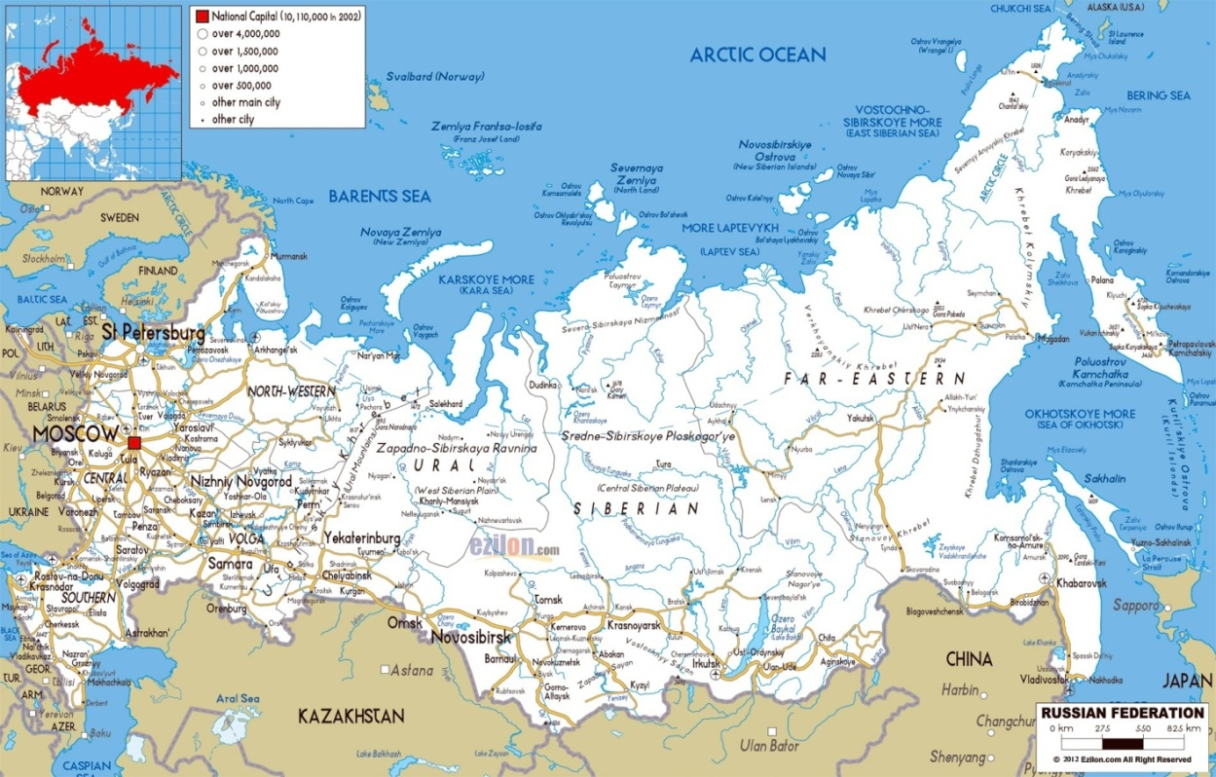
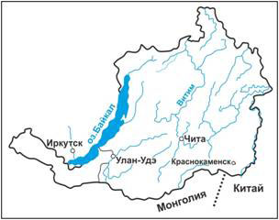
Mineragenic map (Kalashnikov, 2019)
2

Slide 3
Geological map of the Talman area (Asmodyarov, 2015)
3

Slide 4
WorldView-2 composite in natural colors (RGB: R – band 4, G – band 3, B – band 2)
Iron oxides and hydroxides are an important group of minerals for remote sensing due to their similar, pronounced, well-identified absorption bands in the visible and near-infrared regions of the spectrum. This group of minerals includes: hematite, magnetite, goethite, ilmenite, jarosite, and limonite.
The high spectral resolution of WorldView-2 in the VNIR ranges allows you to display detailed spectral characteristics of surface objects: zones of concentration of oxide/hydroxide group minerals containing transition iron ions (Fe²⁺, Fe³+ and Fe3+/Fe2+). The absorption characteristics associated with Fe3+/Fe2+ contain a set from 0.40 to 1.2 μm, which correspond to WorldView-2 VNIR channels 2, 3, 4, 6 and 8. The absorption characteristics associated with Fe3+ are typically 0.49, 0.70 and 0.87 μm, while Fe2+ exhibits absorption properties at 0.51, 0.55 and 1.20 μm.
4

Slide 5
Preprocessing of WorldView-2 data set
1) Radiometric calibration was carried out to convert the digital values ​​(DN) of image pixels to the radiation intensity recorded by the sensor in the upper layers of the atmosphere.
2) The radiance data is then converted to reflectivity by applying the FLAASH atmospheric correction algorithm based on the MODTRAN aerosol atmospheric model.
3) To differentiate vegetation cover and soils, the improved WorldView Vegetation Index (WV-VI) and Normalized Difference Water Index (NDWI) were calculated.
5

Slide 6
False-color composite based on bands ratio method R: (b4 + b2)/b3, G: (b3*b4)/(b2*1000), B: (b6 + b8)/b7
In accordance with the spectral features of the separation of groups of minerals (hematite, magnetite, goethite, ilmenite, jarosite, limonite), iron oxides and hydroxides, WorldView-2 technology is used for VNIR, linking spectral elements (mineralogical indices).
Proposed distribution pattern of hydrothermally altered rocks,
Products of metasomatism and hypergenesis in the promising Talman area
6

Slide 7
Estimated distribution pattern of hydrothermal alterations and hypergenesis products in the study area
7

Slide 8
Conclusions
The results obtained make it possible to identify wallrock alterations, which are the basis for conducting detailed prospecting studies within promising areas.
The proposed methodology makes it possible to correct promising areas at various stages of geological exploration.
8

Slide 9
ACKNOWLEDGMENTS
The authors are grateful to PROXIMA (www.gisproxima.ru) for providing WorldView-2 images.
SOURCE OF FINANCING
The work was carried out within the framework of the state task of IGEM RAS.
9

Slide 10
REFERENCES
Nafigin I.O., Ishmukhametova V.T., Ustinov S.A., Minaev V.A., Petrov V.A. Geological and Mineralogical Mapping Based on Statistical Methods of Remote Sensing Data Processing of Landsat-8: A Case Study in the Southeastern Transbaikalia, Russia //Sustainability 2022, 14(15), 9242; https://doi.org/10.3390/su14159242
Pour A.B., Hashim M., Hong J.K., Park Y. Lithological and alteration mineral mapping in poorly exposed lithologies using Landsat-8 and ASTER satellite data: North-eastern Graham Land, Antarctic Peninsula // Ore Geol. Rev. 2019. 108. 112–133. https://doi.org/10.1016/j.oregeorev.2017.07.018
Pour A.B., Park Y., Crispini L., Laufer A., Kuk Hong J., Park T.-Y.S., Zoheir B., Pradhan B., Muslim A.M., Hossain M.S. et al. Mapping Listvenite Occurrences in the Damage Zones of Northern Victoria Land, Antarctica Using ASTER Satellite Remote Sensing Data // Remote Sens. 2019. 11. 1408. https://doi.org/10.3390/rs11121408
Segal D. Theoretical Basis for Differentiation of Ferric-Iron Bearing Minerals, Using Landsat MSS Data / Proceedings of Symposium for Remote Sensing of Environment, 2nd Thematic Conference on Remote Sensing for Exploratory Geology, Fort Worth, TX (1982). 949–951.
Asmodyarov I.A., Brel A.I., Sinyavin V.I. and others. Exploration and revision work on gold-polymetallic mineralization in the northern part of the Klichinsky gold-polymetallic ore district (Trans-Baikal Territory) for 2012–2014. Object No. 111-27(102-24). Report on State Agreement No. K-01/12-6 dated March 20, 2012. Rosgeolfond No. 515591. M., 2015.
Kalashnikov V.A., Likhanov V.D., Chetverikov M.E. and others. Exploration work for gold-polymetallic mineralization within the Savva-Borzinsky ore cluster (Trans-Baikal Territory). Rosgeolfond No. 536243. M., 2019.
Contacts: Ishmukhametova V.T., IGEM RAS, geoivt@mail.ru
11

