Slide 1
Mapping seagrass meadows and assessing blue carbon stocks using Sentinel-2 satellite imagery: A case study in the Canary Islands, Spain
Jorge Veiras-Yanes ¹*, Laura Martín-García ², Enrique Casas ¹, Manuel Arbelo ¹
1 Departamento de Física, Universidad de La Laguna, 38200 San Cristóbal de La Laguna, Spain.
2 Instituto Español de Oceanografía-CSIC, The Canary Islands, Spain.

Slide 2
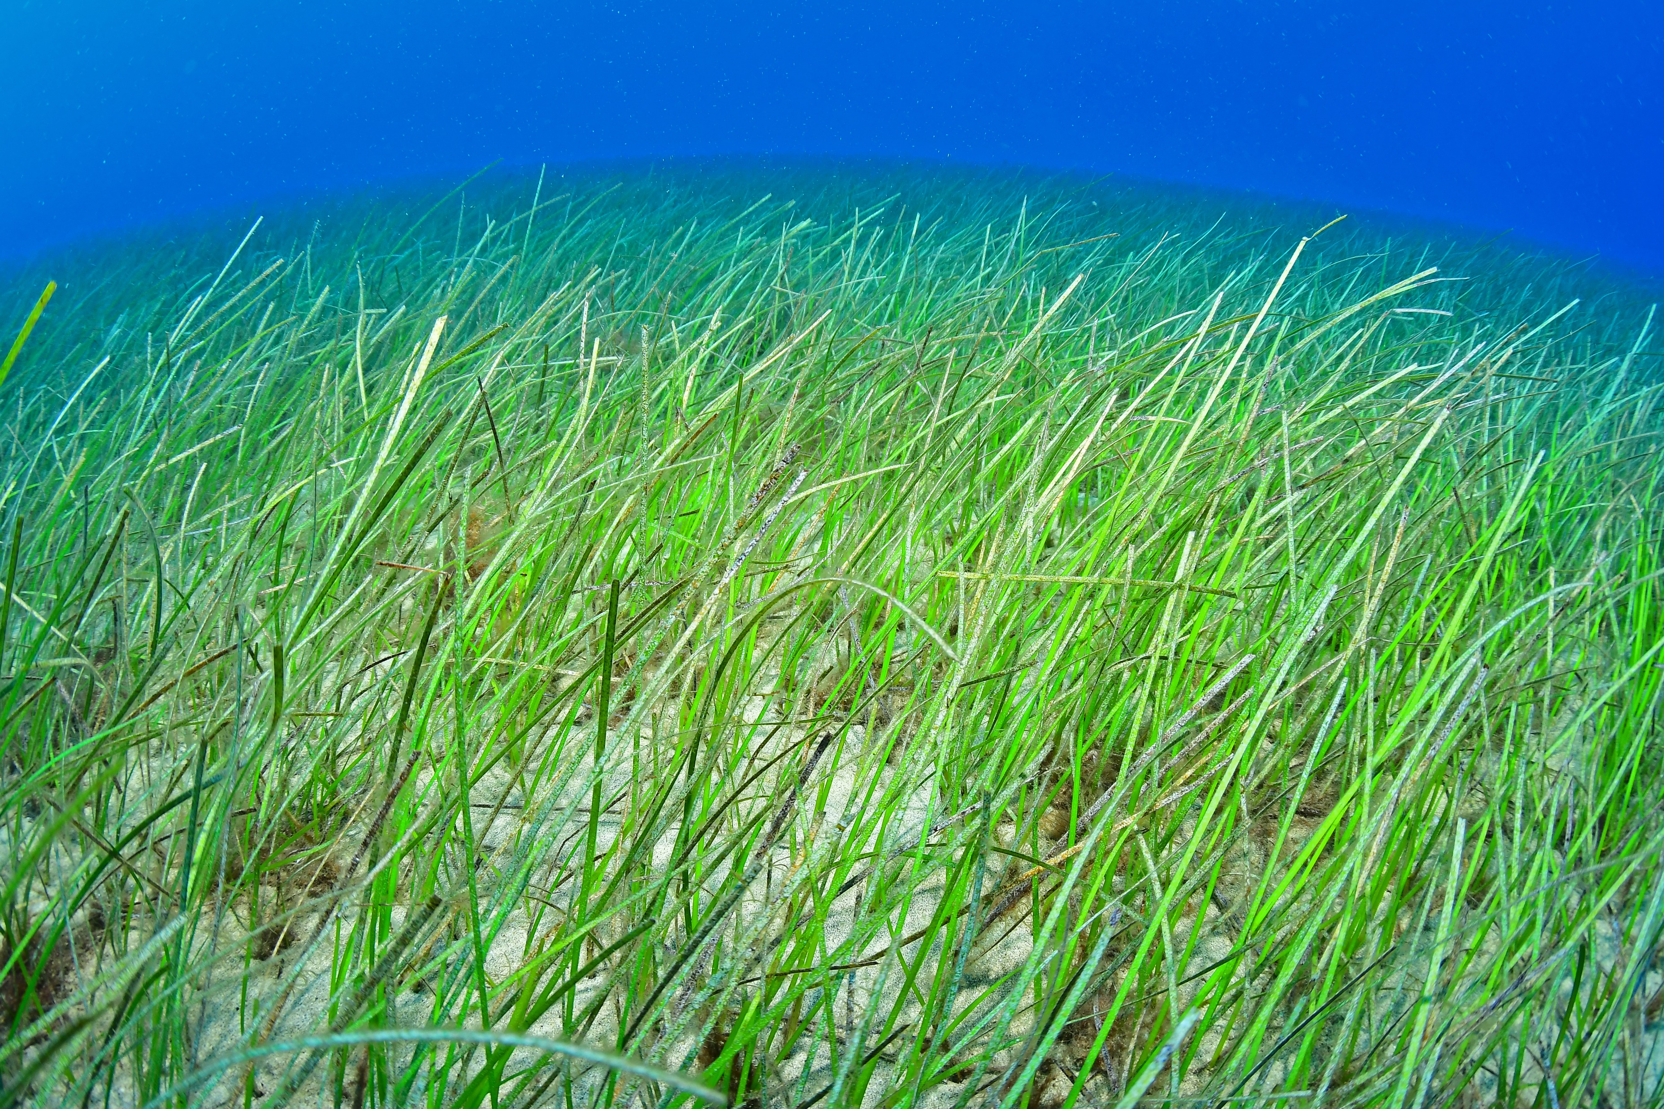
Seagrass Ecosystems: An Overview
Cymodocea nodosa. Extracted from [2]
They capture carbon up to 35 times faster than tropical rainforests. [1]
Objective: evaluate the ability of Sentinel-2 imagery to map seagrass meadows.
In situ monitoring | Remote sensing
Expensive | Potentially free
Time-consuming | Efficient
Limited by extent | Unlimited
[1] Mcleod, E., Chmura, G. L., Bouillon, S., Salm, R., Björk, M., Duarte, C. M., Lovelock, C. E., Schlesinger, W. H., & Silliman, B. R. A blueprint for blue carbon: toward an improved understanding of the role of vegetated coastal habitats in sequestering CO2. Frontiers in Ecology and the Environment 2011, 9, 552-560. https://doi.org/10.1890/110004
[2] Seba (Cymodocea nodosa) – Canal del Área de Tecnología Educativa. (n.d.). https://www3.gobiernodecanarias.org/medusa/mediateca/ecoescuela/?attachment_id=6305

Slide 3
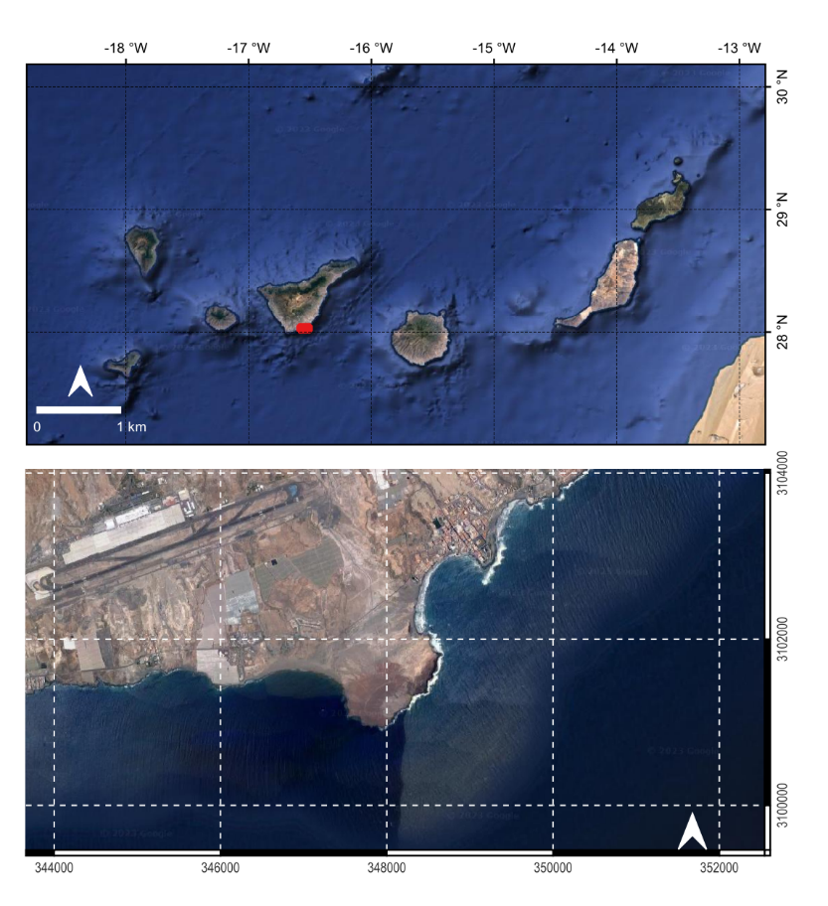
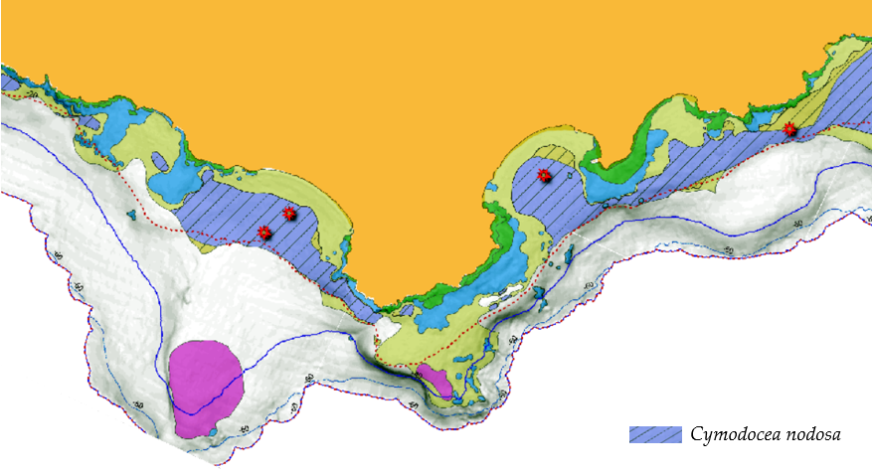
Materials and methods
Field data from 2016. Extracted from [3]
Level-1C image from 27 October 2022.
[3] Monterroso O., Rodríguez M., Pérez O., Ramos E., Álvarez O., Cruces L., Ruiz M., Miguel A., González M. Memoria final del estudio “Cartografía de Cymodocea nodosa en Tenerife y La Gomera”. Viceconsejería de Medio Ambiente del Gobierno de Canarias. Dirección General de Protección de la Naturaleza. Cima -Informe Técnico 2018, 164 pp

Slide 4
Image pre-processing
Atmospheric correction: Sen2Cor
- Aerosol Optical Thickness AUX_CAMSFO
- Water vapour column
- Ozone layer
Land mask: Threshold value of 0.1 in the NIR band (Band 8)
Sunglint correction: Sen2Coral Hedley’s method [4]
Deep water mask: Bathymetry data [3]
European Centre for Medium-Range Weather Forecasts data
AUX_ECMWF
[4] Hedley, J., Harborne, A. R., & Mumby, P. J. Technical note: Simple and robust removal of sun glint for mapping shallow- water benthos. International Journal of Remote Sensing 2005, 26, 2107-2112. https://doi.org/10.1080/01431160500034086

Slide 5
Image pre-processing
Water column correction: Lyzenga’s method [5]
$$DII_{ij}=ln\left(L_{i}\right)−\left[\left(\frac{k_{i}}{k_{j}}\right)ln\left(L_{j}\right)\right]$$
$$\frac{k_{i}}{k_{j}}=a+\sqrt{\left(a^{2}+1\right)}$$
$$a=\frac{σ_{ii}−σ_{jj}}{2σ_{ij}}$$
i refers to a visible band, and j to another visible band (e.g., i=B2 and j=B3)
[5] Lyzenga, D. R. Remote sensing of bottom reflectance and water attenuation parameters in shallow water using aircraft and 187 Landsat data. International Journal of Remote Sensing 1981, 2, 71-82. https://doi.org/10.1080/01431168108948342

Slide 6
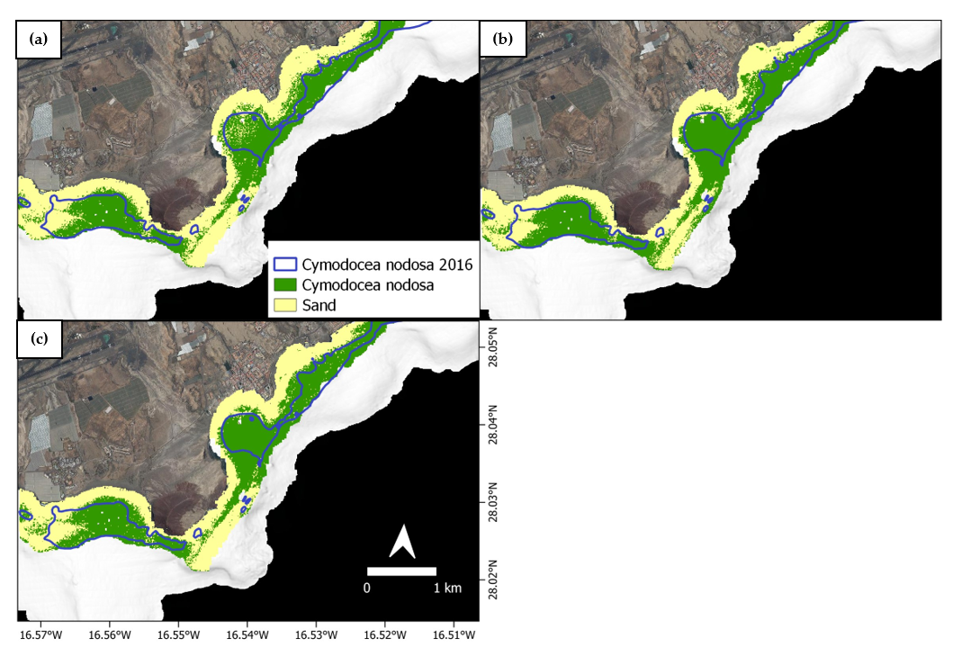
Classification results
(b) 245 ha highest seagrass extent
(c) 230 ha least seagrass extent
F1 scores for RF: 0.96 – 0.99
F1 scores for KNN and KDTree-KNN: 0.84 – 0.96
Classification results for unsupervised and supervised methods. In situ seagrass data is outlined in blue. Classified seagrass areas are shown in green. All other coverings are labeled as “sand” and colored in yellow: (a) Unsupervised classification (K=4), (b) KNN supervised classification (K=5), (c) RF supervised classification (11 trees).

Slide 7
Blue carbon assessment
Average seagrass area extent: 237±5 ha
InVEST Coastal Blue Carbon model
Carbon sequestered in our study area: 111,000±2,000 Mg of CO2
Sector | Mg of CO2 emitted in 2019 | Mg of CO2 emitted in 2020
Energy production and transformation | 5,443,050 | 4,713,440
Industrial combustion plants | 76,430 | 61,690
Not industrial combustion plants | 224,020 | 185,100
Road transport | 3,490,960 | 3,397,980
Other means of transport and machinery | 8,140,270 | 5,494,840
[6] Observatorio de la Energía de Canarias - Emisiones. (s. f.) https://www3.gobiernodecanarias.org/ceic/energia/oecan/esta- 194 disticas-2/emisiones

Slide 8
Conclusion
Valuable pre-processing method for similar studies.
Highlights seagrasses’ key role in regional strategies to achieve net zero carbon emissions.

Slide 9
Thank you for you attention!
Any questions? Contact us at jveiras2001@gmail.com

