Slide 1
Assessing the Impact of Landfills on Surrounding Vegetation: A Remote Sensing Analysis with Sentinel-2 and Landsat 8.
Rajesh Vanguri ¹, Giovanni Laneve ², Enrico Cadau ³, Silvia Scifoni ³ and Martino Luca ³
¹Department of Astronautical, Electric and Energy Engineering (DIAEE), Sapienza University, Rome, Italy; rajesh.vanguri@uniroma1.it ; Tel.: +39 3279847256.
²School of Aerospace Engineering, EOSIA lab, Sapienza University of Rome; giovanni.laneve@uniroma1.it
³Serco Italian Spa; Enrico.Cadau@serco.com, Silvia.Scifoni@serco.com, luca.martino@serco.com

Slide 2
Introduction
Landfill Significance: Landfills play a vital role in global waste disposal due to their cost-effectiveness, but their improper management can lead to significant environmental consequences.
Environmental Concerns: Improperly managed landfills can contaminate water systems, impact vegetation, and compromise air quality, posing substantial public health risks.
Remote Sensing's Role: Remote sensing has emerged as a crucial, non-invasive tool for monitoring landfill impacts on the environment and detecting potential contamination.

Slide 3
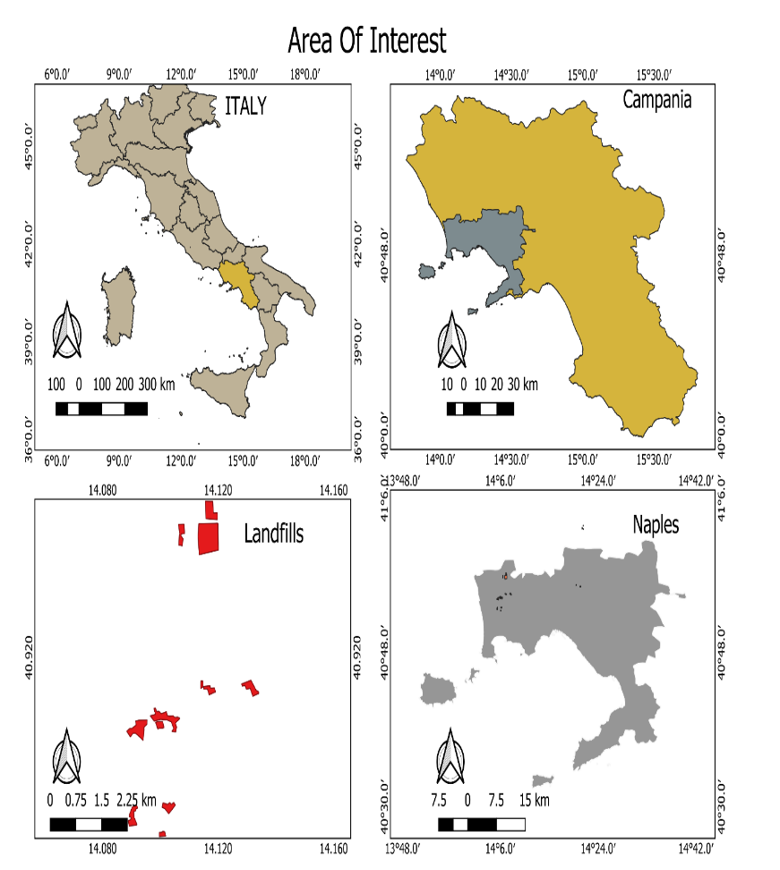
Study area and data used
Study Area Significance:
The study area comprises 17 landfill sites in the province of Naples, Campania, Italy.
Data Fusion for Enhanced Resolution:
Sentinel-2 and Landsat 8 satellite imagery, collected from 2018 to 2022, were processed using the Sen2Like tool.
Figure 1. Landfills in Naples, Campania Region, Italy.

Slide 4
Methodology
Landfill Classification: The landfills in the study area were categorized into two groups.
Zone Division: A multi-buffer ring tool in QGIS was employed, creating three rings spaced at 50 meters intervals, resulting in a 150-meter buffer zone.
Vegetation indexes calculation:
$$NDVI =\frac{NIR−RED}{NIR+RED} GCI=\frac{NIR}{Green} NDWI=\frac{NIR−Green}{NIR+Green}$$
Area of Interest Analysis: For landfills with homogeneous vegetation, we generated three polygons around each site, while for those with heterogeneous vegetation, we generated one polygon with dense vegetation.
Data Analysis and Comparison: Analysis of averaged NDVI, NDWI, and GCI values for each landfill site and its zones, spanning from 2018 to 2022.

Slide 5
Homogeneous vs heterogeneous vegetation.
Figure 2. Zone Division - Homogeneous Vegetation Group Figure 3. Zone Division Heterogeneous Vegetation Group.

Slide 6
Results:
Figure 4. Landfill site with homogeneous vegetation. Figure 5. Landfill site with heterogeneous vegetation.

Slide 7
Analysis with 30-meter buffer zone.
Figure 6. Phenology with 30-Meter Buffer Zone (Target 1) Figure 7. Phenology with 30-Meter Buffer Zone (Target 2)

Slide 8
Discussion:
Impact on Vegetation: The study identified two landfill sites where vegetation exhibited significantly lower NDVI, NDWI, and GCI values, indicating a pronounced impact on nearby vegetation.
Consistency in Index Behaviour: Despite calculating multiple vegetation indices, their behaviour was similar in response to landfill proximity, with NDVI serving as a representative indicator of vegetation health.
Focused Analysis: To gain more insights, a more focused analysis was conducted by reducing the buffer zone size to 30 meters.
Substantial Reduction in Growth: In the affected areas, vegetation near the landfill displayed a substantial reduction in growth, with a 20% and 10% decline compared to areas farther away from the landfill, highlighting the adverse impact.

Slide 9
Conclusion
Identification of Impact: The study identified two landfill sites with a significant impact on surrounding vegetation, demonstrated by lower NDVI values near sites.
Significance of Study: Our research underscores the critical link between landfills and vegetation, emphasizing serious environmental concerns.
Importance of Effective Management: Effective landfill management is vital to safeguard the environment and local ecosystems, as highlighted by our findings.
Future Work: Our ongoing work focuses on developing an algorithm for continuous monitoring, enabling real-time environmental assessments for sustainable landfill management. And to use PRISMA hyperspectral images for further analysis

