Slide 1
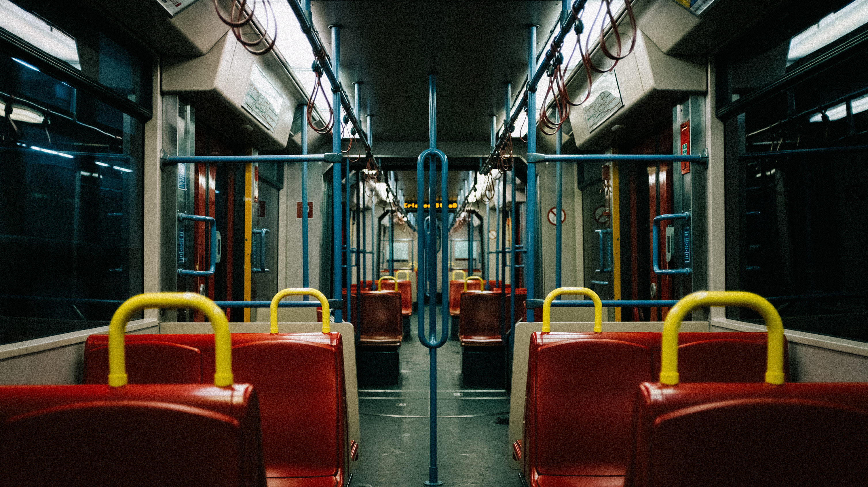
Analysis of Mode Reliability Factors among Off-campus Students using Structural Equation Modelling in Dhaka City
Authors
Md. Mushtaque Tahmid
Fuad Al Mahmud
Oyshee Chowdhury
Dr. Md Asif Raihan
Department of Civil Engineering
Bangladesh University of Engineering and Technology, Dhaka, Bangladesh

Slide 2

Agenda
01
Introduction
02
Objectives
03
Data Collection & Data Analysis
04
Key Findings
05
Policy Implications
Notes:
https://pixabay.com/en/open-book-library-education-read-1428428/

Slide 3

Introduction

Slide 4
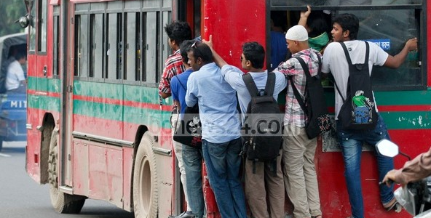
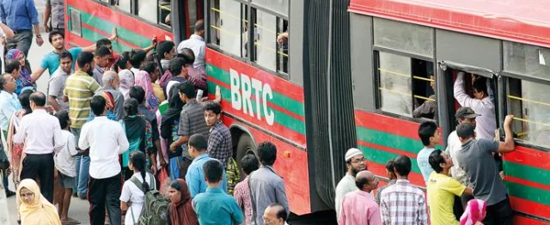
Institutional Bus Service
in Dhaka
Public Bus Service
in Dhaka

Slide 5
Introduction
Determining the mode choice for movement in developing cities like Dhaka is beset with multifaceted challenges and intricacies, rendering it an arduous undertaking.
Determining barriers to selection of sustainable transportation mode in Dhaka among students demand research and extensive analysis.
To improve reliability of sustainable transportation among students and ensure low carbon emissions in developing country like Bangladesh, implementing proper policy implications from findings of questionnaire survey and analysis are urgent.

Slide 6

Objectives

Slide 7

Objectives
Examining users' perceptions of preferred mode choice
Identifying public and institutional bus Reliability
SEM analysis to compare public and institutional transportation services for off-campus students of one of the renowned university
Identifying the Reliability variables
Policy implications, focusing on a developing country like Bangladesh
Providing insight about efficient urban planning, with a target of sustainability.

Slide 8

Data
Collection & Analysis

Slide 9

Data Collection and Demographic of Respondent’s
    Offline questionnaire survey
    1664 sets of data (After filtering and eliminating anomalies)
    Socio-demographic data on age, gender, payment method, and arrival time were amalgamated
    Male participants: 68.4% and female participants: 31.6%
    Higher participation and representation of male students of Engineering universities
    Representative sample size of ground reality

Slide 10

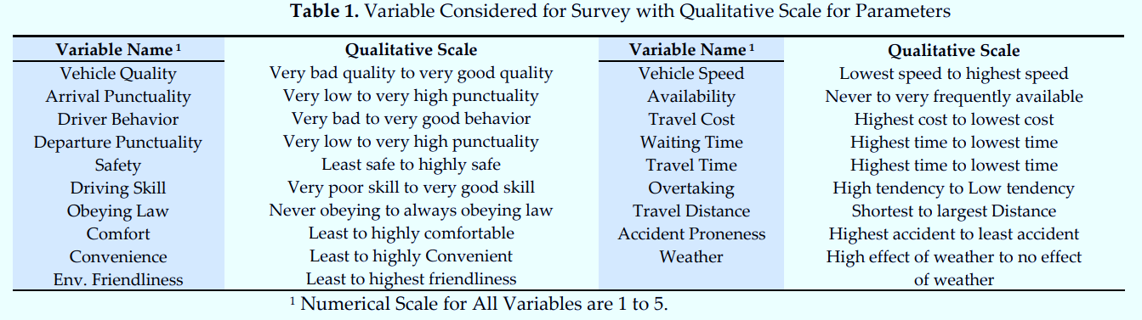
Reliability Variables

Slide 11

Structural Equation Modelling (SEM) [Software: SPSS and STATA 13]
Confirmatory Factor Analysis
(Reduce observed variables into a set of underlying factors)
1
Path Analysis
(Path diagram and coefficient identification)
2
Model Interpretation
(Identifying the most impactful latent attributes)
3

Slide 12

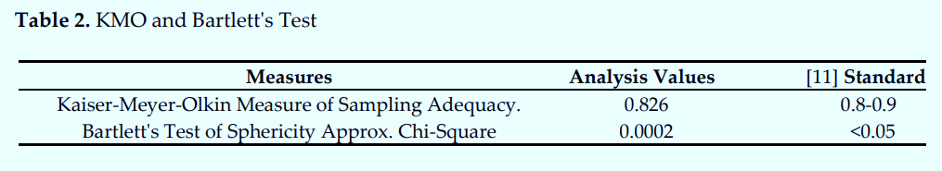
Factor Analysis
  Two factors were extracted
  45.983% of the variation could be explained
  two latent attributes:
            Overall Transportation Experience
            Travel Hassle

Slide 13
SEM Model: Reliability of Public Bus

Slide 14
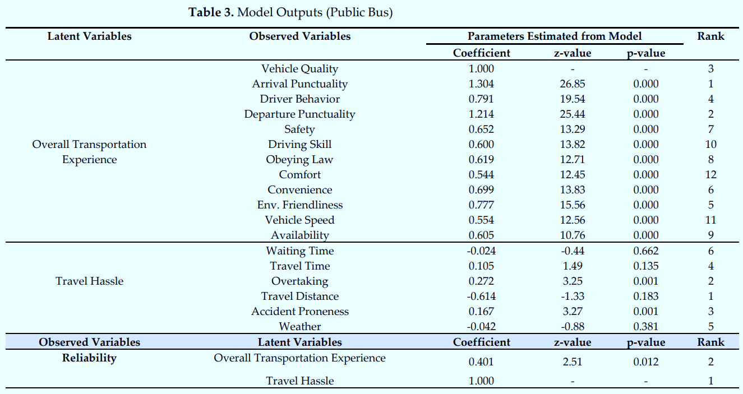
Model Outputs (Public Bus)

Slide 15
SEM Model: Reliability of Institutional Bus

Slide 16
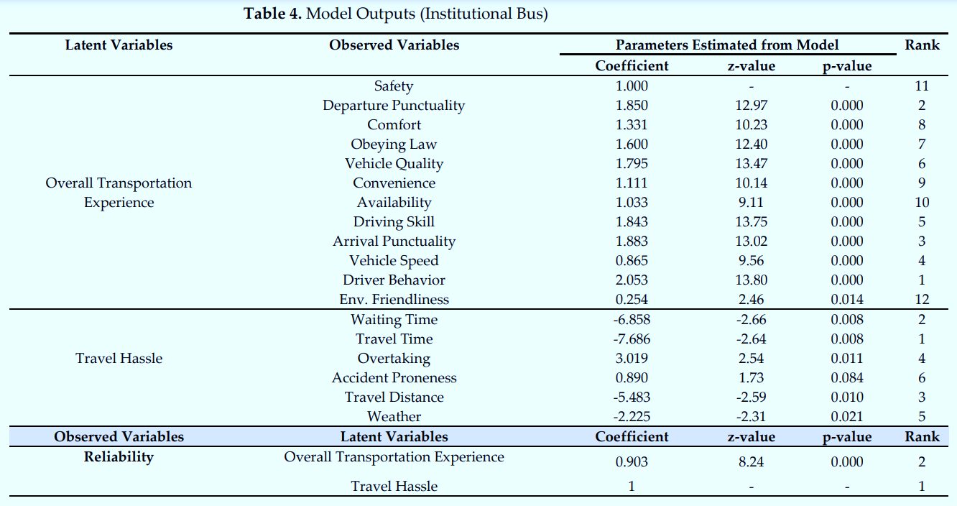
Model Outputs (Institutional Bus)

Slide 17


Slide 18
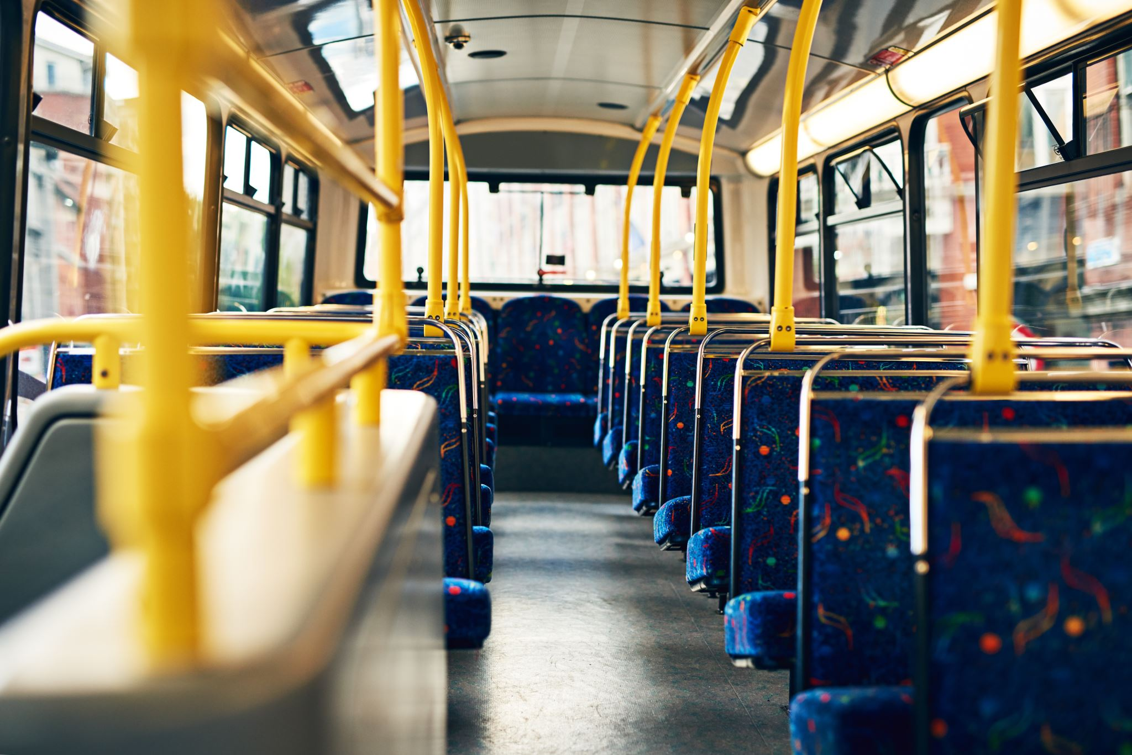
Model Interpretation and Key Findings
  Insignificant Precursors
      For Public Bus
          waiting time (p=0.662)
          travel time (p=0.135)
          travel distance (p=0.183)
          weather (p=0.381)
      For Institutional bus
          accident proneness (p=0.084)
  ‘Travel Hassle’ impacts Reliability more than ‘Transportation Experience’

Slide 19
Model Interpretation and Key Findings
  Striking Factors
      For ‘Public Bus’
          Overtaking
          accident proneness
          Arrival punctuality
          Departure punctuality
          vehicle quality
      For ‘Institutional Bus’
          driver behavior
          departure punctuality
          Arrival punctuality

Slide 20
Model Interpretation and Key Findings
  Negative Influence on Reliability
      For ‘Institutional Bus’
          waiting time
          travel time
          travel distance
  Vehicle quality - Mid-ranked influencing factor of reliability.
  Lesser Influence - safety, availability (ensured by university)
  Lesser environmental concern from administration in public bus services
  More expectation of vehicle speed, driving skill, comfort in institutional bus services

Slide 21
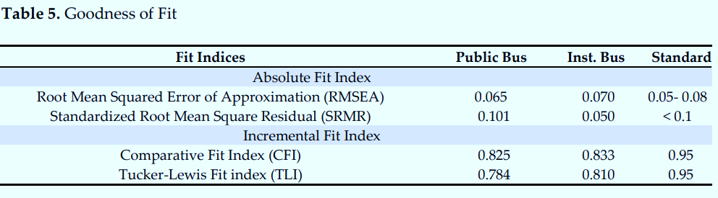
Model Fit

Slide 22

Policy Implications

Slide 23

Policy Implications
  Prioritizing factors such as:
        Optimizing routes
        Improving the efficiency of boarding and alighting
        Minimizing travel time and distance in public services and
        Effectively managing driver behavior and attitude.
  Developing efficient and well-planned routes
  Implementing measures to streamline boarding and disembarking
  Introducing dedicated lanes for public transportation
  Minimizing unnecessary detours and distances
  Enforcing strict training, monitoring protocols for drivers

Slide 24



Thank you

