Slide 1
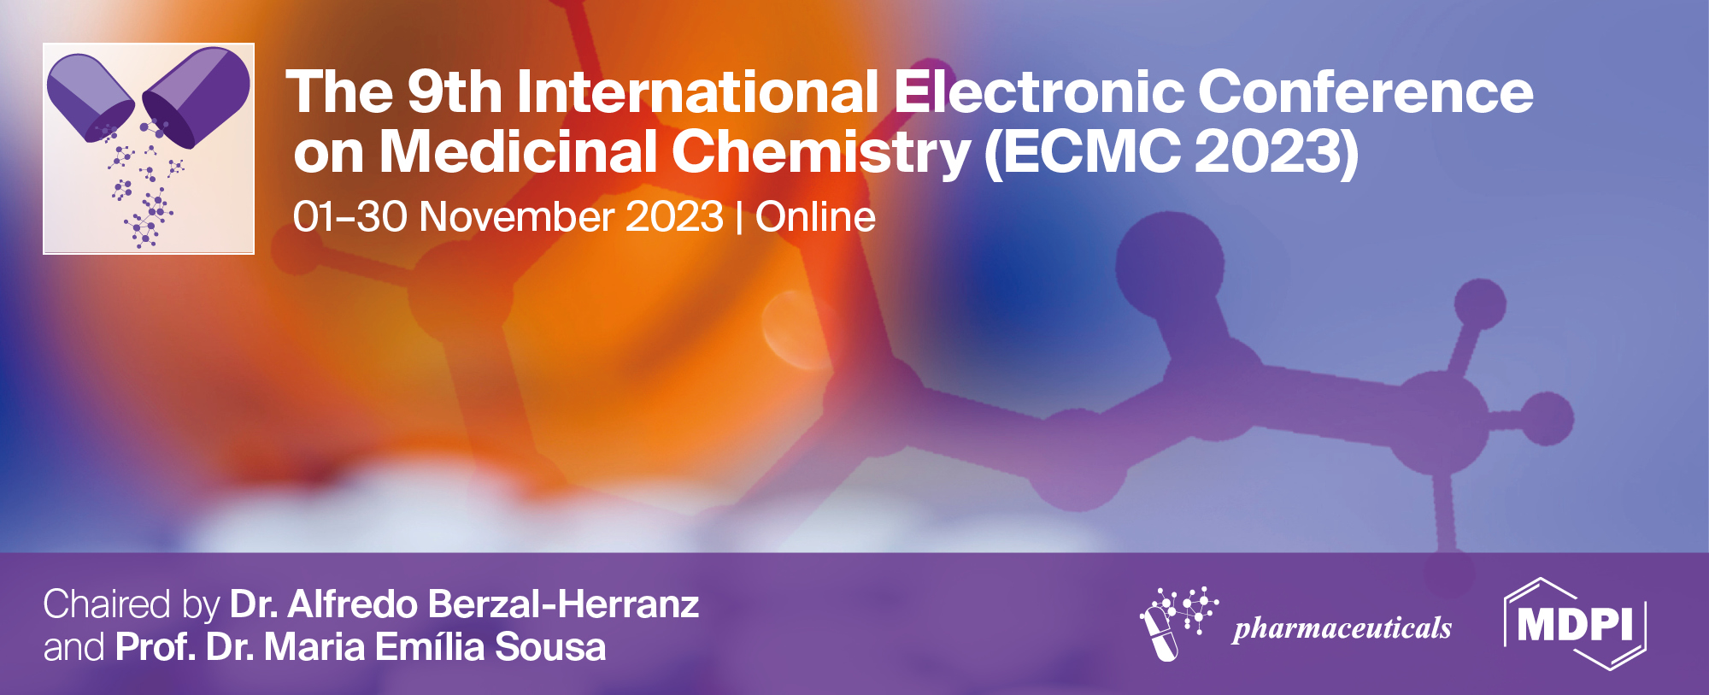




Chitosan Nanocapsules loaded with
Aloe-Emodin for Cancer Treatment
Anastasia Fornari ^{1,2*}, Marco Rossi ¹, Leonardo Mattiello ¹, Fabiana Pandolfi ¹,
Federico Purificato ³, Daniela De Vita ⁴, Marisa Colone ⁵, Annarita Stringaro ⁵
¹ Department of Basic and Applied Sciences for Engineering, Sapienza University of Rome, Via Antonio Scarpa 16, 00161 Rome, Italy
² Nanoshare S.r.l., Via Foscolo 24, 00185 Rome, Italy
³ Scuola Normale Superiore di Pisa, Nanoscience, Fondazione Istituto Italiano di Tecnologia, Via Piazza dei Cavalieri, 7, 56126 Pisa, Italy
⁴ Department of Environmental Biology, Sapienza University of Rome, P.le A. Moro 5, 00185 Rome, Italy
⁵ National Center for Drug Research and Evaluation, Italian National Institute of Health (ISS), Viale Regina Elena, 299, 00161 Rome, Italy
* Corresponding author: anastasia.fornari@uniroma1.it

Slide 2

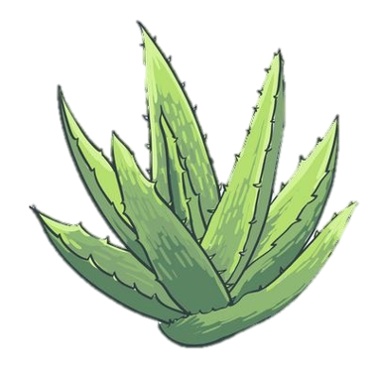
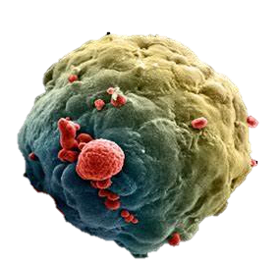

Chitosan Nanocapsules loaded with Aloe-Emodin for Cancer Treatment
Extraction
Test in vitro
Aloe vera L.
Human adenocarcinoma breast line
(MDA-MB-231)
Synthesis and characterization of chitosan nanocapsules

Slide 3
Abstract:
Millions of deaths are caused every year by cancer, which is one of the most widespread diseases in the world. New innovative therapies have been developed by nanomedicine in recent years to address this issue, specifically using drug delivery methods and approaches. Among the many materials used to create nanocarriers, biopolymers like chitosan are widely utilized. The aim of this work is to describe the synthesis of chitosan nanocapsules (NCs) and the encapsulation of anticancer compounds. Two substances have been chosen: doxorubicin (DOX), a drug largely employed in the treatment of cancer for decades, and aloe-emodin (AE), an anthraquinone isolated from the plant of Aloe vera L., that has been shown to have a strong anti-carcinogenic effect. The commercially available A.vera latex was used to extract AE. The obtained Dox-loaded and AE-loaded chitosan NCs were characterized by Scanning Electron Microscopy (SEM), Atomic Force Microscopy (AFM), and Dynamic Light Scattering (DLS). Moreover, UV-vis spectroscopy was used to analyze the encapsulation efficiency of these nanomaterials. Finally, cytotoxicity and in vitro release studies of active agents have been conducted on the cell line of human adenocarcinoma breast MDA-MB-231. The results obtained showed that doxorubicin and aloe-emodin were released gradually from NCs over time and with a dose-dependent effect, resulting in a significant reduction in cellular viability. Moreover, immunofluorescence observations have revealed the uptake of DOX-NCs and AE-NCs in MDA-MB-231 cells and their localization both in the cytoplasm and in the nuclear region.
Keywords: Aloe-emodin; Doxorubicin; drug delivery; nanomaterials; anti-cancer.

Slide 4
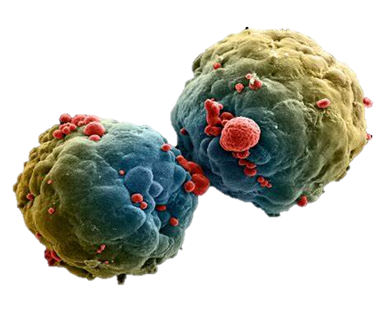

Nanomedicine for cancer treatment
Co-delivery of multiple drugs
Improved drug-circulation times
Reduced off-target toxicity
Stimulus-triggered drug release
Lower dose of drug
Drug Delivery advantages:
Cancer cells

Slide 5
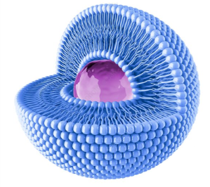
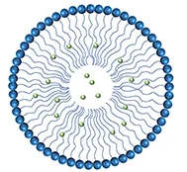
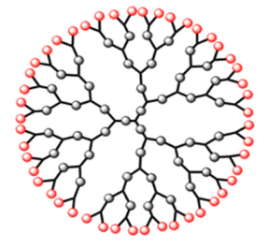
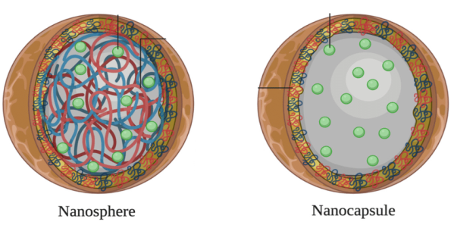
Nanocarriers for cancer therapy
High Biodegradability
Minimize side effects
Ability to encapsulate hydrophilic agents
High Biocompatibility
Specific ligand-link
High surface area to volume ratio
Liposome
Micelle
Dendrimer
Nanocapsule
Nanosphere

Slide 6
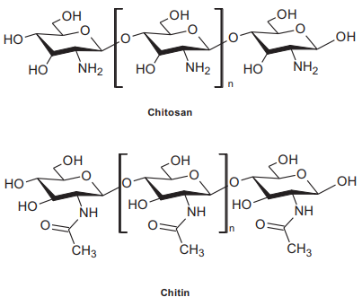

Chitosan
Obtained by partial alkaline deacetylation of chitin.
Natural occurring polysaccharide composed by:
  N-acetyl-D-glucosamine
  D-Glucosamine
Biodegradable
Biocompatible
Non-toxic
Antimicrobial properties
Degree of deacetylation and molecular weight of chitosan are two factors that influence the rate of degradation.

Slide 7
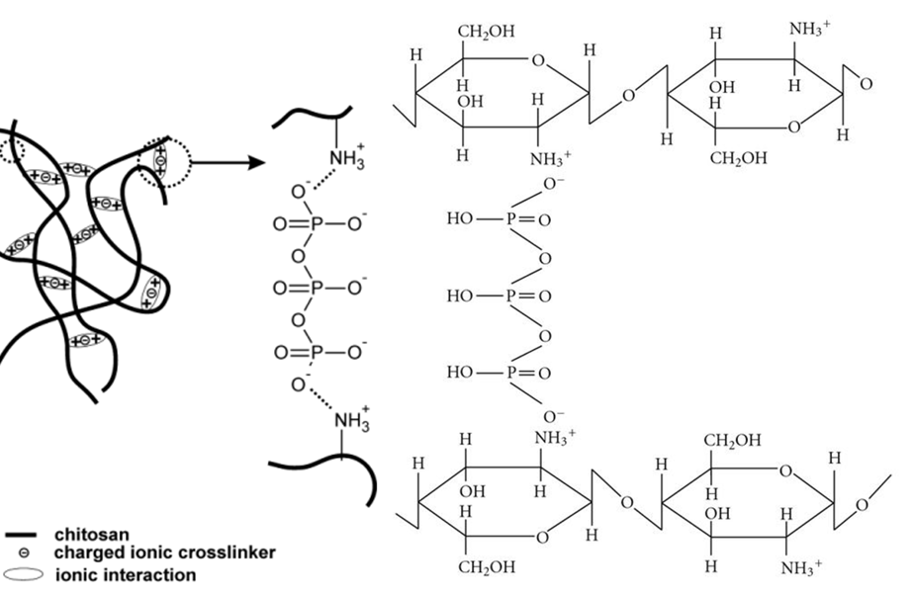
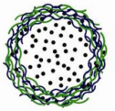

Chitosan nanocapsules (NCs)
Prepared according to Ionotropic Gelation method, based on the electrostatic interaction between anionic phosphate groups of sodium tripolyphosphate (TPP) and cationic amino groups of the chitosan chain.
Chitosan
TPP
Active agent

Slide 8
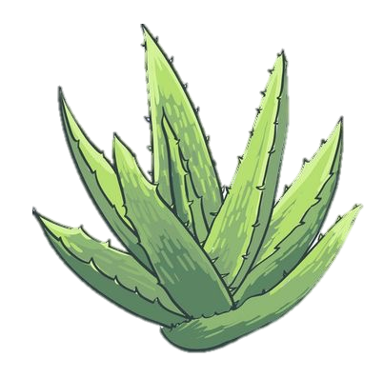


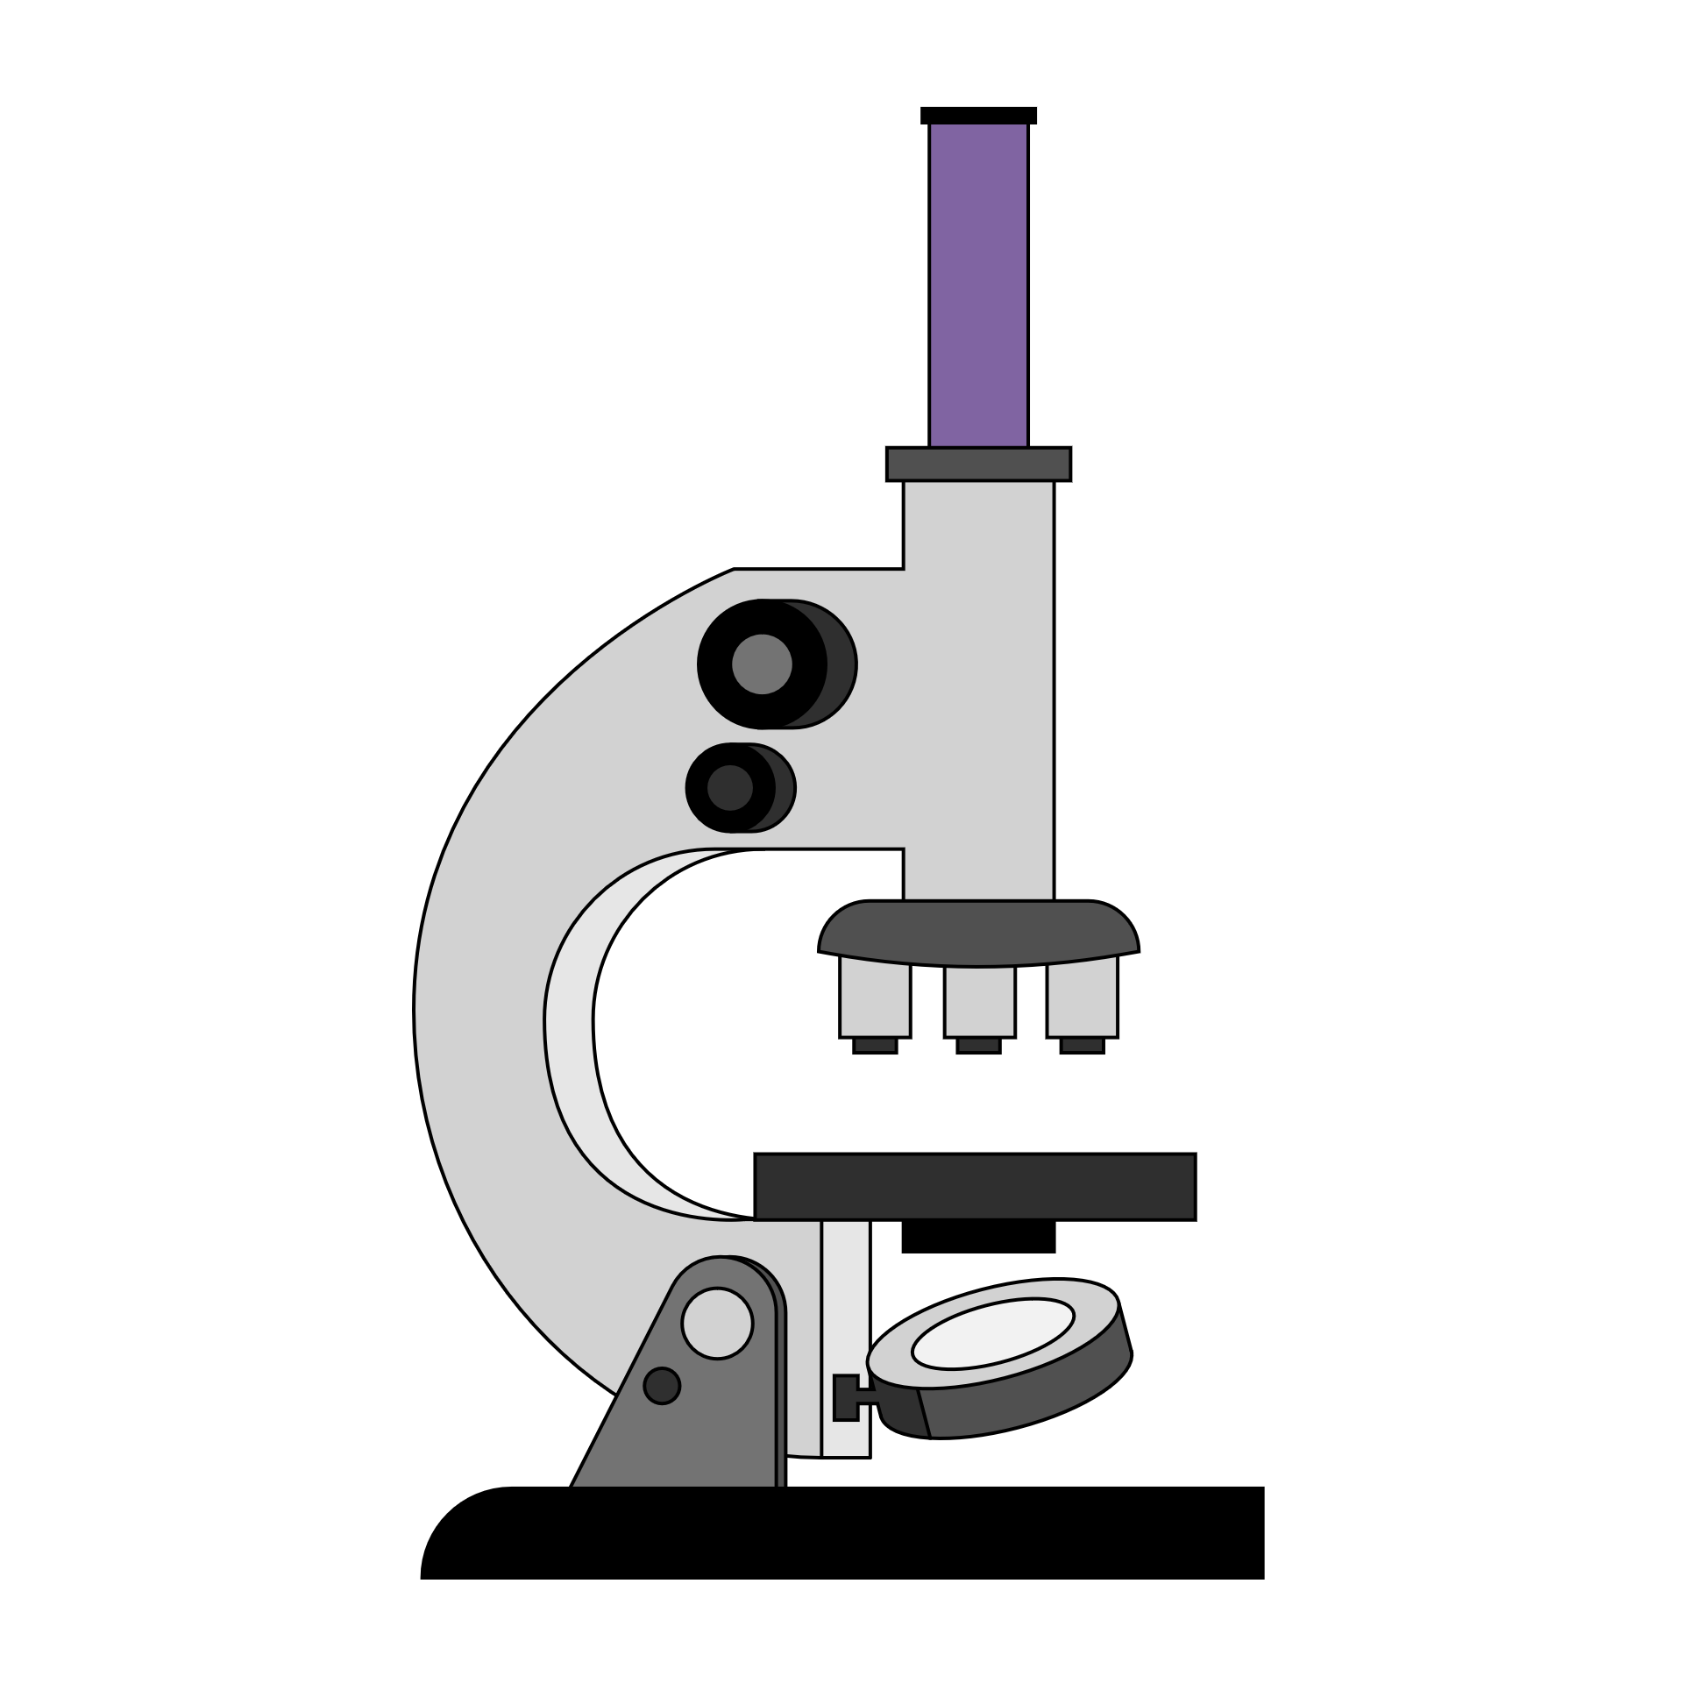
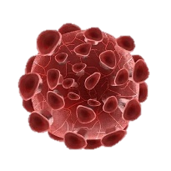
Research Project
Extraction of Aloe-Emodin from natural sources e.g., latex of Aloe vera L.
Synthesis of chitosan NCs (empty, AE-loaded, DOX-loaded).
Characterization of chitosan NCs.
Cytotoxicity evaluation of NCs on human cancer cells.

Slide 9
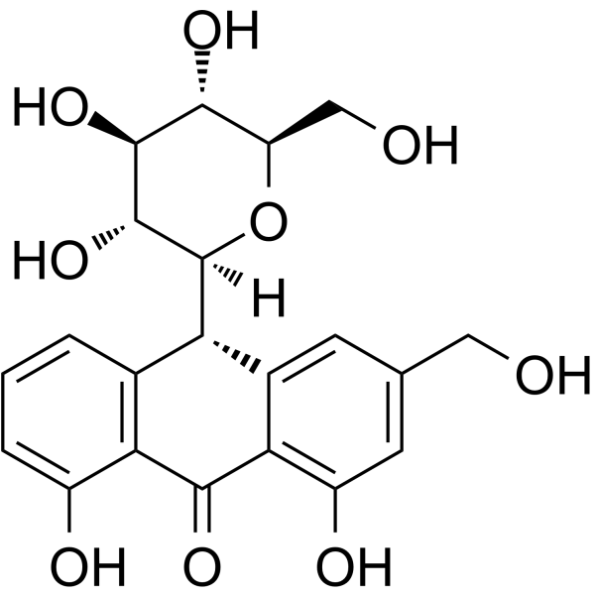
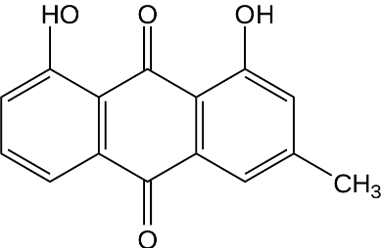
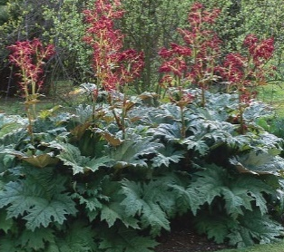
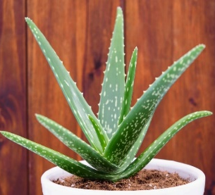
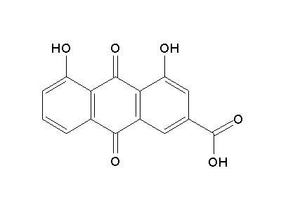
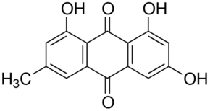
Aloe-Emodin Extraction
Anthranoids
Chrysophanol
Aloin
R. palmatum
A. vera
Aloe-Emodin (AE)
In vitro antineoplastic activity on different cancer cell lines;
Anti-inflammatory agent;
Poor solubility in aqueous environment.
Rhein
Emodin

Slide 10
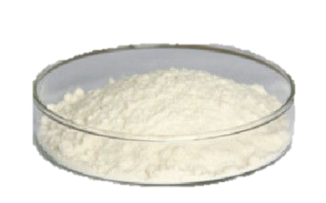
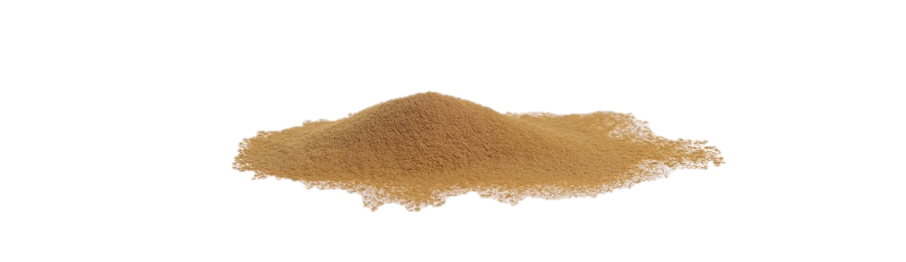
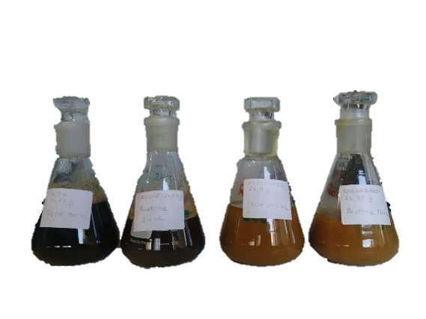
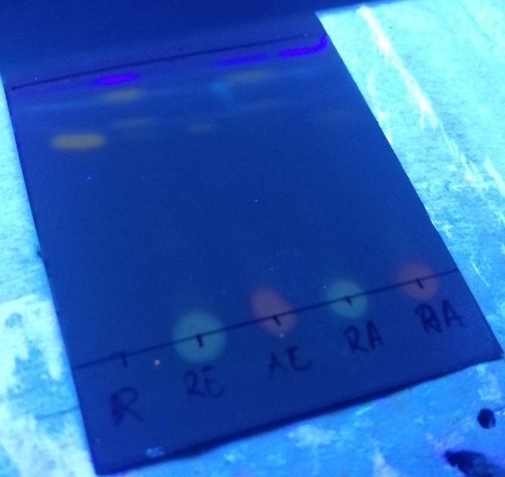



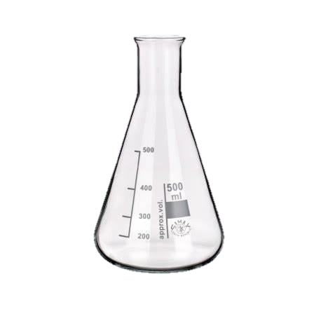

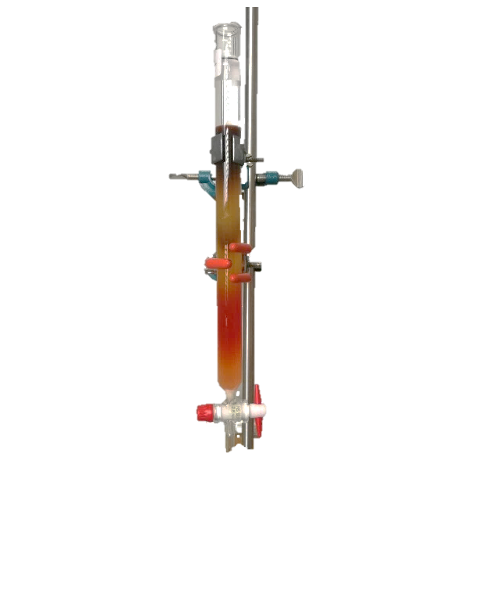
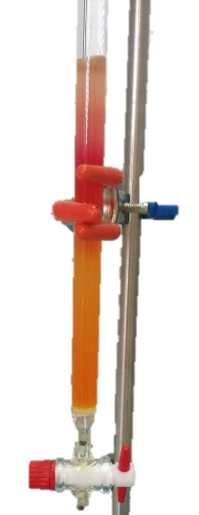
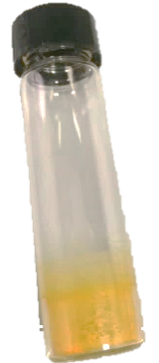
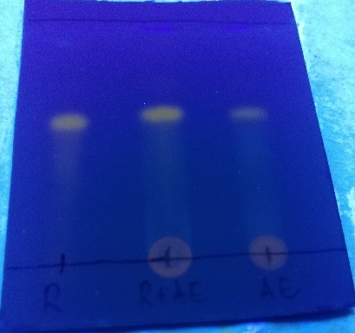
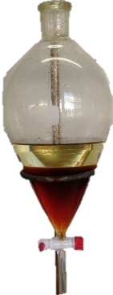
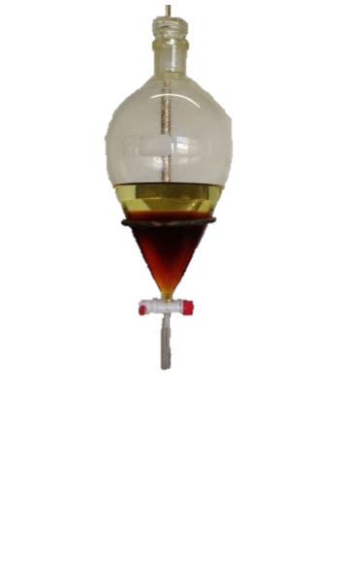
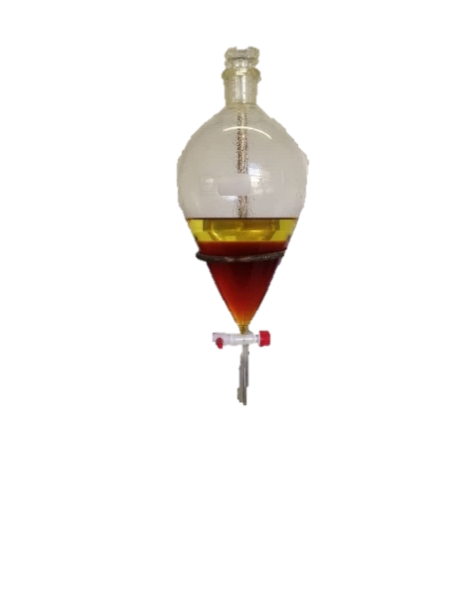
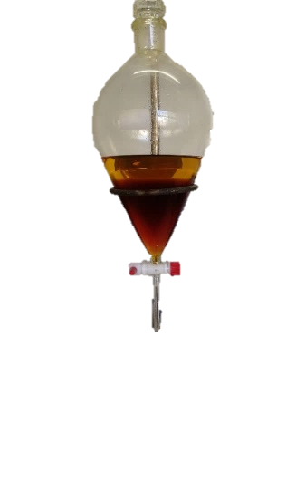
Aloe-Emodin Maceration Extraction procedure
A. vera
R. palmatum
A. vera
R. palmatum
200 mL
Ethanol
150 mL
Acetone
200 mL
Ethanol
150 mL
Acetone
Dynamic Maceration
TLC - macerated
Aloe-Emodin
Column Chromatography
TLC - organic phase
Liquid-Liquid Extraction

Slide 11
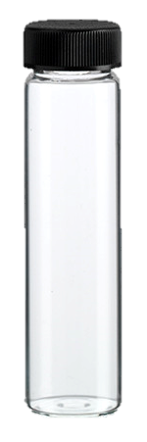
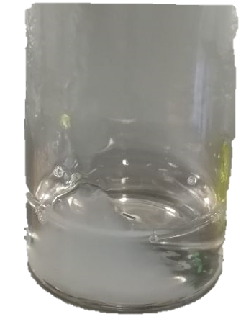
Synthesis – empty chitosan NCs
Chitosan Oligomer 0.2% w/v
30 min
stirring
60 min
stirring
6000 rpm
15 min
centrifugate
DI water
Acetic acid glacial 0.1% w/v
Empty NCs
0.33% w/v
TPP in DI water (dropwise)
Ilk, S. et al., "Chitosan nanoparticles enhances the anti-quorum sensing activity of kaempferol", International Journal of Biological Macromolecules, vol. 94, pp. 653-662, 2017.
Fan, W. et al., "Formation mechanism of monodisperse, low molecular weight chitosan nanoparticles by ionic gelation technique", Colloids and Surfaces B: Biointerfaces, vol. 90, pp. 21-27, 2011.

Slide 12
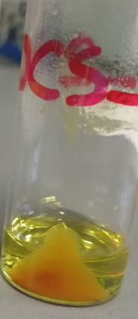
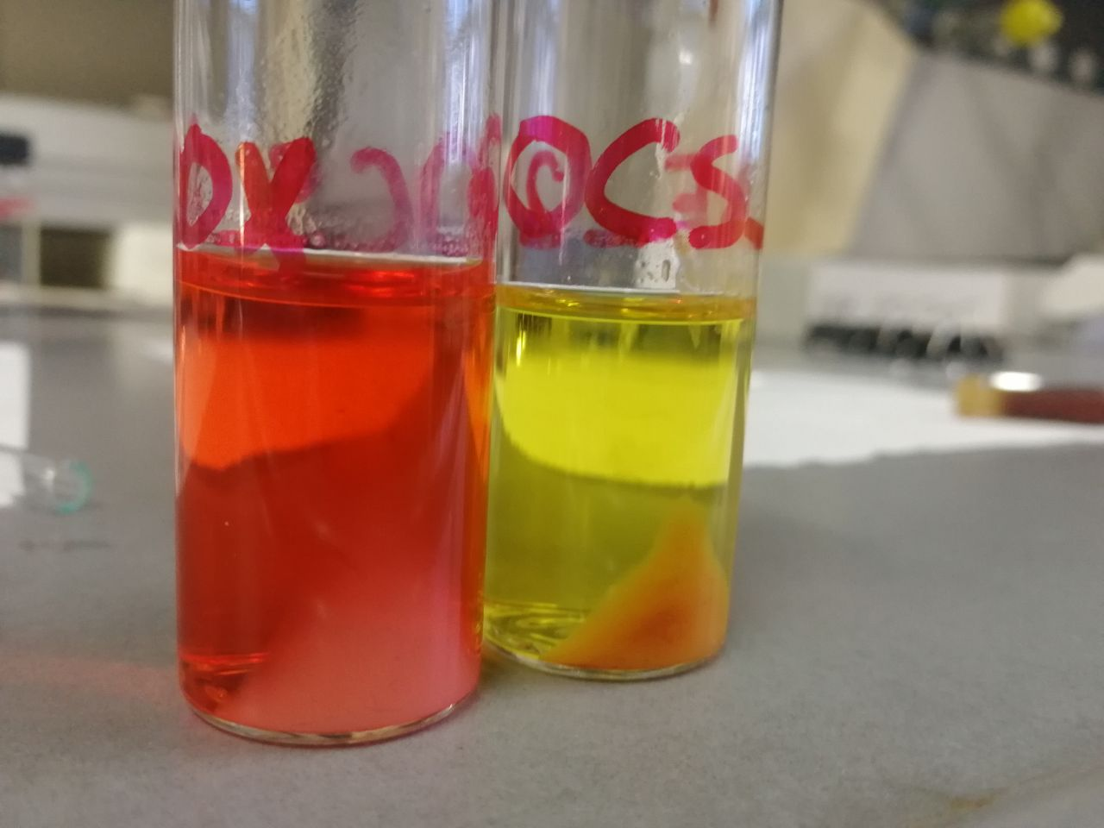
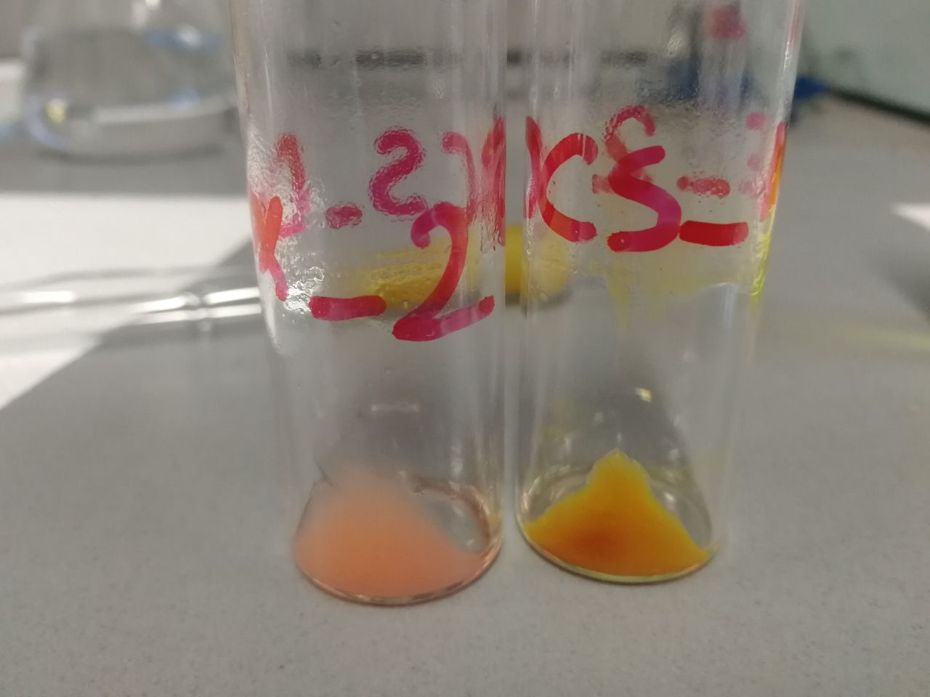
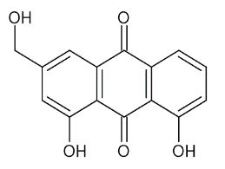



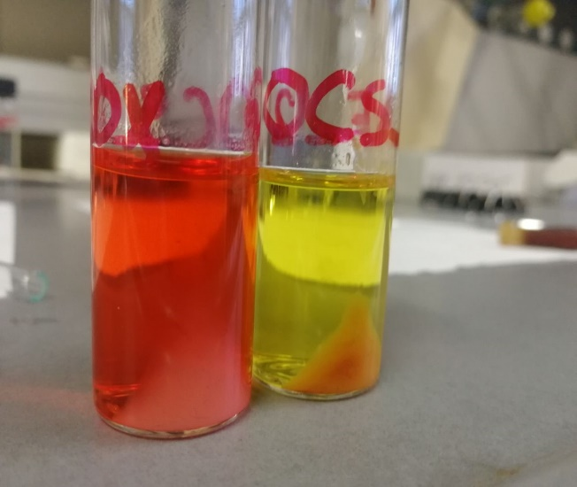

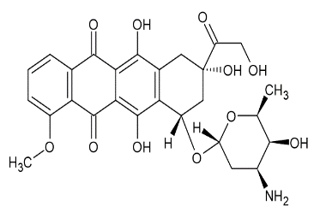


Synthesis – AE/DOX-loaded chitosan NCs
AE-loaded NCs
$$Aloe−Emodin$$
DOX-loaded NCs
$$Doxorubicin$$

Slide 13
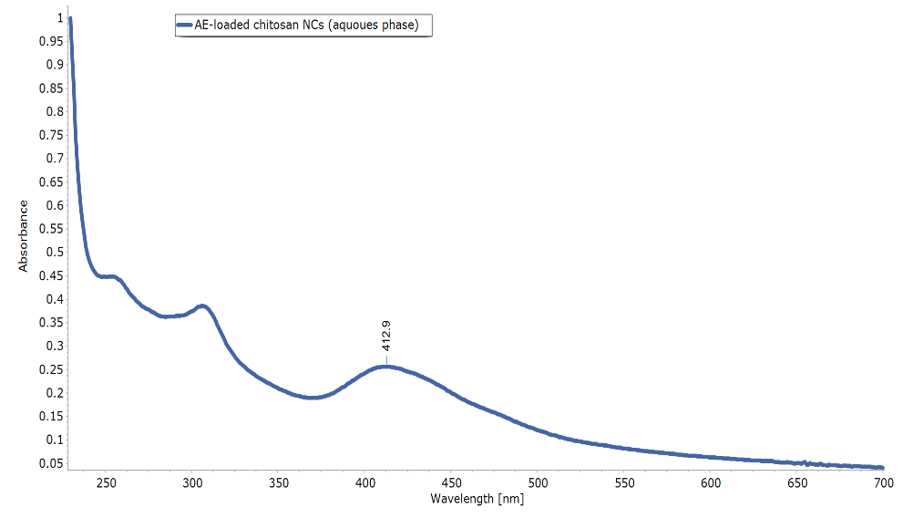
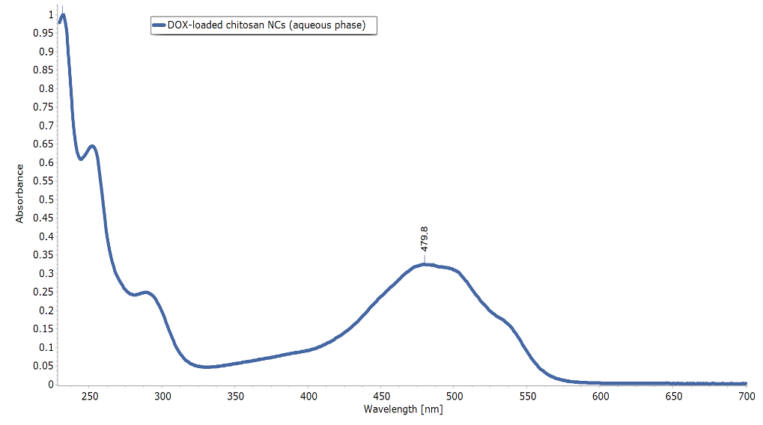

UV/Vis Spectroscopy - Encapsulation Efficiency (EE)
$$EE \left(\%\right)=\left(\frac{Total drug−Unencapsulated drug}{Total drug}\right)x 100$$
98%
93%
Aloe-Emodin
Doxorubicin

Slide 14
Characterization – Scanning Electron Microscopy (SEM)
SEM micrographs of empty chitosan NCs

Slide 15
Characterization (SEM) – AE-loaded NCs
SEM micrographs of AE-loaded chitosan NCs

Slide 16
Characterization (SEM) – DOX-loaded NCs
SEM micrographs of DOX-loaded chitosan NCs

Slide 17
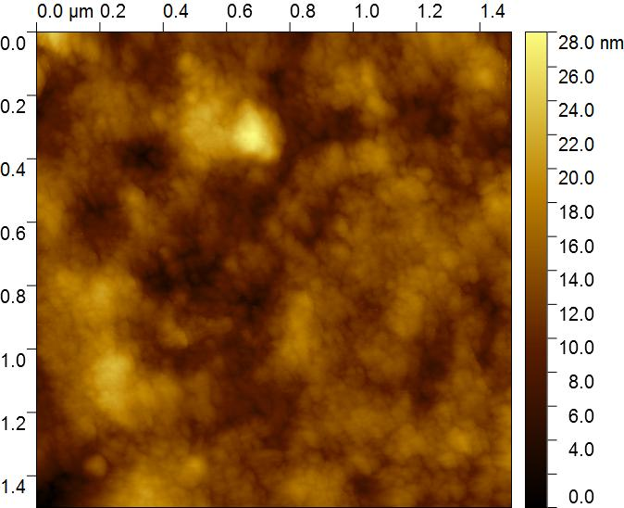
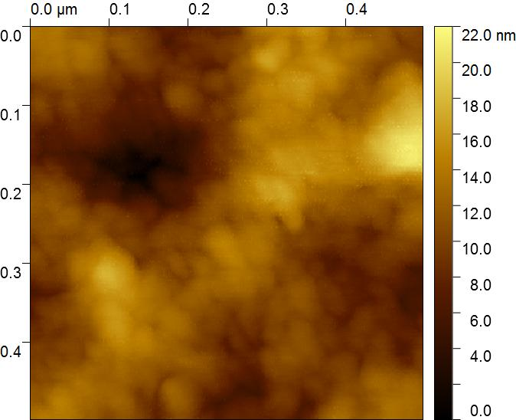
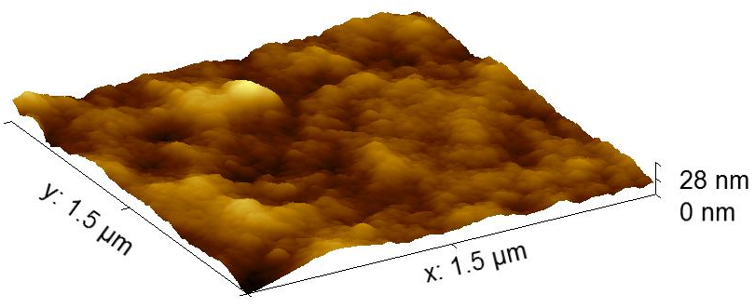
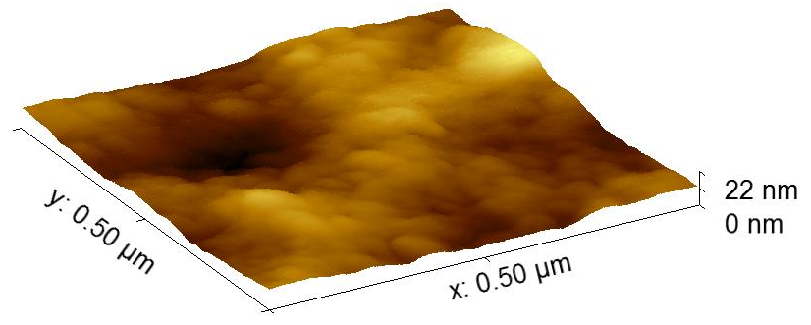
Characterization – Atomic Force Microscopy (AFM)
2D- and 3D-section of empty chitosan NCs

Slide 18
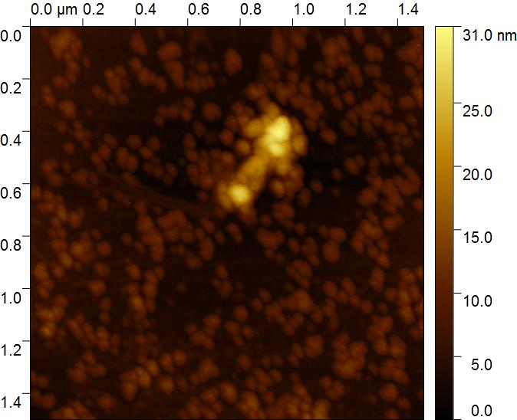
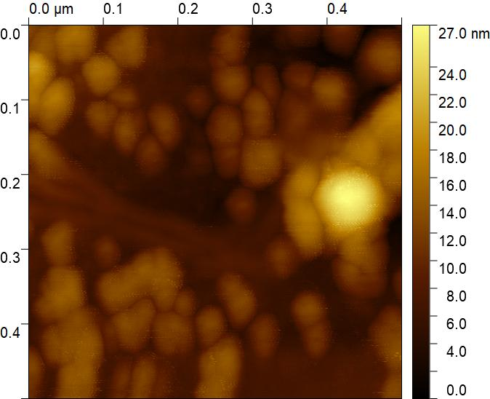
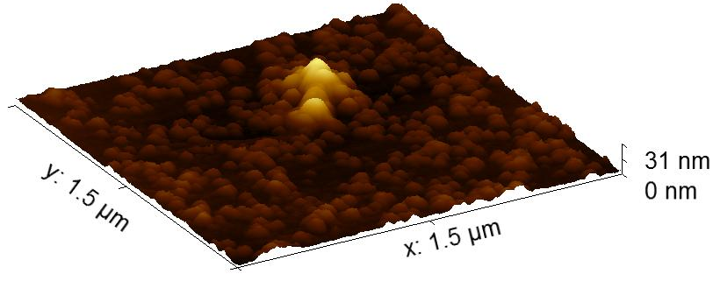

Characterization (AFM) – AE-loaded NCs
2D- and 3D-section of AE-loaded chitosan NCs

Slide 19




Characterization (AFM) – DOX-loaded NCs
2D- and 3D-section of DOX-loaded chitosan NCs

Slide 20
Characterization – Dynamic Light Scattering (DLS)
Size Distribution
(by Intensity)
R2
DLS of empty chitosan NCS
R1
ζ potential
Sample | Mean particle size R1 (nm) | Mean particle size R2 (nm) | ζ potential (mV)
Empty NCs | 80 ± 6 | 455 ± 3 | 48.5 ± 0.5

Slide 21
Characterization (DLS) – AE-loaded NCs
Size Distribution
(by Intensity)
R2
R1
ζ potential
-- AE-NCs -- empty
Size Distribution
(by Number)
Sample | Mean particle size R1 (nm) | Mean particle size R2 (nm) | ζ potential (mV)
AE-loaded NCs | 70 ± 10 | 307 ± 14 | 40 ± 0.5
-- AE-NCs -- empty

Slide 22
Characterization (DLS) – DOX-loaded NCs
Size Distribution
(by Intensity)
R2
R1
ζ potential
-- empty -- DOX-NCs
Size Distribution
(by Number)
-- empty -- DOX-NCs
Sample | Mean particle size R1 (nm) | Mean particle size R2 (nm) | ζ potential (mV)
DOX-loaded NCs | 122 ± 15 | 365 ± 20 | 49 ± 1

Slide 23




Cytotoxicity evaluation
The MTT, or 3-(4,5-dimethylthiazolyl-2)-2,5-diphenyltetrazolium bromide, assay is a sensitive, quantitative, and rapid assessment of cancer cell proliferation, cancer cell viability or the effect of potential drug.
The cell line used to conduct the cytotoxicity tests is the human adenocarcinoma breast cancer cell line MDA-MB-231.
Mitochondrial reductase
MTT
Tetrazolium Salt
Formazan
Formazan
If the viability of the cells is less than 60%, the compound under test is considered toxic.

Slide 24
MTT assay
The activities of NCs were tested after 24h, 48h, and 72h from treatment.
48h
% Cell Viability
48h after treatment, free DOX and free AE efficacies are higher, while DOX- and AE-loaded NCs probably start to release their cargo, inducing a decrease in cell viability.

Slide 25
MTT assay
72h
% Cell Viability
These results indicate a time-dependent and dose-dependent behavior of encapsulated DOX and AE, and the increased effectiveness of DOX over AE.

Slide 26

Immunofluorescence Microscopy
Nuclei
stained with Hoechst (Blue)
Actin filaments
Stained with FITC (Green)
Nuclei
stained with Hoechst (Blue)
Actin filaments
Stained with TRITC (Red)

Slide 27

Conclusions
Simple, quick and economical
extraction procedure of the Aloe-Emodin.
Synthesized nanocapsules with diameters ranging from 30 nm to 90 nm.
Amount of encapsulated drug over 90%.
Gradual release of AE and DOX from chitosan NCs, with a time/dose-dependent behavior.
Significant decrease in cellular viability of breast cancer cells.

Slide 28




Acknowledgments
Prof. Leonardo Mattiello
Dott.ssa Fabiana Pandolfi
Dott. Federico Purificato
Dott.ssa Annarita Stringaro
Dott.ssa Marisa Colone
Prof.ssa Daniela De Vita
Prof. Marco Rossi
Dott. Francesco Mura
Dott. Simone Dinarelli
Prof.ssa Francesca Scaramuzzo

