Slide 1
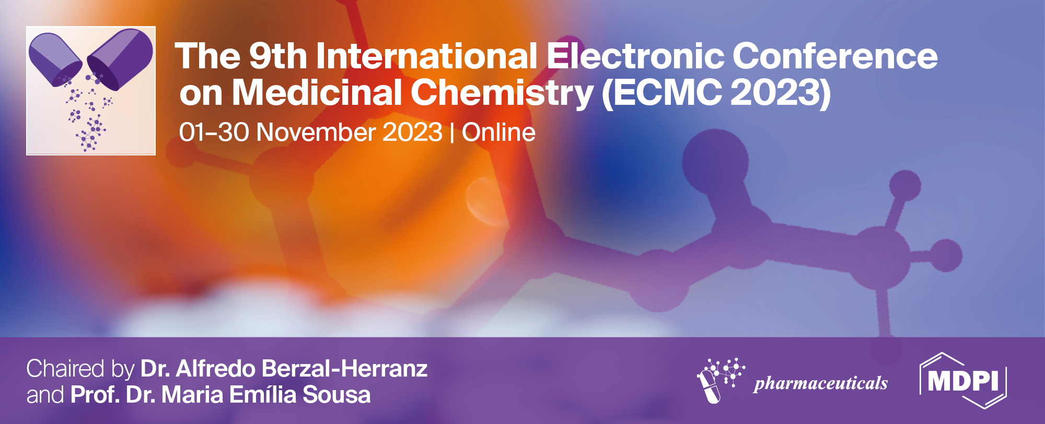
Potential Role of β-blockers and lipid regulators in lung cancer treatment: an in vitro approach
Tiago Amaral¹, Mónica Almeida², Carolina Frazão², Maria de Lourdes Pereira³, Miguel Oliveira^{2,*}
1 Department of Biology, University of Aveiro, 3810-193, Aveiro, Portugal
2 Centre for Environmental and Marine Studies (CESAM), Department of Biology, University of Aveiro, 3810-193 Aveiro, Portugal
3 Department of Medical Sciences, CICECO—Aveiro Institute of Materials, University of Aveiro, 3810-193 Aveiro, Portugal
Corresponding author: tnamaral@ua.pt

Slide 2
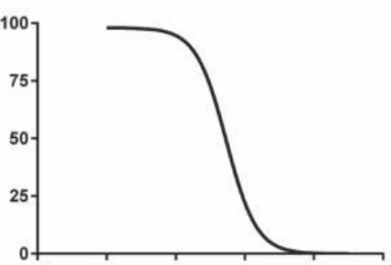
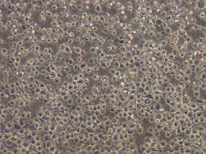
Potential Role of β-blockers and lipid regulators in lung cancer treatment: an in vitro approach
Graphical Abstract

Slide 3
Abstract:
Lung cancer is the second most common type of cancer, affecting more than two million people. The available treatments show limited effectiveness and undesirable side effects, thus, there is a huge demand for more effective treatments. The use of drugs already on the market has been proposed as a potential valuable approach. The aim of this study was to test the potential use of β-blockers, atenolol and metoprolol, and the peroxisome proliferator-activated receptor alpha (PPAR-α) receptor agonists, fenofibrate and gemfibrozil as coadjuvant in the treatment of this pathology. Thus, non-small cell lung cancer cell lines, A549 and H460, were exposed to different concentrations of β-blockers (500, 250, 125, 62.5, 31.25, 15.625 and 7.8125 µM) and PPAR-α receptor agonists (25, 12.5, 6.25, 3.125, 1.563, 0.781 and 0.391 µM). Metabolic viability was assessed by Resazurin and MTT viability assay at three different time points, 24, 48 and 72 hours. Atenolol and metoprolol did not demonstrate toxicity towards both cell lines in the tested concentrations and time-points. Gemfibrozil demonstrated limited toxicity towards both cell lines, with decreases of 20% of cellular viability at the maximum concentration tested at 24 hours and Fenofibrate showed toxicity only towards H460 with a calculated LC50 of 20.6 µM. Therefore, Fenofibrate is a strong candidate to act as coadjuvant in the treatment of non-small cell lung cancer. Further studies are necessary to understand the impact of lipid regulators in the treatment of lung cancer.
Keywords: 3 to 5 keywords in alphabetical order and separated by semi colons

Slide 4
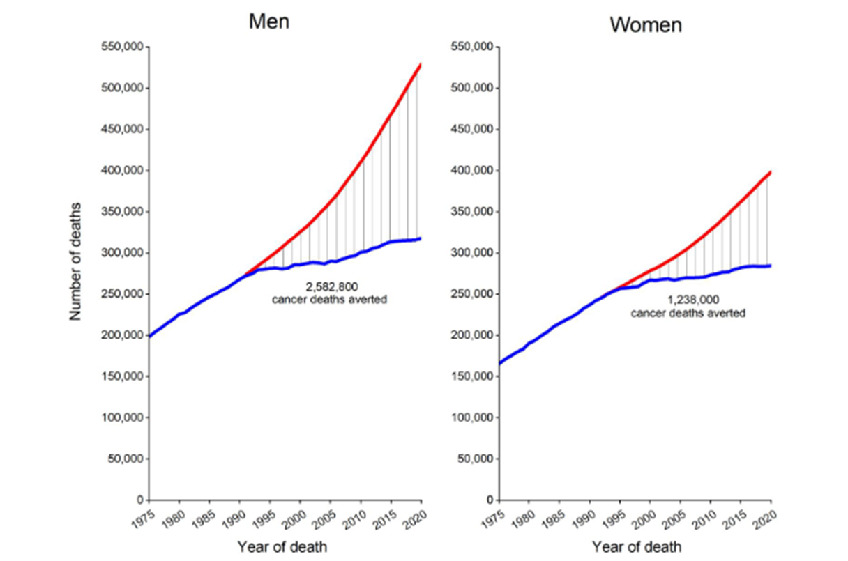
DNA mutation
Epigenetic chances
Hereditary
Cell division error
Introduction
Cancer

Slide 5
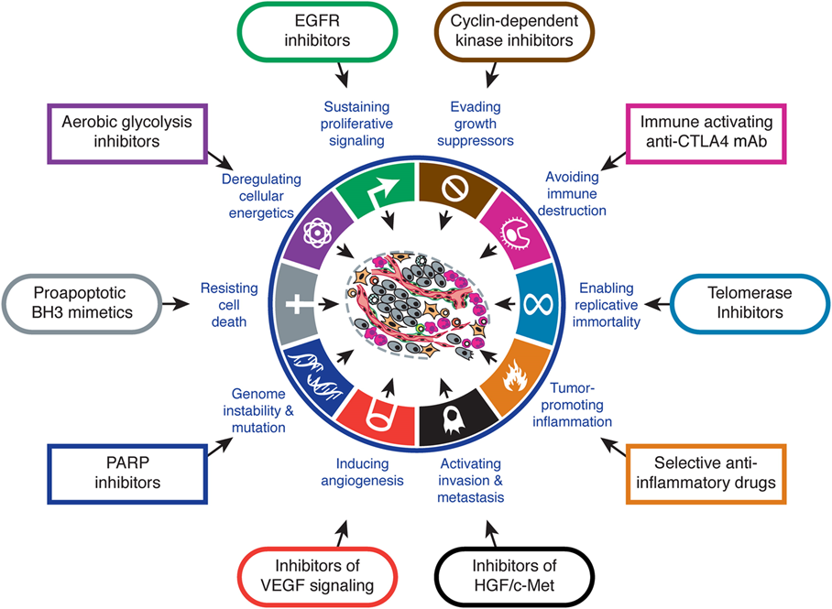
Hallmarks of cancer

Slide 6
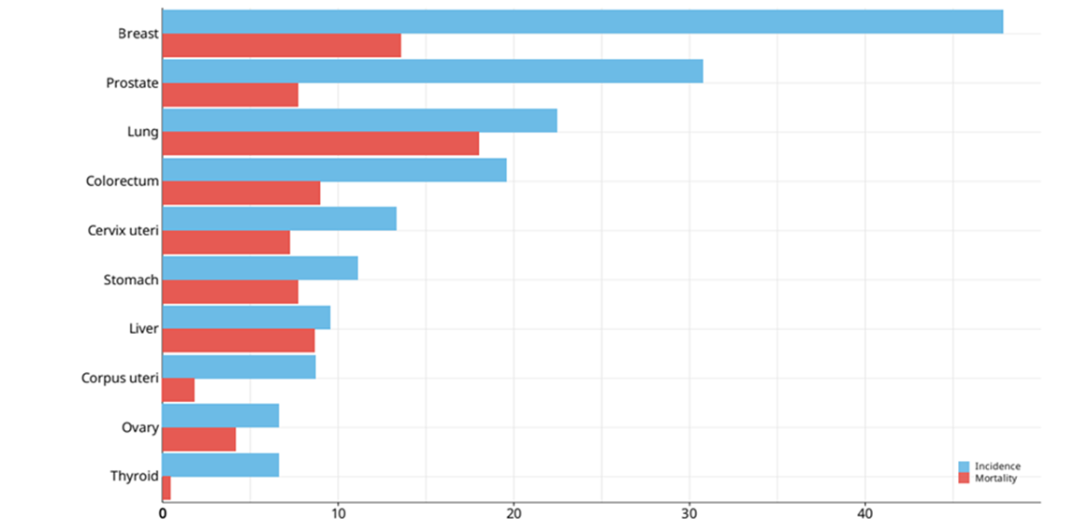
Lung Cancer
Non-small cell lung cancer
Large cell carcinoma
Squamous cell carcinoma
Small cell lung cancer
Adenocarcinoma
Lung Cancer
TREATMENT
Surgery
Chemotherapy, radiation therapy
Targeted therapy

Slide 7
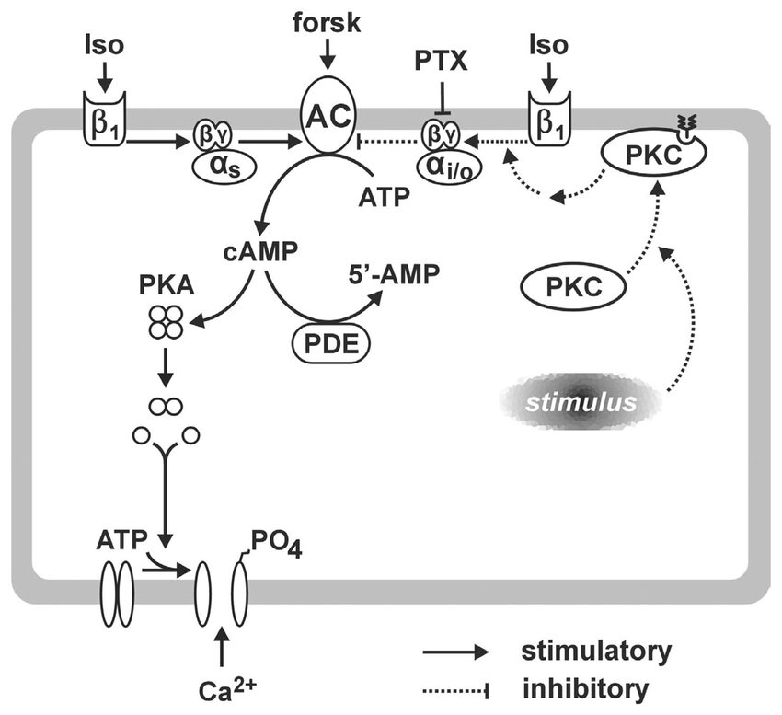
Beta-adrenergic system
Muscles contraction
1
α
2
Pre-synaptic
Stimulates heart rate
1
β
2
muscle relaxation
3
lipolysis

Slide 8
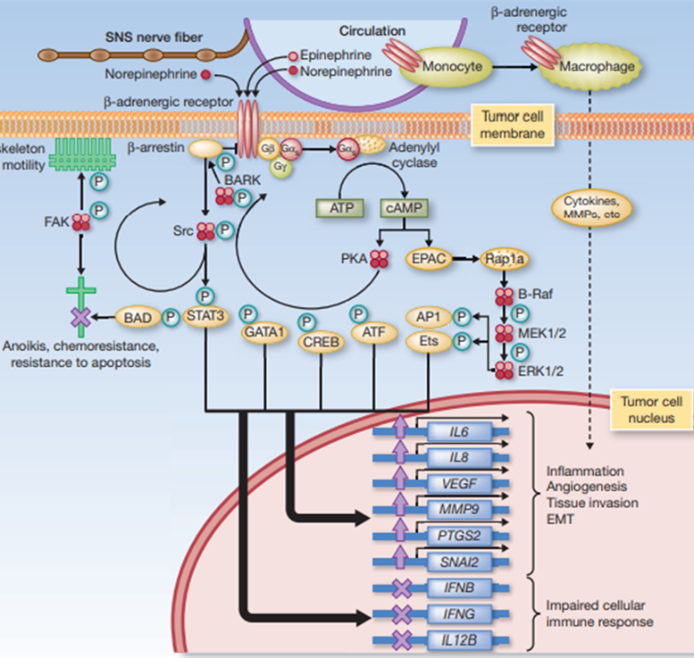

Slide 9
Beta-blockers
Antagonists of the β-receptors
Selectivity
Prescribed for heart disease.
β-blockers
Atenolol
Metoprolol
Betaxolol
Bisoprolol
β1 selective (cardioprotective)
Propanolol
Carvedilol
Nadolol
Sotalol
Non-selective
β1 and β2

Slide 10
Beta-Blockers and cancer
Table1 -Clinical evidence of beta-blockers and cancer treatment
Lung cancer | Reduces risk of mortality, less distant metastases, late onset of the disease
Prostate cancer | Prolonged survival and reduction of distant metastases
Breast cancer | Reduces the rate of metastasis development
(H.H. et al., 2014), (H. M. Wang et al., 2013), (Powe et al., 2010)

Slide 11
PPAR Receptors
PPAR-α
Main tissue expression:
Tissues exhibiting high
carbolic rates of fatty acids
(mainly liver and skeletal
muscle)
Lipid catabolism and homeostasis
Control of inflammatory processes and vascular integrity
PPAR-β
Tissue expression:
Ubiquitous, but the biggest expression is in the gastrointestinal tract (esophagus, liver, intestines) kidneys, and skeletal muscle
Responsible for insulin sensitivity and glucose homeostasis
PPAR-γ
Main tissue expression:
Adipose tissue (white and brown)
Other tissues:
Intestines, liver, kidneys, retina, immunologic system (bone marrow, lymphocytes, monocytes, and macrophages), trace amounts in muscles
Glucose homeostasis and lipid storage

Slide 12
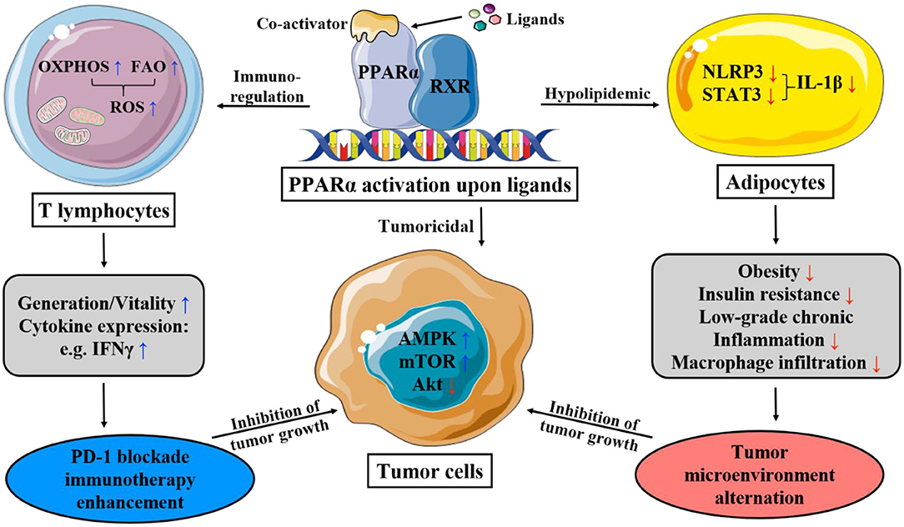
PPAR-α and cancer
Inhibition of angiogenesis
Prioritization of FAO to glycolysis and disruption of the balance of glucose and lipid metabolism to inhibit ATP production
Accumulation of ROS and mitochondrial damage
PPAR and Cancer

Slide 13
Table 2- Clinical evidence of PPAR-α agonist and cancer
Oral cancer | Agonist | Fenofibrate | Regulating the gene expression of mitochondrial energy metabolism
 |  |  | Restraining the process of preneoplastic lesion to oral squamous cell carcinoma
Brest cancer | Agonist | Fenofibrate | Reducing the phosphorylation levels of Akt/NF-κB and augmenting chemosensitivity when combined with paclitaxel
 |  | Clofibrate | Regulating inflammatory, lipogenic pathways, and expression of genes involving FAO
Lung cancer | Agonist | Ave8134 | Reducing the production of AA-derived EETs and promoting the levels of 11-HETE
 |  | Fenofibrate | Arresting G1 cell cycle, restraining NF-κB activity and ERK signaling pathway
(Tan et al., 2021)

Slide 14
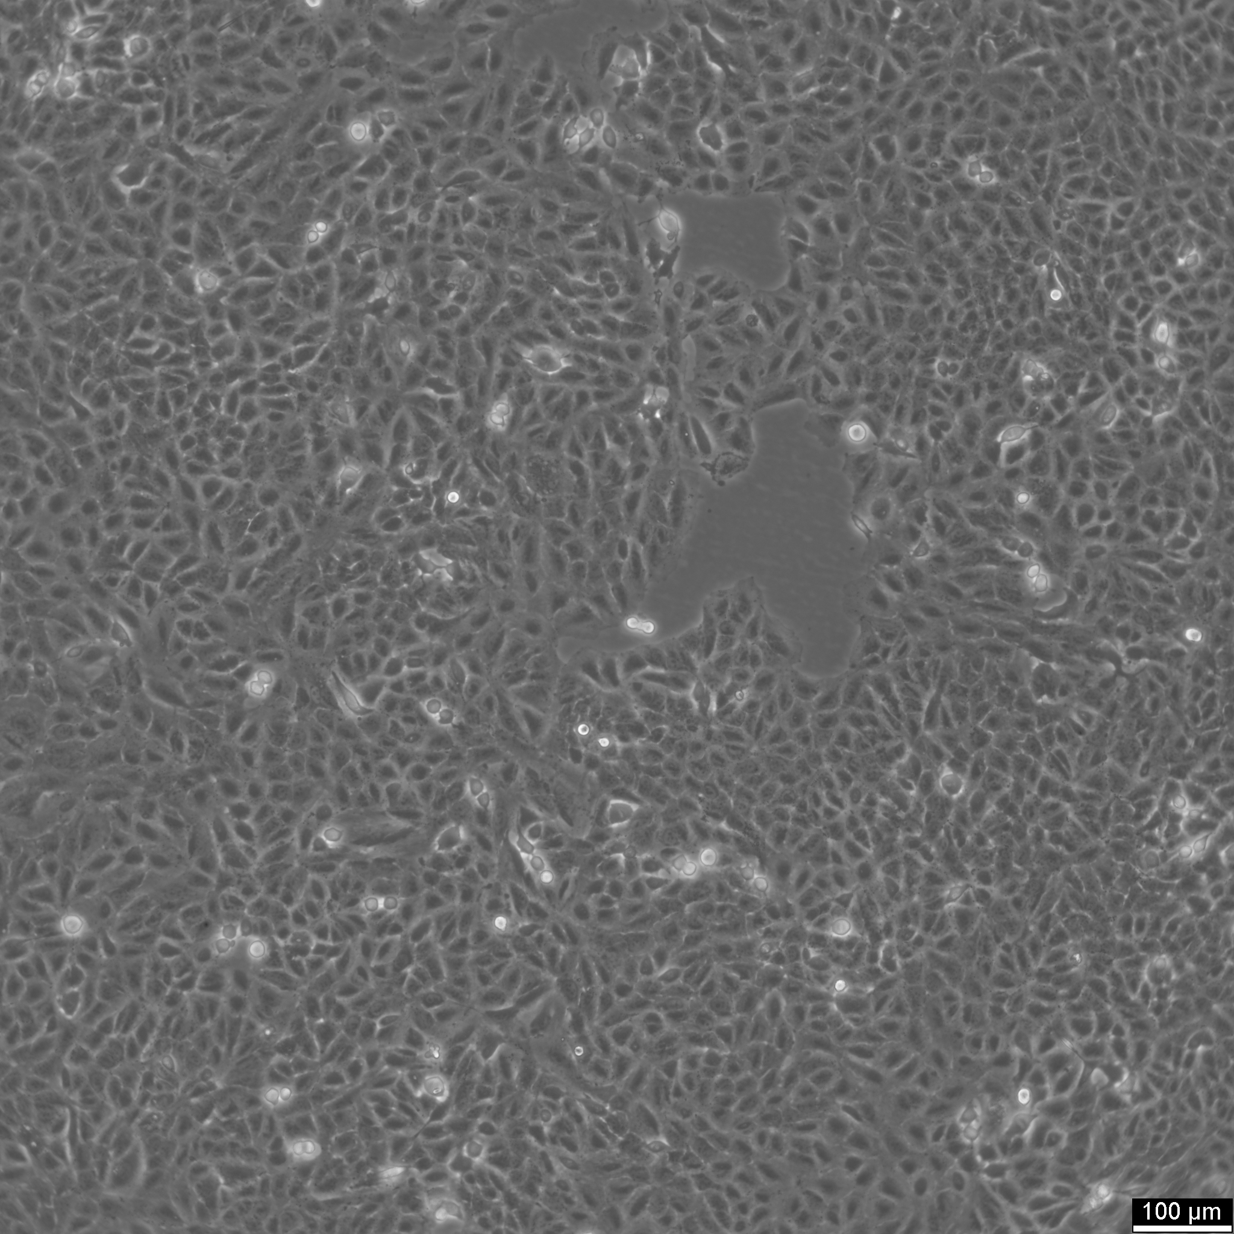
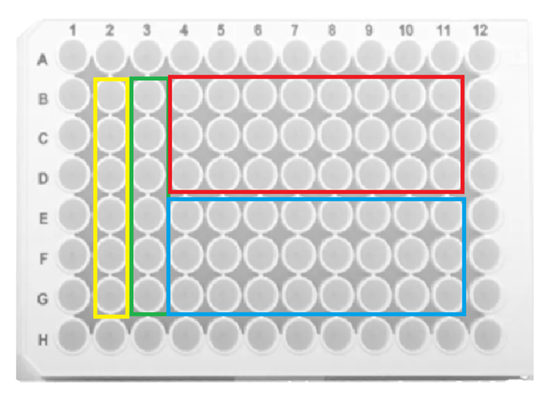
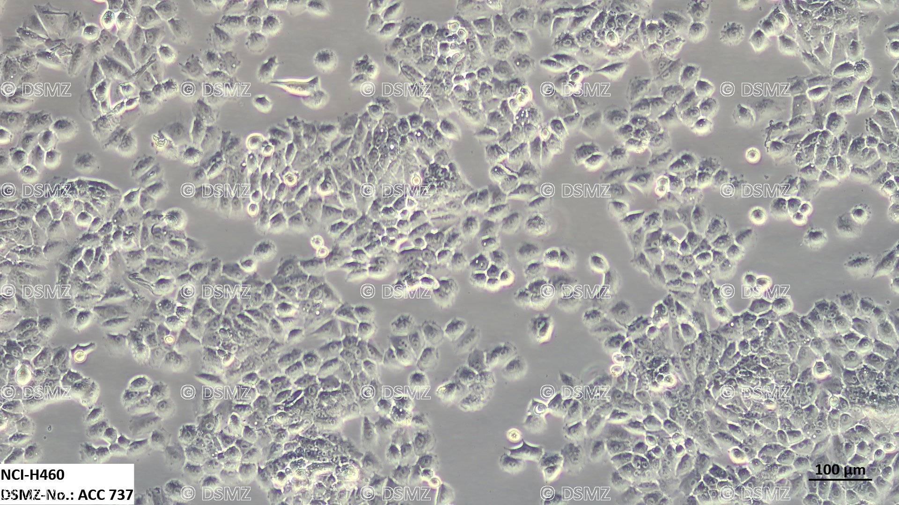
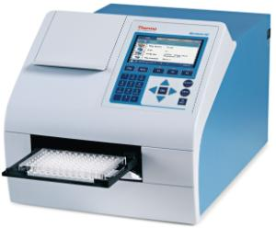
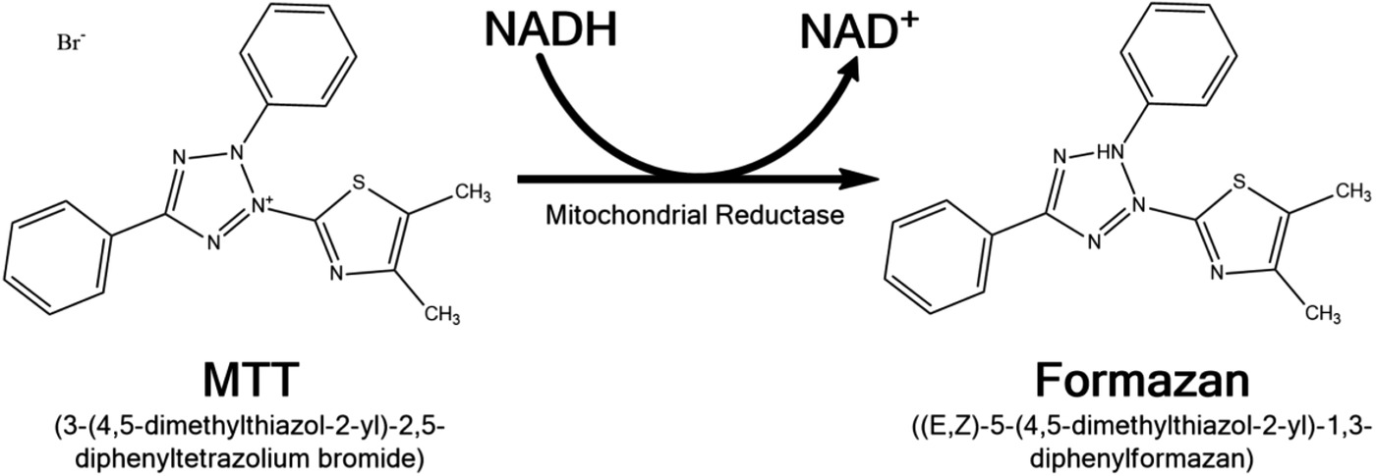
Material and methods
Atenolol and Metoprolol: 500; 250; 125; 62.5; 31.25; 15.625 e 7.8125 µM
Gemfibrozil and Fenofibrate: 25; 12.5; 6.25; 3.125; 1.563; 0.781; 0.391 µM
A549
Control
Control with cell
Atenolol/Gemfibrozil
Metoprolol/Fenofibrate
H460

Slide 15
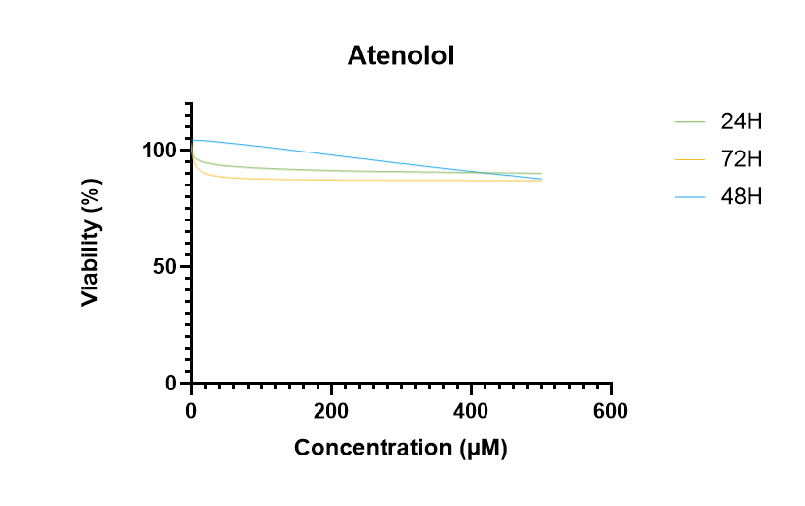
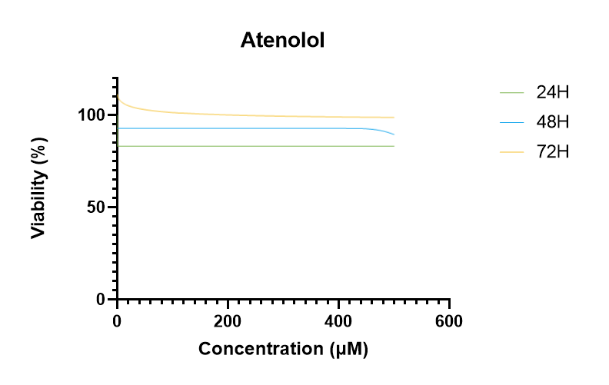
Results and discussion
No cytotoxicity
Atenolol
A549
H460

Slide 16
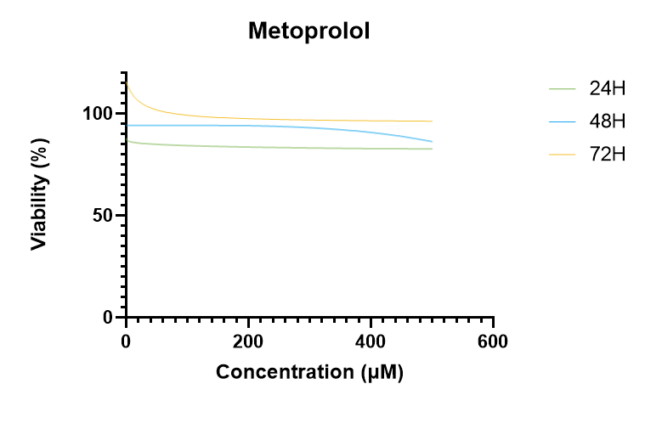
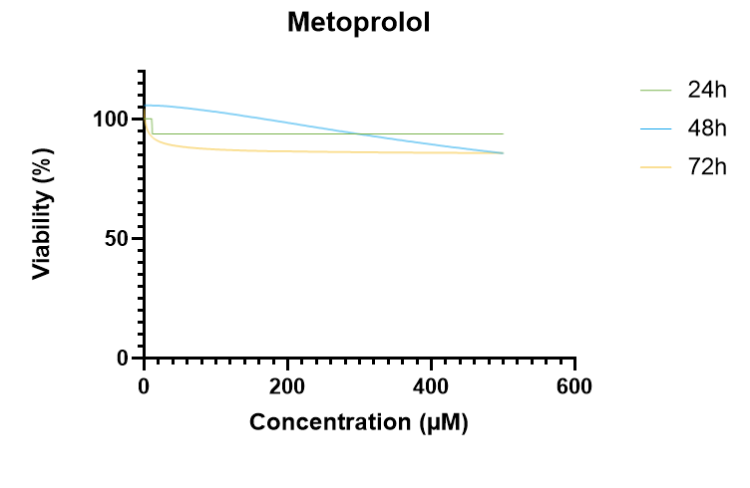
Metoprolol
No cytotoxicity
A549
H460

Slide 17
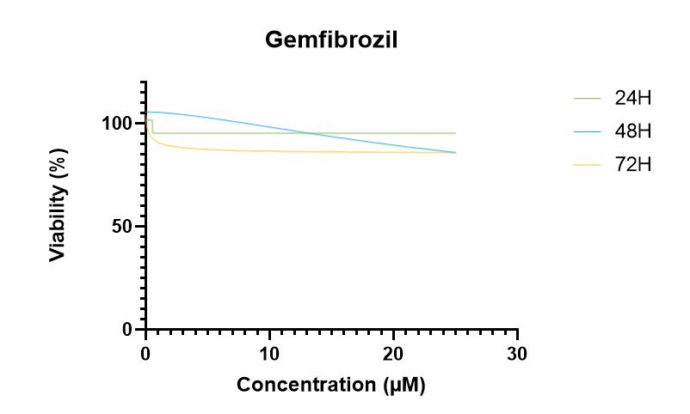
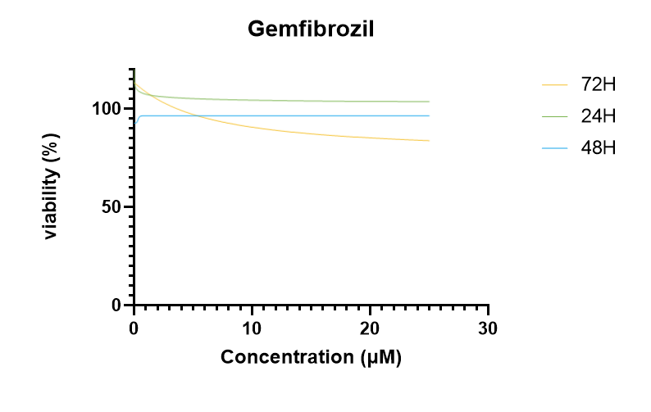
Low cytotoxicity, no significant effect
Gemfibrozil
A549
H460

Slide 18
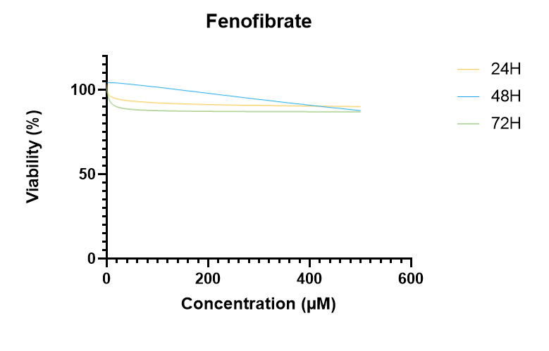
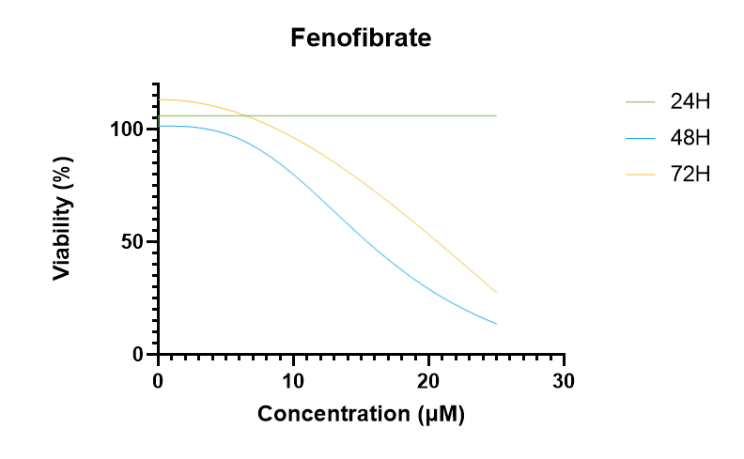
Fenofibrate
A549
H460
H460
 | 24H | 48H | 72H
EC50 (µM) | _ | 15.464 | 20.651
EC10 (µM) | _ | 7.747 | 11.801
A549
 | 24H | 48H | 72H
EC50 (µM) | _ | _ | _
EC10 (µM) | _ | 19.31 | 1.361

Slide 19
Conclusions
The viability of A549 cells was not affected by any of the studied compounds
Fenofibrate shows cytotoxicity towards H460 cells at low concentrations
Future studies using combinations should be performed

Slide 20
Acknowledgments:
Thank you for your attention!
Thanks are due to FCT/MCTES for the financial support to the project NanoPlanet (2022.02340.PTDC), and CESAM (UIDP/50017/2020 + UIDB/50017/2020 + LA/P/0094/2020) through national funds.

