Slide 1
The 4th International Electronic Conference on Applied Sciences
Energy Optimized Edge Computing Framework for the Sustainable Development of Modern Agriculture
Authored by
Neha Bhende
Rupa Kesavan
October 27th – November 10th 2023
October 2023 01 / 21

Slide 2
Outline
Introduction
Literature Survey
Proposed Work
Results and Discussion
Conclusion
References
October 2023 02 / 21

Slide 3
Motivation:
Introduction
To provide farmers with an energy efficient and sustainable smart agriculture system that minimizes energy and resource wastage while repurposing agricultural and industrial waste to power edge and IoT devices deployed within a crop land.
Problem statement:
The sensors and imaging systems present in the cropland generate large amounts of data that need to be processed in an affordable and scalable manner even with a limited internet connection. Errors in processing could lead to tremendous crop loss resulting in declining food security.
October 2023 03 / 21

Slide 4
Literature Survey
Literature Survey
Ojha, Tamoghna, Sudip Misra, and Narendra Singh Raghuwanshi. "Wireless sensor networks for agriculture: The state-of-the-art in practice and future challenges." Computers and electronics in agriculture 118 (2015): 66-84.
Discusses the issues and challenges concerned with deploying WSN’s in a cropland. The paper analyses the specific requirements of the sensors to ensure high performance and accuracy in determining crop needs.
October 2023 04 / 21

Slide 5
Literature Survey
Li, W., Yang, T., Delicato, F. C., Pires, P. F., Tari, Z., Khan, S. U., & Zomaya, A. Y. (2018). On enabling sustainable edge computing with renewable energy resources. IEEE communications magazine, 56(5), 94-101.
Proposes an efficient energy management framework that enables sustainable edge computing while utilising renewable energy sources to power edge devices while ensuring quality of service was delay sensitive IoT applications.
October 2023 05 / 21

Slide 6
Literature Survey
Beyene, Y. B., Worku, G. B., & Tjernberg, L. B. (2023). On the design and optimization of distributed energy resources for sustainable grid-integrated microgrid in Ethiopia. International Journal of Hydrogen Energy.
Proposes a way to minimize the impacts of power grid outages by using green and brown energy sources in microgrids. The use of renewable energy sources reduces the CO2 emissions while increasing the yield revenue
October 2023 06/21

Slide 7
Literature Survey
Tooryan, Fatemeh, Hamid HassanzadehFard, Vahid Dargahi, and Shuangshuang Jin. "A cost-effective approach for optimal energy management of a hybrid CCHP microgrid with different hydrogen production considering load growth analysis." International Journal of Hydrogen Energy 47, no. 10 (2022): 6569-6585.
This paper proposes battery energy storage, thermal energy storage and minimal operational cost in a hybrid microgrid. It uses municipal waste to produce electircity in fuel cells and suggests a way to optimally manage the energy rewuirements of devices.
October 2023 07/21

Slide 8
Literature Survey
Tahir, Kawakib Arar, Montserrat Zamorano, and Javier Ordóñez García. "Scientific mapping of optimisation applied to microgrids integrated with renewable energy systems." International Journal of Electrical Power & Energy Systems 145 (2023): 108698.
Proposes an optimized microgrid architecture for efficient management of energy requirements and as an alternative an sustainable source of energy.
October 2023 08/21

Slide 9
Literature Survey
Jalali, Fatemeh, Arun Vishwanath, Julian De Hoog, and Frank Suits. "Interconnecting Fog computing and microgrids for greening IoT." In 2016 IEEE Innovative Smart Grid Technologies-Asia (ISGT-Asia), pp. 693-698. IEEE, 2016.
This paper analyses the energy consumption of various IoT devices used in weather forecasting in a traditional cloud and fog environment and compares the consumption and wastage when integrated with hybrid microgrids. Further it identifies the factors that influence dynamic energy requirement decision making.
October 2023 09 / 21

Slide 10
Literature Survey
Zaguia, Atef. "Smart greenhouse management system with cloud-based platform and IoT sensors." Spatial Information Research (2023): 1-13.
This paper proposes the use of the FPKM algorithm, incorporated with the K-means clustering algorithm to efficiently denoise the data to improve the efficacy of the prediction of irrigation and temperature control in a greenhouse.
October 2023 10 / 21

Slide 11
Literature Survey
Nadig, Deepak, Sara El Alaoui, Byrav Ramamurthy, and Santosh Pitla. "ERGO: A scalable edge computing architecture for infrastructureless agricultural internet of things." In 2021 IEEE International Symposium on Local and Metropolitan Area Networks (LANMAN), pp. 1-2. IEEE, 2021.
Proposes an architecture to minimize the dependency of IoT devices on cloud assistance. ERGO has outperformed infrastructure dependant systems in terms of latency and throughput while ensuring scalability and accuracy of decisions.
October 2023 11/21

Slide 12
Literature Survey
Ullah, Ihsan, and Hee Yong Youn. "Task classification and scheduling based on K-means clustering for edge computing." Wireless Personal Communications 113 (2020): 2611-2624.
Proposes a way to use K-means clustering for classifying and scheduling tasks based on the resource requirement before it is distributed to the edge device. This has increased the utilisation of devices and reduced the dependency on cloud platforms. Thus, task execution time is reduced and resource utilization is improved.
October 2023 12 / 21

Slide 13
Literature Survey
Hao, Yongsheng, Jie Cao, Qi Wang, and Jinglin Du. "Energy-aware scheduling in edge computing with a clustering method." Future Generation Computer Systems 117 (2021): 259-272.
This paper takes into consideration, devices that are powered by green energy sources and clusters them using a scheduling heuristic approach to immigrate VM’s, transfer energy and allocate tasks so as to reduce the total energy consumption in processing tasks.
October 2023 13/21

Slide 14
Overall System Architecture
Proposed Work
October 2023 14 / 21

Slide 15
Microgrid integrated Edge Computing Architecture in an Agricultural Cropland
Proposed Work
October 2023 14 / 21

Slide 16
Proposed Work
Module 1: Energy Efficiency
Agricultural and industrial waste of a cropland is converted into green and brown energy respectively and fed into the micro grid energy pool.
During the high demand period, the edge devices are allocated energy based on their load and energy profile.
The devices are then evaluated to ascertain whether they are delay sensitive or not.
If the devices are delay sensitive, the necessary task is performed by acquiring energy resources from other delay insensitive devices.
All delay insensitive devices are allocated energy when there is a surplus of it in the grid energy pool.
During the low demand period, all devices with excess energy allocation is required to feed it back to the energy pool where this energy is used to recharge the battery powered devices or monetized to power nearby villages.
October 2023 15 / 21

Slide 17
Proposed Work
Module 2: Clustering
The data is collected from the thousands of sensors deployed in an agricultural cropland.
This data is subjected to the FPKM algorithm integrated with K-means clustering to deniose the data in a robust manner. This reduces the possibilty of erroneous and corrupt values taking part in the desicion making process and thus causing fatally wrong instructions being fed to the actuators.
Clustering also plays a role in distributing the tasks to be performed amongst multiple edge devices to reduce burdening, occurences of idle devices which can lead to exessive enrgy consumption and resource wastage at the same time.
Tasks can be offloaded onto edge devices that have a greateer computational power and energy allocation.
Data can be processed at the closest edge device (cluster head) to minimize the distance of data transmission.
October 2023 16 / 21

Slide 18
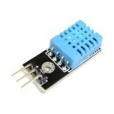
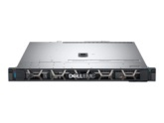
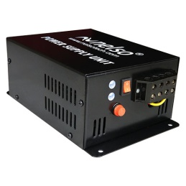
Proposed Work
Experimental Set Up
Computational Edge Computing Platform
Communication Protocol
Sensor DHT11
Edge Device
Dell 1U server
Cloud Service Provider
Renewable energy source- 3 Solar Photovoltaic cell
DC- DC Converter
October 2023 16 / 21

Slide 19
Proposed Work
Experimental Set Up
Our system architecture is a small-scale prototype consisting of:
DHT11 sensors to monitor temperature and humidity of the soil
ZigBee Communication Protocol
Dell 1U server equipped with a 3.3 GHz Intel Xeon CPU, 8 GB RAM, and a 1 TB SATA hard drive. Having per-server maximum and static power consumption 260 W and 120 W respectively.
The edge computing platform is eclipse ioFog paired with kubernetes as the cloud service provider
As the source of renewable energy we have chosen 2 solar photovoltaic cells having peak output of 65 W
We use a DC-DC converter
And we include a battery to store excess energy produced
October 2023 16 / 21

Slide 20
Results and Discussions
The energy storage component of the proposed architecture serves as a sustainable way to efficiently utilize the produced energy, securing future resource requirements and a way to monetize and use the energy produced in cases where it exceeds the edge device requirements.
The microgrid possess the capability of energy monitoring, dynamic load balancing and energy distribution for real-time and continuous data.
Use of the FPKM algorithm integrated with the K-means clustering algorithm ensure robust preprocessing to minimize the latency and discrepancy in actuator instructions.
Clustering in edge computing optimizes task distribution, allocation of resources and efficient device utilization to enable offloading mechanisms and parallel computation.
October 2023 17 / 21

Slide 21
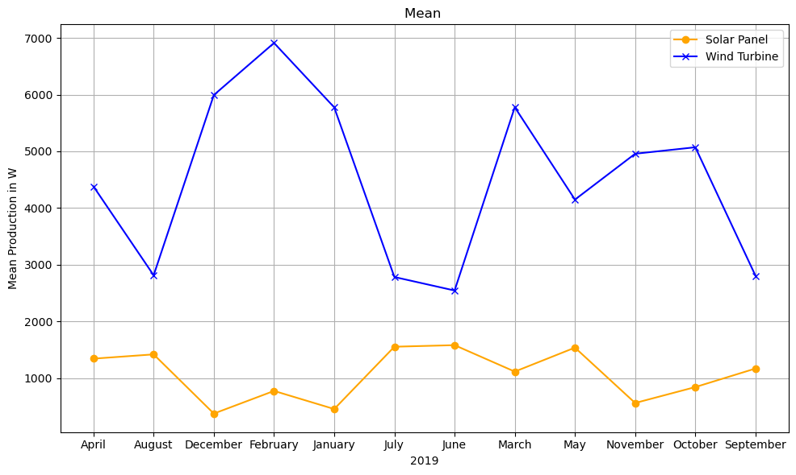
Results and Discussions
Renewable Energy Generation
October 2023 17 / 21

Slide 22
Results and Discussions
October 2023 17 / 21

Slide 23
Results and Discussions
The energy consumption of the edge devices and the IOT sensors was monitored, collecting two sets of data
With microgrid integrated
Without microgrid integrated
The results along with the load of the network was plotted on a graph using MATPLOTLIB libraries on JupyterNotebook.
The graph shows significant reduced energy consumption when using microgrid infrastructure to power the devices.
Additionally shows minimal difference in the energy required and energy consumed when compared to a traditional system.
Thus ensuring minimal energy wastage through heat dissipation.
October 2023 17 / 21

Slide 24
Conclusion
Our work plays an important role in the sustainable development of the agricultural sector by providing solutions to limited network connectivity, off-the grid location of crop lands and abundance of noise that affects the actuator instructions. Furthermore, we highlight the importance of the FPKM algorithm in the preprocessing stage and the essential role of the K-Means clustering algorithm in edge computing to support data analysis, management of resources, offloading and load balancing to develop an optimized computing environment, safeguarded from latency and excess traffic issues all while utilizing resources efficiently. The widespread implementation of our architecture will contribute to the sustainable development goals 2,7,9,11 and13.
October 2023 18/21

Slide 25
References
1.Ojha, Tamoghna, Sudip Misra, and Narendra Singh Raghuwanshi. "Wireless sensor networks for agriculture: The state-of-the-art in practice and future challenges." Computers and electronics in agriculture 118 (2015): 66-84.
2.Li, W., Yang, T., Delicato, F. C., Pires, P. F., Tari, Z., Khan, S. U., & Zomaya, A. Y. (2018). On enabling sustainable edge computing with renewable energy resources. IEEE communications magazine, 56(5), 94-101.
3.Beyene, Y. B., Worku, G. B., & Tjernberg, L. B. (2023). On the design and optimization of distributed energy resources for sustainable grid-integrated microgrid in Ethiopia. International Journal of Hydrogen Energy.
4.Tooryan, Fatemeh, Hamid HassanzadehFard, Vahid Dargahi, and Shuangshuang Jin. "A cost-effective approach for optimal energy management of a hybrid CCHP microgrid with different hydrogen production considering load growth analysis." International Journal of Hydrogen Energy 47, no. 10 (2022): 6569-6585.
5.Tahir, Kawakib Arar, Montserrat Zamorano, and Javier Ordóñez García. "Scientific mapping of optimisation applied to microgrids integrated with renewable energy systems." International Journal of Electrical Power & Energy Systems 145 (2023): 108698.
October 2023 19 / 21

Slide 26
References
6. Jalali, Fatemeh, Arun Vishwanath, Julian De Hoog, and Frank Suits. "Interconnecting Fog computing and microgrids for greening IoT." In 2016 IEEE Innovative Smart Grid Technologies-Asia (ISGT-Asia), pp. 693-698. IEEE, 2016.
7. Zaguia, Atef. "Smart greenhouse management system with cloud-based platform and IoT sensors." Spatial Information Research (2023): 1-13.
8. Nadig, Deepak, Sara El Alaoui, Byrav Ramamurthy, and Santosh Pitla. "ERGO: A scalable edge computing architecture for infrastructureless agricultural internet of things." In 2021 IEEE International Symposium on Local and Metropolitan Area Networks (LANMAN), pp. 1-2. IEEE, 2021.
9. Ullah, Ihsan, and Hee Yong Youn. "Task classification and scheduling based on K-means clustering for edge computing." Wireless Personal Communications 113 (2020): 2611-2624.
10. Hao, Yongsheng, Jie Cao, Qi Wang, and Jinglin Du. "Energy-aware scheduling in edge computing with a clustering method." Future Generation Computer Systems 117 (2021): 259-272.
October 2023 20 / 21

Slide 27
References
https://docs.google.com/spreadsheets/d/1kxwyjiAaMD2wgvY6LS-cXAh8mV_UytKB8v2u4XvWlZ0/edit?usp=sharing Link to the renewable energy data set for solar and wind power
https://docs.google.com/spreadsheets/d/1J4ihXDJObM8_HGOAF6W6FPU6ZwGaSPzs3NQmivzamVk/edit?usp=sharing Link to the raw data having the Load of the Edge device
https://docs.google.com/spreadsheets/d/1ohAVnxL6HLv3hfj5_xQGpE3CcbKtTiI8J1MBz35vQMc/edit?usp=sharing Link to the raw data having energy consumption of the edge device with microgrid integration
https://docs.google.com/spreadsheets/d/1Or4s7zk6i7AbeHzqUQhXLU9SulljYvpJOIVjIW_uGec/edit?usp=sharing Link to the preprocessed and clustered data with comparison of energy consumption
October 2023 20 / 21

Slide 28
Thank You
October 2023 21 / 21

