Slide 1
Motherhood University
ROORKEE ( UTTRAKHAND )
A PRESENTATION SUBMITTED
By
SHAMA PARVEEN
UNDER THE SUPERVISION OF
DR. VIKAS GUPTA
DEPARTMENT OF CHEMISTRY
MOTHERHOOD UNIVERSITY
ROORKEE
India

Slide 2

Topic
In Vitro Antimicrobial and anticancer activity of metallic nanoparticles (FeO, CuO and Ag) against Human pathogenic bacteria and cancer cell lines

Slide 3
Methods used for synthesis of nanoparticles bottom - up approach biological methods

Slide 4
Objectives of the study
Green synthesis of Ag, Cu and FeO nanoparticles from the leaves extract of three different plant that is Abies pindrow royle, Leucas cephalotes and Ajuga macrosperma.
Characterization of synthesized Ag, Cu and FeO nanoparticles.
Biological activities
Anticancer activities
Antimicrobial activity

Slide 5
Preparation of plant extract
The gathered leaves of A. pindrow royle, L. cephalotes, and A. macrosperma were then rinsed with distilled water. A 500 ml and 1000 ml beaker containing 5g, 8g, and 7g of leaves was combined with 150ml, 300ml, and 500ml of sterile water that had been distilled. The combination was then heated for 120 minutes and allowed to cool to room temperature (30°C). The prepared mixture was coarsely ground in an Indian Ken Star kitchen blender before being filtered with Whatman filter paper No. 1. The filtrate was used to create iron oxide, copper, and silver nanoparticles..

Slide 6
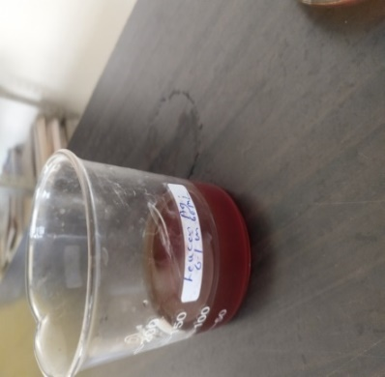
synthesis of silver nanoparticle
Biogenic synthesis of silver nanoparticles
The production of Ag-NPs required mixing the leaf
extract with 60 ml of a 0.1 M solution of water of
AgNO3 and stirring the mixture for 60 minutes at 60 °C.
The tint changed after being mixed with the
reduction mixture.
Figure 5. 13 Synthesized AgNPs solution using Leucas cephalotes

Slide 7
Characterization of Zinc Oxide nanoparticle
A) Uv-Vis spectrophotometry analysis.
B) FTIR (Fourier Transformation Infra-red Spectroscopy) analysis.
C) XRD (X-Ray Diffraction) analysis.
D) SEM (Scanning Electron Microscopy) analysis.
e) TEM (Transmission Electron Microscopy) analysis.
f) DLS (Dynamic Light Scattering) and zeta potential analysis.
g) EDX (Energy Dispersive X-ray Spectroscopy)copy)

Slide 8
Fig. 1. UV-visible spectrum of synthesized ZnO nanoparticles peak range is 340 nm

Slide 9
TABLE-1
PEAK LIST FOR AVERAGE SIZE
CALCULATION OF NANOPARTICLES
2θ (°) | hkl | FWHM left | d-spacing (Å) | Rel. int. (%)
32.00 | 110 | 0.70 | 2.79 | 58.91
34.62 | 002 | 0.35 | 2.59 | 75.54
36.46 | 101 | 0.56 | 2.46 | 100
47.72 | 102 | 1.04 | 1.90 | 15.60
56.79 | 110 | 0.65 | 1.62 | 35.42
63.01 | 103 | 0.71 | 1.47 | 28.76
68.25 | 201 | 1.47 | 1.37 | 21.33
Fig 2. XRD spectra of synthesized ZnO nanoparticles
Where θ is the Bragg's diffraction angle, FWHM is full width at half maxima, (h,k,l) are miller indices and d-spacing is interplanar distance

Slide 10
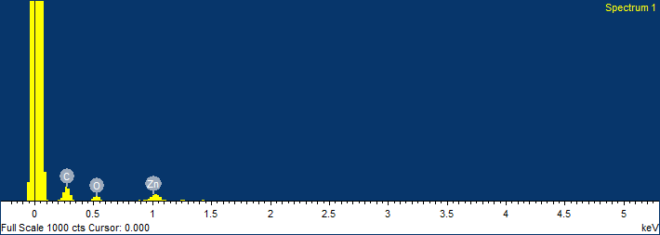
Fig.4. EDX pattern of ZnO nanoparticles

Slide 11

RC SAIF PU, Chandigarh
67.6
67
66
65
64
526.7
63
%T
62
61
2922.8
1241.8
60
1384.1
1036.8
59
1622.7
58
56.9
3430.6
4000.0
3600
3200
2800
2400
2000
1800
cm-1
1600
1400
1200
1000
800
600
400.0
Fig. 5. FTIR spectrum of ZnO nanoparticles

Slide 12
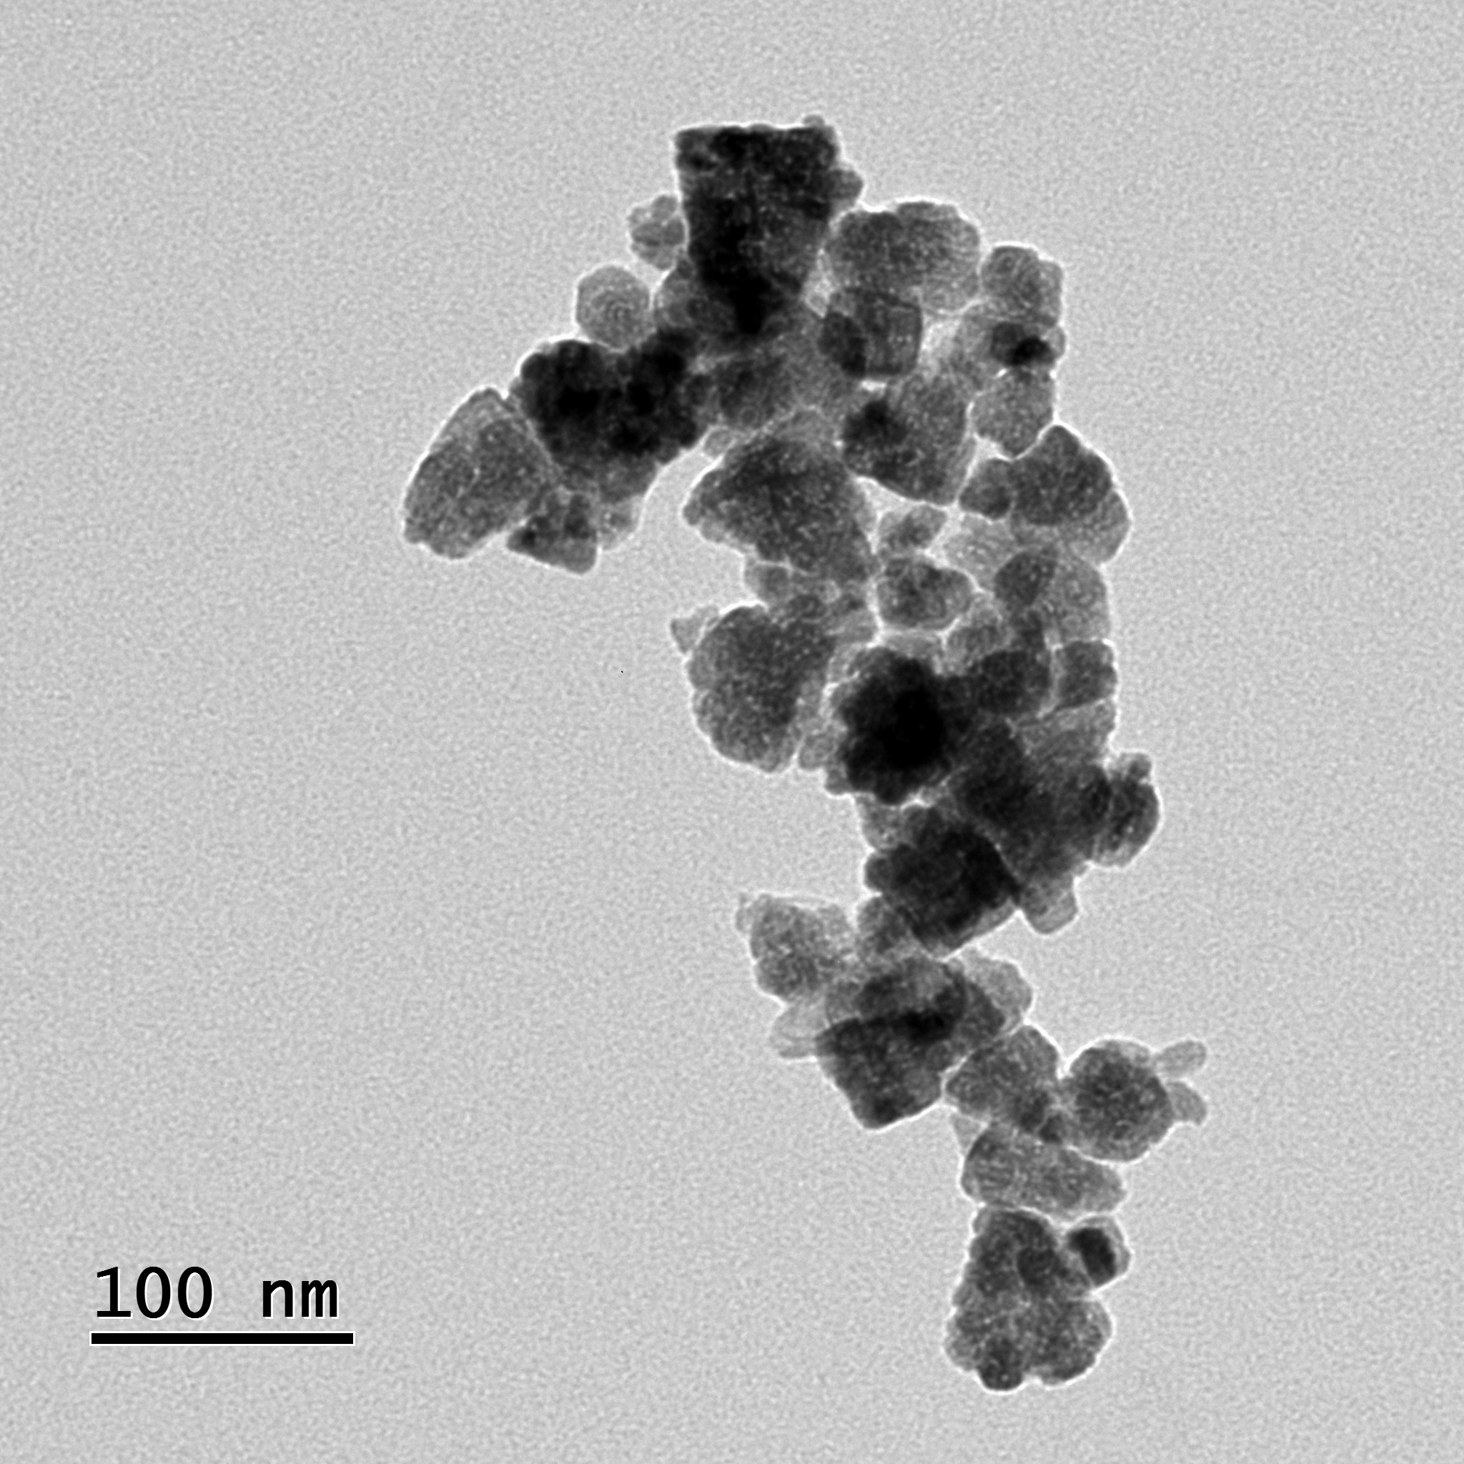
Fig. 5. Transmission electron micro- image of ZnO nanoparticles

Slide 13
CONCLUSION
It can be concluded that green synthesis of ZnO Nano particles using leucas cephalotes leaf extract is successful rapid, energy saving, environmentally benign and cost effective method. In the present study hexagonally shaped, crystalline ZnO nanoparticles with their average size less than 100 nm were synthesized. It is observed that bioactive components of leaf extract of Ajuga bracteosa may be responsible for reducing, capping and stabilizing the zinc oxide nanoparticles.

Slide 14
Thank You

