Slide 1
Comparative analysis of esterification reaction in continuous stirred tank and plug-flow reactors
Presenter: Abdulaziz Bakhtiyorov
Bachelor student on Chemical Engineering
Shahrisabz branch of the Tashkent Institute of Chemical Technology

Slide 2
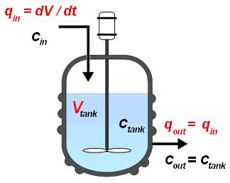
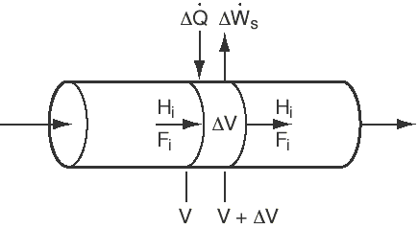
CSTR and PFR reactors for Ethyl Acetate production
Notes:
Chemical reactors are main devices used in chemical engineering to carry out various chemical reactions. They provide a controlled environment for the reaction to occur, allowing for optimal conditions such as temperature, pressure, and mixing. For esterification reactions, which involve the formation of esters from the reaction between an alcohol and an acid, different types of chemical reactors can be used depending on the specific requirements of the reaction. In this study, esterification reaction for obtaining Ethyl acetate (EtAc) was chosen as an object of the research. EtAc can undergo various reactions depending on the conditions and reactants involved. Due to the various applications for the produced esters, esterification is one of the most attractive reactions in industries. For esterification reactions, which involve the formation of esters from the reaction between an alcohol and an acid, different types of chemical reactors, such as Batch Reactors [1], Continuous Stirred Tank Reactors (CSTR) [2], Packed Bed Reactors [3], Plug Flow Reactors (PFR), Fixed Bed Reactors [1, 4], Microwave Reactors [5, 6] and Membrane reactors [7], can be used depending on the specific requirements of the reaction. However, there are lack of comparative techno-economic data for simulated PFR and CSTR processes.

Slide 3
The overall scheme of conversion in the synthesis of EtAc and kinetic factors can be represented as:
$HAc+EtOH\underset{↔}{k2,k1}EtAc+H_{2}O$ (1)
$k_{1}=4619.43exp\left(\frac{−60500}{RT}\right)$ (2)
$k_{2}=3317.28exp\left(\frac{−53740}{RT}\right)$ (3)
where Eq. (1) represents the etherification reaction, Eq. (2) and (3) represent the dependence of the activity-based equilibrium constant with temperature. The UNIFAC estimates of activity coefficients were used to describe the liquid-phase nonideality.

Slide 4
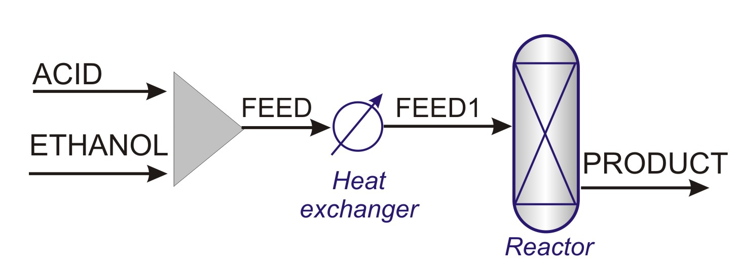
Table 1. Initial feed stream characteristics.
Stream | Component | Concentration, mol% | Flow rate, kmol/hr
ACID | Acetic acid | 99 | 100
 | Water | 1
ETHANOL | Ethanol | 99 | 100
 | Water | 1
Typical PFR process for Ethyl acetate production

Slide 5
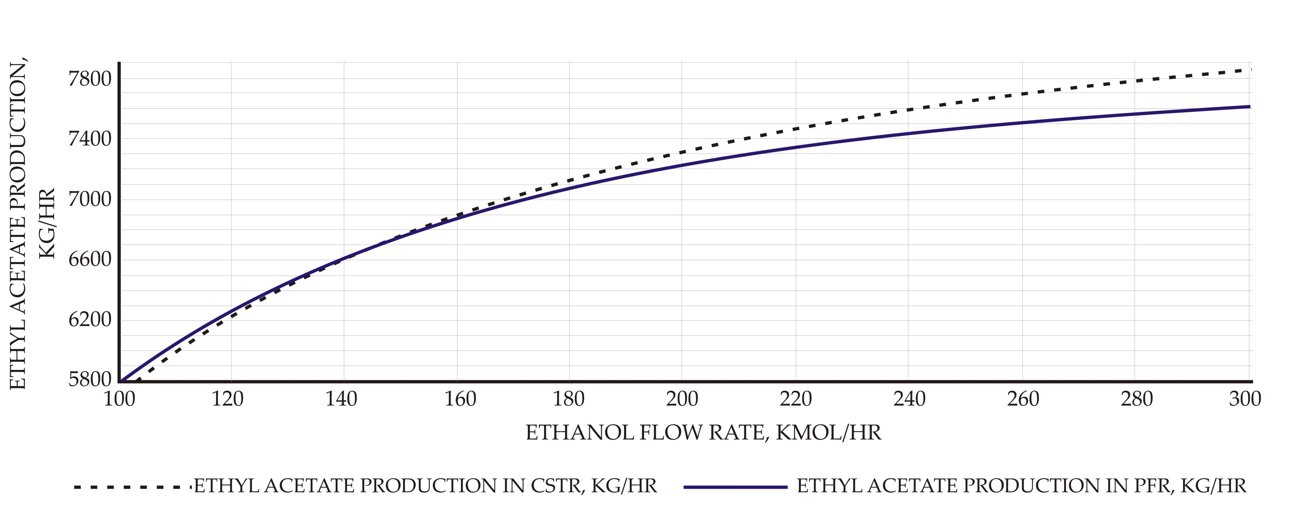
Effect of ethanol molar flow rate to EtAc productivity

Slide 6
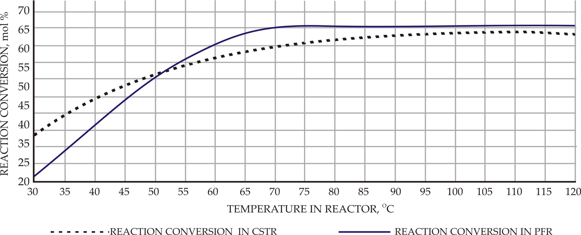
Effect of reactor temperature on the reaction conversion

Slide 7
Conclusions
A comparative model was developed for the production of EtAc
To provide the model, RPLUG and RCSTR operation blocks were used
kinetic expressions and hydrodynamic models were developed using data and models from the literature.
A reaction conversion of 65.9% and negative heat duty about 0.44 Gcal/hr were obtained for PFR as compared with a slightly lower value of 63.6% and 1.77 Gcal/hr for CSTR under steady state conditions.
CSTR process required 110 °C for maximum conversion, whereas this value was approximately 70-75 °C in PFR process.
Maximum conversion of 65.9% and was obtained for multitubular PFR as compared with reaction conversion of 63.6% and for CSTR as temperature varies.
For PFR and CSTR with reactor volume of 7.9 m³, corresponding to flow rates of 100 mol/hr to 300 mol/hr,
reaction conversion varies from 65.9 % to 28.8 % and 63.6% to 28.9%, respectively.

Slide 8
Thank you for your attention!

