Slide 1
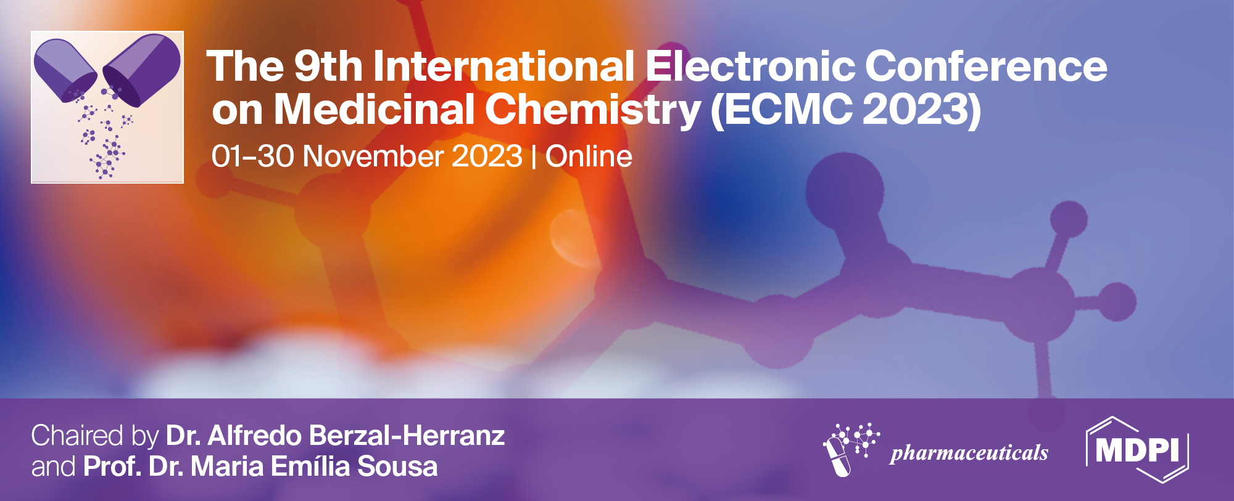
DFT studies on the mechanism of base-catalyzed hydrocyanation of alpha, beta-unsaturated ketones
Kamal Lochan Misra¹, Nrusingha Prasad Nanda¹, and Sidhartha S. Kar ^{2,}*
¹ Department of Pharmaceutical Chemistry, Institute of Pharmacy & Technology, Salipur, Cuttack-754202, Odisha, India;
² Faculty Of Pharmacy, C.V. Raman Global University, Bidyanagr, Mahura, Janla, Bhubaneswar, Odisha-752054, India.
* Corresponding author: sskar06@gmail.com

Slide 2
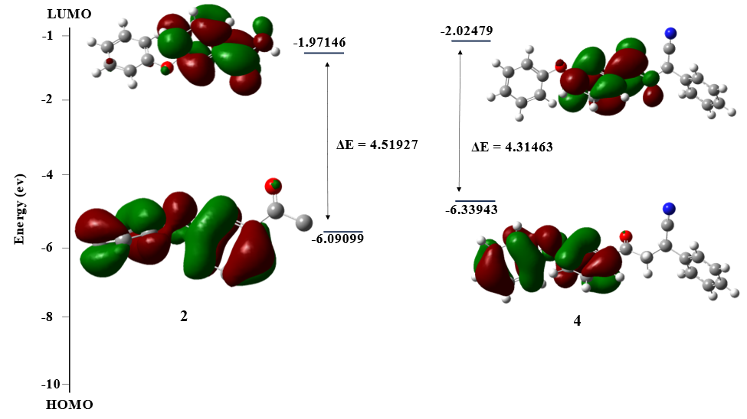
DFT studies on the mechanism of base-catalyzed hydrocyanation of alpha, beta-unsaturated ketones
Graphical Abstract
Fig 1.
Fig 2.
Fig 1. Optimized geometries B3LYP/6-311++G (d, p) method. Deep blue: N, Red: O. Fig 2. FMO orbitals (isovalue: 0.02 [e bohr−3]1/2oftrans-DZgenerated from TD/DFT calculation). Green and Maroon colours depict different phases.

Slide 3
Abstract:
When it comes to creating new carbon-carbon bonds during the hydrocyanation of α, β-unsaturated ketones, catalytic Michael addition reactions are extremely effective tools. A simple method for converting α, β-unsaturated ketone to its hydrocyanic form involves using cyanohydrin acetone with a mild base and a phase transfer catalyst. This reaction stoichiometry produced a high-quality product with a high yield on the gram scale. Density functional theory (DFT) calculations have been used in a comprehensive theoretical investigation to elucidate the mechanism of base-catalyzed hydrocyanation reaction of enolizable α, β-unsaturated ketone. B3LYP-D3(BJ)/6-311+G**//B3LYP-D3(BJ)/6-311G** was used to study the genesis and reaction mechanism of asymmetric induction for conjugate addition of cyanide to the C=C bond of α, β-unsaturated ketone. Additionally taken into account are the relative stability of the investigated compounds as well as their atomic charges, electron densities, energetic characteristics, chemical thermodynamics, dipole moments, etc. The final charge transfer interaction within the investigated molecule is suggested by the narrow frontier orbital gap, which also demonstrated significant chemical reactivity. Lastly, to visualise the charge transfer between the localised bonds and lone pairs, natural bond orbital analysis is done. The current study's mechanistic insights should be helpful in the logical design of efficient catalysts with high selectivity and yield for this type of reaction.
Keywords: DFT; Frontier orbital gap; Hydrocyanation; α, β-unsaturated ketones.

Slide 4
Introduction
Chalcones are carbonyl compounds with α -and β-unsaturation, and two phenyl rings linked to the carbonyl and -carbon, respectively. Synthetic methods for producing chalcones have been outlined in several reviews. They are the main constituents of natural products and are significant precursors for synthesis. As double bonds are present in conjugation with carbonyl groups, chalcones and their derivatives exhibit substantial biological actions that are crucial for drug creation. The α and β unsaturation is responsible for the pharmacological properties of chalcones with significant therapeutic applications, including electrochromic, fluorescence, dielectric, antimicrobial, anti-HIV, antibacterial, anti-inflammatory, anticancer, DNA-binding, and enzyme inhibition properties. They have been used as intermediates in numerous chemical reactions, including the synthesis of flavonoids and isoflavonoids, owing to their high solubilities. Chalcone derivatives are potent free-radical scavengers. In the most recent research publications, density functional theory (DFT), a computational technique to enhance the chemical and physical characteristics of synthesized substances, has been published and proven to be an important tool based on quantum mechanics. Currently, DFT simulations are most frequently used to calculate the gas-phase proton affinities of molecules, various spectroscopic characteristics of compounds, and molecular structural features. To enhance the experimental results and the electrical characteristics of the chalcone derivatives, the use of density functional theory (DFT) in the ground state was further investigated.

Slide 5
Results and discussion
Compounds | HOMO | LUMO | Energy Gap | Hardness (ή) | Softness (S)
2 | -6.49 | -1.971 | 4.519 | 2.259 | 0.442
3 | -6.09 | -2.272 | 3.818 | 1.909 | 0.523
4 | -6.339 | -2.024 | 4.315 | 2.157 | 0.463
Compounds | Ionisation Potential | Electronegativity(χ) | Electron Affinity
2 | 6.49 | 6.49 | 6.49
3 | 6.09 | 6.09 | 6.09
4 | 6.339 | 6.339 | 6.339
Orbitals | 2 | 3 | 4
HOMO | -6.49 | -6.09 | -6.339
LUMO | -1.971 | -2.272 | -2.024
Eg [HOMO-LUMO] | 4.519 | 3.818 | 4.315
HOMO -1 | -7.153 | -6.408 | -6.901
LUMO +1 | -0.838 | -0.752 | -0.499
Eg [(HOMO-1) - (LUMO+1)] | 6.315 | 5.656 | 6.402
HOMO -2 | -7.281 | -6.741 | -7.126
LUMO +2 | -0.707 | -0.259 | -0.379
Eg [(HOMO-2) – (LUMO+2)] | 6.574 | 6.482 | 6.747
HOMO -3 | -7.34 | -6.96 | -7.152
LUMO +3 | -0.405 | -0.245 | -0.329
Eg [(HOMO-3) – (LUMO+3)] | 6.935 | 6.245 | 6.823
Compounds | Electrophilicity Index | Nucleophilicity Index | Chemical Potential
2 | 3.96 | 0.25 | -4.23
3 | 4.57 | 0.21 | -4.181
4 | 4.05 | 0.24 | -4.181
Table 1,2,3.4 Calculated Global Reactivity Descriptors by B3LYP/6-31+G (d, p) Basis Set at DFT Level of Theory

Slide 6
Conclusions
In this study, we report DFT calculation of a new chalcone derivative, A computational study of the conversion of 3-(3-phenoxy phenyl)-1-aryl prop-2-en-1-one into 4-Oxo-4-(3-phenoxy phenyl)-2-phenyl-butane nitrile using density functional theory (DFT) calculations was performed. Using DFT techniques at the B3LYP/6-311++G (d,p) and DFT computational levels, the molecular mechanisms of the likely hydrocyanation reactions of (E)-1-(3-phenoxy phenyl)-3-phenylprop-2-en-1-one with acetone cyanohydrin to 4-oxo-4-(3-phenoxy phenyl)-2-phenyl-butane nitrile were examined. The reaction’s spontaneity may be seen by analysing the energy of HOMO and LUMO, as well as the energy gap value. The reaction pace is determined by the species whose most electrophilic centre corresponds to the hardness or softness value of the compound.

Slide 7
Acknowledgments
The authors are thankful to the Principal of the Institute of Pharmacy and Technology and The Dean of C.V. Raman Global University for providing the necessary facilities to carry out the research paper.

