Slide 1
Calcium Biofortification in Solanum tuberosum L.: assessing the influence of calcium nitrate and calcium chloride on yield
Ana Rita F. Coelho^{1,2*}, Inês Carmo Luís^{1,2}, Ana Coelho Marques^{1,2}, Cláudia Campos Pessoa^{1,2}, Diana Daccak^{1,2}, Carlos Galhano^{1,2}, Manuela Simões^{1,2}, Maria Manuela Silva^{1,2}, Maria F. Pessoa^{1,2}, Fernando H. Reboredo^{1,2}, Paulo Legoinha^{1,2}, José C. Ramalho^{2,3}, Paula S. Campos^{2,4}, Isabel P. Pais^{2,4}, José N. Semedo^{2,4}, Fernando C. Lidon^{1,2}
¹ Departamento de Ciências da Terra, Faculdade de Ciências e Tecnologia, Campus da Caparica, Universidade Nova de Lisboa, 2829-516 Caparica, Portugal.
² Centro de Investigação de Geobiociências, Geoengenharias e Geotecnologias (GeoBioTec), Faculdade de Ciências e Tecnologia, Campus da Caparica, Universidade Nova de Lisboa, 2829-516 Caparica, Portugal.
³Plant Stress & Biodiversity Lab, Centro de Estudos Florestais (CEF), Laboratório Associado TERRA, Instituto Superior Agronomia (ISA), Universidade de Lisboa (ULisboa), Quinta do Marquês, Avenida da República, 2784-505 Oeiras, Portugal.
⁴Instituto Nacional de Investigação Agrária e Veterinária, I.P. (INIAV), Quinta do Marquês, Avenida da República, 2780-157 Oeiras, Portugal
* Corresponding author: arf.coelho@campus.fct.unl.pt

Slide 2
Calcium Biofortification in Solanum tuberosum L.: assessing the influence of calcium nitrate and calcium chloride on yield
Abstract:Potato (Solanum tuberosum L.) is a widely consumed and essential food crop globally, making it an ideal food matrix for biofortification. Agronomic biofortification is one of the strategies used to enhance Ca content in edible parts of crops, considering the adverse health issues associated with Ca deficiency. This study aims to investigate the impact of Ca agronomic biofortification through four foliar applications after the beginning of tuberization, on yield of tubers of Solanum tuberosum L. (Picasso variety) produced in Lourinhã (Portugal) in 2018, focusing on the use of calcium chloride or alternatively, calcium nitrate at different concentrations applied (calcium chloride - 1, 3, 6 and 12 kg/ha or calcium nitrate - 0.5, 1, 2 and 4 kg/ha). Control plants and plants submitted to the different Ca treatments were implemented in plots of 20 x 24 m, having been carried out in quadruplicate (compass 60-80 cm). As such, Ca content in tubers was quantified by atomic absorption spectrophotometry in the different treatments. The Ca biofortification index with calcium chloride or calcium nitrate ranged between 5 – 40 %, being the treatment with 6 kg/ha CaCl₂ the one which presented the highest Ca content in tubers at harvest and 1 kg/ha CaCl2 the treatment with the lowest Ca biofortification index. However, 6 kg/ha CaCl₂ despite presenting the highest Ca content wasn’t the treatment that presented the highest yield. Indeed, all the calcium nitrate treatments demonstrated a substantial increase in tubers yield, which varied between 2.3 (4 kg/ha Ca(NO₃)₂)– 24.3 % (2 kg/ha Ca(NO₃)₂). Statistical analysis was carried out in all the analyses using one-way ANOVA to assess differences among treatments in Solanum tuberosum L. (Picasso variety), followed by Tukey’s analysis for
mean comparison, with a 95% confidence level. Furthermore, these findings emphasize the
potential of Ca biofortification, especially calcium nitrate treatments, in enhancing the yield
of Solanum tuberosum L. tubers.
Keywords: calcium biofortification; calcium nitrate; calcium chloride; Solanum tuberosum L.; yield

Slide 3
Calcium Biofortification in Solanum tuberosum L.: assessing the influence of calcium nitrate and calcium chloride on yield
Calcium is a highly abundant mineral element present in the human body and has a crucial role in various bodily functions, including the development of bones and teeth, muscle contraction and in the circulatory system.
Ca deficiency can lead to various health issues, including osteoporosis and rickets, it’s important to have strategies for combating it.
Agronomic biofortification has emerged as a fast, reliable, and cost-effective approach for that goal of increasing mineral content in edible parts of plants, particularly through foliar applications. However, despite being important to obtain an increase in mineral content of crops, it’s also essential not to reduce their yield.
This study aims to investigate the effects of Ca biofortification on Solanum tuberosum L. tubers of Picasso variety through foliar applications and their subsequent yield, assessing the impact of four different concentrations of calcium chloride (1, 3, 6 and 12 kg/ha) and calcium nitrate (0.5, 1, 2 and 4 kg/ha).

Slide 4
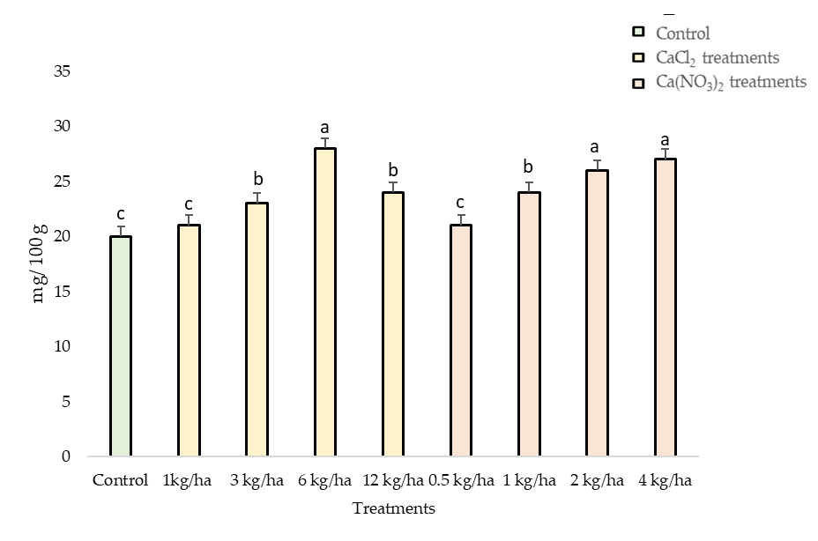
Results
Calcium content in tubers submitted to Ca biofortification treatments presented higher values compared to control (Figure 1). In fact, 3 kg/ha CaCl₂, 6 kg/ha CaCl₂, 12 kg/ha CaCl₂, 1 kg/ha Ca(NO₃)₂, 2kg/ha Ca(NO₃)₂ and 4 kg/ha Ca(NO₃)₂ presented significantly higher values relative to control. Moreover, with Ca biofortification treatments, the biofortification index varied between 5 – 40 %, being 6 kg/ha CaCl₂ the treatment which presented the highest Ca content compared to the remain treatments (Figure 1).
Figure 1. Calcium content (considering dry weight) in tubers of Solanum tuberosum L. (Picasso variety) at harvest. Mean values (n=4) ± SE (standard error). Different letters (a,b,c) indicate significant different between treatments

Slide 5
Results
Table 1. Total yield at harvest of Solanum tuberosum L. tubers (Picasso variety).
Considering the total yield of Solanum tuberosum L. tubers from Picasso variety (Table 1), only treatments with calcium chloride with the concentrations of 1 and 12 kg/ha presented lowest yield value relatively to control. Moreover, 2 kg/ha of Ca(NO₃)₂ treatment showed the highest yield in Picasso variety and CaCl₂ treatments only presented an increase in yield between 0.1 – 3.4 % and Ca(NO₃)₂ treatments showed an increase which varied between 2.3 – 24.3 %. Additionally, calcium nitrate treatments (0.5, 1, 2 and 4 kg/ha) always showed a yield increase, relatively to control. On the other hand, considering the calcium chloride treatments, only 3 and 6 kg/ha treatment showed an increase in yield.
Treatments | Yield (kg)
Control | 106.5
1 kg/ha CaCl₂ | 96.1
3 kg/ha CaCl₂ | 110.1
6 kg/ha CaCl₂ | 106.6
12 kg/ha CaCl₂ | 104.2
0.5 kg/ha Ca(NO₃)₂ | 116.6
1 kg/ha Ca(NO₃)₂ | 131.2
2 kg/ha Ca(NO₃)₂ | 132.4
4 kg/ha Ca(NO₃)₂ | 109

Slide 6
Conclusions
Considering the data obtained in this study, potato (Solanum tuberosum L.) is a highly suitable candidate for biofortification, namely in Ca, despite showing different variations of Ca biofortification index considering the product used (calcium chloride or calcium nitrate).
All the treatments with calcium nitrate presented increases in tuber yield, suggesting that calcium nitrate biofortification holds a potential for increasing yield in Solanum tuberosum L. tubers of Picasso variety.
This study highlights the effectiveness of Ca biofortification in enhancing mineral content in Solanum tuberosum L. tubers and the need of future optimization of a biofortification workflow with calcium nitrate treatments not only in Picasso but also in other varieties of Solanum tuberosum L..

Slide 7
Acknowledgments
The authors thank to Eng. Nuno Cajão and Eng. Mónica Correia (Cooperativa de Apoio e Serviços do Concelho da Lourinhã -LOURICOOP for technical assistance on the field as well as to the research center (GeoBioTec) UIDB/04035/2020, (CEF) UIDB/00239/2020 and Associate Laboratory TERRA (LA/P/0092/2020).
This research was received funding from PDR2020-101-030719. This work was further supported by the grant of the Fundação para a Ciência e Tecnologia (FCT) UI/BD/150806/2020.

