Slide 1
Artificial intelligence and optimisation computing to lead energy retrofit programs in complex real estate investments
Aurora Greta Ruggeri, Laura Gabrielli and Massimiliano Scarpa

Slide 2
Topic of interest
Topic
Planning Energy retrofit actions in wide building stocks
Goal
Elaborate a decision-making model for energy retrofit in property portfolios to achieve the optimal allocation of financial resources under a multi-objective perspective (environmental, social, economic, cultural..), within given constraints (budget, feasibility..)
DECISION SUPPORT SYSTEM
integration of artificial intelligence and optimisation computing to sustain energy retrofit investments in complex real estate assets

Slide 3
Research questions
RQs
Literature gaps
How can we handle energy retrofit operations at the stock level, managing a huge number of properties at a time, addressing the problems of:
Buildings’ energy demand assessment;
Identification of the optimal outcome while considering multiple objectives and constraints;
Evaluation of the risk around the result
Energy assessment
Lack of a shared methodology to assess energy consumption at a portfolio level: fast, reliable, not excessively data-demanding
Retrofit
actions
Lack of automated calculation procedures in order to jump from the single-building perspective to a stock-based one, and that allow comparing a huge amount of retrofit scenarios
Assessment criteria
Optimization
Lack of a shared methodology to allocate resources at a portfolio level considering multiple objectives, within given constraints
Risk and uncertainty
Lack of a shared methodology to “quantify” risk for energy retrofit operations at a portfolio level (sources of uncertainty)

Slide 4
Method: general approach
NEURAL NETWORKS
Energy consumption pre-retrofit
ANALYTIC HIERARCHY PROCESS
Retrofit options
Retrofit scenarios
Energy Savings
Monetary Savings
Restoration Score
Evolutive algorithm
Optimal configuration
MAXIMUM BENEFIT
Risk and uncertainty analysis

Slide 5
Energy assessment with the Artificial Neural Networks
100,000 parametric simulations
The first problem the research faces is the assessment of energy-uses and energy-efficiency potentials for a building asset counting a plethora of premises, which ends up being a problem of mass-appraisal and screening evaluation. To address this first issue, 100,000 parametric simulations are run in Energy Plus.
DATABASE PRODUCED
Development of the NEURAL NETWORKS
INPUT NEURONS
X₁
OUTPUT NEURON
X₂
…
…
…
Y_{forecast}
…
Buindings’ information
X_{r}
Energy consumption
X_{R}
HIDDEN LAYERS

Slide 6
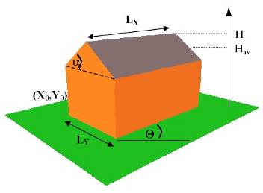
Producing the training database
to develop the Artificial Neural Networks
Such simulations associate the varying building’s characteristics (envelope, installations, dimension, etc.) to the corresponding primary energy consumption.
Geometry
Climatic Area
Exposure
Envelope
Orientation
Installations
Use and Schedule
INPUTS
OUTPUT
Parametric building characteristics
Yearly Primary Energy Demand
100,000 parametric simulations
DATABASE PRODUCED
Development of the NEURAL NETWORKS

Slide 7
A case-study in Italy
All the possible combinations of energy retrofit interventions (Scenarios)
The pilot case-study is a small portfolio of residential buildings in Bologna, Northern Italy.
The portfolio analysed involves eleven residential buildings built in Bologna between years 1950 - 1990.
B_{k}S_{m}
building
scenario
B_{k}, k ∈ N {1, …, 11},
11 buildings B_{k} →
B_{k}, k ∈ N {1, …, 11},
S_{m}, m ∈ N {1, …, M}.
M retrofit Scenarios S_{m} →
S_{m}, m ∈ N {1, …, M},
a total of 1,11504E+43 scenarios can be generated !!!

Slide 8
Three decision-making criteria
To understand which could be the best retrofit scenario to be implemented on every building of a stock, three performance indexes are introduced.
The three indexes measure the impact produced in terms of energy, monetary and architectural aspects.
The energy savings (ES) are assessed using the neural networks, comparing the energy consumption before and after the retrofit.
The net monetary savings (NS) are estimated based on a Life Cycle Costing approach.
The architectural compatibility of the retrofit measure on the building is assessed by means of an Analytic Hierarchy Process allowing the assessment of a restoration score (RS).
Energy Savings
Monetary Savings
Restoration Score

Slide 9
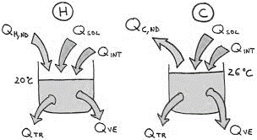

1st decision-making criterion: Energy Savings (ES)
The environmental benefits are given as the energy saved (ES) per year (kWh/m²·y). The ES_{m} parameter measures the yearly primary energy demand for space heating/cooling, hot water and lighting (YED_{m}) saved after the implementation of any m^{th} scenario if compared to the as-is status.
∀ B_{k}, k ∈ N {1, …, 11}
∀ S_{m}, m ∈ N {1, …, M} → ∀ B_{k}S_{m}
$${ES}_{k,m} = \left(\frac{Q{heat}_{k,0} }{η_{g_heat{ }_{k,0} }}−\frac{Q{heat}_{k,m} }{η_{g_heat{ }_{k,m} }}\right)∗fp_{heat} + \left(\frac{{Qcool }_{k,0}}{η_{g_cool{ }_{k,0} }}− \frac{{Qcool }_{k,m}}{η_{g_cool{ }_{k,m} }}\right)∗fp_{cool}+ \left(\frac{Q{dhw}_{k,0} }{η_{g_dhw{ }_{k,0} }}−\frac{Q{dhw}_{k,m} }{η_{g_dhw{ }_{k,m} }}\right)∗ fp_{dhw}+ \left(Q{elec}_{k,0}−Q{elec}_{k,m}\right)∗fp_{elec}$$
HEATING
COOLING

Slide 10
2nd decision-making criterion: Net Savings (NS)
$$Discount factor=r=wacc=k_{e}\left(\frac{E}{D+E}\right)+k_{d}\left(\frac{D}{D+E}\right)$$
Economic variables
$$Energy price growth rate_{natural gas}$$
$$Energy price growth rate_{electricity}$$
The NS_{m} are simply the difference in the LCC pre and post retrofit. The NS are assessed over a period of 30 years:
∀ B_{k}, k ∈ N {1, …, 11}
∀ S_{m}, m ∈ N {1, …, M} → ∀ B_{k}S_{m}
t ∈ N {0, …, 30}
s ∈ N {0, …, 10}
$${NS}_{k,m}={LCC}_{k,0 }−{LCC}_{k,m }==\sum_{t=0}^{T}{\left(\frac{{{{Cop}_{gas}}_{k,0} {\left(1+g_{gas}\right)}^{t} }_{ }}{{\left(1+r\right)}^{t}}+ \frac{{{{Cop}_{ele}}_{k,0} {\left(1+g_{ele}\right)}^{t} }_{ }}{{\left(1+r\right)}^{t}}\right)+} −\sum_{t=0}^{T}{\sum_{s=0}^{S}{\left(\frac{{{Ci}_{k,m}}_{ }}{{\left(1+r\right)}^{t}}+ \frac{{{{Cop}_{gas}}_{k,m} {\left(1+g_{gas}\right)}^{t} }_{ }}{{\left(1+r\right)}^{t}}+ \frac{{{{Cop}_{ele}}_{k,m} {\left(1+g_{ele}\right)}^{t} }_{ }}{{\left(1+r\right)}^{t}}− \frac{\left({\left.F_{k,m}\right)}_{ }\right.}{{\left(1+r\right)}^{s}}\right)}}$$

Slide 11
3rd decision-making criterion: Restoration score (RS)
The restoration score is assessed through an Analytic Hierarchy Process. Each retrofit option is assigned a score that reflects the compatibility of interventions
∀ B_{k}, k ∈ N {1, …, 11}
∀ O_{q}, q ∈ N {1, …, 18} e
Ω = {O₁, …, O_{q}, …, O₁₈}
∀ S_{m}, m ∈ N {1, …, M}
con S_{m} = ∀ ⊂ ∨ ⊆ Ω
→ ∀ B_{k}S_{m}
${RS}_{k,m}$ = function (AHP)
$${RS}_{k,m}=RS_avg= \frac{{\sum{RS}}_{q}}{Ʃq}$$
A commission of 10 experts evaluates the retrofit options according to the principles of restoration
0% <=${RS}_{k,m}$ <= 100%
OBJECTIVE
AHP
Restoration Score
CRITERIA
Reversibility
Distinguishability
Authenticity
Compatibility
Minimum Intervention
Visual Impact
Retrofit 1
Retrofit n
Retrofit 2
ALTERNATIVES
………….
Retrofit n-1

Slide 12
Multi attribute optimization
After the three decisional indexes ES; NS; RS are established, an evolutionary algorithm is launched to test out the overall benefits produced by every scenario if applied to the buildings of a stock and select the best scenario
The algorithm iteratively calculates the indexes for every scenario of intervention inside the feasibility domain, as a sum of the benefits/costs for each building.
The target is the optimal configuration of interventions over the stock, i.e. the one that simultaneously maximizes the three indexes, within the declared constraints.
Weighs are assessed by the 10 experts through an AHP
∀ B_{k}, k ∈ N {1, …, 11}
∀ S_{m}, m ∈ N {1, …, M} → ∀ B_{k}S_{m}
X_{k,m} ∈ N {0,1} = binary decision variable
$$max(fX)\sum_{k=1}^{K}{\sum_{m=0}^{M}{ { [(0,29∗NS}_{k,m})+{(0,60∗ES}_{k,m})+(0,11{∗RS}_{k,m})] }} ∗ {\left(X\right.}_{k,m})$$
∀ k → (B_{k}S_{m_opt}), S_{m_opt} is the optimal set of retrofit options

Slide 13
Identification of the optimal solution
11 buildingsB_{k}
1,11504E+43 combinations
B_{k}S_{m}
18 scenarios S_{m}
Neural networks
Python Code
Automated calculation
Iterative assessment of the indexes ES_{k,m}, NS_{k,m}, RS_{k,m}
Multi attribute optimization
Evolutive algorithm
∀ k → B_{k}S_{m_opt}
Optimal solution
The optimization is solved through an evolutionary algorithm that tests all the feasible combinations building-scenario (B_{k} S_{m}) and stops when the optimum is found.

Slide 14
Results: The Optimal Configuration
Considering the building portfolio as a whole, the investment cost to implement the energy retrofit measures on the eleven buildings is 2,955,063 €, while the produced net saving after a 30-year timeframe is 2,010,305 €.
The overall economic valuation on the entire stock is finally performed through a Discounted Cash Flow analysis (DCFA). It is chosen to prioritize the interventions according to their effectiveness, and a cost-effectiveness index is defined as ES_{k,m_opt}/Ci_{k,m_opt}
$$NPV=\sum_{k=1}^{K}{\sum_{m=0}^{M}{\sum_{t=0}^{n}{\sum_{s=0}^{S}{\left(−\frac{{{Ci}_{k,m }X_{k,m} }_{ }}{{\left(1+r\right)}^{t}}+ \frac{\left({F_{k,m}) X_{k,m} \left[{\left(1+r\right)}^{s}−1\right]}_{ }\right.}{{\left.r(1+r\right)}^{s}}+\frac{{{Sv}_{k,m } {X_{k,m }\left(1+g\right)}^{t}}_{ }}{{\left(1+r\right)}^{t}} \right)}}}}$$
t ∈ N {0, …, 30}
s ∈ N {0, …, 10}
k ∈ N {1, …, 11}
m ∈ N {0, …, M}
As a result, after a 30-year period of analysis, the NPV of cash flows is 1,831,870 €, representing the economic net benefit of the investment over the stock.
The payback period is at year 12, while the IRR is 10.64%.

Slide 15
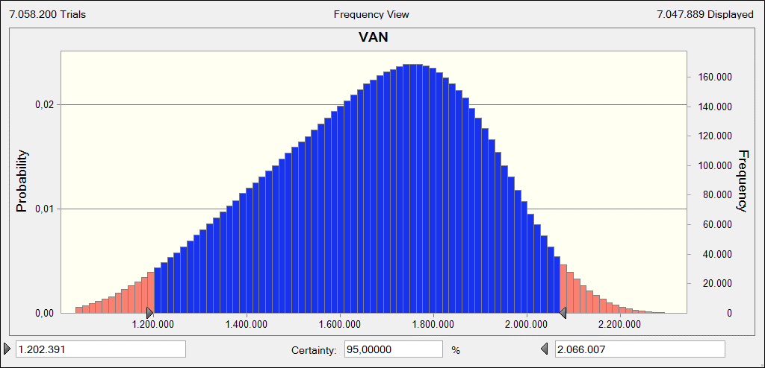
Risk and Uncertainty
In the final part of the research, a risk analysis studies how the uncertainty factors may impact the results of the chosen configuration of interventions.
MONTE CARLO SIMULATION: OUTPUT
Mean
Median
Mode
Standard Deviation
Skewness
Kurtosis
Minimum
Maximum
Range
1,671,546
1,690,936
---
227,760
-0.289
2.58
838,973
2,378,253
1,539,280
NPV (€)
Similar
Higher
Wider

Slide 16
Contribution and Research opportunities
Research
contribution
Fill the lack emerged by the literature of an acknowledged methodology to deal with energy retrofit in wide building stocks, overcoming the single-building perspective
Research
opportunities
Experiment the effectiveness of a flexible decision support system that helps asset holders to evaluate specific, reliable and robust actions to enhance existing building portfolios, optimizing their cash flows
Implication for
practice
Private stakeholders, Public Administrations, real estate companies, asset holders or portfolio managers need reliable decision support systems to select the most cost-effective retrofit solutions to implement

Slide 17
Thank You for Your attention

