Slide 1



Porous material for antimicrobial applications based on β-cyclodextrin and maltol derivative
V. Patamia, C. Zagni, V. Fuochi, S. Dattilo, S. Furnari, P. M. Furneri, G. Floresta, A. Rescifina

Slide 2


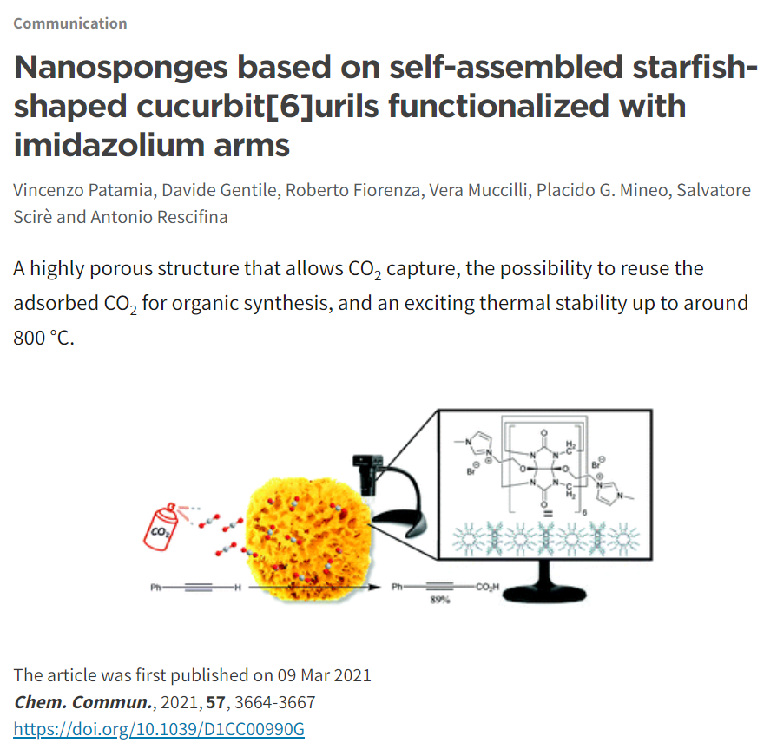
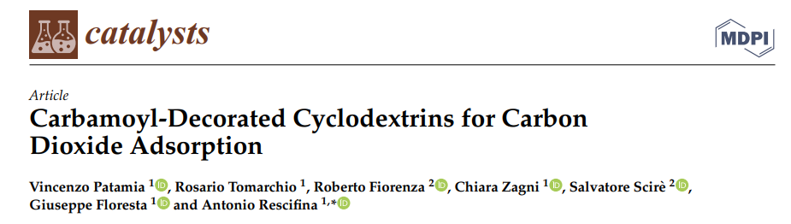
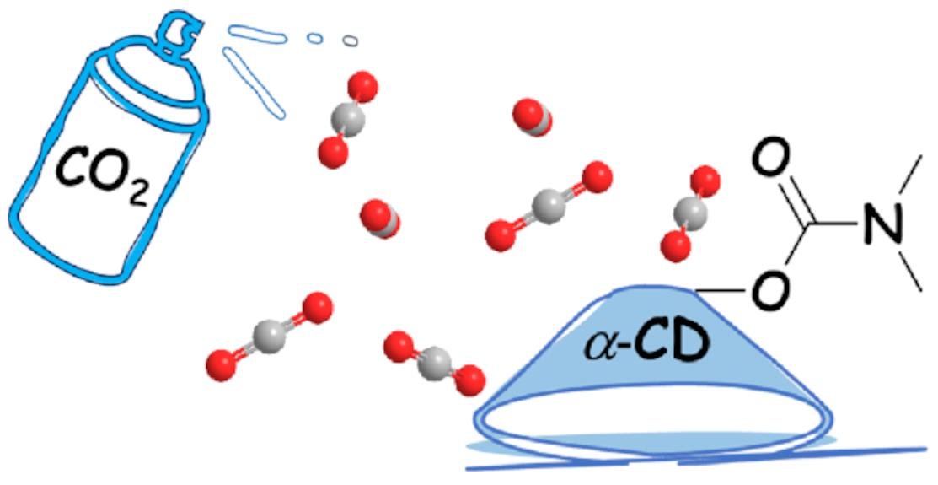
Recently …

Slide 3
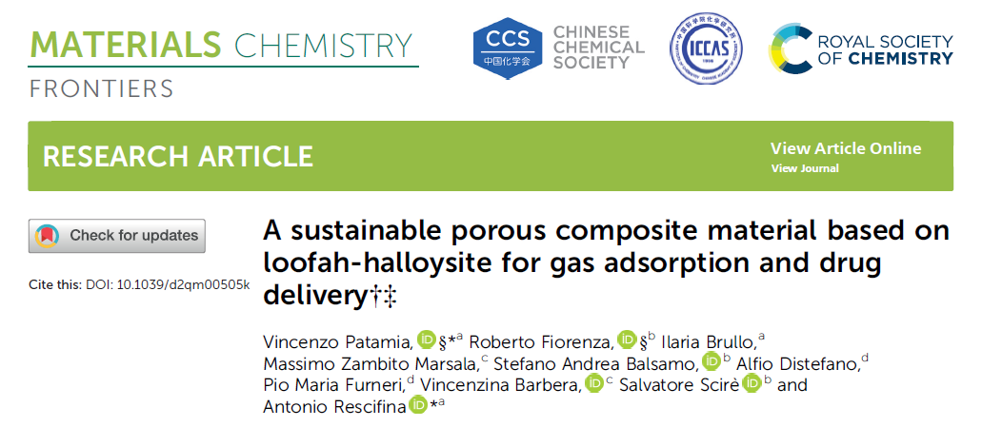
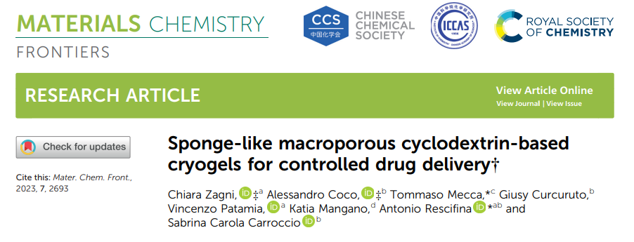
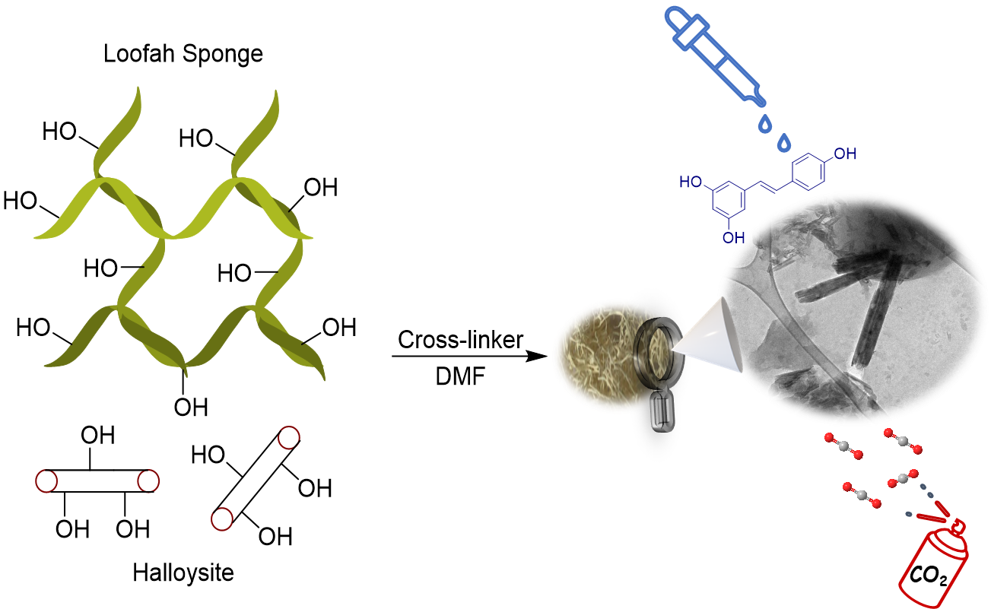
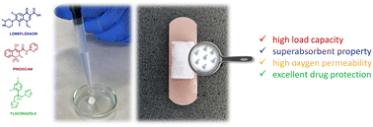
Recently …

Slide 4
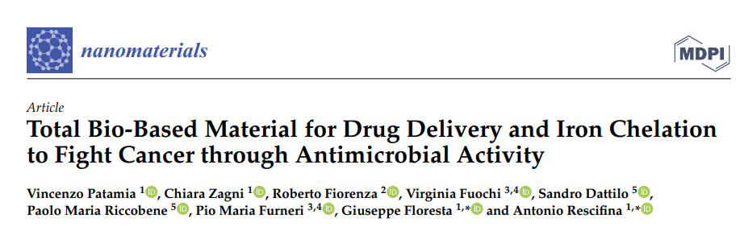
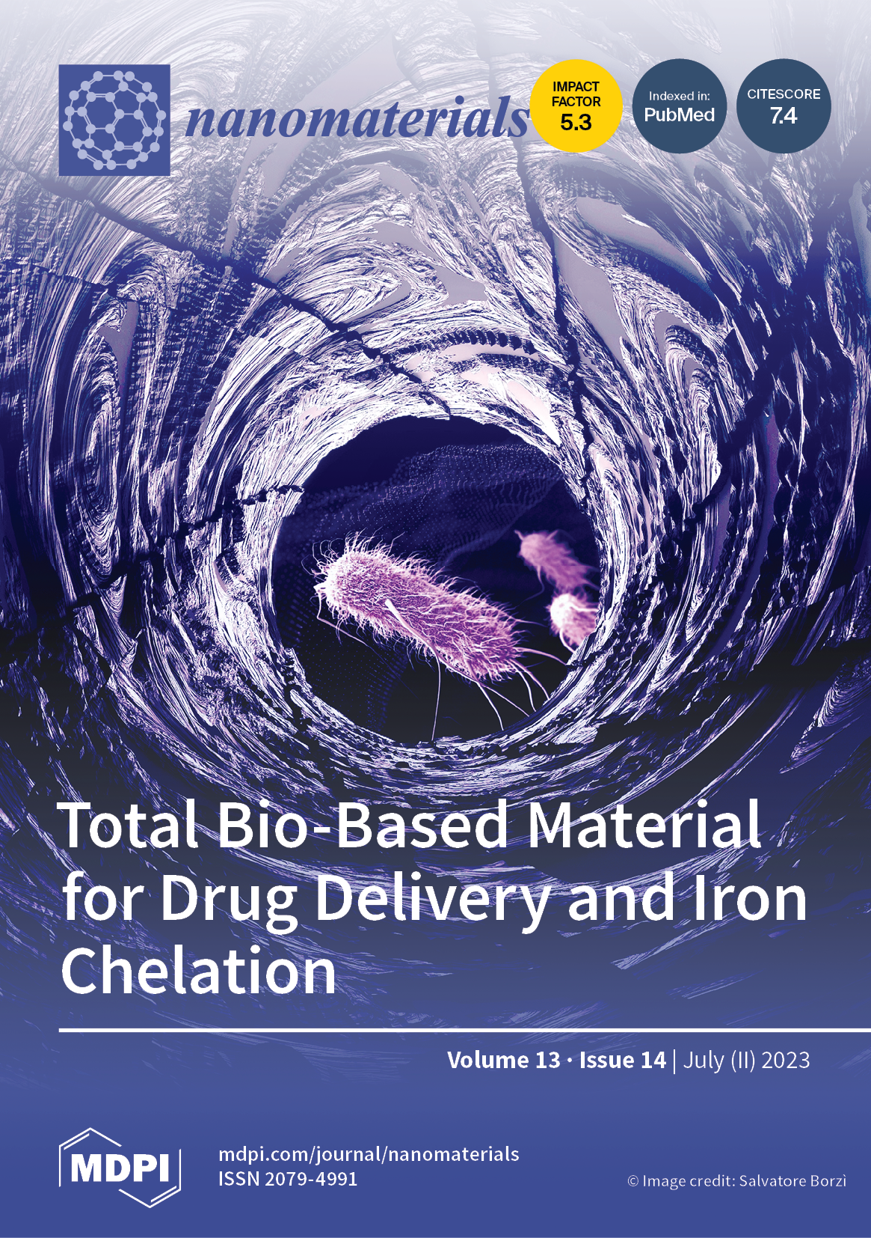
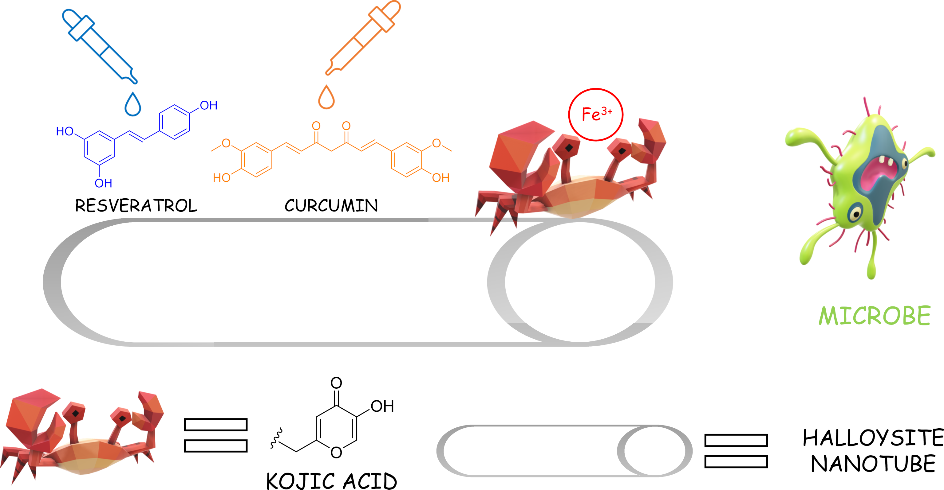
Recently …

Slide 5
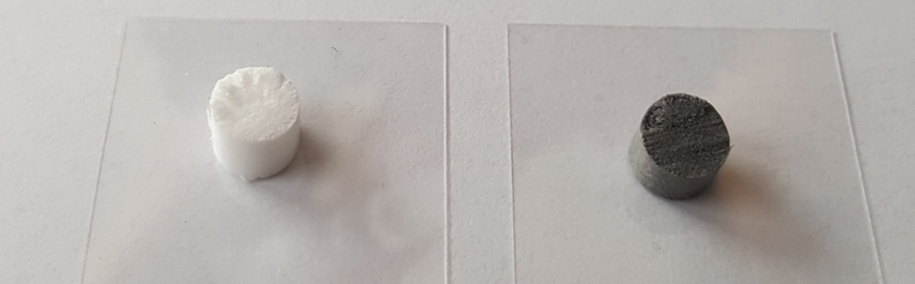
AIM OF THE WORK
DRUG LOADING
IRON CHELATION CAPABILITIES

Slide 6

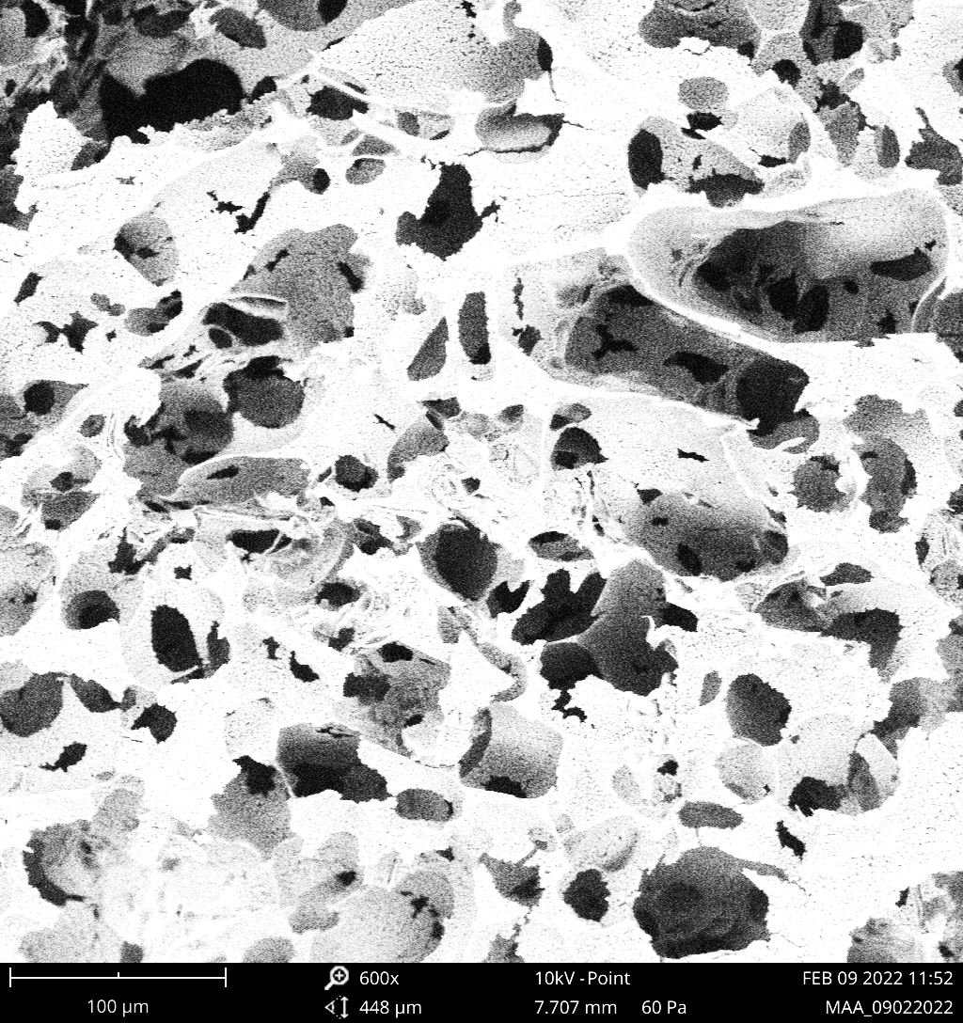
SYNTHESIS
CRYO-POLYMERIZATION
Reactants
T < 0 °C
T > 0 °C
CRYOGELATION
DEFROSTING
Monomer
Solutions
+ crosslinker
+ initiator
10 µm
Solvent crystal
Porous
Schematic diagram of cryogels synthetic procedure

Slide 7
SYNTHESIS

Slide 8
SYNTHESIS

Slide 9
SEM AND
POROSIMETRIC DISTRIBUTION

Slide 10
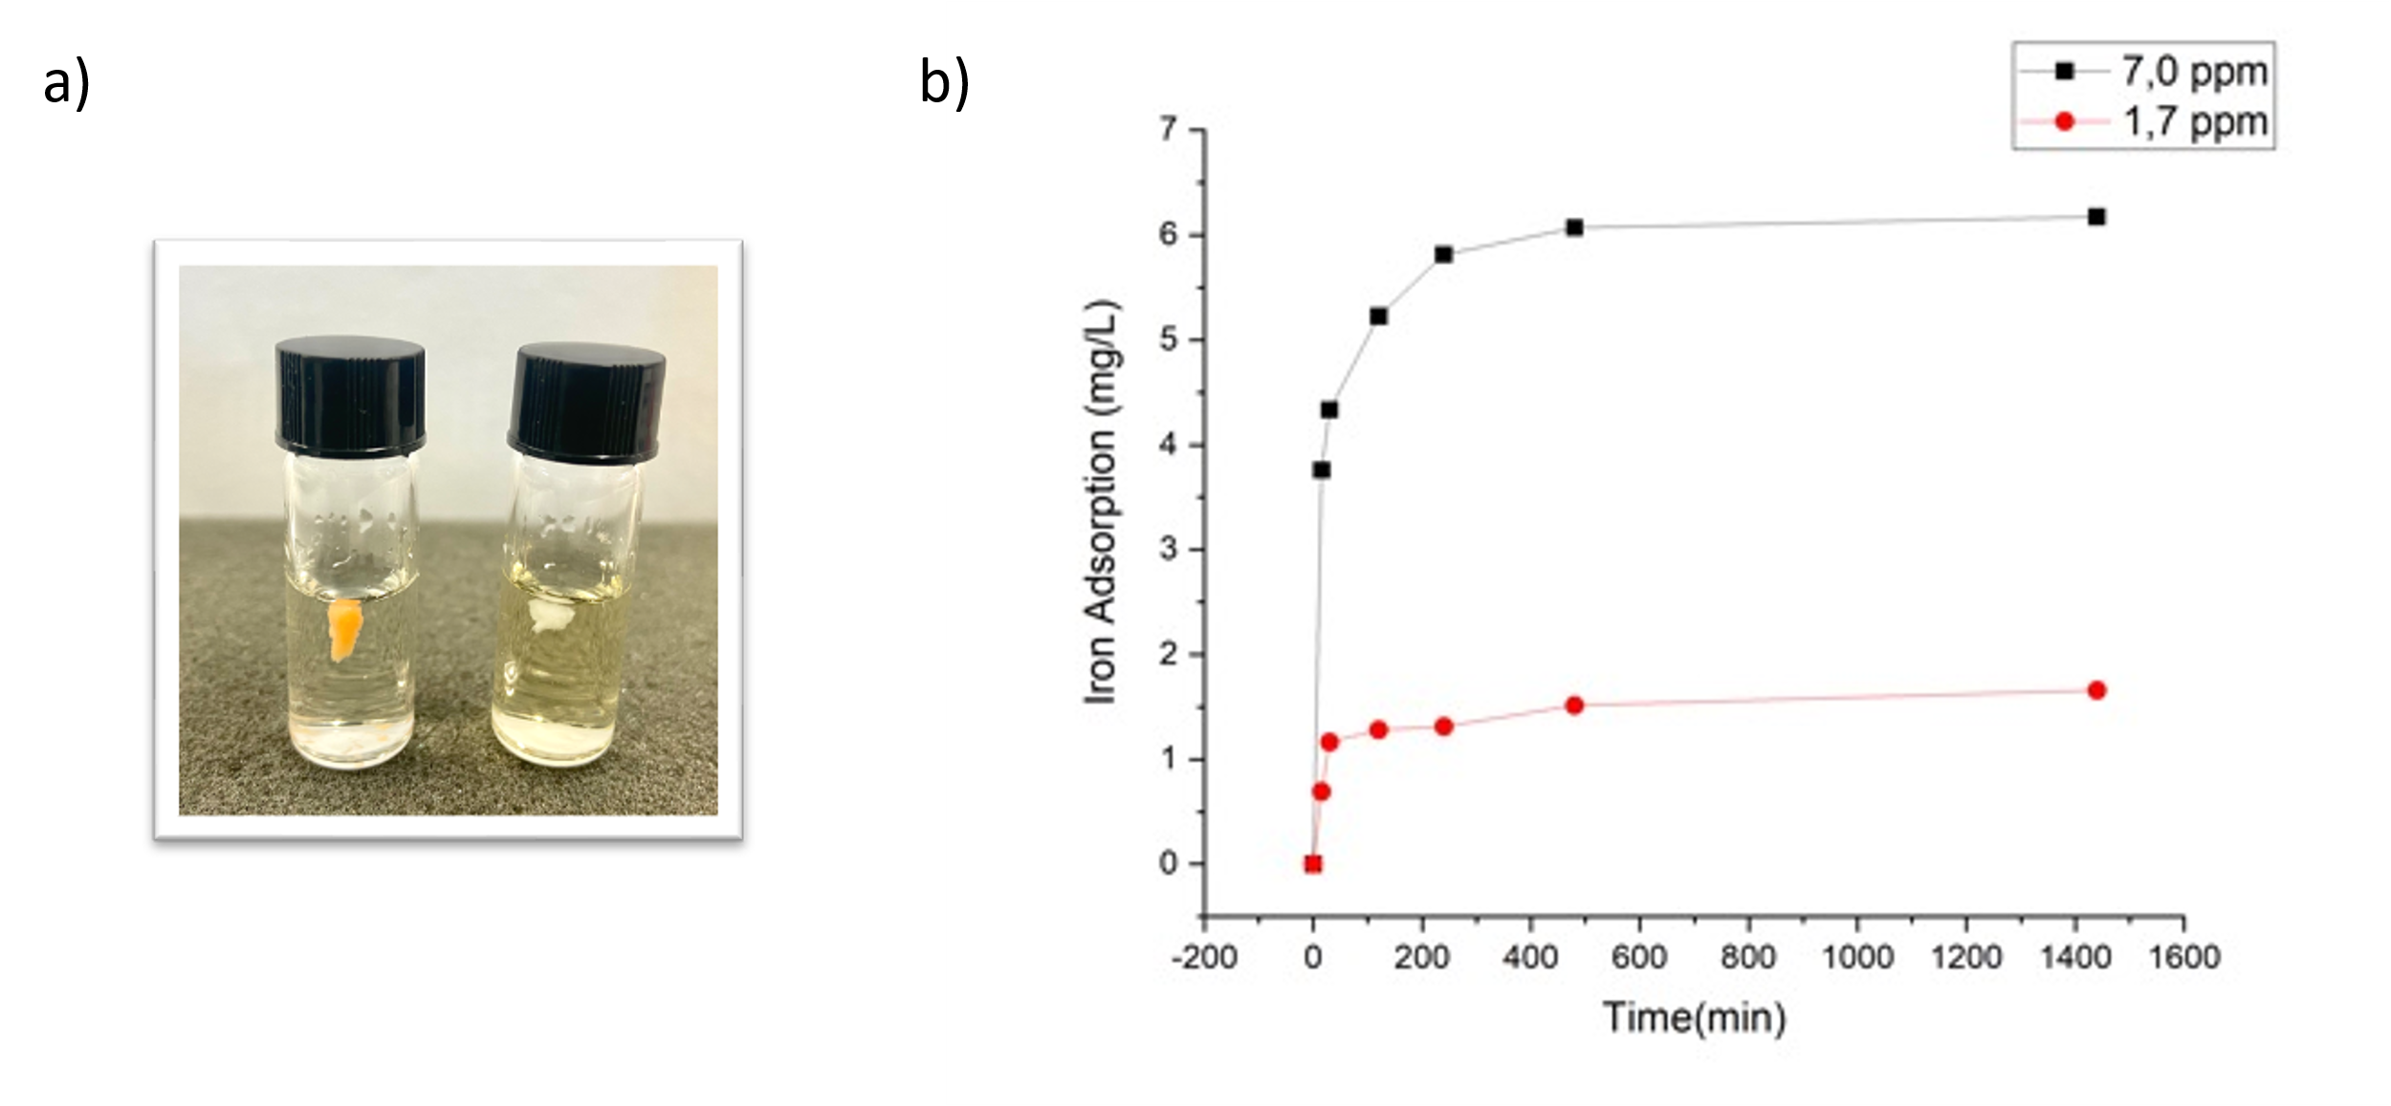
IRON CAPTURE
β-CD/HEMA/Malt
β-CD/HEMA

Slide 11
DRUG LOADING

Slide 12
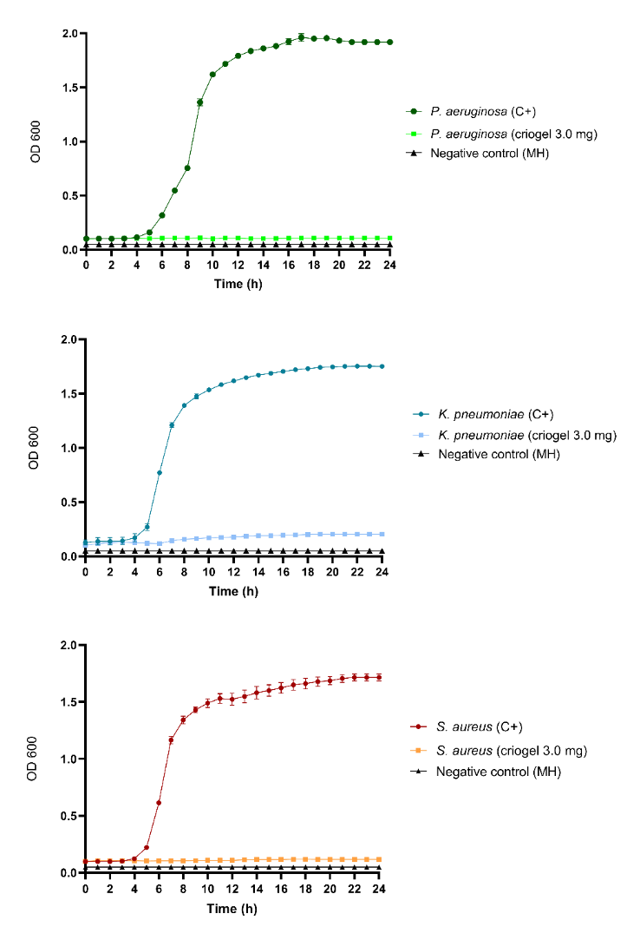
ANTIBACTERIAL ACTIVITY
WITHOUT

Slide 13
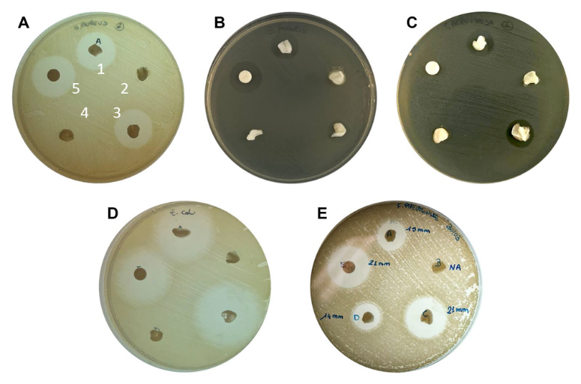
ANTIBACTERIAL ACTIVITY
A) S. aureus
B) E. faecalis
C) P. aeruginosa
D) E. coli
E) K. pneumoniae
WITH
1) β-CD/HEMA + Lomefloxacin
2) β-CD/HEMA
3) β-CD/HEMA/Malt + Lomefloxacin
4) β-CD/HEMA/Malt
5) Lomefloxacin

Slide 14
CYTOTOXICITY

Slide 15

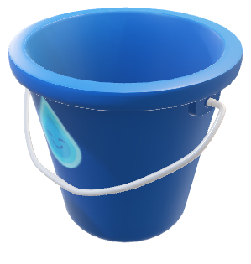
CONCLUSIONS
A drug delivery system based on β-cyclodextrin-maltol derivative was designed
The material has optimal drug loading efficiency and iron chelation capabilities
Dual-acting antibacterial nanomaterial with lomefloxacin and iron depletion properties
No toxicity issue was reported in a human cell line
DRUG
Fe³⁺

Slide 16




THANKS FOR YOUR TIME
acknowledgements
Prof. Antonio Resciﬁna
Dr. Giuseppe Floresta
Dr.^{ssa} Chiara Zagni
Dr.^{ssa} Sabrina Carola Carroccio
Dr. Sandro Dattilo
Prof. Pio Maria Furneri
Dr.^{ssa} Virginia Fuochi
Dr. Salvatore Furnari
GRAZIE
The research leading to these results has received funding from the European Union—NextGenerationEU under PNRR—M4C2-I1.3 Project “HEAL ITALIA”.

