Slide 1
SUBJECT CODE
The 4th International Electronic Conference on Applied Sciences
Submission ID: sciforum-075565
INTELLIGENT SENSING AND CONTROL SYSTEM FOR REAL-TIME GRADED LOAD SHEDDING
Authors: DHANASEKAR RAVIKUMAR *, VIJAYARAJA L, KAUSHIK V N, ANANDAN R, GURU SHARAN G M Section: Electrical, Electronics and Communications Engineering
Project Guided By:Mr.R.Dhanasekar,M.E., (Ph.D.), Associate Professor, Department of EEE
Batch Members:
Anandan R - 412419105002
Gurusharan G M - 412419105008
Kaushik V N - 412419105015
EE8811
PROJECT WORK

Slide 2
PROBLEM STATEMENT
The world necessitates the needs of renewable energy generation for a green and sustainable growth of humanity. In electrical sense, with the current development, this translates to more irregularities and intermittent nature of supply power. Even with the non renewable energy supply has the possibilities of being intermittent in nature. To counter this, we practice load shedding. This has to be done in a very efficient manner in order to continue the working of the essential functionalities, and to protect the equipment from the irregularities.

Slide 4
ABSTRACT
The power shortage is a common case prevailing in today's power scenario. Load Shedding occurs when the demand power is greater than generation power, then the excessive load is to cut avoid power shortage. Usually, load shedding will make use of complex circuitry and systems along with expensive materials. This necessitates the need for a simple and efficient solution that meets all the requirements. The intelligent system is created with the help of microcontrollers achieving Real-time Load shedding. The power limit in the system is obtained from the utility company. The measured value in the system is obtained from the sensor and the value is compared to the power limit. If it is within the limit, no action is taken. When the limit exceeds the calculated value, the power supply is cut off. Graded Load shedding is achieved through the above-mentioned method. Through this graded load-shedding method, the need for changing the existing infrastructure is removed and the existing system is made useful for more amount of time. As this proposed design uses the simplest of the components and technologies, the financial and technical capital that is required to make this is lower as compared to the existing technologies.

Slide 5
OBJECTIVE
Communicate about the load shedding event to the consumer and amount of power to be consumed during load shedding
To achieve Real time sensing and control of load shedding by remote operation.
The utility company to manage the load based on demand and generation by remote system

Slide 6
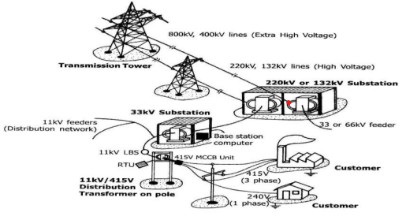
CONVENTIONAL METHOD

Slide 7
PROPOSED METHOD
The proposed system is connected with the power supply from grid and the values are provided to the controller.
The appropriate values of the power ratings for any given time are provided by the utility company to the controller.
The value from the utility company and the value read from the current sensor is compared and the decision is taken.
when the demand power exceeds the supply power the controller will suggest to turn off the tripper, else the normal operation continues.
This is done with the help of gsm model which is used to communicate with the utility company and the control unit.

Slide 8
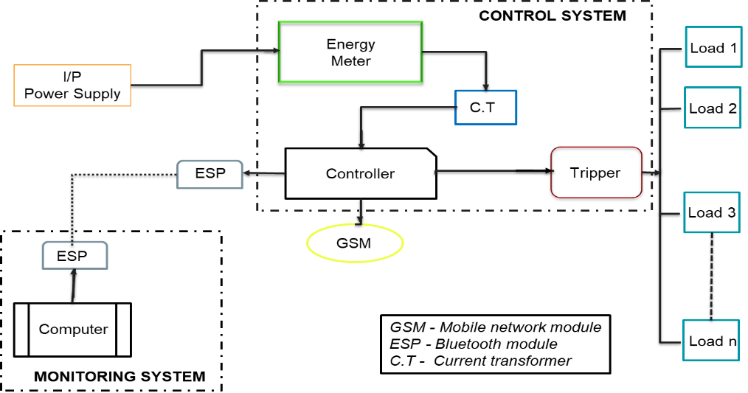
Proposed system of Load shedding

Slide 9
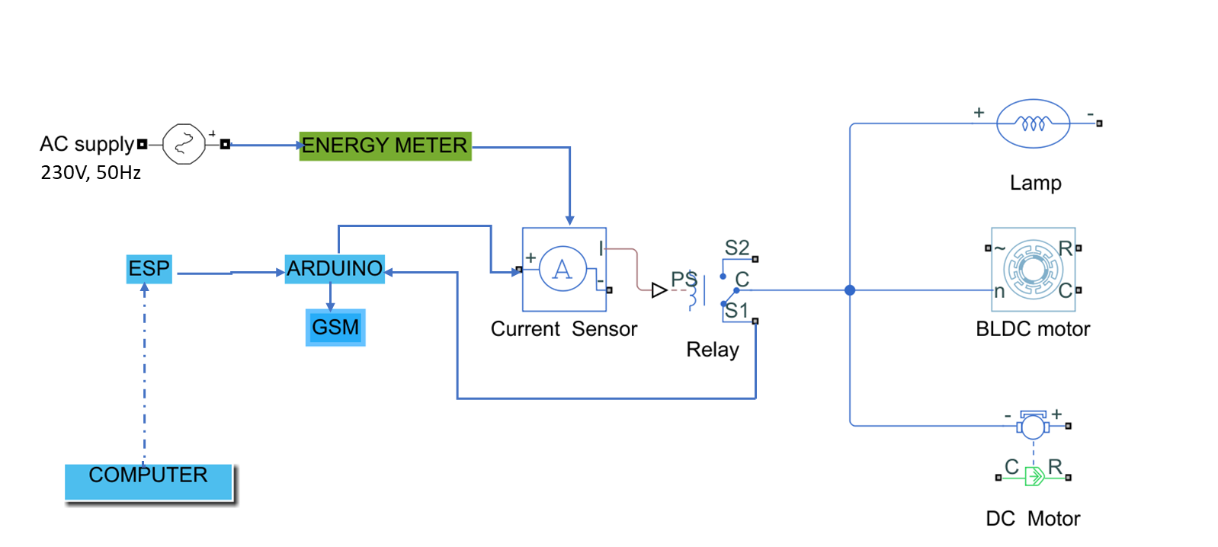
CIRCUIT DIAGRAM

Slide 10
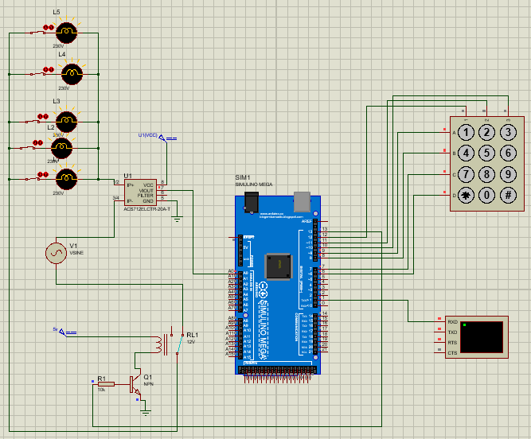
SIMULATION
When there is no load shedding…
L1-1A, L2-2A, L3-3A, L4-4A, L5-5A
SET VALUE – 5A

Slide 11
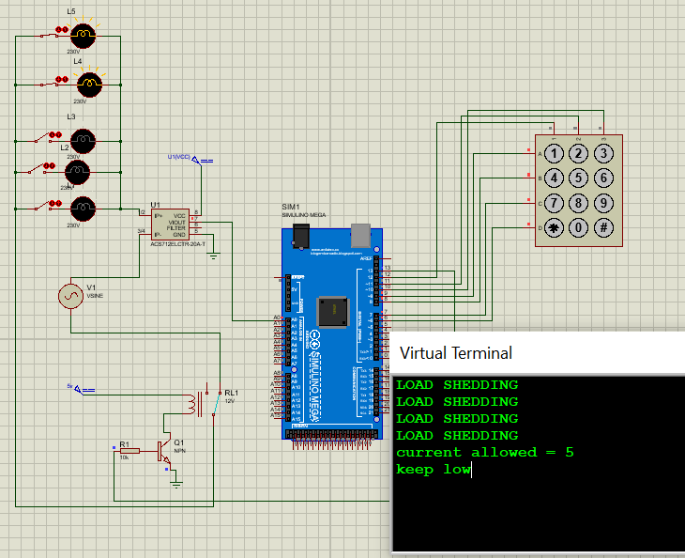
During load shedding, when the power consumption is within the limit…
L1-1A, L2-2A
SET VALUE – 5A ; TOTAL CONSUMPTION – 3A

Slide 12
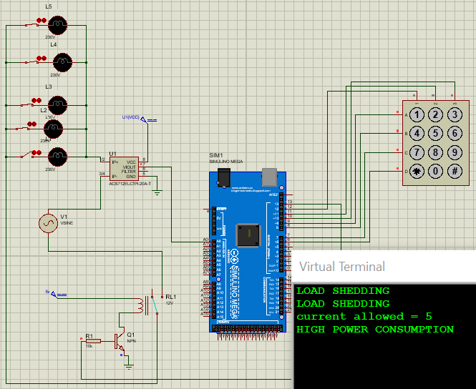
During load shedding, when the power consumption exceed the limit…
L1-1A, L2-2A, L3-3A, L4-4A
SET VALUE – 5A ; TOTAL CONSUMPTION – 10A

Slide 13
COMPONENT DESCRIPTION OF SIMULATION
S.NO | NAME OF THE COMPONENT | DESCRIPTION
1 | Arduino Mega | -
2 | Keypad 4×4 | -
3 | Lamp L1 | 1A
4 | Lamp L2 | 2A
5 | Lamp L3 | 3A
6 | Lamp L4 | 4A
7 | Lamp L5 | 5A
8 | Current Sensor (ACS 712) | 0-30A, 5V
9 | Relay | 16A, 5V

Slide 14
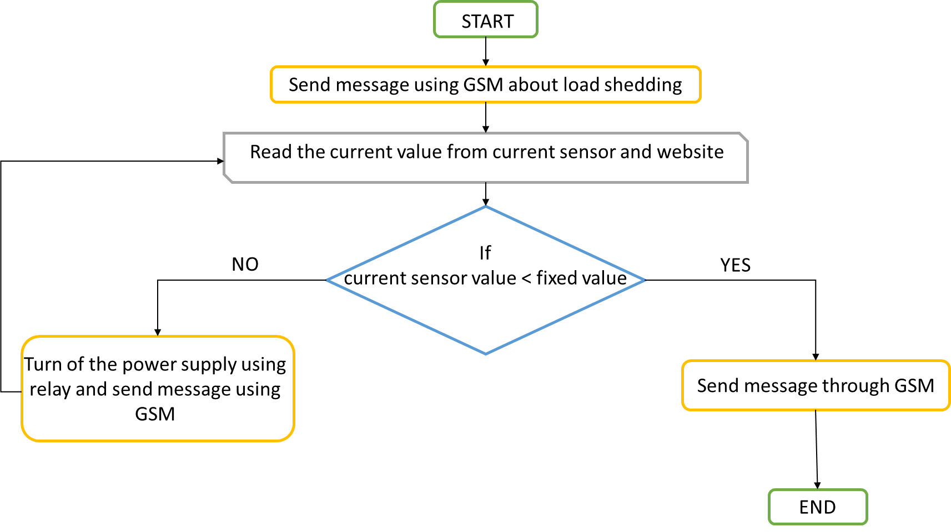
Flow Diagram

Slide 15
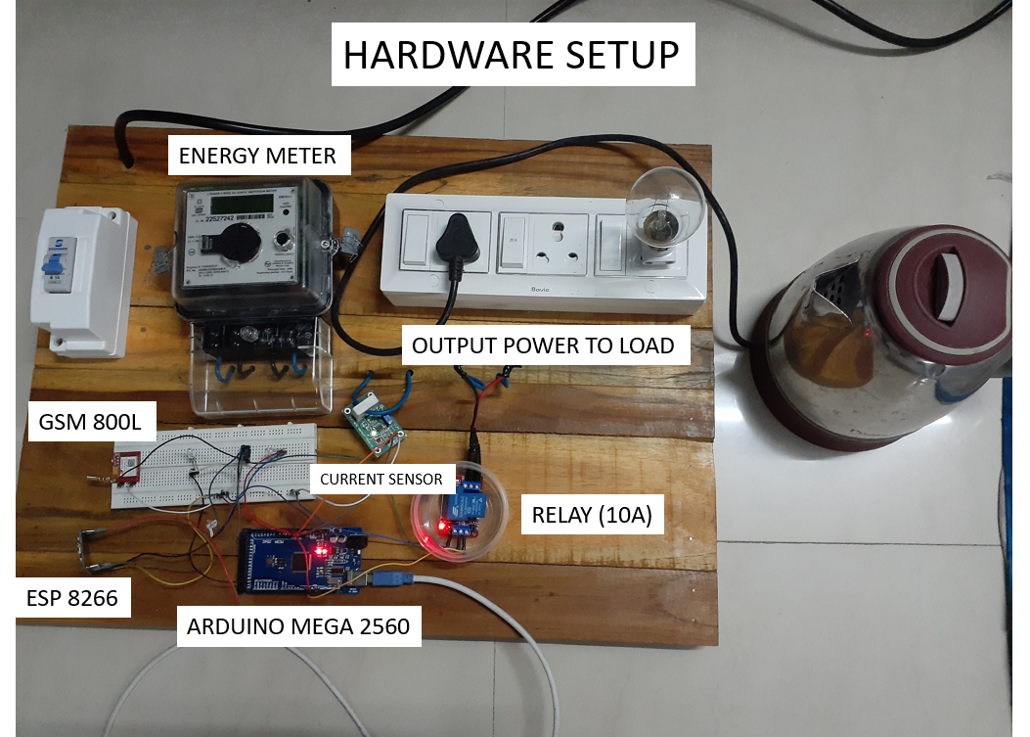

Slide 16
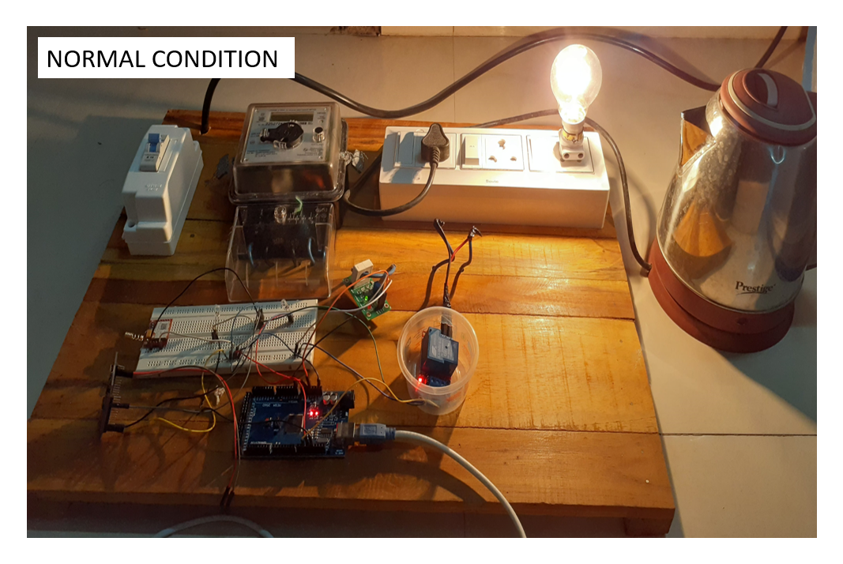

Slide 19
COMPONENT DESCRIPTION OF HARDWARE
S.NO | NAME OF THE APPARATUS | DESCRIPTION
1 | Arduino mega 2560 | -
2 | GSM Module | -
3 | ESP Module | -
4 | Current Sensor (WCS) | 0-35 A, 5V
5 | Relay Module | 0-30 A, 5V
6 | Energy Meter | -

Slide 20
Advantages of the Proposed System
This system can be added without disturbing the existing circuit system.
This circuit deals with remote control providing more reliability.
This system provides information to the consumers, and the electrical professionals for ensuring transparency and availability.
As this system is controlled from a single station, requirement of experts and professionals is reduced.

Slide 21
THANK YOU

