Slide 1
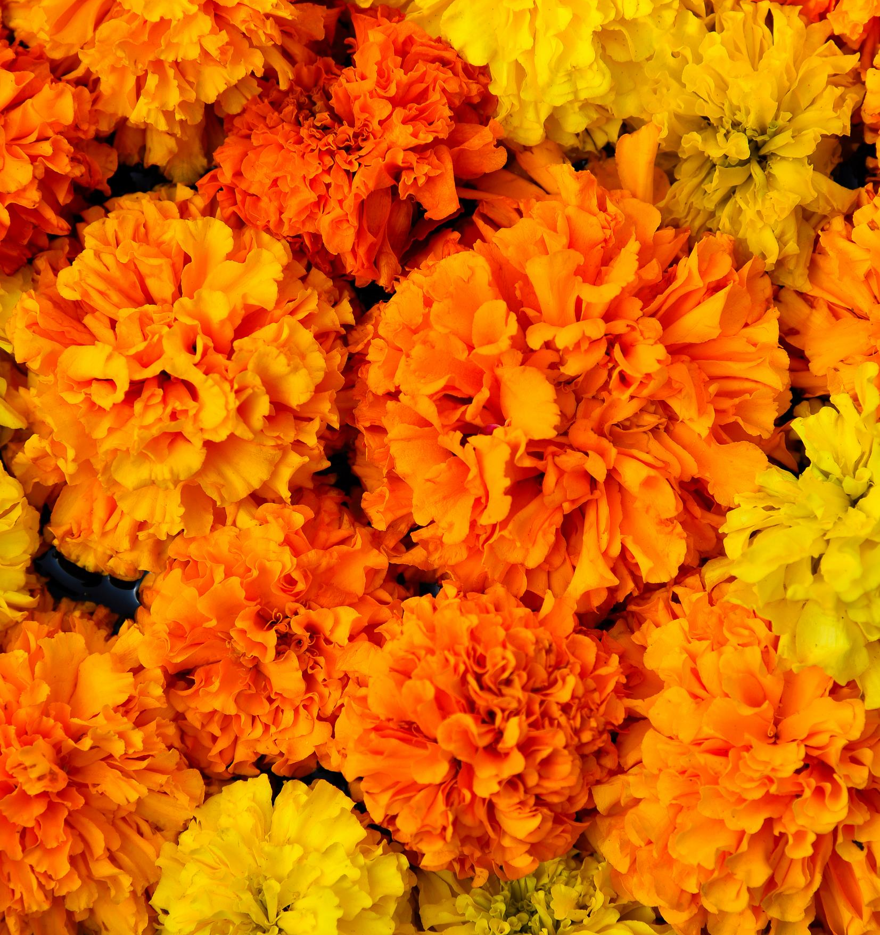
Effects of salinity on the antioxidant response of marigold flowers (Tagetes L.)
María Rita Guzman ¹; Isabel Marques ²
1. Estacion Biológica La Ceiba, Chisec, Guatemala.
2. Forest Research Centre (CEF) & Associate Laboratory TERRA, Instituto Superior de Agronomia (ISA), Universidade de Lisboa, Lisbon, Portugal. isabelmarques@isa.ulisboa.pt

Slide 2
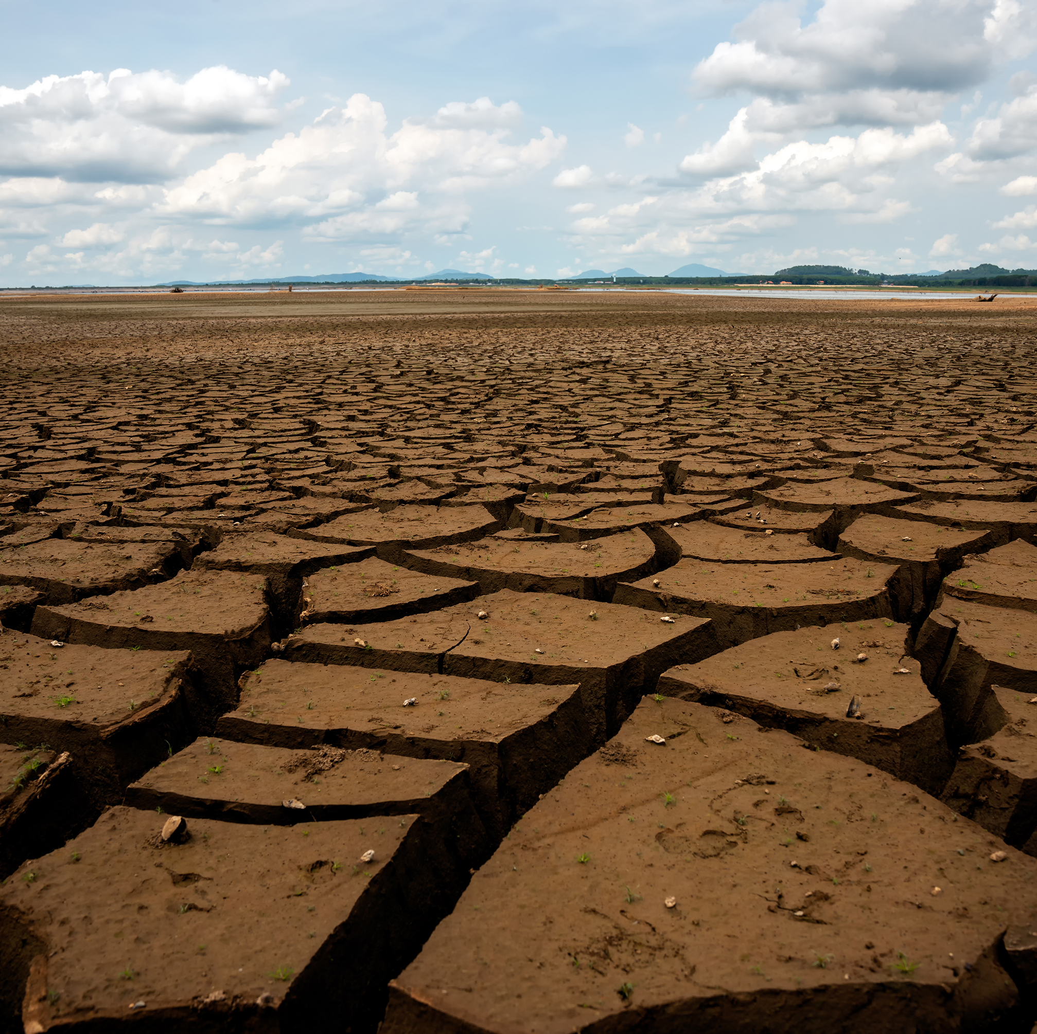
Soil salinity – an increasing problem worldwide
Salinization is a major problem worldwide, limiting crop production.
Soil salinity causes ion toxicity, osmotic stress, nutrient deficiency and oxidative stress on plants, leading to the overproduction of reactive oxygen species (ROS).

Slide 3
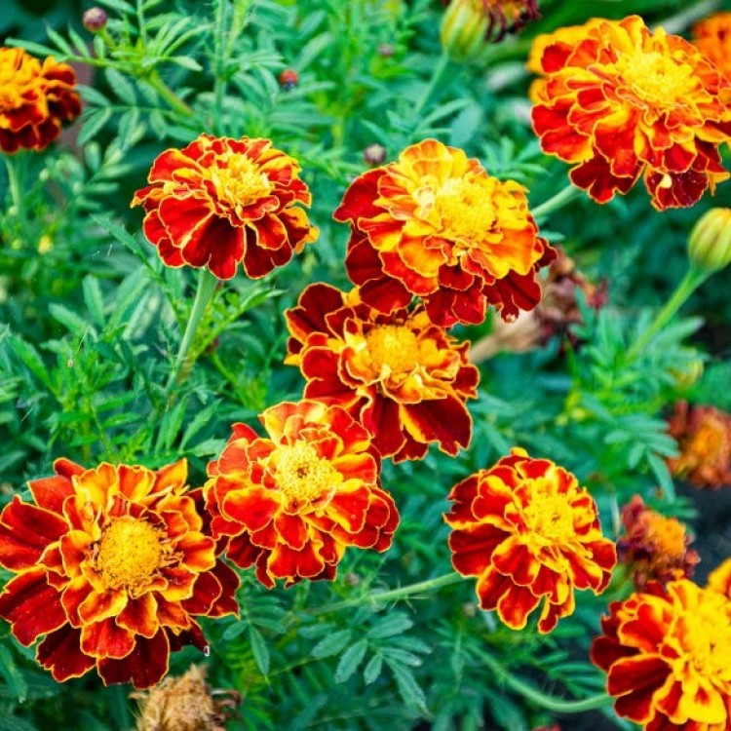
OUR AIMS
Investigate the impacts of salinity (0, 50, 100, 300 mM NaCl) on the flowers of three Tagetes patula cultivars (Aurora Orange, Fireball, Safari Scarlet), harvested after 14 days on:
total carotenoids
minerals
ascorbic acid
total polyphenol content
total flavonoid content

Slide 4
Effects of salinity on carotenoids
Carotenoids | 0 mM NaCl | 50 mM NaCl | 100 mM NaCl | 300 mM NaCl
cv. Aurora Orange | 1.23 ± 0.10 | 1.39 ± 0.15 | 2.64 ± 0.71 | 3.44 ± 0.91
cv. Fireball | 1.28 ± 0.12 | 1.42 ± 0.19 | 2.59 ± 0.81 | 3.19 ± 0.95
cv. Safari Scarlet | 1.27 ± 0.14 | 1.57 ± 0.21 | 3.11 ± 0.90 | 3.74 ± 0.92
The flowers of all cultivars showed an increase in carotenoid contents with the increase in salinity.
The highest levels were found at 300 mM NaCl for all cultivars.
The level of carotenoids was higher in cv. Safari Scarlet than in the other cultivars.

Slide 5
Effects of salinity on polyphenols
Polyphenols | 0 mM NaCl | 50 mM NaCl | 100 mM NaCl | 300 mM NaCl
cv. Aurora Orange | 23.21 ± 0.66 | 33.99 ± 0.55 | 44.61 ± 0.51 | 55.45 ± 1.01
cv. Fireball | 22.25 ± 0.55 | 33.98 ± 0.66 | 44.50 ± 0.44 | 55.66 ± 0.99
cv. Safari Scarlet | 24.21 ± 0.77 | 34.99 ± 0.88 | 45.66 ± 0.90 | 56.11 ± 1.75
Polyphenols showed a moderate increase in all cultivars with the rise of salinity.
All flowers showed the highest levels at 300 mM NaCl.
The level of polyphenols was higher in cv. Safari Scarlet than in the other cultivars.

Slide 6
Effects of salinity on flavonoids
Flavonoids | 0 mM NaCl | 50 mM NaCl | 100 mM NaCl | 300 mM NaCl
cv. Aurora Orange | 4.31 ± 0.34 | 6.32 ± 0.44 | 8.11 ± 0.61 | 10.41 ± 1.92
cv. Fireball | 4.23 ± 0.31 | 6.23 ± 0.55 | 8.59 ± 0.55 | 11.23 ± 1.95
cv. Safari Scarlet | 6.29 ± 0.55 | 7.44 ± 0.61 | 9.11 ± 1.78 | 14.74 ± 2.11
Flavonoids increased in the flowers of all cultivars with the increase of salinity.
The highest levels were found at the highest salinity level.
The level of carotenoids was also higher in cv. Safari Scarlet than in the other cultivars.

Slide 7
Effects of salinity on ascorbic acid
Ascorbic acid | 0 mM NaCl | 50 mM NaCl | 100 mM NaCl | 300 mM NaCl
cv. Aurora Orange | 24.32 ± 2.38 | 26.99 ± 1.24 | 28.11 ± 2.99 | 20.41 ± 2.57
cv. Fireball | 24.33 ± 1.13 | 26.20 ± 1.56 | 28.59 ± 2.78 | 21.23 ± 2.91
cv. Safari Scarlet | 26.55 ± 2.51 | 27.11 ± 1.47 | 29.11 ± 2.67 | 20.74 ± 2.66
Ascorbic acid showed a moderate increase with salinity, although lower at 300 nM NaCl.

Slide 8
Effects of salinity on minerals
Minerals | Cultivars | 0 mM NaCl | 50 mM NaCl | 100 mM NaCl | 300 mM NaCl
N | cv. Aurora Orange | 11.11 ± 1.22 | 16.31 ± 1.22 | 18.25 ± 1.12 | 19.37 ± 1.56
 | cv. Fireball | 10.13 ± 1.31 | 16.44 ± 1.18 | 18.24 ± 1.35 | 19.20 ± 1.33
 | cv. Safari Scarlet | 14.21 ± 1.65 | 17.52 ± 1.11 | 19.22 ± 1.56 | 22.11 ± 1.56
K | cv. Aurora Orange | 11.09 ± 1.17 | 12.22 ± 1.26 | 13.25 ± 1.56 | 12.30 ± 1.68
 | cv. Fireball | 11.11 ± 1.21 | 11.59 ± 1.12 | 11.16 ± 1.65 | 10.23 ± 2.55
 | cv. Safari Scarlet | 11.01 ± 1.13 | 11.55 ± 1.10 | 10.20 ± 1.32 | 10.11 ± 2.15
Ca | cv. Aurora Orange | 3.11 ± 1.12 | 9.55 ± 1.57 | 3.21 ± 1.99 | 3.01 ± 2.95
 | cv. Fireball | 3.15 ± 1.26 | 9.50 ± 1.44 | 3.10 ± 2.60 | 3.00 ± 2.78
 | cv. Safari Scarlet | 4.03 ± 1.19 | 8.52 ± 1.35 | 4.22 ± 2.24 | 3.99 ± 2.67
Mg | cv. Aurora Orange | 0.18 ± 0.04 | 1.55 ± 0.57 | 0.21 ± 0.05 | 0.11 ± 0.01
 | cv. Fireball | 0.14 ± 0.05 | 1.50 ± 0.57 | 0.10 ± 0.08 | 0.20 ± 0.02
 | cv. Safari Scarlet | 0.28 ± 0.04 | 1.52 ± 0.61 | 0.22 ± 0.06 | 0.99 ± 0.03
Salinity triggered an increase in all minerals, although lower at 300 nM NaCl.

Slide 9
Effects of salinity on plant size and flower production
Plant height decreased significantly under 100 nM and 300 nM NaCl, while no diferences were found between control and 50 mM NaCl.
The number of flowers decreased significantly with the increase in salinity levels, especially under 100 mM and 300 mM NaCl.

Slide 10
Results showed that edible marigold flowers are a promising crop with enriched nutritional contents and antioxidant activity that can be a new source of source of nutraceuticals. This study also reports, for the first time, the harsh effects of high salinity in the production of flowers, limiting its production in high-salinity soils. We recommend the production of marigolds only under a short exposure to salinity (up to 100mM NaCl) to achieve a high production of nutraceuticals without compromising the viability of flower production.
MAIN RESULTS

Slide 11
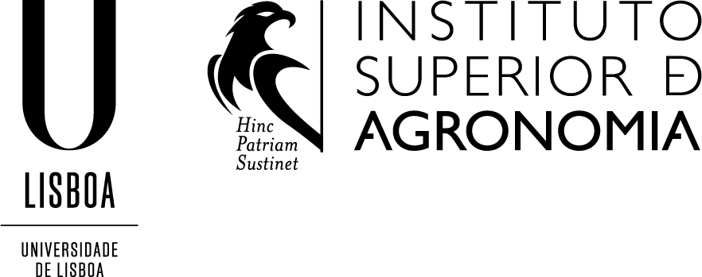
This research received national funds through the FCT – Fundação para a Ciência e a Tecnologia, I.P., Portugal through the research unit UIDB/00239/2020 (CEF), and under the Scientific Employment Stimulus - Individual Call (CEEC Individual) - 2021.01107.CEECIND/CP1689/CT0001.
FUNDING

